Slide 1
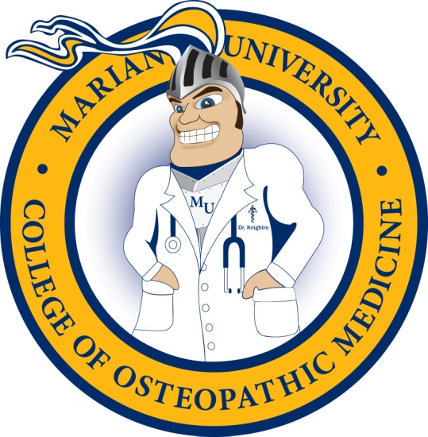
Welcome!
Purdue Caduceus Club
October 14, 2013

Slide 2
Why MU-COM?
Marian University’s new medical school offers a unique opportunity to start a career in osteopathic medicine
MU-COM seeks highly qualified students—like you!
MU-COM offers exceptional features that will provide a quality education in an excellent environment

Slide 3
Innovative Curriculum
Based on learning (student focused) not teaching (faculty focused)
1st in the nation competency-based curriculum modeled after:
Carnegie Report 2010 recommendations
National Board of Osteopathic Medical Examiners (NBOME) Fundamental Osteopathic Medical Competencies 2011
Inter-professional education (IPE) opportunities with School of Nursing

Slide 4
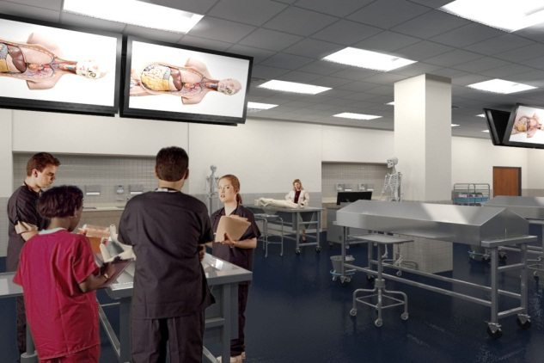
Michael A. Evans Center
High-tech medical education facility
140,000 square feet
LEED Gold designation (eco and energy)
Exceptional technology infrastructure
$7 million technology budget
Computer-based testing
Lecture-capture system (CANVAS)
Top-level simulation labs
Anatomy lab with 35 teaching stations/large monitors
45 OMM teaching stations
Ten video clinical exam rooms
Duplicating licensing board exam facilities
Two 200 seat lecture halls
Houses COM and School of Nursing
Indiana Osteopathic Association (IOA) office onsite

Slide 5
Clinical Partners
Major hospitals and health systems in rural, suburban, and urban environments
St. Vincent Health (30 hospitals)
Community Health Network (8 hospitals)
Community Westview Osteopathic Hospital
Suburban Health System (8 hospitals)
Lutheran and Parkview (Fort Wayne)
Union (Terra Haute)
Deaconess, St. Mary’s (Evansville)
Access to over 10,000 beds
Over 5,000 community physicians

Slide 6
Community Support
Lead gift for Center for Health Sciences ($48 million) from Dr. Michael A. Evans, noted scientist and founder of AIT Laboratories
Many companies and hospitals have invested in MU-COM
Collaborations with IUSOM
Support from physician groups is strong (IOA, ISMA, IMS, IAFP, IHS, others)

Slide 7
Living in Indy
Indianapolis is known as "Crossroads of America"
Ranked 12th largest city in 2010 Census
Big city, small town feel
Carmel and Fishers ranked #1 and #12 “Best Places to Live in US 2012” by Money Magazine
Sports opportunities
Fever, Pacers, Colts, Indians, Indy 500, BMW Golf Championship, NCAA, and more
Arts and cultural exposure
IMA, Indianapolis Symphony, world’s largest children's museum, and more
Recreational opportunities
MU EcoLab, Monon Trail, and one of the country's largest city park systems
Life sciences hub
Listed by Wall Street Journal as a #1 life sciences hub
Over 825 medical device companies, drug manufacturers, and research labs
Lower cost of living
Cost of living 11% less than national average

Slide 8
Learning @ Marian
75 year tradition
Faith-based—Catholic and Franciscan
Liberal arts
Vibrant, active undergraduate campus that is growing and “on the move”
Intercollegiate athletics and intramural sports
MU Knights
22 men's, women's, and co-ed sports
Over 20-time national champion cycling team
#1 NAIA football team—2012 national champions
Student organizations
Service learning opportunities

Slide 9
Admissions 101
Admissions Asks:
Cognitive—
“Can the applicant successfully pass the curriculum?”
“Does the applicant have the aptitude to pass COMLEX Level 1 and Level 2?”
Non-Cognitive—
“Will the applicant successfully and professionally interact with patients?”
“Can the applicant successfully and professionally interact with medical team members?”

Slide 10
Admissions 102
AACOMAS Application
Pre-Screen
Supplemental Application
Screen
Interview
Review
Admissions Committee Decision
Admit/Reject/Hold

Slide 11
Summary
MU-COM offers a unique opportunity for osteopathic education
Center for Health Sciences
Innovative curriculum
Strong hospital partners for clinical education
High community support
Indianapolis location and faith-based campus offer an attractive place to live and learn

