Slide 1
Medical Mission Trip Winter 2013
Alyson Bundy

Slide 2
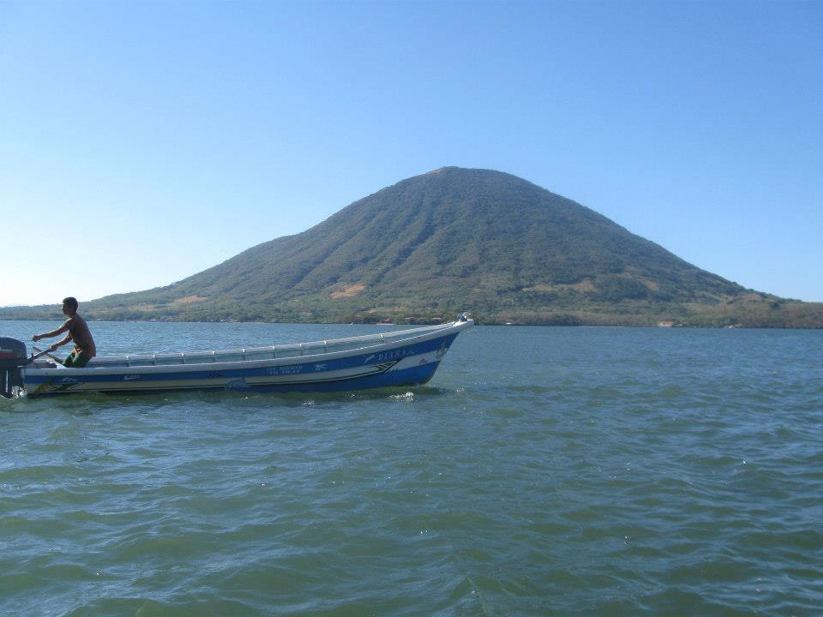
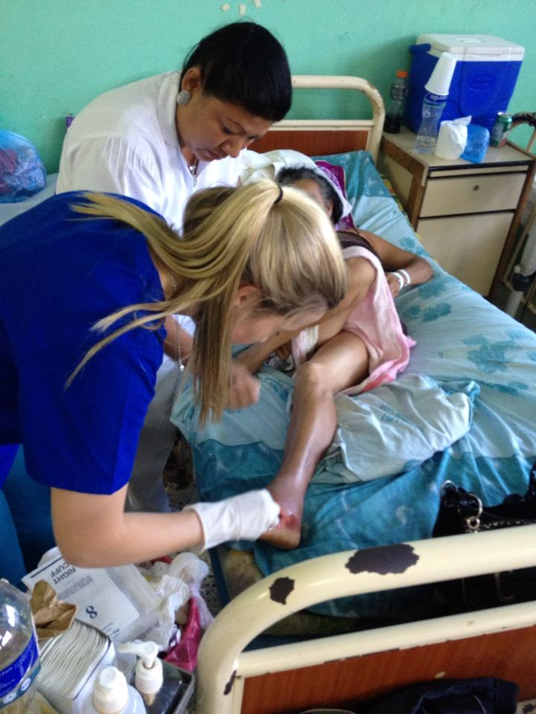
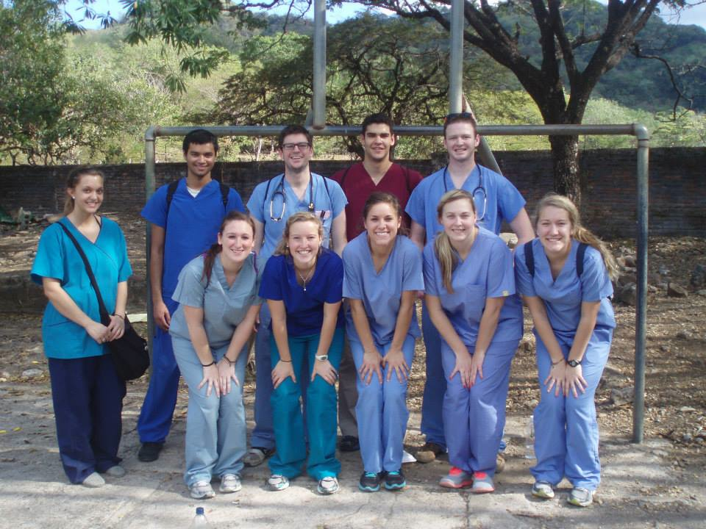

Slide 3
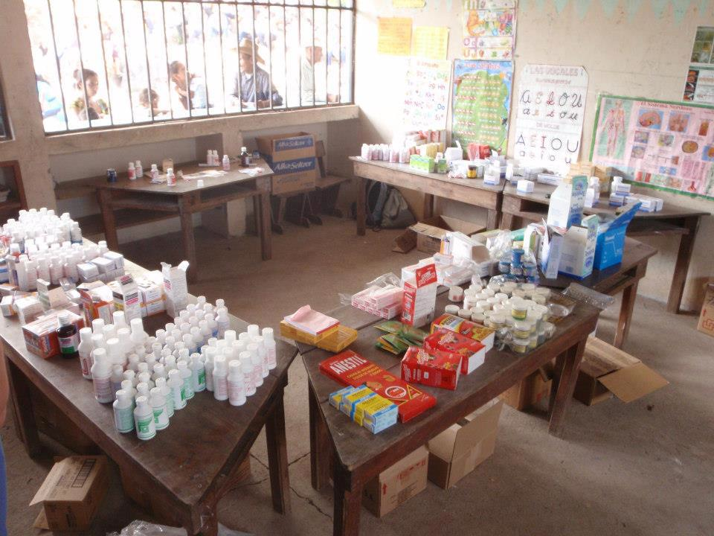
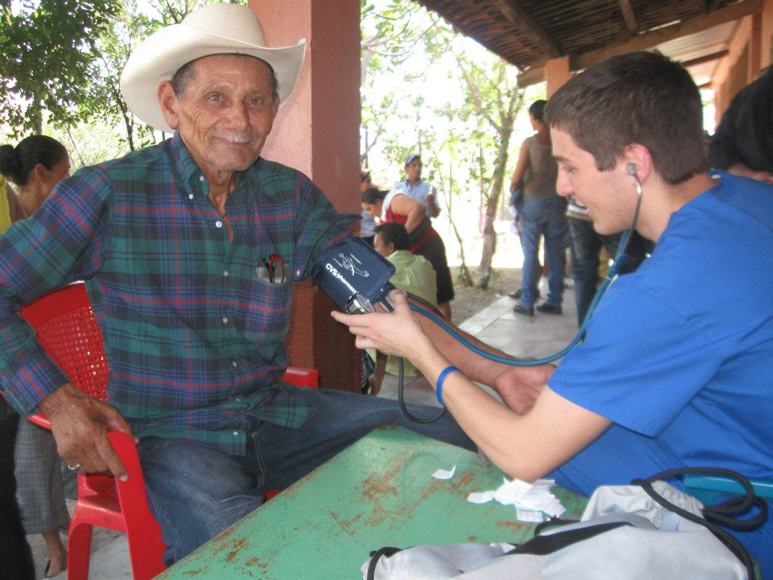
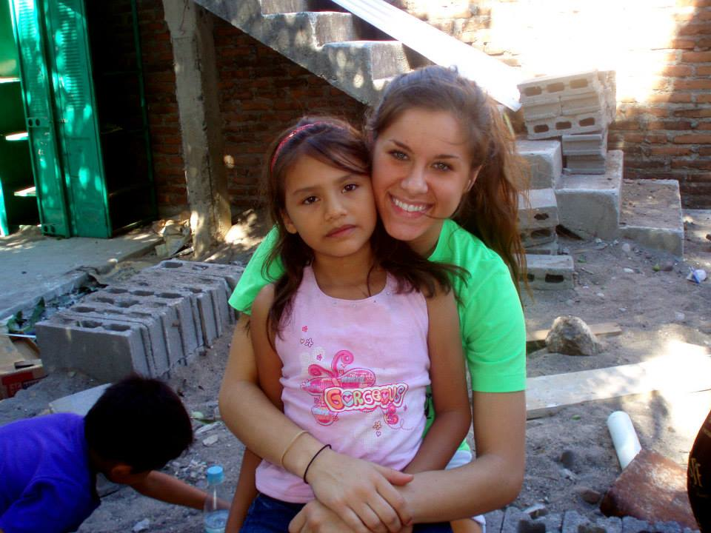

Slide 4
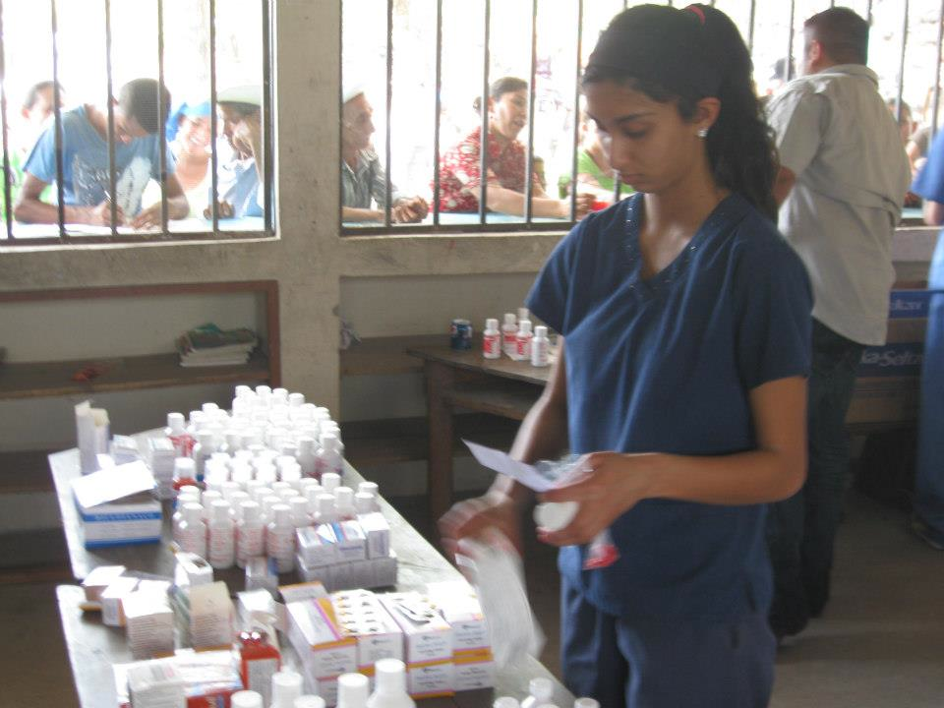
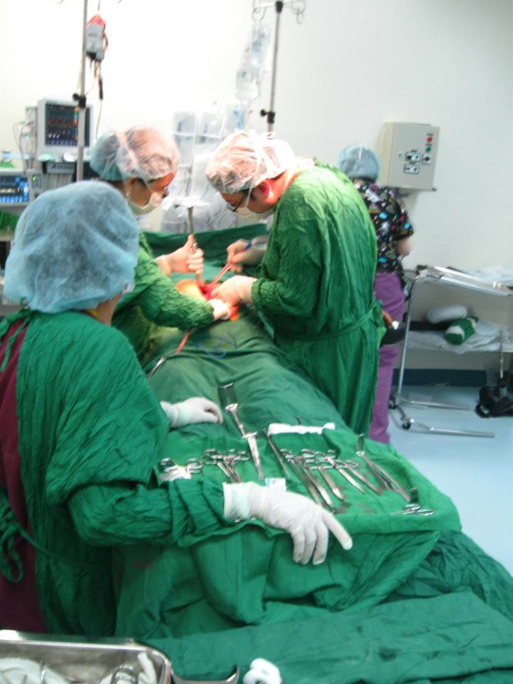
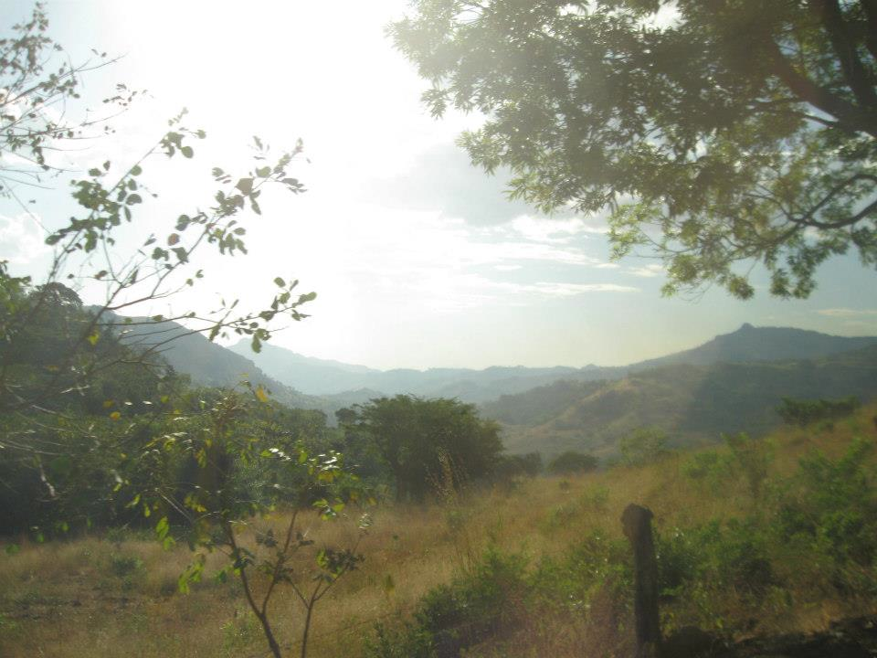

Slide 5
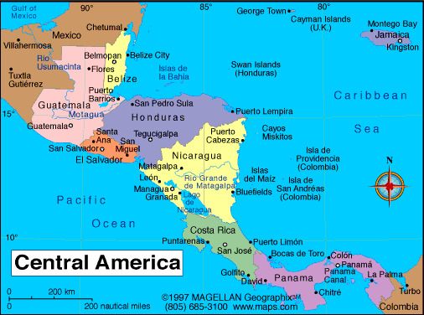
Nicaragua
Capital: Managua
Population: 6 million
2nd poorest country in Latin America
6.3% of population has health care
GDP per capita: $1,587
Currency: Córdoba

Slide 6
Our Trip
Limón, Nicaragua
December 15-22
Focus on pediatrics and maternity
5 clinical days
Beach/Hiking Day!

Slide 7
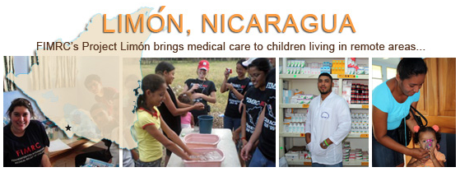
What Will We Do?
Observe doctors
Take vitals
Prenatal home visits
Physical Therapy
Give health talks to schools
http://www.youtube.com/watch?v=wK1ow5yUqf0

Slide 8
Cost Breakdown
$1050 to FIMRC
$800 flight
$30 Purdue insurance
$100 spending money
Total: $2000

