Slide 1
C V N
THE STUDENT
USHERING CLUB
Welcome!
Sign in on a computer!
Eat Pizza!

Slide 2
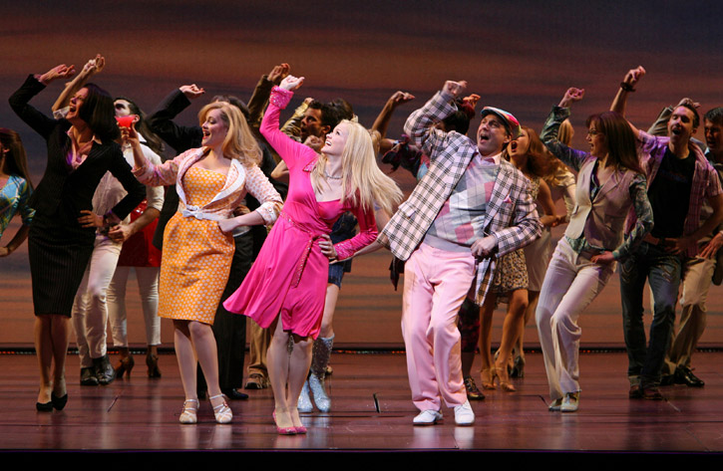
What are we all about?
https://docs.google.com/spreadsheet/ccc?key=0Ak3ktkMWwg68dHo0RkpIb05Gbk15aS1IUy1Sa2t4QVE
Students for the Arts!
Provide volunteer ushering at all Convocations shows
Concerts
Theatre
Broadway
Dance
Family
Ushers have the option of staying to watch the show– FOR FREE!

Slide 3
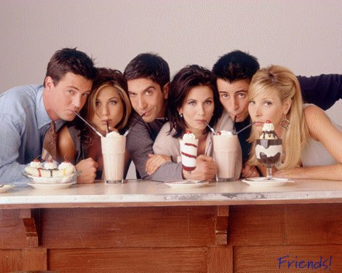
Why Should YOU Join?
Everything is FREE
Free access to shows
Free social activities
Free friends :)
Free food at meetings and select shows
No dues to pay – Ever!
Networking and leadership opportunities
Notes:
-other prizes too– like our shirts? You can have one after ushering at least 2 shows!
-by ushering 1 show a season you are a member!

Slide 4
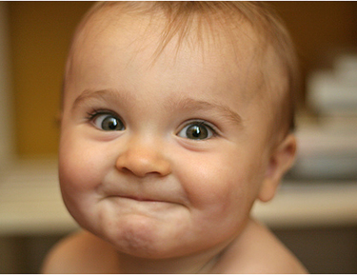
What do I have to do?
Dress in business casual attire
Show up early
Elliott 1:15 before show time
1:30 for pizza
Loeb 1 hour before show time
Attend a pre-show meeting with the House Manager
Get all the details about the show
Stand outside the doors to the theatre, smile beautifully and ask patrons if you can help them find their seat!
Always tell people to enjoy the show!
Notes:
--Our main goal is customer service!! Be proactive! No Cell Phones, Socialize yes, but help patrons first :)
-pre-show meeting will have ticket examples, holds, details about show
-will have time to familiarize yourself with your aisle/area
-head ushers and usher coordinators there to help answer questions!

Slide 5
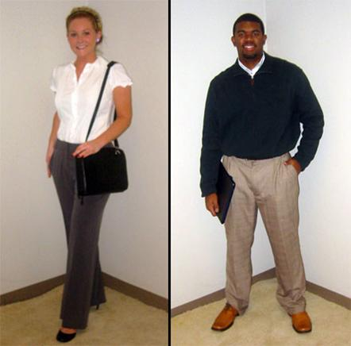
What is this business casual??
Ladies
Nice slacks, dress pants, appropriately-lengthened skirt or dress (style too)
Blouses, button down shirts, or sweaters
Closed toed dress shoes
Gentlemen
Dress pants, khakis or slacks
Button down dress shirt, polo or sweater
Dress shoes
Absolute No-No’s include:
Jeans, revealing tops, sandals, tennis shoes, shorts, spaghetti straps, open toe shoes, Crocs
Notes:
-would you wear it to work/interview?

Slide 6
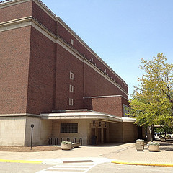
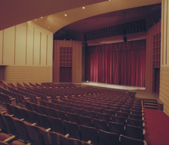
Venues—Staples!!
Elliott Hall of Music
Shows include Broadways, Dance, Concerts
Connected to Hovde Hall just north of the Bell Tower
Past performances include:
Lady Gaga
Bill Cosby
Beauty and the Beast
Irish Tenors
Loeb Playhouse
Family shows, jazz and blues, chamber music
Inside the Stewart Center next to HSSE library
Past performances include: Proof, The Opera Show, Esperanza Spalding
Notes:
-Meet inside the main lobby. Enter through the west doors just across from Hovde Hall and just north of the belltower

Slide 7
Venues New and Exciting Places!
Long Center for the Performing Arts
Downtown Lafayette on 6th St. 2 blocks west of the Courthouse
St. Thomas Aquinas Church
On the corner of State and Marstellar St.
Duncan Hall
Downtown Lafayette on Ferry St.

Slide 8
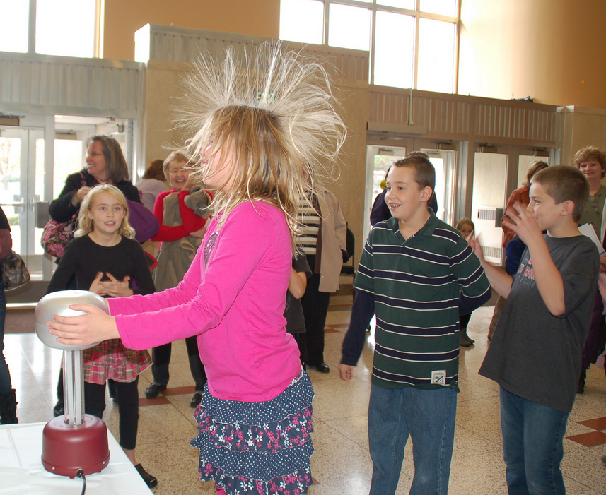
Exciting Ushering Opportunities
Pre-Show and Post-Show
Different, earlier call time
Usually Sundays before family shows
Instead of ushering, help patron complete pre-show activities
Can still stay and watch the show for free!
Cannot work both a pre-show and usher the show
Notes:
-emphasize the fact that they can still stay and watch the show for free!!
-call time is usually about 15 minutes earlier
-activities usually with kids… making necklaces, weird science, zoo animals

Slide 9
Exciting Ushering Opportunities
Friends Intermission Club
The Friends of Convocations are a group of awesome patrons who make contributions to bring shows to Purdue
Intermission Club is a reception for Founder level and higher
Located in the breezeway between Elliott and Hovde
Open 30 minutes prior to each performance as well as during intermission
Usually will receive an email if you are a selected usher
Can still stay and watch the show for free!!!
Notes:
-same call time
-ask that it be someone who plans on staying for the show– not a separate sign up/request
-leave a little bit before the end of first act
-might be checking in Friends, maybe standing there looking pretty with a smile, directing traffic

Slide 10
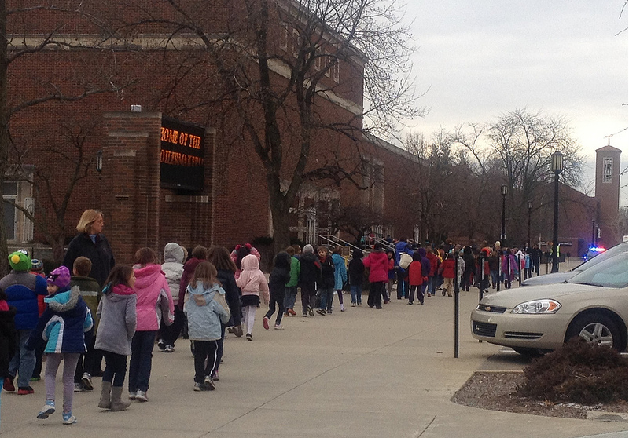
Exciting Ushering Opportunities
School Shows
Two shows on the Monday following the Sunday performance
10am (our call time is 9:15)
1pm (our call time is 12:15)
Can stay and watch the show for free!
Since schools come in a large group, usually done by 10am or 1pm respectively
Double points for school shows!
Notes:
-Kids are crazy fun to interact with!
-read a seating chart and show teachers where to place their kids

Slide 11
Where do I sign up?
www.purdue.edu/cvn and REGISTER!!!
Use your Purdue or Ivy Tech email address
Notes:
Must register with Purdue or Ivy Tech email address
Simply register with your name, email address, create a password and you’re good to go!
Will also ask about marketing interests – explain these- passing out flyers, etc.

Slide 12
Request Shows..
Up to 7 days before the performance
Will be selected based on point totals
<7 days
priority falls to below anyone who requested >7d
regardless of points
Notes:
Can request as many or as little shows as you want
DO NOT HAVE TO USHER EVERY SHOW

Slide 13
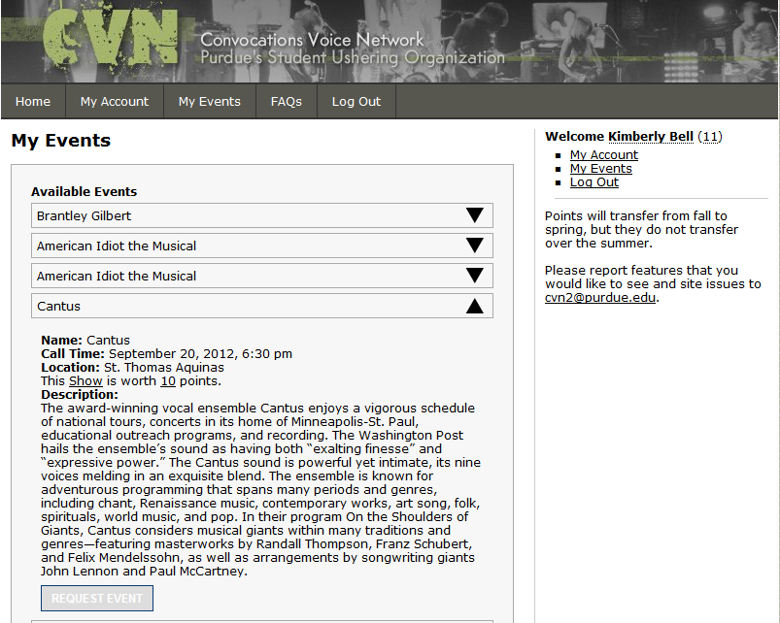
Request Shows..
Request as many or as few shows as you want!
Notes:
-Note the name of the performance
The date and call time
Location
Point total and description of the show

Slide 14
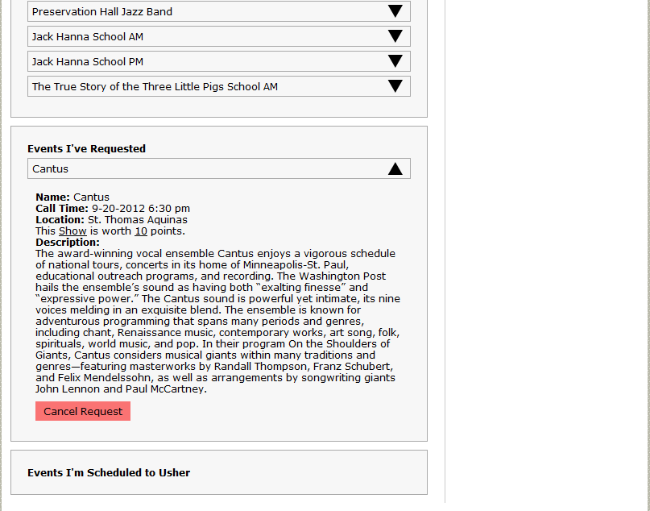
Oops! I don’t want to see that show!
Cancel on the website up to 48 hrs before
No penalty
<48 hrs
(-) 15 points
Notes:
-please cancel request as SOON AS POSSIBLE! As this give new ushers advanced time to be selected.

Slide 15
I’ve requested a show… Now what???
Two scenarios…
Selected!!! – yay!
You will receive an email with all pertinent information
You have up to 48 hours to cancel without penalty
Cut :(
You will be put on the waiting list for the show
Up to 48 hours before a show, as selected ushers cancel, new ushers will be selected from the cut list
Post 48 hours, you may receive an email saying you MAY usher, but are not obligated to do so
In the beginning getting cut is worth more points than getting selected, so you have a better chance at the next show!
Notes:
Note that you can get a cut email and a selected email pretty much within a close time period…
If more than 48 hours you’re confirmed and must cancel request if you cannot usher or you will risk losing points

Slide 16
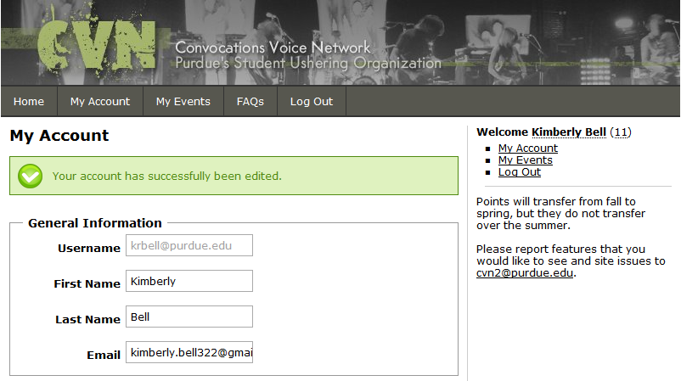
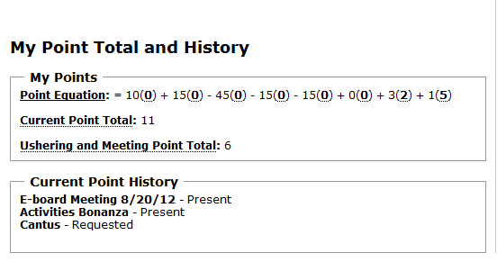
Other Website Fun…
Notes:
-talk about being able to see point totals and point equation breakdown… if you hover over it gives a description of points
-current point history gives a more detailed view of the point equation

Slide 17
How do you Choose?
Point Equation:
10(Shows Ushered)
+15(Shows Cut)
45(Shows Signed Up & Skipped)
15(Shows Cancelled within 48hrs)
+ 3(Social Events/Meetings)
+ 1(# of years returned)
------------------------------------------------------------------------------------------------------
Rank (The more you usher- the better your chance)
Notes:
-the exception is school shows are worth 20 points
-explain why you get more points for being cut from a show
-points transfer from fall to spring, but not from academic school year to the next

Slide 18
FUN STUFF: Pappy’s Social!
Have your ice cream and eat it too!
When? Thursday Sept 6
6:30-8pm
Check FB and email for info on this and other socials!
Let CVN take care of the bill :)
Notes:
--Free free free free free free free free free!

Slide 19
“Like” us on Facebook!
For information on performers
For invites and reminders about socials & activities
To Win Free Tickets to Shows!
CVN: The Student Ushering Group

Slide 20
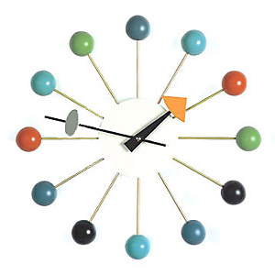
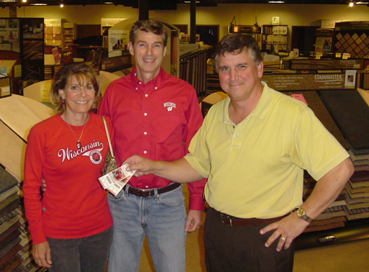
To Win Tickets…
1. Stalk our page CONSTANTLY
(or frequently)
2.Our status will let you
know an approximate time
frame we’ll post a question
about an upcoming show
3. Be the first to “comment”
on our status with the
correct answer, and you’ve
won the tickets!

Slide 21
“Follow” us on Twitter!
@cvn_ushering

Slide 22
2012
-
2013
Season
(Emphasis on 2012)

Slide 23
Green Day’s American Idiot
Saturday, September 1st, 8pm
Sunday, September 2nd, 7pm
Elliott Hall of Music
Notes:
-can request both shows to increase your odds, but we will only let you usher once

Slide 24
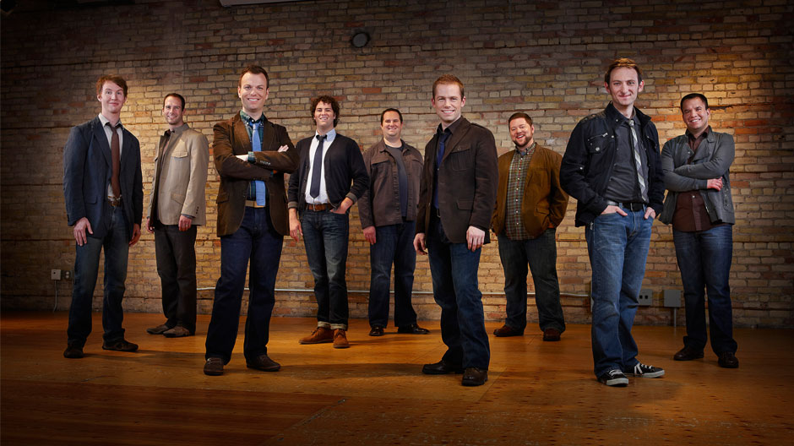
Cantus
On the shoulders of giants
Thursday, September 20th, 7:30pm
St. Thomas Aquinas

Slide 25
Brantley Gilbert With special guests:
uncle kracker, greg bates and brian davis
thursday, september 27th 7:30pm
Elliott hall of music

Slide 26
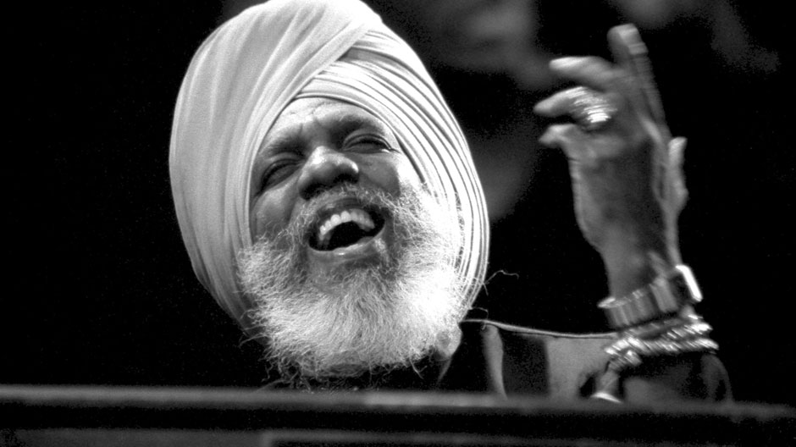
Dr. lonnie smith trio
Friday, october 5th, 8pm
Long center for the performin arts

Slide 27
B.o.B. With special guests:
Shwayze and cyh i da prynce
thursday, October 11th 7:30pm
Elliott hall of music

Slide 28
Rock of Ages
Tuesday, october 16th, 7:30 pm
Elliott hall of music

Slide 29
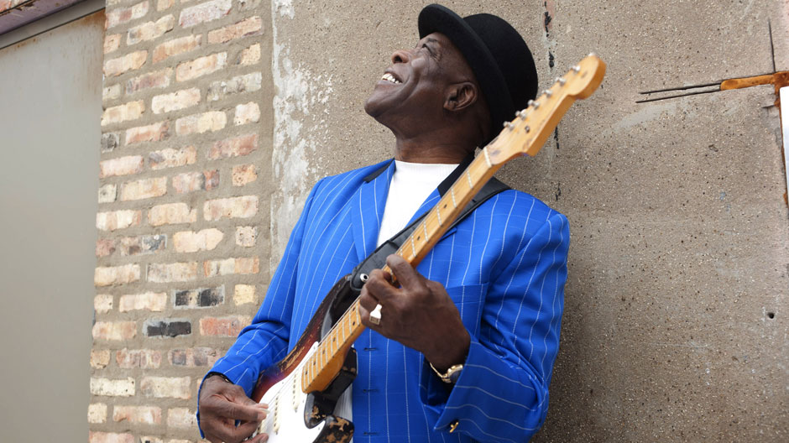
Buddy guy
An evening with a living legend of blues
Saturday, october 20th, 8pm
Loeb playhouse

Slide 30
Jack hanna’s
Into the wild live!
Sunday, october 21st, 3pm
Monday, october 22nd, 10am & 1pm
Loeb playhouse
Notes:
Mention pre show activity with colombian park zoo
-mention school show opportunities

Slide 31
A prairie home companion
With Garrison keillor
Saturday, october 27th, 5:45 pm
Elliott hall of music
Notes:
WBAA 90th anniversary. Live recording of the radio show

Slide 32
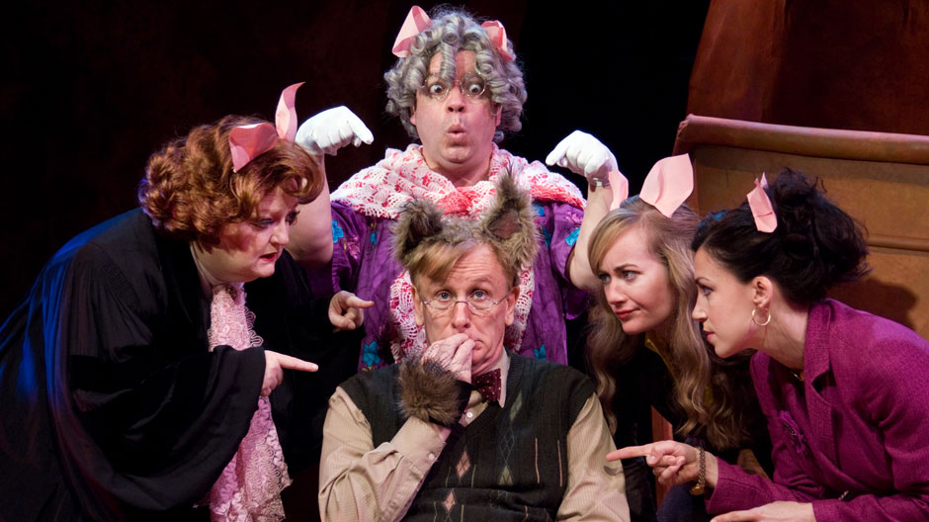
The true story of the
3 little pigs!
Dallas children’s theater
Sunday, November 11th, 3pm
Monday, November 12th, 10am & 1pm
loeb playhouse
Notes:
-mention pre-show activities with Women in Engineering
-mention school shows on Monday

Slide 33
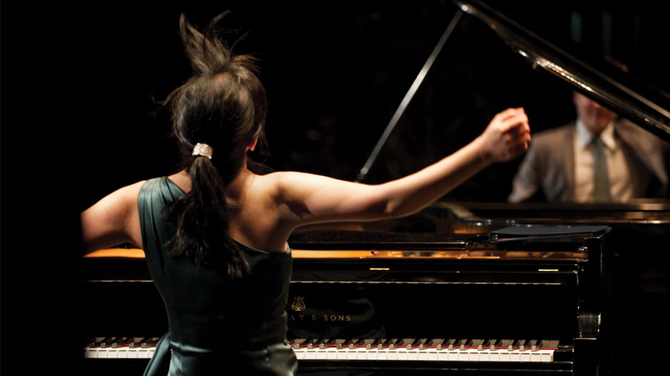
Anderson & roe
Piano duo
Thursday, november 15th, 7:30pm
Loeb playhouse

Slide 34
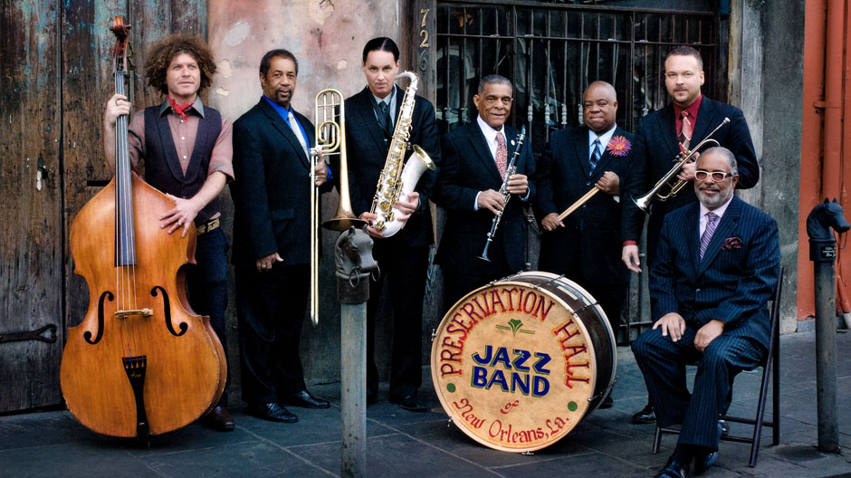
Preservation hall jazz band
Creole christmas
Wednesday, december 5th, 7:30pm
Long center for the performing arts

