Slide 1
Interests, Organizations and Repertoires
Making Sense of Lynching and KKK Events in Indiana, 1858-1930
Richard Hogan, Purdue University
Sociology Department presentation
Fall 2016

Slide 2
Figure 1
Predicting Collective Action
Interests
Organization
Mobilization
Repression/
Facilitation
Opportunity/Threat
Power
Collective Action
Source: Tilly 1978, p. 56

Slide 3
Figure 2
Tilly Meets Lynching and Klan Events
Organizations: Horse-Thief
Detective Association and
Ku Klux Klan
Interests: Petit Bourgeois
Farmers/Shopkeepers
Reactionaries Defending
Home and Hearth
Indirect
effects
Collective Action:
Lynching and
Klan Events
Relations with Authorities:
Democratic and Republican
Candidates and Officials

Slide 4
What is Missing?
This is a static, ahistorical social science model
  Missing history
  Missing culture
  Missing Political Economy
Tilly, 1978-2008 tried to fill in these blanks
  Ultimately abandoned this model
  But I have not
    Just need to tweak it a little
    Add change (and political culture, political economy, and history)

Slide 5
Figure 3
Dialectic of Repertoire Change
State Expansion
Changing
Repertoires
Of Contention
Conflict & Contradictions
Capital Accumulation

Slide 6
Figure 4
U.S. Private Production Per-capita, 1800-1940
Source: U.S. Bureau of the Census, Historical Statistics of the United States, 1789-1945 (D. C., 1949).

Slide 7
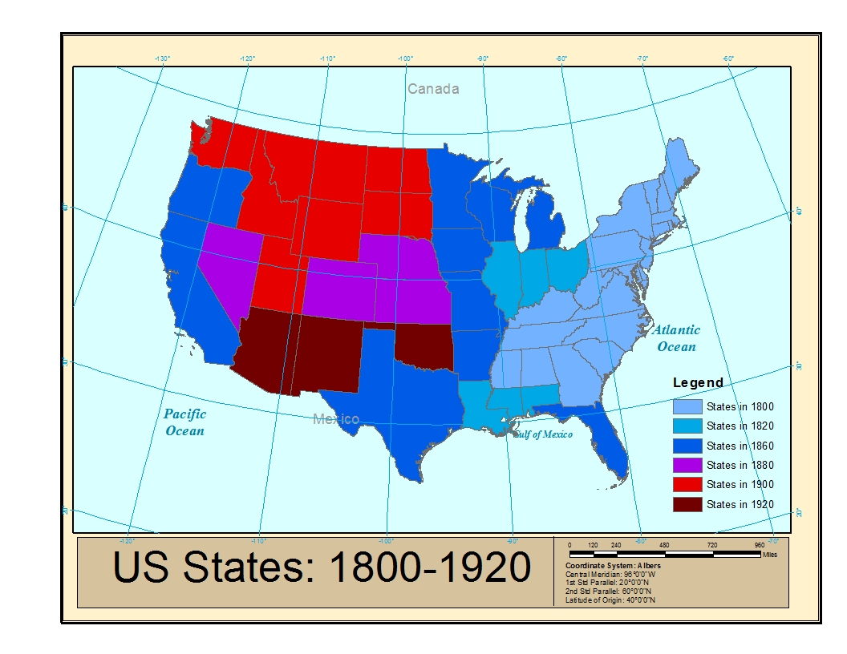
Figure 5
Source: Minnesota Population Center. National Historical Geographic Information System: Version 2.0.
Minneapolis, MN: University of Minnesota 2011. http://www.nhgis.org

Slide 8
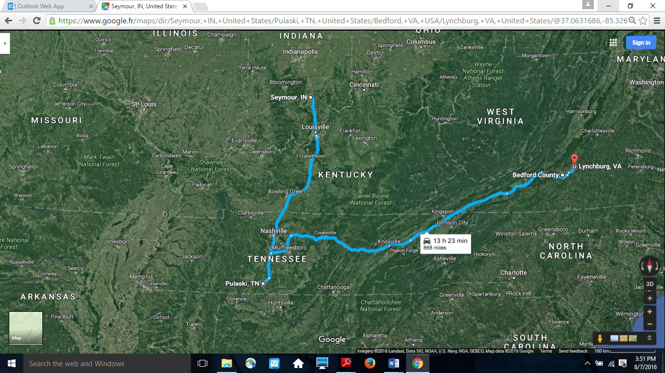
Figure 6: Mapping the Appalachian/Cumberland Plateau Region
Property of google.fr and used here without permission
Notes:
This photo of my computer screen was taken without permission by Google and should not be reproduced in any form

Slide 9
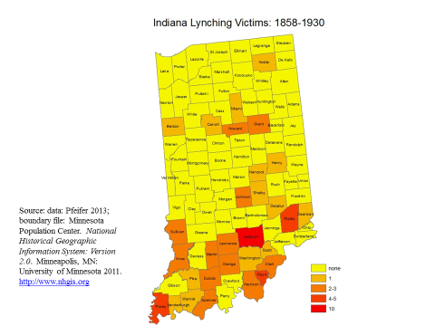
Figure 7

Slide 10
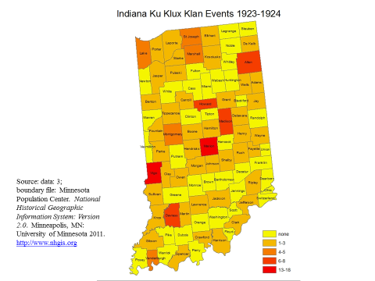
Figure 8

Slide 11
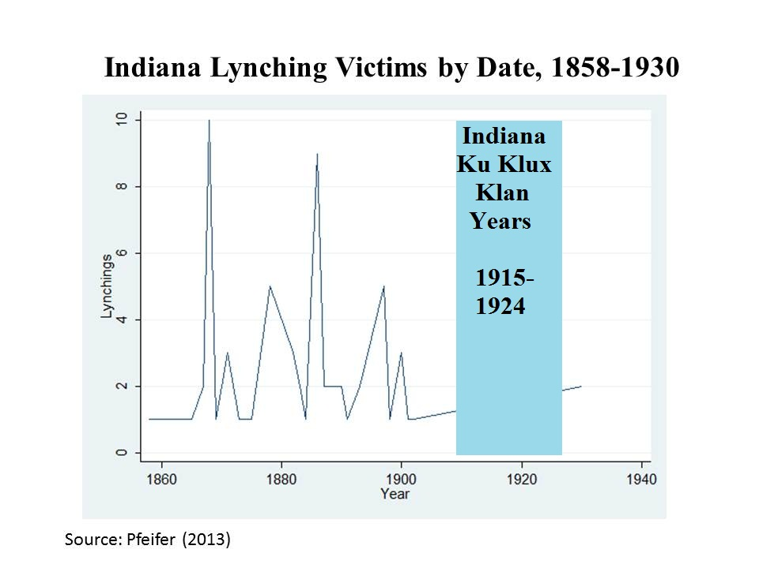
Figure 9

Slide 12
Figure 10
Marion, Grant County, Indiana 1830 Lynching
source: Photograph of 1930 lynching in Marion, Indiana, courtesy of the Indiana State Historical Society

Slide 13
Figure 11
KKK Initiation, Marion, Indiana, 1922
Source: Swift Photo
Collection, Ball State
University Library,
KKK archives

Slide 14
Figure 12
Kiddie Klan Parade Float
Source: Swift Photo
Collection, Ball State
University Library,
KKK archives

Slide 15
How Terrorism Works
Adapting Vigilantism rituals and repertoires
  Imported from Appalachia, backcountry, and Cumberland plateau yeoman farming vigilante tradition of Western colonial USA
    From Regulators of 1770s: Judge Lynch
    To Whiskey Rebellion of 1790s
    Lynch law of 1850s
    To KKK of 1866
  Becoming more/less racial
  Becoming more/less barbarous

Slide 16
How Research Works (Look at Data)

Slide 17
Correlations

Slide 18
Moore (1991) Model

Slide 19
The Heartbreak of Multicollinearity

Slide 20
Best Model for Moore (1991)

Slide 21
Adding School Kids and Democrats

Slide 22
My Favorite Model

Slide 23
Making Up Data: Factor Analysis

Slide 24
Do Measures Matter? Predicting KKK Events

Slide 25
Predicting KKK Members

Slide 26
Predicting Members Per White Native Men

Slide 27
That’s All Folks
Questions?
Comments?
New Statistical tricks?
New Models?

