Slide 1
Wright, Tilly, and Hogan
Wright is probably the most famous
Structural economic
Sociological
American
Marxist theorist and quantitative, statistical empiricist in the world
Since 1977 he has been publishing books and journal articles and is probably the most visible Marxist stratification scholar in the U.S.

Slide 2
Why is Wright So Famous?
Within Marxism he represents the most marginal and suspect of specialties
Structural, empirical, positivist
Economic determinism
Focused on class and exploitation
Plus he is an American Marxist and a sociologist—an oxymoron?
He fits American sociology better than Marxism

Slide 3
The Wright Path
1977: Wright and Perrone—authority
three class model
owners, managers, workers
predicting income with education and class
finding significant interactions
1985: Classes
Retreating from creeping Weberianism
No-nonsense Marxism
Real premises—epistemological and ontological purity

Slide 4
Erik Olin Wright (continued)
1997: Class Counts
Analytical Marxism (bad companions)
macho no bullshit Marxism
economists and pyschologists
the heartbreak of behaviorism
Comparative data
U.K., Norway, Sweden, and Australia, Canada, U.S., and Japan
strange bedfellows but all capitalist economies

Slide 5
Wright and his Students Argued
Status attainment and labor market theories ignore exploitation
Value of worker’s labor is appropriated
Directly, as profit (or reinvested in capital) by employer
Indirectly, as surplus wages/bonuses, by managers and supervisors, using organizations
somewhat mysteriously by professionals, using credentials
Employers and managers earn more and receive greater return for education

Slide 6
Wright and Perrone (1977)
high
employers
earnings
managers
workers
low
Years of education
high

Slide 7
Erik Olin Wright Argues
Need to look at Marxist class categories
Need to look at movement of capital and labor
In and out of industries
In pursuit of windfall/stable profits
In pursuit of high wages/stable employment
As Hogan (1990) argued, industrial frontiers offer high risk/high profits
Entrepreneurial labor and capital absorbs risks
Establishes reliable rates of return (or not)

Slide 8
Hogan (1990) continued
Reliable rates of return (not large but reliable profits) attract big capital
Economies of scale yield higher rates of return (bigger potential profits)
Only if rate of return is reliable
Otherwise excessive overhead and sunk costs make it hard to respond to market fluctuations
Which is why entrepreneurs tend to be small scale and are able to exploit industrial frontiers

Slide 9
Marxist Perspective
Big (corporate/monopoly) capital and big (unionized) labor yield reliable profits and wages in what Hodson calls the “core” sector
But proletarianization reduces skill and return on skill as big capital replaces skilled labor with machines and unskilled machine minders (see Braverman)

Slide 10
Marxist Perspective (continued)
The extent to which there are opportunities for higher wages or better jobs depends on the rate of
emerging industrial frontiers (rocket science in the 1950s, computers in the 1970s, micro computers in the 1980s, the internet.com world of the 21st century)
and proletarianization within industrial sectors

Slide 11
Wright on Race and Gender
Wright and Perrone (1977) also looked at race and gender differences
In earnings
Within class
Return to education within class
Findings
Black and white male managers: intercept but not slope differences
White women managers: intercept and slope differences

Slide 12
Wright and Perrone (1977)
white male mangers
high
black male managers
earnings
white female managers
low
Years of education
high

Slide 13
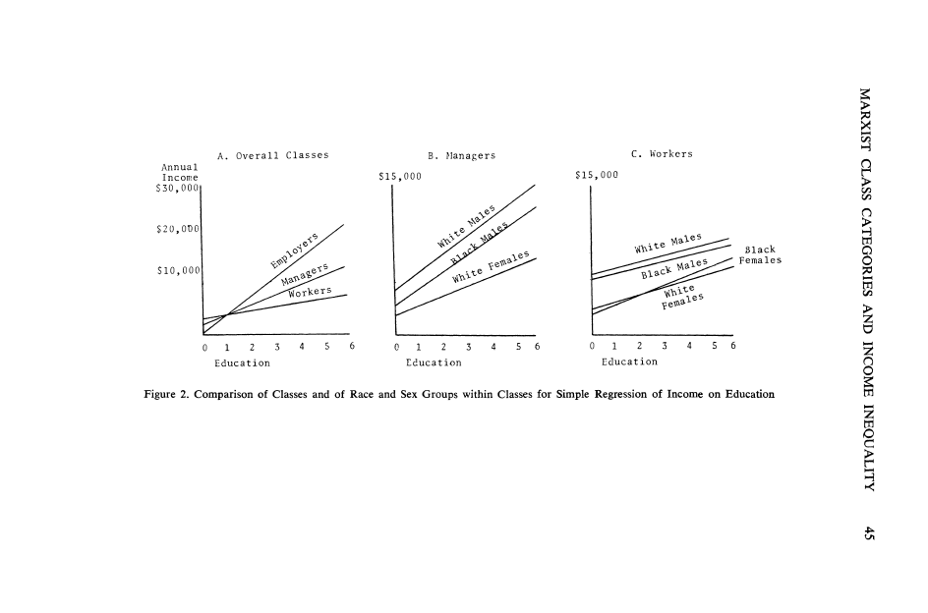

Slide 14
Erik Olin Wright (1997)
women have access to managerial and professional positions
but don't earn as much as comparable men
compared to black men, more self-employed, expert workers, and unskilled workers; less skilled workers and expert managers
most women are unskilled workers

Slide 15
Table 1.Wright’s Class Categories by Race and Sex (Wright 1997, p. 68)
Class | White Males | White Females | Black Males | Black Females
Capitalist | 3.0% | 0.7% | 0% | 0%
Small employer | 8.2% | 4.9% | 0% | 1.3%
Petit Bourgeois | 6.4% | 8.8% | 3.6% | 0%
Tot Self Empl | 17.6% | 14.4% | 3.6% | 1.3%
Expert Mgrs | 8.5% | 2.8% | 5.1% | 0%
Skilled Mgrs | 5.7% | 2.4% | 2.0% | 0%
Unskilled Mgrs | 2.3% | 3.9% | 1.0% | 6.3%
Expert Super | 4.2% | 1.7% | 1.3% | 1.7%
Skilled Super | 7.9% | 4.3% | 7.5% | 2.0%
Unskilled Supr | 5.0% | 9.3% | 4.6% | 7.7%
Experts | 3.2% | 3.5% | 2.9% | 1.8%
Skilled Worker | 17.4% | 7.7% | 23.3% | 10.9%
Unskilled Wkr | 28.2% | 50.0% | 47.7% | 68.4%

Slide 16
Table 2. Comparative Data on Males and Females in Management Positions (Wright 1997, p. 337)
 | Top Mgr |  | Upper Mgr |  | Mid Mgr |  | Low Mgr |  | Supervisor |  | Non Mgr
 | M% | F% | M% | F% | M% | F% | M% | F% | M% | F% | M% | F%
US | 3.3 | 2.8 | 4.5 | 1.5 | 5.7 | 3.6 | 3.3 | 2.2 | 20.7 | 15.9 | 62.4 | 74.1
AU | 3.0 | 1.9 | 5.9 | 2.1 | 8.7 | 4.1 | 2.4 | 2.6 | 30.3 | 29.1 | 49.6 | 60.1
UK | 3.9 | 0.9 | 1.2 | 0.2 | 8.6 | 1.8 | 4.9 | 1.1 | 20.2 | 18.4 | 61.3 | 77.6
CA | 3.7 | 0.9 | 5.2 | 0.9 | 5.4 | 3.0 | 2.3 | 2.0 | 18.9 | 11.9 | 64.6 | 81.2
SW | 1.9 | 1.0 | 2.3 | 0.0 | 6.2 | 1.7 | 4.9 | 2.6 | 18.8 | 11.1 | 65.9 | 83.7
NR | 5.0 | 0.9 | 5.5 | 0.9 | 5.1 | 0.5 | 0.5 | 0.2 | 23.4 | 8.3 | 60.6 | 89.3
JP | 1.2 | 0.0 | 4.3 | 0.0 | 2.8 | 0.0 | 1.6 | 0.0 | 37.2 | 3.5 | 53.0 | 96.5

Slide 17
Major Issues
Measuring/estimating class versus occupation or industrial (labor market) effects
on income/earnings
on social life (friends and lovers)
on political alliances (interests and class-based coalitions)
Permeability of class: generational or social
property: least permeable
credential/skill: most permeable

Slide 18
More Issues
International differences
North American super-capitalist less permeable classes and less polarized class consciousness
European social democratic egalitarianism
the inscrutable Japanese
Gender Benders
- U. S. gender justice?
- the glass ceiling?

Slide 19
Charles Tilly (1929-2008)
Charles Tilly was legitimately famous as a revisionist French historian
criticizing Marx on the French Revolution
and the peasant role in the counter-revolution, especially in the Vendée
he was a famous sociologist, whose From Mobilization to Revolution set a new standard for the study of collective behavior and revolution

Slide 20
Tilly (continued)
Chuck also challenged the students of social movements with the idea that the social movement
was a repertoire of contention
developed with the rise of capitalism and statemaking
was a critical component of modern democracy
http://www.nytimes.com/2008/05/02/nyregion/02tilly.html

Slide 21
Why Chuck Wrote Durable Inequality
He wanted to spend more time dealing with issues that his brother, Richard, and his son, Chris were working on
He wanted to write something with them but needed to develop his theory of durable inequality first
He wanted to return to his Marxist roots and explore exploitation as the base of inequality

Slide 22
Tilly, Durable Inequality (1998)
Categorical Inequality: unequal relations between mutually exclusive categories of individuals: "black/white, male/female, married/unmarried, and citizen/noncitizen" (p. 8).
relationships rather than positions or distribution of resources
Exploitation: derriving profit or benefit from relations through which "powerful, connected people command resources from which they draw significantly increased returns by coordinating the efforts of outsiders whom they exclude from the full value added by that effort" (p. 10).

Slide 23
Tilly (cont)
Opportunity Hoarding: limiting access to the potentially profitable: means through which "members of a categorically bounded network acquire access to a resource that is valuable, renewable, subject to monopoly, supportive of network activities, and enhanced by the network's modus operandi" (p.10).
Tilly argues that familiar and enduring relations of social inequality, including “class, gender, race, ethnicity” (p. 4), although qualitatively different, are established through "exploitation" and "opportunity hoarding" and then generalized through "emulation" and institutionalized through "adaptation."

Slide 24
Applying Tilly to the Analysis of Class, Race, and Gender Inequality (Hogan 2001)
Class, Race, Gender, and Patronage Relations Distinguished by Mechanism of Surplus Appropriation and Locus of Relations
Locus of Relations | Mechanism of Surplus Appropriation
 | Exploitation | Opportunity Hoarding
Production | Class | Patronage
Reproduction | Gender | Race

Slide 25
How Do We Explain Inequality?
Functional
necessary but variable
ascribed/inherited
achieved
status attainment
Weberian/Labor market
inevitable but multi-faceted: class, status, party
unequal distribution of resources
competition and hoarding

Slide 26
How Do We Explain Inequality? (cont.)
Marxist
imposed and unnecessary/unnatural
exploitation of labor
accumulation of capital
investment/accumulation
frontiers
Proletarianization
Tilly offers synthesis or combination of Weberian and Marxist
Hogan attempt to maintain Marxist perspective without adopting rational choice/analytical Marxism or avoiding creeping Weberianism

