Slide 1
Karl Marx
Sociology 402
Sociological Theory
Classical Theorists

Slide 2
Biography
Frustrated Revolutionary
Born too late for bourgeois revolutions
Too early for proletarian revolution
Lived in exile through 19th Century Civil Wars

Slide 3
Sociological Approach
Perspective: radical
Model: dialectical: student of Hegel
Holistic
Oppositional
Dynamic
progressive
Focus: material/economic

Slide 4
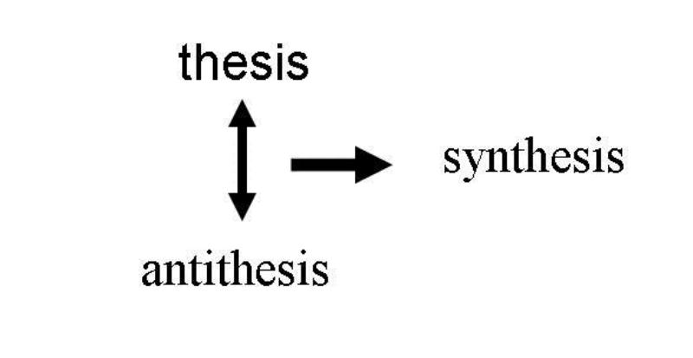
Structure of Dialectical Model

Slide 5
Hegel’s Model of Western Philosophy
Theology
Metaphysics
Science

Slide 6
Sociological Approach (continued)
Focus: economic (materialist: reaction to German Idealism

Slide 7
Explanation of Social Change: Revolution
Exploitation
Alienation
Commodification
Economic and political crises
Revolution

Slide 8
Marx's Model of Western Political Exconomy
Plantation
Estate
Factory
master
lord
employer
classless
society
slave
peasant
employee

