Slide 1
Indiana State Tax Return
Wei-Chiu Chuang
Due: April 15

Slide 2
Paper file vs. e-file
Notes:
Why paper file when you can efile for free

Slide 3
Paper Filing
Form IT-40 if you’re a full-year Indiana resident IT-40 Booklet
Form IT-PNR otherwise
Schedule A, C, D(E), F, H http://www.in.gov/dor/4657.htm
If Indiana state owe you refund
If you owe the state
Indiana Department of Revenue
P.O. Box 40
Indianapolis, IN 46206-0040
Indiana Department of Revenue
P.O. Box 7224
Indianapolis, IN 46207-7224
Make check payable to
“Indiana Department of Revenue”
Do not send cash!

Slide 4
INfreefile Program
A joint free state tax return program for eligible tax payers
Some can file state/federal return separately: TaxHawk, Turbo Tax and TaxAct
H & R Block, TaxSlayer and OLT: Must file state/federal together

Slide 5
TurboTax Freedom Edition
Start from here
正常狀況下Purdue grad student應該不會超過吧!
如果真的超過就換另一個軟體
TaxHawk: free if < $57K
TaxAct: free if < $51K

Slide 6
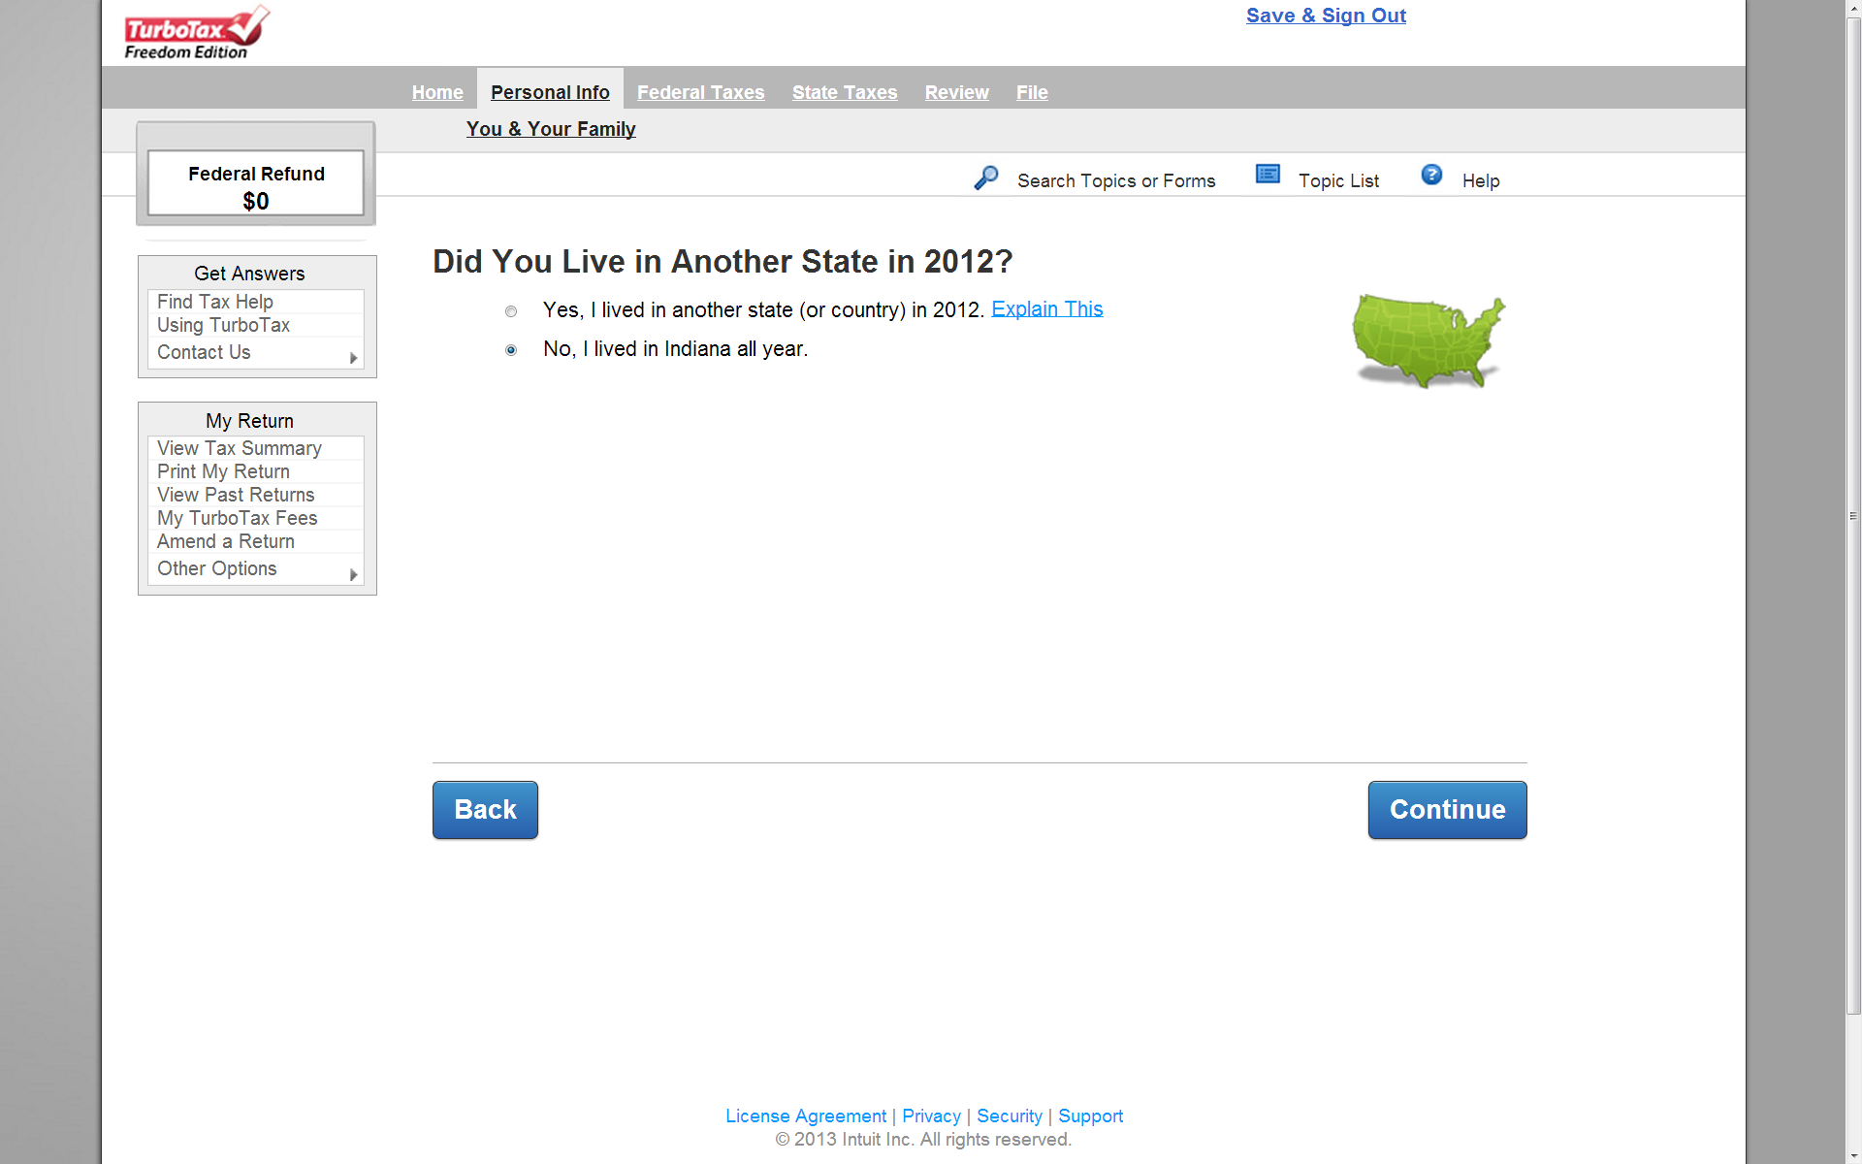

Slide 7
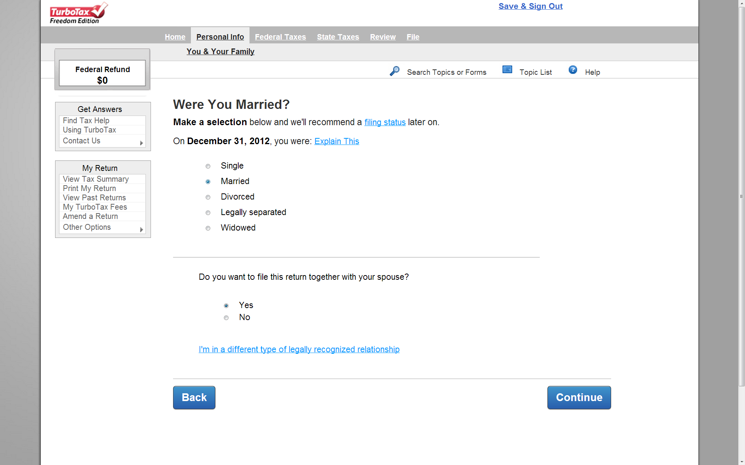
州稅可以file jointly

Slide 8
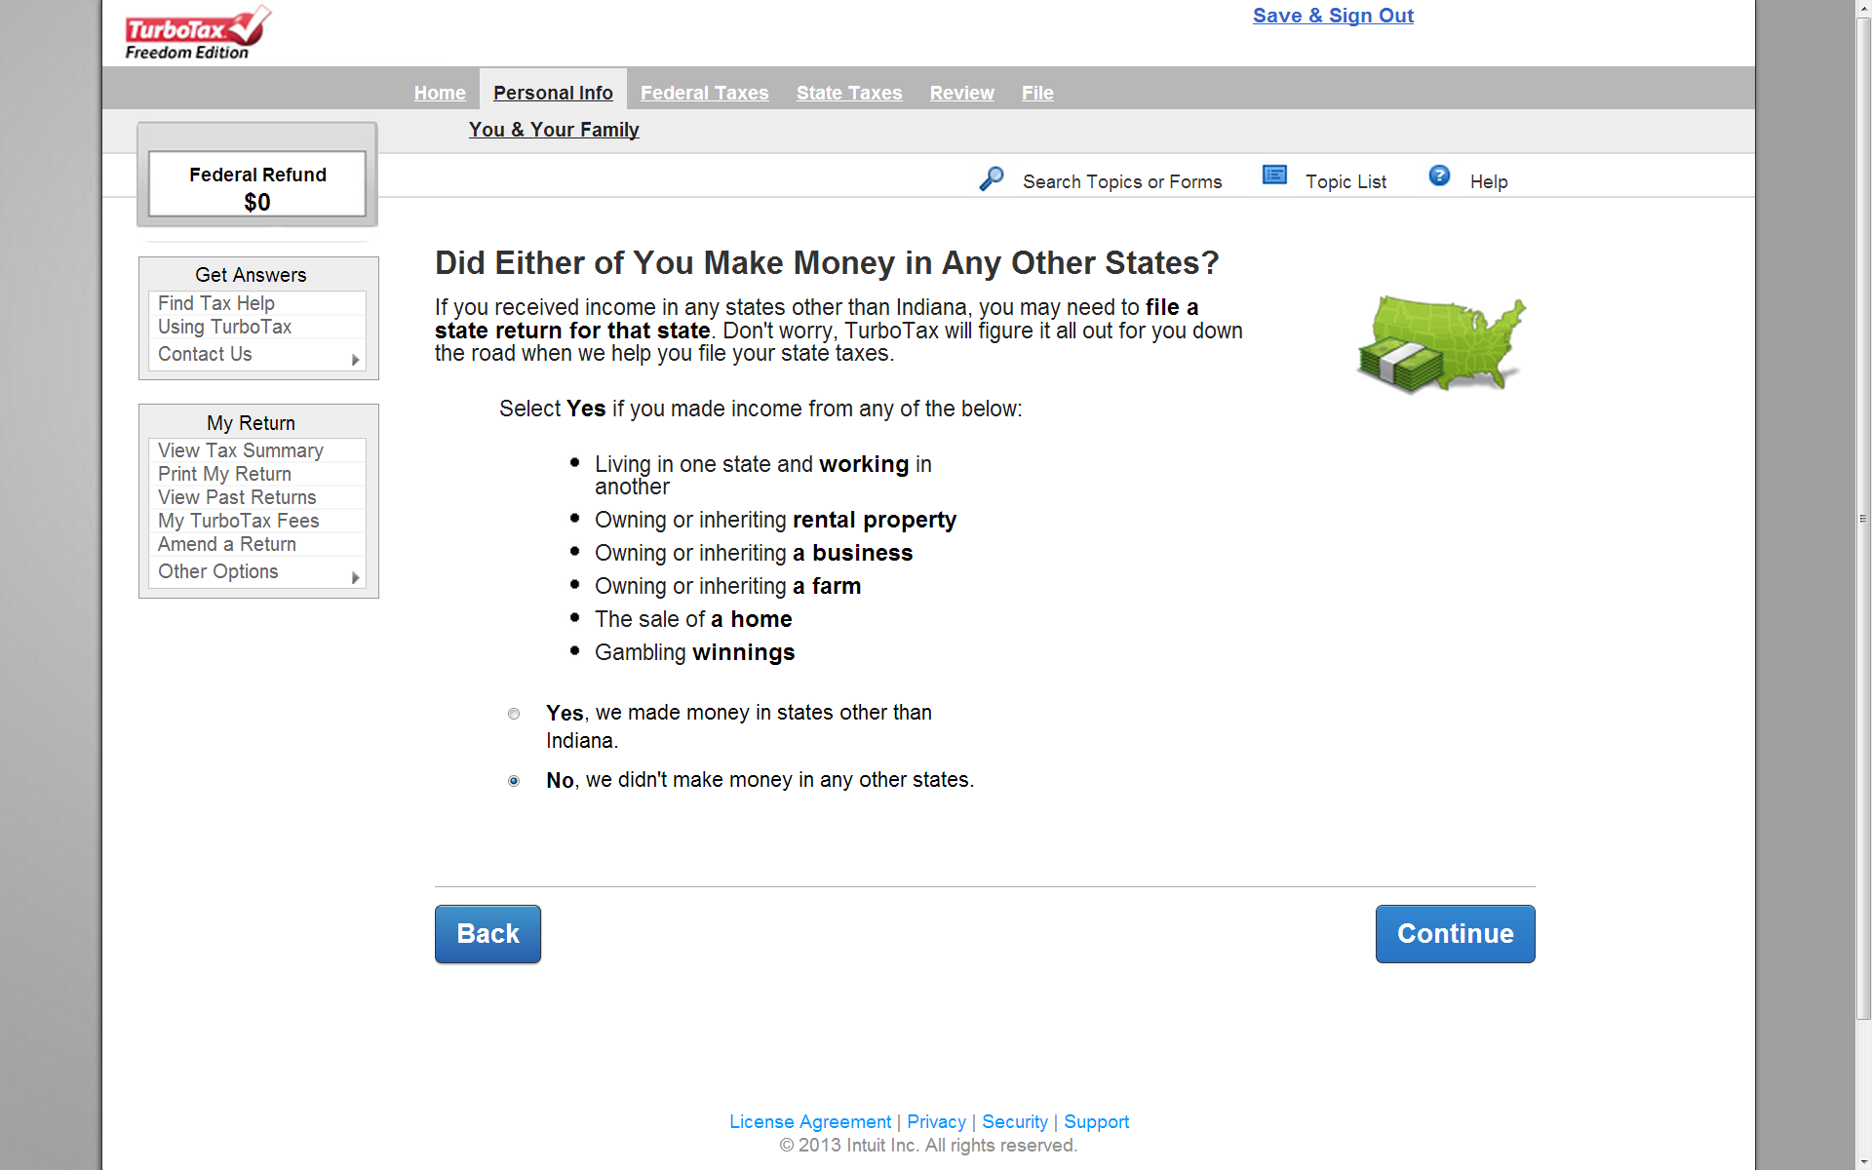

Slide 9
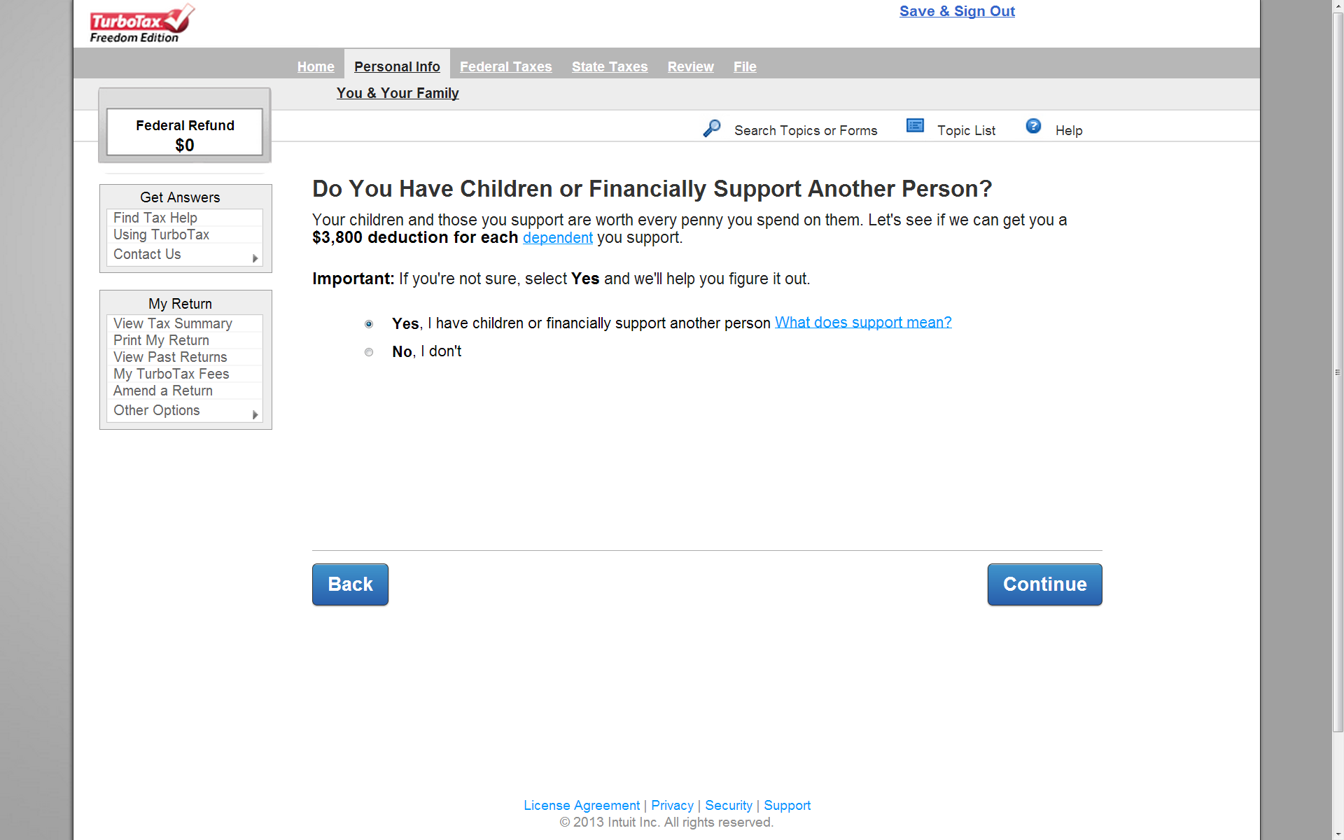
Federal NR報稅沒有眷屬免稅額
可是州稅有

Slide 10
$1000 exemption per person
Additional $1500 exemption for < 19 yr old dependent.
Notes:
Can’t claim exemption without SSN/ITIN
What to do? File the federal return along with ITIN, and file state tax return extension.

Slide 11
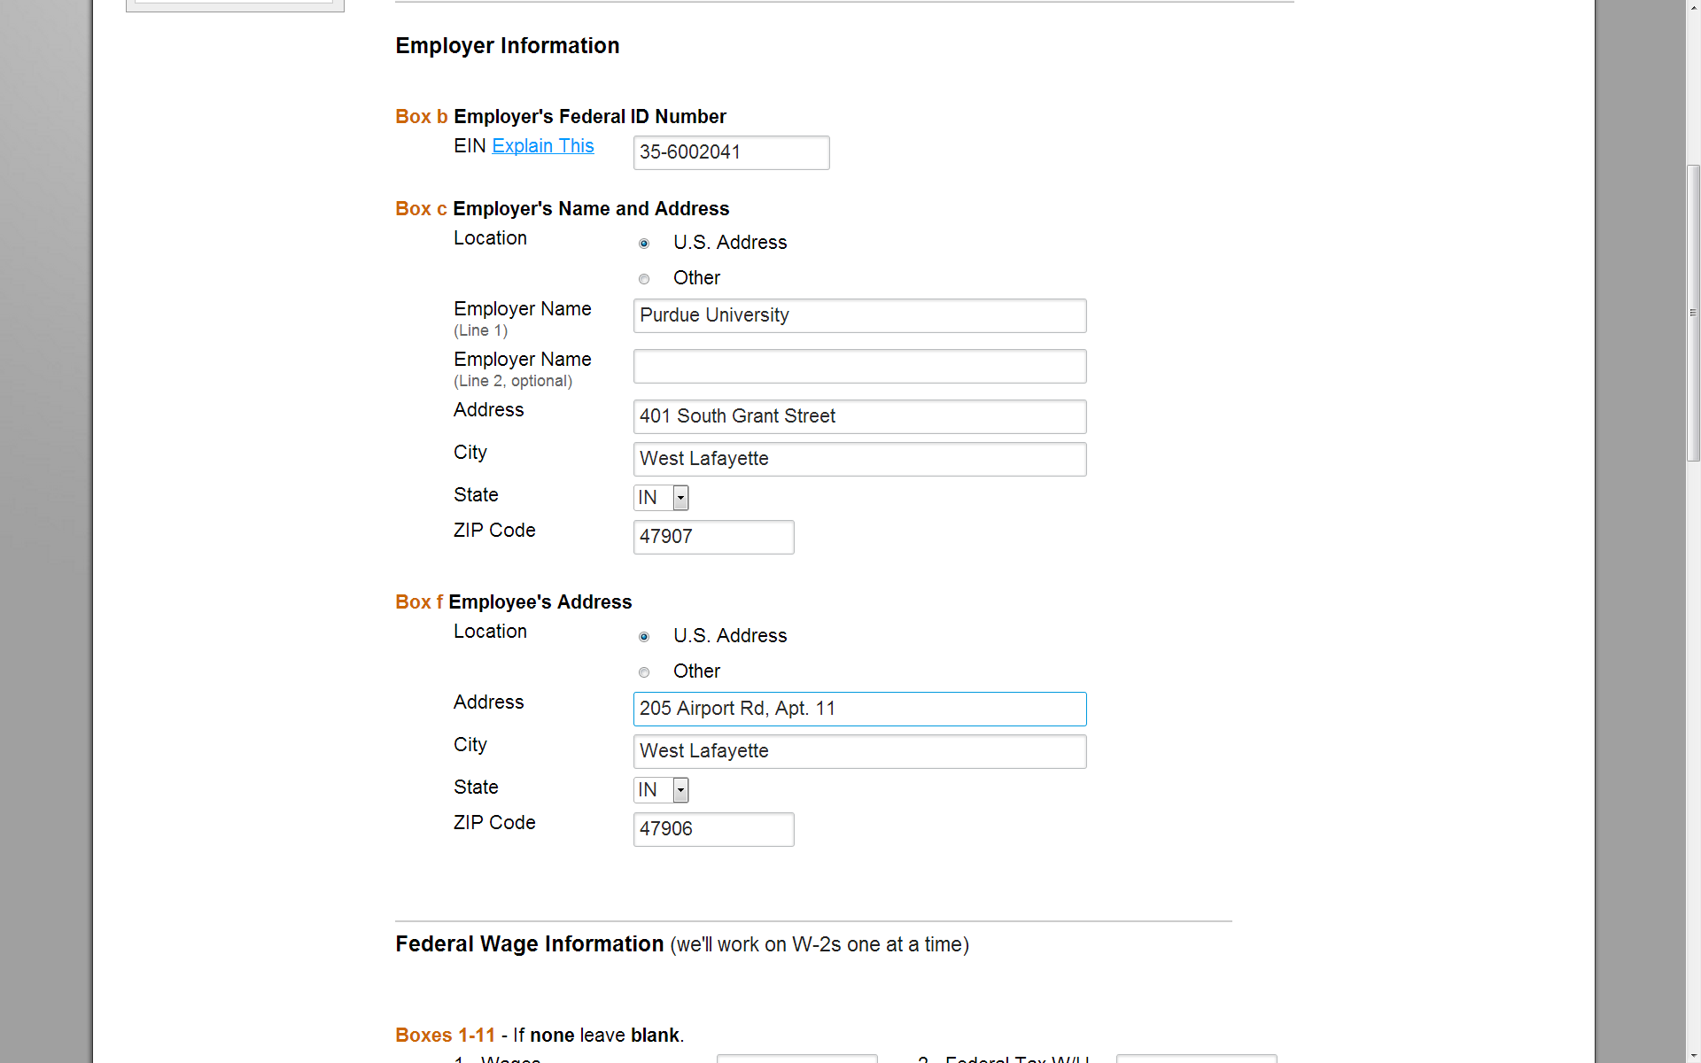

Slide 12
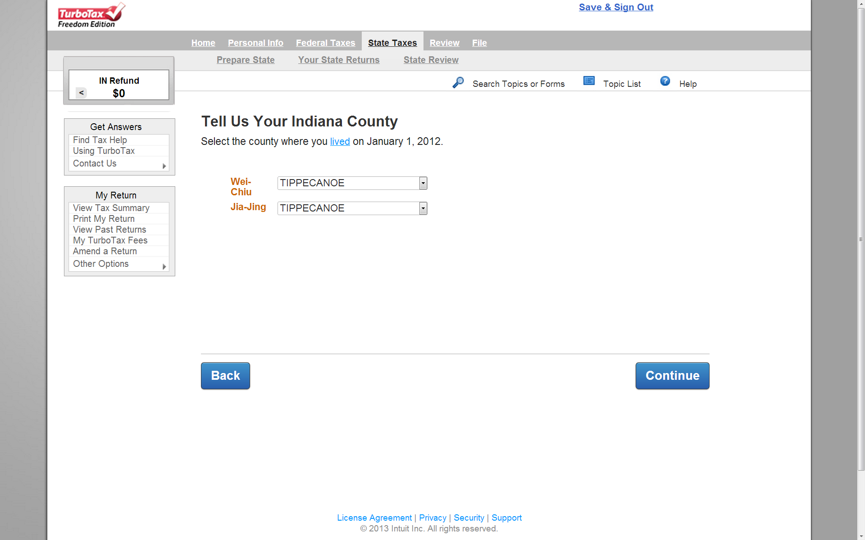

Slide 13
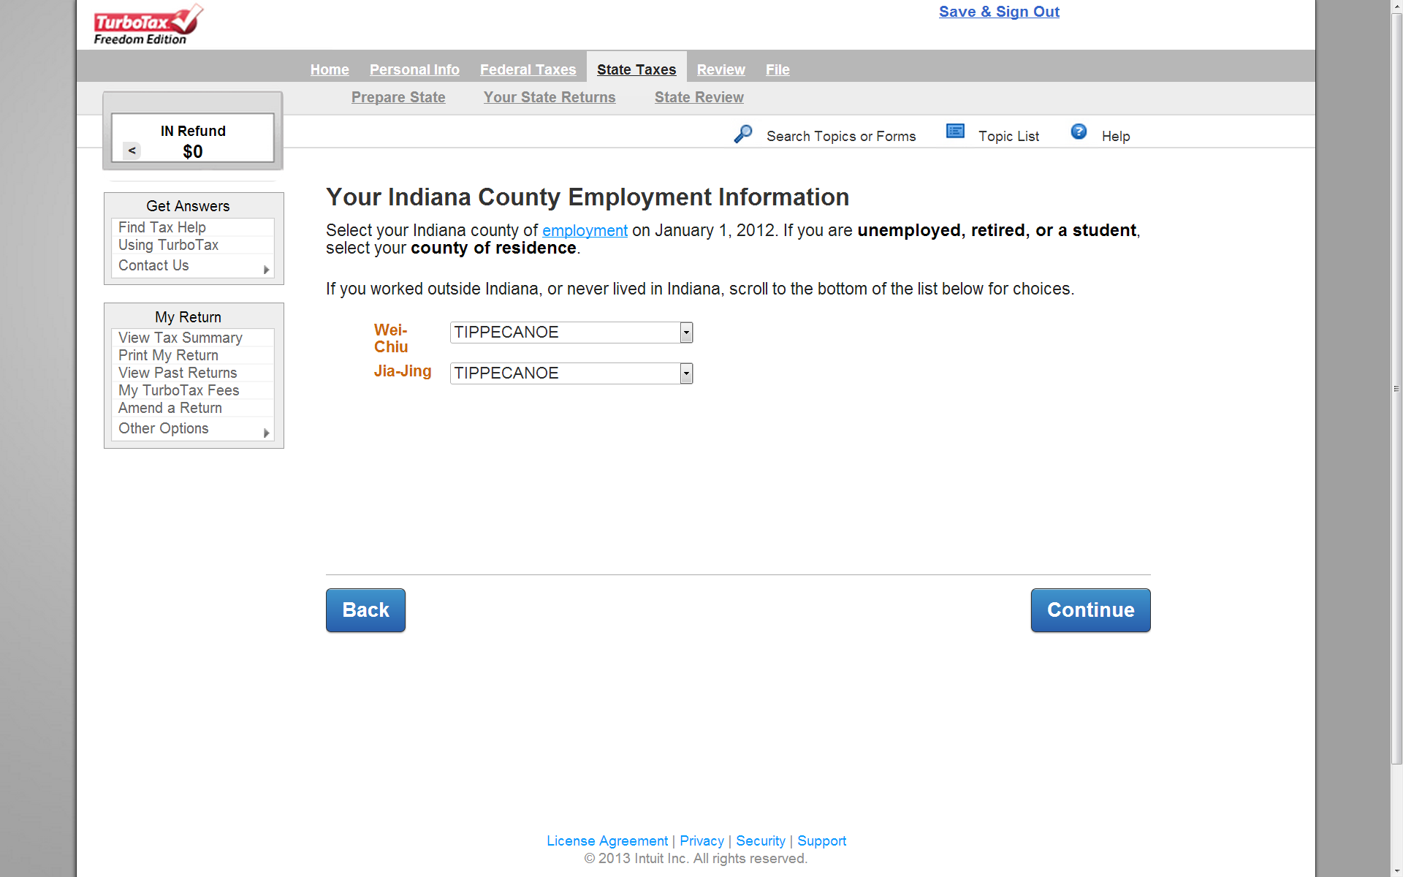

Slide 14
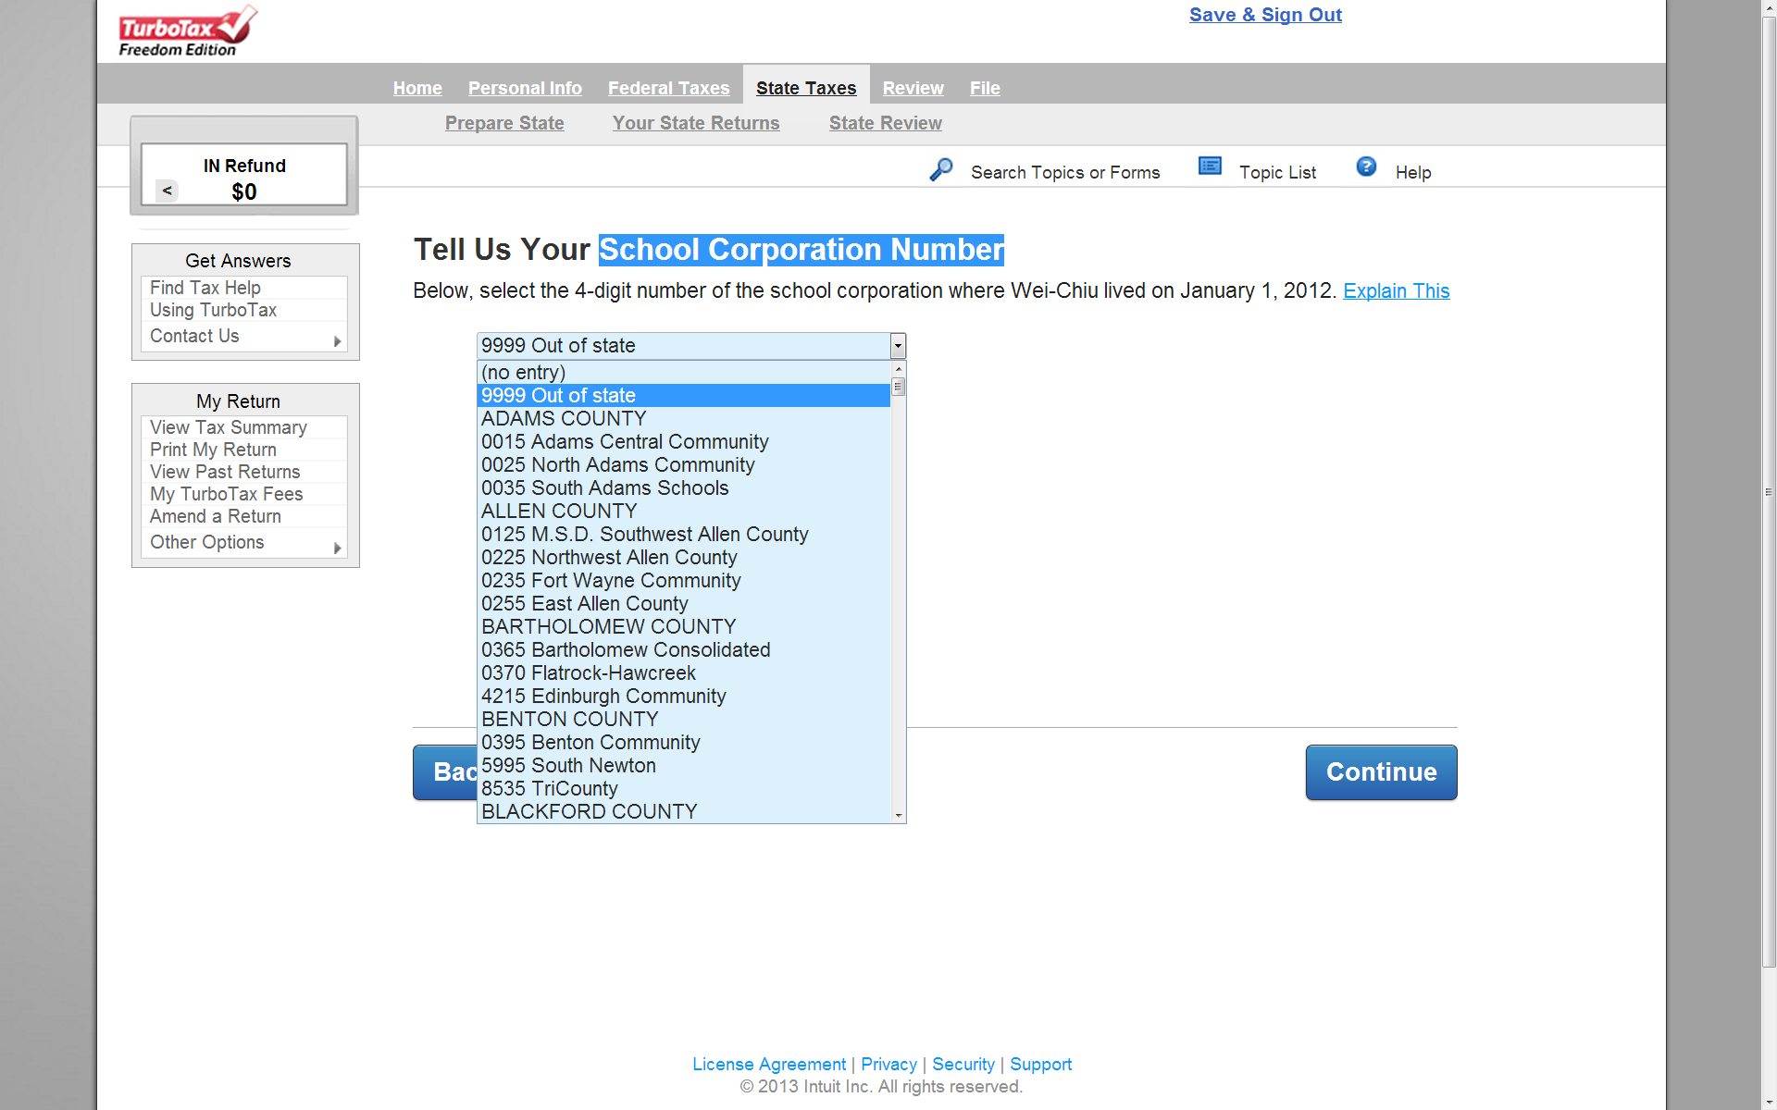
去年1月1日不住在Indiana的話就填9999 Out of state

Slide 15
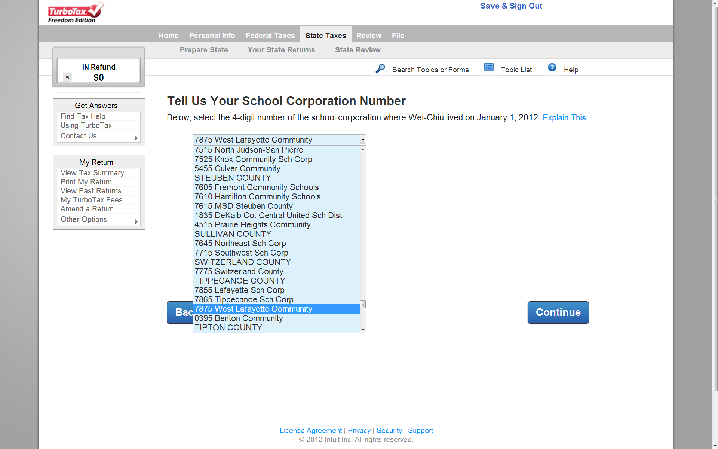

Slide 16
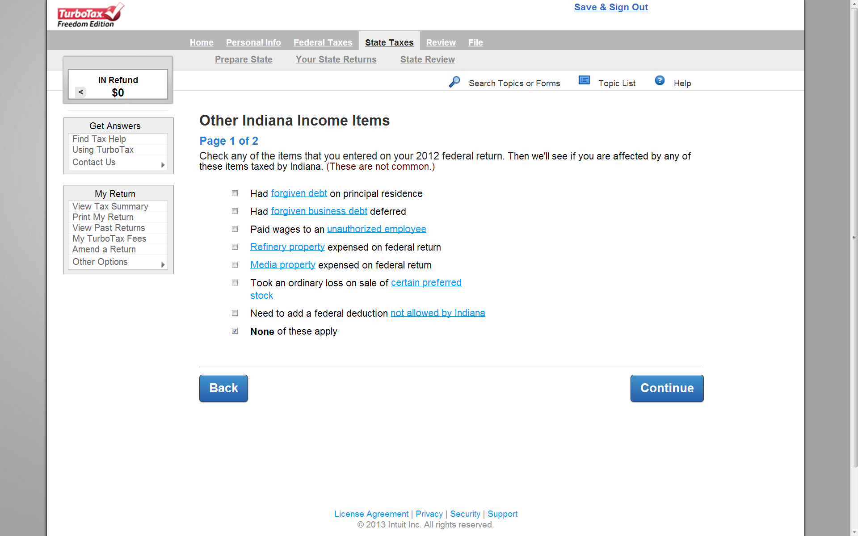
正常的普度研究僧應該沒有這些收入…

Slide 17
Use Tax 101
Use Tax vs Sales Tax

Slide 18
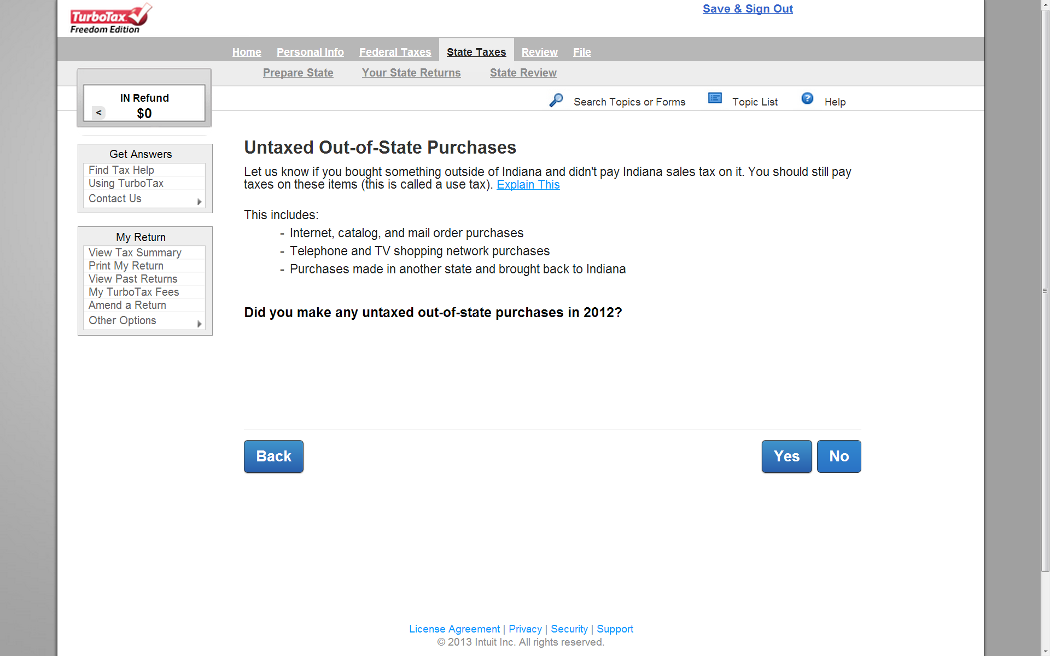
Use Tax 7%
Notes:
Federal universal sales tax
Amazon to collect sales tax from 01/01/2014!

Slide 19
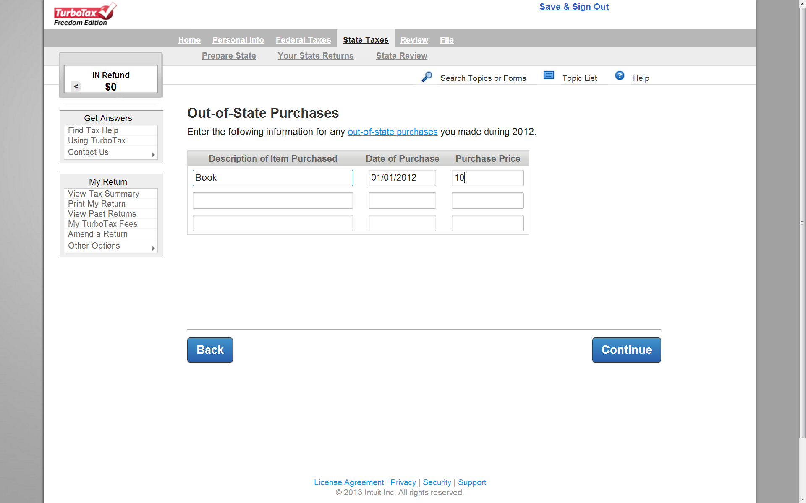
如果你有在Amazon, eBay 上買東西
買車、船、飛機不算!

Slide 20
Deductions
Notes:
大家都最喜歡的部份

Slide 21
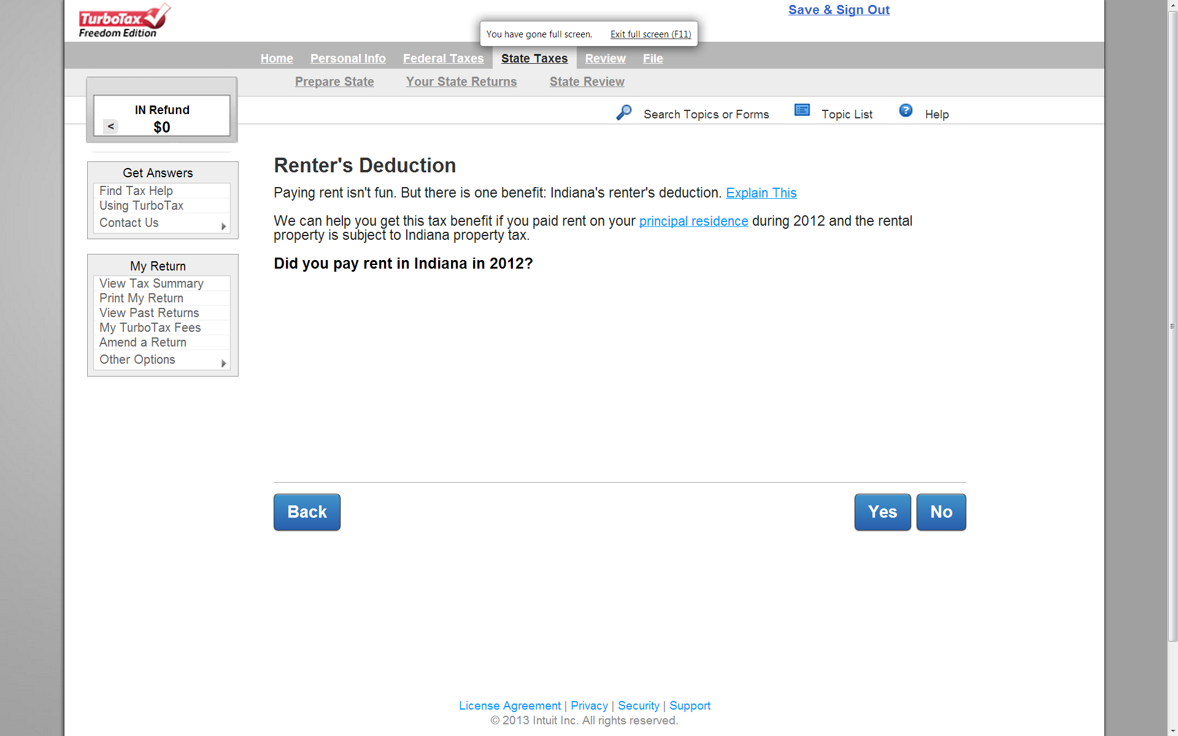
可以抵最多$3000免稅額
住PV或學校宿舍不能報!
Notes:
(1) Renter’s deduction
(2) 另外 如果是住自己的房子，有繳property tax. Property tax 可以抵income tax, 最多$2500

Slide 22
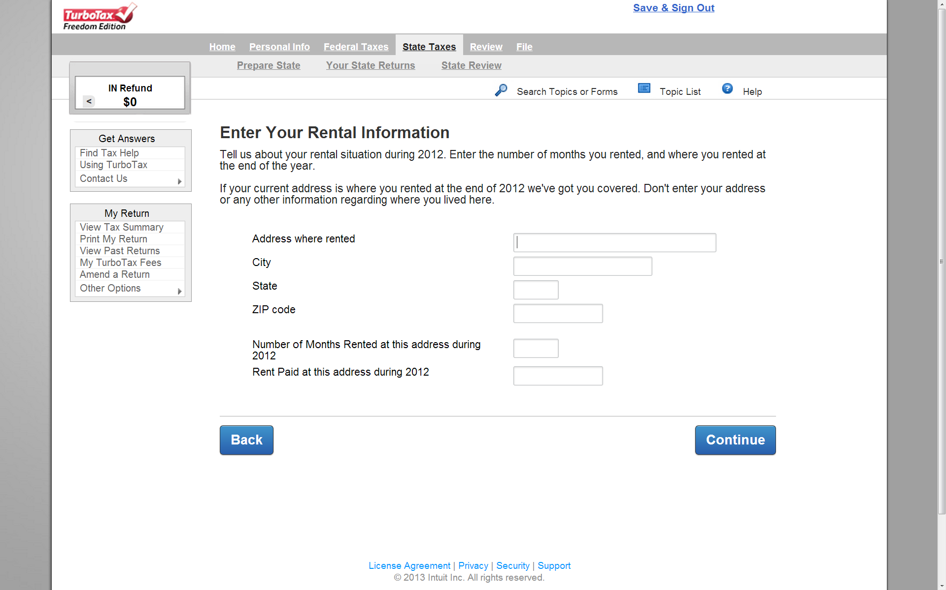

Slide 23
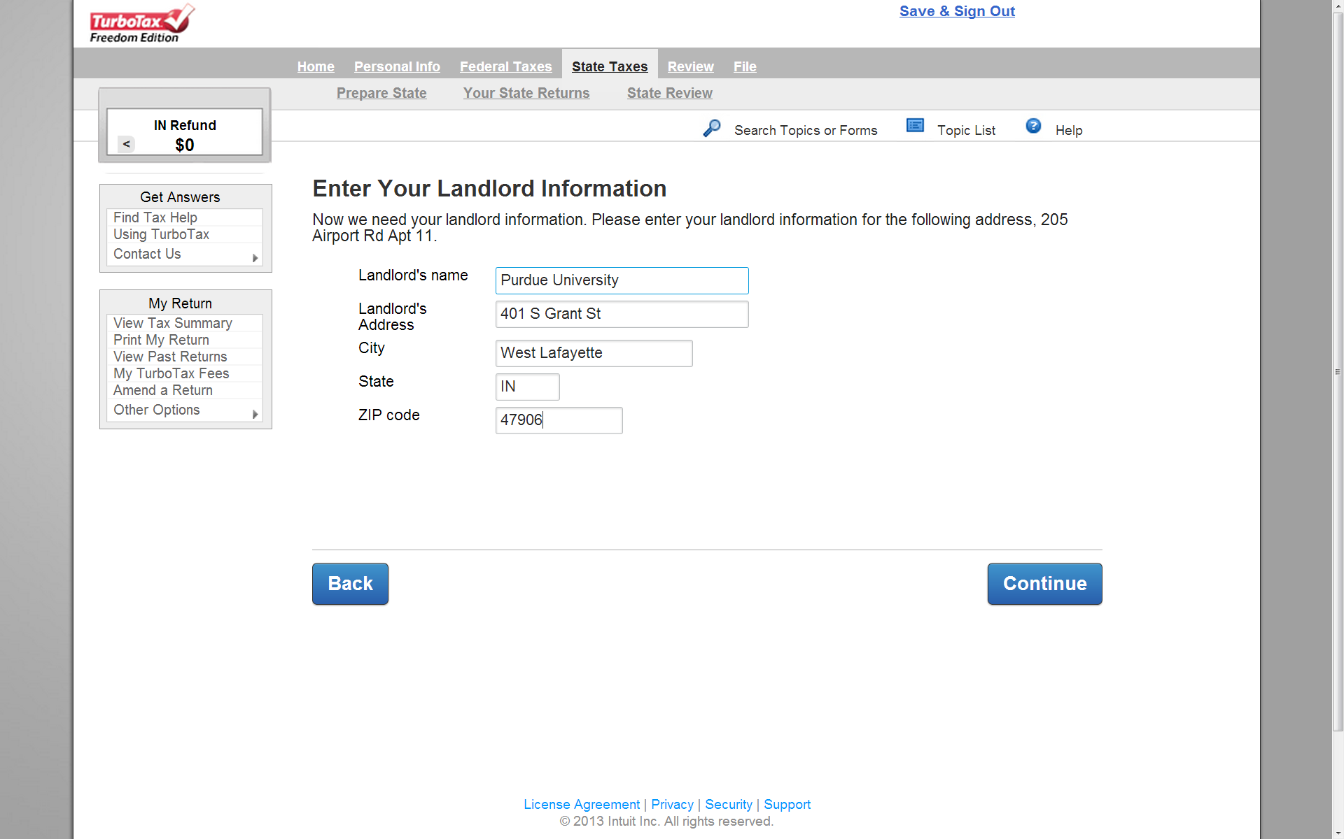
這只是範例，再次強調住普度宿舍房租不能抵稅

Slide 24
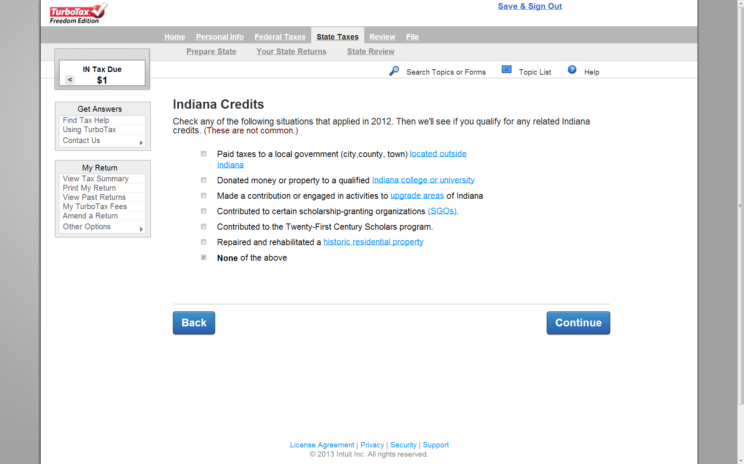
繳學費不是捐款
Notes:
Education expenditure.
tuition, fees, computer software, textbooks, workbooks,
curricula, school supplies (other than personal computers), and
other written materials used primarily for academic instruction or for
academic tutoring, or both.

Slide 25
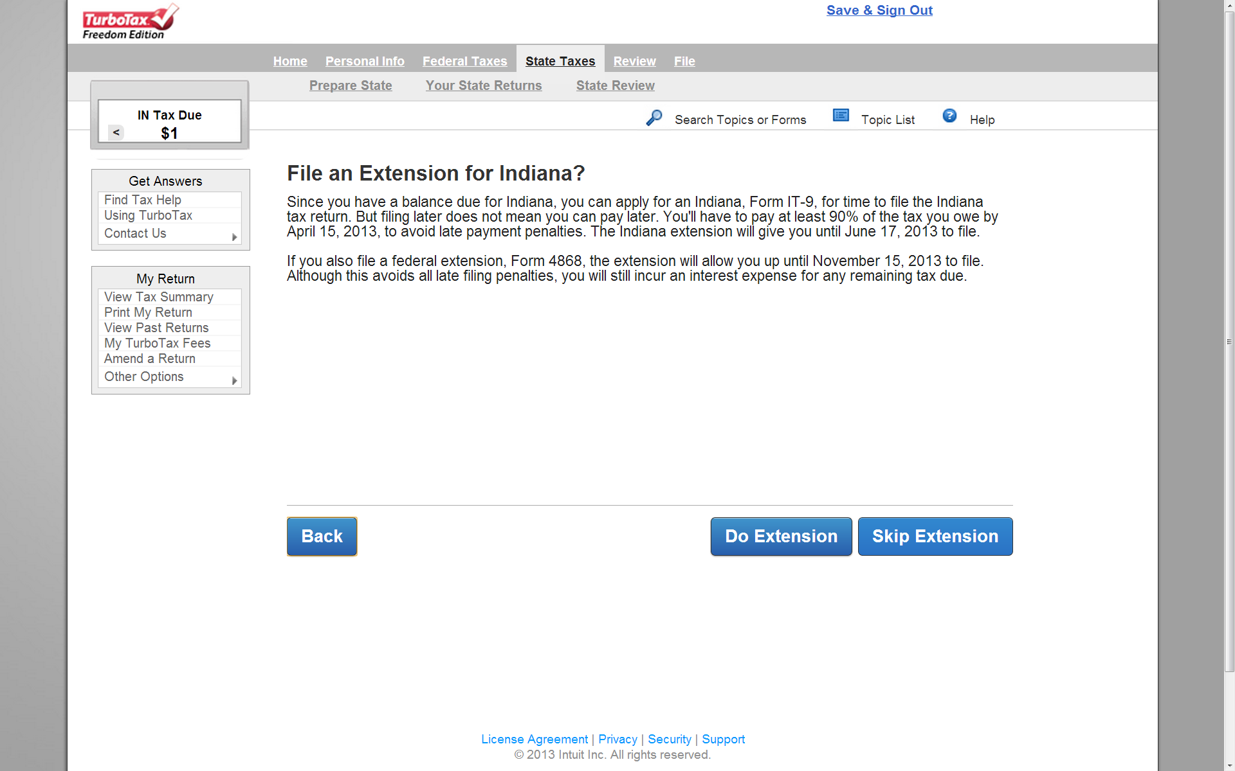
Extensions
April 15前可以申請延期到六月中(state/federal tax都可)
但如果時間過了忘記報就不能延期(遲繳要罰錢+利息)

Slide 26
Where’s my state tax refund?
Check online https://secure.in.gov/apps/dor/tax/refund/
Social Security Number
Refund amount claimed
Tax year: 2012
Or call (317) 233-4018
http://iot.custhelp.com/app/answers/detail/a_id/653

