Slide 1
Online Library Research
English 203-Fall 2008

Slide 2
Purdue’s Library Website

Slide 3
MegaSearch searches several databases at once will produce some full-text articles can connect directly to Purdue’s holdings, if available

Slide 4
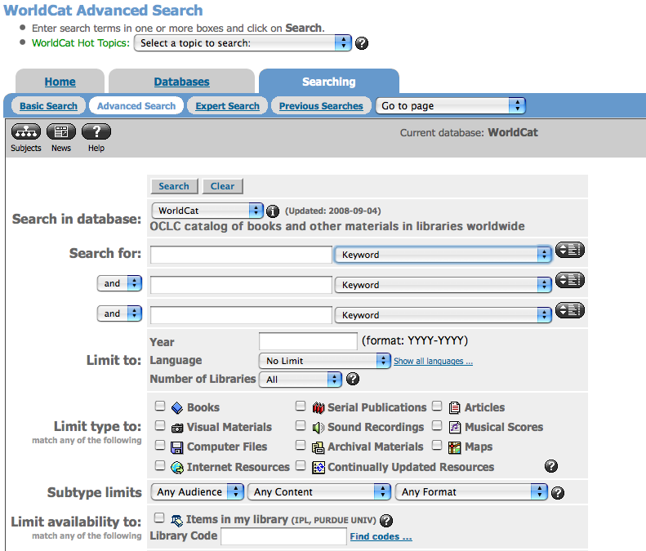
WorldCat & Library of Congress
Use Worldcat to find books in any library.
Use loc.gov to find any books that have a loc number (like almost like books in print)

Slide 5
ILL (Interlibrary Loan)
Use ILL if your book or journal is not available in our library
If it is a book chapter or journal article, ILL will email a pdf of the document to you.
Turnaround is quicker than stated. In the “Request Needed by” section, choose 1-2 weeks rather than the default date.

Slide 6
Interlibrary Loan page

Slide 7
Useful article databases for PW
Academic Search Premier
ACM Digital Library
IEEE Xplore
Omnifile Full Text Mega
Proquest Research Library
Safari Tech Books Online

Slide 8
Search Procedures
Different databases have different search procedures.
Most provide fields in which to search and/or use boolean terms/operators/stop words.
Search terms are important: make sure you brainstorm lots of words and phrases relevant to your topic.
Look through you’re the research you have for keywords, often listed under and article’s abstract.

Slide 9
Article keywords example

Slide 10
Search terms example
Blog
Weblog
Web/Online/Internet
Diary
Wordpress, Typepad, Blogger, Myspace (software for blogging)
Writing
Chronicles/Thoughts

Slide 11
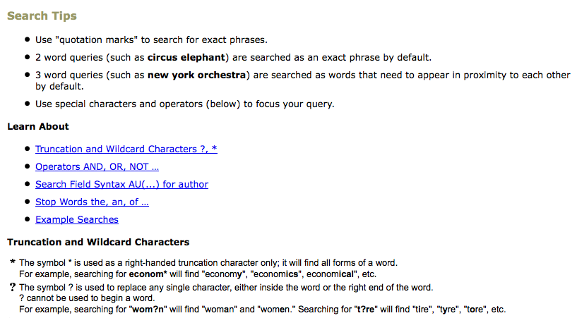
Search Tips

Slide 12
Operators

Slide 13
Stop Words

Slide 14
Sample Searches

Slide 15
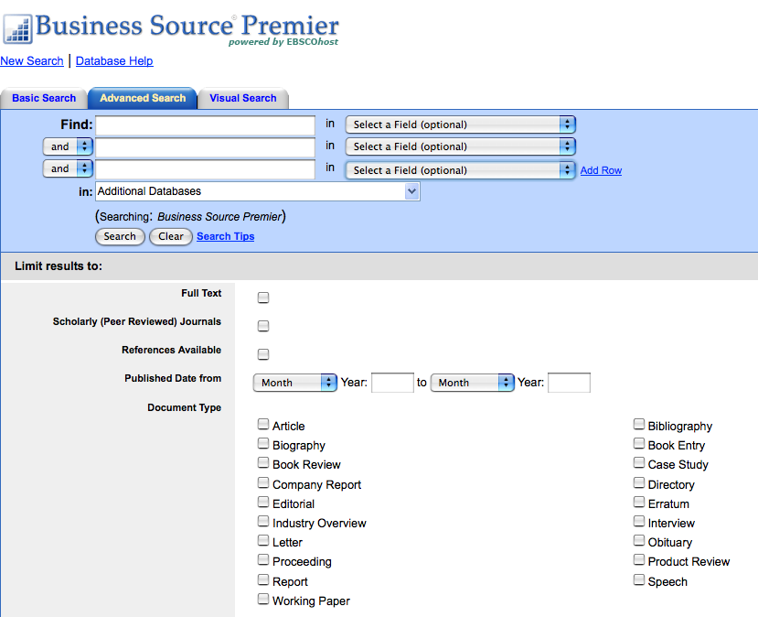
Limiting your search results

Slide 16
Scholarly and Peer-Reviewed Publications Use scholarly and peer-reviewed publications in your report. While you might be tempted to use magazines or popular publications, the material is often thin and too simplistic for your report.

Slide 17
Choosing multiple databases

Slide 18
Citations within the database Some databases show citations within the article

Slide 19
Most Cited/Popular Articles

