Slide 1
Some context for the semester ahead:
The world food and financial crisis of 2007-09
AGEC 640
Agricultural Development and Policy
Thursday, August 23, 2018
?
Our goal for today: much data, a few hypotheses

Slide 2
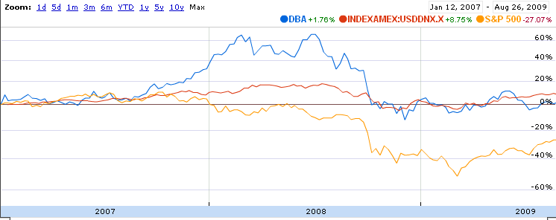
The 2007-09 crises, in one picture
DBA
DNX
S&P500
all rise
commodities rise as stocks fall
all fall, then
move together
Three Indices:
DBA: corn, wheat, soy and sugar (25% each)
USD DNX: currencies of Europe (57.6%), Japan (13.6%), Britain (11.9%), Canada (9.1%), Sweden (4.2), Switzerland (3.6%) per US dollar
S&P500: value-weighted sum of large U.S. companies
Source: Computed from data at www.google.com/finance.

Slide 3
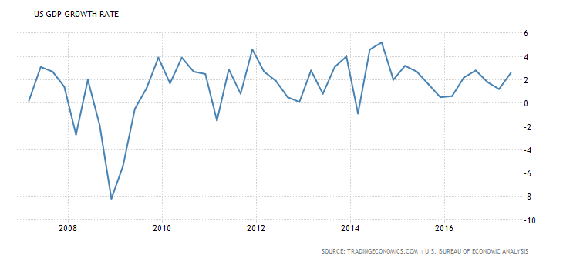
Let’s start with the economy as a whole
GDP growth in the United States
(pct/year, quarterly data)
Things
have improved!
Reprinted from IMF (2009), Country Report: United States (July). http://www.imf.org/external/pubs/ft/scr/2009/cr09229.pdf

Slide 4
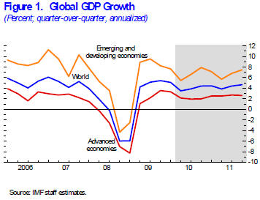
The global economy is now relatively synchronized
Who is doing best?
Why?
Source: http://www.imf.org/external/pubs/ft/weo/2010/update/02/index.htm

Slide 5
Reprinted from IMF(2009), World Economic Outlook Update (July, www.imf.org).

Slide 6
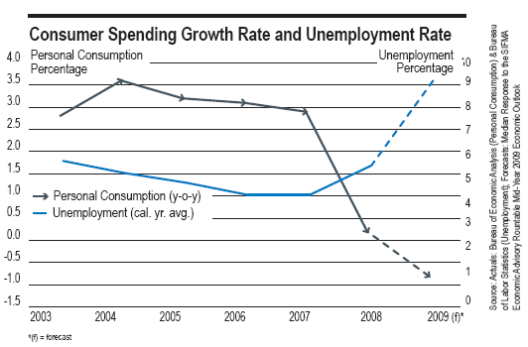
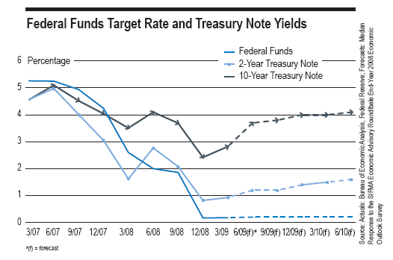
In the U.S., consumption and employment
DRIVE policy choices, especially interest rates…
Reprinted from SIFMA (2009), Economic Outlook (June). http://www.sifma.org/research/pdf/EconOutlook0609.pdf

Slide 7
A new aspect of the 2008/09 crisis was the collapse of mortgage-backed securities in the U.S.
Residential
Commercial
Reprinted from SIFMA (2009), Research Quarterly (August)
http://www.sifma.org/research/pdf/RRVol4-8.pdf

Slide 8
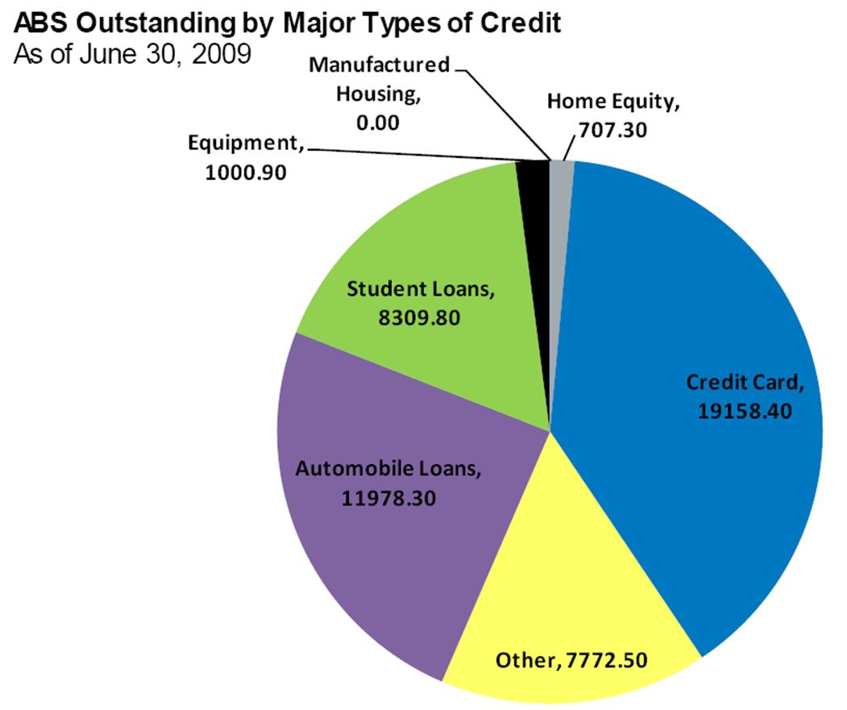
…and the collapse of a large
“shadow banking” sector on other assets
Reprinted from SIFMA (2009), Research Quarterly (August)
http://www.sifma.org/research/pdf/RRVol4-8.pdf

Slide 9
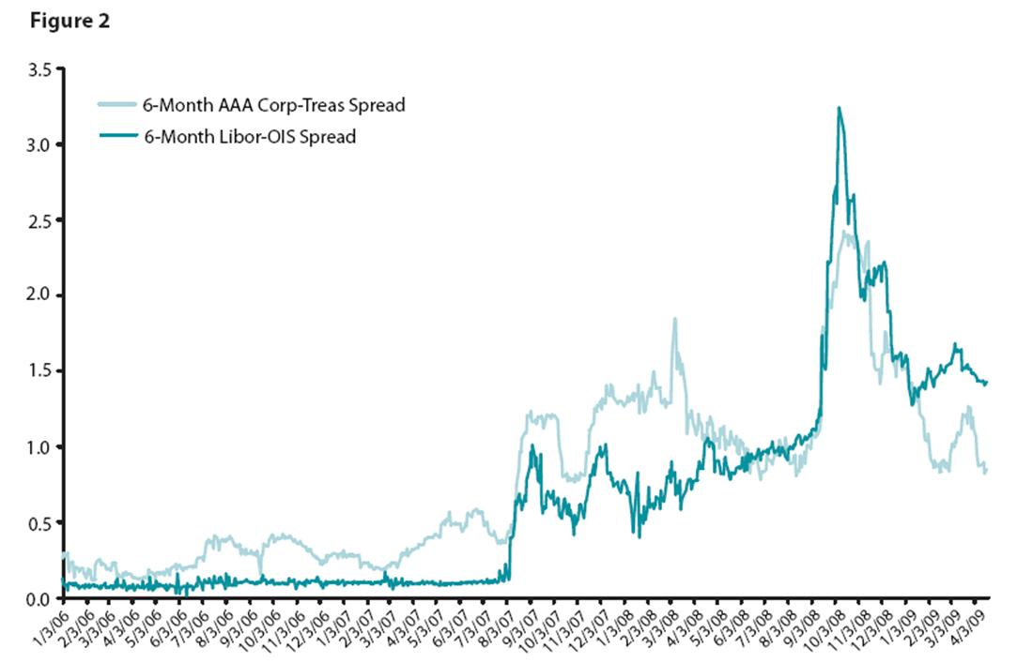
…which made all financial transactions unusually risky
Perceived bankruptcy risk for banks
Perceived bankruptcy risk
for U.S. companies
Source: Federal Reserve Bank of St. Louis, 2009. (http://research.stlouisfed.org/publications/es/09/ES0924.pdf)

Slide 10
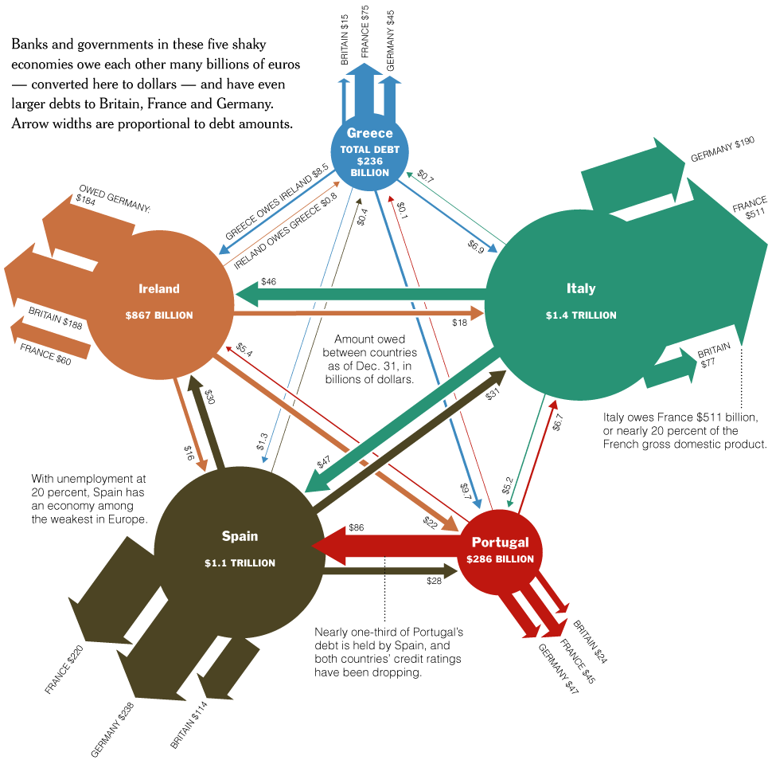
…and remember we are all connected
Source: NY Times “Europe’s Web of Debt” (May 1, 2010)

Slide 11
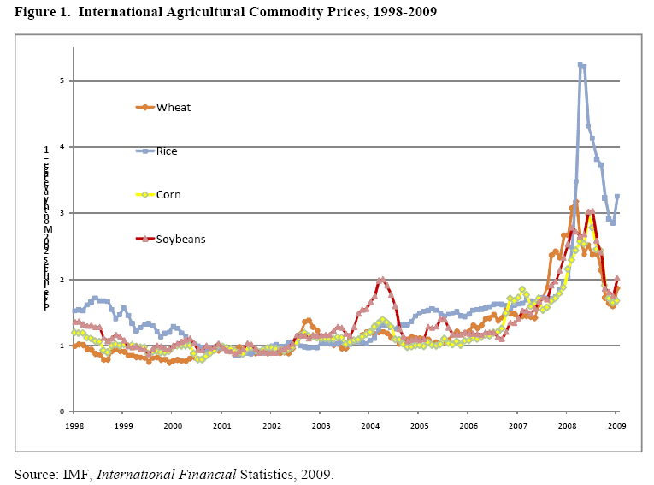
Looking within the food price crisis
Rice rose first and spiked highest.
Why?
Other crops rose/fell in sync
Note typical spike-and-valley pattern
…we’ll return this later in the semester
Reprinted from P.C. Abbott (2009), Development Dimensions of High Food Prices. Paris: OECD.

Slide 12
A pre-history of the current crisis
Index of real international food prices, 1900 to 2005 (1977-79 =100)
In 2006, no sign yet of the 2007-08 price rise
Source: K. Anderson (2006), “Reducing Distortions to Agricultural Incentives: Progress, Pitfalls and Prospects.” <www.worldbank.org/agdistortions>. Data shown are an index of export prices in US dollars for all major traded agricultural products, deflated by the MUV index which is the unit value of manufactures exported from France, Germany, Japan, UK and US, with weights based on those countries’ exports to developing countries.

Slide 13
A pre-history of the current crisis
Index of real international food prices, 1900 to 2005 (1977-79 =100)
The spike-and-valley pattern creates cycles of panic and then complacency
The 1973 crisis led to investments that brought prices down to unusually low and stable levels
Source: K. Anderson (2006), “Reducing Distortions to Agricultural Incentives: Progress, Pitfalls and Prospects.” <www.worldbank.org/agdistortions>. Data shown are an index of export prices in US dollars for all major traded agricultural products, deflated by the MUV index which is the unit value of manufactures exported from France, Germany, Japan, UK and US, with weights based on those countries’ exports to developing countries.

Slide 14
The spike-and-valley cycles, differ somewhat among crops, but not by much. Why?
IMF indexes of nominal commodity prices, January 1992=100
Source: Reproduced from Ronald Trostle, “Global Agricultural Supply and Demand: Factors Contributing to the Recent Increase in Food Commodity Prices”, Outlook Report WRS-0801. Washington, DC: ERS/USDA, July 2008.

Slide 15
Other commodities fluctuate even more than food. Why?
Reprinted from P.C. Abbott (2009), Development Dimensions of High Food Prices. Paris: OECD.

Slide 16
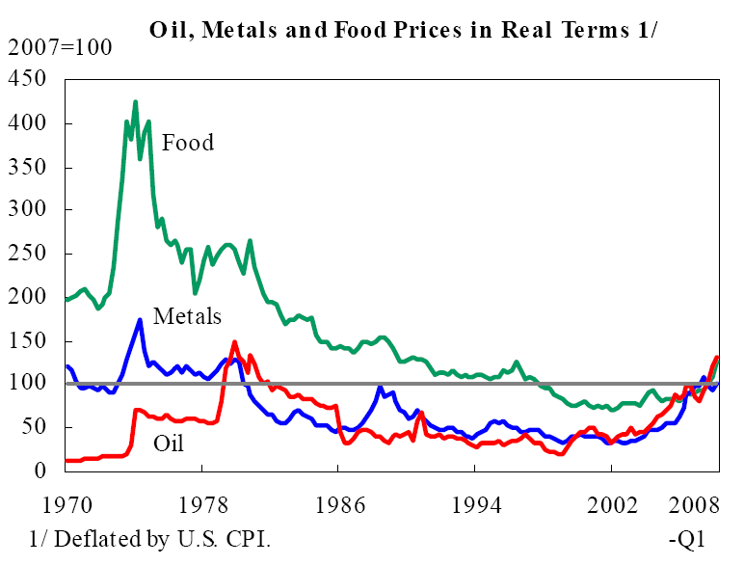
Relative to other things, food has
remained cheap by historical standards…
Index values
(2007=100)
Source: Reproduced from IMF, “Food and Fuel Prices—Recent Developments, Macro-economic Impact, and Policy Responses.” Washington, DC: IMF, June 30, 2008 (58 pages).

Slide 17
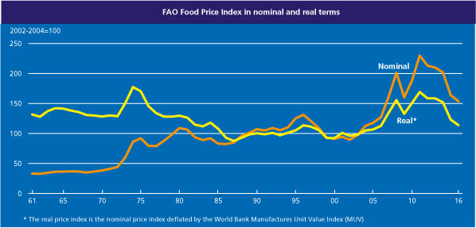
Food prices rebounded to levels that echoed the 1970s, but have since moderated
Source: Reproduced from FAO “World Food Situation” Rome: FAO (accessed 08/12/2016).
http://www.fao.org/worldfoodsituation/foodpricesindex/en/

Slide 18

But food is still barely affordable for the poorest
Index values
(2007=100)
At the all-time low prices of 2002…
And when prices rise…
March 13, 2002
World: Many Hungry Mouths
Around 815 million people -- 13 percent of the world's population -- suffer from hunger and malnutrition, mostly in developing countries, said Jacques Diouf, head of the United Nations Food and Agriculture Organization.
Source: Reproduced from IMF, “Food and Fuel Prices—Recent Developments, Macro-economic Impact, and Policy Responses.” Washington, DC: IMF, June 30, 2008 (58 pages).

Slide 19
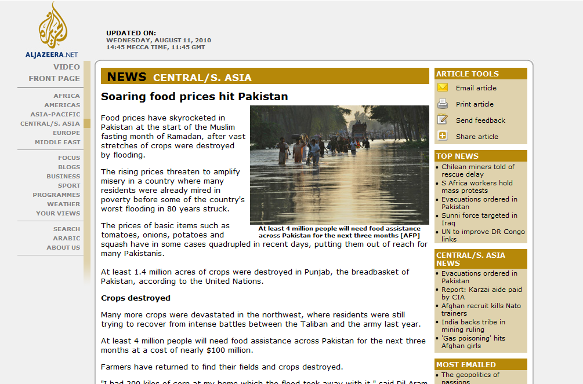
Local crises are driven by underlying world market conditions and local “stochastic” events

Slide 20
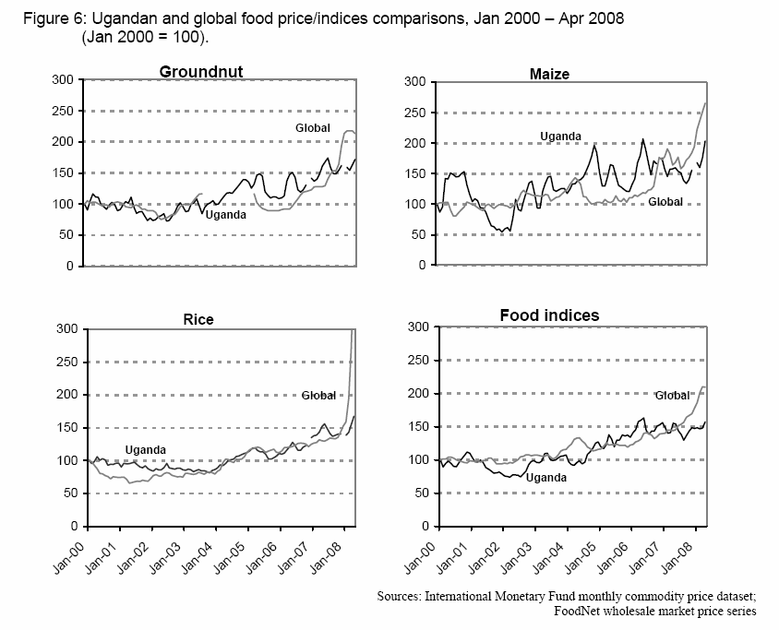
But local prices don’t always link directly to “world market” prices
Source: Reprinted from IFPRI (2008), “An Assessment of the Likely Impact on Ugandan Households of Rising Global Food Prices.” Kampala, Uganda: IFPRI, June 9th 2008 (39 pages).

Slide 21
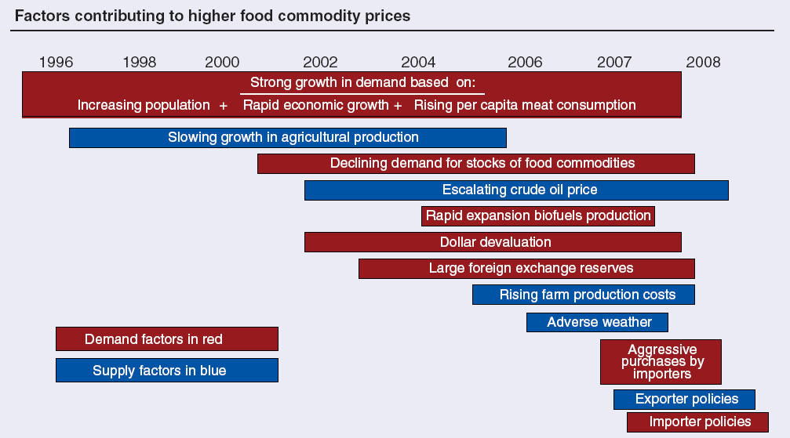
Why did food prices spike?
The USDA’s summary of conventional wisdom
Source: Reproduced from Ronald Trostle, “Global Agricultural Supply and Demand: Factors Contributing to the Recent Increase in Food Commodity Prices”, Outlook Report WRS-0801. Washington, DC: ERS/USDA, July 2008.

Slide 22
The stage was set by low world stocks
IMF
price indexes
Total world grain & oilseeds stocks
Source: Reproduced from Trostle (2008), from IMF data on prices and USDA estimates on stocks.

Slide 23
Stock changes were mostly in Asia

Slide 24
On the demand side, food consumption is driven by population and income…
Reprinted from The Economist, 8 December 2007.

Slide 25
…and recently by biofuels policy as well
Ethanol (mostly US)
Biodiesel (mostly EU)
Source: Reproduced from Trostle (2008), from USDA data and projections.

Slide 26
The U.S. use of corn for ethanol has been especially fast-growing
Source: Reproduced from Trostle (2008), from USDA data and projections.

Slide 27
U.S. increased corn use for ethanol accounts for 30% of world increase in all uses of all grains
…about the same share as increased feed use; food use accounts for 44% of growth
Source: Reproduced from Trostle (2008), from USDA data and projections.

Slide 28
Global trade of grain is mainly
into East Asia

Slide 29
…but on a per-capita basis,
Africa imports even more than Asia

Slide 30
The price rise was due partly to slowdown in per-capita production growth…

Slide 31
Yield trends drive output

Slide 32
But not all farmers are net sellers!
Table 1.
Proportion of households who produce, sell or are net sellers of food, 1998-2001
 |  |  | Ethiopia (2000) |  |  | Madagascar (2001) |  |  | Zambia (1998)
 |  |  | Total | Rural |  | Total | Rural |  | Total | Rural
Rural population (% of total) |  |  | 50.7 |  |  | 75.8 |  |  | 47.8
All foods
 | producers | (% of all hhlds) | 78.1 | 97.0 |  | 71.2 | 83.1 |  | 66.5 | 89.4
 | sellers | (% of all hhlds) | 68.4 | 87.9 |  | 58.1 | 68.5 |  | 36.7 | 53.9
 | net sellers | (% of all hhlds) | 40.6 | 53.2 |  | 41.4 | 49.1 |  | 7.9 | 12.6
 | net sellers | (% of poor hhlds) | 44.3 | 51.5 |  | 54.5 | 56.2 |  | 10.6 | 12.5
Main staple foods
 | producers | (% of all hhlds) | 55.4 | 71.5 |  | 64.4 | 75.7 |  | 47.5 | 69.5
 | sellers | (% of all hhlds) | 28.5 | 36.9 |  | 35.1 | 41.7 |  | 28.8 | 42.5
 | net sellers | (% of all hhlds) | 23.1 | 27.3 |  | 31.7 | 37.6 |  | 19.1 | 29.6
 | net sellers | (% of poor hhlds) | 21.8 | 24.3 |  | 41.0 | 42.7 |  | 23.9 | 28.1
Note: Poor households are defined as the lowest 40% of income per capita; staple crops are wheat and maize (Ethiopia), rice, maize, groundnut and beans (Zambia) and rice and maize (Madagascar). Source: Reproduced from W.A. Masters (2008), “Beyond the Food Crisis in Africa.” African Technology Development Forum, 5(1-2): 3-13. Data shown are compiled from M.A. Aksoy and A.Isik-Dikmelik (2008), "Are Low Food Prices Pro-Poor? Net Food Buyers and Sellers in Low-Income Countries" Policy Research Working Paper 4642. Washington, DC: The World Bank, June 2008 (30 pages).

Slide 33
The poor sell little, or are net buyers
Farm household net crop sales in Tanzania, by income level
Net buyers
Net buyers
Net buyers
Note: All data are from the Kagera Health and Development Survey (www.worldbank.org/lsms); results shown are a local polynomial regression with its 95% confidence interval, for surveyed households with agricultural production (579 in 1991-92, and 557 in 1992-93). Staple food crops are maize, cassava, cooking bananas, millet, sorghum, and yams or potatoes. The household’s expenditure per capita is measured in 2006 U.S. dollars converted at PPP prices.
Source: Reprinted from A. Rios, W.A. Masters and G.E. Shively (2008), “Agricultural Prices and Income Distribution among Farmers .” Working Paper available online at www.agecon.purdue.edu/staff/shively/RMS.pdf.

Slide 34
Aid has risen, but not for food & ag.

Slide 35
Aid to ag. in Africa has fallen the most

Slide 36
Whew! Conclusions?
There’s a lot of data out there
  not everything is measured, but much is known
  relationships between variables remain questionable
Hw #1 will give you experience using those data
  write-ups should describe what you see in the data; inferring causality is risky (avoid saying “because”);
  it is far more honest to speak of “association”
Next week, we begin systematic search for links between economic growth, agricultural development and government policies…

