Slide 1
AGEC 640 -- Agricultural Development and Policy
Impact Evaluation
Tuesday, October 23, 2018
Today: An introduction to impact evaluation
  Readings (recommended only):
    Angrist and Pischke (2014) Mastering Metrics
    Morgan and Winship (2007) Counterfactuals and Causal Inference.
    Jagger, Sills, Lawlor and Sunderlin (2010) “A guide to learning about livelihood impacts of REDD+ projects.” CIFOR occasional paper 56.
Next time: An example from Malawi

Slide 2
Evaluating Projects and Policies
Types of evaluation:
M&E – track set of project indicators across space and time
Process – assess program operation and adherence to implementation design
Economic – analyze costs/benefits, incentives and behaviors (BCA/CBA)
Sector – review of sector strategy and accomplishments
Impact evaluation – establish a causal effect of a specific program or policy by establishing a counterfactual

Slide 3

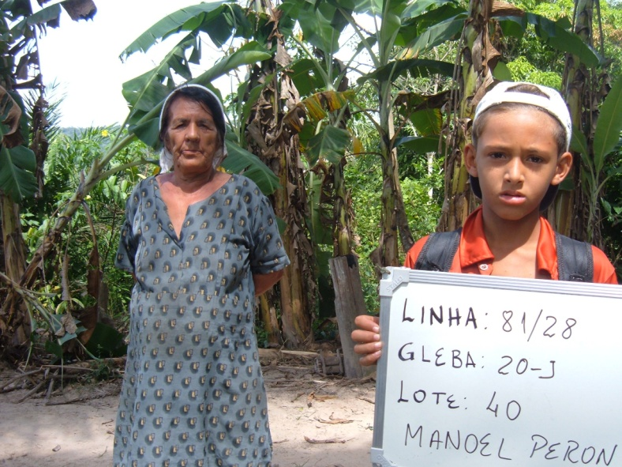
Project impacts
With Project
Outcome
Impact
Project
Intervention
?
Without Project

Slide 4
M&E vs. Impact Evaluation
Traditional M&E
  Measures trends in indicators and implementation
  Are the benefits going to those intended?
  Is the project being implemented as planned?
  Not focused on causality
Impact evaluation
  Measures impact on the beneficiaries that are caused by the intervention/program/policy
  Asks: “What are the effects of the intervention?”
  Asks: “How would the outcome change if the program or policy changed?”
  The focus is on establishing causality (hard!!!)

Slide 5
Key elements of Impact Evaluation
The question of causality makes IE different from other monitoring and evaluation approaches:
Main question is one of attribution – isolating the effects of the program from other factors and potential selection bias:
  Counterfactual outcomes (i.e. outcomes for participants not exposed to the program), or
  Use survey data to construct comparison groups for those who are participants or receive treatment.

Slide 6
The Problem of Bias
X
T
Y
Expectation: T (the treatment) influences
Y (the outcome)
Problem: X (a confounder) influences both T and Y.
If T is correlated with X, the estimate of
the effect of T on Y will be biased.
Goal: Break the link between X and T

Slide 7
Causation
How to establish that T (treatment, program, policy) causes Y (the outcome):
  Does T precede Y in time?
  Is T correlated with Y?
  Can we rule out or control for other variables(X) that can explain the relationship between T and Y?
  Key: The researcher must understand the process or theory that generates the data – otherwise you can only establish a correlation between T and Y.

Slide 8
Approaches
1. Make assignment to the treatment group random by
construction. This is normally referred to as a
“Randomized Control Trial” (RCT) and is the gold
standard for impact evaluation studies.
(a “natural experiment” might suffice) or
2. Perform regression with adequate controls for X. This is
the “standard” regression approach, but may be plagued
by the problem that not all elements of X may be observed. This is the problem of unobservables and
leads to omitted variable bias.

Slide 9
Intervention/program
/policy
The most effective way to link interventions/programs to outcomes is by establishing a control group
Outcomes

Slide 10
Project impacts
With Project
Outcome
Impact
Project
Intervention
?
Without Project

Slide 11
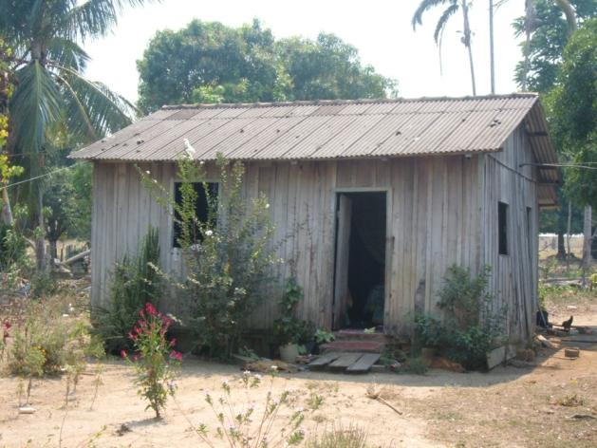
Project impacts
With Project
Outcome
Impact
Project
Intervention
?
Without Project

Slide 12
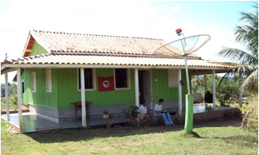
Project impacts
With Project
Outcome
Impact
Project
Intervention
?
Without Project

Slide 13
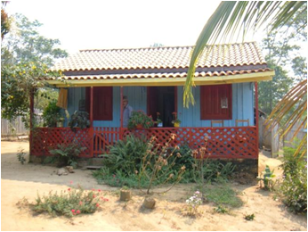
Project impacts
With Project
Outcome
Impact
Project
Intervention
?
Without Project

Slide 14
Project impacts
With Project
Outcome
Impact
Project
Intervention
Missing
counterfactual
Without Project

Slide 15
Confounders – a challenge for causation
The counterfactual should tell us “what would have happened, had there been no policy or treatment?”
In addition to omitted variables, policy evaluation must deal with human behavior (strategic and a source of confounding):
  Mimics intervention or masks impacts
  Persistent omitted variables
  Lack of balance across treatment and control
Potential confounders or omitted variables in policy analysis:
  Institutional factors (e.g. other programs, NGOs, etc.)
  Biophysical characteristics (e.g. soil conditions, weather)
  Psycho-social behavior (e.g. volunteering or targeting)
  Historical trends (e.g. technical change, political bias, institutional bias, project presence)

Slide 16
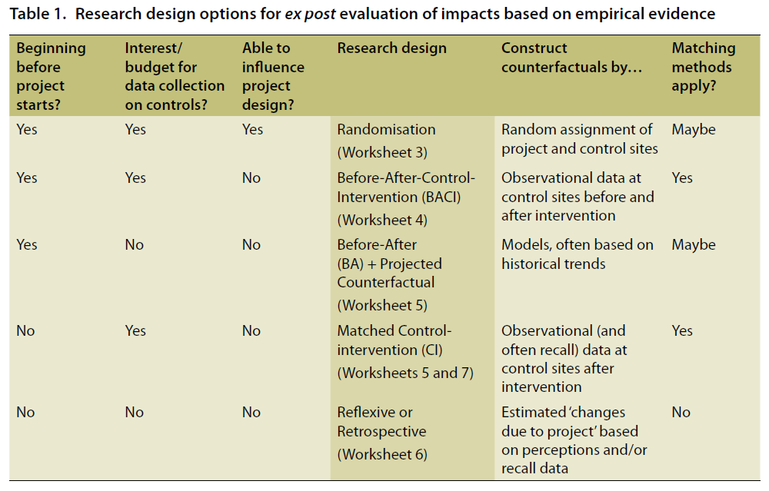
Notes:
KEEP AS APPENDIX

Slide 17
Research Designs
Q1→ | Starting before | Starting after
 | Before-After Control-Intervention | Control-Intervention (+ retrospective)
 | Before-After (+ modeling) | Reflexive/ Retrospective

Slide 18
Research Designs
Q2↓ Q1→ | Starting before | Starting after
Budget to collect data on “controls” | Before-After Control-Intervention | Control-Intervention (+ retrospective)
Budget to collect data on intervention only | Before-After (+ modeling) | Reflexive/ Retrospective

Slide 19
Research Designs
Q2↓ Q1→ | Starting before | Starting after
Budget to collect data on “controls” | Before-After Control-Intervention | Control-Intervention (+ retrospective)
Budget to collect data on intervention only | Before-After (+ modeling) | Reflexive/ Retrospective

Slide 20
Research Designs
Q2↓ Q1→ | Starting before | Starting after
Budget to collect data on “controls” | Before-After Control-Intervention | Control-Intervention (+ retrospective)
Budget to collect data on intervention only | Before-After (+ modeling) | Reflexive/ Retrospective

Slide 21
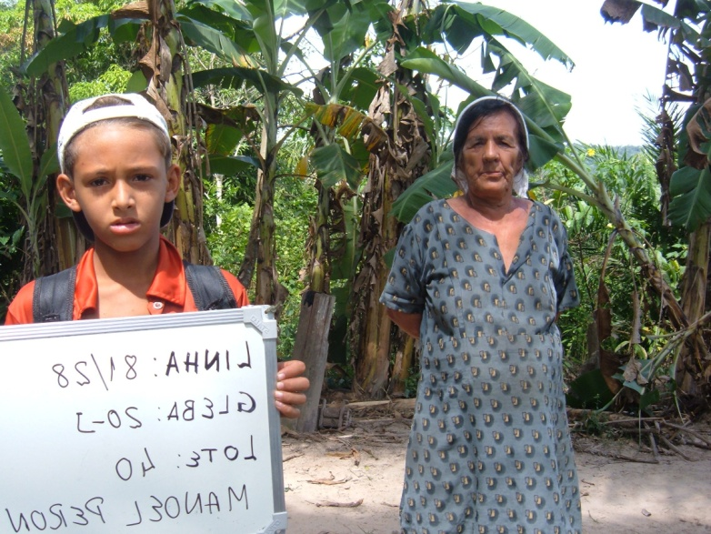
Research Designs with ‘Controls’
With Project
Outcome with
Impact
Project
Intervention
?
Outcome without
No Project:
“Control”

Slide 22
Analysis
Simple difference in means between treatment and control/comparison groups does not account for pre-existing differences;
Multivariate regression will be valid only if all differences can be observed and controlled for;
A difference-in-difference estimator compares indicator values between treatment and control (first difference) and before and after (second difference).

Slide 23
BACI
Comparison (Control)
Project site (Intervention)
 | Before | After
Control
Before
Control
After
IMPACT
Intervention
Before
Intervention
After

Slide 24
Good impact evaluation will allow you to…
Confidently say whether the intended intervention is “working” i.e. effective in delivering the intended outcomes
Conditional on design, sampling and analysis
  What incentives and activities are most effective?
  Who benefits or loses?
  Where (sites) and when (in production cycle) will we see the best results?

Slide 25
Example: Income Shocks in Malawi
Research question:
Do households use natural resources to cope with unexpected events such as income shocks?
Policy importance to environmental protection and poverty reduction.

Slide 26
Motivation
Life is precarious in rural Malawi:
  policy shocks (e.g. economic reforms)
  illness & death (e.g. HIV/AIDS, malaria)
  weather events (e.g. drought, flood)
Missing markets for credit and insurance
  coping strategies are “informal”
  forests may serve as a “safety net”

Slide 27
Study Sites
major road
urban center
Blantyre District
Mulanje District
study site
Lake
Malawi
V3
V1
V2
Blantyre
0
12.5
25
50
Kilometers
0
12.5
25
50
Kilometers

Slide 28
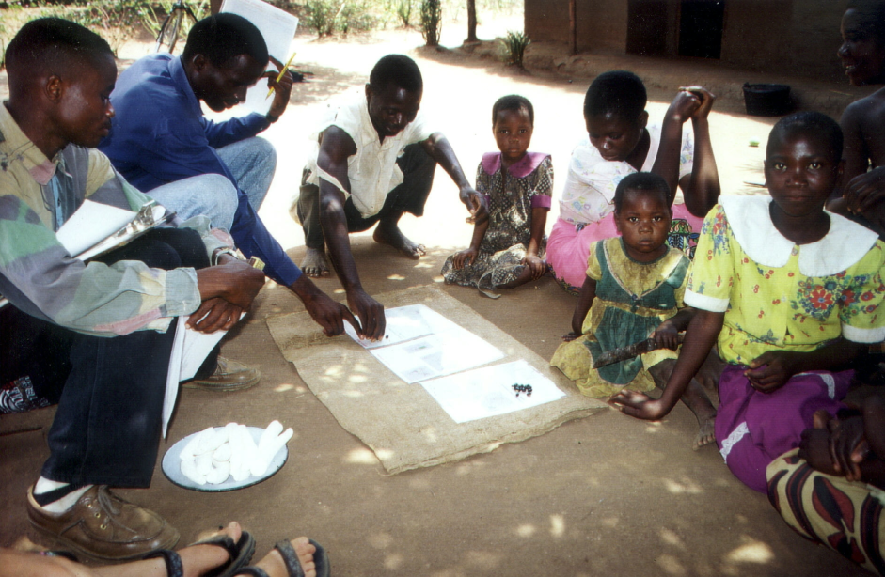

Fieldwork Methods
HH survey
Random selection
(natural experiment)
Large set of variables
Quarterly observations
Direct measurements
of outcome variables
(e.g. quantity of products removed from the forest)

Slide 29
Sample Households, Selected Attributes
 | Village 1 | Village 2 | Village 3
HH population | 4.64 | 4.79 | 5.36
FHH (%) | 49 | 45 | 23
Head sec. ed. (%) | 8 | 11 | 14
Farm size (ha) | 1.17 | 0.96 | 1.94
Income (1999 USD/person) | $208 | $156 | $282

Slide 30
Empirical Approach
Quantify the “effect” of an income shock on wood extracted for marketing (e.g., charcoal, timber, firewood, crafts, bricks, food, drink).
Treatment = an income “shock”
(receipt/non-receipt of a subsidy package)
unpredictable at the time (nearly a RCT)
  sizable impact (enough to produce an effect?)

Slide 31
Marketed Wood Extraction (kg), SP Non-Recipients
No positive income shock,
increase in forest extraction…
Qty. wood extracted (kg)
a
b

Slide 32
Marketed Wood Extraction (kg), SP Recipients
Positive income shock,
decline in forest extraction…
Qty. wood extracted (kg)
c
d

Slide 33
Difference-in-Difference (DID) without controls
3000
Recipients
Non-recipients
2500
c
e
DID Est.
of Impact
(d-b)-(c-a)
2000
d
Qty. wood extracted (kg)
1500
1000
b
a
500
0
Season 1
(Before “Treatment”)
Season 2
(After “Treatment”)

Slide 34
Difference-in-Difference (DID) with village controls
2500
Recipients
Non-recipients
2000
DID Est.
w/ village
controls
1500
Qty. wood extracted (kg)
1000
500
0
Season 1
(Before Treatment)
Season 2
(After Treatment)

Slide 35
Empirical Approach
Base DID model:
Y = β₀ + β₁Seas2 + β₂Treat + β₃(Seas2*Treat)
+ δX + ε
DID Est. of Impact
Include interaction terms:
Y = β₀ + β₁Seas2 + β₂Treat + β₃(Seas2*Treat)
+ δX + γ (Seas2*Treat*X) + ε
DID Est. of Differential Impact

Slide 36
Random-Effects Tobit Regression Results
for forest extraction (n = 198)

Slide 37
Empirical Approach
Include interaction terms to examine differential effects of starter pack:
Q = β₀ + β₁Seas2 + β₂Treat + β₃(Seas2*Treat)
+ δX + γ (Seas2*Treat*X’) + ε
X’ = older household, # adult males,
and distance to forest

Slide 38
Differential Effect, by Householder Age
0
-50
-100
-150
SP Effect on Wood Extracted (kg)
-200
-250
-300
Base HHs
(Younger Head)
“Older” Head
Difference
(p = 0.023)
Mean
90% CI

Slide 39
Differential Effect, by Number Adult Males
0
-200
-400
SP Effect on Wood Extracted (kg)
-600
-800
-1000
-1200
Base HH
(No Men)
One Man in HH
Difference
(p = 0.001)
Mean
90% CI

Slide 40
Differential Effect, by Distance to Forest
0
-50
-100
SP Effect on Wood Extracted (kg)
-150
-200
-250
-300
Base HH
(0 km to Forest)
1 km to Forest
Difference
(p = 0.047)
Mean
90% CI

Slide 41
Conclusion & Implications
Evidence Malawi smallholders use forests for shock coping
Some evidence that positive income shocks reduced forest use
Some ideas for future research:
  larger sample (improved causal analysis)
  longer panel (confirm validity of DID)
  other shock measures
  control for more (unobservable) contextual factors (e.g., market conditions, property regime, climate, etc.)

Slide 42
Understand the intervention
Characterize the site
Intervention
Outcomes
Test hypotheses and revisit assumptions
Develop testable hypotheses
Collect data

Slide 43
With thanks to…..
Pamela Jagger (UNC)
William Sunderlin (CIFOR)
Monica Fisher (CIMMYT)
Subhrendu Pattanayak (Duke University)
Erin Sills (North Carolina State University)
for contributions to this presentation

