Slide 1
AGEC 640 – Agricultural Development and Policy
Nutrition and Food Markets
September 13, 2018
Today:
Nutrition, health and human capital
(Reading: Haddad et al., 2004)

Slide 2
Lack of food is the world’s greatest health threat!
Worldwide disease burden from major risk factors, 2000
Underweight
Unsafe sex
Blood pressure
Water & sanitation
Tobacco
Indoor smoke from fuels
Cholesterol
Alcohol
Zinc deficiency
Vitamin A deficiency
Annual loss of
Iron deficiency
Disability-Adjusted Life-Years
Low fruit and vegetable intake
(millions of DALYs)
Overweight
0
20
40
60
80
100
120
140
Source: WHO (2002),
World Health Report 2002,
available online at www.who.int.

Slide 3
Nepal: comparison of district-level nutrition and agriculture outcomes
 | HAZ < average | HAZ > average
yield < average | 22 | 21
yield > average | 13 | 19
Negative deviants
Table entries show # of districts
HAZ from 2006 DHS
yields from 2004 NLSS
Positive deviants

Slide 4
What’s behind consumers’ price and income response?
Quantity of food consumed
Price of food
“demand curve”
“Engel curve”
(=income-consumption curve)
P₁
price elasticity of demand:
%∆Q/ %∆P
Q₂
income elasticity of demand:
%∆Q/ %∆Y
Q₁
P₂
Q₁
Q₂
Quantity of food consumed
Y₁
Y₂
Consumers’ income
…we need to think very carefully about what generates these curves!

Slide 5
To understand food demand, we’ll want to consider…
consumers’ optimization (“Econ 101” effects)
  preferences: indifference curves and welfare
  price effects: demand curves and elasticity
  income effects: Engel curves and elasticity
really constrained optimization (Econ 102, 103…)
  what else might be useful to understand food intake?
  benefits are delayed, and often not observable
    credit/insurance constraints (poor can’t borrow to buy food)
    “behavioral” effects (predictable violations of rationality)
      weak self-discipline (addiction, obesity, etc.)
      distorted perceptions (anxiety, obsession, etc.)
    information asymmetries (need for 3rd party quality assurance)

Slide 6
Optimization and consumer preferences
The points in this
quadrant offer more
of both goods, so
any optimizing
consumer would
prefer them to “O”
Quantity of “a”, all other goods
Initial
observed
point “O”
Qa
The points in this
quadrant offer less
of both goods, so
any optimizing
consumer would
prefer “O” to them
All combinations amongst which the consumer is indifferent must fall along a downward sloping line.
Qb
Quantity of “b” goods

Slide 7
Optimization and substitution possibilities
The “indifference curve”
Eventually, one becomes less willing to reduce “b” in exchange for more of all other things, so the indifference curve becomes steeper here
Quantity of “a”, all other goods
There is an indifference curve, drawn smooth for simplicity.
Q_{a}
Eventually, one becomes less willing to reduce all other things in exchange for more of “b”, so the indifference curve becomes flatter here
Q_{b}
Quantity of “b” goods

Slide 8
Constrained optimization:
Indifference curves and the “expenditure line”
Indifference
curve through
initial point
Quantity of “a”, all other goods
higher
indifference
levels
lower
indiff.
levels
Qa
Exp. = PaQa + PbQb
Expenditure
level at the
initial point
Qa = Exp./Qa – (Pb/Pa)Qb
Slope of expenditure
line = -Pb/Pa
Qb
Qb
Quantity of “b” goods

Slide 9
Constrained optimization:
When the price of “b” rises, how do consumers adjust?
the price of b has no effect on this point
Quantity of “a”, all other goods
Indifference level at the initial point
The new expenditure
line is steeper
slope = -Pb’/Pa
The new indifference level is lower
Slope of expenditure
line = -Pb/Pa
Quantity
of “b” goods
higher prices induce substitution and reduce “real income”

Slide 10
Price effects
The Demand Curve
Price
When price changes, consumers
move along their demand curve.
Welfare is lower at higher prices
(later, we’ll see this as “consumer surplus”)
Quantity Consumed

Slide 11
Income effects
The Demand Curve
Price
When income rises, consumers’
demand curve shifts (usually to the right,
as consumers buy
larger quantities
at each price)
Quantity Consumed

Slide 12
Price Elasticity of Demand
Price
($/lb)
To measure the “steepness” of demand curves
in a more useful way than with its slope, we use
+5
the elasticity of demand (ε):
1.25
-0.25
= percentage change in quantity for a percentage change in price
= %ΔQ/%ΔP
= (5/10)/(-0.25/1.25)
= -0.5/-0.2
= -2.5
1.00
Quantity Consumed
(lbs/yr)
10
15

Slide 13
Income Effects on Food Consumption
Price
($/lb)
Remember that when income rises, consumers’
demand curve shifts (usually to the right)
1.25
It’s helpful to draw a curve of consumption on income, for a given price
1.00
Quantity Consumed
(lbs/yr)
10
15

Slide 14
Income Effects on Food Consumption
A hypothetical “Engel” curve
Quantity
Consumed
(lbs/yr/pers)
Engel curve for all uses
700
Engel curve for food use only
500
200
0
250
500
1000
5000
10,000
Income ($/yr/pers)

Slide 15
Income Elasticity of Demand
Quantity
Consumed
(lbs/yr/pers)
Income elasticity (e) :
% change in Q / % change in Y
varies widely by income level, and by type of use
700
500
200
0
250
500
1000
5000
10,000
Income ($/yr/pers)

Slide 16
Qty.
Consumed
(kg/year)
Elasticity along the Engel Curve
30
inelastic or “normal”
negative or
“inferior”
“necessary”
20
Income elasticity (e=%ΔQ/ %ΔY) is closely linked to income level :
income-elastic (“luxury”) goods: e > 1
income-inelastic (“normal”) goods: 0 < e < 1
negative-elasticity (“inferior”) goods: e < 0
elastic or
“luxury”
10
0
500
1000
1500
2000
2500
3000
3500
Income ($/year)
no
effect

Slide 17
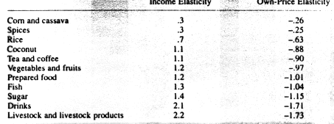
Average income and price elasticities of demand in Indonesia (estimated in the 1970s)
“inelastic”
“inelastic”
“elastic”
“elastic”
Reminder: elasticity is %ΔQ/%ΔY (income) or %ΔQ/%ΔP (price).
Elastic means responsive to changes (in income or price)
Inelastic means not very responsive to changes.

Slide 18
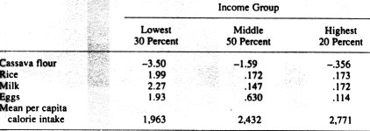
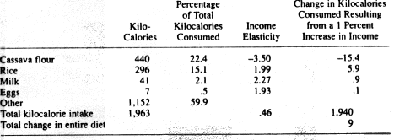
Income elasticities by income group, rural Brazil, 1974-75
(“inferior” for everyone)
(“luxuries” for the poor)
Effect of income growth among the poorest 30% in Brazil, 1974-75

Slide 19
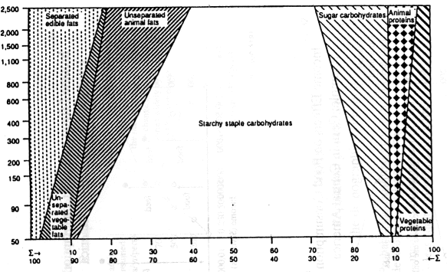
Calorie intake by nutrient group and income level
income level in 1962 (log scale)
The poorest eat mainly carbohydrates; income growth permits an increase in fats and proteins
calories from each nutrient group (percent of total)

Slide 20
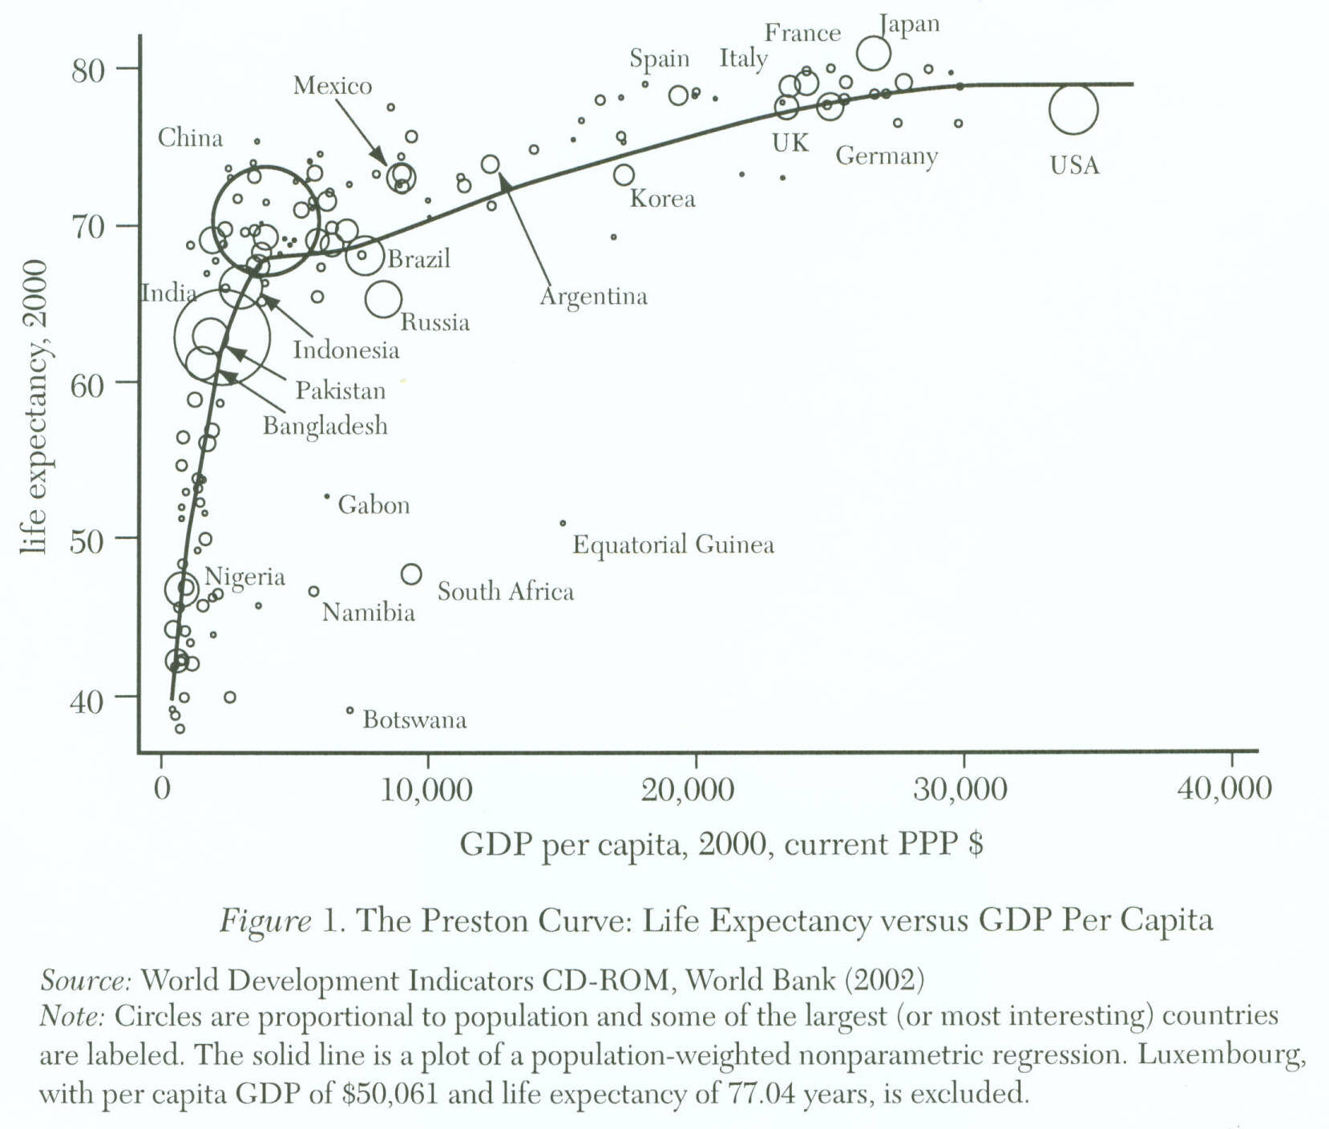
Source: Angus Deaton, “Health, Inequality, and Economic Development.” Journal of Economic Literature, XLI(1), March 2003: 113–158.
Note: Circle size is proportional to population.
Now…how does health change with income?

Slide 21
How does health change over time?
Source: Computed from UN Population Division, 2004 <http://esa.un.org/unpp>

Slide 22
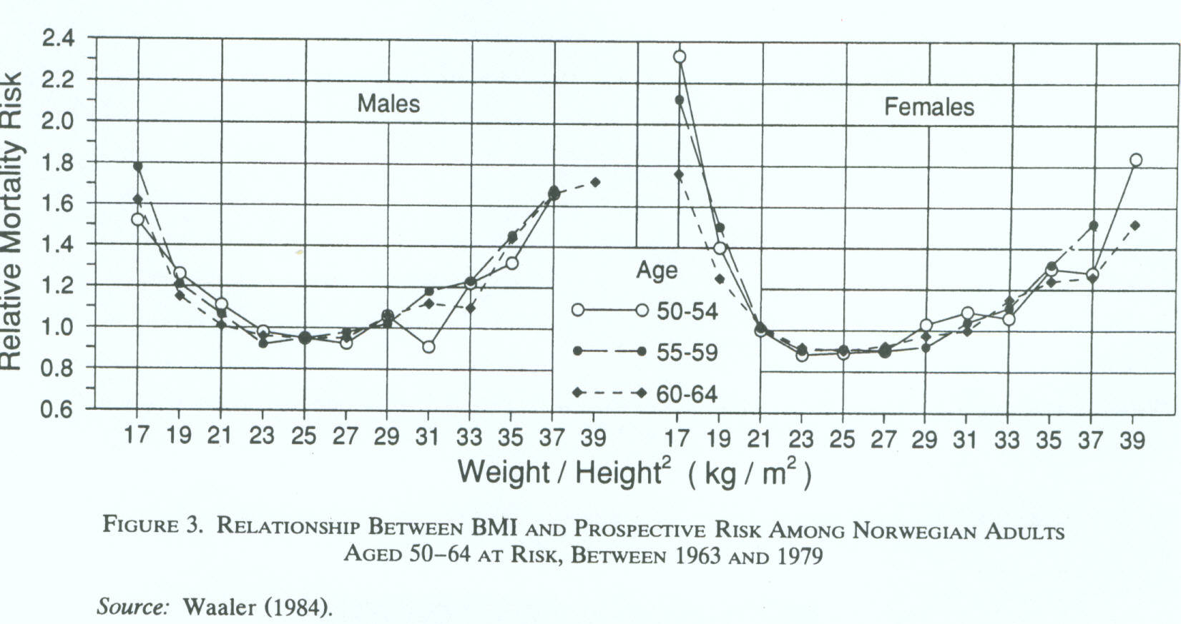
Health is closely related to weight
The “Waaler Curve”
Reprinted from: Fogel, R.W. “Economic Growth, Population Theory, and Physiology.” American Economic Review, Vol. 84, No. 3. (Jun., 1994), pp. 369-395.

Slide 23
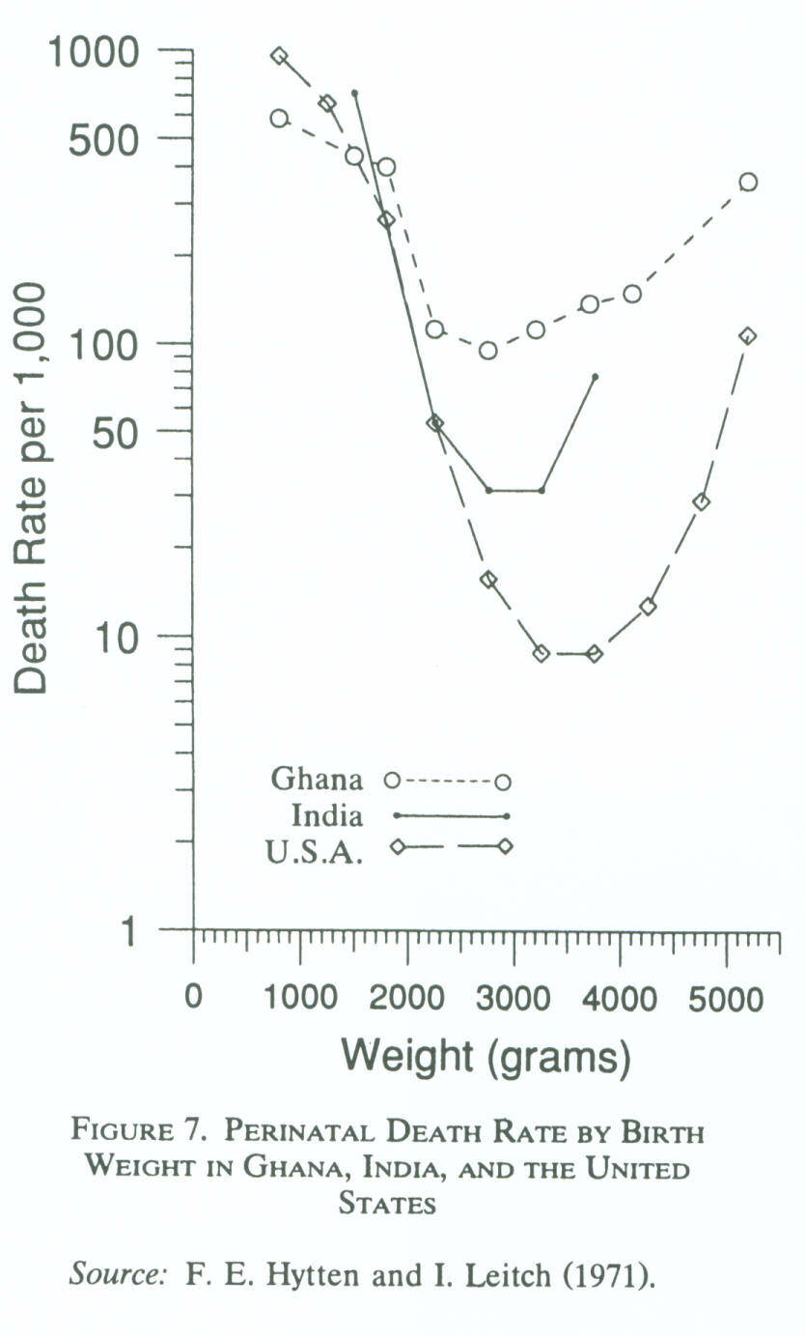
The closest nutrition-mortality link is for infants
Source: Fogel (1994), p. 382.

Slide 24
A common metric: Z-scores
Height-for-age (chronic stunting)
Weight-for-height (acute wasting)
Weight-for-age (body mass relative to age)
  Problematic because it depends on weight and height
  Same score could signal tall + thin or short + normal
Value compared to WHO international reference age-sex population for well-nourished children
Typical cut-off is < - 2

Slide 25
Distribution of height-for-age (left panel) and weight-for-height (right panel)
for children under 5 in Nepal in 2006, by agroecological zone
(from left to right, means = -2.27, -2.02, -1.89, -1.11, -0.82, -0.73)
Source: Shively, Sununtnasuk and Brown (2015) “Environmental Variability and Child Growth in Nepal.” Health and Place 35(1):37-51.

Slide 26
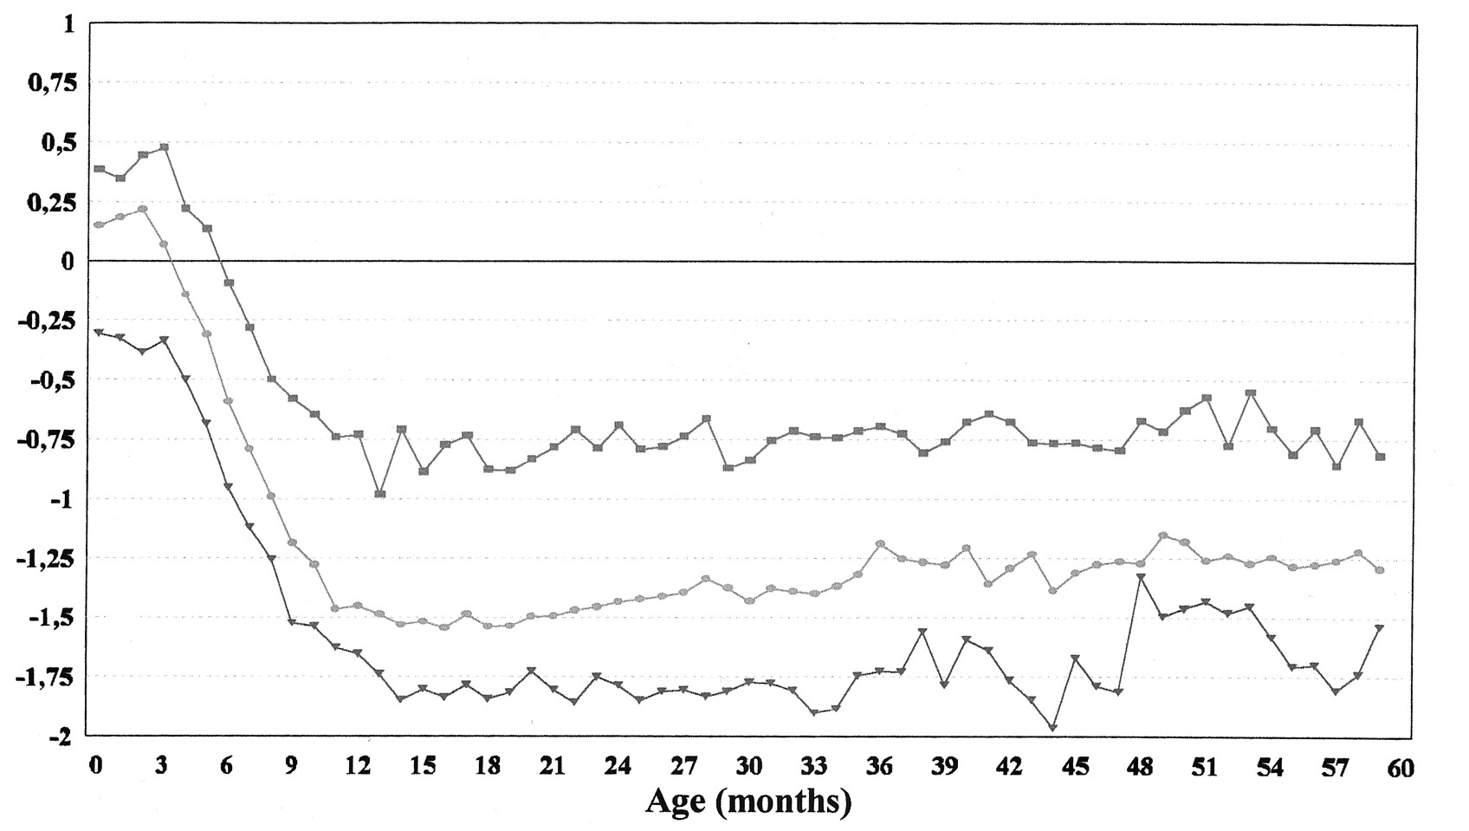
Almost all shortfall in child growth occurs between 4 and 14 months of age
Mean weight-for-age z scores,
relative to the NCHS reference
Latin America and the Caribbean
Asia
Africa
Source: Shrimpton, R. et al., 2001. “Worldwide Timing of Growth Faltering: Implications for Nutritional Interventions” Pediatrics 107:e75.

Slide 27
Does Agriculture Matter? Yes, but…
Plots of height-for-age for children under 5 in Nepal in 2006 against
cluster average NDVI for district in Aug-Oct of birth year (left panel)
and year prior to birth (right panel), Mountain zone only
Source: Shively, Sununtnasuk and Brown (2015) “Environmental Variability and Child Growth in Nepal.”
Health and Place 35(1):37-51.

Slide 28
Nepal: comparison of district-level nutrition and agriculture outcomes
 | HAZ < average | HAZ > average
yield < average | 22 | 21
yield > average | 13 | 19
Negative deviants
Table entries show # of districts
HAZ from 2006 DHS
yields from 2004 NLSS
Positive deviants

Slide 29
Lack of food is still the world’s greatest health threat!

Slide 30
Nutrient deficiencies are major health risks
Worldwide disease burden attributable to major health risk factors, 2000
 |  | DALYs (M) | % total
Disease burden attributable to undernutrition
 | Underweight | 138 | 9.5%
 | Iron deficiency | 35 | 2.4%
 | Zinc deficiency | 28 | 1.9%
 | Inadequate fruit and vegetable intake | 27 | 1.8%
 | Vitamin A deficiency | 27 | 1.8%
 |  | 254 | 17.5%
Disease burden attributable to risk-factor exposure
 | Unsafe sex | 92 | 6.3%
 | Smoking and oral tobacco | 59 | 4.1%
 | Alcohol | 58 | 4.0%
 |  | 209 | 14.4%
Disease burden attributable to cardiovascular condition
 | Blood pressure | 64 | 4.4%
 | Cholesterol | 40 | 2.8%
 | Body mass index | 33 | 2.3%
 | Physical inactivity | 19 | 1.3%
 |  | 157 | 10.8%
Disease burden attributable to environmental conditions
 | Unsafe water, sanitation, and hygiene | 54 | 3.7%
 | Indoor smoke from solid fuels | 39 | 2.6%
 |  | 93 | 6.4%
Source: WHO (2002), World Health Report 2002. Online at www.who.int/whr. Data shown are from web annexes at www.who.int/whr/2002/material/en.
Som
e
i
n
t
e
rac
t
i
on

Slide 31
Risk factors vary with income
Why?
Contribution to global burden of disease by risk factor and region

Slide 32
The role of nutrition in disease is rarely clear
Notes: Arrows are roughly proportional to attribution rates. Risk factors and diseases associated with under-nutrition are in italics. The selected risk factors cause diseases in addition to those relationships illustrated, and additional risk factors are also important in the aetiology of the diseases illustrated.
Data shown are totals for 69 countries defined by the WHO as having both high child mortality and high adult mortality.
Source: WHO (2002), World Health Report 2002, Annex Table 14 (p. 232). Available online at www.who.int/whr.

Slide 33
Undernutrition is falling, except in Africa
Data and projections on childhood underweight, 1995-2015

Slide 34
Some conclusions
Nutrition is clearly a major driver of health and human capital…
But the link between food availability and nutritional status is complicated, and depends on
  price and incomes, along with price and income elasticities
  inequality in access and entitlements
  disease pressure and public health
  market failures and policy failures

