Slide 1
Learning and Agency through Design Negotiation: The Honeycomb of Engineering
Şenay Purzer
Purdue University, West Lafayette, Indiana
https://web.ics.purdue.edu/~spurzer/esera2023

Slide 2
Why “Engineering” in K-12 Education
Historically under technological design (Heywood, 1993; Vries, 2005)
More recently under STEM movement worldwide
Next generation science standards in the US
Educators have different perspectives about engineering
Technological literacy – everyday life
Promote creativity and problem solving
Motivate students to learn science and mathematics (hands-on)
Diversify the STEM workforce
A pedagogical approach for teaching science (application of science)
There are in fact three arguments frequently made for engineering in policy documents, research, and practice (Purzer et al, 2019)

Slide 3
Three arguments
"STEM is a teaching philosophy and an integrated approach to teaching. Students learn disciplinary science concepts through design."
"I want my students to develop mindsets and abilities to solve problems, think creatively and critically, engineering design projects help them learn these skills."
"Knowledge, skills, and reasoning associated with engineering are important to teach in K-12 education. And engineering is inherently interdisciplinary lending itself to interdisciplinary learning"
Pedagogical Argument
Methodological Argument
Epistemological Argument
Inquiry-based learning vs design-based learning
What is assessed is learning science concepts
Emphasis on the design process
What is assessed is 21st century skills
Conative knowledge and skills
Emphasis is on authenticity and nature of engineering
What is assed is reasoning but includes disciplinary core ideas as well as trade-off decisions
Purzer, S., Quintana-Cifuentes, J.P. (2019). Integrating engineering in K-12 science education: spelling out the pedagogical, epistemological, and methodological arguments. Disciplinary Interdisciplinary Science Educ Res, 1(13), 1-12. https://doi.org/10.1186/s43031-019-0010-0
Notes:
These differnces are nto because of

Slide 4
Epistemological Definition
Methodological Distinctions
6 types of engineering inquiries
Pedagogical Translation
Curriculum
Notes:
Earlier I talked about different arguments…

Slide 5
What is engineering?
Britannica
“Engineering, the application of science to the optimum conversion of the resources of nature to the uses of humankind.
“creative application of scientific principles to design or develop structures, machines, apparatus, or manufacturing processes, or works utilizing them”
Wikipedia
“Engineering is the practice of using natural science, mathematics, and the engineering design process to solve problems, increase efficiency and productivity, and improve systems.”
For a good definition, see Engineering in South Africa
“Solutions must take into account the needs of society, sustainability and the protection of the physical environment.”
https://www.ecsa.co.za

Slide 6
No best solution
All solutions are developed under constraints.
All new solutions create new problems. We must ask, “which problem is worth having?”

Slide 7
What is engineering?
 | Engineering is engaging in conscientious negotiation of risks and benefits in order to create, monitor, manage, or improve technological systems for the betterment and transformation of societies at the intersection of people and natural resources. (Purzer, 2023)
Notes:
Engineering is the creation, monitoring, management, and improvement of technological systems through the careful negotiation of risks and benefits.
Engineering is multi-facetted with different types of inquiries
The design process is adoptable to different types of engineering inquiries

Slide 8
Negotiation and argumentation
Engineering reasoning is engaging in conscientious negotiation of risks and benefits in order to create, monitor, manage, or improve technological systems for the betterment and transformation of societies at the intersection of people and natural resources. | Scientific reasoning is engaging in argumentation from evidence in order to construct explanations or develop explanatory models.
Purzer, Ş., Quintana‐Cifuentes, J., & Menekse, M. (2021). The honeycomb of engineering framework: Philosophy of engineering guiding precollege engineering education. Journal of Engineering Education, 111(1), 19-39. https://doi.org/10.1002/jee.20441
Osborne, J. (2013). The 21st century challenge for science education: Assessing scientific reasoning. Thinking Skills and Creativity, 10, 265-279. https://doi.org/10.1016/j.tsc.2013.07.006
Notes:
Engineering is the creation, monitoring, management, and improvement of technological systems through the careful negotiation of risks and benefits.
Engineering is multi-facetted with different types of inquiries
The design process is adoptable to different types of engineering inquiries

Slide 9
6 Engineering Inquiries in the Honeycomb of Engineering Framework
ENGINEERING ANALYSIS
Given data...
USER-CENTERED DESIGN
Given a vague problem description …
PROBLEM SCOPING
Purpose: understand the challenge
Gather information on context, users, issues, and existing solutions
Analyze, visualize, consolidate evidence to form arguments
Determine design requirements, functions, metrics, and trade-offs
ENGINEERING OPTIMIZATION
Given a sub-optimal system…
Conscientious
Negotiation of
Risks & Benefits
DESIGN-BUILD-TEST
Given design requirements…
EVALUATION
Purpose: generate evidence
communicate evidence
communicate requirements
Set up experiments, test beds to collect data
Generate and represent
ideas with sketches and low-fidelity prototypes
communicate alternatives
Build testable prototypes to simulate form and function
REVERSE ENGINEERING
Given a system to be examined…
ENGINEERING SCIENCE
Given a research question…
Purpose: develop alternatives
IDEATION
Purzer, Ş., Quintana-Cifuentes, J., & Menekse, M. (2021). The honeycomb of engineering framework: Philosophy of engineering guiding precollege engineering education. Journal of Engineering Education, 111( 1), 19– 39. https://doi.org/10.1002/jee.20441
Notes:
Taking an epistemological position, I created the Honeycomb of Engineering framework, which recognized multiple inquiries of engineering but also provide the pedagogical translations of these inquiries. The Honeycomb of Engineering takes an epistemological perspective to outline a classification of six types of engineering inquiries:

Slide 10
Why delineate engineering inquiries?
For curriculum authenticity: more accurate representation of nature of engineering
For learning research- different inquiries promote different type of learning outcomes
For instructional choice: allows educators select from options

Slide 11
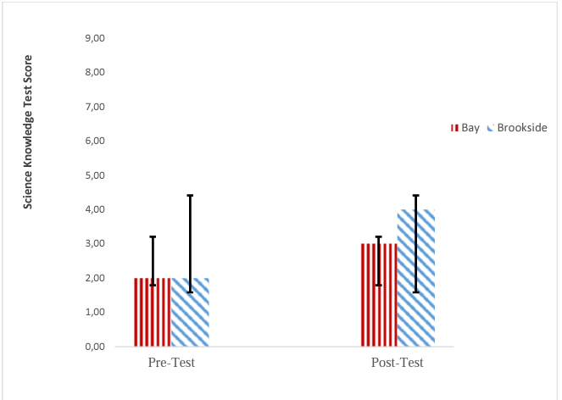
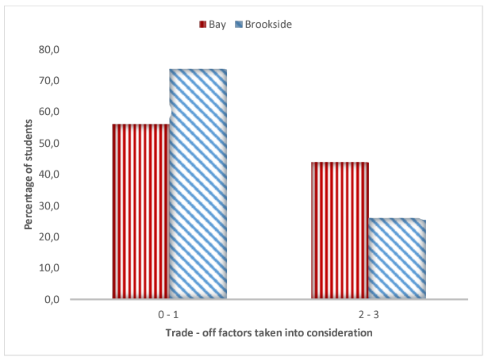
Design-Build-Test (DBT) vs User-Centered Design (UCD)
For learning research
◻ DBT ◻ UCD
◻ DBT ◻ UCD
Goldstein, M. H., Omar, S. A., Purzer, S., & Adams, R. S. (2018). Comparing Two Approaches to Engineering Design in the 7th Grade Science Classroom. International Journal of Education in Mathematics, Science and Technology, 6(4), 381-397. DOI:10.18404/ijemst.440340

Slide 12
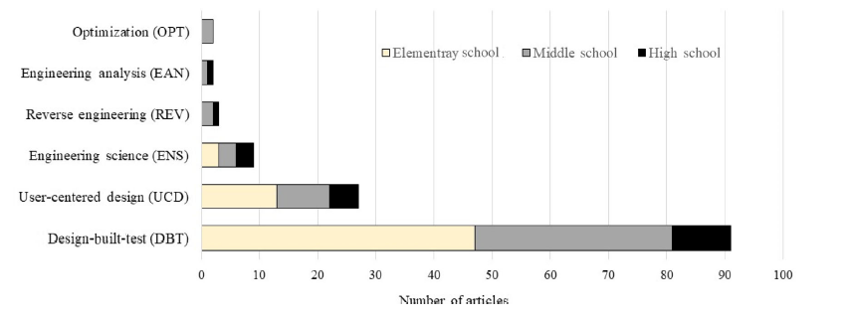
For instructional choice
Purzer, Ş., Quintana‐Cifuentes, J., & Menekse, M. (2021). The honeycomb of engineering framework: Philosophy of engineering guiding precollege engineering education. Journal of Engineering Education. https://doi.org/10.1002/jee.20441

Slide 13
PROBLEM SCOPING
Purpose: understand the challenge
USER-CENTERED DESIGN
Given a vague problem description …
UCD introduces students to a realistic problem (farming impacting bird habitats), where student explore the context (problem scoping).
Example: student study a habitat and bird species before developing ways to safely transport eggs.
Gather information on context, users, issues, and existing solutions
Analyze, visualize, consolidate evidence to form arguments
Determine design requirements, functions, metrics, and trade-offs
Conscientious
Negotiation of
Risks & Benefits
communicate evidence
communicate requirements
EVALUATION
Purpose: generate evidence
Set up experiments, test beds to collect data
Generate and represent
ideas with sketches and low-fidelity prototypes
communicate alternatives
Build testable prototypes to simulate form and function
Purpose: develop alternatives
IDEATION
Notes:
Updated model on July 4, 2020, Purzer

Slide 14
DBT Build aims to test a prototype top establish proof of a protype base don clearly defined design requirements.
Example: A structure that can withstand an earthquake shake table for 1 minute using only straws and marshmallows
Gather information on context, users, issues, and existing solutions
PROBLEM SCOPING
Purpose: understand the challenge
Analyze, visualize, consolidate evidence to form arguments
Determine design requirements, functions, metrics, and trade-offs
EVALUATION
Purpose: generate evidence
Conscientious
Negotiation of
Risks & Benefits
DESIGN-BUILD-TEST
Given design requirements…
communicate evidence
communicate requirements
Set up experiments, test beds to collect data
Generate and represent
ideas with sketches and low-fidelity prototypes
communicate alternatives
Build testable prototypes to simulate form and function
Purpose: develop alternatives
IDEATION
Notes:
Updated model on July 4, 2020, Purzer

Slide 15
OPT is the process of analyzing and improving the performance of an existing suboptimal system.
Example: Analyze the performance and optimize the design of a residential plumbing system to maximize water pressure and minimize cost of plumbing
Gather information on context, users, issues, and existing solutions
PROBLEM SCOPING
Purpose: understand the challenge
Analyze, visualize, consolidate evidence to form arguments
Determine design requirements, functions, metrics, and trade-offs
ENGINEERING OPTIMIZATION
Given a sub-optimal system…
Conscientious
Negotiation of
Risks & Benefits
EVALUATION
Purpose: generate evidence
communicate evidence
communicate requirements
Set up experiments, test beds to collect data
Generate and represent
ideas with sketches and low-fidelity prototypes
communicate alternatives
Build testable prototypes to simulate form and function
Purpose: develop alternatives
IDEATION
Notes:
Updated model on July 4, 2020, Purzer

Slide 16
Gather information on context, users, issues, and existing solutions
PROBLEM SCOPING
Purpose: understand the challenge
ENS is conducting research in the context of designed systems (as opposed to natural systems) through controlled experiments
Example: Develop a durable plank by manipulating materials composition using controlled experimentation and testing
Analyze, visualize, consolidate evidence to form arguments
Determine design requirements, functions, metrics, and trade-offs
EVALUATION
Purpose: generate evidence
Conscientious
Negotiation of
Risks & Benefits
communicate evidence
communicate requirements
Set up experiments, test beds to collect data
Generate and represent
ideas with sketches and low-fidelity prototypes
communicate alternatives
Build testable prototypes to simulate form and function
ENGINEERING SCIENCE
Given a research question…
Purpose: develop alternatives
IDEATION
Notes:
Updated model on July 4, 2020, Purzer

Slide 17
ENGINEERING ANALYSIS
Given data...
EAN is the use of data analysis to inform decisions about designed systems.
Example: Evaluating the effectiveness of two crop planting options by analyzing data on crop production, water quality, and profit margins.
Gather information on context, users, issues, and existing solutions
PROBLEM SCOPING
Purpose: understand the challenge
Analyze, visualize, consolidate evidence to form arguments
Determine design requirements, functions, metrics, and trade-offs
Conscientious
Negotiation of
Risks & Benefits
EVALUATION
Purpose: generate evidence
communicate evidence
communicate requirements
Set up experiments, test beds to collect data
Generate and represent
ideas with sketches and low-fidelity prototypes
communicate alternatives
Build testable prototypes to simulate form and function
Purpose: develop alternatives
IDEATION
Notes:
Updated model on July 4, 2020, Purzer

Slide 18
Conclusion – Why use the Honeycomb framework?
Conscientious
Negotiation of
Risks & Benefits
communicate evidence
communicate requirements
communicate alternatives
If we want more nuanced evidence on student learning
The delineation of engineering inquiries is critical
The 6 engineering inquiries also provide options for teachers based on available school resources.
If we want next generations to be better equipped to address issues such as climate change, sustainability, social justice
We need to reject narrow definitions of the profession.
What kind of a future would come out if we followed this definition?
Notes:
it is plausible and beneficial to integrate engineering into formal K-12 science education.
Clarity in our position and motivation (pedagogical, epistemological, etc.)
Clarity in design inquiry (design-build-test, optimization, etc.)
Clarity in our definition

Slide 19
Learning and Agency through Design Negotiation: The Honeycomb of Engineering
Presenter Author 1290
LEARNING AND AGENCY THROUGH DESIGN NEGOTIATION: THE HONEYCOMB OF ENGINEERING
Parallel Session - 1.11 (Oral Presentations), 15:00-16:30 Monday, 28 August, 2023
Presenter Author 1291
ENGINEERING DESIGN COACHING TOOL FOR SUSTAINABILITY AND ETHICALLY-CONSCIENTIOUS EDUCATION
Parallel Session - 3.17 (Workshop), 09:00-11:00 Tuesday, 29 August, 2023
The work presented in this manuscript is based upon work supported by the National Science Foundation DRL #1721054. Any opinions, findings, and conclusions or recommendations expressed in this paper, however, are those of the authors and do not necessarily reflect the views of the National Science Foundation.
Şenay Purzer
purzer@purdue.edu
Purdue University
https://web.ics.purdue.edu/~spurzer/esera2023
Notes:
The practice of negotiation in engineering can be considered as analogous to argumentation in science. Engineering is creating, monitoring, managing, and improving technological systems through the careful negotiation of risks and benefits. The Honeycomb of Engineering framework describes engineering with an epistemological lens first but then articulate its pedagogical translations. Engineering encompasses different types of inquiries: user-centered design, design-build-test, engineering optimization, engineering science, engineering analysis, reverse engineering. In addition, engineering design is a flexible and adoptable vehicle that can be used to guide different types of engineering inquiries, with the negotiation of risk and benefits at the center of this process. My goal is to broaden the view of engineering education from simply being defined as a hands-on approach and uncover the underestimated potential of engineering for education. Engineering education can promote a diverse range of outcomes such as purposeful utilization of students’ cultural heritage and assets, develop reasoning necessary for learning but also sustainable and ethically-conscientious design; and build students’ agency and decision-making skills.

Slide 20
The potential of engineering in K-12 education
Engineering education can promote student agency as well as sustainable and ethically-conscientious decision-making through purposeful utilization of students’ cultural heritage and assets
engages youth as transformative agents by promoting agency and ownership of ideas and with authentic design projects [transformative AGENCY]
values different ways of thinking and approaching problems (e.g., cultural and indigenous ways of thinking) [multicultural INGENUITY]
requires the careful examination of benefits and burdens and conscientious negotiation of design trade-offs [ethical INTEGRITY]
promotes reasoning with practical as well as theoretical knowledge and disciplinary depth as well as interdisciplinary breadth towards a fluency across experimental reasoning, first-principles reasoning and, and futures reasoning [reasoning FLUENCY]

Slide 21
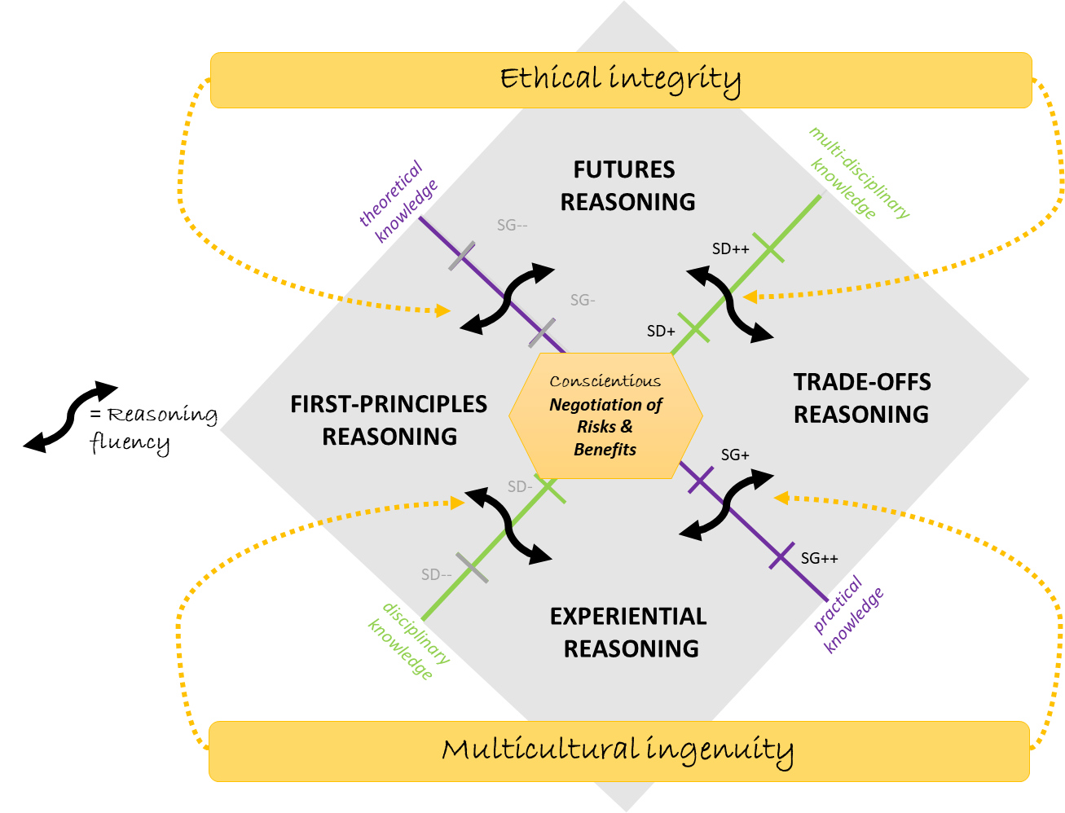
Engineering Design Reasoning Quadrants framework
Experiential observations represent reasoning based on new experiments as well as past lived experiences. Such reasoning can reflect subjective values or objective claims.
First-principles reasoning represents thinking in terms of disciplinary core ideas that can be associated with science as well as other disciplines.
Trade-offs reasoning entails the designer’s multi-criteria thinking and efforts to optimize the design while weighing and balancing multiple competing design requirements.
Complex abstractions reasoning enable predicting the performance of a design in a new setting and require the combination of first-principles and trade-offs reasoning (Quintana-Cifuentes & Purzer, 2022).

