Slide 1



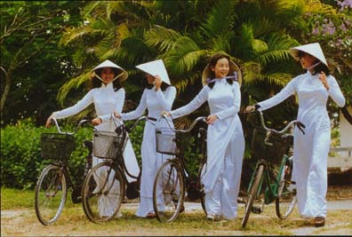

VIP Callout
Vietnamese International Student Association at Purdue
Fall 2011

Slide 2
Officers
President: Duc Nguyen
  Email: nguyend@purdue.edu
Treasurer: Quan Nguyen
  Email: nguyend95@purdue.edu
Webmaster: Huy Tran
  Email: tranh@purdue.edu

Slide 3

Why join?
Learn Vietnamese Culture
Make new friends
Discount on merchandise
Subsidized activities
V I

Slide 4
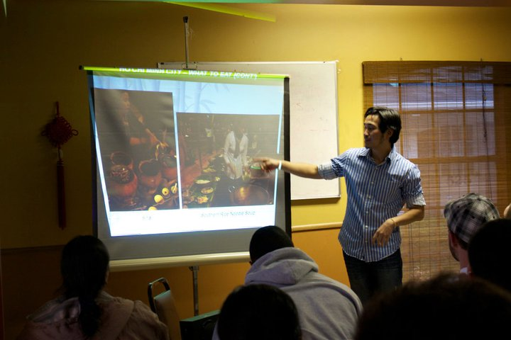
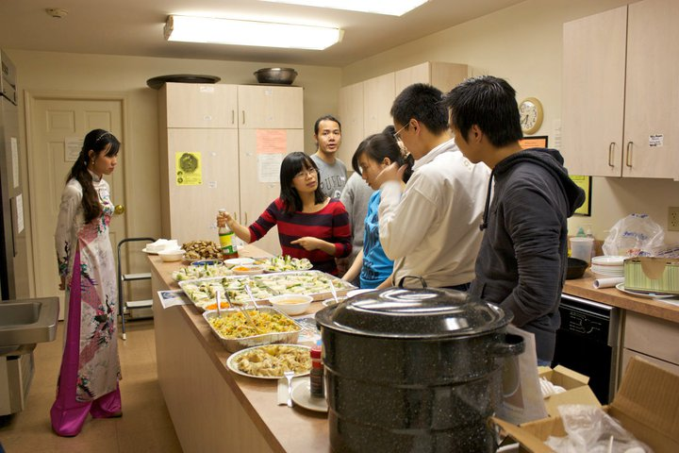
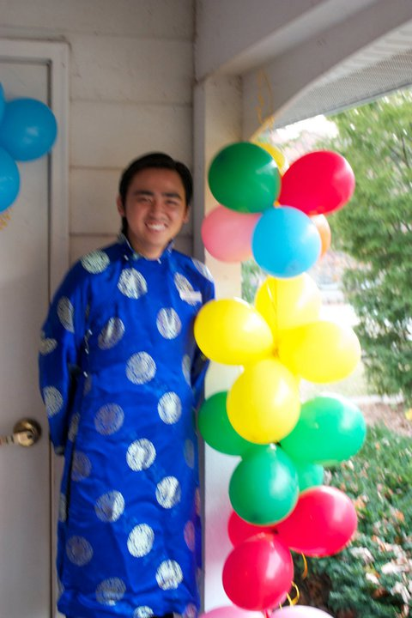
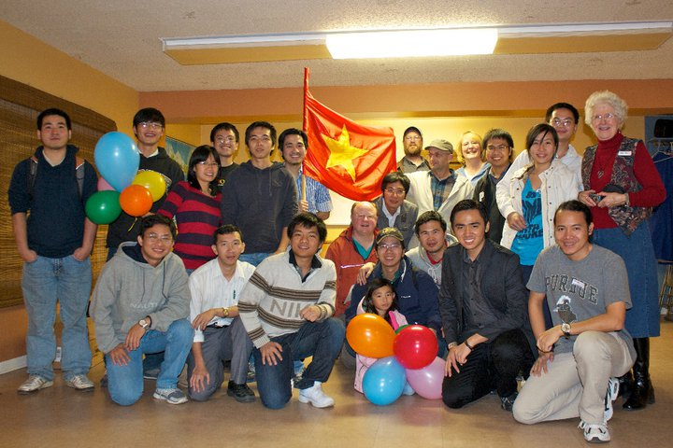
Future events
Oct 21th, 5:30pm: Global Café

Slide 5
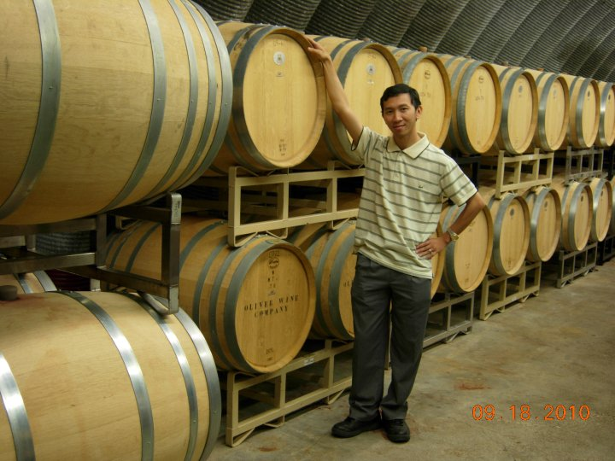
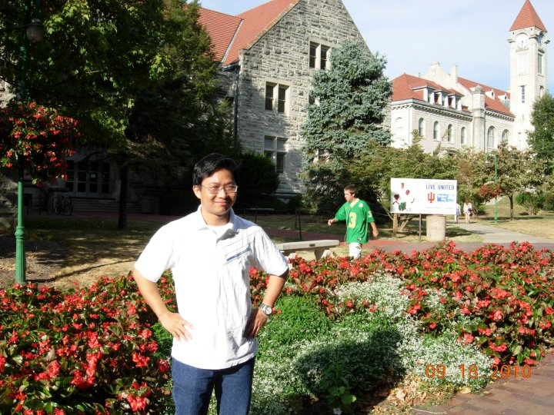



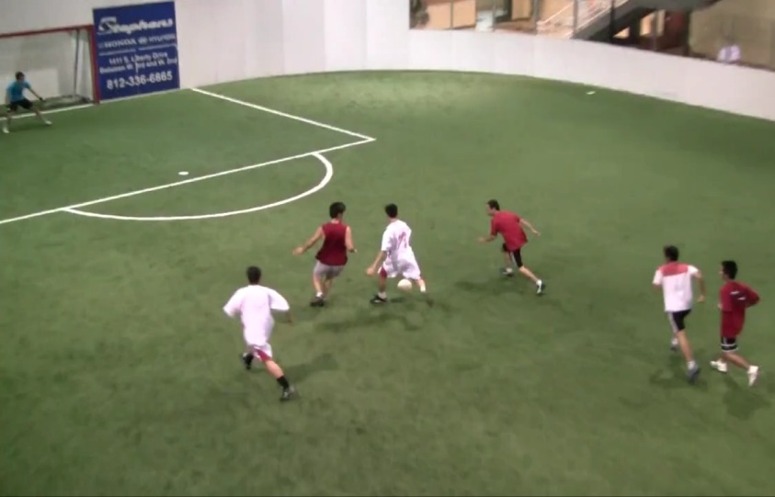
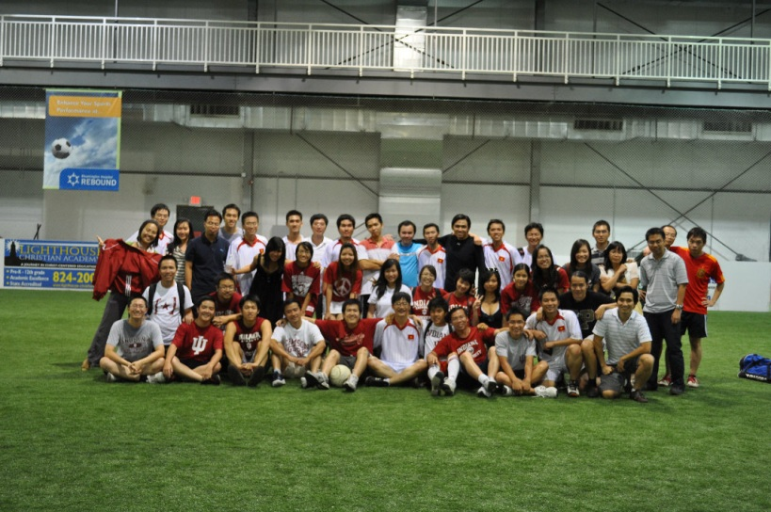
Future events
Oct 29th: Midwest Vietnamese Soccer Tournament
Location: IU Bloomington
Indoor
Schools: Purdue, IU, UIC, IIT

Slide 6
Future events
Cầu Truyền Hình
Food festival

Slide 7
Services that we offer
University car rental
Mailing list
  Request should be send to admin@vietinpurdue.org
Mail account: @vietinpurdue.org
  https://www.vietinpurdue.org/owa/

Slide 8
To do
Guide for new students
  Set up Wikipedia-like service
Enable www.purdue.edu/vip

Slide 9
Membership
$10 / semester
$15 / year

Slide 10
Questions?
Email Officers@vietinpurdue.org

Slide 11
Thanks for coming!

