Slide 1
In this course, we will look at:
Algorithms for solving problems efficiently
Data structures for efficiently storing, accessing, and modifying data
We will see that all data structures have trade-offs
There is no ultimate data structure...
The choice depends on our requirements

Slide 2
Consider accessing the k^{th} entry in an array or linked list
In an array, we can access it using an index array[k]
You will see that there is a single machine instruction for this
We must step through the first k – 1 nodes in a linked list
Consider searching for an entry in a sorted array or linked list
In a sorted array, we use a fast binary search
Very fast
We must step through all entries less than the entry we’re looking for
Slow

Slide 3
However, consider inserting a new entry to the start of an array or a linked list
An array requires that you copy all the elements in the array over
Slow for large arrays
A linked list allows you to make the insertion very quickly
Very fast regardless of size

Slide 4
Syllabus
Course Web Page: http://web.ics.purdue.edu/~elgamala/ECE368/index.html
5 Homeworks 15%, Project 15%, 8 Class Participation Sessions 15%
Midterm 1 20%, Midterm 2 10%, Final Exam 25%
Check posted syllabus for dates
Reading assignment before each class

Slide 5
Class Participation
8 sessions, dates posted in Syllabus
Each group has 4-6 members
Agree on groups before session
Interactive learning
Reading assignment before session
Arrive 5 minutes early

Slide 6
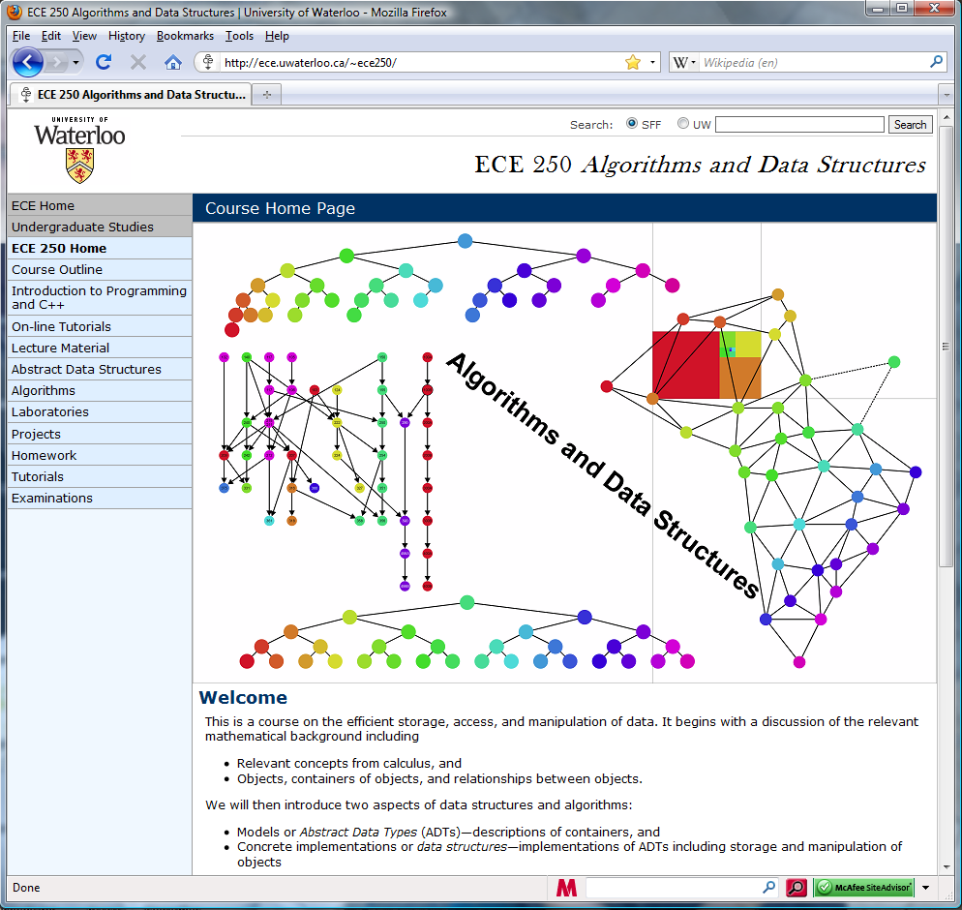
I am borrowing material from the following course at Waterloo
http://ece.uwaterloo.ca/~dwharder/aads/
This includes:
The Course Outline
Various tutorials
Lecture Material
Lecture Topics
Projects
Homework
Tutorial summaries
Examination Details

Slide 7
C++
You will be using the C++ programming language in this course
Modified for C++ from http://www.foxtrot.com/

Slide 8
C++
This course does not teach C++ programming
You will use C++ to demonstrate your knowledge in this course
One lecture covers:
Features of C++

Slide 9
C++
Other sources of help in C++ are:
The T.A.s,
The instructor
Other online tutorials: http://www.cplusplus.com/

Slide 10
Project
Each group has 4-6 members
Proposal Due: Feb. 18th
I will post topics next Tuesday
You can suggest a topic!
Project Due: Apr. 21st – Apr. 28th

Slide 11
Your tasks for now
Prepare for class through reading assignment
Summarize class in your own words
Form groups for project and class participation session
First class participation session in 9 days!
Read the required text book for more help

Slide 12
Distribution of Information
Information may be pass to the class through one of the following:
An announcement in class,
An e-mail
Web page update

Slide 13
Mathematical background
This topic reviews the basic mathematics required in this course:
A justification for a mathematical framework
The ceiling and floor functions
L’Hôpital’s rule
Logarithms
Arithmetic and other polynomial series
Mathematical induction
Geometric series
Recurrence relations
Weighted averages
Combinations

Slide 14
Justification
Qualitative statements cannot guide engineering design decisions:
Algorithm A could be better than Algorithm B, but Algorithm A would require three person weeks to implement, test, and integrate while Algorithm B has already been implemented and has been used for the past year
There are circumstances where it may beneficial to use Algorithm A, but not based on the word better

Slide 15
Justification
Thus, we will look at a quantitative means of describing data structures and algorithms:
quantitative, a. Relating to, concerned with, quantity or its measurement; ascertaining or expressing quantity. OED
This will be based on mathematics, and therefore we will look at a number of properties which will be used again and again throughout this course

Slide 16
Floor and ceiling functions
The floor function maps any real number x onto the greatest integer less than or equal to x:
Consider it rounding towards negative infinity
The ceiling function maps x onto the least integer greater than or equal to x:
Consider it rounding towards positive infinity
The cmath library implements these as
double floor( double ); double ceil( double );
Necessary because double
have a range just under 2¹⁰²⁴
long can only represent numbers as large as 2⁶³ – 1

Slide 17
L’Hôpital’s rule
If you are attempting to determine
but both , it follows
Repeat as necessary…
Note: the k^{th} derivative will always be shown as

Slide 18
Logarithms
We will begin with a review of logarithms:
If n = e^{m}, we define
m = ln( n )
It is always true that e^{ln(n)} = n; however, ln(e^{n}) = n requires that n is real

Slide 19
Logarithms
Exponentials grow faster than any non-constant polynomial
for any d > 0
Thus, their inverses—logarithms—grow slower than any polynomial
Notes:
This can be also argued as follows:
The inverse of n^{d} is n^{1/d} and to assume otherwise would suggest that a polynomial grows as fast as an exponential, which is false simply by applying l’Hopital’s rule.

Slide 20
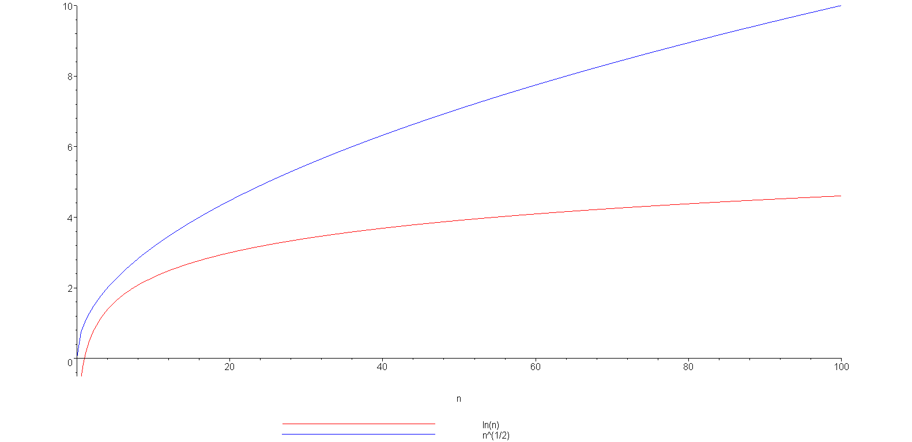
Logarithms
Example: is strictly greater than ln(n)
ln(n)

Slide 21
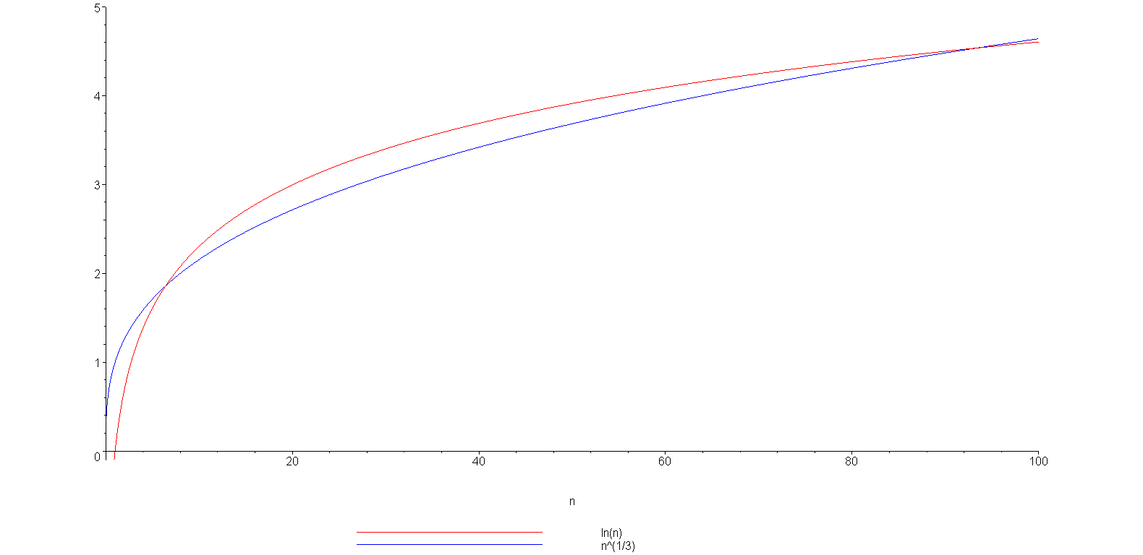
Logarithms
grows slower but only up to n = 93
(93.354, 4.536)
ln(n)

Slide 22
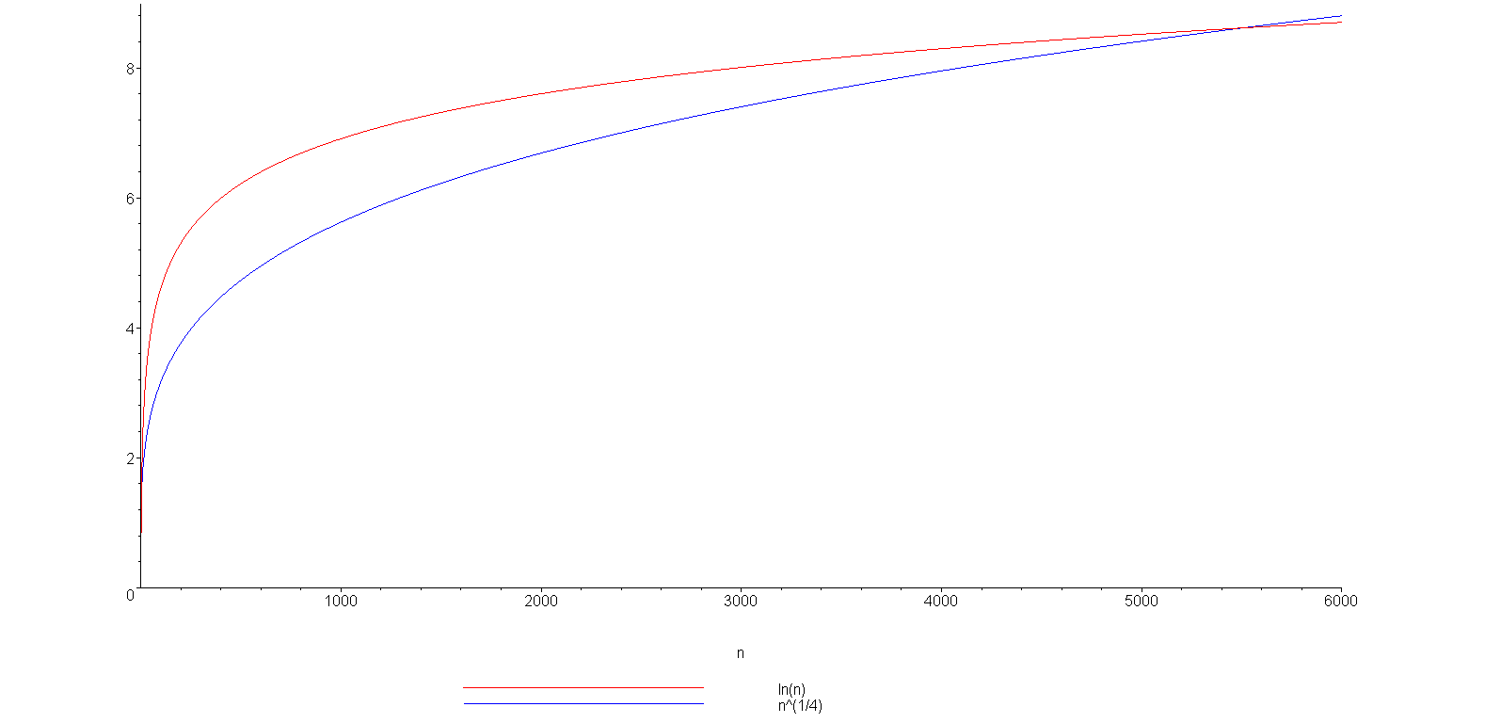
Logarithms
You can view this with any polynomial
ln(n)
(5503.66, 8.61)

Slide 23
Logarithms
We have compared logarithms and polynomials
How about log₂(n) versus ln(n) versus log₁₀(n)
You have seen the formula
All logarithms are scalar multiples of each others
Constant

Slide 24
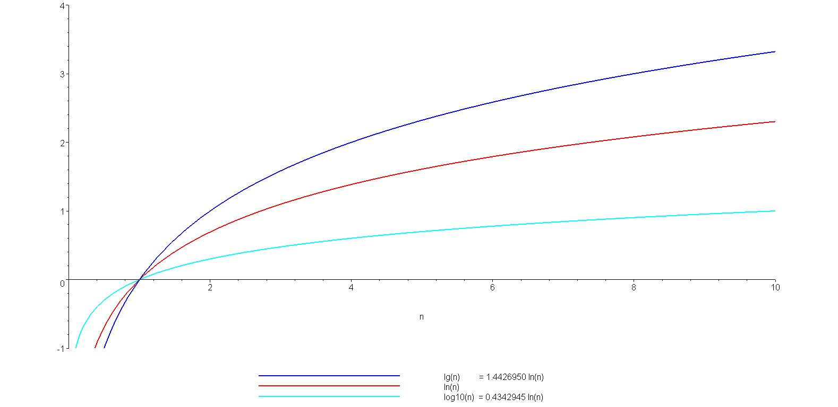
Logarithms
A plot of log₂(n) = lg(n), ln(n), and log₁₀(n)
lg(n)
ln(n)
log₁₀(n)

Slide 25
Logarithms
Note: the base-2 logarithm log₂(n) is written as lg(n)
It is an industry standard to implement the natural logarithm ln(n) as
double log( double );
The common logarithm log₁₀(n) is implemented as
double log10( double );

Slide 26
Logarithms
A more interesting observation we will repeatedly use:
n^{logb (m)} = m^{logb(n)},
a consequence of :
n^{logb (m)} = (b^{logb(n)})^{logb(m)} = b^{logb(n) logb(m)} = (b^{logb(m)})^{logb(n)}
= m^{logb(n)}

Slide 27
Logarithms
You should also, as electrical or computer engineers be aware of the relationship:
lg(2¹⁰) = lg(1024) = 10
lg(2²⁰) = lg(1 048 576) = 20
and consequently:
lg(10³) = lg(1000) ≈ 10 kilo
lg(10⁶) = lg(1 000 000) ≈ 20 mega
lg(10⁹) ≈ 30 giga
lg(10¹²) ≈ 40 tera

Slide 28
Arithmetic series
Next we will look various series
Each term in an arithmetic series is increased by a constant value (usually 1) :

Slide 29
Arithmetic series
Proof 1: write out the series twice and add each column
1 + 2 + 3 + . . . + n – 2 + n – 1 + n
+ n + n – 1 + n – 2 + . . . + 3 + 2 + 1
(n + 1) + (n + 1) + (n + 1) + . . . + (n + 1) + (n + 1) + (n + 1)
= n (n + 1)
Since we added the series twice, we must divide the result by 2

Slide 30
Arithmetic series
Proof 2 (by induction):
The statement is true for n = 0:
Assume that the statement is true for an arbitrary n:

Slide 31
Arithmetic series
Using the assumption that
for n, we must show that

Slide 32
Arithmetic series
Then, for n + 1, we have:
By assumption, the second sum is known:

Slide 33
Arithmetic series
The statement is true for n = 0 and
the truth of the statement for n implies
the truth of the statement for n + 1.
Therefore, by the process of mathematical induction, the statement is true for all values of n ≥ 0.
Reference: Mr. Oprendick

Slide 34
Other polynomial series
We could repeat this process, after all:
however, it is easier to see the pattern:

Slide 35
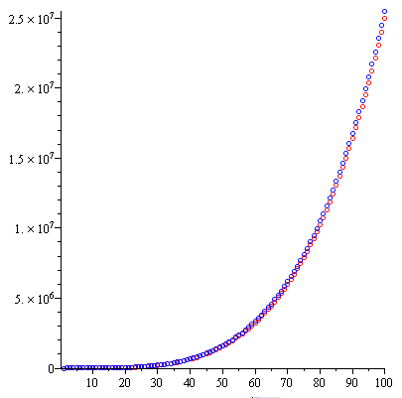
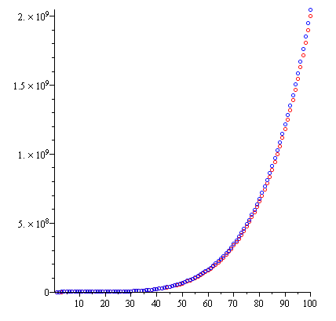
Other polynomial series
We can generalize this formula
Demonstrating with d = 3 and d = 4:

Slide 36
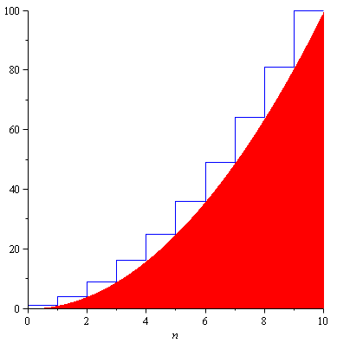
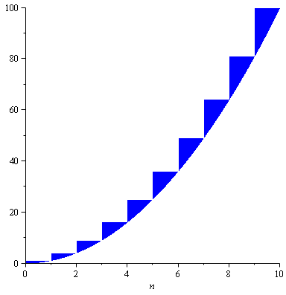
Other polynomial series
The justification for the approximation is that we are approximating the sum with an integral:
However, there is an accumulating error:
n²

Slide 37
Other polynomial series
How large is the error?
Assuming d > 1, shifting the errors, we see that they would be
n² = 100
n² = 10

Slide 38
Other polynomial series
The ratio between the error and the actual value goes to zero:
In the limit, as n → ∞, the ratio between the sum and the approximation goes to 1
The relative error of the approximation goes to 0

Slide 39
Geometric series
The next series we will look at is the geometric series with common ratio r:
and if |r| < 1 then it is also true that

Slide 40
Geometric series
Elegant proof: multiply by
Ref: Bret D. Whissel, A Derivation of Amortization
Telescoping series:
all but the first and last terms cancel

Slide 41
Geometric series
Proof by induction:
The formula is correct for n = 0:
Assume the formula is true for an arbitrary n; then
and therefore, by the process of mathematical induction, the statement is true for all n ≥ 0.

Slide 42
Geometric series
Note that we can use a change-of-index with summations like we do with integration:
Letting j = i – 1:

Slide 43
Geometric series
A common geometric series will involve the ratios r = ½ and r = 2:

Slide 44
Recurrence relations
Finally, we will review recurrence relations:
Sequences may be defined explicitly: x_{n} = 1/n
1, ¹/₂, ¹/₃, ¹/₄, ...
A recurrence relationship is a means of defining a sequence based on previous values in the sequence
Such definitions of sequences are said to be recursive

Slide 45
Recurrence relations
Define an initial value: e.g., x₁ = 1
Defining x_{n} in terms of previous values:
For example,
x_{n} = x_{n – 1} + 2
x_{n} = 2x_{n – 1} + n
x_{n} = x_{n – 1} + x_{n – 2}

Slide 46
Recurrence relations
Given the two recurrence relations
x_{n} = x_{n – 1} + 2 x_{n} = 2x_{n – 1} + n
and the initial condition x₁ = 1 we would like to find explicit formulae for the sequences
In this case, we have
x_{n} = 2n – 1 x_{n} = 2^{n + 1} – n – 2
respectively

Slide 47
Recurrence relations
We will use a functional form of recurrence relations:
Calculus | ECE 250
x₁ = 1............. | f(1) = 1...................
x_{n} = x_{n – 1} + 2.. | f(n) = f(n – 1) + 2...
x_{n} = 2x_{n – 1} + n | f(n) = 2 f(n – 1) + n

Slide 48
Recurrence relations
The previous examples using the functional notation are:
f(n) = f(n – 1) + 2 g(n) = 2 g(n – 1) + n
With the initial conditions f(1) = g(1) = 1, the solutions are:
f(n) = 2n – 1 g(n) = 2^{n + 1} – n – 2

Slide 49
Recurrence relations
In some cases, given the recurrence relation, we can find the explicit formula:
Consider the Fibonacci sequence:
f(n) = f(n – 1) + f(n – 2)
f(0) = f(1) = 1
that has the solution
where φ is the golden ratio:

Slide 50
Weighted averages
Given n objects x₁, x₂, x₃, ..., x_{n}, the average is
Given a sequence of coefficients c₁ , c₂ , c₃ , … , c_{n} where
then we refer to
as a weighted average
For an average,

Slide 51
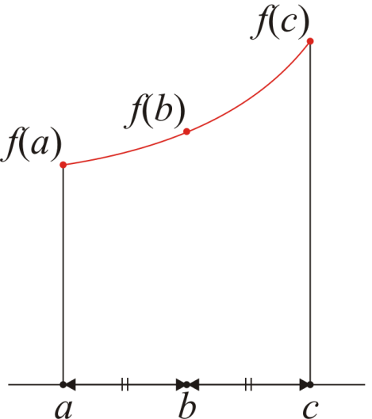
Weighted averages
Examples:
Simpson’s method approximates an integral by sampling the function at three points: f(a), f(b), f(c)
The average value of the function is approximated by
It can be shown that that
is a significant better approximation than

Slide 52
Weighted averages
Examples:
Using the weighted average:
Using a simple average:

Slide 53
Combinations
Given n distinct items, in how many ways can you choose k of these?
I.e., “In how many ways can you combine k items from n?”
For example, given the set {1, 2, 3, 4, 5}, I can choose three of these in any of the following ways:
{1, 2, 3}, {1, 2, 4}, {1, 2, 5}, {1, 3, 4}, {1, 3, 5},
{1, 4, 5}, {2, 3, 4}, {2, 3, 5}, {2, 4, 5}, {3, 4, 5},
The number of ways such items can be chosen is written
where is read as “n choose k”s
There is a recursive definition:

Slide 54
Combinations
The most common question we will ask in this vein:
Given n items, in how many ways can we choose two of them?
In this case, the formula simplifies to:
For example, given {0, 1, 2, 3, 4, 5, 6}, we have the following 21 pairs:
{0, 1}, {0, 2}, {0, 3}, {0, 4}, {0, 5}, {0, 6},
{1, 2}, {1, 3}, {1, 4}, {1, 5}, {1, 6},
{2, 3}, {2, 4}, {2, 5}, {2, 6},
{3, 4}, {3, 5}, {3, 6},
{4, 5}, {4, 6},
{5, 6}

Slide 55
Combinations
You have also seen this in expanding polynomials:
For example,

Slide 56
Combinations
These are also the coefficients of Pascal’s triangle:

Slide 57
Summary
In this topic, we have discussed:
A review of the necessity of quantitative analysis in engineering
We reviewed the following mathematical concepts:
The floor and ceiling functions
L’Hôpital’s rule
Logarithms
Arithmetic and other polynomial series
Mathematical induction
Geometric series
Recurrence relations
Weighted average
Combinations

Slide 58
Reference
[1] Cormen, Leiserson, and Rivest, Introduction to Algorithms, McGraw Hill, 1990, Chs 2-3, p.42-76.
[2] Weiss, Data Structures and Algorithm Analysis in C++, 3rd Ed., Addison Wesley, §§ 1.2-3, p.2-11.

Slide 59
Usage Notes
These slides are made publicly available on the web for anyone to use
If you choose to use them, or a part thereof, for a course at another institution, I ask only three things:
that you inform me that you are using the slides,
that you acknowledge my work, and
that you alert me of any mistakes which I made or changes which you make, and allow me the option of incorporating such changes (with an acknowledgment) in my set of slides
Sincerely,
Douglas Wilhelm Harder, MMath
dwharder@alumni.uwaterloo.ca

