Slide 1
Outline
In this topic, we will look at linked lists
The Node and List classes
Accessors and mutators
The implementation of various member functions
Stepping through a linked list
Defining the copy and assignment operator
Defining move constructors and move assignment operators
Discussed efficiencies

Slide 2
Definition
A linked list is a data structure where each object is stored in a node
As well as storing data, the node must also contains a reference/pointer to the node containing the next item of data

Slide 3
Linked Lists
1
We must dynamically create the nodes in a linked list
Thus, because new returns a pointer, the logical manner in which to track a linked lists is through a pointer
A Node class must store the data and a reference to the next node (also a pointer)

Slide 4
Node Class
1
The node must store data and a pointer:
class Node {
private:
int element;
Node *next_node;
public:
Node( int = 0, Node * = nullptr );
int retrieve() const;
Node *next() const;
};

Slide 5
Node Constructor
1.1
The constructor assigns the two member variables based on the arguments
Node::Node( int e, Node *n ):
element( e ),
next_node( n ) {
// empty constructor
}
The default values are given in the class definition:
class Node {
private:
int element;
Node *next_node;
public:
Node( int = 0, Node * = nullptr );
int retrieve() const;
Node *next() const;
};

Slide 6
Accessors
The two member functions are accessors which simply return the element and the next_node member variables, respectively
int Node::retrieve() const { return element;
}
Node *Node::next() const {
return next_node;
}
Member functions that do not change the object acted upon are variously called accessors, readonly functions, inspectors, and, when it involves simply returning a member variable, getters

Slide 7
Linked List Class
Because each node in a linked lists refers to the next, the linked list class need only link to the first node in the list
The linked list class requires member variable: a pointer to a node
class List {
private:
Node *list_head;
// ...
};

Slide 8
Structure
To begin, let us look at the internal representation of a linked list
Suppose we want a linked list to store the values
42 95 70 81
in this order

Slide 9
Structure
A linked list uses linked allocation, and therefore each node may appear anywhere in memory
Also the memory required for each node equals the memory required by the member variables
4 bytes for the linked list (a pointer)
8 bytes for each node (an int and a pointer)
We are assuming a 32-bit machine

Slide 10
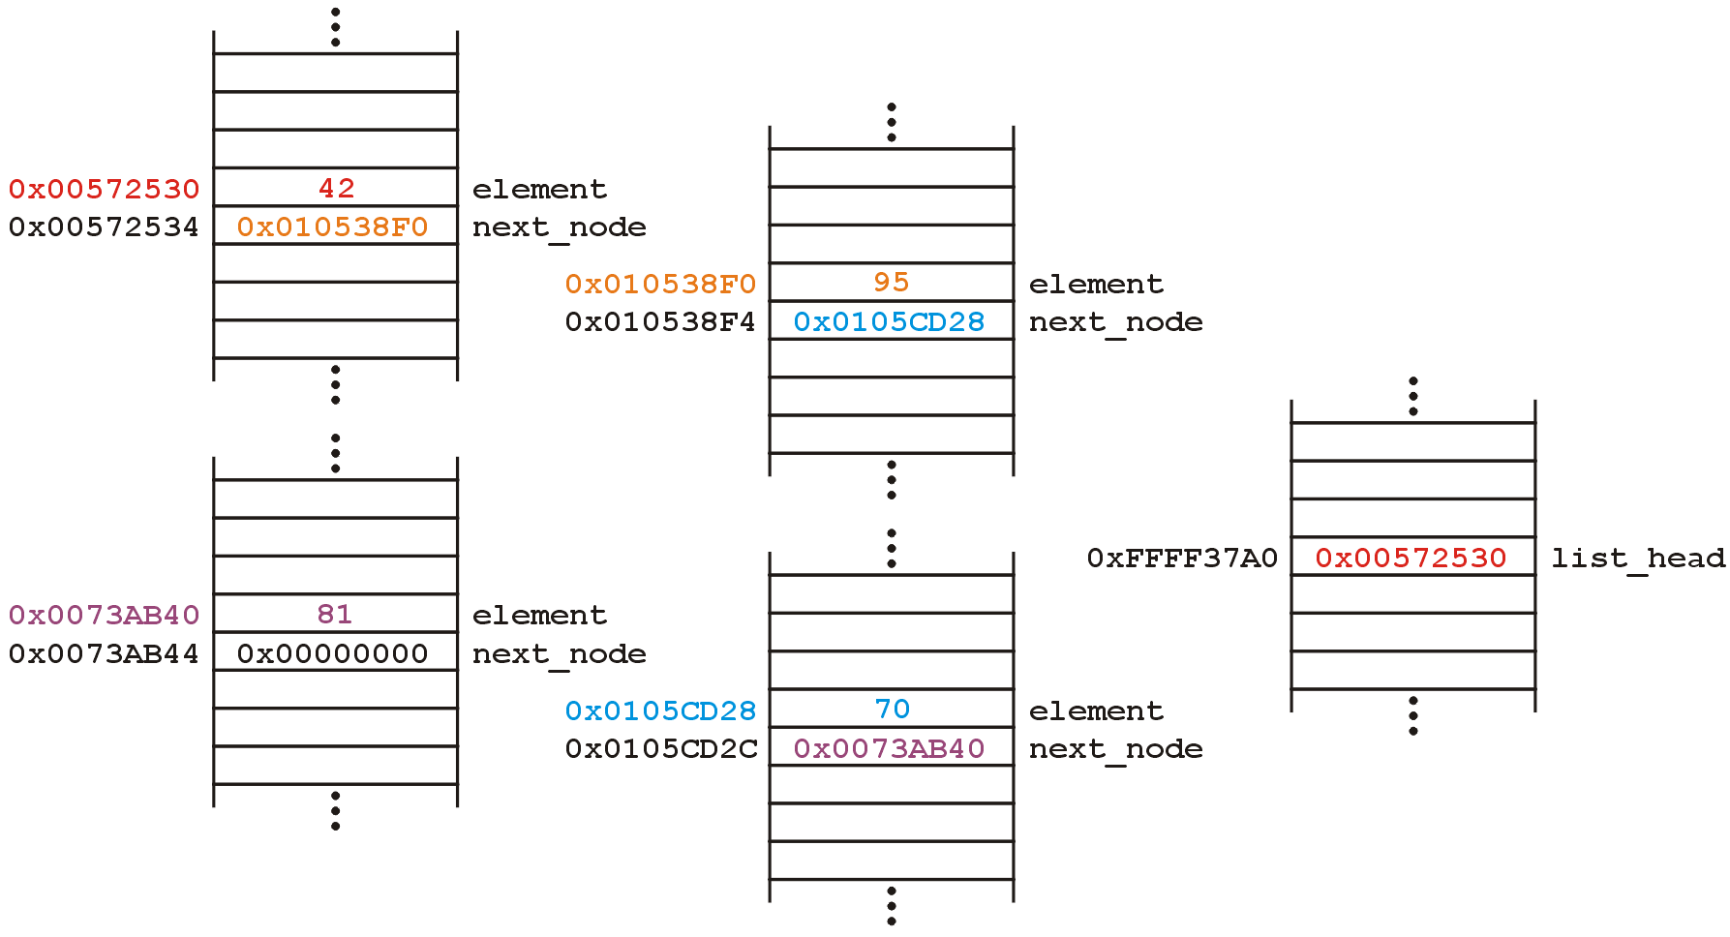
Structure
Such a list could occupy memory as follows:
Linked List Object

Slide 11
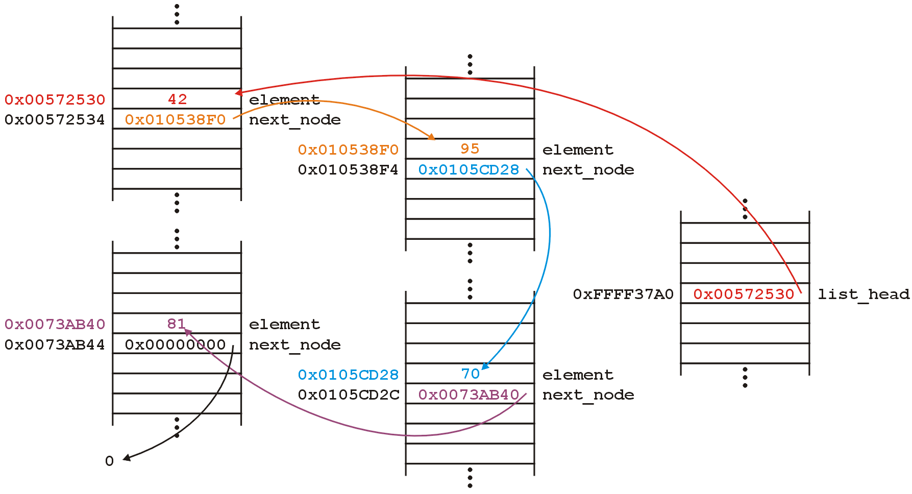
Structure
The next_node pointers store the addresses of the next node in the list

Slide 12
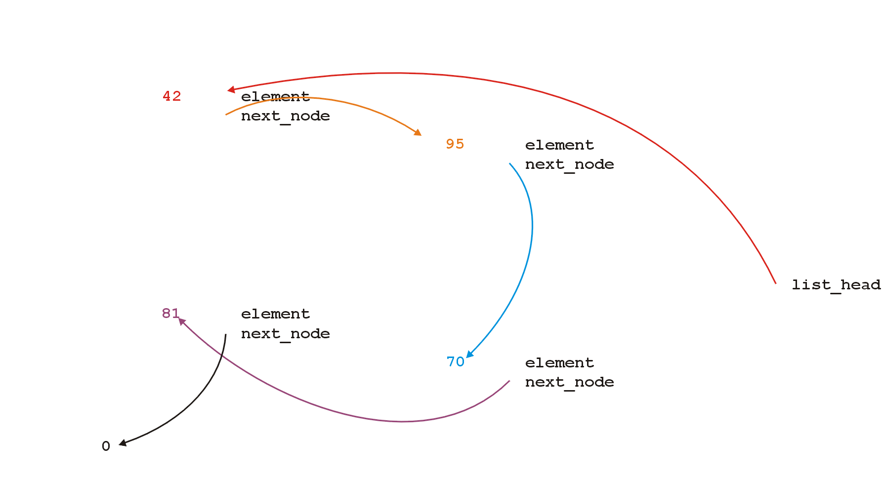
Structure
Because the addresses are arbitrary, we can remove that information:

Slide 13
Structure
We will clean up the representation as follows:
We do not specify the addresses because they are arbitrary and:
The contents of the circle is the element
The next_node pointer is represented by an arrow
list_

Slide 14
Operations
First, we want to create a linked list
We also want to be able to:
insert into,
access, and
erase from
the elements stored in the linked list

Slide 15
Operations
We can do them with the following operations:
Adding, retrieving, or removing the value at the front of the linked list
void push_front( int );
int front() const;
void pop_front();
We may also want to access the head of the linked list
Node *head() const;
Member functions that may change the object acted upon are variously called mutators, modifiers, and, when it involves changing a single member variable, setters

Slide 16
Operations
All these operations relate to the first node of the linked list
We may want to perform operations on an arbitrary node of the linked list, for example:
Find the number of instances of an integer in the list:
int count( int ) const;
Remove all instances of an integer from the list:
int erase( int );

Slide 17
Linked Lists
Additionally, we may wish to check the state:
Is the linked list empty?
bool empty() const;
How many objects are in the list?
int size() const;
The list is empty when the list_head pointer is set to nullptr

Slide 18
Linked Lists
Consider this simple (but incomplete) linked list class:
class List {
private:
Node *list_head;
public:
List();
// Accessors
bool empty() const;
int size() const;
int front() const;
Node *head() const;
int count( int ) const;
// Mutators
void push_front( int );
int pop_front();
int erase( int );
};

Slide 19
Linked Lists
The constructor initializes the linked list
We do not count how many objects are in this list, thus:
we must rely on the last pointer in the linked list to point to a special value
in C++, that standard value is nullptr

Slide 20
The Constructor
Thus, in the constructor, we assign list_head the value nullptr
List::List():list_head( nullptr ) {
// empty constructor
}
We will always ensure that when a linked list is empty, the list head is assigned nullptr

Slide 21
Allocation
The constructor is called whenever an object is created, either:
Statically
The statement List ls; defines ls to be a linked list and the compiler deals with memory allocation
Dynamically
The statement List *pls = new List(); requests sufficient memory from the OS to store an instance of the class
In both cases, the memory is allocated and then the constructor is called

Slide 22
Static Allocation
Example:
int f() {
List ls; // ls is declared as a local variable on the stack
ls.push_front( 3 );
cout << ls.front() << endl;
// The return value is evaluated
// The compiler then calls the destructor for local variables
// The memory allocated for 'ls' is deallocated
return 0;
}

Slide 23
Dynamic Allocation
Example:
List *f( int n ) {
List *pls = new List(); // pls is allocated memory by the OS
pls->push_front( n );
cout << pls->front() << endl;
// The address of the linked list is the return value
// After this, the 4 bytes for the pointer 'pls' is deallocated
// The memory allocated for the linked list is still there
return pls;
}

Slide 24
Static Allocation
What if I do?
List *f() {
List ls; // ls is declared as a local variable on the stack
ls.push_front( 3 );
cout << ls.front() << endl;
// The return value is evaluated
// The compiler then calls the destructor for local variables
// The memory allocated for 'ls' is deallocated
return &ls;
}

Slide 25
bool empty() const
Starting with the easier member functions:
bool List::empty() const {
if ( list_head == nullptr ) {
return true;
} else {
return false;
}
}
Better yet:
bool List::empty() const {
return ( list_head == nullptr );
}

Slide 26
Node *head() const
The member function Node *head() const is easy enough to implement:
Node *List::head() const {
return list_head;
}
This will always work: if the list is empty, it will return nullptr

Slide 27
int front() const
To get the first element in the linked list, we must access the node to which the list_head is pointing
Because we have a pointer, we must use the -> operator to call the member function:
int List::front() const {
return head()->retrieve();
}

Slide 28
int front() const
The member function int front() const requires some additional consideration, however:
what if the list is empty?
If we tried to access a member function of a pointer set to nullptr, we would access restricted memory
The operating system would terminate the running program

Slide 29
int front() const
Instead, we can use an exception handling mechanism where we thrown an exception
We define a class
class underflow {
// emtpy
};
and then we throw an instance of this class:
throw underflow();

Slide 30
int front() const
Thus, the full function is
int List::front() const {
if ( empty() ) {
throw underflow(); }
return head()->retrieve();
}

Slide 31
int front() const
Why is emtpy() better than
int List::front() const {
if ( list_head == nullptr ) {
throw underflow(); }
return list_head->element;
}
?
Two benefits:
More readable
If the implementation changes we do nothing

Slide 32
void push_front( int )
Next, let us add an element to the list
If it is empty, we start with:
and, if we try to add 81, we should end up with:

Slide 33
void push_front( int )
To visualize what we must do:
We must create a new node which:
stores the value 81, and
is pointing to 0
We must then assign its address to list_head
We can do this as follows:
list_head = new Node( 81, nullptr );
We could also use the default value...

Slide 34
void push_front( int )
Suppose however, we already have a non-empty list
Adding 70, we want:

Slide 35
void push_front( int )
To achieve this, we must we must create a new node which:
stores the value 70, and
is pointing to the current list head
we must then assign its address to list_head
We can do this as follows:
list_head = new Node( 70, list_head );

Slide 36
void push_front( int )
Thus, our implementation could be:
void List::push_front( int n ) {
if ( empty() ) {
list_head = new Node( n, nullptr );
} else {
list_head = new Node( n, head() );
}
}

Slide 37
void push_front( int )
We could, however, note that when the list is empty, list_head == 0, thus we could shorten this to:
void List::push_front( int n ) {
list_head = new Node( n, list_head );
}

Slide 38
void push_front( int )
Are we allowed to do this?
void List::push_front( int n ) {
list_head = new Node( n, head() );
}
Yes: the right-hand side of an assignment is evaluated first
The original value of list_head is accessed first before the function call is made

Slide 39
void push_front( int )
Question: does this work?
void List::push_front( int n ) {
Node new_node( n, head() );
list_head = &new_node;
}
Why or why not? What happens to new_node?
How does this differ from
void List::push_front( int n ) {
Node *new_node = new Node( n, head() );
list_head = new_node;
}

Slide 40
int pop_front()
Erasing from the front of a linked list is even easier:
We assign the list head to the next pointer of the first node
Graphically, given:
we want:

Slide 41
int pop_front()
Easy enough:
int List::pop_front() {
int e = front();
list_head = head()->next();
return e;
}
Unfortunately, we have some problems:
The list may be empty
We still have the memory allocated for the node containing 70

Slide 42
int pop_front()
Does this work?
int List::pop_front() {
if ( empty() ) {
throw underflow();
}
int e = front();
delete head();
list_head = head()->next();
return e;
}

Slide 43
int pop_front()
int List::pop_front() {
if ( empty() ) {
throw underflow();
}
int e = front();
delete head();
list_head = head()->next();
return e;
}

Slide 44
int pop_front()
int List::pop_front() {
if ( empty() ) {
throw underflow();
}
int e = front();
delete head();
list_head = head()->next();
return e;
}

Slide 45
int pop_front()
int List::pop_front() {
if ( empty() ) {
throw underflow();
}
int e = front();
delete head();
list_head = head()->next();
return e;
}

Slide 46
int pop_front()
The problem is, we are accessing a node which we have just deleted
Unfortunately, this will work more than 99% of the time:
The running program (process) may still own the memory
Once in a while it will fail ...
... and it will be almost impossible to debug
http://xkcd.com/379/

Slide 47
int pop_front()
The correct implementation assigns a temporary pointer to point to the node being deleted:
int List::pop_front() {
if ( empty() ) {
throw underflow();
}
int e = front();
Node *ptr = list_head;
list_head = list_head->next();
delete ptr;
return e;
}

Slide 48
int pop_front()
int List::pop_front() {
if ( empty() ) {
throw underflow();
}
int e = front();
Node *ptr = head();
list_head = head()->next();
delete ptr;
return e;
}

Slide 49
int pop_front()
int List::pop_front() {
if ( empty() ) {
throw underflow();
}
int e = front();
Node *ptr = head();
list_head = head()->next();
delete ptr;
return e;
}

Slide 50
int pop_front()
int List::pop_front() {
if ( empty() ) {
throw underflow();
}
int e = front();
Node *ptr = head();
list_head = head()->next();
delete ptr;
return e;
}

Slide 51
int pop_front()
int List::pop_front() {
if ( empty() ) {
throw underflow();
}
int e = front();
Node *ptr = head();
list_head = head()->next();
delete ptr;
return e;
}

Slide 52
Stepping through a Linked List
The next step is to look at member functions which potentially require us to step through the entire list:
int size() const;
int count( int ) const;
int erase( int );
The second counts the number of instances of an integer, and the last removes the nodes containing that integer

Slide 53
Stepping through a Linked List
The process of stepping through a linked list can be thought of as being analogous to a for-loop:
We initialize a temporary pointer with the list head
We continue iterating until the pointer equals nullptr
With each step, we set the pointer to point to the next object

Slide 54
Stepping through a Linked List
Thus, we have:
for ( Node *ptr = head(); ptr != nullptr; ptr = ptr->next() ) {
// do something
// use ptr->fn() to call member functions
// use ptr->var to assign/access member variables
}

Slide 55
Stepping through a Linked List
Analogously:
for ( Node *ptr = head(); ptr != nullptr; ptr = ptr->next() )
for ( int i = 0; i != N; ++i )

Slide 56
Stepping through a Linked List
With the initialization and first iteration of the loop, we have:
ptr != nullptr and thus we evaluate the body of the loop and then set ptr to the next pointer of the node it is pointing to

Slide 57
Stepping through a Linked List
ptr != nullptr and thus we evaluate the loop and increment the pointer
In the loop, we can access the value being pointed to by using ptr->retrieve()

Slide 58
Stepping through a Linked List
ptr != nullptr and thus we evaluate the loop and increment the
pointer
Also, in the loop, we can access the next node in the list by using ptr->next()

Slide 59
Stepping through a Linked List
ptr != nullptr and thus we evaluate the loop and increment the
pointer
This last increment causes ptr == nullptr

Slide 60
Stepping through a Linked List
Here, we check and find ptr != nullptr is false, and thus we exit
the loop
Because the variable ptr was declared inside the loop, we can no longer access it

Slide 61
int count( int ) const
To implement int count(int) const, we simply check if the argument matches the element with each step
Each time we find a match, we increment the count
When the loop is finished, we return the count
The size function is simplification of count

Slide 62
int count( int ) const
The implementation:
int List::count( int n ) const {
int node_count = 0;
for ( Node *ptr = list(); ptr != nullptr; ptr = ptr->next() ) {
if ( ptr->retrieve() == n ) {
++node_count;
}
}
return node_count;
}

Slide 63
int erase( int )
To remove an arbitrary element, i.e., to implement int erase( int ), we must update the previous node
For example, given
if we delete 70, we want to end up with

Slide 64
Accessing Private Member Variables
Notice that the erase function must modify the member variables of the node prior to the node being removed
Thus, it must have access to the member variable next_node
We could supply the member function
void set_next( Node * );
however, this would be globally accessible
Possible solutions:
Friends
Nested classes
Inner classes

Slide 65
C++ Friends
In C++, you explicitly break encapsulation by declaring the class List to be a friend of the class Node:
class Node {
Node *next() const;
// ... declaration ...
friend class List;
};
Now, inside erase (a member function of List), you can modify all the member variables of any instance of the Node class

Slide 66
C++ Friends
For example, the erase member function could be implemented using the following code:
int List::erase( int n ) {
int node_count = 0;
// ...
for ( Node *ptr = head(); ptr != nullptr; ptr = ptr->next() ) {
// ...
if ( some condition ) {
ptr->next_node = ptr->next()->next();
// ...
++node_count;
}
}
return node_count;
}

Slide 67
Nested Classes
In C++, you can nest one class inside another
class Outer {
private:
class Nested {
private:
int element;
public:
int get() const;
void set( int );
};
Nested stored;
public:
int get() const;
void set( int );
};

Slide 68
Nested Classes
The function definitions are as one would expect:
int Outer::Nested::get() const {
return element;
}
void Outer::Nested::set( int n ) {
element = n;
}
int Outer::get() const {
return stored.get();
}
void Outer::set( int n ) {
// Not allowed, as element is private
// stored.element = n;
stored.set( n );
}

Slide 69
Inner Classes
In Java/C#, there is also the notion of an inner class
This is an elegant object-oriented solution
Any instance of the inner class is linked to the instance of the outer class that created it
That inner class can access the member variables of the outer class
If Node was an inner class of List, the node could determine its position with the list (not possible in C++):
int List::Node::position() const {
int posn = 1;
for ( Node *ptr = list_head; ptr != this; ptr = ptr->next() ) {
} // empty loop body
return posn;
}

Slide 70
Destructor
We dynamically allocated memory each time we added a new int into this list
Suppose we delete a list before we remove everything from it
This would leave the memory allocated with no reference to it

Slide 71
Destructor
Thus, we need a destructor:
class List {
private:
Node *list_head;
public:
List();
~List();
// ...etc...
};

Slide 72
Destructor
The destructor has to delete any memory which had been allocated but has not yet been deallocated
This is straight-forward enough:
while ( !empty() ) {
pop_front();
}

Slide 73
Destructor
Is this efficient?
It runs in O(n) time, where n is the number of objects in the linked list
Given that delete is approximately 100× slower than most other instructions (it does call the OS), the extra overhead is negligible...

Slide 74
Making Copies
Is this sufficient for a linked list class?
Initially, it may appear yes, but we now have to look at how C++ copies objects during:
Passing by value (making a copy), and
Assignment

Slide 75
Pass by Value
Recall that when you pass an integer to a function, a copy is made, so any changes to that parameter does not affect the original:
#include <iostream>
void increment( int n ) {
++n;
}
int main() {
int counter = 0;
increment( counter );
std::cout << counter << std::endl; // counter is still 0
}

Slide 76
Pass by Reference
If you want to change the value, you can pass by reference:
#include <iostream>
void increment( int &n ) {
++n;
}
int main() {
int counter = 0;
increment( counter );
std::cout << counter << std::endl; // counter is now 1
}

Slide 77
Pass by Pointer (C)
In C, you would pass the address of the object to change it:
#include <stdio.h>
void increment( int *pn ) {
++(*pn);
}
int main() {
int counter = 0;
increment( &counter );
printf( "%d", counter ); // counter is now 1
}

Slide 78
Modifying Arguments
Pass by reference could be used to modify a list
void reverse( List &list ) {
List tmp;
while ( !list.empty() ) {
tmp.push_front( ls.pop_front() );
}
// All the member variables of 'list' and 'tmp' are swapped
std::swap( list, tmp );
// The memory for 'tmp' will be cleaned up
}

Slide 79
Modifying Arguments
If you wanted to prevent the argument from being modified, you could declare it const:
double average( List const &ls, int min, int max ) {
double sum = 0, count = 0;
for ( Node *ptr = head(); ptr != nullptr; ptr = ptr->next() ) {
sum += ptr->retrieve();
++count;
}
return sum/count;
}

Slide 80
Modifying Arguments
What if you want to pass a copy of a linked list to a function—where the function can modify the passed argument, but the original is unchanged?
By default, all the member variables are simply copied over into the new instance of the class
This is the default copy constructor
Because a copy is made, the destructor must also be called on it
void send_copy( List ls ) {
// The compiler creates a new instance and copies the values
// The function does something with 'ls'
// The compiler ensures the destructor is called on 'ls'
}

Slide 81
Modifying Arguments
First, the list prim is created and three elements are pushed onto it
void send_copy( List ls ) {
// The compiler creates a new instance and copies the values
// The function does something with 'ls'
// The compiler ensures the destructor is called on 'ls'
}
int main() {
List prim;
for ( int i = 2; i <= 4; ++i ) {
prim.push_front( i*i );
}
send_copy( prim );
std::cout << prim.empty() << std::endl;
return 0;
}

Slide 82
Modifying Arguments
Next, we call send_copy and assign the parameter ls a copy of the argument prim
The default is to copy member variables:
ls.list_head = prim.list_head
void send_copy( List ls ) {
// The compiler creates a new instance and copies the values
// The function does something with 'ls'
// The compiler ensures the destructor is called on 'ls'
}
int main() {
List prim;
for ( int i = 2; i <= 4; ++i ) {
prim.push_front( i*i );
}
send_copy( prim );
std::cout << prim.empty() << std::endl;
return 0;
}

Slide 83
Modifying Arguments
When send_copy returns, the destructor is called on the parameter ls
void send_copy( List ls ) {
// The compiler creates a new instance and copies the values
// The function does something with 'ls'
// The compiler ensures the destructor is called on 'ls'
}
int main() {
List prim;
for ( int i = 2; i <= 4; ++i ) {
prim.push_front( i*i );
}
send_copy( prim );
std::cout << prim.empty() << std::endl;
return 0;
}

Slide 84
Modifying Arguments
When send_copy returns, the destructor is called on the parameter ls
void send_copy( List ls ) {
// The compiler creates a new instance and copies the values
// The function does something with 'ls'
// The compiler ensures the destructor is called on 'ls'
}
int main() {
List prim;
for ( int i = 2; i <= 4; ++i ) {
prim.push_front( i*i );
}
send_copy( prim );
std::cout << prim.empty() << std::endl;
return 0;
}

Slide 85
Modifying Arguments
When send_copy returns, the destructor is called on the parameter ls
void send_copy( List ls ) {
// The compiler creates a new instance and copies the values
// The function does something with 'ls'
// The compiler ensures the destructor is called on 'ls'
}
int main() {
List prim;
for ( int i = 2; i <= 4; ++i ) {
prim.push_front( i*i );
}
send_copy( prim );
std::cout << prim.empty() << std::endl;
return 0;
}

Slide 86
Modifying Arguments
Back in main(), prim.list_head still stores the address of the Node containing 16, memory that has since been returned to the OS
Additionally, the destructor will be called on prim once main() exits
void send_copy( List ls ) {
// The compiler creates a new instance and copies the values
// The function does something with 'ls'
// The compiler ensures the destructor is called on 'ls'
}
int main() {
List prim;
for ( int i = 2; i <= 4; ++i ) {
prim.push_front( i*i );
}
send_copy( prim );
std::cout << prim.empty() << std::endl;
return 0;
}

Slide 87
Modifying Arguments
What do we really want?
void send_copy( List ls ) {
// The compiler creates a new instance and copies the values
// The function does something with 'ls'
// The compiler ensures the destructor is called on 'ls'
}
int main() {
List prim;
for ( int i = 2; i <= 4; ++i ) {
prim.push_front( i*i );
}
send_copy( prim );
std::cout << prim.empty() << std::endl;
return 0;
}

Slide 88
Modifying Arguments
What do we really want?
We really want a copy of the linked list
If this copy is modified, it leaves the original unchanged
void send_copy( List ls ) {
// The compiler creates a new instance and copies the values
// The function does something with 'ls'
// The compiler ensures the destructor is called on 'ls'
}
int main() {
List prim;
for ( int i = 2; i <= 4; ++i ) {
prim.push_front( i*i );
}
send_copy( prim );
std::cout << prim.empty() << std::endl;
return 0;
}

Slide 89
Copy Constructor
You can modify how copies are made by defining a copy constructor
The default copy constructor simply copies the member variables
In this case, this is not what we want
The signature for the copy constructor is
Class_name( Class_name const & );
In this case, we would define the member function
List( List const & );

Slide 90
Copy Constructor
If such a function is defined, every time an instance is passed by value, the copy constructor is called to make that copy
Additionally, you can use the copy constructor as follows:
List ls1;
ls1.push_front( 4 );
ls1.push_front( 2 );
List ls2( ls1 ); // make a copy of ls1
When an object is returned by value, again, the copy constructor is called to make a copy of the returned value

Slide 91
Copy Constructor
Thus, we must define a copy constructor:
The copy constructor allows us to initialize the member variables
List::List( List const &list ):list_head( nullptr ) {
// Make a copy of list
}
We now want to go from
to

Slide 92
Copy Constructor
Naïvely, we step through list and call push_front( int ):
List::List( List const &list ):list_head( nullptr ) {
for ( Node *ptr = list.head(); ptr != nullptr; ptr = ptr->next() ) {
push_front( ptr->retrieve() );
}
}
Does this work?
How could we make this work?
We need a push_back( int ) member function:
List::List( List const &list ):list_head( nullptr ) {
for ( Node *ptr = list.head(); ptr != nullptr; ptr = ptr->next() ) {
push_back( ptr->retrieve() );
}
}

Slide 93
Copy Constructor
Unfortunately, to make push_back( int ) more efficient, we need a pointer to the last node in the linked list
We require a list_tail member variable
Otherwise, push_back( int ) becomes a Θ(n) function
This would make the copy constructor Θ(n²)

Slide 94
Copy Constructor
First, make life simple: if list is empty, we are finished, so return
List::List( List const &list ):list_head( nullptr ) {
if ( list.empty() ) {
return;
}
}

Slide 95
Copy Constructor
Otherwise, the list being copied is not empty…
List::List( List const &list ):list_head( nullptr ) {
if ( list.empty() ) {
return;
}
}

Slide 96
Copy Constructor
Copy the first node—we no longer modifying list_head
List::List( List const &list ):list_head( nullptr ) {
if ( list.empty() ) {
return;
}
push_front( list.front() );
}

Slide 97
Copy Constructor
We need what we want to copy next and where we want to copy it
List::List( List const &list ):list_head( nullptr ) {
if ( list.empty() ) {
return;
}
push_front( list.front() );
}
Note, we will need to loop through the list… How about a for loop?

Slide 98
Copy Constructor
We modify the next pointer of the node pointed to by copy
List::List( List const &list ):list_head( nullptr ) {
if ( list.empty() ) {
return;
}
push_front( list.front() );
for (
Node *original = list.head()->next(), *copy = head();
original != nullptr;
original = original->next(), copy = copy->next()
) {
copy->next_node = new Node( original->retrieve(), nullptr );
}
}

Slide 99
Copy Constructor
Then we move each pointer forward:
List::List( List const &list ):list_head( nullptr ) {
if ( list.empty() ) {
return;
}
push_front( list.front() );
for (
Node *original = list.head()->next(), *copy = head();
original != nullptr;
original = original->next(), copy = copy->next()
) {
copy->next_node = new Node( original->retrieve(), nullptr );
}
}

Slide 100
Copy Constructor
We’d continue copying until we reach the end
List::List( List const &list ):list_head( nullptr ) {
if ( list.empty() ) {
return;
}
push_front( list.front() );
for (
Node *original = list.head()->next(), *copy = head();
original != nullptr;
original = original->next(), copy = copy->next()
) {
copy->next_node = new Node( original->retrieve(), nullptr );
}
}

Slide 101
References
Donald E. Knuth, The Art of Computer Programming, Volume 3: Sorting and Searching, 2nd Ed., Addison Wesley, 1998, §5.4, pp.248-379.
Wikipedia, https://en.wikipedia.org/wiki/Linked_list
http://stackoverflow.com/error?aspxerrorpath=/questions/8848363/rvalue-reference-with-assignement-operator
These slides are provided for the ECE 250 Algorithms and Data Structures course. The material in it reflects Douglas W. Harder’s best judgment in light of the information available to him at the time of preparation. Any reliance on these course slides by any party for any other purpose are the responsibility of such parties. Douglas W. Harder accepts no responsibility for damages, if any, suffered by any party as a result of decisions made or actions based on these course slides for any other purpose than that for which it was intended.

