Slide 1
Assignment
What about assignment?
Suppose you have linked lists:
List lst1, lst2;
lst1.push_front( 35 );
lst1.push_front( 18 );
lst2.push_front( 94 );
lst2.push_front( 72 );

Slide 2
Assignment
This is the current state:
Consider an assignment:
lst2 = lst1;
What do we want? What should this do?
The default is to copy the member variables from lst1 to lst2

Slide 3
Assignment
Because the only member variable of this class is list_head, the value it is storing (the address of the first node) is copied over
It is equivalent to writing:
lst2.list_head = lst1.list_head;
Graphically:

Slide 4
Assignment
What’s wrong with this picture?
We no longer have links to either of the nodes storing 72 or 94
Also, suppose we call the member function
lst1.pop_front();
This only affects the member variable from the object lst1

Slide 5
Assignment
Now, the second list lst2 is pointing to memory which has been deallocated...
What is the behavior if we make this call?
lst2.pop_front();
The behaviour is undefined, however, soon this will probably lead to an access violation

Slide 6
Assignment
Like making copies, we must have a reasonable means of assigning
Starting with
We need to erase the content of lst2 and copy over the nodes in lst1

Slide 7
Assignment
First, to overload the assignment operator, we must overload the function named operator =
This is a how you indicate to the compiler that you are overloading the assignment (=) operator
The signature is:
List &operator = ( List );

Slide 8
Return by Value
Now, suppose you create the following function:
List initialize( int a, int b ) {
List ls;
for ( int i = b; i >= a; --i ) {
ls.push_front( i );
}
return ls;
}
and call
List vec = initialize( 3, 6 );

Slide 9
Return by Value
Because ls is a local variable, it will be garbage collected once the function returns—thus, we would normally make a copy
List initialize( int a, int b ) {
List ls;
for ( int i = b; i >= a; --i ) {
ls.push_front( i );
}
return ls;
}

Slide 10
Return by Value
Because ls is a local variable, it will be garbage collected once the function returns—thus, we would normally make a copy
Create a copy
List initialize( int a, int b ) {
List ls;
for ( int i = b; i >= a; --i ) {
ls.push_front( i );
}
return ls;
}

Slide 11
Return by Value
Because ls is a local variable, it will be garbage collected once the function returns—thus, we would normally make a copy
Create a copy
Call the destructor on ls
List initialize( int a, int b ) {
List ls;
for ( int i = b; i >= a; --i ) {
ls.push_front( i );
}
return ls;
}

Slide 12
Return by Value
Because ls is a local variable, it will be garbage collected once the function returns—thus, we would normally make a copy
Create a copy
Call the destructor on ls
Remove the memory for ls from the stack
List initialize( int a, int b ) {
List ls;
for ( int i = b; i >= a; --i ) {
ls.push_front( i );
}
return ls;
}

Slide 13
Return by Value
Why are we allocating and deallocating so much memory?
Until C++11, this was the only way
List initialize( int a, int b ) {
List ls;
for ( int i = b; i >= a; --i ) {
ls.push_front( i );
}
return ls;
}

Slide 14
Return by Value
Wouldn’t it be easier to link vec.list_head to the first node in ls and then set ls.list_head = nullptr?
List initialize( int a, int b ) {
List ls;
for ( int i = b; i >= a; --i ) {
ls.push_front( i );
}
return ls;
}

Slide 15
Return by Value
Wouldn’t it be easier to link vec.list_head to the first node in ls and then set ls.list_head = nullptr?
The destructor called on ls does nothing and the memory for it is popped from the stack
List initialize( int a, int b ) {
List ls;
for ( int i = b; i >= a; --i ) {
ls.push_front( i );
}
return ls;
}

Slide 16
Move Constructors
The move constructor was added to the C++11 standard
It is called when an rvalue is being assigned—as an rvalue, it will be deleted anyway
The instance ls is being deleted as soon as it is copied
If a move constructor is defined, it will be called instead of a copy constructor
List( List &&list ):list_head( list.list_head ) {
// make 'list' empty so that nothing is
// done when it is passed to the destructor
list.list_head = nullptr;
}

Slide 17
Assignment
The right-hand side is passed by value (a copy is made) The return value is passed by reference
List &operator = ( List rhs );
Note that rhs is a copy of the list, it is not a pointer to a list
Use rhs.head() or rhs.list_head

Slide 18
Assignment
We will swap all the values of the member variables between the left- and right-hand sides
rhs is already a copy, so we swap all member variables of it and *this
List &operator = ( List rhs ) {
// 'rhs' is passed by value--it is a copy of the
// right-hand side of the assignment
// Swap all the entries of the copy with this
return *this;
}

Slide 19
Assignment
Under C++11, the following is the appropriate implementation:
List &List::operator = ( List rhs ) {
std::swap( *this, rhs );
// Memory for rhs was allocated on the stack
// and the destructor will delete it
return *this;
}

Slide 20
Assignment
Until compilers are C++11 compliant, this may be necessary:
List &List::operator = ( List rhs ) {
swap( rhs );
// Memory for rhs was allocated on the stack
// and the destructor will delete it
return *this;
}
void List::swap( List &list ) {
std::swap( list_head, list.list_head );
}

Slide 21
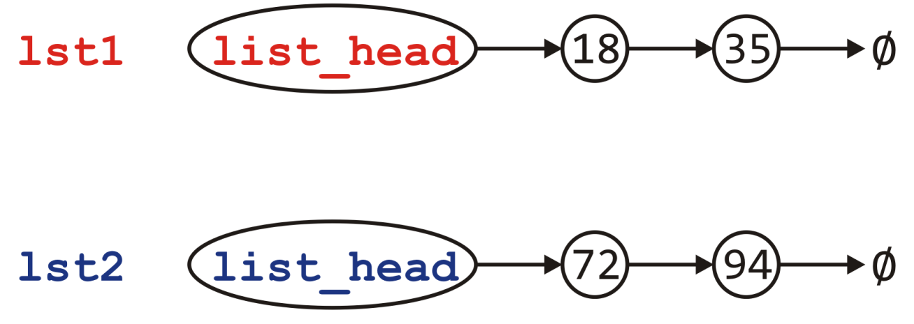
Assignment
Visually, we are doing the following:
List &List::operator = ( List rhs ) {
swap( *this, rhs );
return *this;
}

Slide 22
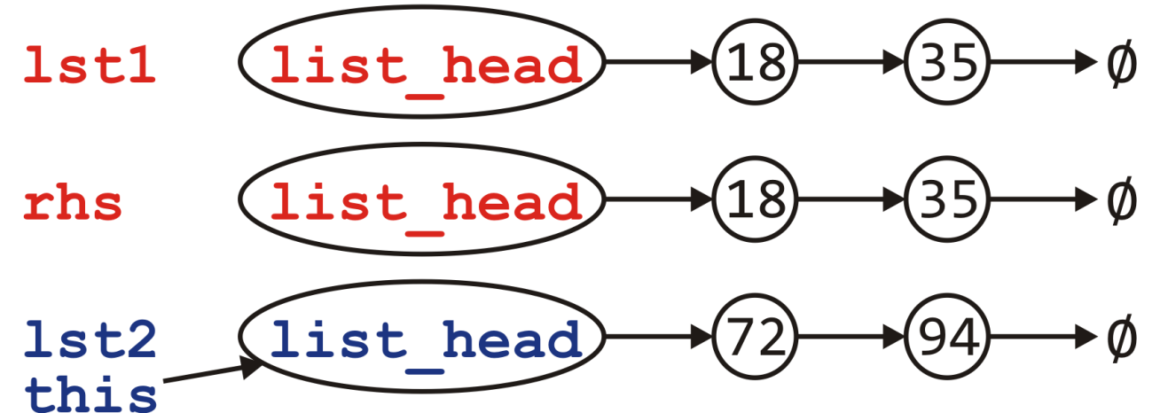
Assignment
Visually, we are doing the following:
Passed by value, the copy constructor is called to create rhs
List &List::operator = ( List rhs ) {
std::swap( *this, rhs );
return *this;
}

Slide 23
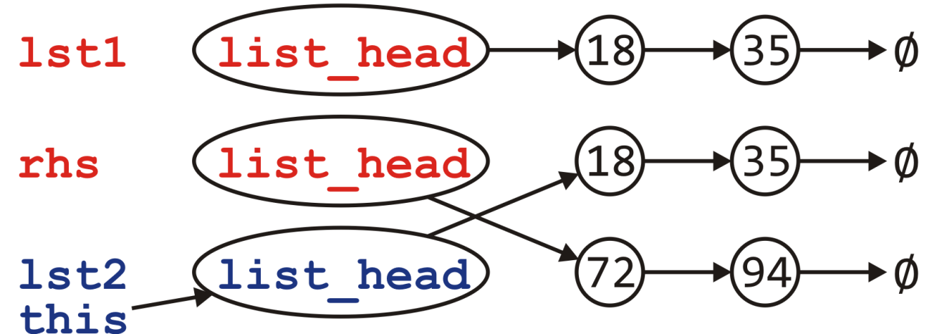
Assignment
Visually, we are doing the following:
Passed by value, the copy constructor is called to create rhs
Swapping the member variables of *this and rhs
List &List::operator = ( List rhs ) {
std::swap( *this, rhs );
return *this;
}

Slide 24
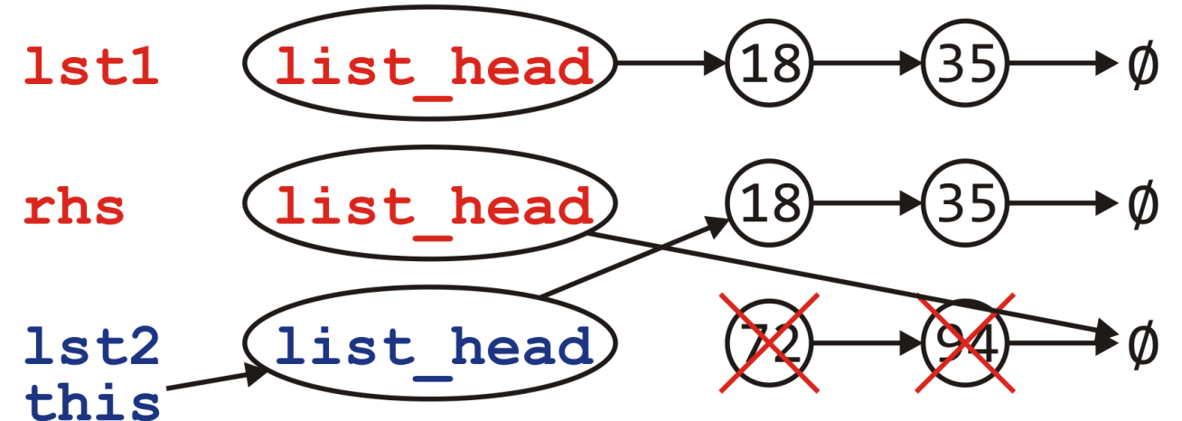
Assignment
Visually, we are doing the following:
Passed by value, the copy constructor is called to create rhs
Swapping the member variables of *this and rhs
We return and the destructor is called on rhs
List &List::operator = ( List rhs ) {
std::swap( *this, rhs );
return *this;
}

Slide 25
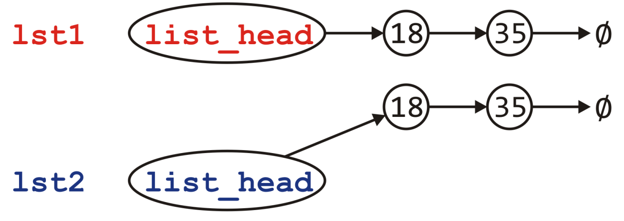
Assignment
Visually, we are doing the following:
Passed by value, the copy constructor is called to create rhs
Swapping the member variables of *this and rhs
We return and the destructor is called on rhs
Back in the calling function, the two lists contain the same values
List &List::operator = ( List rhs ) {
std::swap( *this, rhs );
return *this;
}

Slide 26
Assignment
Can we do better?
This idea of copy and swap is highly visible in the literature
If the copy constructor is written correctly, it will be fast
Is it always the most efficient?
Consider the calls to new and delete
Each of these is very expensive…
Would it not be better to reuse the nodes if possible?
Reference: Howard Hinnant

Slide 27
Assignment
Can we do better?
This idea of copy and swap is highly visible in the literature
If the copy constructor is written correctly, it will be fast
Is it always the most efficient?
Consider the calls to new and delete
Each of these is very expensive…
Would it not be better to reuse the nodes if possible?
No calls to new or delete
Reference: Howard Hinnant

Slide 28
Assignment
What is the plan?
First, we must pass by reference—no copying
Ensure we are not assigning something to itself
If the right-hand side is empty, it’s straight-forward:
Just empty this list
Otherwise, step through the right-hand side list and for each node there
If there is a corresponding node in this, copy over the value, else
There is no corresponding node; create a new node and append it
If there are any nodes remaining in this, delete them
Special case:
Dealing with the first node which is pointed to by list_head and not a next_node member variable

Slide 29
Assignment
The implementation must be more carefully written
List &List::operator = ( List const &rhs ) {
if ( this == &rhs ) {
return *this;
}
if ( rhs.empty() ) {
while ( !empty() ) {
pop_front();
}
return *this;
}

Slide 30
Assignment
if ( empty() ) {
list_head = new Node( rhs.front() );
} else {
head()->element = rhs.front();
}
Node *this_node = list_head,
*rhs_node = rhs.head()->next();
while ( rhs_node != 0 ) {
if ( this_node->next() == 0 ) {
this_node->next_node = new Node( rhs_node->retrieve() );
this_node = this_node->next();
} else {
this_node->next();
this_node->element = rhs_node->retrive();
}
rhs_node = rhs_node->next();
}

Slide 31
Assignment
while ( this_node->next() != 0 ) {
Node *tmp = this_node->next();
this_node->next_node = this_node->next()->next();
delete tmp;
}
return *this;
}

Slide 32
Move Assignment
Similarly, we need a move assignment:
List &List::operator = ( List &&rhs ) {
while ( !empty() ) {
pop_front();
}
list_head = rhs.head();
rhs.list_head = 0;
return *this;
}

Slide 33
Linked Lists
Thus, the complete class is:
class List {
private:
Node *list_head;
void swap( List & );
public:
// Constructors and destructors
List();
List( List const & );
List( List && );
~List();
// Assignment operators
List &operator = ( List const & );
List &operator = ( List && );
// Accessors
bool empty() const;
int size() const;
int front() const;
Node *head() const;
int count( int ) const;
// Mutators
void push_front( int );
int pop_front();
int erase( int );
};

Slide 34
Linked Lists
With asymptotic analysis of linked lists, we can now make the following statements:
* these become Θ(1) if we have a tail pointer
 | front | arbitrary | back
insert | Θ(1) | O(n) | Θ(n) *
access | Θ(1) | O(n) | Θ(n) *
erase | Θ(1) | O(n) | Θ(n)

Slide 35
Efficient Allocation
In all our examples, we use new and delete to allocate and deallocate nodes
This is exceptionally inefficient
It requires the operating system to allocate and deallocate memory with each node
Could we pre-allocate memory for a number of nodes and use them?
Suggestions?

Slide 36
Efficient Allocation
Consider the following strategy:
Allocate an array of N nodes
The address of the node is the index in the array
Therefore, next_node is an integer
Each time we require a new node, use one of these
If all the nodes in the block are used, we double the size of the array of the allocated nodes and move the objects over
To track which nodes are being used, we could use a stack
Initially, the stack would contain the values from 0 to N – 1
If we need an unused entry in the array, pop the next index from the top of the stack
If we no longer are using a node, push its index onto the stack

Slide 37
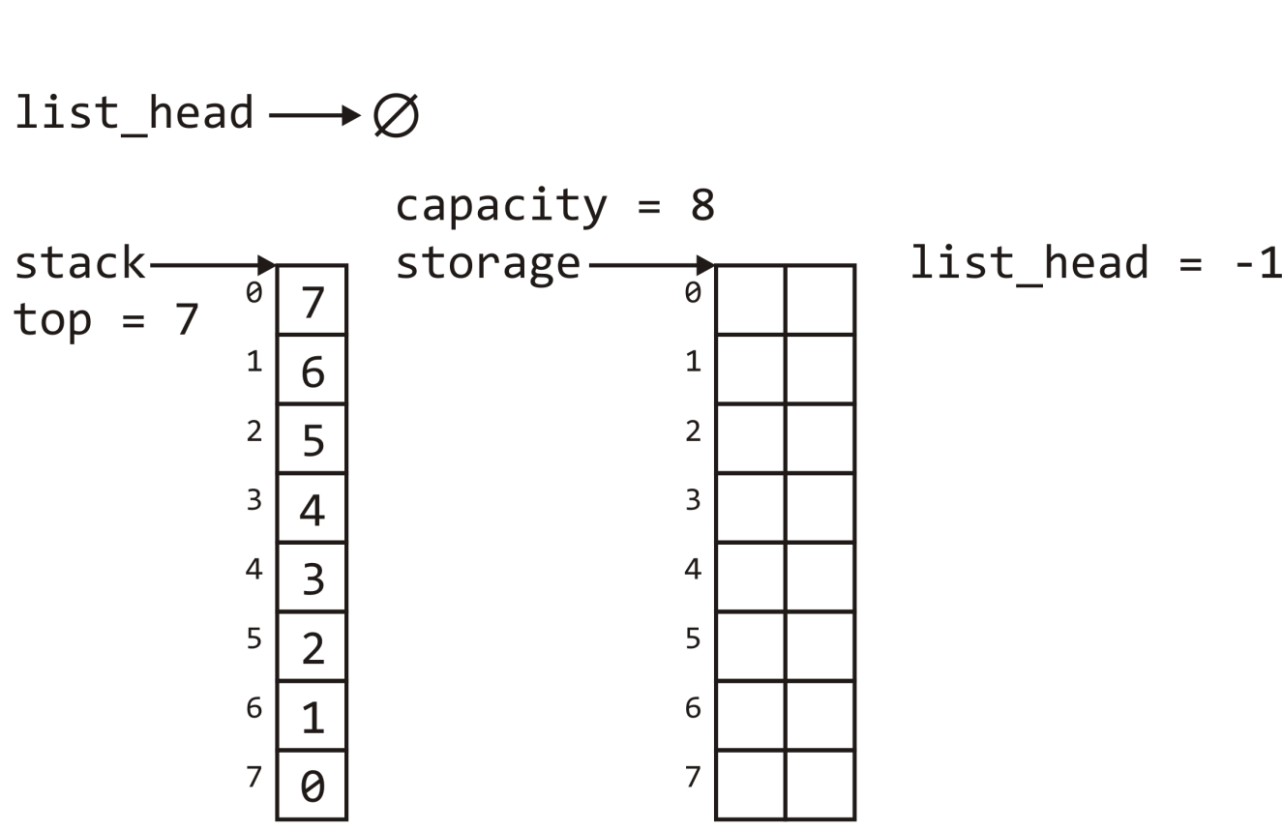
Efficient Allocation
We would use -1 to represent the end of the list
More intelligently, we would define a constant:
int const NULL = -1;

Slide 38
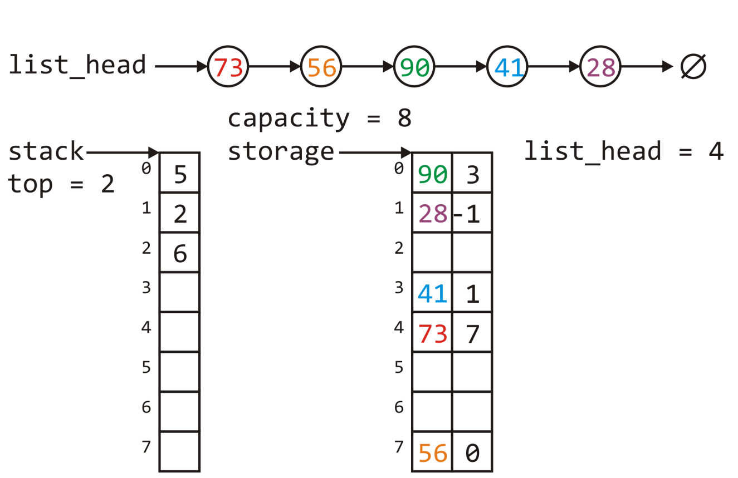
Efficient Allocation
After a few calls to push_front and erase, we could end up with an allocation as follows:

Slide 39
Efficient Allocation
If we wanted to call pop_front, we would:
Push 4 onto the stack
Updated list_head to be 7

Slide 40
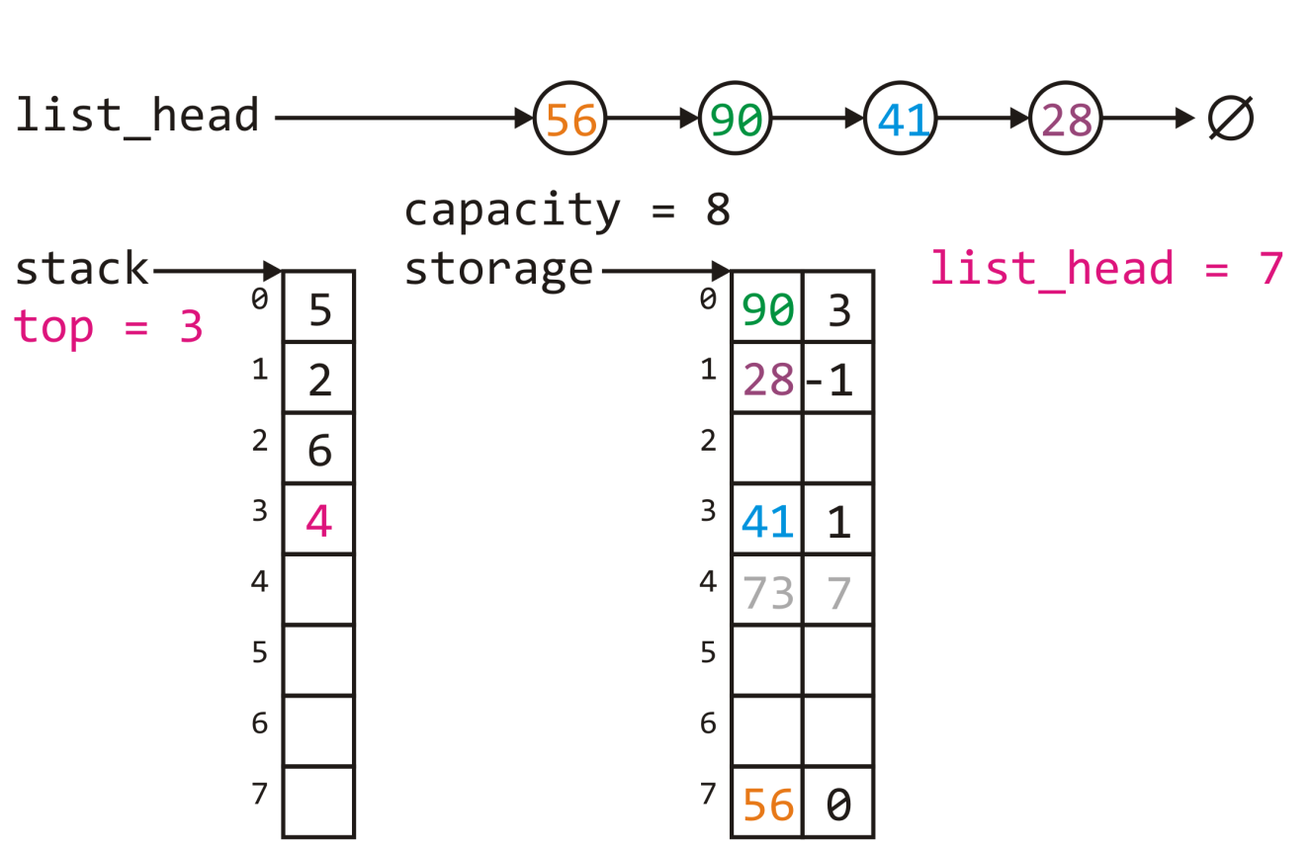
Efficient Allocation
If we wanted to call pop_front, we would:
Push 4 onto the stack
Updated list_head to be 7
The result:

Slide 41
Efficient Allocation
If we wanted to push 99 onto the front of this list, we would:
Get to top of the stack, 6
At this location, place 99 and the current value of list_head
Update list_head = 6

Slide 42
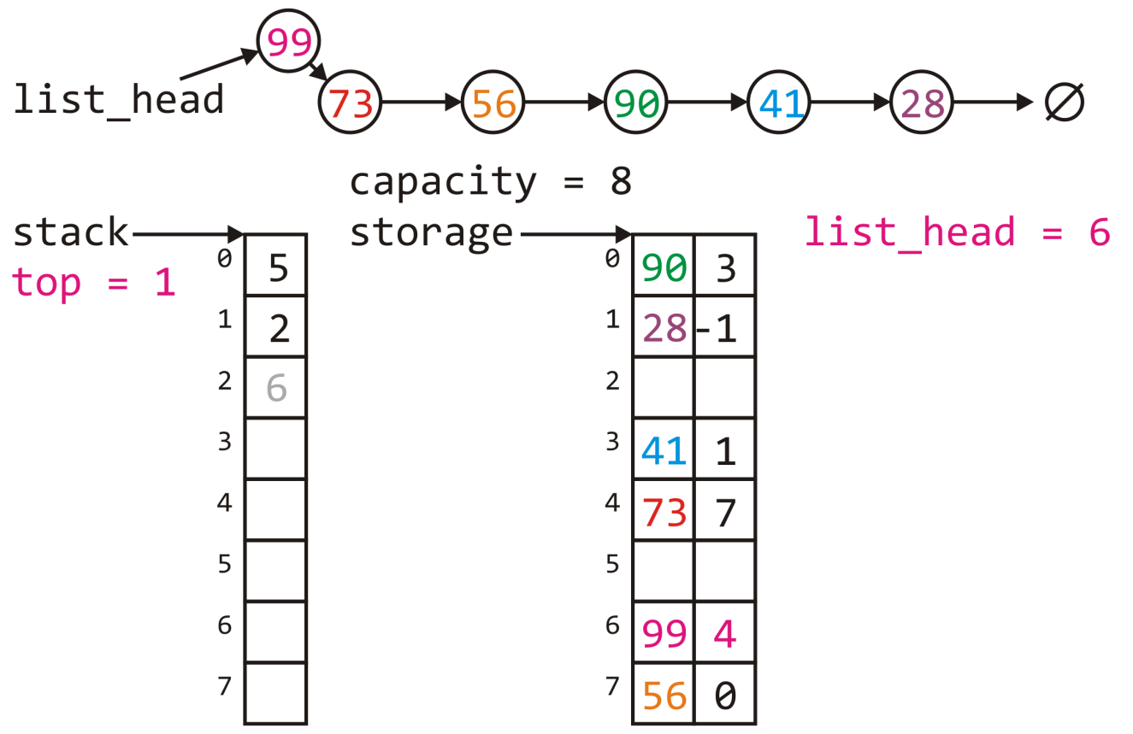
Efficient Allocation
This results in:

Slide 43
Efficient Allocation
Originally, we would require n calls to new() to insert n objects into the linked list
This updated allocation strategy requires lg(n) calls to new and n copies

Slide 44
Summary
We have considered the implementation of linked lists in C++
Aspects of the Node class
Accessors and mutators
The implementation of various member functions
Stepping through a linked list
Defining the copy and assignment operator
Defining move constructors and move assignment operators
Discussed efficiencies

Slide 45
References
Donald E. Knuth, The Art of Computer Programming, Volume 3: Sorting and Searching, 2nd Ed., Addison Wesley, 1998, §5.4, pp.248-379.
Wikipedia, https://en.wikipedia.org/wiki/Linked_list
http://stackoverflow.com/error?aspxerrorpath=/questions/8848363/rvalue-reference-with-assignement-operator
These slides are provided for the ECE 250 Algorithms and Data Structures course. The material in it reflects Douglas W. Harder’s best judgment in light of the information available to him at the time of preparation. Any reliance on these course slides by any party for any other purpose are the responsibility of such parties. Douglas W. Harder accepts no responsibility for damages, if any, suffered by any party as a result of decisions made or actions based on these course slides for any other purpose than that for which it was intended.

