Slide 1
Outline
In this topic, we will cover:
Definition of a tree data structure and its components
Concepts of:
Root, internal, and leaf nodes
Parents, children, and siblings
Paths, path length, height, and depth
Ancestors and descendants
Ordered and unordered trees
Subtrees
Examples
XHTML and CSS

Slide 2
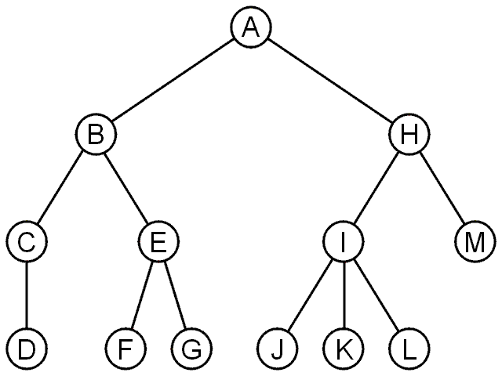
Trees
4.1.1
A rooted tree data structure stores information in nodes
Similar to linked lists:
There is a first node, or root
Each node has variable number of references to successors
Each node, other than the root, has exactly one node pointing to it

Slide 3
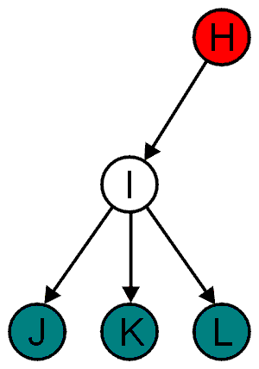
Terminology
4.1.1.1
All nodes will have zero or more child nodes or children
I has three children: J, K and L
For all nodes other than the root node, there is one parent node
H is the parent I

Slide 4
Terminology
4.1.1.1
The degree of a node is defined as the number of its children: deg(I) = 3
Nodes with the same parent are siblings
J, K, and L are siblings

Slide 5
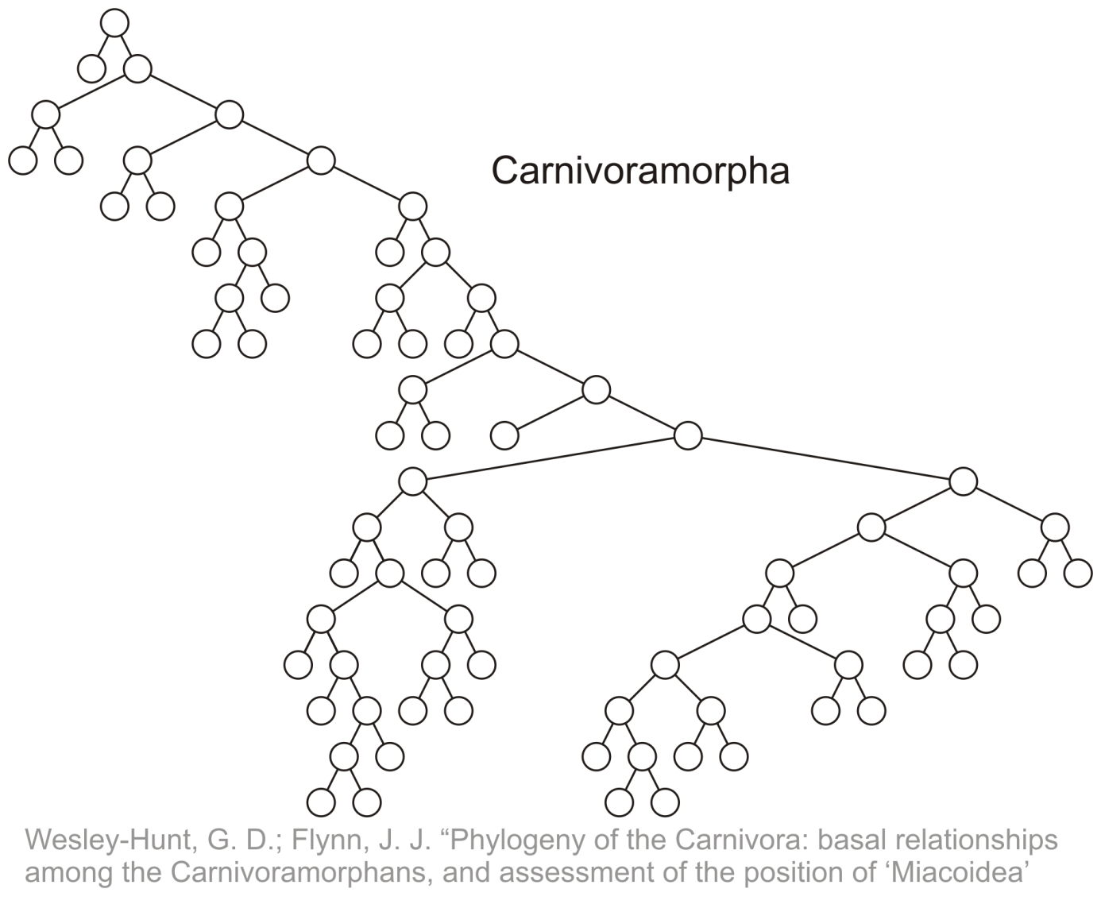
Terminology
4.1.1.1
Phylogenetic trees have nodes with degree 2 or 0:

Slide 6
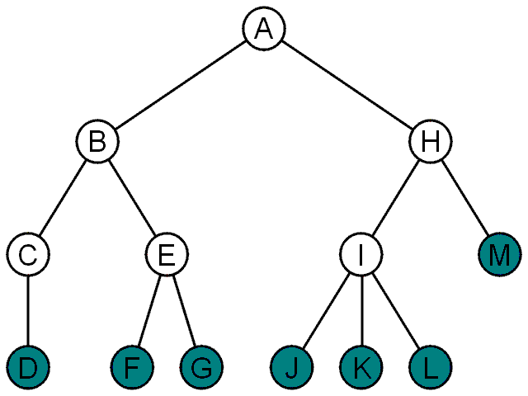
Terminology
4.1.1.1
Nodes with degree zero are also called leaf nodes
All other nodes are said to be internal nodes, that is, they are internal to the tree

Slide 7
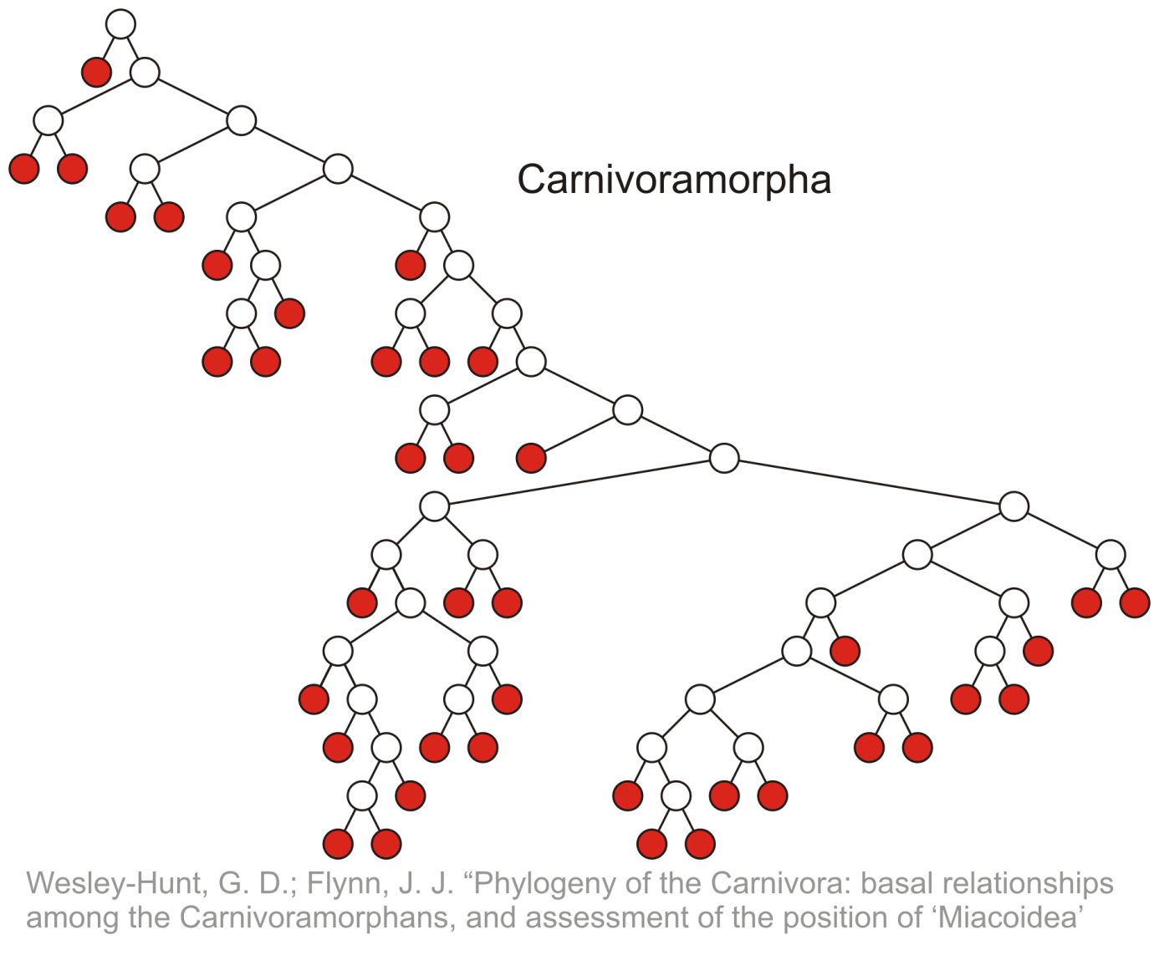
Terminology
4.1.1.1
Leaf nodes:

Slide 8
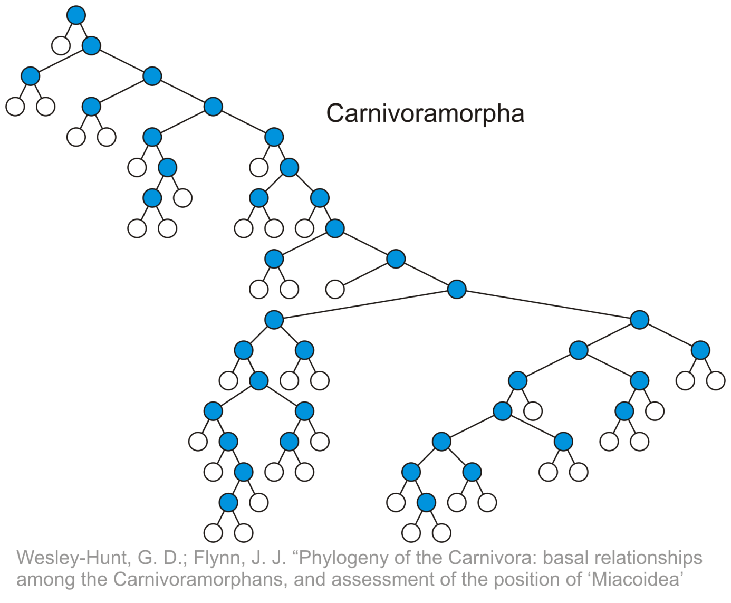
Terminology
4.1.1.1
Internal nodes:

Slide 9
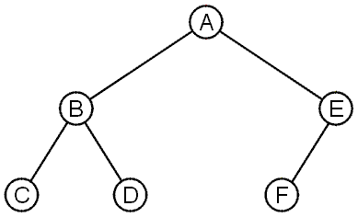
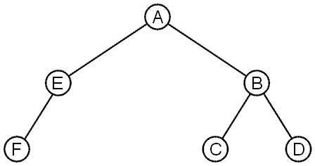
Terminology
4.1.1.2
These trees are equal if the order of the children is ignored
unordered trees
They are different if order is relevant (ordered trees)
We will usually examine ordered trees (linear orders)
In a hierarchical ordering, order is not relevant

Slide 10
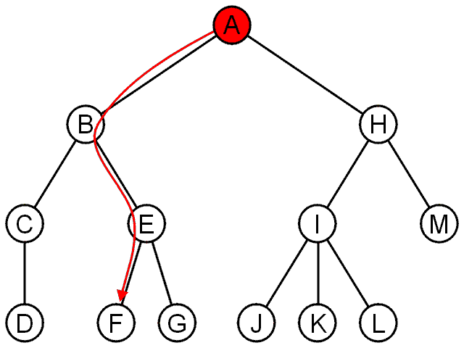
Terminology
4.1.1.3
The shape of a rooted tree gives a natural flow from the root node, or just root

Slide 11
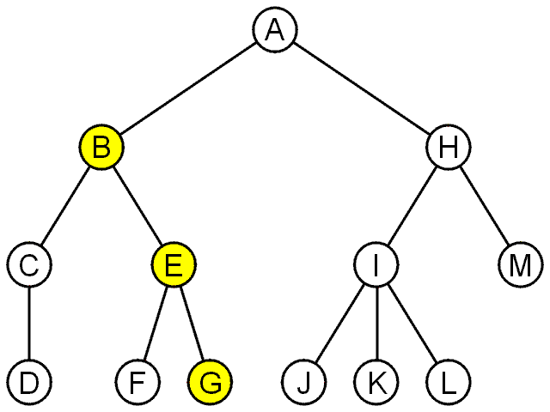
Terminology
4.1.1.3
A path is a sequence of nodes
(a₀, a₁, ..., a_{n})
where a_{k + 1} is a child of a_{k} is
The length of this path is n
E.g., the path (B, E, G) has length 2

Slide 12
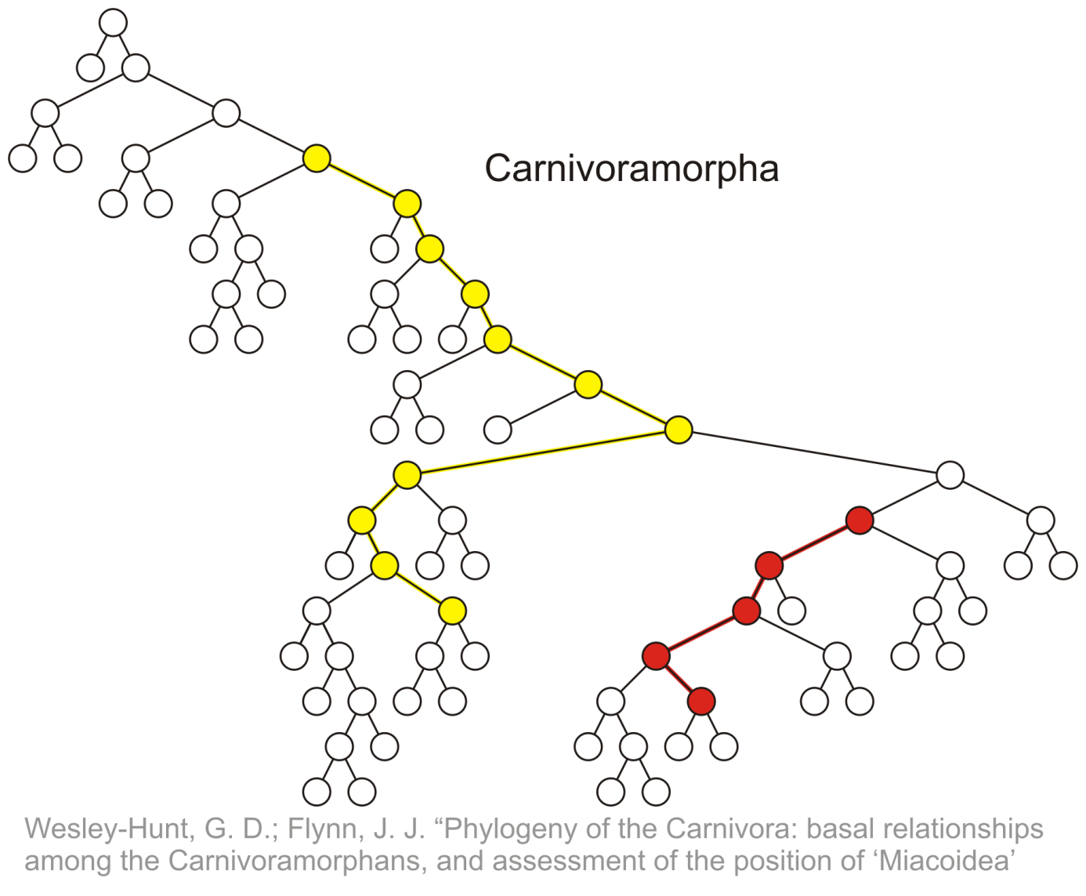
Terminology
4.1.1.3
Paths of length 10 (11 nodes) and 4 (5 nodes)
Start of these paths
End of these paths

Slide 13
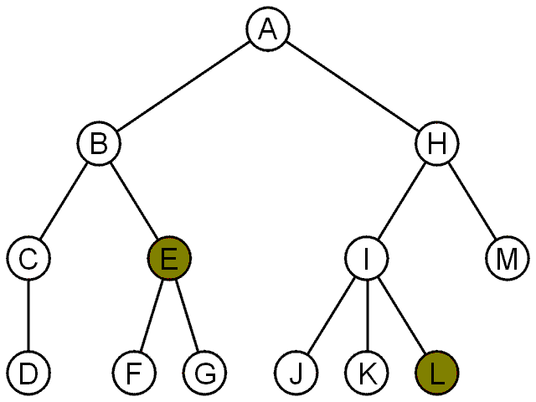
Terminology
4.1.1.3
For each node in a tree, there exists a unique path from the root node to that node
The length of this path is the depth of the node, e.g.,
E has depth 2
L has depth 3

Slide 14
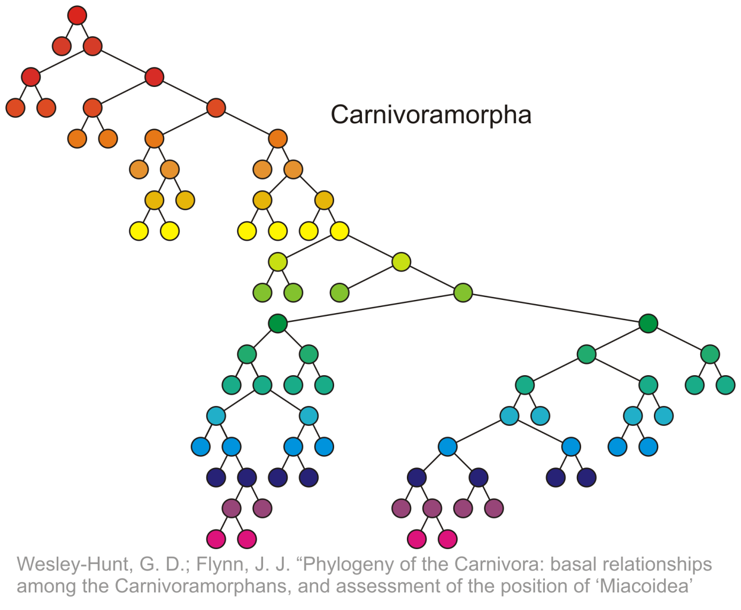
Terminology
4.1.1.3
Nodes of depth up to 17
0
4
9
14
17

Slide 15
Terminology
4.1.1.3
The height of a tree is defined as the maximum depth of any node within the tree
The height of a tree with one node is 0
Just the root node
For convenience, we define the height of the empty tree to be –1

Slide 16
Terminology
4.1.1.3
The height of this tree is 17
17

Slide 17
Terminology
4.1.1.4
If a path exists from node a to node b:
a is an ancestor of b
b is a descendent of a
Thus, a node is both an ancestor and a descendant of itself
We can add the adjective strict to exclude equality: a is a strict descendent of b if a is a descendant of b but a ≠ b
The root node is an ancestor of all nodes

Slide 18
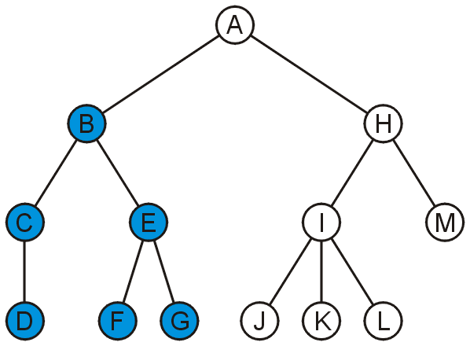
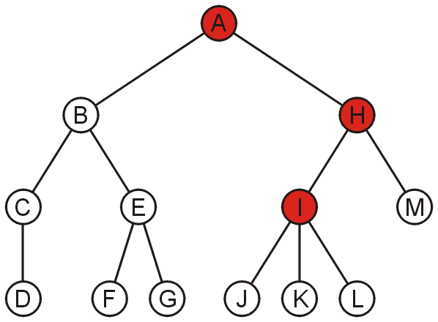
Terminology
4.1.1.4
The descendants of node B are B, C, D, E, F, and G:
The ancestors of node I are I, H, and A:

Slide 19
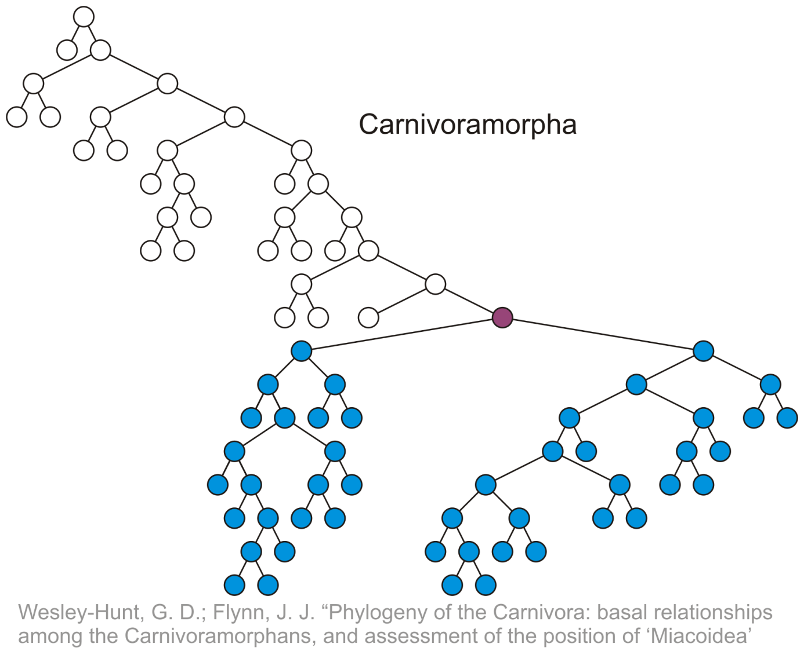
Terminology
4.1.1.4
All descendants (including itself) of the indicated node

Slide 20
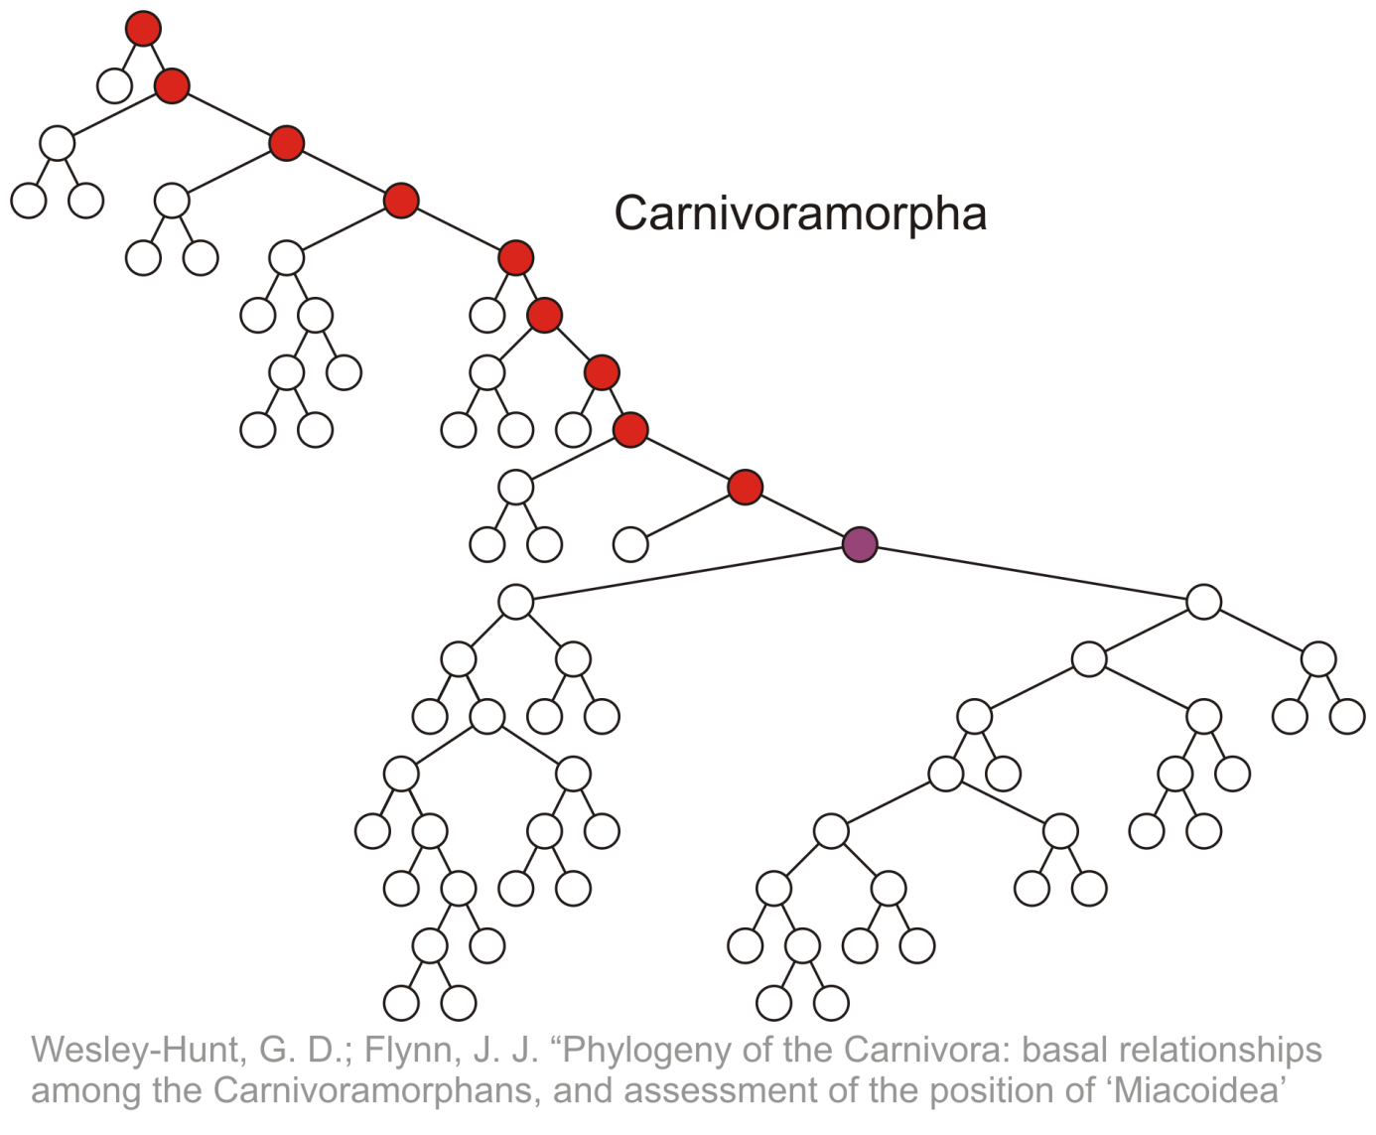
Terminology
4.1.1.4
All ancestors (including itself) of the indicated node

Slide 21
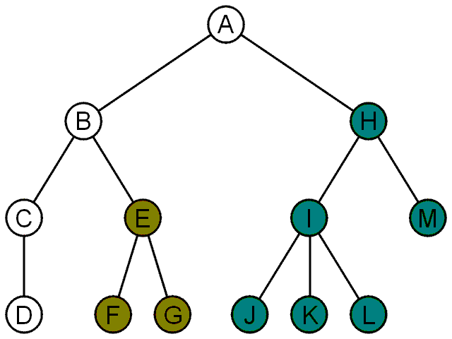
Terminology
4.1.2
Another approach to a tree is to define the tree recursively:
A degree-0 node is a tree
A node with degree n is a tree if it has n children and all of its children are disjoint trees (i.e., with no intersecting nodes)
Given any node a within a tree with root r, the collection of a and all of its descendants is said to be a subtree of the tree with root a

Slide 22
Example: XHTML and CSS
4.1.3
The XML of XHTML has a tree structure
Cascading Style Sheets (CSS) use the tree structure to modify the display of HTML

Slide 23
Example: XHTML and CSS
4.1.3
Consider the following XHTML document
<html>
<head>
<title>Hello World!</title>
</head>
<body>
<h1>This is a <u>Heading</u></h1>
<p>This is a paragraph with some
<u>underlined</u> text.</p>
</body>
</html>

Slide 24
Example: XHTML and CSS
4.1.3
Consider the following XHTML document
<html>
<head>
<title>Hello World!</title>
</head>
<body>
<h1>This is a <u>Heading</u></h1>
<p>This is a paragraph with some
<u>underlined</u> text.</p>
</body>
</html>
title
heading
body of page
underlining
paragraph

Slide 25
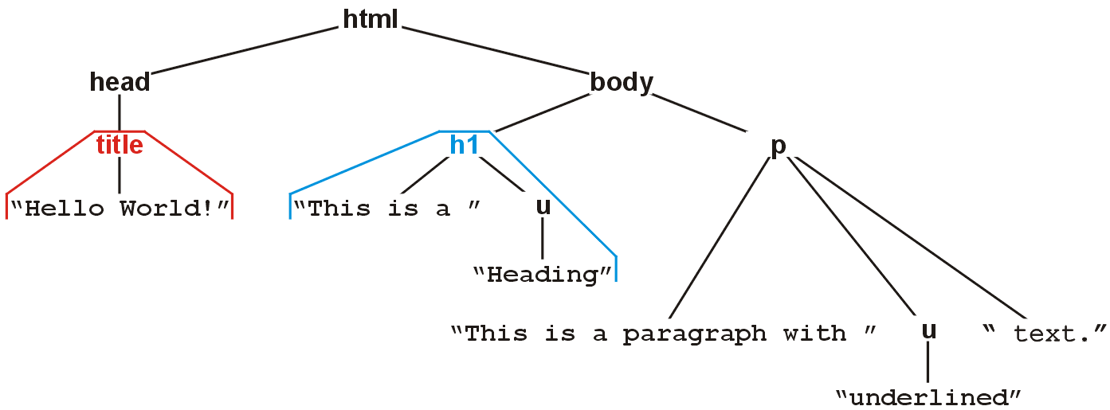
Example: XHTML and CSS
4.1.3
The nested tags define a tree rooted at the HTML tag
<html>
<head>
<title>Hello World!</title>
</head>
<body>
<h1>This is a <u>Heading</u></h1>
<p>This is a paragraph with some
<u>underlined</u> text.</p>
</body>
</html>

Slide 26
Example: XHTML and CSS
4.1.3
Web browsers render this tree as a web page

Slide 27
Example: XHTML and CSS
4.1.3
XML tags <tag>...</tag> must be nested
For example, to get the following effect:
1 2 3 4 5 6 7 8 9
you may use
<u>1 2 3 <b>4 5 6</b></u><b> 7 8 9</b>
You may not use:
<u>1 2 3 <b>4 5 6</u> 7 8 9</b>

Slide 28
Example: XHTML and CSS
4.1.3.1
Cascading Style Sheets (CSS) make use of this tree structure to describe how HTML should be displayed
For example:
<style type="text/css">
h1 { color:blue; }
</style>
indicates all text/decorations descendant from an h1 header should be blue

Slide 29
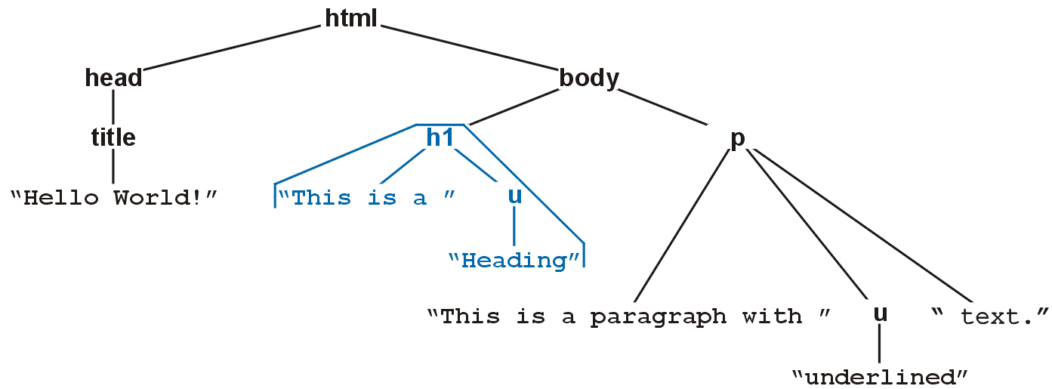
Example: XHTML and CSS
4.1.3.1
For example, this style renders as follows:
<style type="text/css">
h1 { color:blue; }
</style>

Slide 30
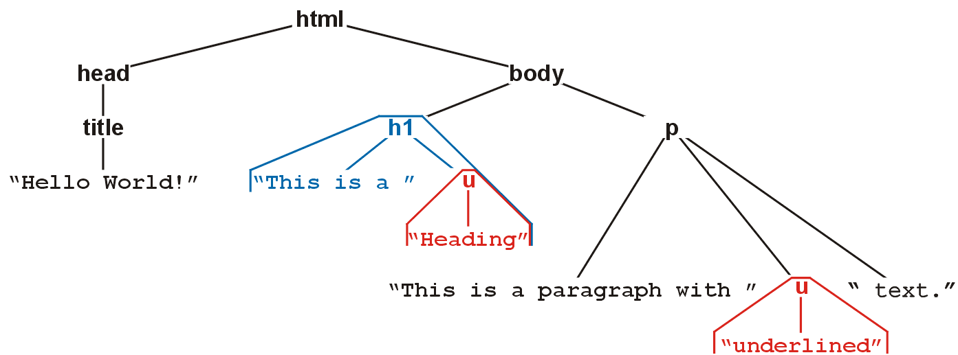
Example: XHTML and CSS
4.1.3.1
For example, this style renders as follows:
<style type="text/css">
h1 { color:blue; }
u { color:red; }
</style>

Slide 31
Example: XHTML and CSS
4.1.3.1
Suppose you don’t want underlined items in headers (h1) to be red
More specifically, suppose you want any underlined text within paragraphs to be red
That is, you only want text marked as <u>text</u> to be underlined if it is a descendant of a <p> tag

Slide 32
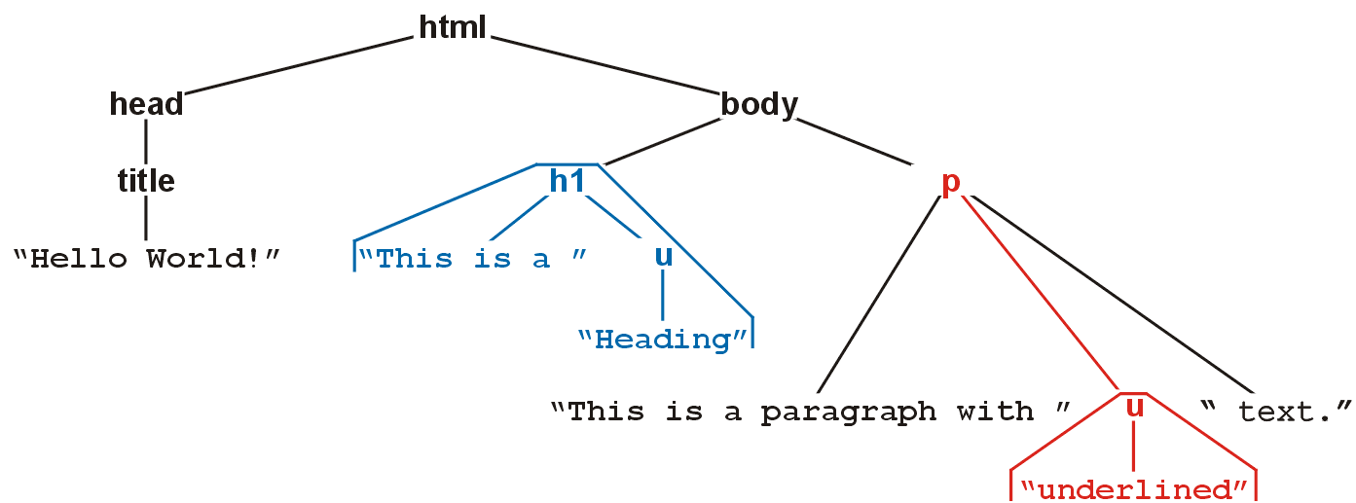
Example: XHTML and CSS
4.1.3.1
For example, this style renders as follows:
<style type="text/css">
h1 { color:blue; }
p u { color:red; }
</style>

Slide 33
Example: XHTML and CSS
4.1.3.1
You can read the second style
<style type="text/css">
h1 { color:blue; }
p u { color:red; }
</style>
as saying “text/decorations descendant from the underlining tag (<u>) which itself is a descendant of a paragraph tag should be coloured red”

Slide 34
Example: XML
4.1.3.1
In general, any XML can be represented as a tree
All XML tools make use of this feature
Parsers convert XML into an internal tree structure
XML transformation languages manipulate the tree structure
E.g., XMLT

Slide 35
Summary
In this topic, we have:
Introduced the terminology used for the tree data structure
Discussed various terms which may be used to describe the properties of a tree, including:
root node, leaf node
parent node, children, and siblings
ordered trees
paths, depth, and height
ancestors, descendants, and subtrees
We looked at XHTML and CSS

Slide 36
References
[1] Donald E. Knuth, The Art of Computer Programming, Volume 1: Fundamental Algorithms, 3rd Ed., Addison Wesley, 1997, §2.2.1, p.238.

Slide 37
Usage Notes
These slides are made publicly available on the web for anyone to use
If you choose to use them, or a part thereof, for a course at another institution, I ask only three things:
that you inform me that you are using the slides,
that you acknowledge my work, and
that you alert me of any mistakes which I made or changes which you make, and allow me the option of incorporating such changes (with an acknowledgment) in my set of slides
Sincerely,
Douglas Wilhelm Harder, MMath
dwharder@alumni.uwaterloo.ca

