Slide 1
Outline
This topic quickly looks at a generalization of a binary tree, where each node has up to N children
Definition
Perfect N-ary trees
Complete N-ary trees
Implementation using templates

Slide 2
N-ary Trees
5.4.1
One generalization of binary trees are a class of trees termed N-ary trees:
A tree where each node had N sub-trees, any of which may be empty trees

Slide 3
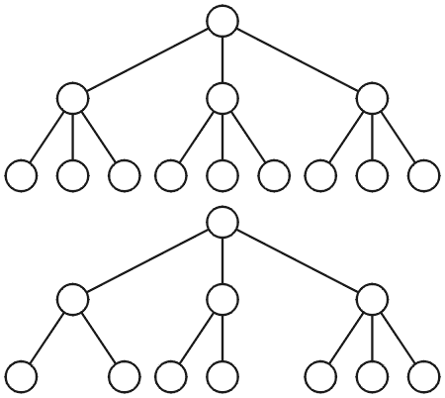
Ternary Trees
5.4.1
Examples of a ternary (3-ary) trees
We don’t usually indicate empty sub-trees

Slide 4
Quaternary Trees
5.4.1
Example of a perfect quaternary (4-ary) tree
Under certain conditions, the number of operations required may be slightly fewer with quaternary trees (e.g., with heaps)
The asymptotic behaviour is similar

Slide 5
Perfect N-ary Trees
5.4.2.1
Each node can have N children
The number of nodes in a perfect N-ary tree of height h is
1 + N + N² + N³ ⋅⋅⋅ + N^{h}
This is a geometric sum, and therefore, the number of nodes is

Slide 6
Perfect N-ary Trees
5.4.2.2
Solving this equation for h, a perfect N-ary tree with n nodes has a height given by

Slide 7
Perfect N-ary Trees
5.4.2.2
We note, however, that log_{N}(nN) – 1 = log_{N}(n), hence, we may postulate that log_{N}(n) should be an equally good approximation

Slide 8
N-ary Trees
5.4.2.3
Recall that the height for perfect binary tree is approximately lg(n)
Therefore, if the height of an N-ary tree is log_{N}(n), the ratio of the heights is:

Slide 9
N-ary Trees
5.4.2.3
Therefore:
The height of a perfect quaternary tree is approximately ½ the height of a perfect binary tree with approximately the same number of nodes
The height of a perfect 16-ary tree is approximately ¼ the height of a perfect binary tree with the same number of nodes

Slide 10
Complete N-ary Trees
5.4.2.4
A complete N-ary tree has height
Like complete binary trees, complete N-ary trees can also be stored efficiently using an array:
Assume the root is at index 0
The parent of a node with index k is at location
The children of a node with index k are at locations
kN + j
for j = 1, …, N

Slide 11
Implementation of N-ary Trees
5.4.3
The “obvious” implementation of N-ary trees may be something like:
# include <algorithm>
template <typename Type>
class Nary_tree {
private:
Type element;
int N;
Nary_tree **children;
public:
Nary_tree( Type const &, int = 2 );
// ...
};
template <typename Type>
Nary_tree<Type>::Nary_tree( Type const &e, int n ):
element( e ),
N( std::max( 2, n ) ),
children( new *Nary_tree[N] ) {
for ( int i = 0; i < N; ++i ) {
children[i] = nullptr;
}
}

Slide 12
Implementation of N-ary Trees
5.4.3
Problems with this implementation:
Requires dynamic memory allocation
A destructor is required to delete the memory
No optimizations possible
Dynamic memory allocation may not always be available (embedded systems)
Solution?
Specify N at compile time...

Slide 13
N-ary Trees with Template Parameters
5.4.3
#include <algorithm>
template <typename Type, int N>
class Nary_tree {
private:
Type element;
Nary_tree *children[std::max(N, 2)]; // an array of N children
public:
Nary_tree( Type const & = Type() )
// ...
};
template <typename Type, int N>
Nary_tree<Type, N>::Nary_tree( Type const &e ):element( e ) {
for ( int i = 0; i < N; ++i ) {
children[i] = nullptr;
}
}

Slide 14
N-ary Trees with Template Parameters
5.4.3
Sample code using this class:
Nary_tree<int, 4> i4tree( 1975 ); // create a 4-way tree
std::cout << i4tree.retrieve() << std::endl;

Slide 15
N-ary Trees
5.4.3
Because the size of the array (the 2nd template parameter) is specified at compile time:
The compiler can make certain optimizations
All memory is allocated at once
Possibly even on the stack at compile time
No destructor required

Slide 16
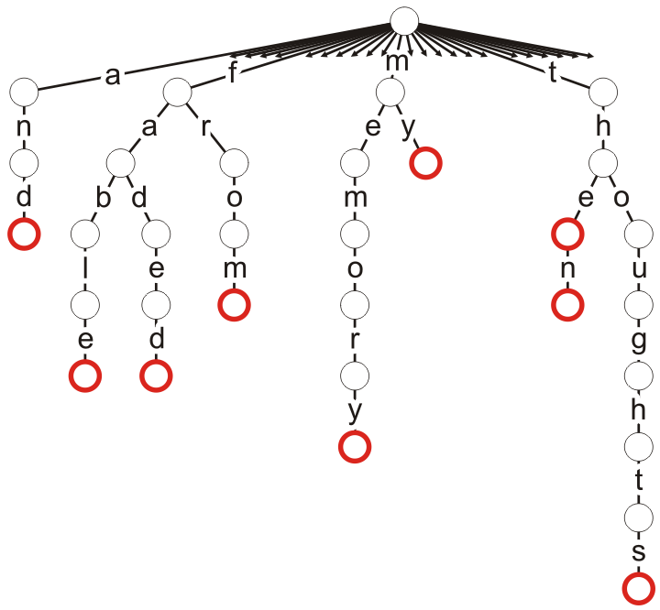
Applications
5.4.4
One application of a 26-ary trees is a trie where the root represents the start of each valid word, and the different sub-trees represent next letters in valid words
Consider the words in the phrase
“The fable then faded from my thoughts and memory.”
All 26 sub-trees are only shown for the root node, but all nodes have 26 sub-trees
Some nodes are marked as terminal indicating the end of a valid word
These terminal points could be used to store a list of all places in a document where the word occurs
Consider the ultimate index to a book

Slide 17
Summary
An N-ary tree is similar to a binary tree, however, each node can have up to N children
A binary tree has a height approximately log₂(N) times the height of an N-ary tree containing the same number of nodes

Slide 18
Reference
[1] Cormen, Leiserson, and Rivest, Introduction to Algorithms, McGraw Hill, 1990, §5.5.3, p.94-96.

Slide 19
Usage Notes
These slides are made publicly available on the web for anyone to use
If you choose to use them, or a part thereof, for a course at another institution, I ask only three things:
that you inform me that you are using the slides,
that you acknowledge my work, and
that you alert me of any mistakes which I made or changes which you make, and allow me the option of incorporating such changes (with an acknowledgment) in my set of slides
Sincerely,
Douglas Wilhelm Harder, MMath
dwharder@alumni.uwaterloo.ca

