Slide 1

Outline
This topic covers binary search trees:
  Abstract Sorted Lists
  Background
  Definition and examples
  Implementation:
    Front, back, insert, erase
    Previous smaller and next larger objects
    Finding the k^{th} object

Slide 2
Abstract Sorted Lists
6.1.1
Previously, we discussed Abstract Lists: the objects are explicitly linearly ordered by the programmer
We will now discuss the Abstract Sorted List:
  The relation is based on an implicit linear ordering
Certain operations no longer make sense:
  push_front and push_back are replaced by a generic insert

Slide 3
Abstract Sorted Lists
6.1.1
Queries that may be made about data stored in a Sorted List ADT include:
  Finding the smallest and largest entries
  Finding the k^{th} largest entry
  Find the next larger and previous smaller objects of a given object which may or may not be in the container
  Iterate through those objects that fall on an interval [a, b]

Slide 4
Implementation
6.1.1
If we implement an Abstract Sorted List using an array or a linked list, we will have operations which are O(n)
  As an insertion could occur anywhere in a linked list or array, we must either traverse or copy, on average, O(n) objects

Slide 5
Background
6.1.2
Recall that with a binary tree, we can dictate an order on the two children
We will exploit this order:
  Require all objects in the left sub-tree to be less than the object stored in the root node, and
  Require all objects in the right sub-tree to be greater than the object in the root object

Slide 6
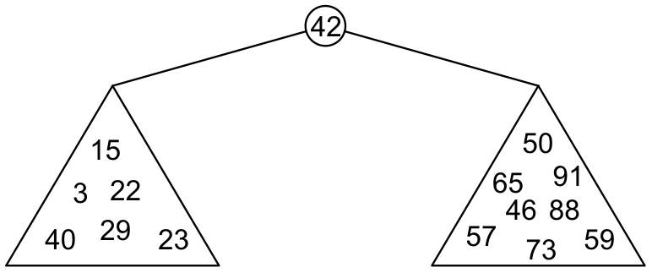
Binary Search Trees
6.1.2
Graphically, we may have the following relationship
  Each of the two sub-trees will themselves be binary search trees

Slide 7
Binary Search Trees
6.1.2
Notice that we can already use this structure for searching: examine the root node and if we have not found what we are looking for:
  If the object is less than what is stored in the root node, continue searching in the left sub-tree
  Otherwise, continue searching the right sub-tree
With a linear order, one of the following three must be true:
a < b a = b a > b

Slide 8
Definition
6.1.2
Thus, we define a non-empty binary search tree as a binary tree with the following properties:
  The left sub-tree (if any) is a binary search tree and all elements are less than the root element, and
  The right sub-tree (if any) is a binary search tree and all elements are greater than the root element

Slide 9
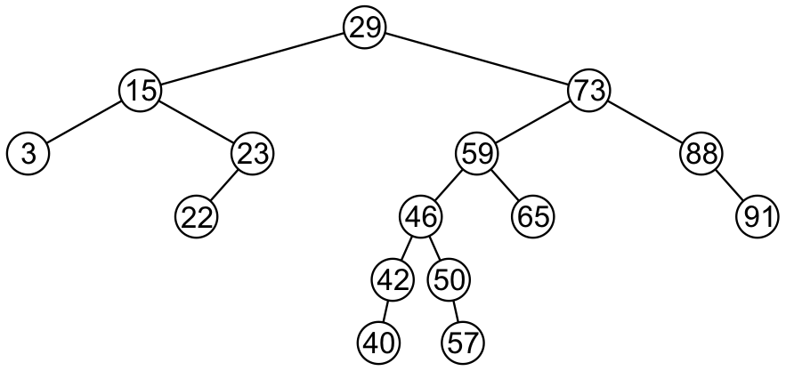
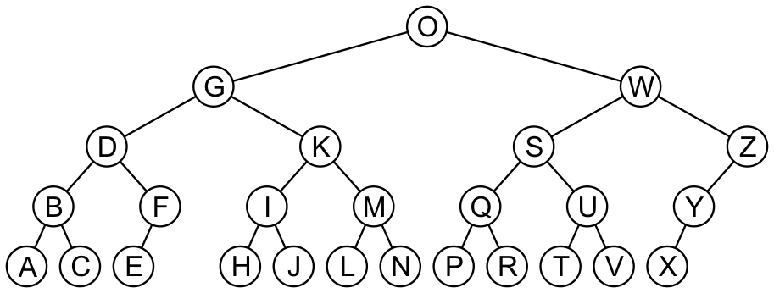
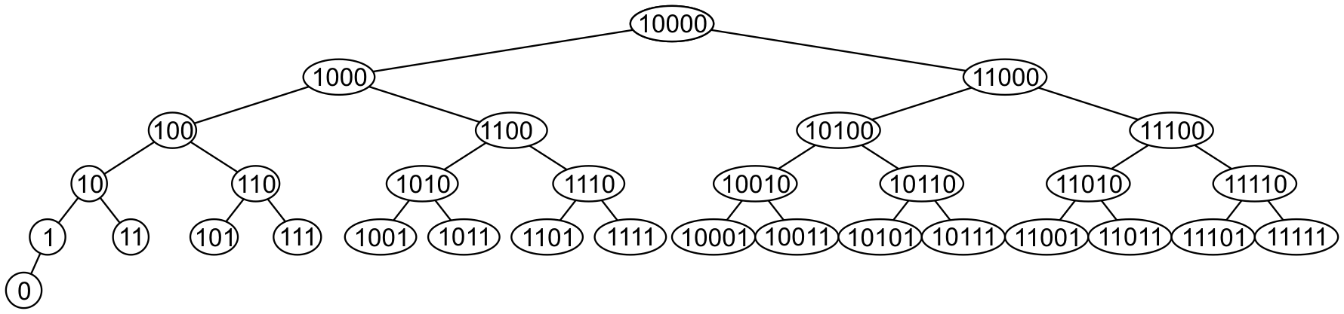
Examples
6.1.2
Here are other examples of binary search trees:

Slide 10
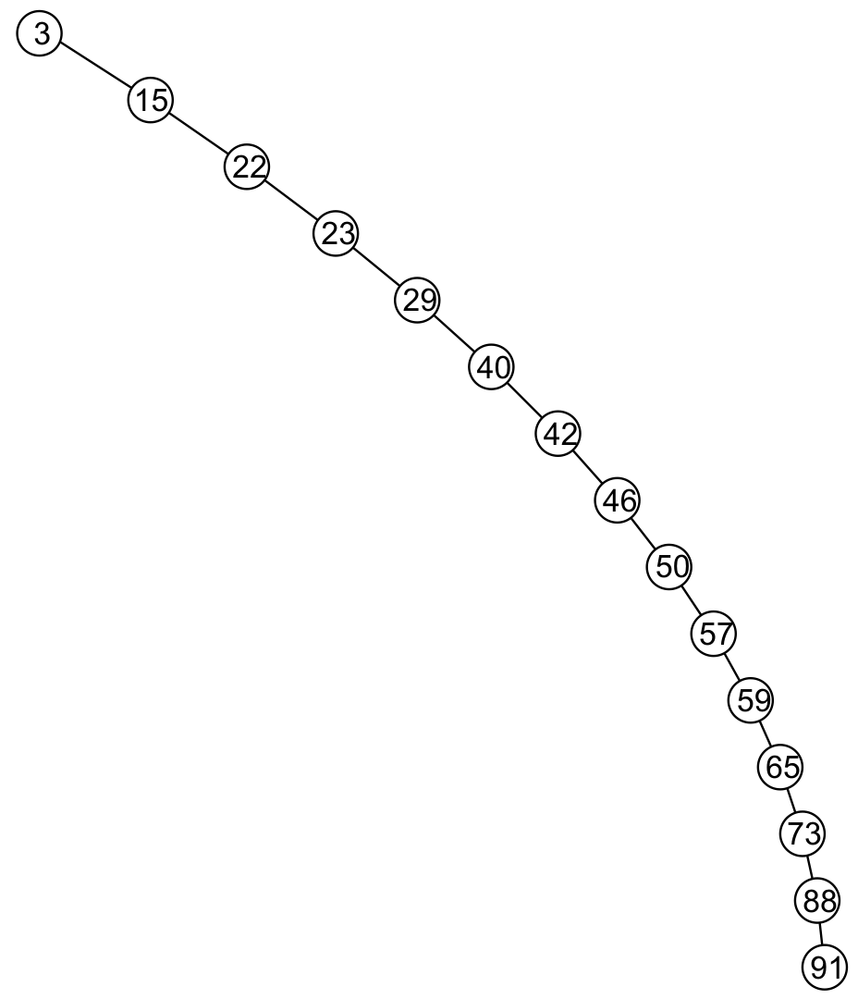
Examples
6.1.2
Unfortunately, it is possible to construct degenerate binary search trees
  This is equivalent to a linked list, i.e., O(n)

Slide 11
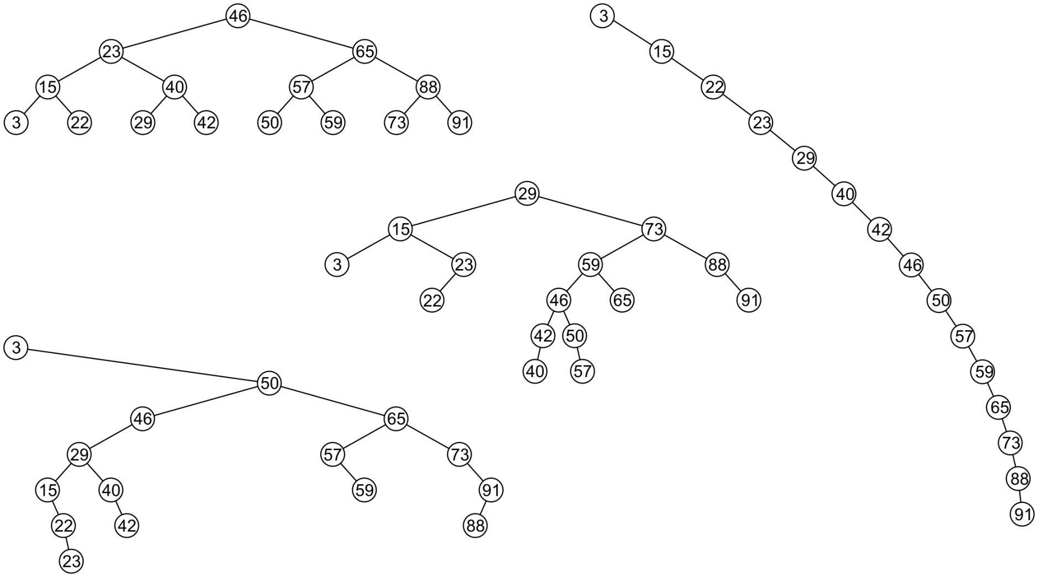
Examples
6.1.2
All these binary search trees store the same data

Slide 12
Duplicate Elements
6.1.3
We will assume that in any binary tree, we are not storing duplicate elements unless otherwise stated
  In reality, it is seldom the case where duplicate elements in a container must be stored as separate entities
You can always consider duplicate elements with modifications to the algorithms we will cover

Slide 13
Implementation
6.1.4
We will look at an implementation of a binary search tree in the same spirit as we did with our Single_list class
  We will have a Binary_search_nodes class
  A Binary_search_tree class will store a pointer to the root
We will use templates, however, we will require that the class overrides the comparison operators

Slide 14
Implementation
6.1.4
Any class which uses this binary-search-tree class must therefore implement:
bool operator<=( Type const &, Type const & );
bool operator< ( Type const &, Type const & );
bool operator==( Type const &, Type const & );
That is, we are allowed to compare two instances of this class
  Examples: int and double

Slide 15
Implementation
6.1.4
#include "Binary_node.h"
template <typename Type>
class Binary_search_tree;
template <typename Type>
class Binary_search_node:public Binary_node<Type> {
using Binary_node<Type>::element;
using Binary_node<Type>::left_tree;
using Binary_node<Type>::right_tree;
public:
Binary_search_node( Type const & );
Binary_search_node *left() const;
Binary_search_node *right() const;

Slide 16
Implementation
6.1.4
Type front() const;
Type back() const;
bool find( Type const & ) const;
void clear();
bool insert( Type const & );
bool erase( Type const &, Binary_search_node *& );
friend class Binary_search_tree<Type>;
};

Slide 17
Constructor
6.1.4
The constructor simply calls the constructor of the base class
  Recall that it sets both left_tree and right_tree to nullptr
  It assumes that this is a new leaf node
template <typename Type>
Binary_search_node<Type>::Binary_search_node( Type const &obj ):
Binary_node<Type>( obj ) {
// Just calls the constructor of the base class
}

Slide 18
Standard Accessors
6.1.4
Because it is a derived class, it already inherits the function:
Type retrieve() const;
Because the base class returns a pointer to a Binary_node, we
must recast them as Binary_search_node:
template <typename Type>
Binary_search_node<Type> *Binary_search_node<Type>::left() const {
return reinterpret_cast<Binary_search_node *>( Binary_node<Type>::left() );
}
template <typename Type>
Binary_search_node<Type> *Binary_search_node<Type>::right() const {
return reinterpret_cast<Binary_search_node *>( Binary_node<Type>::right() );
}

Slide 19
Inherited Member Functions
6.1.4
The member functions
  bool empty() const
  bool is_leaf() const
  int size() const
  int height() const
are inherited from the bas class Binary_node

Slide 20
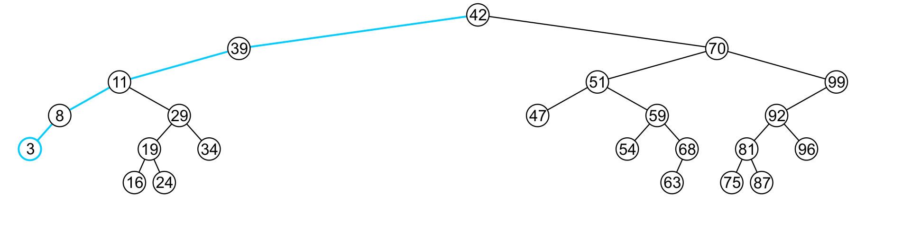
Finding the Minimum Object
6.1.4.1
template <typename Type>
Type Binary_search_node<Type>::front() const {
if ( empty() ) {
throw underflow();
}
return ( left()->empty() ) ? retrieve() : left()->front();
}
  The run time O(h)

Slide 21
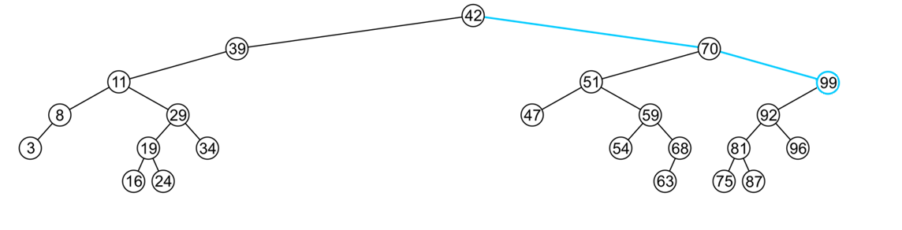
Finding the Maximum Object
6.1.4.2
template <typename Type>
Type Binary_search_node<Type>::back() const {
if ( empty() ) {
throw underflow();
}
return ( right()->empty() ) ? retrieve() : right()->back();
}
  The extreme values are not necessarily leaf nodes
Notes:
21

Slide 22
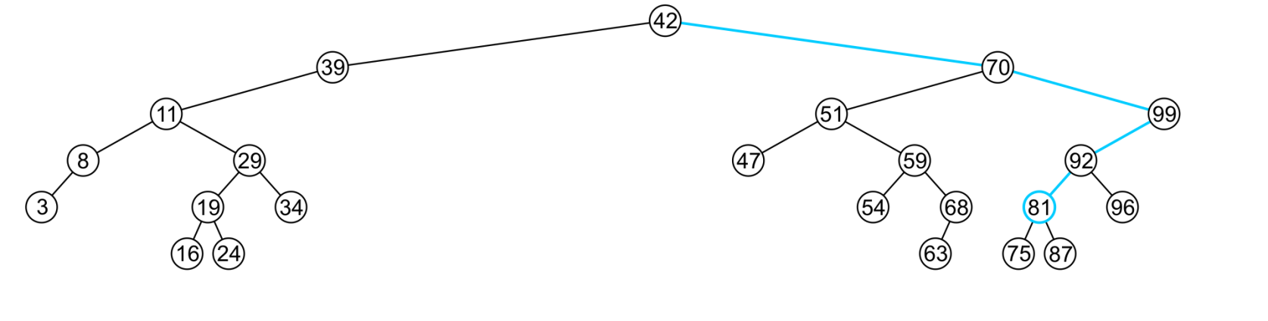
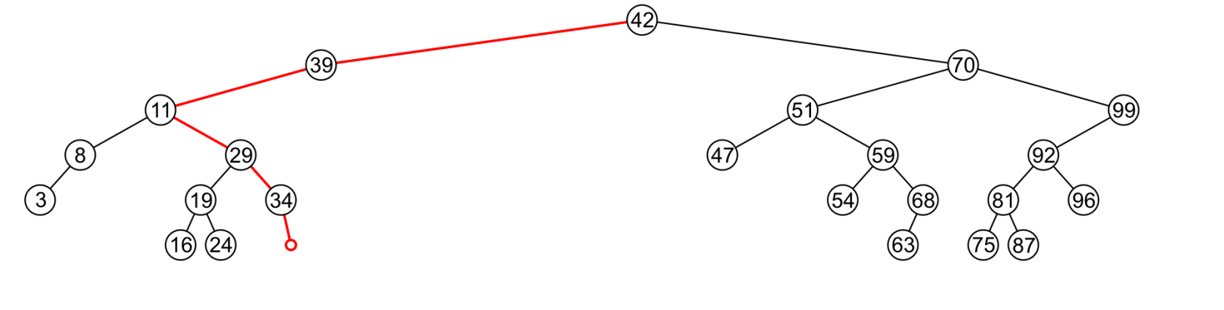
Find
6.1.4.3
To determine membership, traverse the tree based on the linear relationship:
  If a node containing the value is found, e.g., 81, return 1
  If an empty node is reached, e.g., 36, the object is not in the tree:

Slide 23
Find
6.1.4.3
The implementation is similar to front and back:
template <typename Type>
bool Binary_search_node<Type>::find( Type const &obj ) const {
if ( empty() ) {
return false;
} else if ( retrieve() == obj ) {
return true;
}
return ( obj < retrieve() ) ?
left()->find( obj ) : right()->find( obj );
}
  The run time is O(h)
Notes:
23

Slide 24
Insert
6.1.4.4
Recall that a Sorted List is implicitly ordered
  It does not make sense to have member functions such as push_front and push_back
  Insertion will be performed by a single insert member function which places the object into the correct location

Slide 25
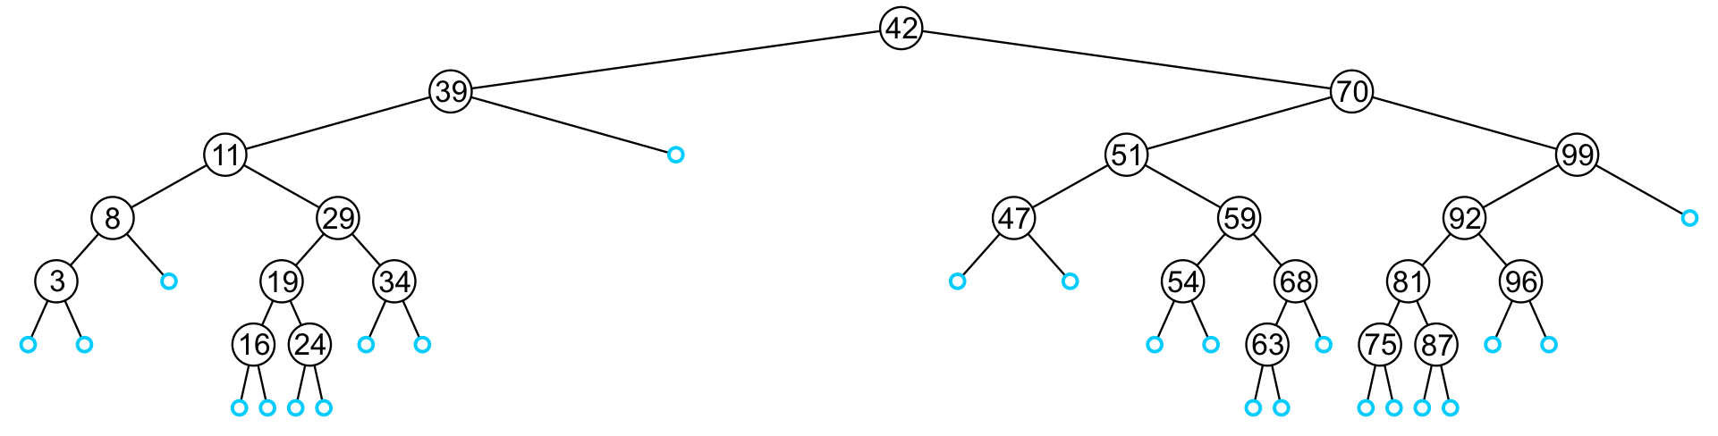
Insert
6.1.4.4
An insertion will be performed at a leaf node:
  Any empty node is a possible location for an insertion
The values which may be inserted at any empty node depend on the surrounding nodes

Slide 26
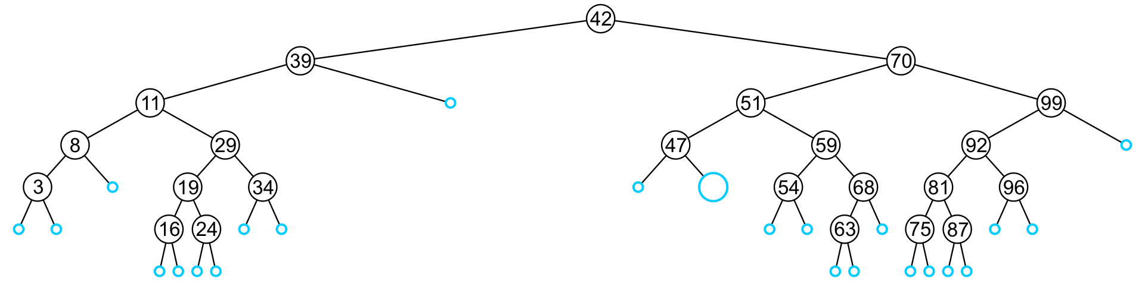
Insert
6.1.4.4
For example, this node may hold 48, 49, or 50

Slide 27
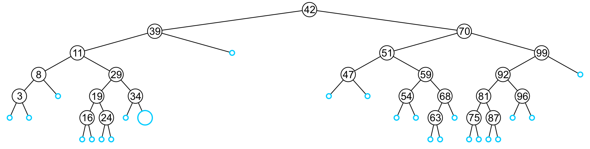
Insert
6.1.4.4
An insertion at this location must be 35, 36, 37, or 38

Slide 28
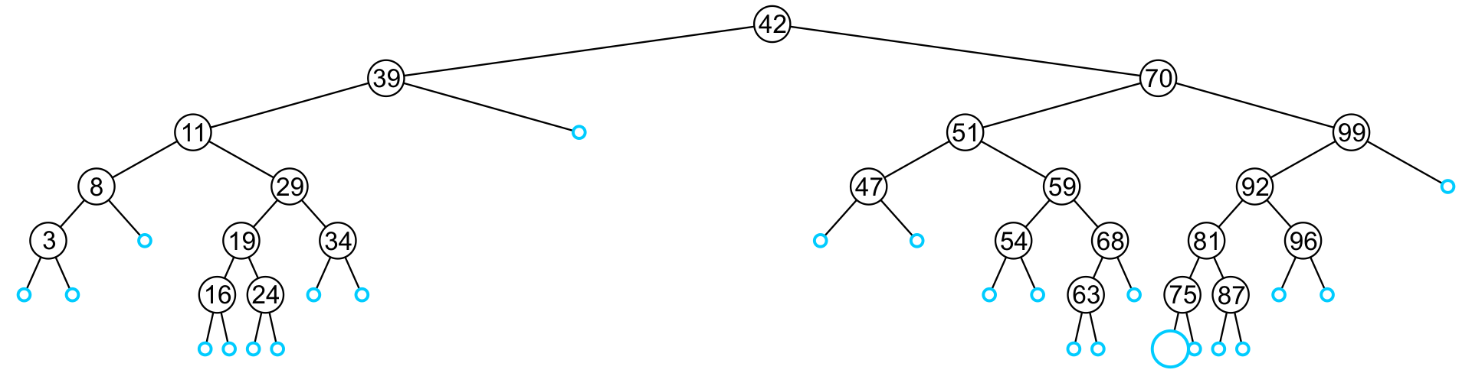
Insert
6.1.4.4
This empty node may hold values from 71 to 74

Slide 29
Insert
6.1.4.4
Like find, we will step through the tree
  If we find the object already in the tree, we will return
    The object is already in the binary search tree (no duplicates)
  Otherwise, we will arrive at an empty node
  The object will be inserted into that location
  The run time is O(h)

Slide 30
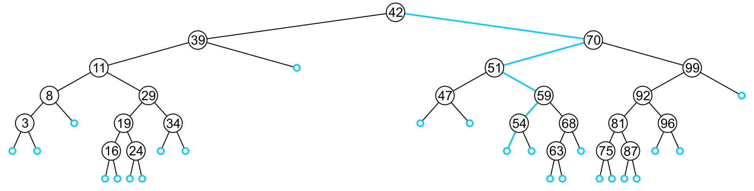
Insert
6.1.4.4
In inserting the value 52, we traverse the tree until we reach an empty node
  The left sub-tree of 54 is an empty node

Slide 31
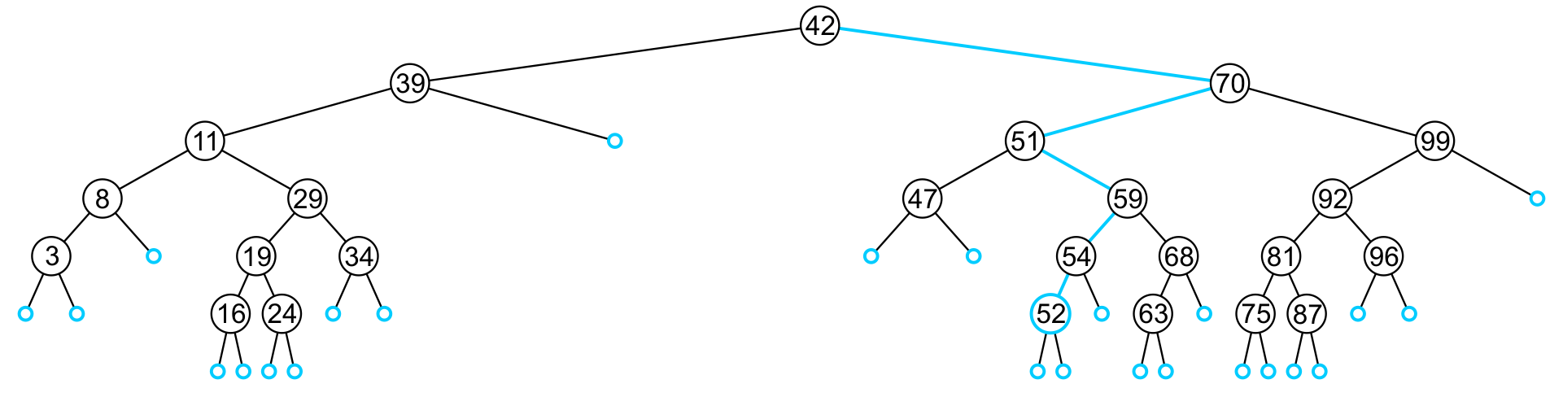
Insert
6.1.4.4
A new leaf node is created and assigned to the member variable left_tree

Slide 32
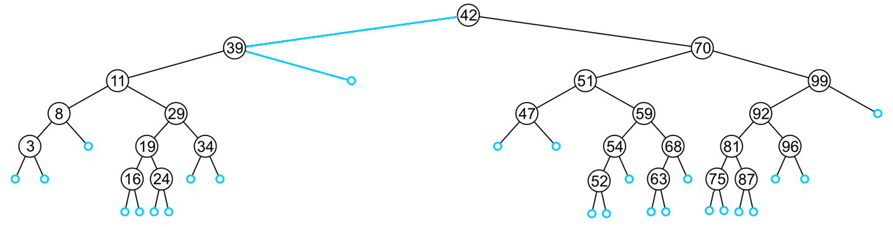
Insert
6.1.4.4
In inserting 40, we determine the right sub-tree of 39 is an empty node

Slide 33
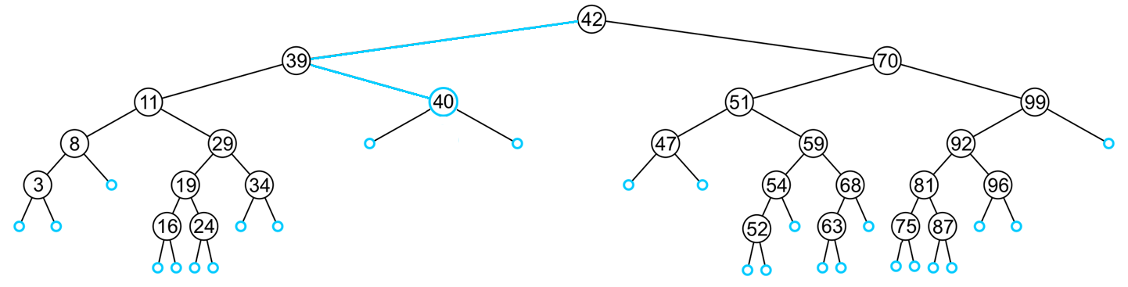
Insert
6.1.4.4
A new leaf node storing 40 is created and assigned to the member variable right_tree

Slide 34
Insert
6.1.4.4
Exercise:
  In the given order, insert these objects into an initially empty binary search tree:
  31 45 36 14 52 42 6 21 73 47 26 37 33 8
  What values could be placed:
    To the left of 21?
    To the right of 26?
    To the left of 47?
  How would we determine if 40 is in this binary search tree?
  Which values could be inserted to increase the height of the tree?

Slide 35
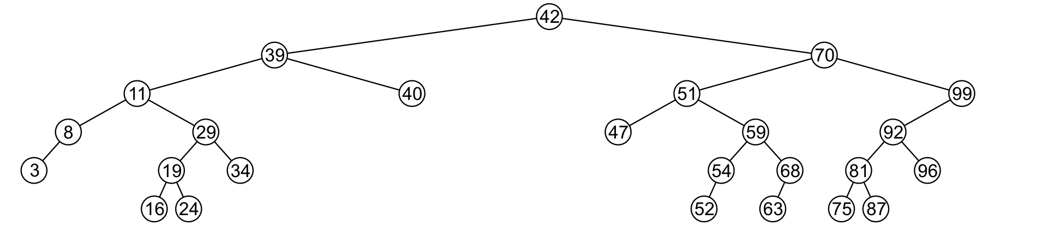
Erase
6.1.4.5
A node being erased is not always going to be a leaf node
There are three possible scenarios:
  The node is a leaf node,
  It has exactly one child, or
  It has two children (it is a full node)

Slide 36
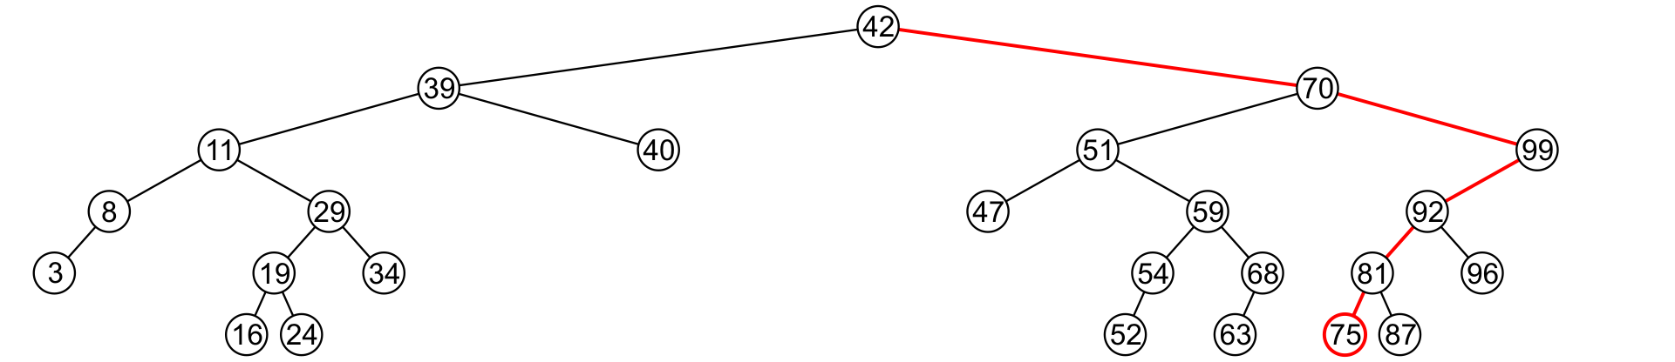
Erase
6.1.4.5
A leaf node simply must be removed and the appropriate member variable of the parent is set to nullptr
  Consider removing 75

Slide 37
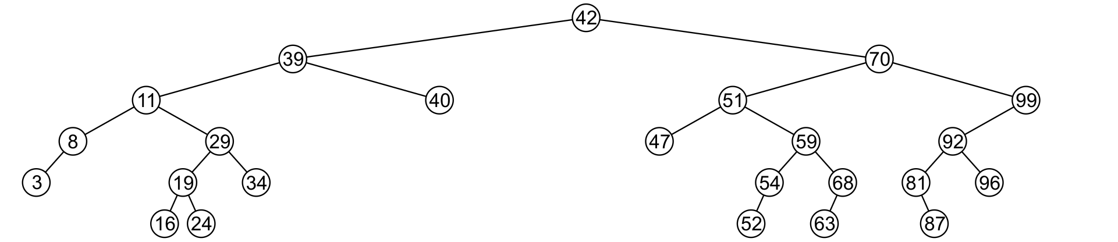
Erase
6.1.4.5
The node is deleted and left_tree of 81 is set to nullptr

Slide 38
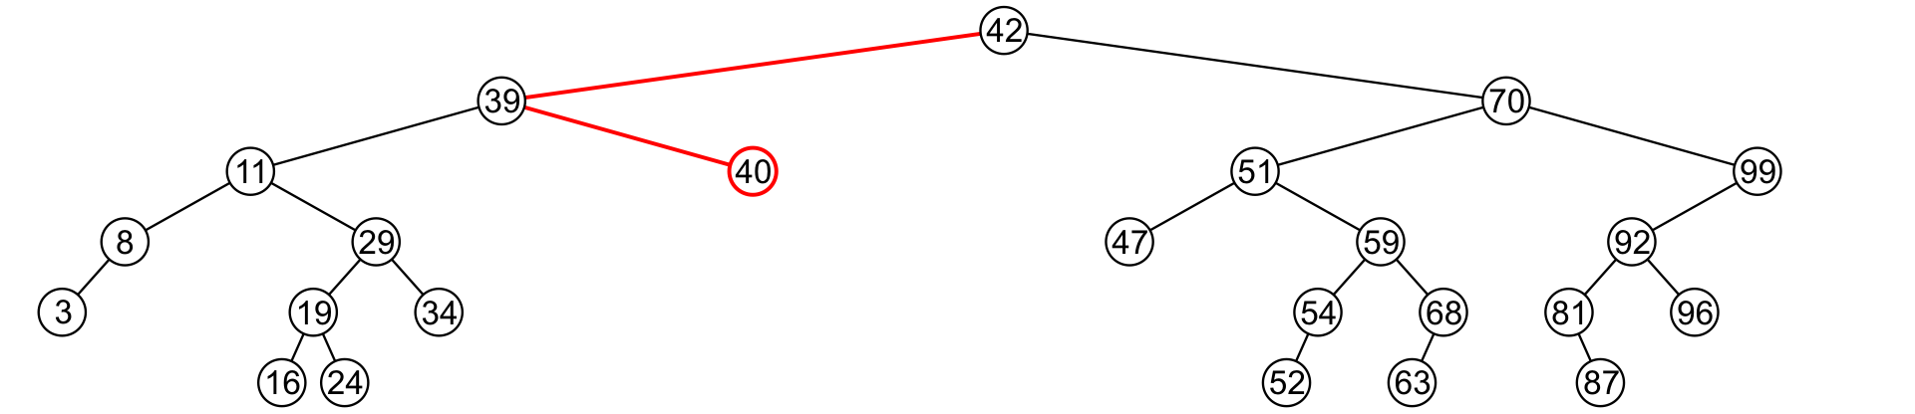
Erase
6.1.4.5
Erasing the node containing 40 is similar

Slide 39
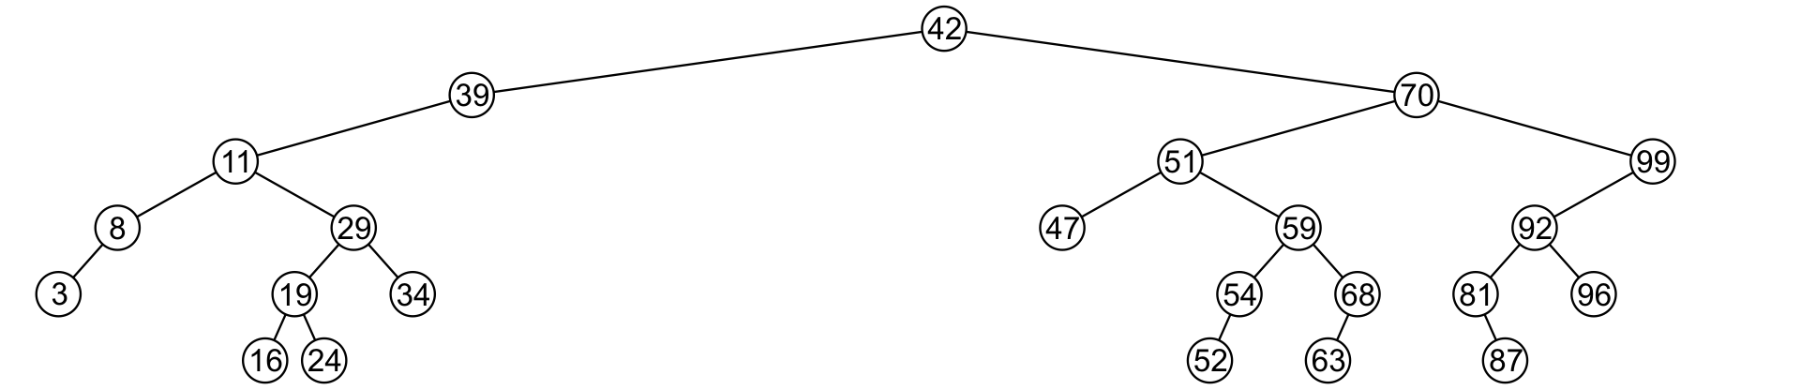
Erase
6.1.4.5
The node is deleted and right_tree of 39 is set to nullptr

Slide 40
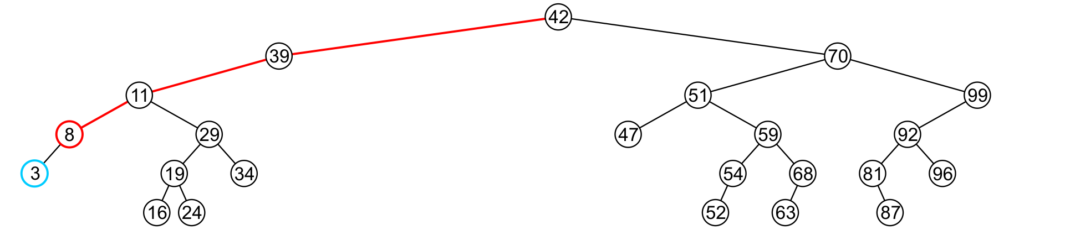
Erase
6.1.4.5
If a node has only one child, we can simply promote the sub-tree associated with the child
  Consider removing 8 which has one left child

Slide 41
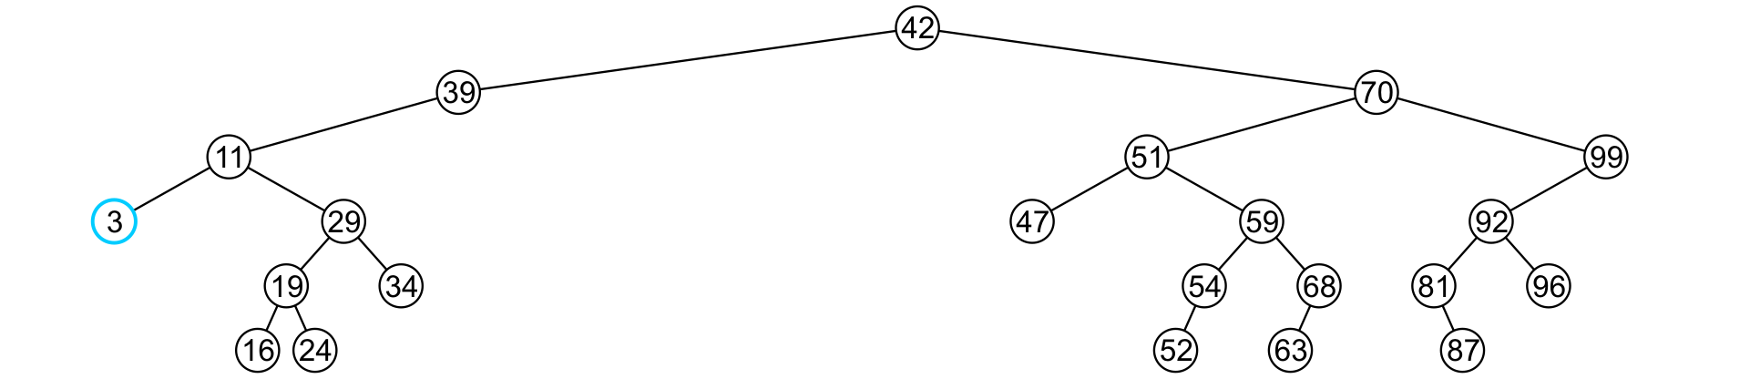
Erase
6.1.4.5
The node 8 is deleted and the left_tree of 11
is updated to point to 3

Slide 42
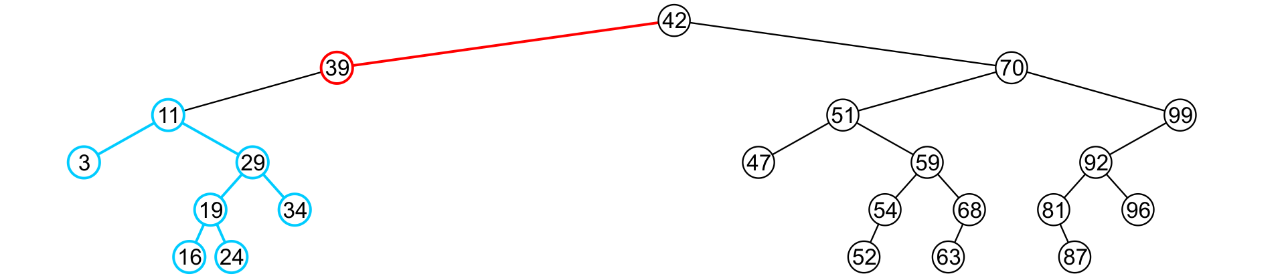
Erase
6.1.4.5
There is no difference in promoting a single node or a sub-tree
  To remove 39, it has a single child 11

Slide 43
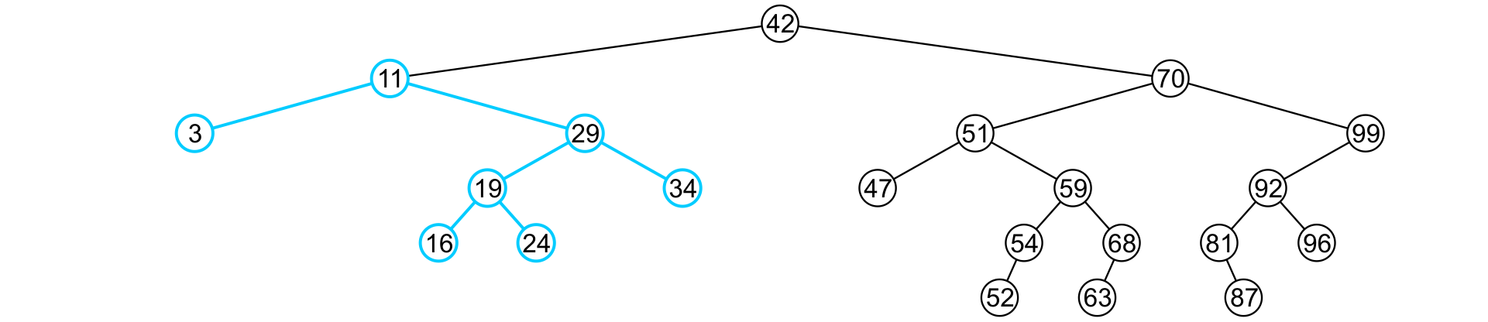
Erase
6.1.4.5
The node containing 39 is deleted and left_node of 42 is updated to point to 11
  Notice that order is still maintained

Slide 44
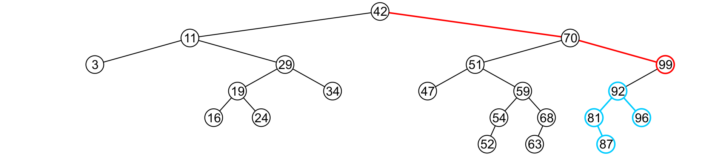
Erase
6.1.4.5
Consider erasing the node containing 99

Slide 45
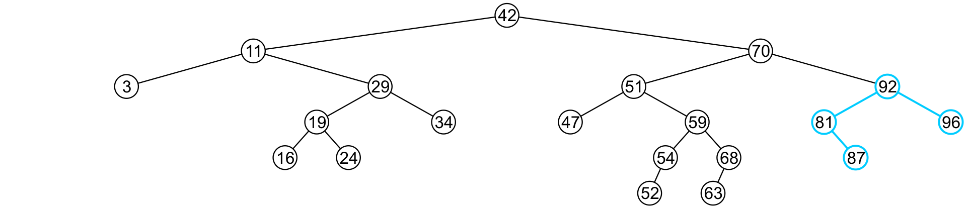
Erase
6.1.4.5
The node is deleted and the left sub-tree is promoted:
  The member variable right_tree of 70 is set to point to 92
  Again, the order of the tree is maintained

Slide 46
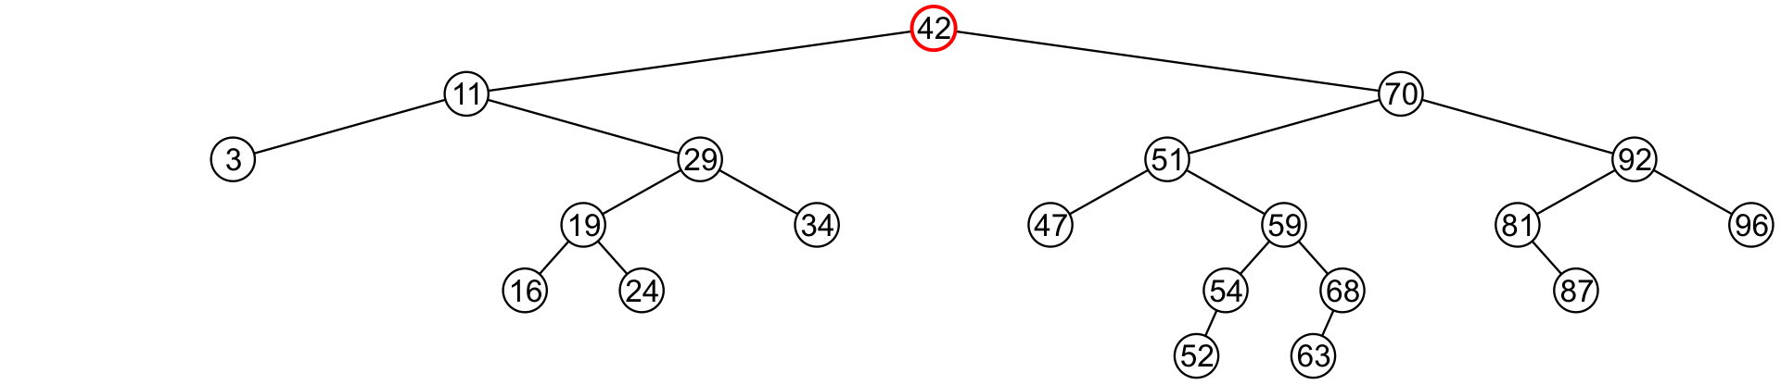
Erase
6.1.4.5
Finally, we will consider the problem of erasing a full node, e.g., 42
We will perform two operations:
  Replace 42 with the minimum object in the right sub-tree
  Erase that object from the right sub-tree

Slide 47
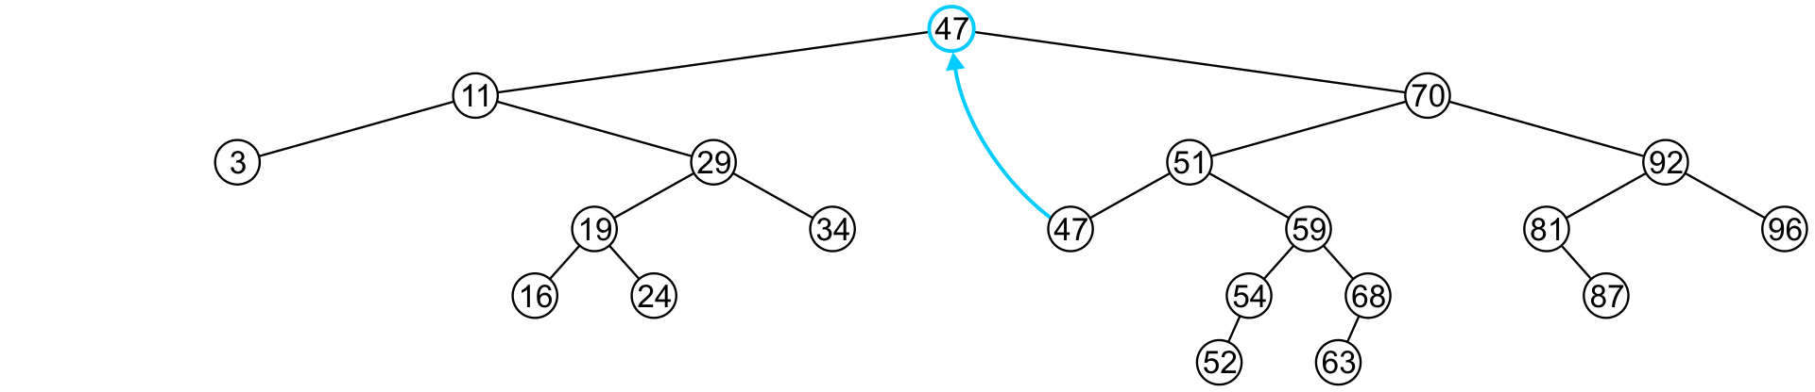
Erase
6.1.4.5
In this case, we replace 42 with 47
  We temporarily have two copies of 47 in the tree

Slide 48
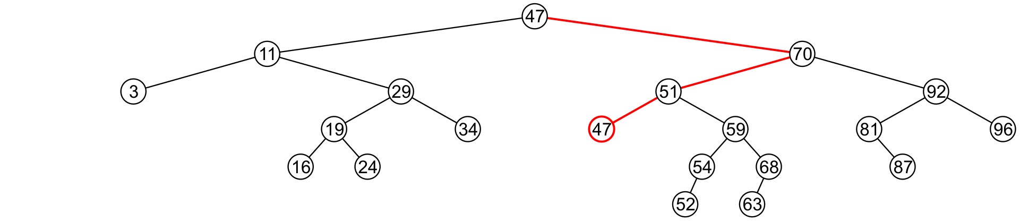
Erase
6.1.4.5
We now recursively erase 47 from the right sub-tree
  We note that 47 is a leaf node in the right sub-tree

Slide 49
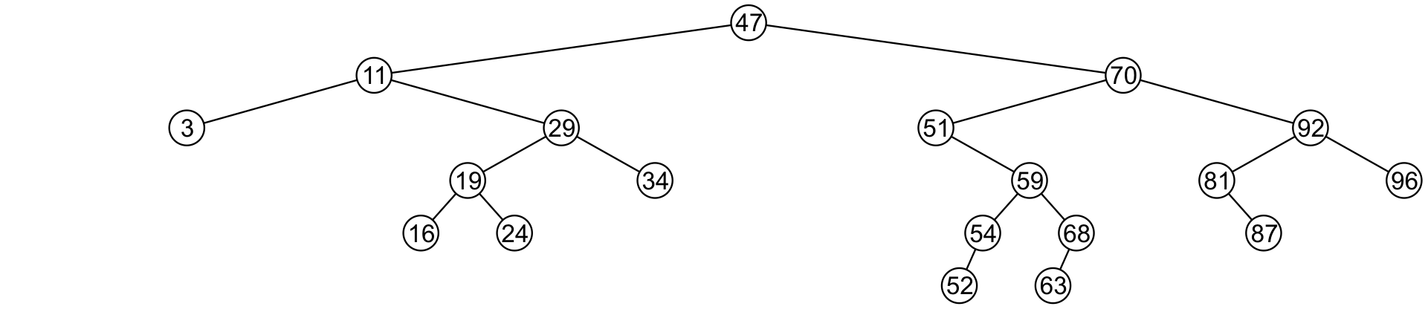
Erase
6.1.4.5
Leaf nodes are simply removed and left_tree of 51 is set to nullptr
  Notice that the tree is still sorted:
  47 was the least object in the right sub-tree

Slide 50
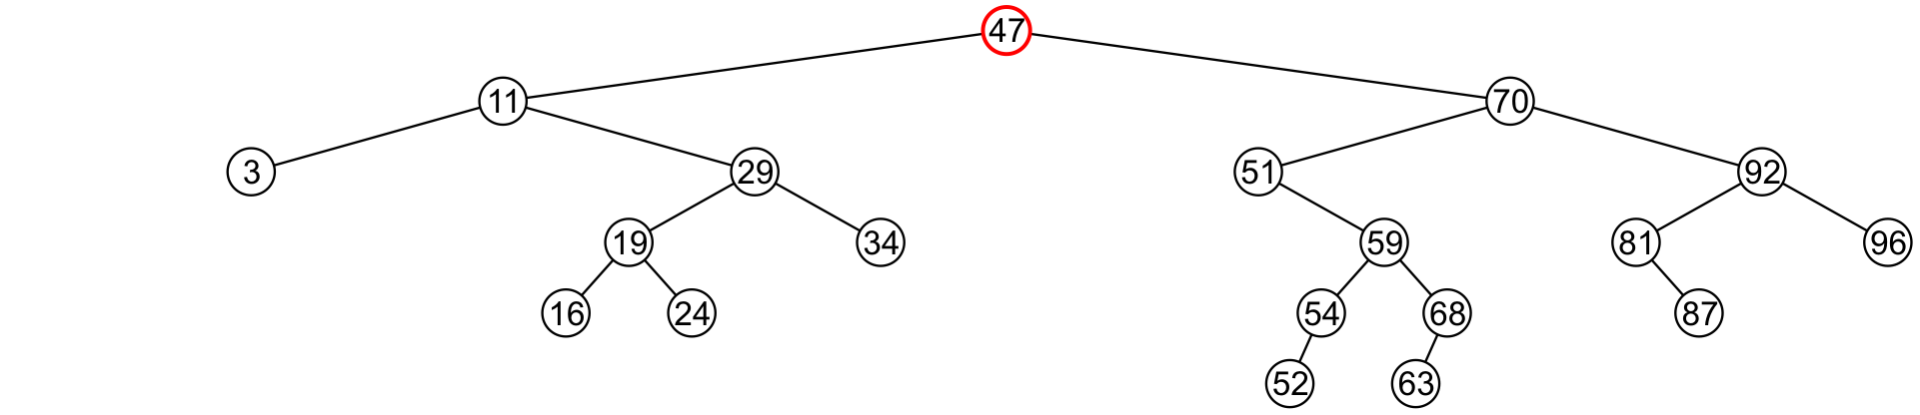
Erase
6.1.4.5
Suppose we want to erase the root 47 again:
  We must copy the minimum of the right sub-tree
  We could promote the maximum object in the left sub-tree and achieve similar results

Slide 51
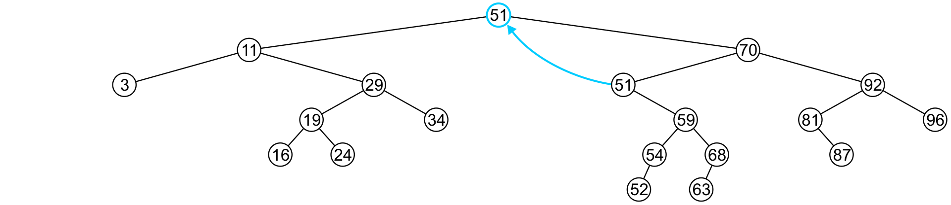
Erase
6.1.4.5
We copy 51 from the right sub-tree

Slide 52
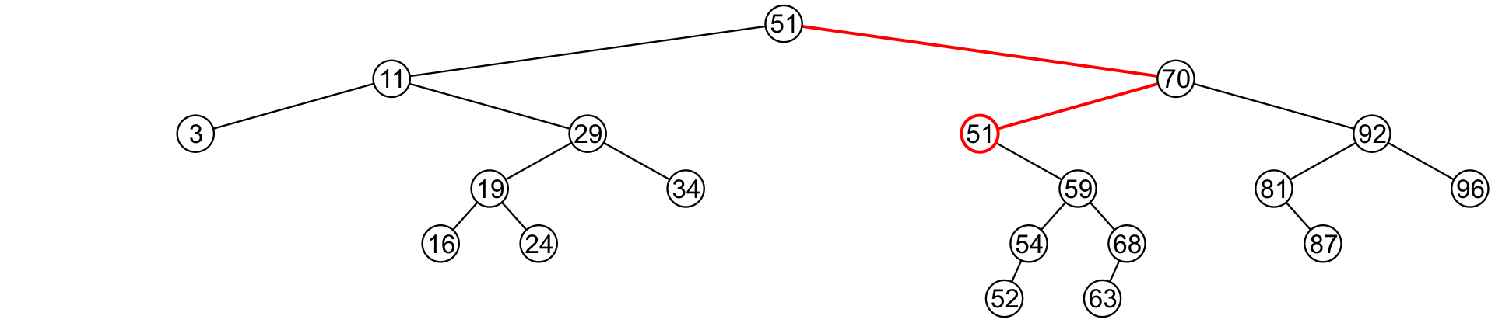
Erase
6.1.4.5
We must proceed by delete 51 from the right sub-tree

Slide 53
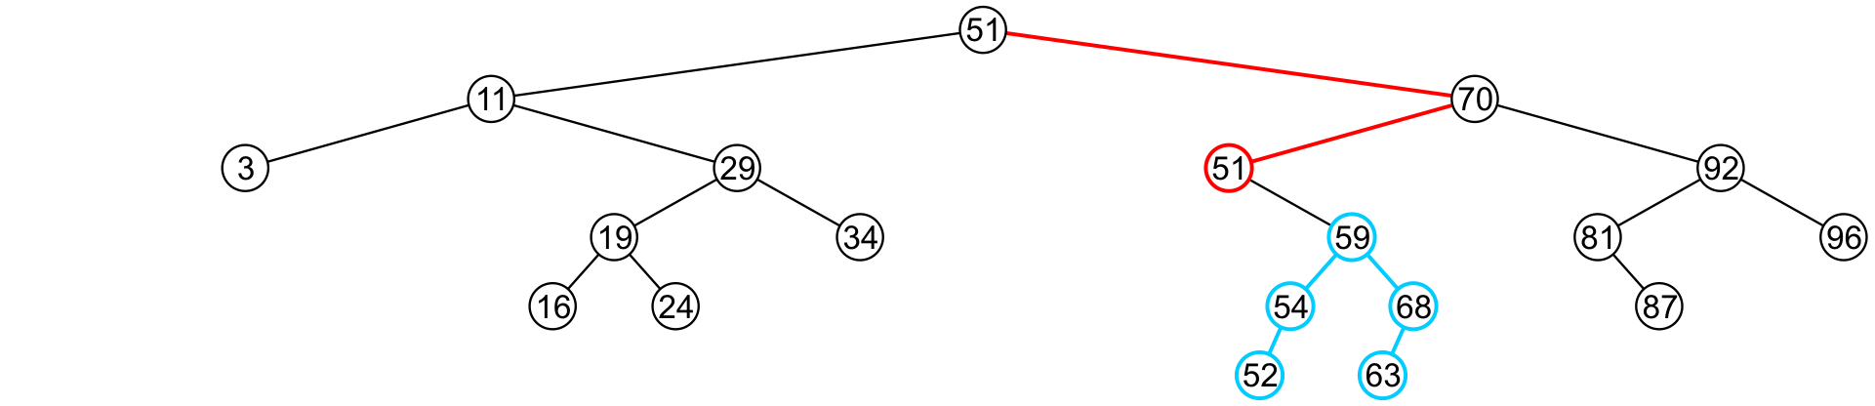
Erase
6.1.4.5
In this case, the node storing 51 has just a single child

Slide 54
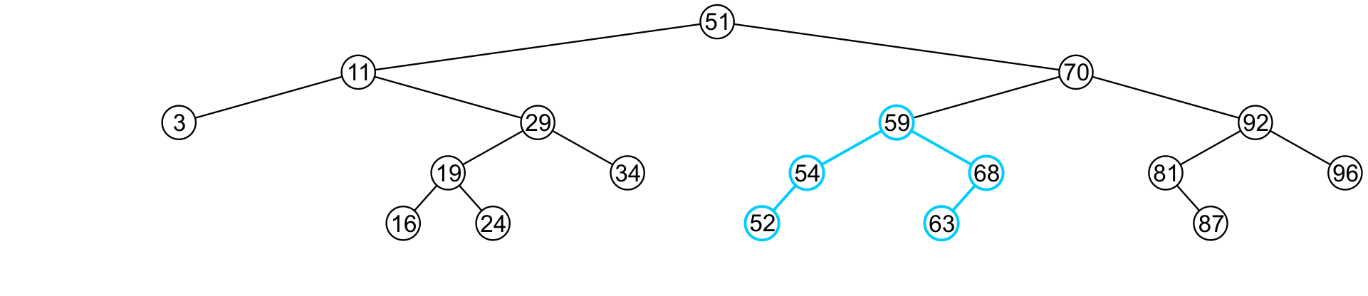
Erase
6.1.4.5
We delete the node containing 51 and assign the member variable left_tree of 70 to point to 59

Slide 55
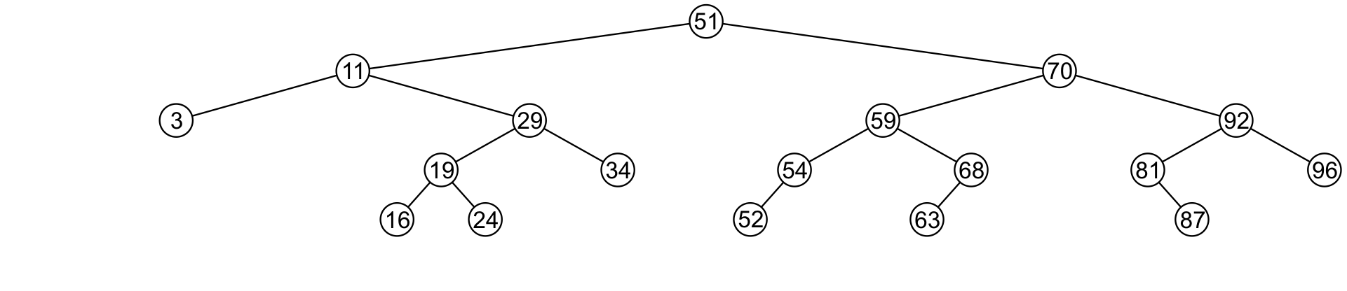
Erase
6.1.4.5
Note that after seven removals, the remaining tree is still correctly sorted

Slide 56


Erase
6.1.4.5
In the two examples of removing a full node, we promoted:
  A node with no children
  A node with right child
Is it possible, in removing a full node, to promote a child with two children?

Slide 57
Erase
6.1.4.5
Recall that we promoted the minimum element in the right sub-tree
  If that node had a left sub-tree, that sub-tree would contain a smaller value

Slide 58
Erase
6.1.4.5
In order to properly remove a node, we will have to change the member variable pointing to the node
  To do this, we will pass that member variable by reference
Additionally: We will return 1 if the object is removed and 0 if the object was not found

Slide 59
Erase
6.1.4.5
Exercise:
  In the binary search tree generated previously:
    Erase 47
    Erase 21
    Erase 45
    Erase 31
    Erase 36

Slide 60
Binary Search Tree
6.1.5
We have defined binary search nodes
  Similar to the Single_node defined in previous lectures
We must now introduce a container which stores the root
  A Binary_search_tree class
Most operations will be simply passed to the root node

Slide 61
Implementation
6.1.5
    template <typename Type>
    class Binary_search_tree {
    private:
    Binary_search_node<Type> *root_node;
    Binary_search_node<Type> *root() const;
    public:
    Binary_search_tree();
    ~Binary_search_tree();
    bool empty() const;
    int size() const;
    int height() const;
    Type front() const;
    Type back() const;
    int count( Type const &obj ) const;
    void clear();
    bool insert( Type const &obj );
    bool erase( Type const &obj );
    };

Slide 62
Constructor, Destructor, and Clear
6.1.5
template <typename Type>
Binary_search_tree<Type>::Binary_search_tree():
root_node( nullptr ) {
// does nothing
}
template <typename Type>
Binary_search_tree<Type>::~Binary_search_tree() {
clear();
}
template <typename Type>
void Binary_search_tree<Type>::clear() {
root()->clear( root_node );
}

Slide 63
Constructor, Destructor, and Clear
6.1.5
template <typename Type>
Binary_search_tree<Type> *Binary_search_tree<Type>::root() const {
return tree_root;
}
template <typename Type>
bool Binary_search_tree<Type>::empty() const {
return root()->empty();
}
template <typename Type>
int Binary_search_tree<Type>::size() const {
return root()->size();
}

Slide 64
Empty, Size, Height and Count
6.1.5
template <typename Type>
int Binary_search_tree<Type>::height() const {
return root()->height();
}
template <typename Type>
bool Binary_search_tree<Type>::find( Type const &obj ) const {
return root()->find( obj );
}

Slide 65
Front and Back
6.1.5
// If root() is nullptr, 'front' will throw an underflow exception
template <typename Type>
Type Binary_search_tree<Type>::front() const {
return root()->front();
}
// If root() is nullptr, 'back' will throw an underflow exception
template <typename Type>
Type Binary_search_tree<Type>::back() const {
return root()->back();
}

Slide 66
Insert and Erase
6.1.5
template <typename Type>
bool Binary_search_tree<Type>::insert( Type const &obj ) {
return root()->insert( obj, root_node );
}
template <typename Type>
bool Binary_search_tree<Type>::erase( Type const &obj ) {
return root()->erase( obj, root_node );
}

Slide 67
Other Relation-based Operations
6.1.6
We will quickly consider two other relation-based queries that are very quick to calculate with an array of sorted objects:
  Finding the previous and next entries, and
  Finding the k^{th} entry

Slide 68
Previous and Next Objects
6.1.6.1
All the operations up to now have been operations which work on any container: count, insert, etc.
  If these are the only relevant operations, use a hash table
Operations specific to linearly ordered data include:
  Find the next larger and previous smaller objects of a given object which may or may not be in the container
  Find the k^{th} entry of the container
  Iterate through those objects that fall on an interval [a, b]
We will focus on finding the next largest object
  The others will follow

Slide 69
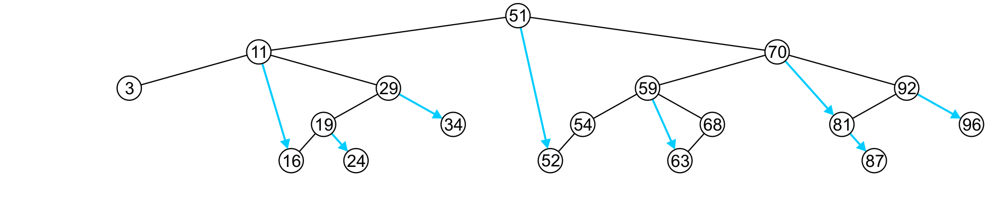
Previous and Next Objects
6.1.6.1
To find the next largest object:
  If the node has a right sub-tree, the minimum object in that sub-tree is the next-largest object

Slide 70
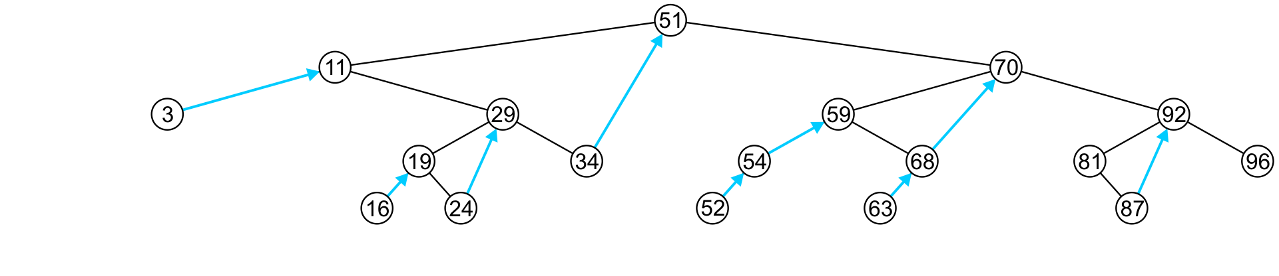
Previous and Next Objects
6.1.6.1
If, however, there is no right sub-tree:
  It is the next largest object (if any) that exists in the path from the root to the node

Slide 71
Previous and Next Objects
6.1.6.1
More generally: what is the next largest entry of an arbitrary object?
  This can be found with a single search from the root node to one of the leaves—an O(h) operation
  This function returns the object if it did not find something greater than it
  template <typename Type>
  Type Binary_search_node<Type>::next( Type const &obj ) const {
  if ( empty() ) {
  return obj;
  } else if ( retrieve() == obj ) {
  return ( right()->empty() ) ? obj : right()->front();
  } else if ( retrieve() > obj ) {
  Type tmp = left()->next( obj );
  return ( tmp == obj ) ? retrieve() : tmp;
  } else {
  return right()->next( obj );
  }
  }

Slide 72
Finding the k^{th} Object
6.1.6.2
Another operation on sorted lists may be finding the k^{th} largest object
  Recall that k goes from 0 to n – 1
  If the left-sub-tree has ℓ = k entries, return the current node,
  If the left sub-tree has ℓ < k entries, return the k^{th} entry of the left sub-tree,
  Otherwise, the left sub-tree has ℓ > k entries, so return the (k – ℓ – 1)^{th} entry of the right sub-tree
18
7
10
1
5
0
1
2
3
4
5
6
7
8
9
10
11
12
13
14
15
16
17

Slide 73
Finding the k^{th} Object
6.1.6.2
template <typename Type>
Type Binary_search_tree<Type>::at( int k ) const {
return ( k < 0 || k >= size() ) ? Type() : root()->at( k );
// Need to go from 0, ..., n - 1
}
template <typename Type>
Type Binary_search_node<Type>::at( int k ) const {
if ( left()->size() == k ) {
return retrieve();
} else if ( left()->size() > k ) {
return left()->at( k );
} else {
return right()->at( k - left()->size() – 1 );
}
}

Slide 74
Finding the k^{th} Object
6.1.7
This requires that size() returns in Θ(1) time
  We must have a member variable
    int tree_size;
  which stores the number of descendants of this node
  This requires Θ(n) additional memory
template <typename Type>
bool Binary_search_tree<Type>::size() const {
return root()->size();
}
  We can implement this in the Binary_node class, if we want
    The constructor will set the size to 1

Slide 75
Finding the k^{th} Object
6.1.7
We must now update insert(…) and erase(…) to update it
  template <typename Type>
  bool Binary_search_node<Type>::insert( Type const &obj,
  Binary_search_node *&ptr_to_this ) {
  if ( empty() ) {
  ptr_to_this = new Binary_search_node<Type>( obj );
  return true;
  } else if ( obj < retrieve() ) {
  return left()->insert( obj, left_tree ) ? ++tree_size : false;
  } else if ( obj > retrieve() ) {
  return right()->insert( obj, right_tree ) ? ++tree_size : false;
  } else {
  return false;
  }
  }
Clever trick: in C and C++, any non-zero value is interpreted as true

Slide 76
Run Time: O(h)
6.1.7
Almost all of the relevant operations on a binary search tree are O(h)
  If the tree is close to a linked list, the run times is O(n)
    Insert 1, 2, 3, 4, 5, 6, 7, ..., n into a empty binary search tree
  The best we can do is if the tree is perfect: O(ln(n))
  One important goal will be to find tree structures where we can maintain a height of Θ(ln(n))
You can look at
  AVL trees
  B+ trees
both of which ensure that the height remains Θ(ln(n))
Others exist, too

Slide 77
Summary
In this topic, we covered binary search trees
  Described Abstract Sorted Lists
  Problems using arrays and linked lists
  Definition a binary search tree
  Looked at the implementation of:
    Empty, size, height, count
    Front, back, insert, erase
    Previous smaller and next larger objects

Slide 78
Usage Notes
These slides are made publicly available on the web for anyone to use
If you choose to use them, or a part thereof, for a course at another institution, I ask only three things:
  that you inform me that you are using the slides,
  that you acknowledge my work, and
  that you alert me of any mistakes which I made or changes which you make, and allow me the option of incorporating such changes (with an acknowledgment) in my set of slides
  Sincerely,
  Douglas Wilhelm Harder, MMath
  dwharder@alumni.uwaterloo.ca

