Slide 1
Outline
This topic covers merge sort
A recursive divide-and-conquer algorithm
Merging two lists
The merge sort algorithm
A run-time analysis

Slide 2
Merge Sort
8.5
The merge sort algorithm is defined recursively:
If the list is of size 1, it is sorted—we are done;
Otherwise:
Divide an unsorted list into two sub-lists,
Sort each sub-list recursively using merge sort, and
Merge the two sorted sub-lists into a single sorted list
This is the first significant divide-and-conquer algorithm we will see
Question: How quickly can we recombine the two sub-lists
into a single sorted list?

Slide 3
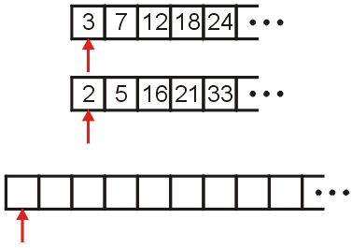
Merging Example
8.5.1
Consider the two sorted arrays and an empty array
Define three indices at the start of each array

Slide 4
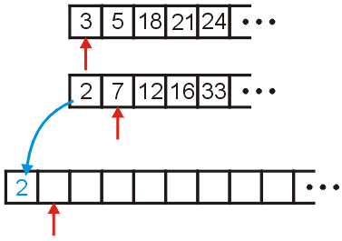
Merging Example
8.5.1
We compare 2 and 3: 2 < 3
Copy 2 down
Increment the corresponding indices

Slide 5
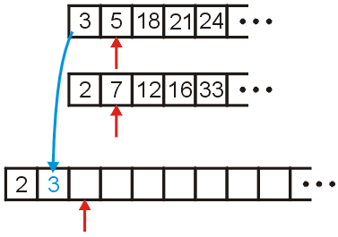
Merging Example
8.5.1
We compare 3 and 7
Copy 3 down
Increment the corresponding indices

Slide 6
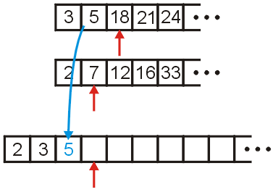
Merging Example
8.5.1
We compare 5 and 7
Copy 5 down
Increment the appropriate indices

Slide 7
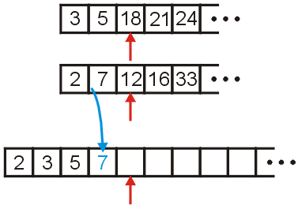
Merging Example
8.5.1
We compare 18 and 7
Copy 7 down
Increment...

Slide 8
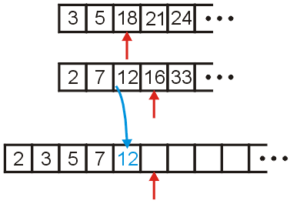
Merging Example
8.5.1
We compare 18 and 12
Copy 12 down
Increment...

Slide 9
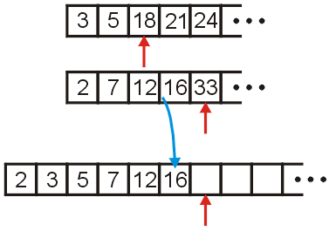
Merging Example
8.5.1
We compare 18 and 16
Copy 16 down
Increment...

Slide 10
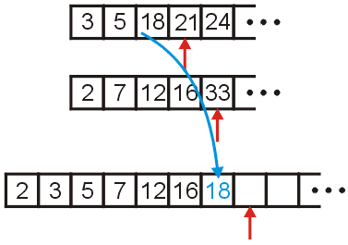
Merging Example
8.5.1
We compare 18 and 33
Copy 18 down
Increment...

Slide 11
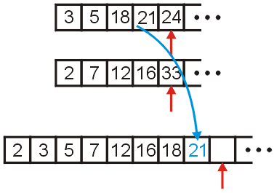
Merging Example
8.5.1
We compare 21 and 33
Copy 21 down
Increment...

Slide 12
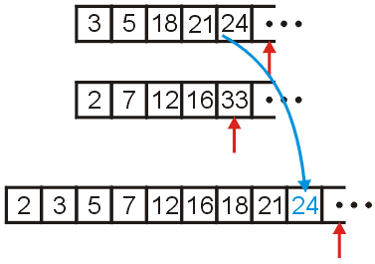
Merging Example
8.5.1
We compare 24 and 33
Copy 24 down
Increment...

Slide 13
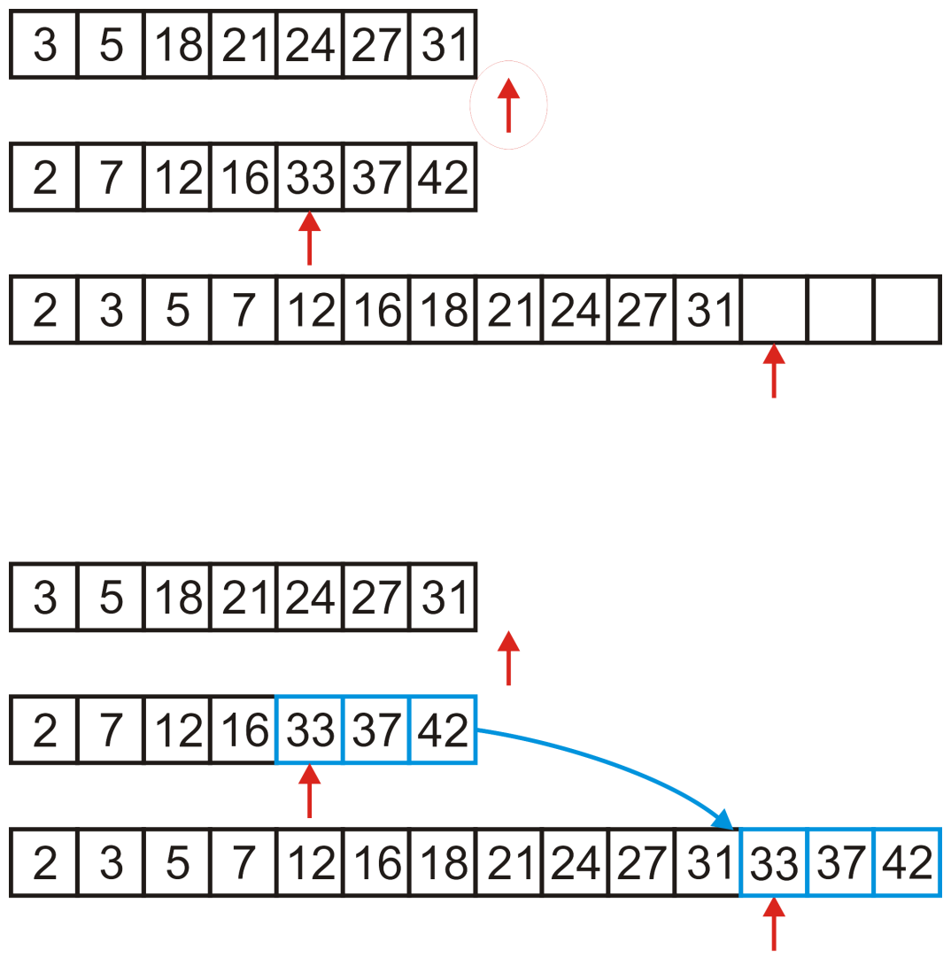
Merging Example
8.5.1
We would continue until we have passed beyond the limit of one of the two arrays
After this, we simply copy over all remaining entries in the non- empty array

Slide 14
Merging Two Lists
8.5.1.1
Programming a merge is straight-forward:
the sorted arrays, array1 and array2, are of size n1 and n2, respectively, and
we have an empty array, arrayout, of size n1 + n2
Define three variables int i1 = 0, i2 = 0, k = 0;
which index into these three arrays

Slide 15
Merging Two Lists
8.5.1.1
We can then run the following loop:
int i1 = 0, i2 = 0, k = 0;
while ( i1 < n1 && i2 < n2 ) {
if ( array1[i1] < array2[i2] ) {
arrayout[k] = array1[i1];
++i1;
} else {
arrayout[k] = array2[i2];
++i2;
}
++k;
}

Slide 16
Merging Two Lists
8.5.1.1
We’re not finished yet, we have to empty out the remaining array
for ( ; i1 < n1; ++i1, ++k ) {
arrayout[k] = array1[i1];
}
for ( ; i2 < n2; ++i2, ++k ) {
arrayout[k] = array2[i2];
}

Slide 17
Analysis of merging
8.5.1.2
The statement ++out will only be run at most n₁ + n₂ times
Therefore, the body of the loops run a total of n₁ + n₂ times
Hence, merging may be performed in Θ(n₁ + n₂) time
If the arrays are approximately the same size, n = n₁ and n₁ ≈ n₂, we can say that the run time is Θ(n)
Problem: We cannot merge two arrays in-place
This algorithm always required the allocation of a new array
Therefore, the memory requirements are also Θ(n)

Slide 18
The Algorithm
8.5.2
The algorithm:
Split the list into two approximately equal sub-lists
Recursively call merge sort on both sub lists
Merge the resulting sorted lists

Slide 19
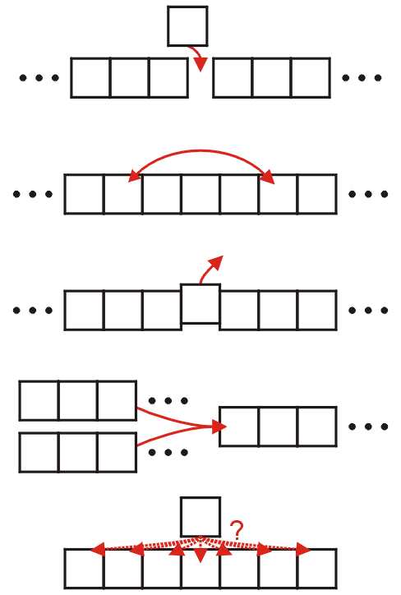
The Algorithm
8.5.2
Recall the five sorting techniques:
Insertion
Exchange
Selection
Merging
Distribution
Clearly merge sort falls into the fourth category

Slide 20
The Algorithm
8.5.2
Question:
we split the list into two sub-lists and sort them
how should we sort those lists?
Answer (theoretical):
if the size of these sub-lists is > 1, use merge sort again
if the sub-lists are of length 1, do nothing: a list of length one is sorted

Slide 21
The Algorithm
8.5.2
However, just because an algorithm has excellent asymptotic properties, this does not mean that it is practical at all levels
Answer (practical):
If the sub-lists are less than some threshold length, use an algorithm like insertion sort to sort the lists
Otherwise, use merge sort, again

Slide 22
Implementation
8.5.3
Suppose we already have a function
template <typename Type>
void merge( Type *array, int a, int b, int c );
that assumes that the entries
array[a] through array[b - 1], and
array[b] through array[c - 1]
are sorted and merges these two sub-arrays into a single sorted array from index a through index c - 1, inclusive

Slide 23
Implementation
8.5.3
For example, given the array,
a call to
void merge( array, 14, 20, 26 );
merges the two sub-lists
forming
9 | 10 | 11 | 12 | 13 | 14 | 15 | 16 | 17 | 18 | 19 | 20 | 21 | 22 | 23 | 24 | 25 | 26 | 27 | 28 | 29 | 30 | 31 | 32 | 33
13 | 77 | 49 | 35 | 61 | 3 | 23 | 48 | 73 | 89 | 95 | 17 | 32 | 37 | 57 | 94 | 99 | 28 | 15 | 55 | 7 | 51 | 88 | 97 | 62
9 | 10 | 11 | 12 | 13 | 14 | 15 | 16 | 17 | 18 | 19 | 20 | 21 | 22 | 23 | 24 | 25 | 26 | 27 | 28 | 29 | 30 | 31 | 32 | 33
13 | 77 | 49 | 35 | 61 | 3 | 23 | 48 | 73 | 89 | 95 | 17 | 32 | 37 | 57 | 94 | 99 | 28 | 15 | 55 | 7 | 51 | 88 | 97 | 62
9 | 10 | 11 | 12 | 13 | 14 | 15 | 16 | 17 | 18 | 19 | 20 | 21 | 22 | 23 | 24 | 25 | 26 | 27 | 28 | 29 | 30 | 31 | 32 | 33
13 | 77 | 49 | 35 | 61 | 3 | 17 | 23 | 32 | 37 | 48 | 57 | 73 | 89 | 94 | 95 | 99 | 28 | 15 | 55 | 7 | 51 | 88 | 97 | 62

Slide 24
Implementation
8.5.3
We will therefore implement a function
template <typename Type>
void merge_sort( Type *array, int first, int last );
that will sort the entries in the positions first <= i and i < last
If the number of entries is less than N, call insertion sort
Otherwise:
Find the mid-point,
Call merge sort recursively on each of the halves, and
Merge the results

Slide 25
Implementation
8.5.3
The actual body is quite small:
template <typename Type>
void merge_sort( Type *array, int first, int last ) {
if ( last - first <= N ) {
insertion_sort( array, first, last );
} else {
int midpoint = (first + last)/2;
merge_sort( array, first, midpoint );
merge_sort( array, midpoint, last );
merge( array, first, midpoint, last );
}
}

Slide 26
Implementation
8.5.3
Like merge sort, insertion sort will sort a sub-range of the array:
template <typename Type>
void insertion_sort( Type *array, int first, int last ) {
for ( int k = first + 1; k < last; ++k ) {
Type tmp = array[k];
for ( int j = k; k > first; --j ) {
if ( array[j - 1] > tmp ) {
array[j] = array[j - 1];
} else {
array[j] = tmp;
goto finished;
}
}
array[first] = tmp;
finished: ;
}
}

Slide 27
Example
8.5.4
Consider the following example of an unsorted array of 25 entries
We will call insertion sort if the list being sorted of size N = 6 or less
0 | 1 | 2 | 3 | 4 | 5 | 6 | 7 | 8 | 9 | 10 | 11 | 12 | 13 | 14 | 15 | 16 | 17 | 18 | 19 | 20 | 21 | 22 | 23 | 24
13 | 77 | 49 | 35 | 61 | 48 | 73 | 23 | 95 | 3 | 89 | 37 | 57 | 99 | 17 | 32 | 94 | 28 | 15 | 55 | 7 | 51 | 88 | 97 | 62

Slide 28
Example
8.5.4
We call merge_sort( array, 0, 25 )
0 | 1 | 2 | 3 | 4 | 5 | 6 | 7 | 8 | 9 | 10 | 11 | 12 | 13 | 14 | 15 | 16 | 17 | 18 | 19 | 20 | 21 | 22 | 23 | 24
13 | 77 | 49 | 35 | 61 | 48 | 73 | 23 | 95 | 3 | 89 | 37 | 57 | 99 | 17 | 32 | 94 | 28 | 15 | 55 | 7 | 51 | 88 | 97 | 62
merge_sort( array, 0, 25 )

Slide 29
Example
8.5.4
We are calling merge_sort( array, 0, 25 )
First, 25 – 0 > 6, so find the midpoint and call merge_sort recursively
midpoint = (0 + 25)/2; // == 12
merge_sort( array, 0, 12 );
0 | 1 | 2 | 3 | 4 | 5 | 6 | 7 | 8 | 9 | 10 | 11 | 12 | 13 | 14 | 15 | 16 | 17 | 18 | 19 | 20 | 21 | 22 | 23 | 24
13 | 77 | 49 | 35 | 61 | 48 | 73 | 23 | 95 | 3 | 89 | 37 | 57 | 99 | 17 | 32 | 94 | 28 | 15 | 55 | 7 | 51 | 88 | 97 | 62
merge_sort( array, 0, 25 )

Slide 30
Example
8.5.4
We are now executing merge_sort( array, 0, 12 )
First, 12 – 0 > 6, so find the midpoint and call merge_sort recursively
midpoint = (0 + 12)/2; // == 6
merge_sort( array, 0, 6 );
0 | 1 | 2 | 3 | 4 | 5 | 6 | 7 | 8 | 9 | 10 | 11 | 12 | 13 | 14 | 15 | 16 | 17 | 18 | 19 | 20 | 21 | 22 | 23 | 24
13 | 77 | 49 | 35 | 61 | 48 | 73 | 23 | 95 | 3 | 89 | 37 | 57 | 99 | 17 | 32 | 94 | 28 | 15 | 55 | 7 | 51 | 88 | 97 | 62
merge_sort( array, 0, 12 )
merge_sort( array, 0, 25 )

Slide 31
Example
8.5.4
We are now executing merge_sort( array, 0, 6 )
Now, 6 – 0 ≤ 6, so find we call insertion sort
0 | 1 | 2 | 3 | 4 | 5 | 6 | 7 | 8 | 9 | 10 | 11 | 12 | 13 | 14 | 15 | 16 | 17 | 18 | 19 | 20 | 21 | 22 | 23 | 24
13 | 77 | 49 | 35 | 61 | 48 | 73 | 23 | 95 | 3 | 89 | 37 | 57 | 99 | 17 | 32 | 94 | 28 | 15 | 55 | 7 | 51 | 88 | 97 | 62
merge_sort( array, 0, 6 )
merge_sort( array, 0, 12 )
merge_sort( array, 0, 25 )

Slide 32
Example
8.5.4
Insertion sort just sorts the entries from 0 to 5
0 | 1 | 2 | 3 | 4 | 5 | 6 | 7 | 8 | 9 | 10 | 11 | 12 | 13 | 14 | 15 | 16 | 17 | 18 | 19 | 20 | 21 | 22 | 23 | 24
13 | 77 | 49 | 35 | 61 | 48 | 73 | 23 | 95 | 3 | 89 | 37 | 57 | 99 | 17 | 32 | 94 | 28 | 15 | 55 | 7 | 51 | 88 | 97 | 62
insertion_sort( array, 0, 6 )
merge_sort( array, 0, 6 )
merge_sort( array, 0, 12 )
merge_sort( array, 0, 25 )

Slide 33
Example
8.5.4
Insertion sort just sorts the entries from 0 to 5
This function call completes and so we exit
0 | 1 | 2 | 3 | 4 | 5 | 6 | 7 | 8 | 9 | 10 | 11 | 12 | 13 | 14 | 15 | 16 | 17 | 18 | 19 | 20 | 21 | 22 | 23 | 24
13 | 35 | 48 | 49 | 61 | 77 | 73 | 23 | 95 | 3 | 89 | 37 | 57 | 99 | 17 | 32 | 94 | 28 | 15 | 55 | 7 | 51 | 88 | 97 | 62
insertion_sort( array, 0, 6 )
merge_sort( array, 0, 6 )
merge_sort( array, 0, 12 )
merge_sort( array, 0, 25 )

Slide 34
Example
8.5.4
This call to merge_sort is now also finished, so it, too, exits
0 | 1 | 2 | 3 | 4 | 5 | 6 | 7 | 8 | 9 | 10 | 11 | 12 | 13 | 14 | 15 | 16 | 17 | 18 | 19 | 20 | 21 | 22 | 23 | 24
13 | 35 | 48 | 49 | 61 | 77 | 73 | 23 | 95 | 3 | 89 | 37 | 57 | 99 | 17 | 32 | 94 | 28 | 15 | 55 | 7 | 51 | 88 | 97 | 62
merge_sort( array, 0, 6 )
merge_sort( array, 0, 12 )
merge_sort( array, 0, 25 )

Slide 35
Example
8.5.4
We return to continue executing merge_sort( array, 0, 12 )
We continue calling
midpoint = (0 + 12)/2; // == 6
merge_sort( array, 0, 6 );
merge_sort( array, 6, 12 );
0 | 1 | 2 | 3 | 4 | 5 | 6 | 7 | 8 | 9 | 10 | 11 | 12 | 13 | 14 | 15 | 16 | 17 | 18 | 19 | 20 | 21 | 22 | 23 | 24
13 | 35 | 48 | 49 | 61 | 77 | 73 | 23 | 95 | 3 | 89 | 37 | 57 | 99 | 17 | 32 | 94 | 28 | 15 | 55 | 7 | 51 | 88 | 97 | 62
merge_sort( array, 0, 12 )
merge_sort( array, 0, 25 )

Slide 36
Example
8.5.4
We are now executing merge_sort( array, 6, 12 )
Now, 12 – 6 ≤ 6, so find we call insertion sort
0 | 1 | 2 | 3 | 4 | 5 | 6 | 7 | 8 | 9 | 10 | 11 | 12 | 13 | 14 | 15 | 16 | 17 | 18 | 19 | 20 | 21 | 22 | 23 | 24
13 | 35 | 48 | 49 | 61 | 77 | 73 | 23 | 95 | 3 | 89 | 37 | 57 | 99 | 17 | 32 | 94 | 28 | 15 | 55 | 7 | 51 | 88 | 97 | 62
merge_sort( array, 6, 12 )
merge_sort( array, 0, 12 )
merge_sort( array, 0, 25 )

Slide 37
Example
8.5.4
Insertion sort just sorts the entries from 6 to 11
0 | 1 | 2 | 3 | 4 | 5 | 6 | 7 | 8 | 9 | 10 | 11 | 12 | 13 | 14 | 15 | 16 | 17 | 18 | 19 | 20 | 21 | 22 | 23 | 24
13 | 35 | 48 | 49 | 61 | 77 | 73 | 23 | 95 | 3 | 89 | 37 | 57 | 99 | 17 | 32 | 94 | 28 | 15 | 55 | 7 | 51 | 88 | 97 | 62
insertion_sort( array, 6, 12 )
merge_sort( array, 6, 12 )
merge_sort( array, 0, 12 )
merge_sort( array, 0, 25 )

Slide 38
Example
8.5.4
Insertion sort just sorts the entries from 6 to 11
This function call completes and so we exit
0 | 1 | 2 | 3 | 4 | 5 | 6 | 7 | 8 | 9 | 10 | 11 | 12 | 13 | 14 | 15 | 16 | 17 | 18 | 19 | 20 | 21 | 22 | 23 | 24
13 | 35 | 48 | 49 | 61 | 77 | 3 | 23 | 37 | 73 | 89 | 95 | 57 | 99 | 17 | 32 | 94 | 28 | 15 | 55 | 7 | 51 | 88 | 97 | 62
insertion_sort( array, 6, 12 )
merge_sort( array, 6, 12 )
merge_sort( array, 0, 12 )
merge_sort( array, 0, 25 )

Slide 39
Example
8.5.4
This call to merge_sort is now also finished, so it, too, exits
0 | 1 | 2 | 3 | 4 | 5 | 6 | 7 | 8 | 9 | 10 | 11 | 12 | 13 | 14 | 15 | 16 | 17 | 18 | 19 | 20 | 21 | 22 | 23 | 24
13 | 35 | 48 | 49 | 61 | 77 | 3 | 23 | 37 | 73 | 89 | 95 | 57 | 99 | 17 | 32 | 94 | 28 | 15 | 55 | 7 | 51 | 88 | 97 | 62
merge_sort( array, 6, 12 )
merge_sort( array, 0, 12 )
merge_sort( array, 0, 25 )

Slide 40
Example
8.5.4
We return to continue executing merge_sort( array, 0, 12 )
We continue calling
midpoint = (0 + 12)/2; // == 6
merge_sort( array, 0, 6 );
merge_sort( array, 6, 12 );
merge( array, 0, 6, 12 );
0 | 1 | 2 | 3 | 4 | 5 | 6 | 7 | 8 | 9 | 10 | 11 | 12 | 13 | 14 | 15 | 16 | 17 | 18 | 19 | 20 | 21 | 22 | 23 | 24
13 | 35 | 48 | 49 | 61 | 77 | 3 | 23 | 37 | 73 | 89 | 95 | 57 | 99 | 17 | 32 | 94 | 28 | 15 | 55 | 7 | 51 | 88 | 97 | 62
merge_sort( array, 0, 12 )
merge_sort( array, 0, 25 )

Slide 41
Example
8.5.4
We are executing merge( array, 0, 6, 12 )
These two sub-arrays are merged together
0 | 1 | 2 | 3 | 4 | 5 | 6 | 7 | 8 | 9 | 10 | 11 | 12 | 13 | 14 | 15 | 16 | 17 | 18 | 19 | 20 | 21 | 22 | 23 | 24
13 | 35 | 48 | 49 | 61 | 77 | 3 | 23 | 37 | 73 | 89 | 95 | 57 | 99 | 17 | 32 | 94 | 28 | 15 | 55 | 7 | 51 | 88 | 97 | 62
merge( array, 0, 6, 12 )
merge_sort( array, 0, 12 )
merge_sort( array, 0, 25 )

Slide 42
Example
8.5.4
We are executing merge( array, 0, 6, 12 )
These two sub-arrays are merged together
This function call exists
0 | 1 | 2 | 3 | 4 | 5 | 6 | 7 | 8 | 9 | 10 | 11 | 12 | 13 | 14 | 15 | 16 | 17 | 18 | 19 | 20 | 21 | 22 | 23 | 24
3 | 13 | 23 | 35 | 37 | 48 | 49 | 61 | 73 | 77 | 89 | 95 | 57 | 99 | 17 | 32 | 94 | 28 | 15 | 55 | 7 | 51 | 88 | 97 | 62
merge( array, 0, 6, 12 )
merge_sort( array, 0, 12 )
merge_sort( array, 0, 25 )

Slide 43
Example
8.5.4
We return to executing merge_sort( array, 0, 12 )
We are finished calling this function as well
midpoint = (0 + 12)/2; // == 6
merge_sort( array, 0, 6 );
merge_sort( array, 6, 12 );
merge( array, 0, 6, 12 );
Consequently, we exit
0 | 1 | 2 | 3 | 4 | 5 | 6 | 7 | 8 | 9 | 10 | 11 | 12 | 13 | 14 | 15 | 16 | 17 | 18 | 19 | 20 | 21 | 22 | 23 | 24
3 | 13 | 23 | 35 | 37 | 48 | 49 | 61 | 73 | 77 | 89 | 95 | 57 | 99 | 17 | 32 | 94 | 28 | 15 | 55 | 7 | 51 | 88 | 97 | 62
merge_sort( array, 0, 12 )
merge_sort( array, 0, 25 )

Slide 44
Example
8.5.4
We return to executing merge_sort( array, 0, 25 )
We continue calling
midpoint = (0 + 25)/2; // == 12
merge_sort( array, 0, 12 );
merge_sort( array, 12, 25 );
0 | 1 | 2 | 3 | 4 | 5 | 6 | 7 | 8 | 9 | 10 | 11 | 12 | 13 | 14 | 15 | 16 | 17 | 18 | 19 | 20 | 21 | 22 | 23 | 24
3 | 13 | 23 | 35 | 37 | 48 | 49 | 61 | 73 | 77 | 89 | 95 | 57 | 99 | 17 | 32 | 94 | 28 | 15 | 55 | 7 | 51 | 88 | 97 | 62
merge_sort( array, 0, 25 )

Slide 45
Example
8.5.4
We are now executing merge_sort( array, 12, 25 )
First, 25 – 12 > 6, so find the midpoint and call merge_sort recursively
midpoint = (12 + 25)/2; // == 18
merge_sort( array, 12, 18 );
0 | 1 | 2 | 3 | 4 | 5 | 6 | 7 | 8 | 9 | 10 | 11 | 12 | 13 | 14 | 15 | 16 | 17 | 18 | 19 | 20 | 21 | 22 | 23 | 24
3 | 13 | 23 | 35 | 37 | 48 | 49 | 61 | 73 | 77 | 89 | 95 | 57 | 99 | 17 | 32 | 94 | 28 | 15 | 55 | 7 | 51 | 88 | 97 | 62
merge_sort( array, 12, 25 )
merge_sort( array, 0, 25 )

Slide 46
Example
8.5.4
We are now executing merge_sort( array, 12, 18 )
Now, 18 – 12 ≤ 6, so find we call insertion sort
0 | 1 | 2 | 3 | 4 | 5 | 6 | 7 | 8 | 9 | 10 | 11 | 12 | 13 | 14 | 15 | 16 | 17 | 18 | 19 | 20 | 21 | 22 | 23 | 24
3 | 13 | 23 | 35 | 37 | 48 | 49 | 61 | 73 | 77 | 89 | 95 | 57 | 99 | 17 | 32 | 94 | 28 | 15 | 55 | 7 | 51 | 88 | 97 | 62
merge_sort( array, 12, 18 )
merge_sort( array, 12, 25 )
merge_sort( array, 0, 25 )

Slide 47
Example
8.5.4
Insertion sort just sorts the entries from 12 to 17
0 | 1 | 2 | 3 | 4 | 5 | 6 | 7 | 8 | 9 | 10 | 11 | 12 | 13 | 14 | 15 | 16 | 17 | 18 | 19 | 20 | 21 | 22 | 23 | 24
3 | 13 | 23 | 35 | 37 | 48 | 49 | 61 | 73 | 77 | 89 | 95 | 57 | 99 | 17 | 32 | 94 | 28 | 15 | 55 | 7 | 51 | 88 | 97 | 62
insertion_sort( array, 12, 18 )
merge_sort( array, 12, 18 )
merge_sort( array, 12, 25 )
merge_sort( array, 0, 25 )

Slide 48
Example
8.5.4
Insertion sort just sorts the entries from 12 to 17
This function call completes and so we exit
0 | 1 | 2 | 3 | 4 | 5 | 6 | 7 | 8 | 9 | 10 | 11 | 12 | 13 | 14 | 15 | 16 | 17 | 18 | 19 | 20 | 21 | 22 | 23 | 24
3 | 13 | 23 | 35 | 37 | 48 | 49 | 61 | 73 | 77 | 89 | 95 | 17 | 28 | 32 | 57 | 94 | 99 | 15 | 55 | 7 | 51 | 88 | 97 | 62
insertion_sort( array, 12, 18 )
merge_sort( array, 12, 18 )
merge_sort( array, 12, 25 )
merge_sort( array, 0, 25 )

Slide 49
Example
8.5.4
This call to merge_sort is now also finished, so it, too, exits
0 | 1 | 2 | 3 | 4 | 5 | 6 | 7 | 8 | 9 | 10 | 11 | 12 | 13 | 14 | 15 | 16 | 17 | 18 | 19 | 20 | 21 | 22 | 23 | 24
3 | 13 | 23 | 35 | 37 | 48 | 49 | 61 | 73 | 77 | 89 | 95 | 17 | 28 | 32 | 57 | 94 | 99 | 15 | 55 | 7 | 51 | 88 | 97 | 62
merge_sort( array, 12, 18 )
merge_sort( array, 12, 25 )
merge_sort( array, 0, 25 )

Slide 50
Example
8.5.4
We return to continue executing merge_sort( array, 12, 25 )
We continue calling
midpoint = (12 + 25)/2; // == 18
merge_sort( array, 12, 18 );
merge_sort( array, 18, 25 );
0 | 1 | 2 | 3 | 4 | 5 | 6 | 7 | 8 | 9 | 10 | 11 | 12 | 13 | 14 | 15 | 16 | 17 | 18 | 19 | 20 | 21 | 22 | 23 | 24
3 | 13 | 23 | 35 | 37 | 48 | 49 | 61 | 73 | 77 | 89 | 95 | 17 | 28 | 32 | 57 | 94 | 99 | 15 | 55 | 7 | 51 | 88 | 97 | 62
merge_sort( array, 12, 25 )
merge_sort( array, 0, 25 )

Slide 51
Example
8.5.4
We are now executing merge_sort( array, 18, 25 )
First, 25 – 18 > 6, so find the midpoint and call merge_sort recursively
midpoint = (18 + 25)/2; // == 21
merge_sort( array, 18, 21 );
0 | 1 | 2 | 3 | 4 | 5 | 6 | 7 | 8 | 9 | 10 | 11 | 12 | 13 | 14 | 15 | 16 | 17 | 18 | 19 | 20 | 21 | 22 | 23 | 24
3 | 13 | 23 | 35 | 37 | 48 | 49 | 61 | 73 | 77 | 89 | 95 | 17 | 28 | 32 | 57 | 94 | 99 | 15 | 55 | 7 | 51 | 88 | 97 | 62
merge_sort( array, 18, 25 )
merge_sort( array, 12, 25 )
merge_sort( array, 0, 25 )

Slide 52
Example
8.5.4
We are now executing merge_sort( array, 18, 21 )
Now, 21 – 18 ≤ 6, so find we call insertion sort
0 | 1 | 2 | 3 | 4 | 5 | 6 | 7 | 8 | 9 | 10 | 11 | 12 | 13 | 14 | 15 | 16 | 17 | 18 | 19 | 20 | 21 | 22 | 23 | 24
3 | 13 | 23 | 35 | 37 | 48 | 49 | 61 | 73 | 77 | 89 | 95 | 17 | 28 | 32 | 57 | 94 | 99 | 15 | 55 | 7 | 51 | 88 | 97 | 62
merge_sort( array, 18, 21 )
merge_sort( array, 18, 25 )
merge_sort( array, 12, 25 )
merge_sort( array, 0, 25 )

Slide 53
Example
8.5.4
Insertion sort just sorts the entries from 18 to 20
0 | 1 | 2 | 3 | 4 | 5 | 6 | 7 | 8 | 9 | 10 | 11 | 12 | 13 | 14 | 15 | 16 | 17 | 18 | 19 | 20 | 21 | 22 | 23 | 24
3 | 13 | 23 | 35 | 37 | 48 | 49 | 61 | 73 | 77 | 89 | 95 | 17 | 28 | 32 | 57 | 94 | 99 | 15 | 55 | 7 | 51 | 88 | 97 | 62
insertion_sort( array, 18, 21 )
merge_sort( array, 18, 21 )
merge_sort( array, 18, 25 )
merge_sort( array, 12, 25 )
merge_sort( array, 0, 25 )

Slide 54
Example
8.5.4
Insertion sort just sorts the entries from 18 to 20
This function call completes and so we exit
0 | 1 | 2 | 3 | 4 | 5 | 6 | 7 | 8 | 9 | 10 | 11 | 12 | 13 | 14 | 15 | 16 | 17 | 18 | 19 | 20 | 21 | 22 | 23 | 24
3 | 13 | 23 | 35 | 37 | 48 | 49 | 61 | 73 | 77 | 89 | 95 | 17 | 28 | 32 | 57 | 94 | 99 | 7 | 15 | 55 | 51 | 88 | 97 | 62
insertion_sort( array, 18, 21 )
merge_sort( array, 18, 21 )
merge_sort( array, 18, 25 )
merge_sort( array, 12, 25 )
merge_sort( array, 0, 25 )

Slide 55
Example
8.5.4
This call to merge_sort is now also finished, so it, too, exits
0 | 1 | 2 | 3 | 4 | 5 | 6 | 7 | 8 | 9 | 10 | 11 | 12 | 13 | 14 | 15 | 16 | 17 | 18 | 19 | 20 | 21 | 22 | 23 | 24
3 | 13 | 23 | 35 | 37 | 48 | 49 | 61 | 73 | 77 | 89 | 95 | 17 | 28 | 32 | 57 | 94 | 99 | 7 | 15 | 55 | 51 | 88 | 97 | 62
merge_sort( array, 18, 21 )
merge_sort( array, 18, 25 )
merge_sort( array, 12, 25 )
merge_sort( array, 0, 25 )

Slide 56
Example
8.5.4
We return to executing merge_sort( array, 18, 25 )
We continue calling
midpoint = (18 + 25)/2; // == 21
merge_sort( array, 18, 21 );
merge_sort( array, 21, 25 );
0 | 1 | 2 | 3 | 4 | 5 | 6 | 7 | 8 | 9 | 10 | 11 | 12 | 13 | 14 | 15 | 16 | 17 | 18 | 19 | 20 | 21 | 22 | 23 | 24
3 | 13 | 23 | 35 | 37 | 48 | 49 | 61 | 73 | 77 | 89 | 95 | 17 | 28 | 32 | 57 | 94 | 99 | 7 | 15 | 55 | 51 | 88 | 97 | 62
merge_sort( array, 18, 25 )
merge_sort( array, 12, 25 )
merge_sort( array, 0, 25 )

Slide 57
Example
8.5.4
We are now executing merge_sort( array, 21, 25 )
Now, 25 – 21 ≤ 6, so find we call insertion sort
0 | 1 | 2 | 3 | 4 | 5 | 6 | 7 | 8 | 9 | 10 | 11 | 12 | 13 | 14 | 15 | 16 | 17 | 18 | 19 | 20 | 21 | 22 | 23 | 24
3 | 13 | 23 | 35 | 37 | 48 | 49 | 61 | 73 | 77 | 89 | 95 | 17 | 28 | 32 | 57 | 94 | 99 | 7 | 15 | 55 | 51 | 88 | 97 | 62
merge_sort( array, 21, 25 )
merge_sort( array, 18, 25 )
merge_sort( array, 12, 25 )
merge_sort( array, 0, 25 )

Slide 58
Example
8.5.4
Insertion sort just sorts the entries from 21 to 24
0 | 1 | 2 | 3 | 4 | 5 | 6 | 7 | 8 | 9 | 10 | 11 | 12 | 13 | 14 | 15 | 16 | 17 | 18 | 19 | 20 | 21 | 22 | 23 | 24
3 | 13 | 23 | 35 | 37 | 48 | 49 | 61 | 73 | 77 | 89 | 95 | 17 | 28 | 32 | 57 | 94 | 99 | 7 | 15 | 55 | 51 | 88 | 97 | 62
insertion_sort( array, 21, 25 )
merge_sort( array, 21, 25 )
merge_sort( array, 18, 25 )
merge_sort( array, 12, 25 )
merge_sort( array, 0, 25 )

Slide 59
Example
8.5.4
Insertion sort just sorts the entries from 21 to 24
This function call completes and so we exit
0 | 1 | 2 | 3 | 4 | 5 | 6 | 7 | 8 | 9 | 10 | 11 | 12 | 13 | 14 | 15 | 16 | 17 | 18 | 19 | 20 | 21 | 22 | 23 | 24
3 | 13 | 23 | 35 | 37 | 48 | 49 | 61 | 73 | 77 | 89 | 95 | 17 | 28 | 32 | 57 | 94 | 99 | 7 | 15 | 55 | 51 | 62 | 88 | 97
insertion_sort( array, 21, 25 )
merge_sort( array, 21, 25 )
merge_sort( array, 18, 25 )
merge_sort( array, 12, 25 )
merge_sort( array, 0, 25 )

Slide 60
Example
8.5.4
This call to merge_sort is now also finished, so it, too, exits
0 | 1 | 2 | 3 | 4 | 5 | 6 | 7 | 8 | 9 | 10 | 11 | 12 | 13 | 14 | 15 | 16 | 17 | 18 | 19 | 20 | 21 | 22 | 23 | 24
3 | 13 | 23 | 35 | 37 | 48 | 49 | 61 | 73 | 77 | 89 | 95 | 17 | 28 | 32 | 57 | 94 | 99 | 7 | 15 | 55 | 51 | 62 | 88 | 97
merge_sort( array, 21, 25 )
merge_sort( array, 18, 25 )
merge_sort( array, 12, 25 )
merge_sort( array, 0, 25 )

Slide 61
Example
8.5.4
We return to continue executing merge_sort( array, 18, 25 )
We continue calling
midpoint = (18 + 25)/2; // == 21
merge_sort( array, 18, 21 );
merge_sort( array, 21, 25 );
merge( array, 18, 21, 25 );
0 | 1 | 2 | 3 | 4 | 5 | 6 | 7 | 8 | 9 | 10 | 11 | 12 | 13 | 14 | 15 | 16 | 17 | 18 | 19 | 20 | 21 | 22 | 23 | 24
3 | 13 | 23 | 35 | 37 | 48 | 49 | 61 | 73 | 77 | 89 | 95 | 17 | 28 | 32 | 57 | 94 | 99 | 7 | 15 | 55 | 51 | 62 | 88 | 97
merge_sort( array, 18, 25 )
merge_sort( array, 12, 25 )
merge_sort( array, 0, 25 )

Slide 62
Example
8.5.4
We are executing merge( array, 18, 21, 25 )
These two sub-arrays are merged together
0 | 1 | 2 | 3 | 4 | 5 | 6 | 7 | 8 | 9 | 10 | 11 | 12 | 13 | 14 | 15 | 16 | 17 | 18 | 19 | 20 | 21 | 22 | 23 | 24
3 | 13 | 23 | 35 | 37 | 48 | 49 | 61 | 73 | 77 | 89 | 95 | 17 | 28 | 32 | 57 | 94 | 99 | 7 | 15 | 55 | 51 | 62 | 88 | 97
merge( array, 18, 21, 25 )
merge_sort( array, 18, 25 )
merge_sort( array, 12, 25 )
merge_sort( array, 0, 25 )

Slide 63
Example
8.5.4
We are executing merge( array, 18, 21, 25 )
These two sub-arrays are merged together
This function call exists
0 | 1 | 2 | 3 | 4 | 5 | 6 | 7 | 8 | 9 | 10 | 11 | 12 | 13 | 14 | 15 | 16 | 17 | 18 | 19 | 20 | 21 | 22 | 23 | 24
3 | 13 | 23 | 35 | 37 | 48 | 49 | 61 | 73 | 77 | 89 | 95 | 17 | 28 | 32 | 57 | 94 | 99 | 7 | 15 | 51 | 55 | 62 | 88 | 97
merge( array, 18, 21, 25 )
merge_sort( array, 18, 25 )
merge_sort( array, 12, 25 )
merge_sort( array, 0, 25 )

Slide 64
Example
8.5.4
We return to executing merge_sort( array, 18, 25 )
We are finished calling this function as well
midpoint = (18 + 25)/2; // == 21
merge_sort( array, 18, 21 );
merge_sort( array, 21, 25 );
merge( array, 18, 21, 25 );
Consequently, we exit
0 | 1 | 2 | 3 | 4 | 5 | 6 | 7 | 8 | 9 | 10 | 11 | 12 | 13 | 14 | 15 | 16 | 17 | 18 | 19 | 20 | 21 | 22 | 23 | 24
3 | 13 | 23 | 35 | 37 | 48 | 49 | 61 | 73 | 77 | 89 | 95 | 17 | 28 | 32 | 57 | 94 | 99 | 7 | 15 | 51 | 55 | 62 | 88 | 97
merge_sort( array, 18, 25 )
merge_sort( array, 12, 25 )
merge_sort( array, 0, 25 )

Slide 65
Example
8.5.4
We return to continue executing merge_sort( array, 12, 25 )
We continue calling
midpoint = (12 + 25)/2; // == 18
merge_sort( array, 12, 18 );
merge_sort( array, 18, 25 );
merge( array, 12, 18, 25 );
0 | 1 | 2 | 3 | 4 | 5 | 6 | 7 | 8 | 9 | 10 | 11 | 12 | 13 | 14 | 15 | 16 | 17 | 18 | 19 | 20 | 21 | 22 | 23 | 24
3 | 13 | 23 | 35 | 37 | 48 | 49 | 61 | 73 | 77 | 89 | 95 | 17 | 28 | 32 | 57 | 94 | 99 | 7 | 15 | 51 | 55 | 62 | 88 | 97
merge_sort( array, 12, 25 )
merge_sort( array, 0, 25 )

Slide 66
Example
8.5.4
We are executing merge( array, 12, 18, 25 )
These two sub-arrays are merged together
0 | 1 | 2 | 3 | 4 | 5 | 6 | 7 | 8 | 9 | 10 | 11 | 12 | 13 | 14 | 15 | 16 | 17 | 18 | 19 | 20 | 21 | 22 | 23 | 24
3 | 13 | 23 | 35 | 37 | 48 | 49 | 61 | 73 | 77 | 89 | 95 | 17 | 28 | 32 | 57 | 94 | 99 | 7 | 15 | 51 | 55 | 62 | 88 | 97
merge( array, 12, 18, 25 )
merge_sort( array, 12, 25 )
merge_sort( array, 0, 25 )

Slide 67
Example
8.5.4
We are executing merge( array, 12, 18, 25 )
These two sub-arrays are merged together
This function call exists
0 | 1 | 2 | 3 | 4 | 5 | 6 | 7 | 8 | 9 | 10 | 11 | 12 | 13 | 14 | 15 | 16 | 17 | 18 | 19 | 20 | 21 | 22 | 23 | 24
3 | 13 | 23 | 35 | 37 | 48 | 49 | 61 | 73 | 77 | 89 | 95 | 7 | 15 | 17 | 28 | 32 | 51 | 55 | 57 | 62 | 88 | 94 | 97 | 99
merge( array, 12, 18, 25 )
merge_sort( array, 12, 25 )
merge_sort( array, 0, 25 )

Slide 68
Example
8.5.4
We return to executing merge_sort( array, 12, 25 )
We are finished calling this function as well
midpoint = (12 + 25)/2; // == 18
merge_sort( array, 12, 18 );
merge_sort( array, 18, 25 );
merge( array, 12, 18, 25 );
Consequently, we exit
0 | 1 | 2 | 3 | 4 | 5 | 6 | 7 | 8 | 9 | 10 | 11 | 12 | 13 | 14 | 15 | 16 | 17 | 18 | 19 | 20 | 21 | 22 | 23 | 24
3 | 13 | 23 | 35 | 37 | 48 | 49 | 61 | 73 | 77 | 89 | 95 | 7 | 15 | 17 | 28 | 32 | 51 | 55 | 57 | 62 | 88 | 94 | 97 | 99
merge_sort( array, 12, 25 )
merge_sort( array, 0, 25 )

Slide 69
Example
8.5.4
We return to continue executing merge_sort( array, 0, 25 )
We continue calling
midpoint = (0 + 25)/2; // == 12
merge_sort( array, 0, 12 );
merge_sort( array, 12, 25 );
merge( array, 0, 12, 25 );
0 | 1 | 2 | 3 | 4 | 5 | 6 | 7 | 8 | 9 | 10 | 11 | 12 | 13 | 14 | 15 | 16 | 17 | 18 | 19 | 20 | 21 | 22 | 23 | 24
3 | 13 | 23 | 35 | 37 | 48 | 49 | 61 | 73 | 77 | 89 | 95 | 7 | 15 | 17 | 28 | 32 | 51 | 55 | 57 | 62 | 88 | 94 | 97 | 99
merge_sort( array, 0, 25 )

Slide 70
Example
8.5.4
We are executing merge( array, 0, 12, 25 )
These two sub-arrays are merged together
0 | 1 | 2 | 3 | 4 | 5 | 6 | 7 | 8 | 9 | 10 | 11 | 12 | 13 | 14 | 15 | 16 | 17 | 18 | 19 | 20 | 21 | 22 | 23 | 24
3 | 13 | 23 | 35 | 37 | 48 | 49 | 61 | 73 | 77 | 89 | 95 | 7 | 15 | 17 | 28 | 32 | 51 | 55 | 57 | 62 | 88 | 94 | 97 | 99
merge( array, 0, 12, 25 )
merge_sort( array, 0, 25 )

Slide 71
Example
8.5.4
We are executing merge( array, 0, 12, 25 )
These two sub-arrays are merged together
This function call exists
0 | 1 | 2 | 3 | 4 | 5 | 6 | 7 | 8 | 9 | 10 | 11 | 12 | 13 | 14 | 15 | 16 | 17 | 18 | 19 | 20 | 21 | 22 | 23 | 24
3 | 7 | 13 | 15 | 17 | 23 | 28 | 32 | 35 | 37 | 48 | 49 | 51 | 55 | 57 | 61 | 62 | 73 | 77 | 88 | 89 | 94 | 95 | 97 | 99
merge( array, 0, 12, 25 )
merge_sort( array, 0, 25 )

Slide 72
Example
8.5.4
We return to executing merge_sort( array, 0, 25 )
We are finished calling this function as well
midpoint = (0 + 25)/2; // == 12
merge_sort( array, 0, 12 );
merge_sort( array, 12, 25 );
merge( array, 0, 12, 25 );
Consequently, we exit
0 | 1 | 2 | 3 | 4 | 5 | 6 | 7 | 8 | 9 | 10 | 11 | 12 | 13 | 14 | 15 | 16 | 17 | 18 | 19 | 20 | 21 | 22 | 23 | 24
3 | 7 | 13 | 15 | 17 | 23 | 28 | 32 | 35 | 37 | 48 | 49 | 51 | 55 | 57 | 61 | 62 | 73 | 77 | 88 | 89 | 94 | 95 | 97 | 99
merge_sort( array, 0, 25 )

Slide 73
Example
8.5.4
The array is now sorted
Question: What is the run-time of this algorithm?
0 | 1 | 2 | 3 | 4 | 5 | 6 | 7 | 8 | 9 | 10 | 11 | 12 | 13 | 14 | 15 | 16 | 17 | 18 | 19 | 20 | 21 | 22 | 23 | 24
3 | 7 | 13 | 15 | 17 | 23 | 28 | 32 | 35 | 37 | 48 | 49 | 51 | 55 | 57 | 61 | 62 | 73 | 77 | 88 | 89 | 94 | 95 | 97 | 99

Slide 74
Run-time Analysis of Merge Sort
8.5.5
Thus, the time required to sort an array of size n > 1 is:
the time required to sort the first half,
the time required to sort the second half, and
the time required to merge the two lists
That is:

Slide 75
Run-time Analysis of Merge Sort
8.5.5
We have that this recurrence relation has the solution:
Simplifying this, we have n + n lg(n)
The run time is Θ(n ln(n))

Slide 76
Run-time Summary
8.5.5
The following table summarizes the run-times of merge sort
Case | Run Time | Comments
Worst | Θ(n ln(n)) | No worst case
Average | Θ(n ln(n))
Best | Θ(n ln(n)) | No best case

Slide 77
Why is it not O(n²)
8.5.6
When we are merging, we are comparing values
What operation prevents us from performing O(n²) comparisons?
During the merging process, if 2 came from the second half, it was only compared to 3 and it was not compared to any other of the other n – 1 entries in the first array
In this case, we remove n inversions with one comparison

Slide 78
Comments
8.5.5
In practice, merge sort is faster than heap sort, though they both have the same asymptotic run times
Merge sort requires an additional array
Heap sort does not require
Next we see quick sort
Faster, on average, than either heap or merge sort
Requires o(n) additional memory

Slide 79
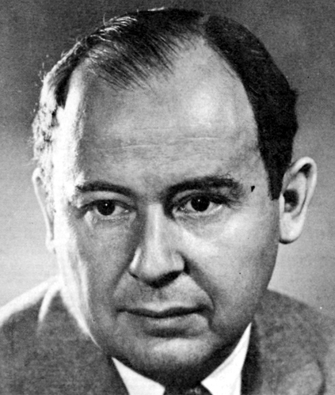
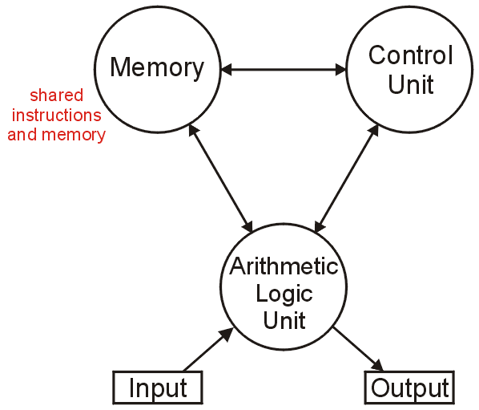
Merge Sort
The (likely) first implementation of merge sort was on the ENIAC in 1945 by John von Neumann
The creator of the von Neumann architecture used by all modern computers:
http://en.wikipedia.org/wiki/Von_Neumann

Slide 80
Summary
This topic covered merge sort:
Divide an unsorted list into two equal or nearly equal sub lists,
Sorts each of the sub lists by calling itself recursively, and then
Merges the two sub lists together to form a sorted list

Slide 81
References
Wikipedia, http://en.wikipedia.org/wiki/Sorting_algorithm http://en.wikipedia.org/wiki/Sorting_algorithm#Inefficient.2Fhumorous_sorts
[1] Donald E. Knuth, The Art of Computer Programming, Volume 3: Sorting and Searching, 2nd Ed., Addison Wesley, 1998, §5.1, 2, 3.
[2] Cormen, Leiserson, and Rivest, Introduction to Algorithms, McGraw Hill, 1990, p.137-9 and §9.1.
[3] Weiss, Data Structures and Algorithm Analysis in C++, 3rd Ed., Addison Wesley, §7.1, p.261-2.
[4] Gruber, Holzer, and Ruepp, Sorting the Slow Way: An Analysis of Perversely Awful Randomized Sorting Algorithms, 4th International Conference on Fun with Algorithms, Castiglioncello, Italy, 2007.
These slides are provided for the ECE 250 Algorithms and Data Structures course. The material in it reflects Douglas W. Harder’s best judgment in light of the information available to him at the time of preparation. Any reliance on these course slides by any party for any other purpose are the responsibility of such parties. Douglas W. Harder accepts no responsibility for damages, if any, suffered by any party as a result of decisions made or actions based on these course slides for any other purpose than that for which it was intended.

