Slide 1

Outline
In this topic, we will:
  Define a binary min-heap
  Look at some examples
  Operations on heaps:
    Top
    Pop
    Push
  An array representation of heaps
  Define a binary max-heap
  Using binary heaps as priority queues

Slide 2
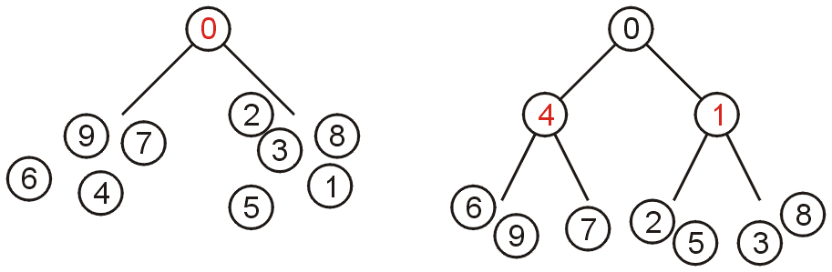
Definition
7.2
A non-empty binary tree is a min-heap if
  The key associated with the root is less than or equal to the keys associated with either of the sub-trees (if any)
  Both of the sub-trees (if any) are also binary min-heaps
From this definition:
  A single node is a min-heap
  All keys in either sub-tree are greater than the root key

Slide 3
Definition
7.2
Important:
THERE IS NO OTHER RELATIONSHIP BETWEEN
THE ELEMENTS IN THE TWO SUBTREES

Slide 4
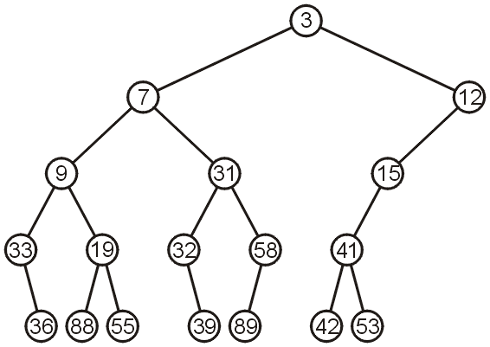
Example
7.2
This is a binary min-heap:

Slide 5
Operations
7.2.1
We will consider three operations:
  Top
  Pop
  Push
Notes:
5

Slide 6
Example
7.2.1.1
We can find the top object in Θ(1) time: 3

Slide 7
Pop
7.2.1.2
To remove the minimum object:
  Promote the node of the sub-tree which has the least value
  Recurs down the sub-tree from which we promoted the least value

Slide 8
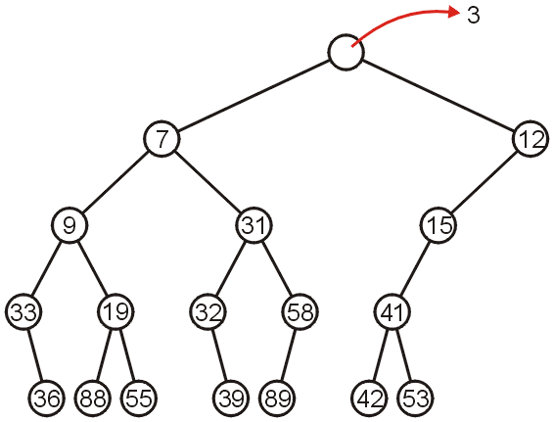
Pop
7.2.1.2
Using our example, we remove 3:

Slide 9
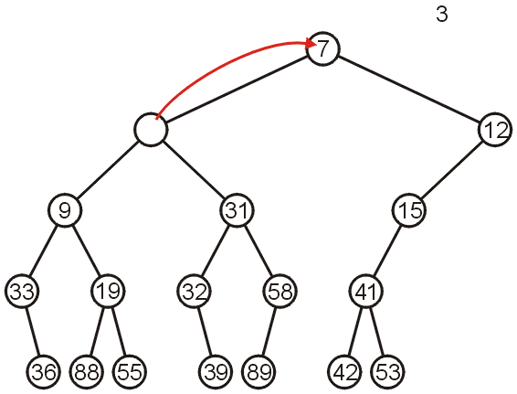
Pop
7.2.1.2
We promote 7 (the minimum of 7 and 12) to the root:

Slide 10
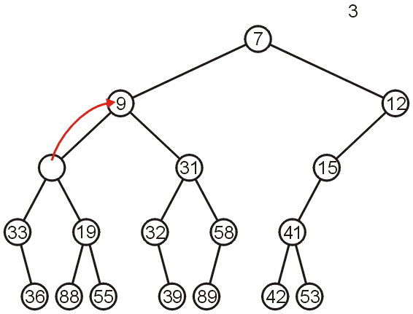
Pop
7.2.1.2
In the left sub-tree, we promote 9:

Slide 11
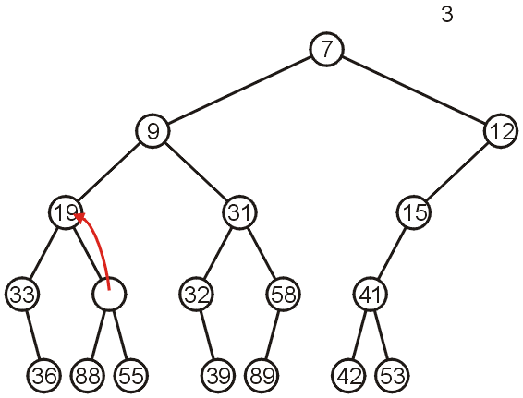
Pop
7.2.1.2
Recursively, we promote 19:

Slide 12
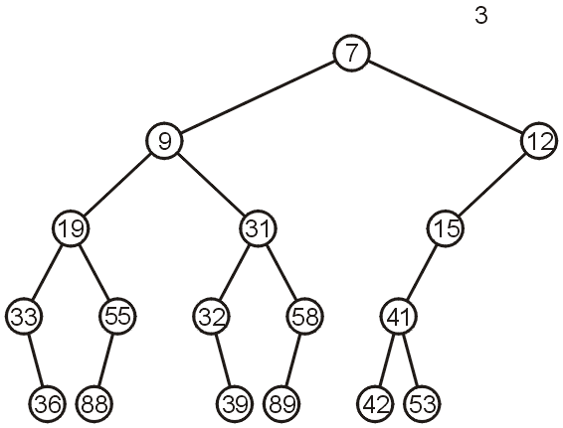
Pop
7.2.1.2
Finally, 55 is a leaf node, so we promote it and delete the leaf

Slide 13
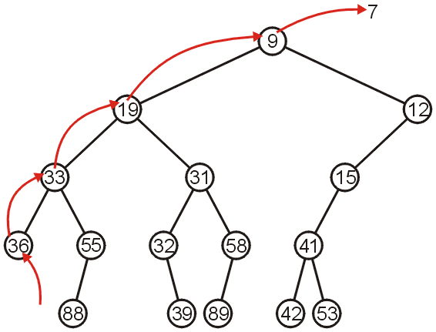
Pop
7.2.1.2
Repeating this operation again, we can remove 7:

Slide 14
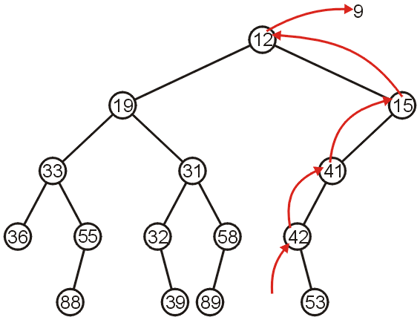
Pop
7.2.1.2
If we remove 9, we must now promote from the right sub-tree:

Slide 15
Push
7.2.1.3
Inserting into a heap may be done either:
  At a leaf (move it up if it is smaller than the parent)
  At the root (insert the larger object into one of the subtrees)
We will use the first approach with binary heaps
  Other heaps use the second

Slide 16
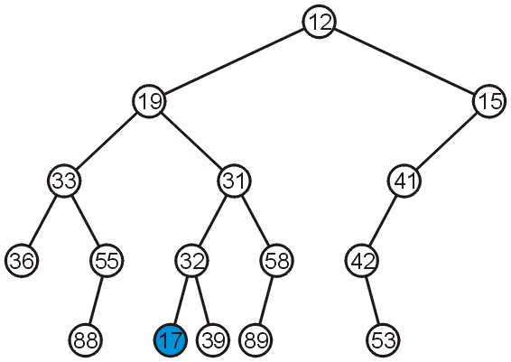
Push
7.2.1.3
Inserting 17 into the last heap
  Select an arbitrary node to insert a new leaf node:

Slide 17
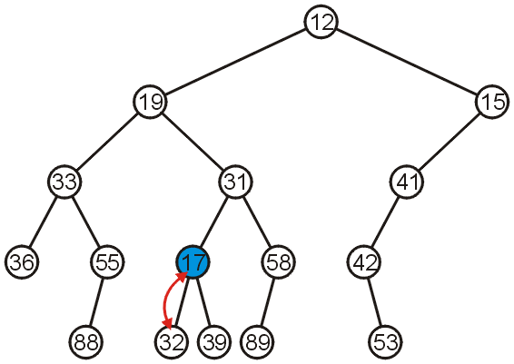
Push
7.2.1.3
The node 17 is less than the node 32, so we swap them

Slide 18
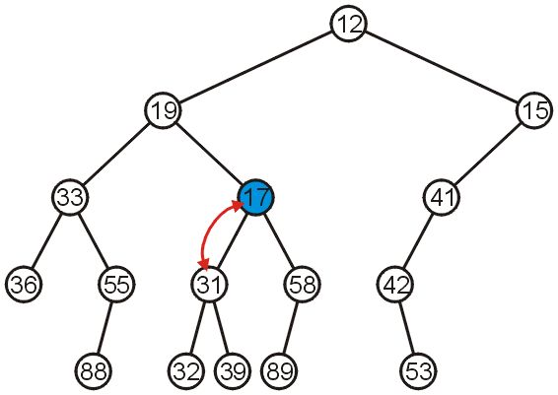
Push
7.2.1.3
The node 17 is less than the node 31; swap them

Slide 19
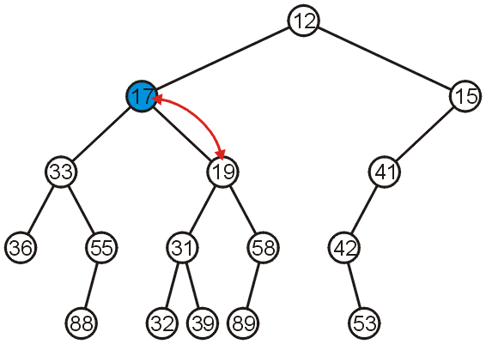
Push
7.2.1.3
The node 17 is less than the node 19; swap them

Slide 20
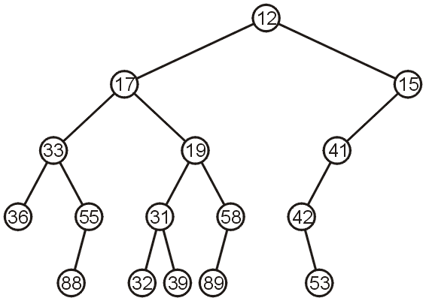
Push
7.2.1.3
The node 17 is greater than 12 so we are finished

Slide 21
Push
7.2.1.3
Observation: both the left and right subtrees of 19 were greater than 19, thus we are guaranteed that we don’t have to send the new node down
This process is called percolation, that is, the lighter (smaller) objects move up from the bottom of the min-heap

Slide 22
Balance
7.2.2
With binary search trees, we introduced the concept of balance
From this, we looked at:
  AVL Trees
  B-Trees
  Red-black Trees (not course material)
How can we determine where to insert so as to keep balance?

Slide 23
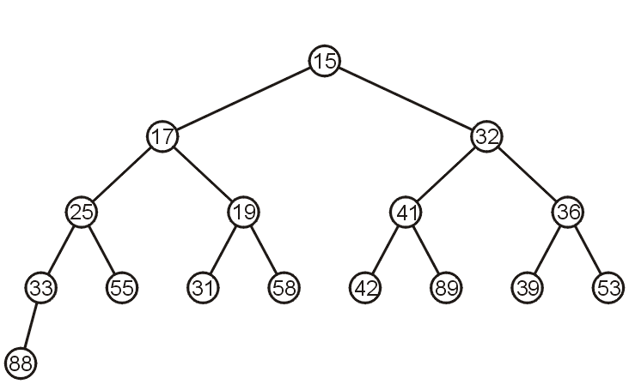
Array Implementation
7.2.3.1
For the heap
a breadth-first traversal yields:

Slide 24
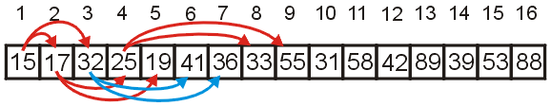
Array Implementation
7.2.3.1
Recall that If we associate an index–starting at 1–with each entry in the breadth-first traversal, we get:
Given the entry at index k, it follows that:
  The parent of node is a k/2 parent = k >> 1;
  the children are at 2k and 2k + 1 left_child = k << 1;
  right_child = left_child | 1;
Cost (trivial): start array at position 1 instead of position 0

Slide 25
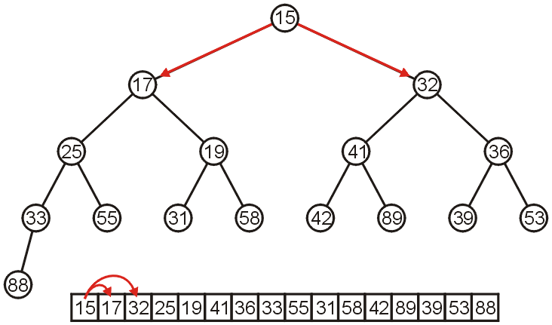
Array Implementation
7.2.3.1
The children of 15 are 17 and 32:

Slide 26
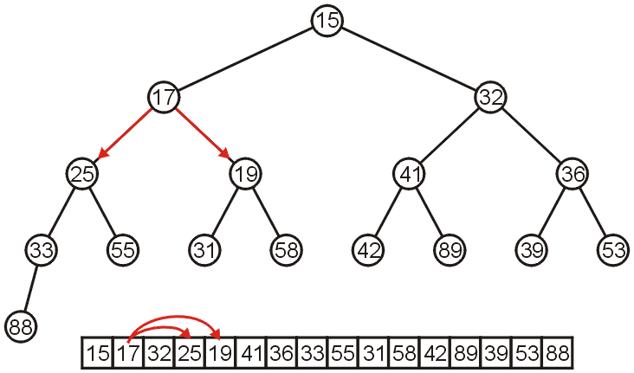
Array Implementation
7.2.3.1
The children of 17 are 25 and 19:

Slide 27
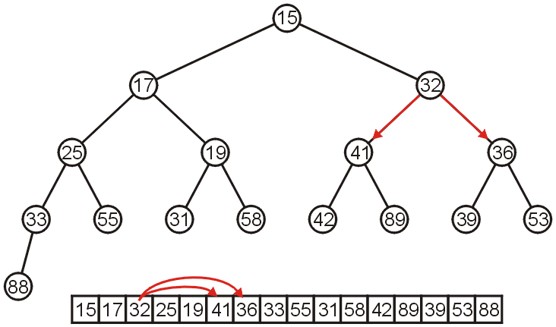
Array Implementation
7.2.3.1
The children of 32 are 41 and 36:

Slide 28
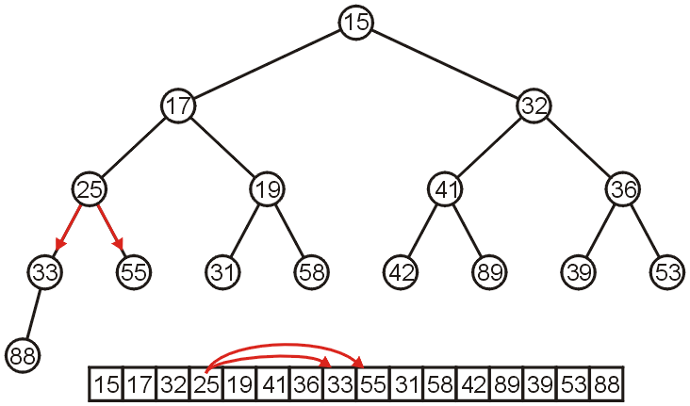
Array Implementation
7.2.3.1
The children of 25 are 33 and 55:

Slide 29
Array Implementation
7.2.3.1
If the heap-as-array has count entries, then the next empty node in the corresponding complete tree is at location posn = count + 1
We compare the item at location posn with the item at posn/2
If they are out of order
  Swap them, set posn /= 2 and repeat

Slide 30
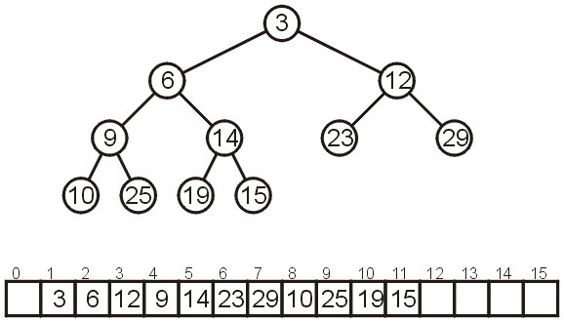
Array Implementation
7.2.3.2
Consider the following heap, both as a tree and in its array representation

Slide 31
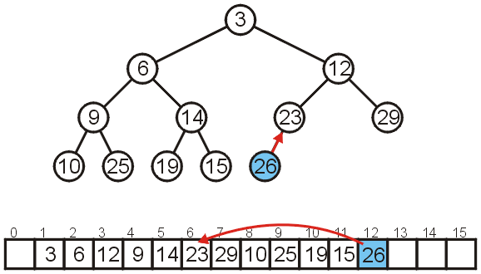
Array Implementation: Push
7.2.3.2.1
Inserting 26 requires no changes

Slide 32
Array Implementation: Push
7.2.3.2.1
Inserting 8 requires a few percolations:
  Swap 8 and 23

Slide 33
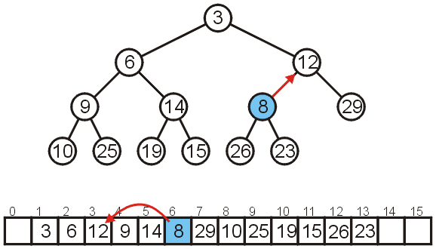
Array Implementation: Push
7.2.3.2.1
Swap 8 and 12

Slide 34
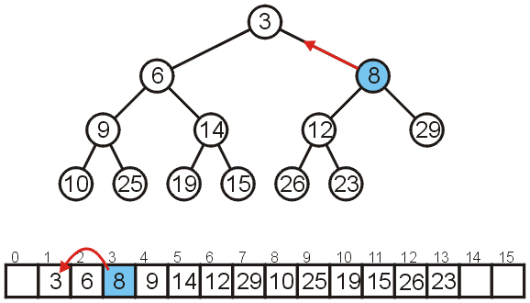
Array Implementation: Push
7.2.3.2.1
At this point, it is greater than its parent, so we are finished

Slide 35
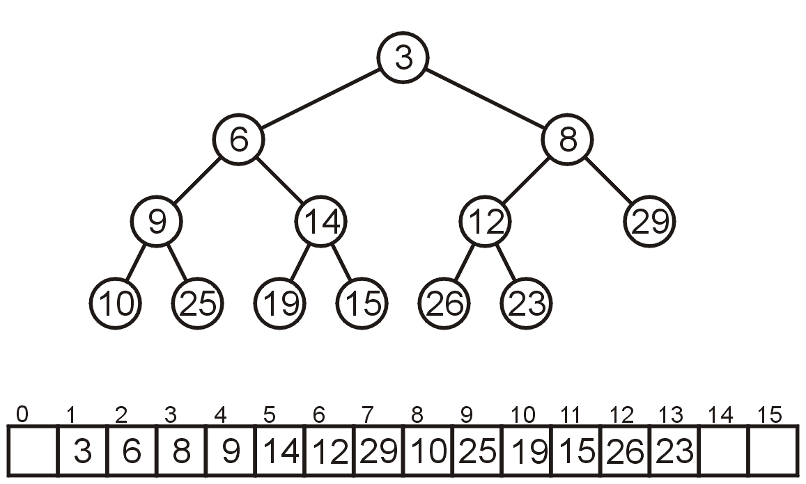
Array Implementation: Pop
7.2.3.2.2
As before, popping the top has us copy the last entry to the top

Slide 36
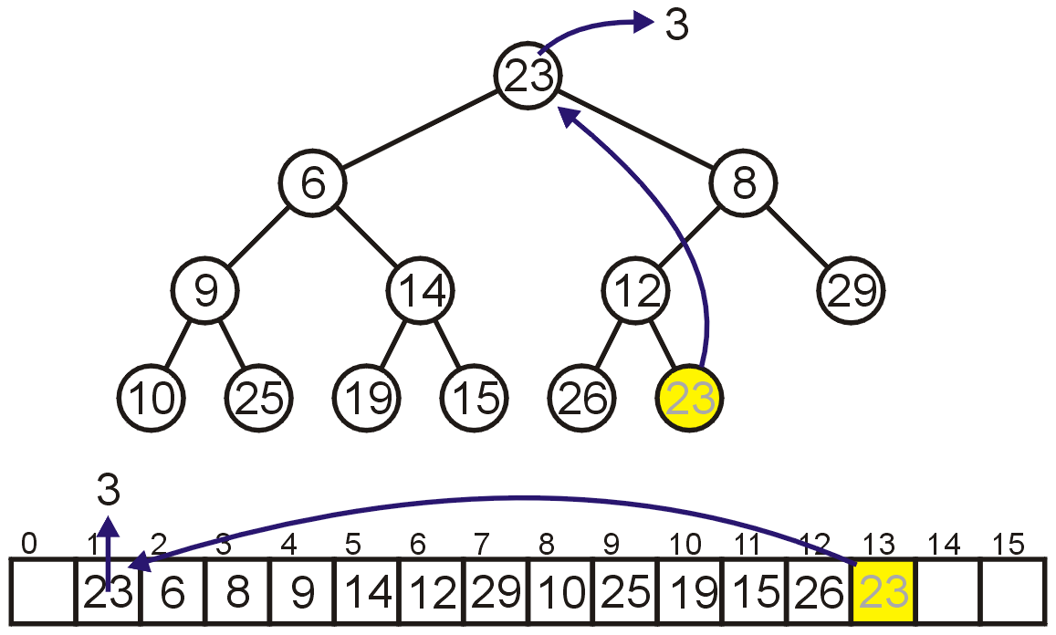
Array Implementation: Pop
7.2.3.2.2
Instead, consider this strategy:
  Copy the last object, 23, to the root

Slide 37
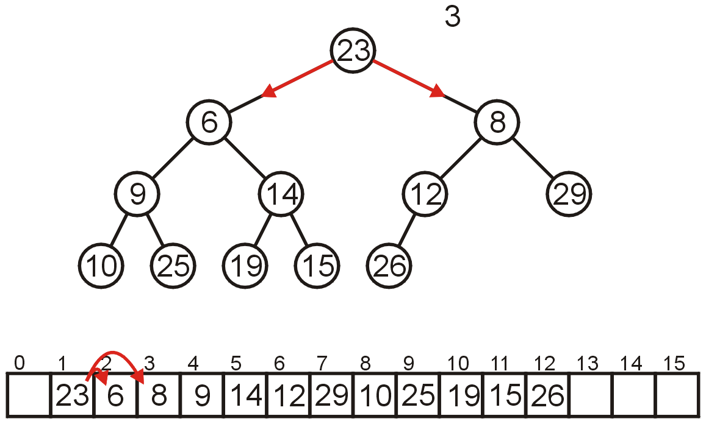
Array Implementation: Pop
7.2.3.2.2
Now percolate down
Compare Node 1 with its children: Nodes 2 and 3
  Swap 23 and 6

Slide 38
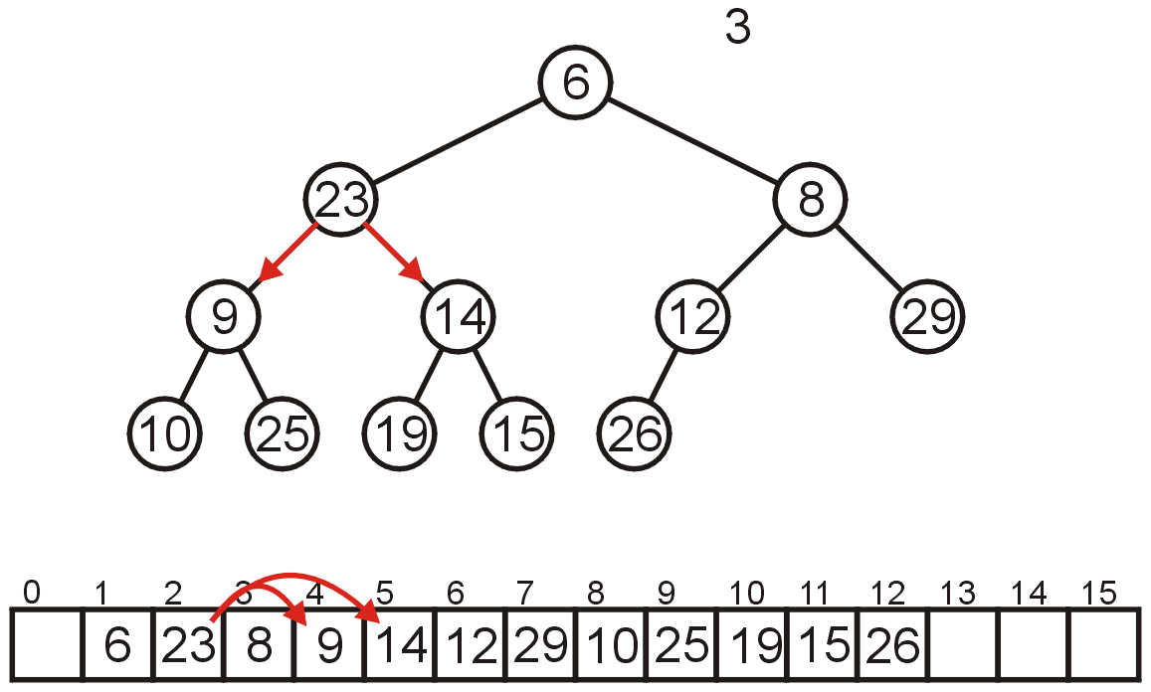
Array Implementation: Pop
7.2.3.2.2
Compare Node 2 with its children: Nodes 4 and 5
  Swap 23 and 9

Slide 39
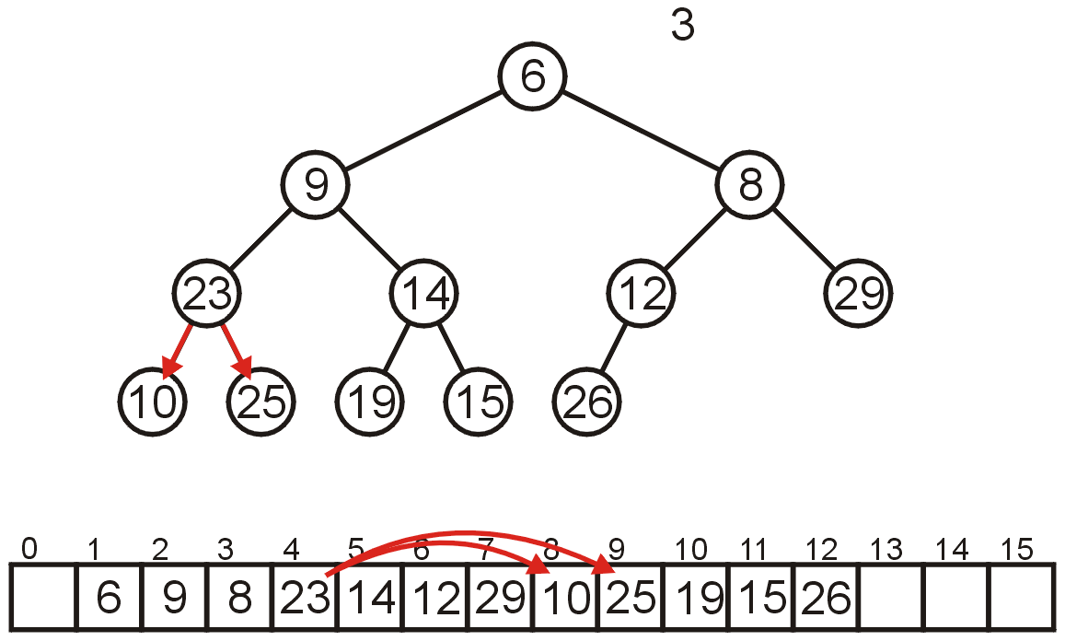
Array Implementation: Pop
7.2.3.2.2
Compare Node 4 with its children: Nodes 8 and 9
  Swap 23 and 10

Slide 40
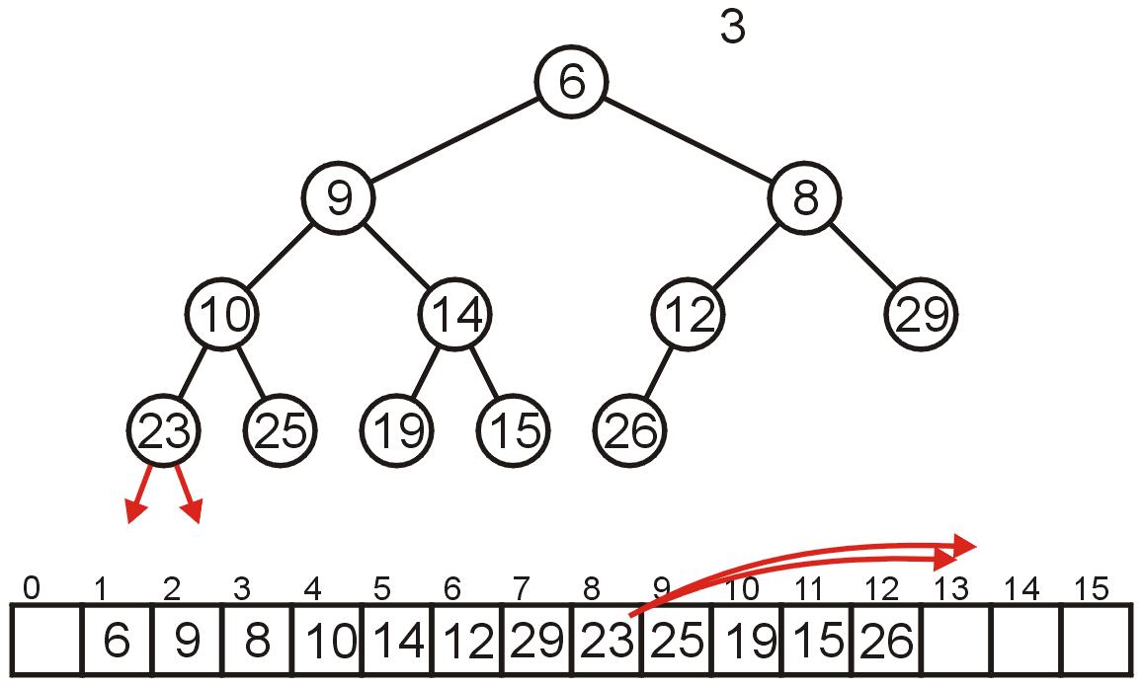
Array Implementation: Pop
7.2.3.2.2
The children of Node 8 are beyond the end of the array:
  Stop

Slide 41
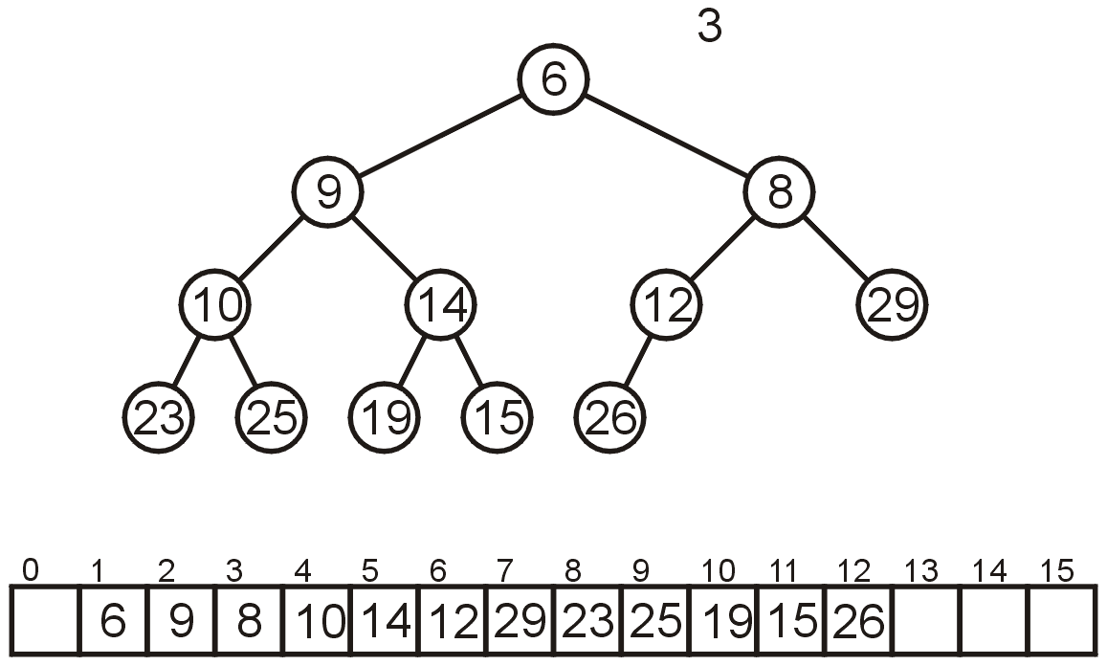
Array Implementation: Pop
7.2.3.2.2
The result is a binary min-heap

Slide 42
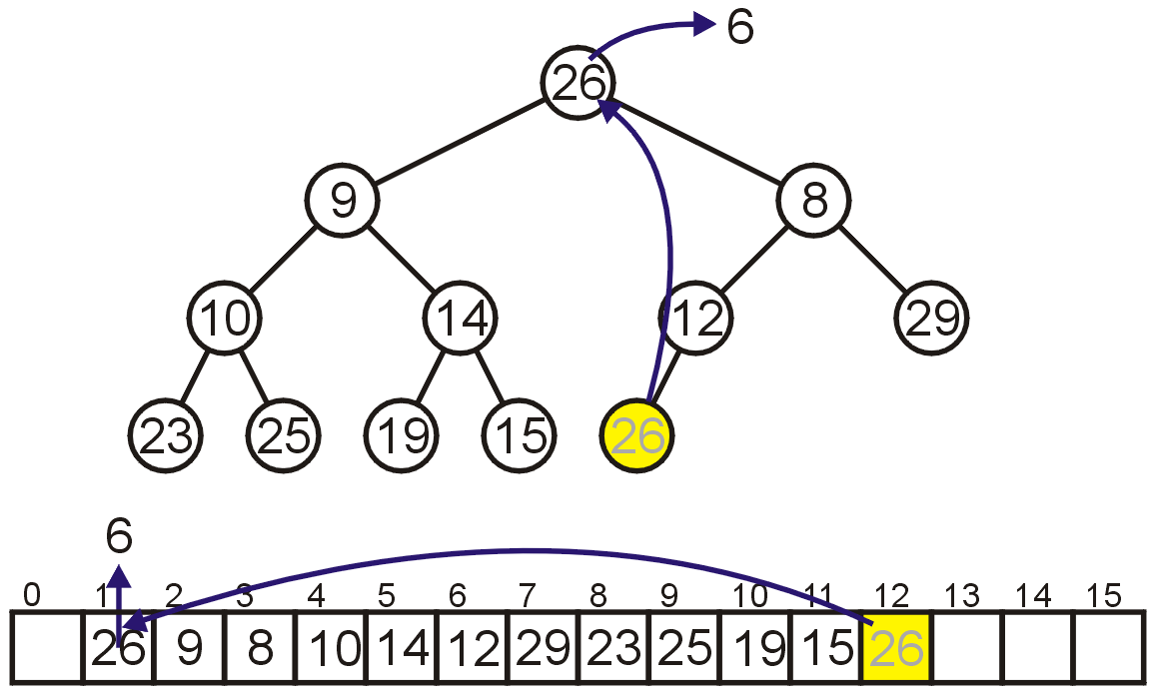
Array Implementation: Pop
7.2.3.2.2
Dequeuing the minimum again:
  Copy 26 to the root

Slide 43
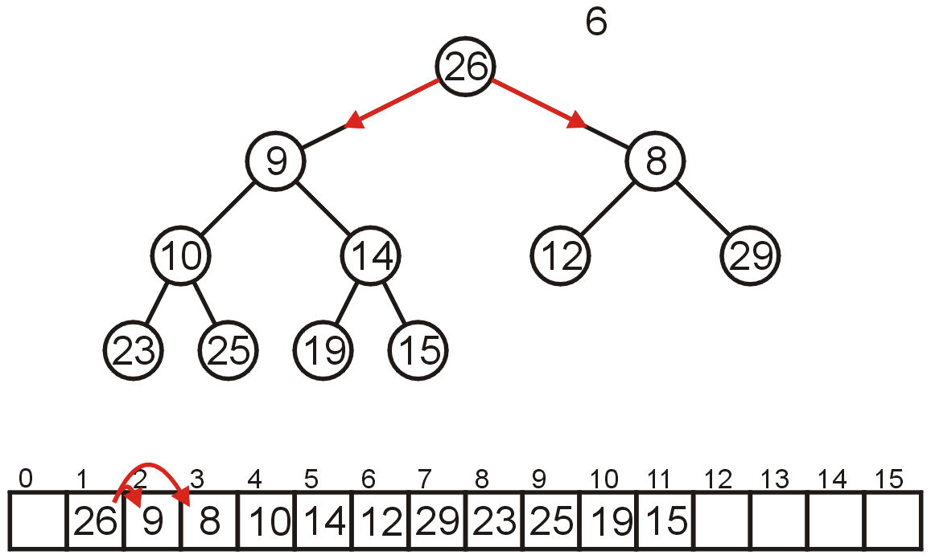
Array Implementation: Pop
7.2.3.2.2
Compare Node 1 with its children: Nodes 2 and 3
  Swap 26 and 8

Slide 44
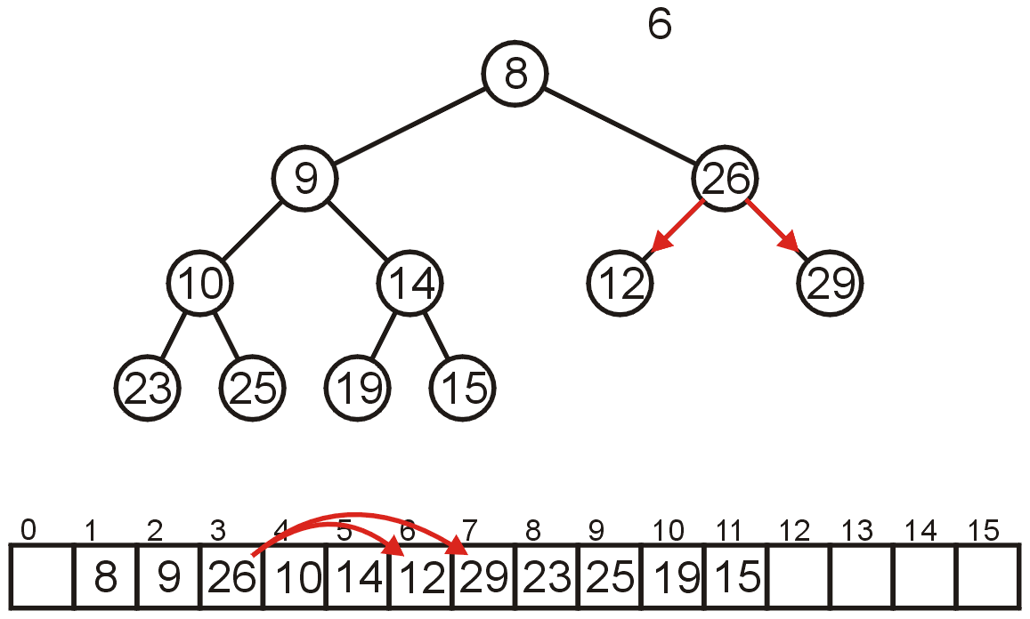
Array Implementation: Pop
7.2.3.2.2
Compare Node 3 with its children: Nodes 6 and 7
  Swap 26 and 12

Slide 45
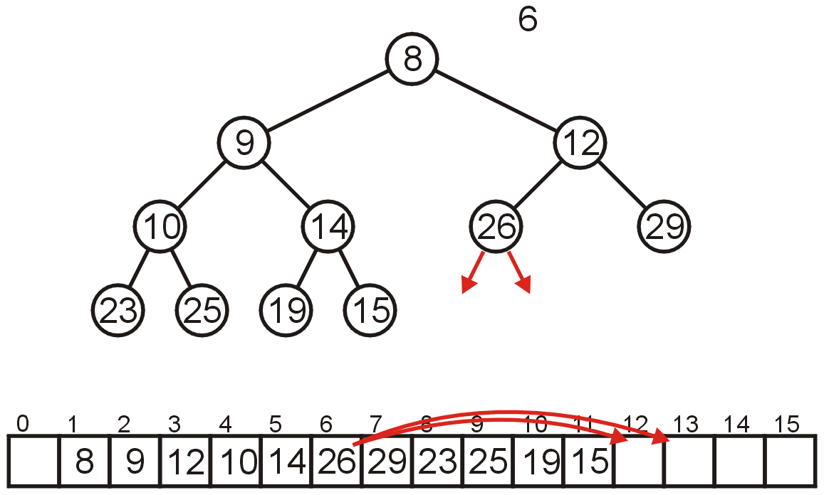
Array Implementation: Pop
7.2.3.2.2
The children of Node 6, Nodes 12 and 13 are unoccupied
  Currently, count == 11

Slide 46
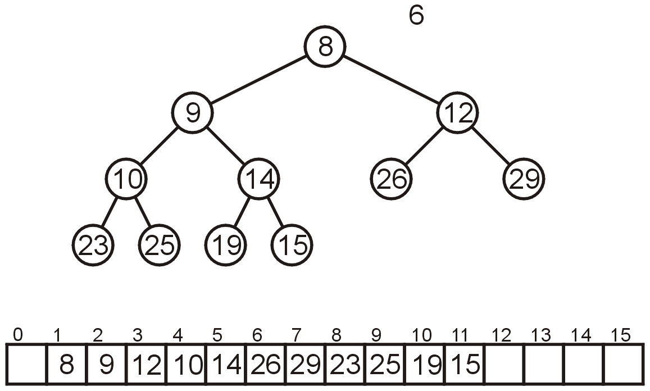
Array Implementation: Pop
7.2.3.2.2
The result is a min-heap

Slide 47
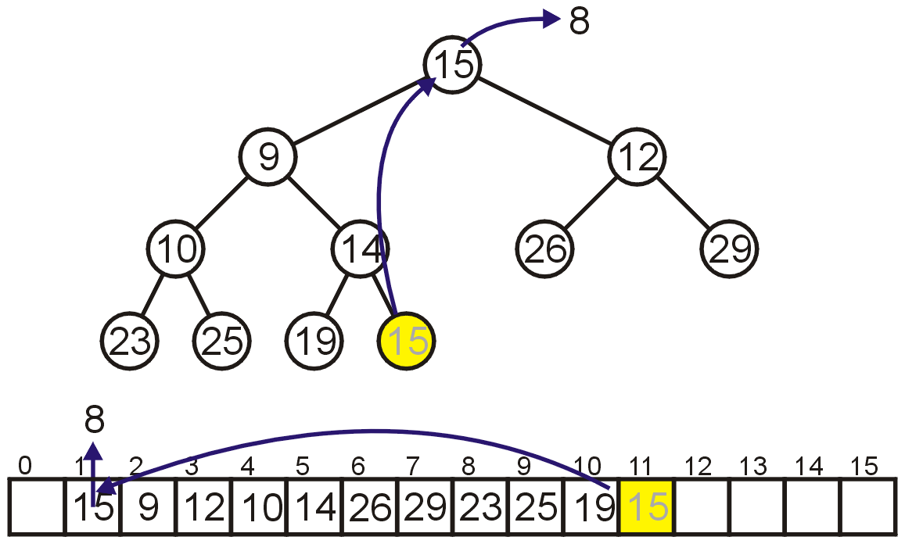
Array Implementation: Pop
7.2.3.2.2
Dequeuing the minimum a third time:
  Copy 15 to the root

Slide 48
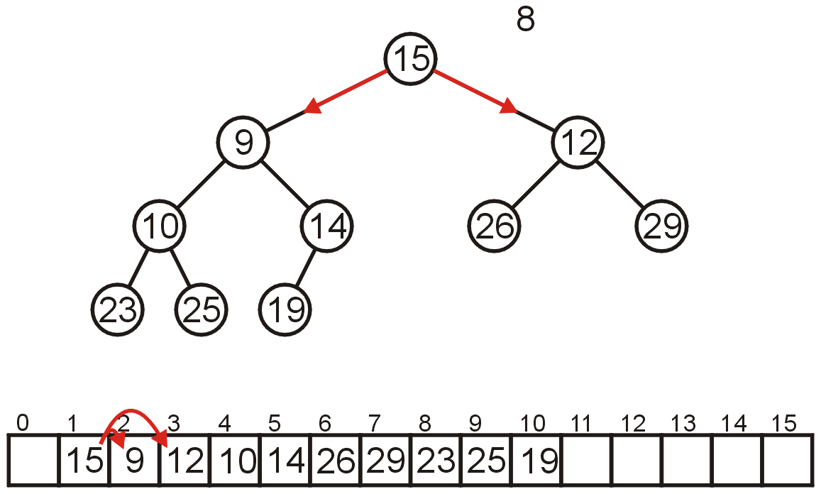
Array Implementation: Pop
7.2.3.2.2
Compare Node 1 with its children: Nodes 2 and 3
  Swap 15 and 9

Slide 49
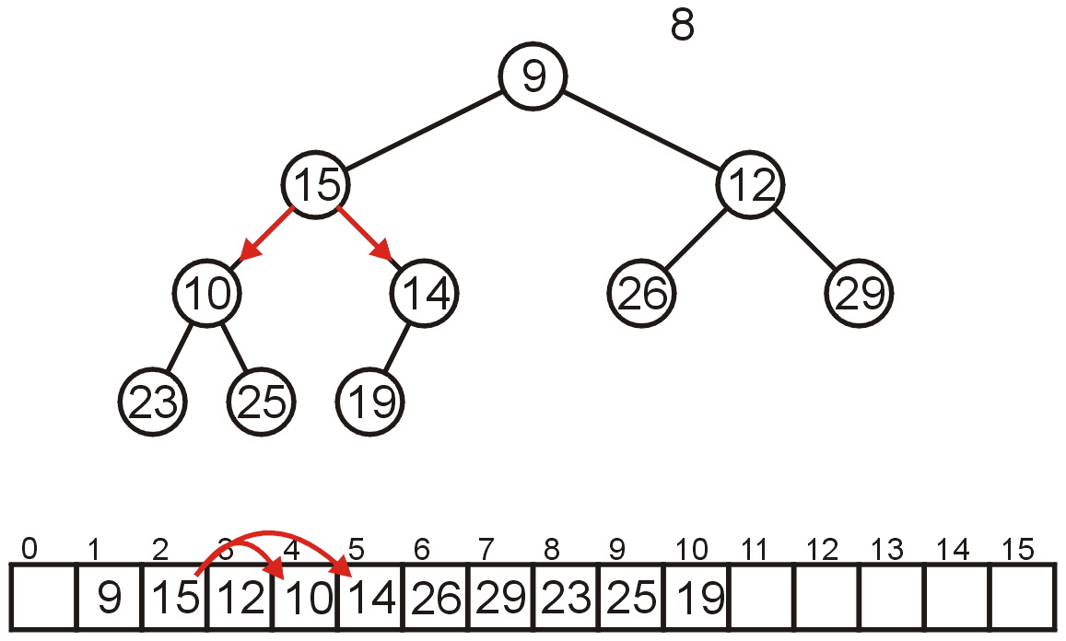
Array Implementation: Pop
7.2.3.2.2
Compare Node 2 with its children: Nodes 4 and 5
  Swap 15 and 10

Slide 50
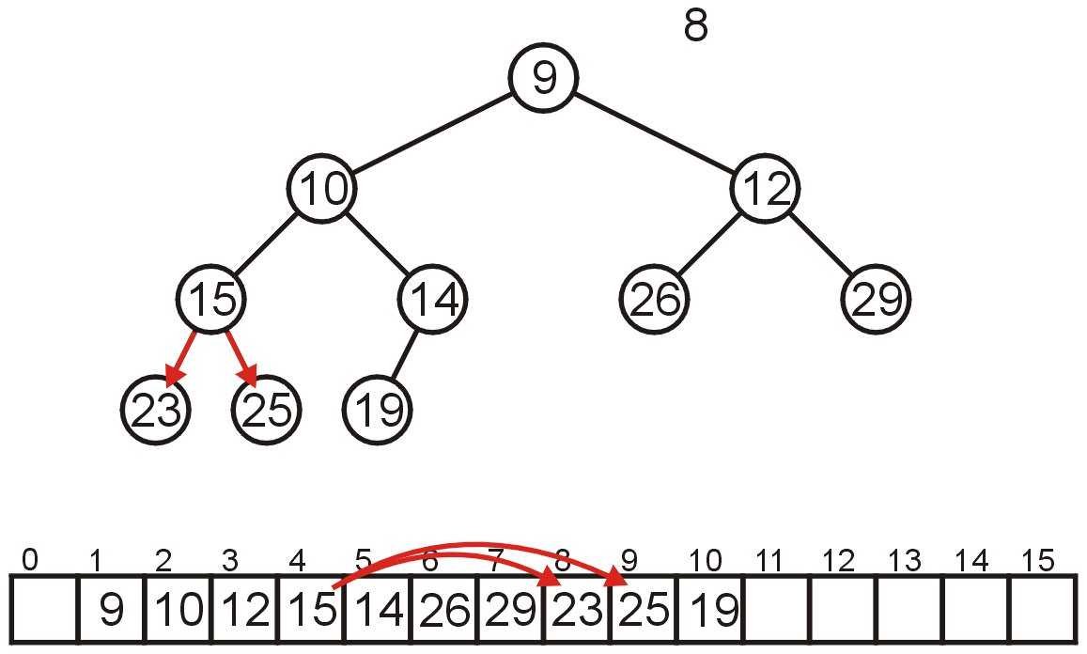
Array Implementation: Pop
7.2.3.2.2
Compare Node 4 with its children: Nodes 8 and 9
  15 < 23 and 15 < 25 so stop

Slide 51
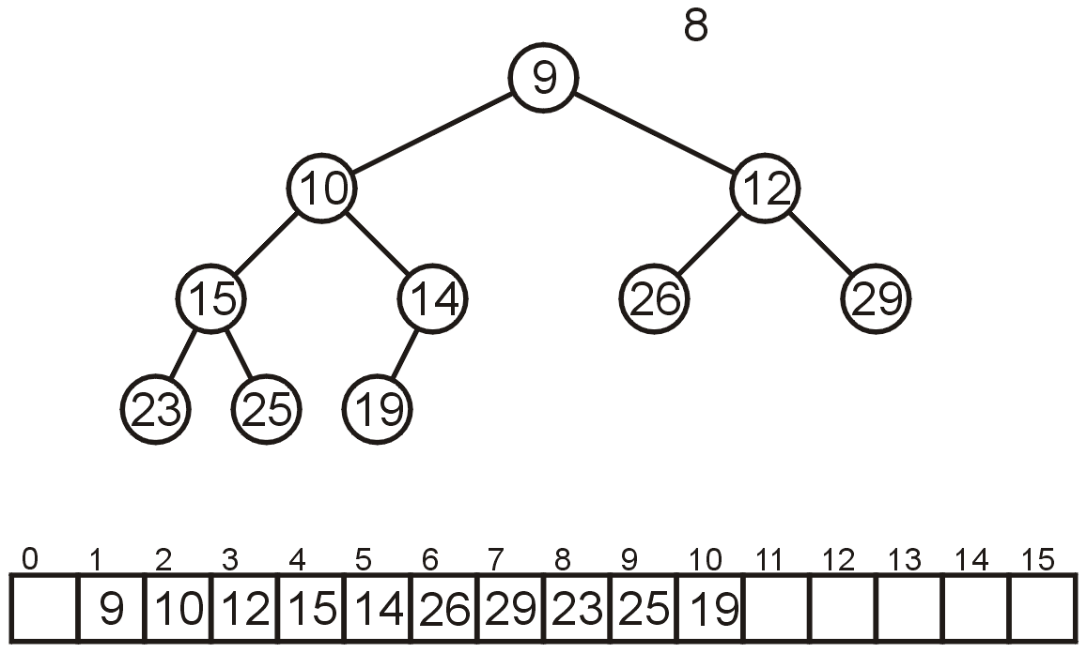
Array Implementation: Pop
7.2.3.2.2
The result is a properly formed binary min-heap

Slide 52
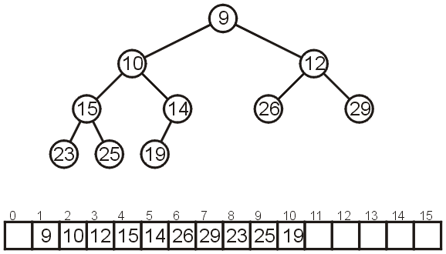
Array Implementation: Pop
7.2.3.2.2
After all our modifications, the final heap is

Slide 53
Run-time Analysis
7.2.4
Accessing the top object is Θ(1)
Popping the top object is O(ln(n))
  We copy something that is already in the lowest depth—it will likely be moved back to the lowest depth
How about push?

Slide 54
Run-time Analysis
7.2.4
If we are inserting an object less than the root (at the front), then the run time will be Θ(ln(n))
If we insert at the back (greater than any object) then the run time will be Θ(1)
How about an arbitrary insertion?
  It will be O(ln(n))? Could the average be less?

Slide 55
Run-time Analysis
7.2.4
With each percolation, it will move an object past half of the remaining entries in the tree
  Therefore after one percolation, it will probably be past half of the entries, and therefore on average will require no more percolations
Therefore, we have an average run time of Θ(1)

Slide 56
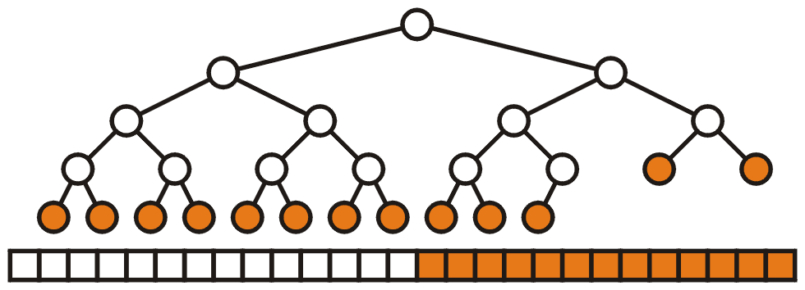
Run-time Analysis
7.2.4
An arbitrary removal requires that all entries in the heap be checked: O(n)
A removal of the largest object in the heap still requires all leaf nodes to be checked – there are approximately n/2 leaf nodes: O(n)

Slide 57
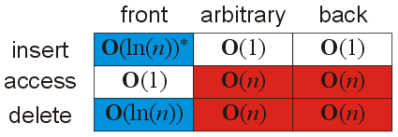
Run-time Analysis
7.2.4
Thus, our grid of run times is given by:

Slide 58
Outline
This topic covers the simplest Θ(n ln(n)) sorting algorithm: heap sort
We will:
  define the strategy
  analyze the run time
  convert an unsorted list into a heap
  cover some examples
Bonus: may be performed in place

Slide 59
Heap Sort
8.4.1
Recall that inserting n objects into a min-heap and then taking n objects will result in them coming out in order
Strategy: given an unsorted list with n objects, place them into a heap, and take them out

Slide 60
Run time Analysis of Heap Sort
8.4.1
Taking an object out of a heap with n items requires O(ln(n)) time
Therefore, taking n objects out requires
Recall that ln(a) + ln(b) = ln(ab)
Question: What is the asymptotic growth of ln(n!)?

Slide 61
Run time Analysis of Heap Sort
8.4.1
Using Maple:
> asympt( ln( n! ), n );
The leading term is (ln(n) – 1) n
Therefore, the run time is O(n ln(n))

Slide 62
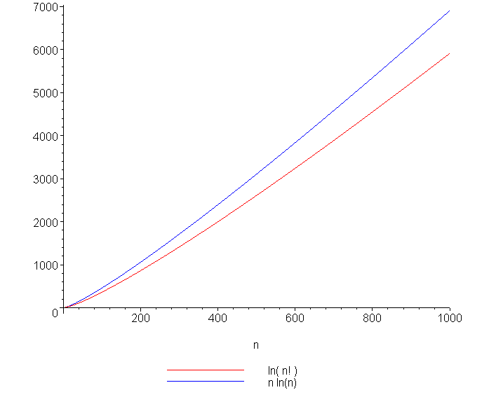
ln(n!) and n ln(n)
8.4.1
A plot of ln(n!) and n ln(n) also suggests that they are asymptotically related:

Slide 63
In-place Implementation
8.4.2
Problem:
  This solution requires additional memory, that is, a min-heap of size n
This requires Θ(n) memory and is therefore not in place
Is it possible to perform a heap sort in place, that is, require at most Θ(1) memory (a few extra variables)?

Slide 64
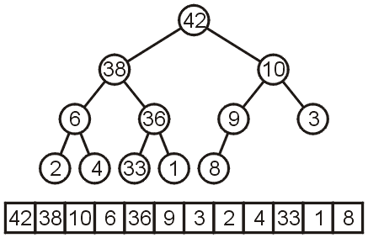
In-place Implementation
8.4.2
Instead of implementing a min-heap, consider a max-heap:
  A heap where the maximum element is at the top of the heap and the next to be popped

Slide 65

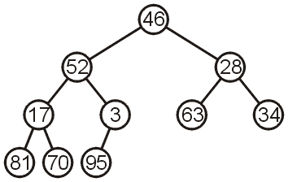
In-place Heapification
8.4.2
Now, consider this unsorted array:
This array represents the following complete tree:
This is neither a min-heap, max-heap, or binary search tree

Slide 66
In-place Heapification
8.4.2
Now, consider this unsorted array:
Additionally, because arrays start at 0 (we started at entry 1 for binary heaps) , we need different formulas for the children and parent
The formulas are now:
Children 2*k + 1 2*k + 2
Parent (k + 1)/2 - 1

Slide 67
In-place Heapification
8.4.2
Can we convert this complete tree into a max heap?
Restriction:
  The operation must be done in-place

Slide 68
In-place Heapification
Two strategies:
  Assume 46 is a max-heap and keep inserting the next element into the existing heap (similar to the strategy for insertion sort)
  Start from the back: note that all leaf nodes are already max heaps, and then make corrections so that previous nodes also form max heaps

Slide 69
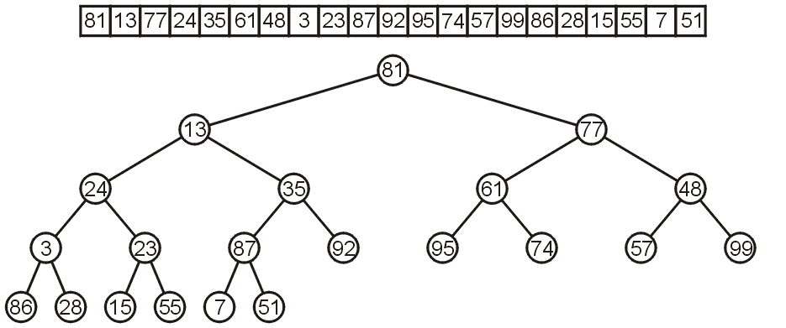
In-place Heapification
8.4.3
Let’s work bottom-up: each leaf node is a max heap on its own

Slide 70
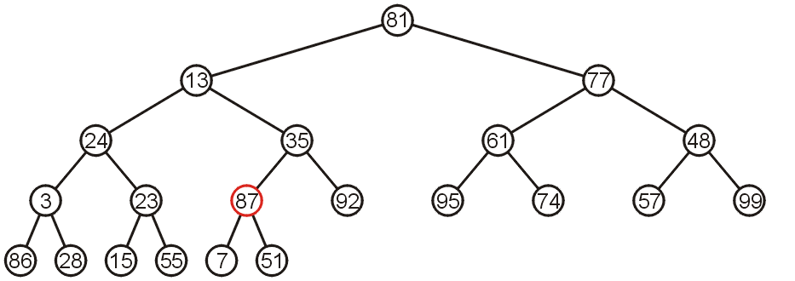
In-place Heapification
8.4.3
Starting at the back, we note that all leaf nodes are trivial heaps
Also, the subtree with 87 as the root is a max-heap

Slide 71
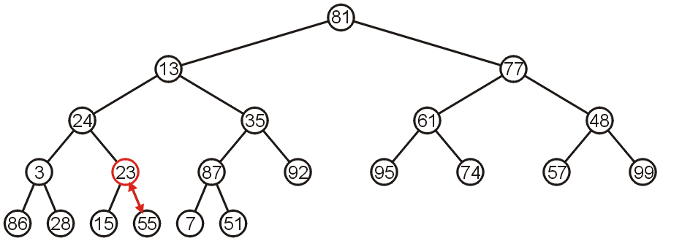
In-place Heapification
8.4.3
The subtree with 23 is not a max-heap, but swapping it with 55 creates a max-heap
This process is termed percolating down

Slide 72

In-place Heapification
8.4.3
The subtree with 3 as the root is not max-heap, but we can swap 3 and the maximum of its children: 86

Slide 73

In-place Heapification
8.4.3
Starting with the next higher level, the subtree with root 48 can be turned into a max-heap by swapping 48 and 99

Slide 74

In-place Heapification
8.4.3
Similarly, swapping 61 and 95 creates a max-heap of the next subtree

Slide 75

In-place Heapification
8.4.3
As does swapping 35 and 92

Slide 76

In-place Heapification
8.4.3
The subtree with root 24 may be converted into a max-heap by first swapping 24 and 86 and then swapping 24 and 28

Slide 77

In-place Heapification
8.4.3
The right-most subtree of the next higher level may be turned into a max-heap by swapping 77 and 99

Slide 78

In-place Heapification
8.4.3
However, to turn the next subtree into a max-heap requires that 13 be percolated down to a leaf node

Slide 79

In-place Heapification
8.4.3
The root need only be percolated down by two levels

Slide 80

In-place Heapification
8.4.3
The final product is a max-heap

Slide 81

Run-time Analysis of Heapify
8.4.3.1
Considering a perfect tree of height h:
  The maximum number of swaps which a second-lowest level would experience is 1, the next higher level, 2, and so on

Slide 82
Run-time Analysis of Heapify
8.4.3.1
At depth k, there are 2^{k} nodes and in the worst case, all of these nodes would have to percolated down h – k levels
  In the worst case, this would requiring a total of 2^{k}(h – k) swaps
Writing this sum mathematically, we get:

Slide 83
Run-time Analysis of Heapify
8.4.3.1
Recall that for a perfect tree, n = 2^{h + 1} – 1 and h + 1 = lg(n + 1), therefore
Each swap requires two comparisons (which child is greatest), so there is a maximum of 2n (or Θ(n)) comparisons

Slide 84
Run-time Analysis of Heapify
8.4.3.1
Note that if we go the other way (treat the first entry as a max heap and then continually insert new elements into that heap, the run time is at worst
  It is significantly better to start at the back

Slide 85
Example Heap Sort
8.4.4
Let us look at this example: we must convert the unordered array with n = 10 elements into a max-heap
None of the leaf nodes need to
be percolated down, and the first
non-leaf node is in position n/2
Thus we start with position 10/2 = 5

Slide 86

Example Heap Sort
8.4.4
We compare 3 with its child and swap them

Slide 87

Example Heap Sort
8.4.4
We compare 17 with its two children and swap it with the maximum child (70)

Slide 88

Example Heap Sort
8.4.4
We compare 28 with its two children, 63 and 34, and swap it with the largest child

Slide 89

Example Heap Sort
8.4.4
We compare 52 with its children, swap it with the largest
  Recursing, no further swaps are needed

Slide 90

Example Heap Sort
8.4.4
Finally, we swap the root with its largest child, and recurse, swapping 46 again with 81, and then again with 70

Slide 91

Heap Sort Example
8.4.4
We have now converted the unsorted array
into a max-heap:

Slide 92


Heap Sort Example
8.4.4
Suppose we pop the maximum element of this heap
This leaves a gap at the back of the array:

Slide 93


Heap Sort Example
8.4.4
This is the last entry in the array, so why not fill it with the largest element?
Repeat this process: pop the maximum element, and then insert it at the end of the array:

Slide 94


Heap Sort Example
8.4.4
Repeat this process
  Pop and append 70
  Pop and append 63

Slide 95


Heap Sort Example
8.4.4
We have the 4 largest elements in order
  Pop and append 52
  Pop and append 46

Slide 96


Heap Sort Example
8.4.4
Continuing...
  Pop and append 34
  Pop and append 28

Slide 97

Heap Sort Example
8.4.4
Finally, we can pop 17, insert it into the 2nd location, and the resulting array is sorted

Slide 98
Black Board Example
8.4.5
Sort the following 12 entries using heap sort
34, 15, 65, 59, 79, 42, 40, 80, 50, 61, 23, 46

Slide 99
Heap Sort
8.4.6
Heapification runs in Θ(n)
Popping n items from a heap of size n, as we saw, runs in Θ(n ln(n)) time
  We are only making one additional copy into the blank left at the end of the array
Therefore, the total algorithm will run in Θ(n ln(n)) time

Slide 100
Heap Sort
8.4.6
There are no worst-case scenarios for heap sort
  Dequeuing from the heap will always require the same number of operations regardless of the distribution of values in the heap
There is one best case: if all the entries are identical, then the run time is Θ(n)
The original order may speed up the heapification, however, this would only speed up an Θ(n) portion of the algorithm

Slide 101
Run-time Summary
8.4.6
The following table summarizes the run-times of heap sort
Case | Run Time | Comments
Worst | Θ(n ln(n)) | No worst case
Average | Θ(n ln(n))
Best | Θ(n) | All or most entries are the same

Slide 102
Summary
8.4.6
We have seen our first in-place Θ(n ln(n)) sorting algorithm:
  Convert the unsorted list into a max-heap as complete array
  Pop the top n times and place that object into the vacancy at the end
  It requires Θ(1) additional memory—it is truly in-place
It is a nice algorithm; however, we will see two other faster n ln(n) algorithms; however:
  Merge sort requires Θ(n) additional memory
  Quick sort requires Θ(ln(n)) additional memory

Slide 103
References
Wikipedia, http://en.wikipedia.org/wiki/Heapsort
[1] Donald E. Knuth, The Art of Computer Programming, Volume 3: Sorting and Searching, 2nd Ed., Addison Wesley, 1998, §5.2.3, p.144-8.
[2] Cormen, Leiserson, and Rivest, Introduction to Algorithms, McGraw Hill, 1990, Ch. 7, p.140-9.
[3] Weiss, Data Structures and Algorithm Analysis in C++, 3rd Ed., Addison Wesley, §7.5, p.270-4.
These slides are provided for the ECE 250 Algorithms and Data Structures course. The material in it reflects Douglas W. Harder’s best judgment in light of the information available to him at the time of preparation. Any reliance on these course slides by any party for any other purpose are the responsibility of such parties. Douglas W. Harder accepts no responsibility for damages, if any, suffered by any party as a result of decisions made or actions based on these course slides for any other purpose than that for which it was intended.

