Slide 1
Outline
This topic will:
Describe Dijkstra’s algorithm for finding a shortest path from a single source vertex

Slide 2
Dijkstra’s algorithm
Dijkstra’s algorithm solves the single-source shortest path problem
It is very similar to Prim’s algorithm
Assumption: all the weights are positive

Slide 3
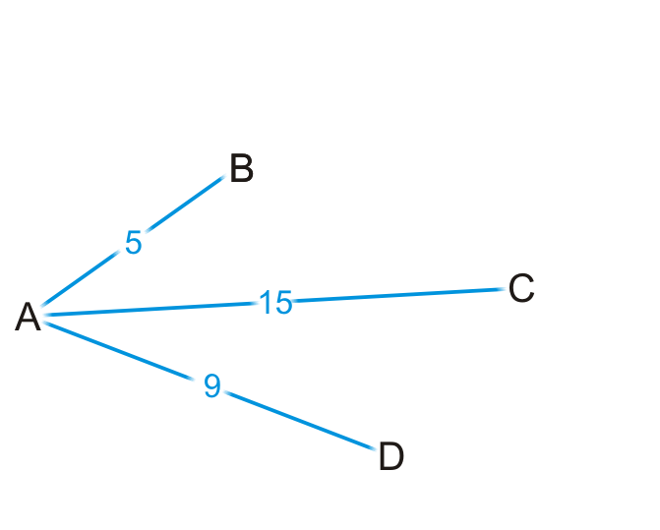
Strategy
Suppose you are at vertex A
You are aware of all vertices adjacent to it
This information is either in an adjacency list or adjacency matrix

Slide 4
Strategy
Is 5 the shortest distance to B via the edge (A, B)?
Why or why not?

Slide 5
Strategy
Are you guaranteed that the shortest path to C is (A, C), or that (A, D) is the shortest path to vertex D?

Slide 6
Strategy
We accept that (A, B) is the shortest path to vertex B from A
Let’s see where we can go from B

Slide 7
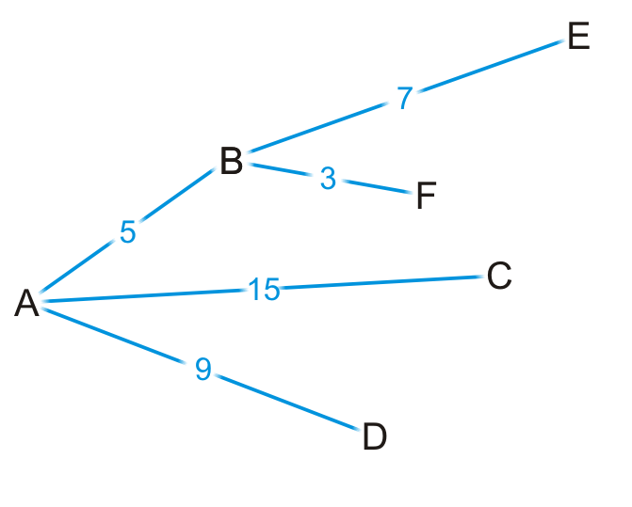
Strategy
By some simple arithmetic, we can determine that
There is a path (A, B, E) of length 5 + 7 = 12
There is a path (A, B, F) of length 5 + 3 = 8

Slide 8
Strategy
Is (A, B, F) is the shortest path from vertex A to F?
Why or why not?

Slide 9
Strategy
Are we guaranteed that any other path we are currently aware of is also going to be the shortest path?

Slide 10
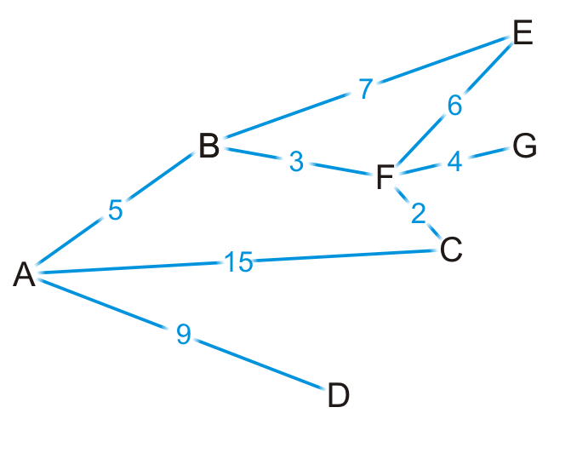
Strategy
Okay, let’s visit vertex F
We know the shortest path is (A, B, F) and it’s of length 8

Slide 11
Strategy
There are three edges exiting vertex F, so we have paths:
(A, B, F, E) of length 8 + 6 = 14
(A, B, F, G) of length 8 + 4 = 12
(A, B, F, C) of length 8 + 2 = 10

Slide 12
Strategy
By observation:
The path (A, B, F, E) is longer than (A, B, E)
The path (A, B, F, C) is shorter than the path (A, C)

Slide 13
Strategy
At this point, we’ve discovered the shortest paths to:
Vertex B: (A, B) of length 5
Vertex F: (A, B, F) of length 8

Slide 14
Strategy
At this point, we have the shortest distances to B and F
Which remaining vertex are we currently guaranteed to have the shortest distance to?

Slide 15
Dijkstra’s algorithm
Like Prim’s algorithm, we initially don’t know the distance to any vertex except the initial vertex
We require an array of distances, all initialized to infinity except for the source vertex, which is initialized to 0
Each time we visit a vertex, we will examine all adjacent vertices
We need to track visited vertices—a Boolean table of size |V|
Do we need to track the shortest path to each vertex?
That is, do I have to store (A, B, F) as the shortest path to vertex F?
We really only have to record that the shortest path to vertex F came from vertex B
We would then determine that the shortest path to vertex B came from vertex A
Thus, we need an array of previous vertices, all initialized to null

Slide 16
Dijkstra’s algorithm
Thus, we will iterate |V| times:
Find that unvisited vertex v that has a minimum distance to it
Mark it as having been visited
Consider every adjacent vertex w that is unvisited:
Is the distance to v plus the weight of the edge (v, w) less than our currently known shortest distance to w
If so, update the shortest distance to w and record v as the previous pointer
Continue iterating until all vertices are visited or all remaining vertices have a distance to them of infinity

Slide 17
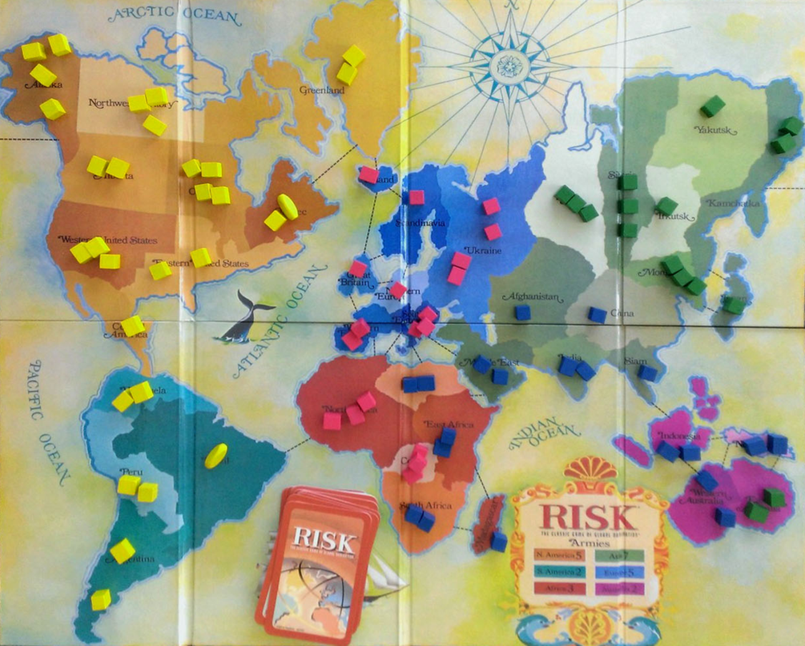
Example
Consider the game of Risk from Parker Brothers
A game of world domination
The world is divided into 42 connected regions
http://thunderbird37.com/tag/parker-brothers/

Slide 18
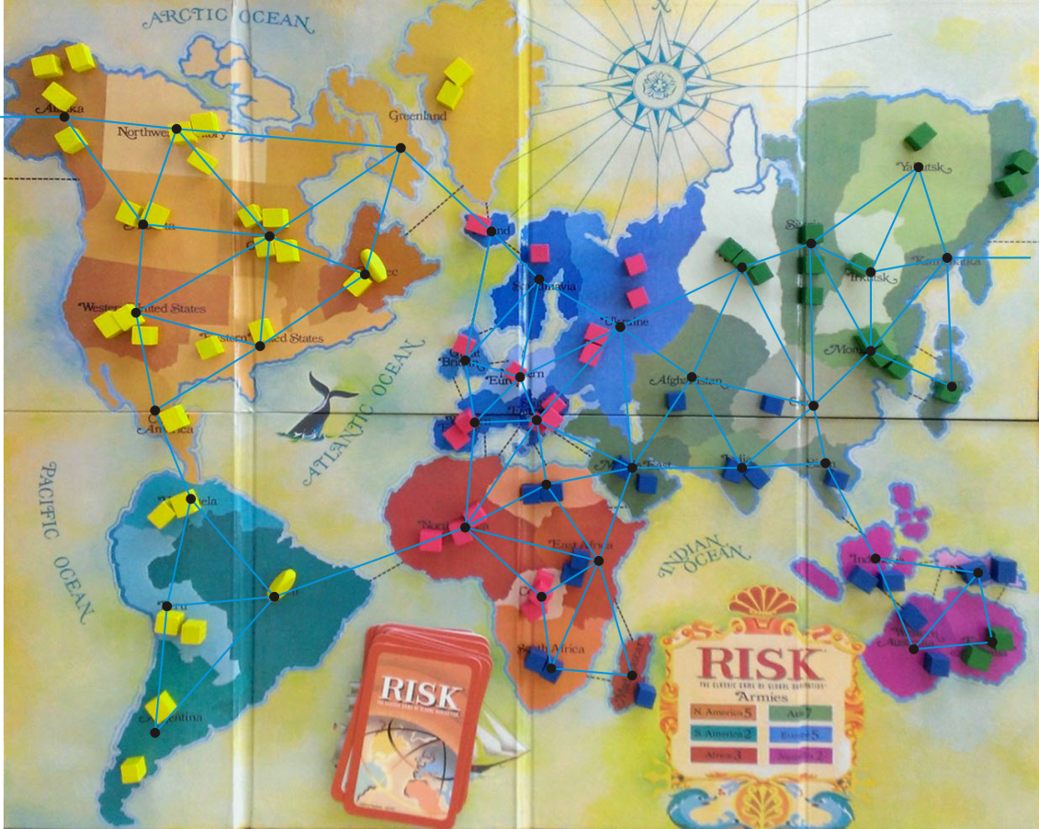
Example
Consider the game of Risk from Parker Brothers
A game of world domination
The world is divided into 42 connected regions
The regions are vertices and edges indicate adjacent regions
http://thunderbird37.com/tag/parker-brothers/

Slide 19
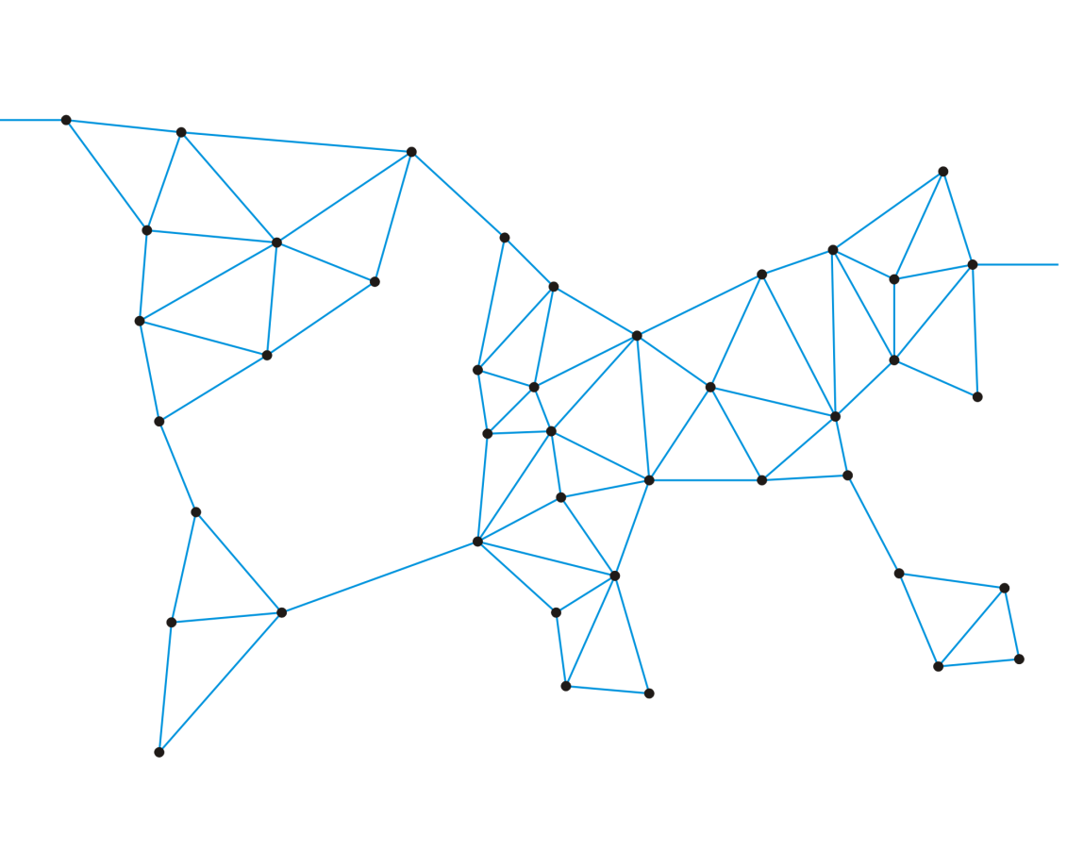
Example
Consider the game of Risk from Parker Brothers
A game of world domination
The world is divided into 42 connected regions
The regions are vertices and edges indicate adjacent regions
The graph is sufficient to describe the game

Slide 20
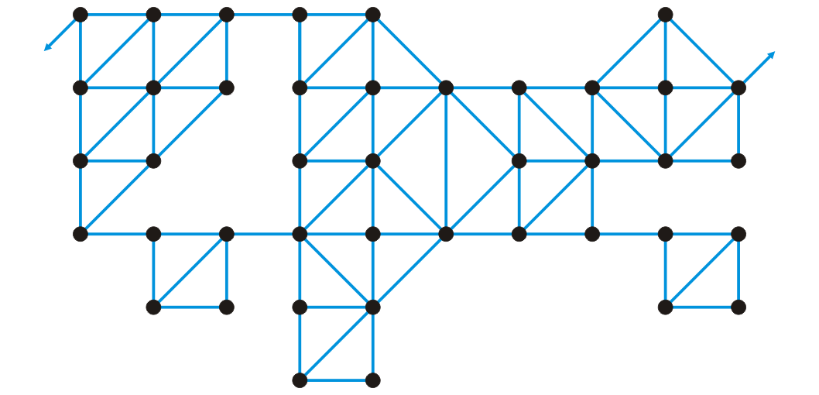
Example
Consider the game of Risk from Parker Brothers
Here is a more abstract representation of the game board

Slide 21
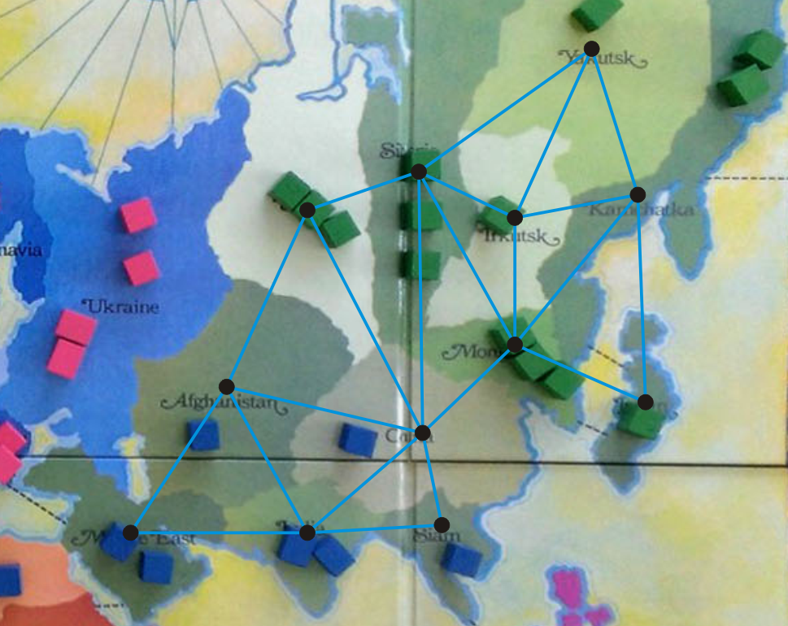
Example
We’ll focus on Asia
http://thunderbird37.com/tag/parker-brothers/

Slide 22
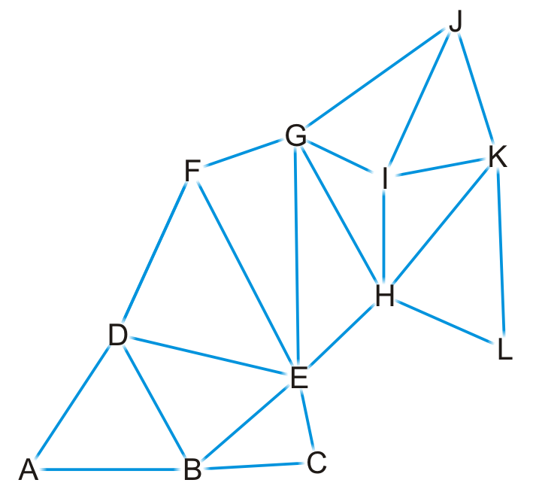
Example
Here is our abstract representation

Slide 23
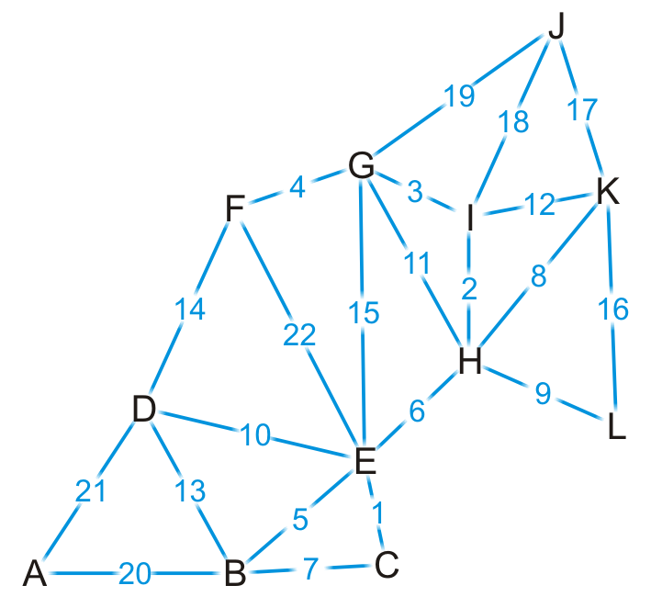
Example
Let us give a weight to each of the edges

Slide 24
Example
Find the shortest distance from Kamchatka (K) to every other region

Slide 25
Example
We set up our table
Which unvisited vertex has the minimum distance to it?
Vertex | Visited | Distance | Previous
A | F | ∞ | Ø
B | F | ∞ | Ø
C | F | ∞ | Ø
D | F | ∞ | Ø
E | F | ∞ | Ø
F | F | ∞ | Ø
G | F | ∞ | Ø
H | F | ∞ | Ø
I | F | ∞ | Ø
J | F | ∞ | Ø
K | F | 0 | Ø
L | F | ∞ | Ø

Slide 26
Example
We visit vertex K
Vertex | Visited | Distance | Previous
A | F | ∞ | Ø
B | F | ∞ | Ø
C | F | ∞ | Ø
D | F | ∞ | Ø
E | F | ∞ | Ø
F | F | ∞ | Ø
G | F | ∞ | Ø
H | F | ∞ | Ø
I | F | ∞ | Ø
J | F | ∞ | Ø
K | T | 0 | Ø
L | F | ∞ | Ø

Slide 27
Example
Vertex K has four neighbors: H, I, J and L
Vertex | Visited | Distance | Previous
A | F | ∞ | Ø
B | F | ∞ | Ø
C | F | ∞ | Ø
D | F | ∞ | Ø
E | F | ∞ | Ø
F | F | ∞ | Ø
G | F | ∞ | Ø
H | F | ∞ | Ø
I | F | ∞ | Ø
J | F | ∞ | Ø
K | T | 0 | Ø
L | F | ∞ | Ø

Slide 28
Example
We have now found at least one path to each of these vertices
Vertex | Visited | Distance | Previous
A | F | ∞ | Ø
B | F | ∞ | Ø
C | F | ∞ | Ø
D | F | ∞ | Ø
E | F | ∞ | Ø
F | F | ∞ | Ø
G | F | ∞ | Ø
H | F | 8 | K
I | F | 12 | K
J | F | 17 | K
K | T | 0 | Ø
L | F | 16 | K

Slide 29
Example
We’re finished with vertex K
To which vertex are we now guaranteed we have the shortest path?
Vertex | Visited | Distance | Previous
A | F | ∞ | Ø
B | F | ∞ | Ø
C | F | ∞ | Ø
D | F | ∞ | Ø
E | F | ∞ | Ø
F | F | ∞ | Ø
G | F | ∞ | Ø
H | F | 8 | K
I | F | 12 | K
J | F | 17 | K
K | T | 0 | Ø
L | F | 16 | K

Slide 30
Example
We visit vertex H: the shortest path is (K, H) of length 8
Vertex H has four unvisited neighbors: E, G, I, L
Vertex | Visited | Distance | Previous
A | F | ∞ | Ø
B | F | ∞ | Ø
C | F | ∞ | Ø
D | F | ∞ | Ø
E | F | ∞ | Ø
F | F | ∞ | Ø
G | F | ∞ | Ø
H | T | 8 | K
I | F | 12 | K
J | F | 17 | K
K | T | 0 | Ø
L | F | 16 | K

Slide 31
Example
Consider these paths:
(K, H, E) of length 8 + 6 = 14 (K, H, G) of length 8 + 11 = 19
(K, H, I) of length 8 + 2 = 10 (K, H, L) of length 8 + 9 = 17
Which of these are shorter than any known path?
Vertex | Visited | Distance | Previous
A | F | ∞ | Ø
B | F | ∞ | Ø
C | F | ∞ | Ø
D | F | ∞ | Ø
E | F | ∞ | Ø
F | F | ∞ | Ø
G | F | ∞ | Ø
H | T | 8 | K
I | F | 12 | K
J | F | 17 | K
K | T | 0 | Ø
L | F | 16 | K

Slide 32
Example
We already have a shorter path (K, L), but we update the other three
Vertex | Visited | Distance | Previous
A | F | ∞ | Ø
B | F | ∞ | Ø
C | F | ∞ | Ø
D | F | ∞ | Ø
E | F | 14 | H
F | F | ∞ | Ø
G | F | 19 | H
H | T | 8 | K
I | F | 10 | H
J | F | 17 | K
K | T | 0 | Ø
L | F | 16 | K

Slide 33
Example
We are finished with vertex H
Which vertex do we visit next?
Vertex | Visited | Distance | Previous
A | F | ∞ | Ø
B | F | ∞ | Ø
C | F | ∞ | Ø
D | F | ∞ | Ø
E | F | 14 | H
F | F | ∞ | Ø
G | F | 19 | H
H | T | 8 | K
I | F | 10 | H
J | F | 17 | K
K | T | 0 | Ø
L | F | 16 | K

Slide 34
Example
The path (K, H, I) is the shortest path from K to I of length 10
Vertex I has two unvisited neighbors: G and J
Vertex | Visited | Distance | Previous
A | F | ∞ | Ø
B | F | ∞ | Ø
C | F | ∞ | Ø
D | F | ∞ | Ø
E | F | 14 | H
F | F | ∞ | Ø
G | F | 19 | H
H | T | 8 | K
I | T | 10 | H
J | F | 17 | K
K | T | 0 | Ø
L | F | 16 | K

Slide 35
Example
Consider these paths:
(K, H, I, G) of length 10 + 3 = 13 (K, H, I, J) of length 10 + 18 = 28
Vertex | Visited | Distance | Previous
A | F | ∞ | Ø
B | F | ∞ | Ø
C | F | ∞ | Ø
D | F | ∞ | Ø
E | F | 14 | H
F | F | ∞ | Ø
G | F | 19 | H
H | T | 8 | K
I | T | 10 | H
J | F | 17 | K
K | T | 0 | Ø
L | F | 16 | K

Slide 36
Example
We have discovered a shorter path to vertex G, but (K, J) is still the shortest known path to vertex J
Vertex | Visited | Distance | Previous
A | F | ∞ | Ø
B | F | ∞ | Ø
C | F | ∞ | Ø
D | F | ∞ | Ø
E | F | 14 | H
F | F | ∞ | Ø
G | F | 13 | I
H | T | 8 | K
I | T | 10 | H
J | F | 17 | K
K | T | 0 | Ø
L | F | 16 | K

Slide 37
Example
Which vertex can we visit next?
Vertex | Visited | Distance | Previous
A | F | ∞ | Ø
B | F | ∞ | Ø
C | F | ∞ | Ø
D | F | ∞ | Ø
E | F | 14 | H
F | F | ∞ | Ø
G | F | 13 | I
H | T | 8 | K
I | T | 10 | H
J | F | 17 | K
K | T | 0 | Ø
L | F | 16 | K

Slide 38
Example
The path (K, H, I, G) is the shortest path from K to G of length 13
Vertex G has three unvisited neighbors: E, F and J
Vertex | Visited | Distance | Previous
A | F | ∞ | Ø
B | F | ∞ | Ø
C | F | ∞ | Ø
D | F | ∞ | Ø
E | F | 14 | H
F | F | ∞ | Ø
G | T | 13 | I
H | T | 8 | K
I | T | 10 | H
J | F | 17 | K
K | T | 0 | Ø
L | F | 16 | K

Slide 39
Example
Consider these paths:
(K, H, I, G, E) of length 13 + 15 = 28 (K, H, I, G, F) of length 13 + 4 = 17
(K, H, I, G, J) of length 13 + 19 = 32
Which do we update?
Vertex | Visited | Distance | Previous
A | F | ∞ | Ø
B | F | ∞ | Ø
C | F | ∞ | Ø
D | F | ∞ | Ø
E | F | 14 | H
F | F | ∞ | Ø
G | T | 13 | I
H | T | 8 | K
I | T | 10 | H
J | F | 17 | K
K | T | 0 | Ø
L | F | 16 | K

Slide 40
Example
We have now found a path to vertex F
Vertex | Visited | Distance | Previous
A | F | ∞ | Ø
B | F | ∞ | Ø
C | F | ∞ | Ø
D | F | ∞ | Ø
E | F | 14 | H
F | F | 17 | G
G | T | 13 | I
H | T | 8 | K
I | T | 10 | H
J | F | 17 | K
K | T | 0 | Ø
L | F | 16 | K

Slide 41
Example
Where do we visit next?
Vertex | Visited | Distance | Previous
A | F | ∞ | Ø
B | F | ∞ | Ø
C | F | ∞ | Ø
D | F | ∞ | Ø
E | F | 14 | H
F | F | 17 | G
G | T | 13 | I
H | T | 8 | K
I | T | 10 | H
J | F | 17 | K
K | T | 0 | Ø
L | F | 16 | K

Slide 42
Example
The path (K, H, E) is the shortest path from K to E of length 14
Vertex G has four unvisited neighbors: B, C, D and F
Vertex | Visited | Distance | Previous
A | F | ∞ | Ø
B | F | ∞ | Ø
C | F | ∞ | Ø
D | F | ∞ | Ø
E | T | 14 | H
F | F | 17 | G
G | T | 13 | I
H | T | 8 | K
I | T | 10 | H
J | F | 17 | K
K | T | 0 | Ø
L | F | 16 | K

Slide 43
Example
The path (K, H, E) is the shortest path from K to E of length 14
Vertex G has four unvisited neighbors: B, C, D and F
Vertex | Visited | Distance | Previous
A | F | ∞ | Ø
B | F | ∞ | Ø
C | F | ∞ | Ø
D | F | ∞ | Ø
E | T | 14 | H
F | F | 17 | G
G | T | 13 | I
H | T | 8 | K
I | T | 10 | H
J | F | 17 | K
K | T | 0 | Ø
L | F | 16 | K

Slide 44
Example
Consider these paths:
(K, H, E, B) of length 14 + 5 = 19 (K, H, E, C) of length 14 + 1 = 15
(K, H, E, D) of length 14 + 10 = 24 (K, H, E, F) of length 14 + 22 = 36
Which do we update?
Vertex | Visited | Distance | Previous
A | F | ∞ | Ø
B | F | ∞ | Ø
C | F | ∞ | Ø
D | F | ∞ | Ø
E | T | 14 | H
F | F | 17 | G
G | T | 13 | I
H | T | 8 | K
I | T | 10 | H
J | F | 17 | K
K | T | 0 | Ø
L | F | 16 | K

Slide 45
Example
We’ve discovered paths to vertices B, C, D
Vertex | Visited | Distance | Previous
A | F | ∞ | Ø
B | F | 19 | E
C | F | 15 | E
D | F | 24 | E
E | T | 14 | H
F | F | 17 | G
G | T | 13 | I
H | T | 8 | K
I | T | 10 | H
J | F | 17 | K
K | T | 0 | Ø
L | F | 16 | K

Slide 46
Example
Which vertex is next?
Vertex | Visited | Distance | Previous
A | F | ∞ | Ø
B | F | 19 | E
C | F | 15 | E
D | F | 24 | E
E | T | 14 | H
F | F | 17 | G
G | T | 13 | I
H | T | 8 | K
I | T | 10 | H
J | F | 17 | K
K | T | 0 | Ø
L | F | 16 | K

Slide 47
Example
We’ve found that the path (K, H, E, C) of length 15 is the shortest path from K to C
Vertex C has one unvisited neighbor, B
Vertex | Visited | Distance | Previous
A | F | ∞ | Ø
B | F | 19 | E
C | T | 15 | E
D | F | 24 | E
E | T | 14 | H
F | F | 17 | G
G | T | 13 | I
H | T | 8 | K
I | T | 10 | H
J | F | 17 | K
K | T | 0 | Ø
L | F | 16 | K

Slide 48
Example
The path (K, H, E, C, B) is of length 15 + 7 = 22
We have already discovered a shorter path through vertex E
Vertex | Visited | Distance | Previous
A | F | ∞ | Ø
B | F | 19 | E
C | T | 15 | E
D | F | 24 | E
E | T | 14 | H
F | F | 17 | G
G | T | 13 | I
H | T | 8 | K
I | T | 10 | H
J | F | 17 | K
K | T | 0 | Ø
L | F | 16 | K

Slide 49
Example
Where to next?
Vertex | Visited | Distance | Previous
A | F | ∞ | Ø
B | F | 19 | E
C | T | 15 | E
D | F | 24 | E
E | T | 14 | H
F | F | 17 | G
G | T | 13 | I
H | T | 8 | K
I | T | 10 | H
J | F | 17 | K
K | T | 0 | Ø
L | F | 16 | K

Slide 50
Example
We now know that (K, L) is the shortest path between these two points
Vertex L has no unvisited neighbors
Vertex | Visited | Distance | Previous
A | F | ∞ | Ø
B | F | 19 | E
C | T | 15 | E
D | F | 24 | E
E | T | 14 | H
F | F | 17 | G
G | T | 13 | I
H | T | 8 | K
I | T | 10 | H
J | F | 17 | K
K | T | 0 | Ø
L | T | 16 | K

Slide 51
Example
Where to next?
Does it matter if we visit vertex F first or vertex J first?
Vertex | Visited | Distance | Previous
A | F | ∞ | Ø
B | F | 19 | E
C | T | 15 | E
D | F | 24 | E
E | T | 14 | H
F | F | 17 | G
G | T | 13 | I
H | T | 8 | K
I | T | 10 | H
J | F | 17 | K
K | T | 0 | Ø
L | T | 16 | K

Slide 52
Example
Let’s visit vertex F first
It has one unvisited neighbor, vertex D
Vertex | Visited | Distance | Previous
A | F | ∞ | Ø
B | F | 19 | E
C | T | 15 | E
D | F | 24 | E
E | T | 14 | H
F | T | 17 | G
G | T | 13 | I
H | T | 8 | K
I | T | 10 | H
J | F | 17 | K
K | T | 0 | Ø
L | T | 16 | K

Slide 53
Example
The path (K, H, I, G, F, D) is of length 17 + 14 = 31
This is longer than the path we’ve already discovered
Vertex | Visited | Distance | Previous
A | F | ∞ | Ø
B | F | 19 | E
C | T | 15 | E
D | F | 24 | E
E | T | 14 | H
F | T | 17 | G
G | T | 13 | I
H | T | 8 | K
I | T | 10 | H
J | F | 17 | K
K | T | 0 | Ø
L | T | 16 | K

Slide 54
Example
Now we visit vertex J
It has no unvisited neighbors
Vertex | Visited | Distance | Previous
A | F | ∞ | Ø
B | F | 19 | E
C | T | 15 | E
D | F | 24 | E
E | T | 14 | H
F | T | 17 | G
G | T | 13 | I
H | T | 8 | K
I | T | 10 | H
J | T | 17 | K
K | T | 0 | Ø
L | T | 16 | K

Slide 55
Example
Next we visit vertex B, which has two unvisited neighbors:
(K, H, E, B, A) of length 19 + 20 = 39 (K, H, E, B, D) of length 19 + 13 = 32
We update the path length to A
Vertex | Visited | Distance | Previous
A | F | 39 | B
B | T | 19 | E
C | T | 15 | E
D | F | 24 | E
E | T | 14 | H
F | T | 17 | G
G | T | 13 | I
H | T | 8 | K
I | T | 10 | H
J | T | 17 | K
K | T | 0 | Ø
L | T | 16 | K

Slide 56
Example
Next we visit vertex D
The path (K, H, E, D, A) is of length 24 + 21 = 45
We don’t update A
Vertex | Visited | Distance | Previous
A | F | 39 | B
B | T | 19 | E
C | T | 15 | E
D | T | 24 | E
E | T | 14 | H
F | T | 17 | G
G | T | 13 | I
H | T | 8 | K
I | T | 10 | H
J | T | 17 | K
K | T | 0 | Ø
L | T | 16 | K

Slide 57
Example
Finally, we visit vertex A
It has no unvisited neighbors and there are no unvisited vertices left
We are done
Vertex | Visited | Distance | Previous
A | T | 39 | B
B | T | 19 | E
C | T | 15 | E
D | T | 24 | E
E | T | 14 | H
F | T | 17 | G
G | T | 13 | I
H | T | 8 | K
I | T | 10 | H
J | T | 17 | K
K | T | 0 | Ø
L | T | 16 | K

Slide 58
Example
Thus, we have found the shortest path from vertex K to each of the other vertices
Vertex | Visited | Distance | Previous
A | T | 39 | B
B | T | 19 | E
C | T | 15 | E
D | T | 24 | E
E | T | 14 | H
F | T | 17 | G
G | T | 13 | I
H | T | 8 | K
I | T | 10 | H
J | T | 17 | K
K | T | 0 | Ø
L | T | 16 | K

Slide 59
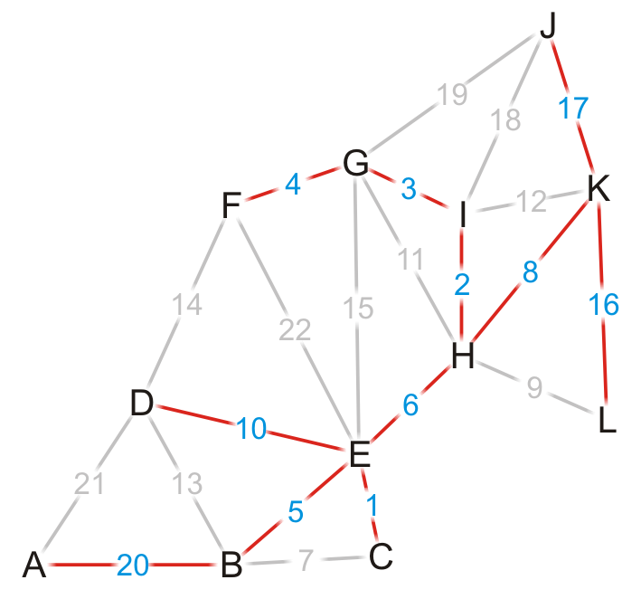
Example
Using the previous pointers, we can reconstruct the paths
Vertex | Visited | Distance | Previous
A | T | 39 | B
B | T | 19 | E
C | T | 15 | E
D | T | 24 | E
E | T | 14 | H
F | T | 17 | G
G | T | 13 | I
H | T | 8 | K
I | T | 10 | H
J | T | 17 | K
K | T | 0 | Ø
L | T | 16 | K

Slide 60
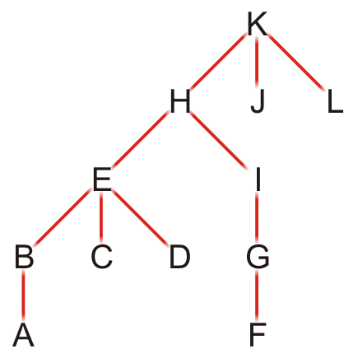
Example
Note that this table defines a rooted parental tree
The source vertex K is at the root
The previous pointer is the parent of the vertex in the tree
Vertex | Previous
A | B
B | E
C | E
D | E
E | H
F | G
G | I
H | K
I | H
J | K
K | Ø
L | K

Slide 61
Comments on Dijkstra’s algorithm
Questions:
What if at some point, all unvisited vertices have a distance ∞?
This means that the graph is not connected
We have found the shortest paths to all vertices in the connected subgraph containing the source vertex
What if we just want to find the shortest path between vertices v_{j} and v_{k}?
Apply the same algorithm, but stop when we are visiting vertex v_{k}
Does the algorithm change if we have a directed graph?
No

Slide 62
Implementation and analysis
The initialization requires Θ(|V|) memory and run time
We iterate |V| – 1 times, each time finding next closest vertex to the source
Iterating through the table requires Θ(|V|) time
Each time we find a vertex, we must check all of its neighbors
With an adjacency matrix, the run time is Θ(|V|(|V| + |V|)) = Θ(|V|²)
With an adjacency list, the run time is Θ(|V|² + |E|) = Θ(|V|²) as |E| = O(|V|²)
Can we do better?
Recall, we only need the closest vertex
How about a priority queue?
Assume we are using a binary heap
We will have to update the heap structure—this requires additional work

Slide 63
Implementation and analysis
The initialization still requires Θ(|V|) memory and run time
The priority queue will also requires Ο(|V|) memory
We must use an adjacency list, not an adjacency matrix
We iterate |V| times, each time finding the closest vertex to the source
Place the distances into a priority queue
The size of the priority queue is Ο(|V|)
Thus, the work required for this is O(|V| ln(|V|))
Is this all the work that is necessary?
Recall that each edge visited may result in a new edge being pushed to the very top of the heap
Thus, the work required for this is O(|E| ln(|V|))
Thus, the total run time is O(|V| ln(|V|) + |E| ln(|V|)) = O(|E| ln(|V|))

Slide 64
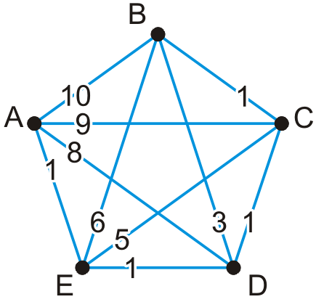
Implementation and analysis
Here is an example of a worst-case scenario:
Immediately, all of the vertices are placed into the queue
Each time a vertex is visited, all the remaining vertices are checked, and in succession, each is pushed to the top of the binary heap

Slide 65
Implementation and analysis
We could use a different heap structure:
A Fibonacci heap is a node-based heap
Pop is still O(ln(|V|)), but inserting and moving a key is Θ(1)
Thus, because we are only calling pop |V| – 1 times, the work required reduces to O(|E| + |V| ln(|V|))
Thus, the overall run-time is O(|E| + |V| ln(|V|))

Slide 66
Implementation and analysis
Thus, we have two run times when using
A binary heap: O(|E| ln(|V|))
A Fibonacci heap: O(|E| + |V| ln(|V|))
Questions: Which is faster if |E| = Θ(|V|)? How about if |E| = Θ(|V|²)?

Slide 67
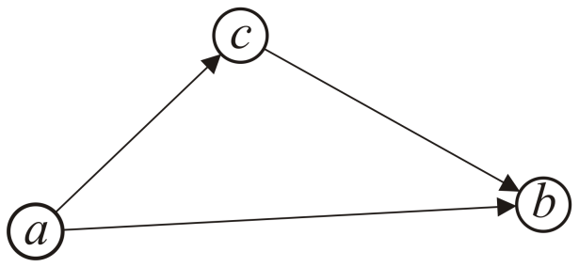
Triangle Inequality
If the distances satisfy the triangle inequality,
That is, the distance between a and b is less than the distance from a to c plus the distance from c to b,
we can use the A* search which is faster than Dijkstra’s algorithm
All Euclidean distances satisfy the triangle inequality

Slide 68
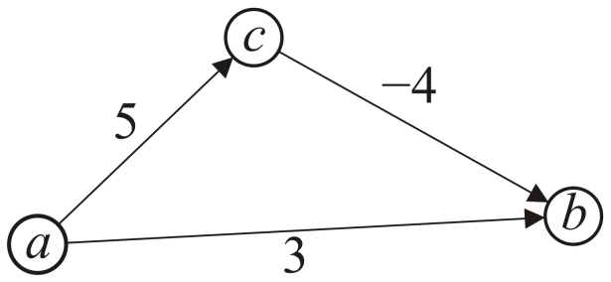
Negative Weights
If some of the edges have negative weight, so long as there are no cycles with negative weight, the Bellman-Ford algorithm will find the minimum distance
It is slower than Dijkstra’s algorithm
http://xkcd.com/69/

Slide 69
Summary
We have seen an algorithm for finding single-source shortest paths
Start with the initial vertex
Continue finding the next vertex that is closest
Dijkstra’s algorithm always finds the next closest vertex
It solves the problem in O(|E| + |V| ln(|V|)) time

Slide 70
References
Cormen, Leiserson, Rivest and Stein, Introduction to Algorithms, The MIT Press, 2001, §25.2, pp.629-35.
Mark A. Weiss, Data Structures and Algorithm Analysis in C++, 3rd Ed., Addison Wesley, 2006, Ch.?, p.?.
Joh Kleinberg and Eva Tardos,
Algorithm Design, Pearson, 2006.
Elliot B. Koffman and Paul A.T. Wolfgang,
Objects, Abstractions, Data Structures and Design using C++, Wiley, 2006.
These slides are provided for the ECE 250 Algorithms and Data Structures course. The material in it reflects Douglas W. Harder’s best judgment in light of the information available to him at the time of preparation. Any reliance on these course slides by any party for any other purpose are the responsibility of such parties. Douglas W. Harder accepts no responsibility for damages, if any, suffered by any party as a result of decisions made or actions based on these course slides for any other purpose than that for which it was intended.

