Slide 1

Outline
2.2
This topic will describe:
  The concrete data structures that can be used to store information
  The basic forms of memory allocation
    Contiguous
    Linked
    Indexed
  The prototypical examples of these: arrays and linked lists
  Other data structures:
    Trees
    Hybrids
    Higher-dimensional arrays
  Finally, we will discuss the run-time of queries and operations on arrays and linked lists

Slide 2
Memory Allocation
2.2.1
Memory allocation can be classified as either
  Contiguous
  Linked
  Indexed
Prototypical examples:
  Contiguous allocation: arrays
  Linked allocation: linked lists

Slide 3
Memory Allocation
2.2.1.1
Contiguous, adj.
  Touching or connected throughout in an unbroken sequence.
  Meriam Webster
  Touching, in actual contact, next in space; meeting at a common
  boundary, bordering, adjoining.
www.oed.com

Slide 4
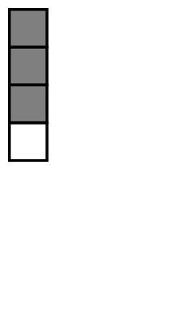
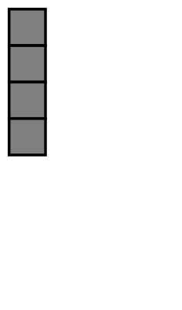
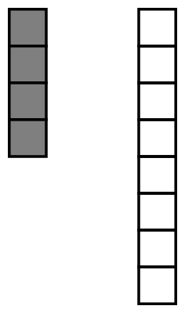
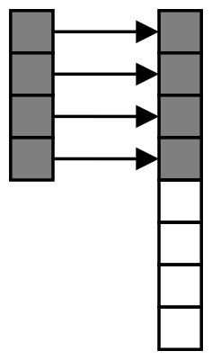
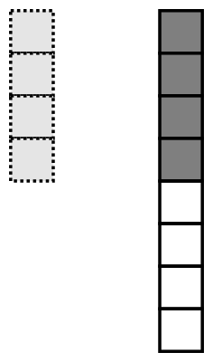
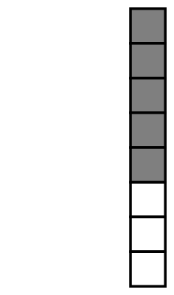

Contiguous Allocation
2.2.1
2.2.1.1
An array stores n objects in a single contiguous space of memory
Unfortunately, if more memory is required, a request for new memory usually requires copying all information into the new memory
  In general, you cannot request for the operating
  system to allocate to you the next n memory
  locations

Slide 5

Linked Allocation
2.2.1.2
Linked storage such as a linked list associates two pieces of data with each item being stored:
  The object itself, and
  A reference to the next item
    In C++ that reference is the address of the next node

Slide 6
Linked Allocation
2.2.1.2
This is a class describing such a node
template <typename Type>
class Node {
private:
Type element;
Node *next_node;
public:
// ...
};

Slide 7
Linked Allocation
2.2.1.2
The operations on this node must include:
  Constructing a new node
  Accessing (retrieving) the value
  Accessing the next pointer
  Node( const Type& = Type(), Node* = nullptr );
  Type retrieve() const;
  Node *next() const;
Pointing to nothing has been represented as:
C NULL
Java/C# null
C++ (old) 0
C++ (new) nullptr
Symbolically Ø

Slide 8
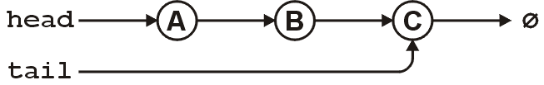
Linked Allocation
2.2.1.2
For a linked list, however, we also require an object which links to the first object
The actual linked list class must store two pointers
  A head and tail:
  Node *head;
  Node *tail;
Optionally, we can also keep a count
  int count;
The next_node of the last node is assigned nullptr

Slide 9
Linked Allocation
2.2.1.2
The class structure would be:
template <typename Type>
class List {
private:
Node<Type> *head;
Node<Type> *tail;
int count;
public:
// constructor(s)...
// accessor(s)...
// mutator(s)...
};

Slide 10
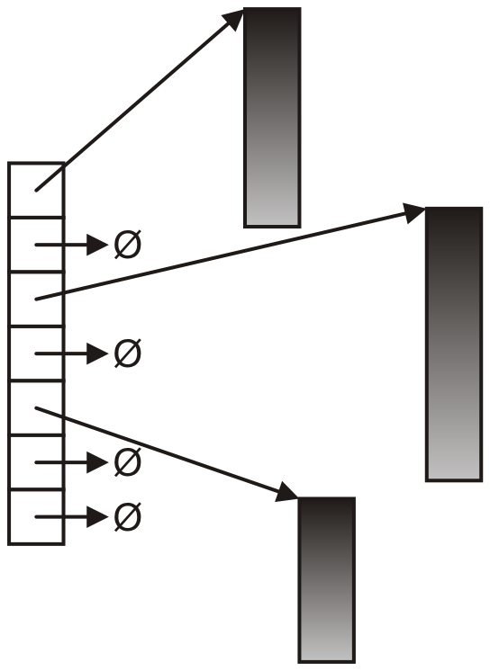
Indexed Allocation
2.2.1.3
With indexed allocation, an array of pointers
(possibly NULL) link to a sequence of allocated
memory locations
Used in the C++ standard template library
Computer engineering students will see indexed
allocation in their operating systems course

Slide 11
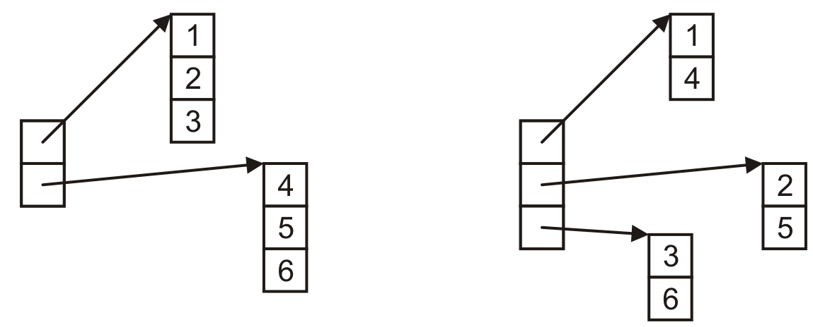
Indexed Allocation
2.2.1.3
Matrices can be implemented using indexed allocation:

Slide 12
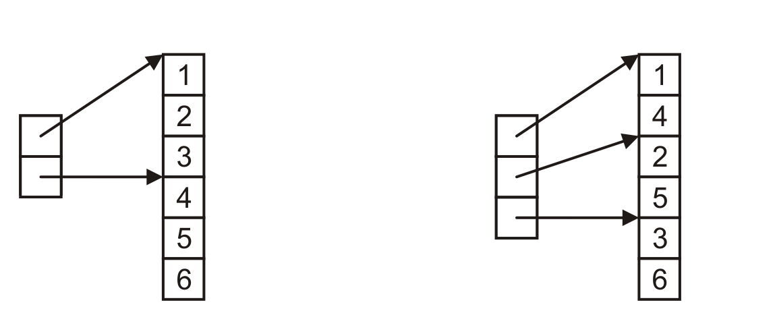
Indexed Allocation
2.2.1.3
Matrices can be implemented using indexed allocation
  Most implementations of matrices (or higher-dimensional arrays) use indices pointing into a single contiguous block of memory
Row-major order
Column-major order
C, Python
Matlab, Fortran

Slide 13
Other Allocation Formats
2.2.2
We will look at some variations or hybrids of these memory allocations including:
  Trees
  Graphs
  Deques (linked arrays)
  inodes

Slide 14
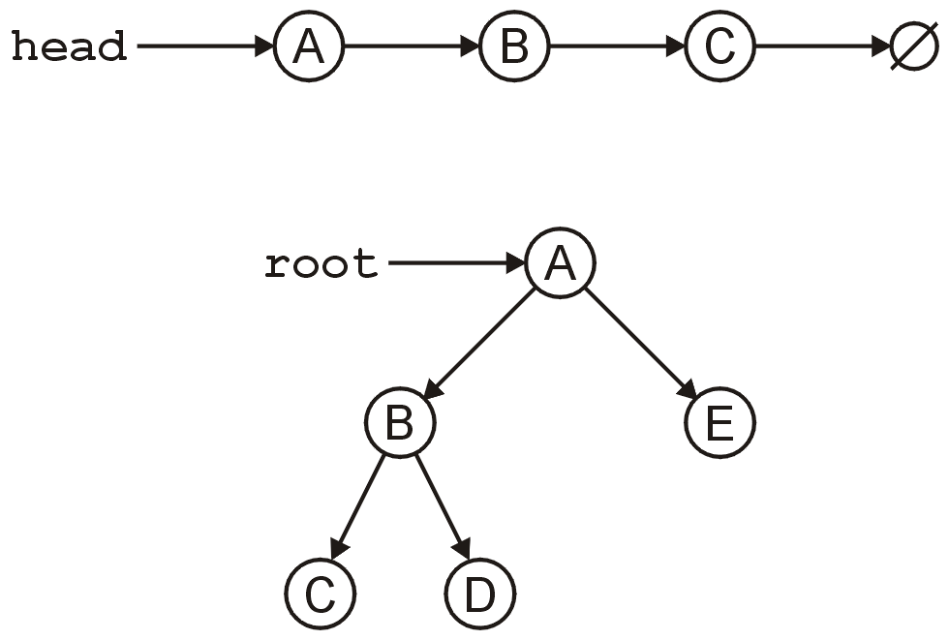
Trees
2.2.2.2
The linked list can be used to store linearly ordered data
  What if we have multiple next pointers?
A rooted tree is similar
to a linked list but with multiple next
pointers

Slide 15
Trees
2.2.2.2
A tree is a variation on a linked list:
  Each node points to an arbitrary number of subsequent nodes
  Useful for storing hierarchical data
  We will see that it is also useful for storing sorted data
  Usually we will restrict ourselves to trees where each node points to at most two other nodes

Slide 16
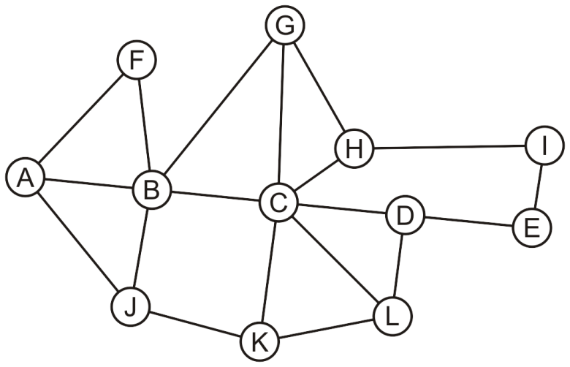
Graphs
2.2.2.2
Suppose we allow arbitrary relations between any two objects in a container
  Given n objects, there are n² – n possible relations
    If we allow symmetry, this reduces to
  For example, consider the network

Slide 17
Arrays
2.2.2.2
Suppose we allow arbitrary relations between any two objects in a container
  We could represent this using a two-dimensional array
  In this case, the matrix is
  symmetric
 | A | B | C | D | E | F | G | H | I | J | K | L
A |  | × |  |  |  | × |  |  |  | ×
B | × |  | × |  |  | × | × |  |  | ×
C |  | × |  | × |  |  | × | × |  |  | × | ×
D |  |  | × |  | × |  |  |  |  |  |  | ×
E |  |  |  | × |  |  |  |  | ×
F | × | ×
G |  | × | × |  |  |  |  | ×
H |  |  | × |  |  |  | × |  | ×
I |  |  |  |  | × |  |  | ×
J | × | × |  |  |  |  |  |  |  |  | ×
K |  |  | × |  |  |  |  |  |  | × |  | ×
L |  |  | × | × |  |  |  |  |  |  | ×

Slide 18
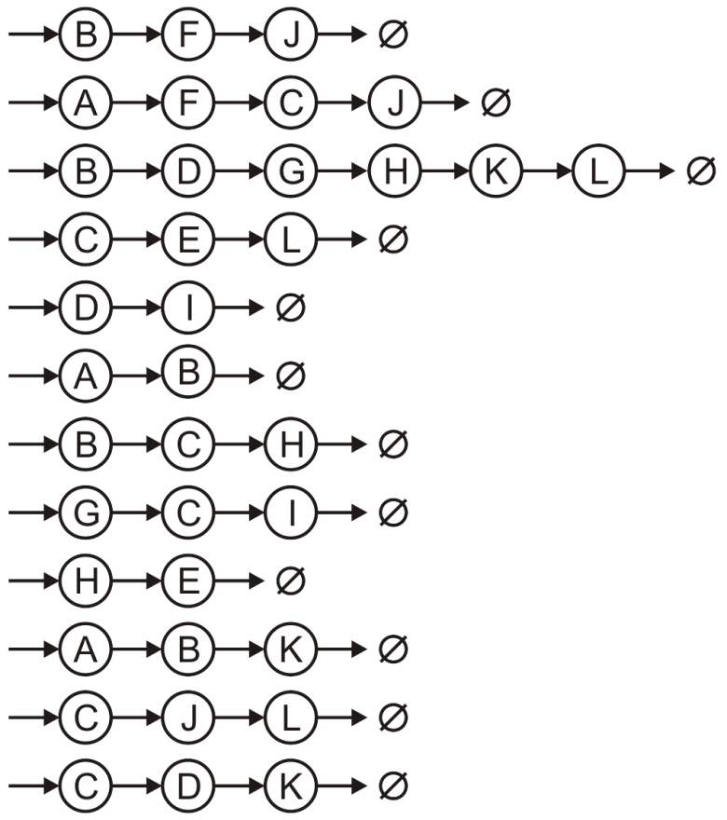
Array of Linked Lists
2.2.2.2
Suppose we allow arbitrary relations between any two objects in a container
  Alternatively, we could use a hybrid: an array of linked lists
A
B
C
D
E
F
G
H
I
J
K
L

Slide 19
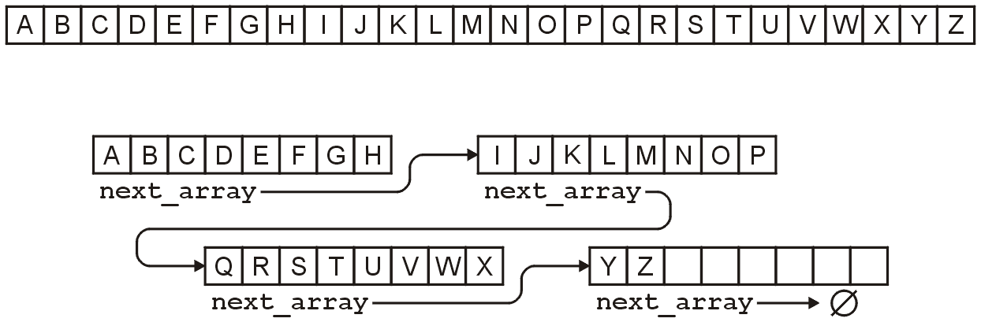
Linked Arrays
2.2.2.3
Other hybrids are linked lists of arrays
  Something like this is used for the C++ STL deque container
For example, the alphabet could be stored either as:
  An array of 26 entries, or
  A linked list of arrays of 8 entries

Slide 20
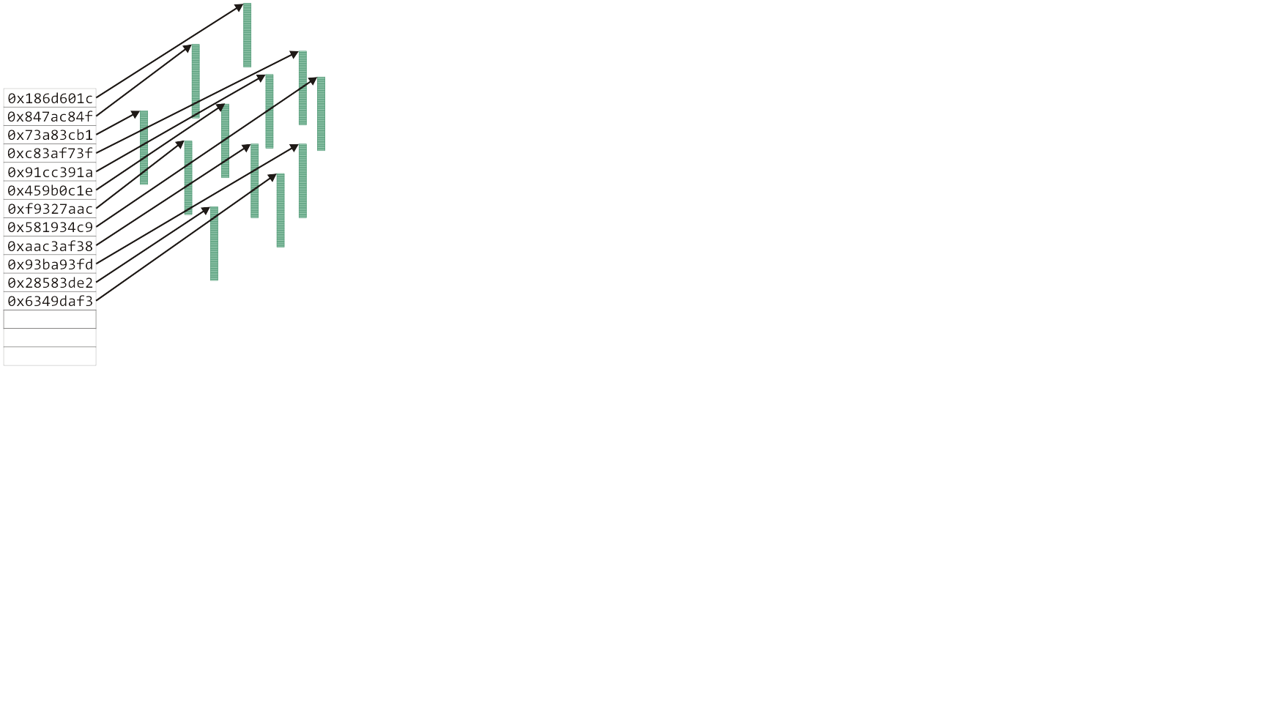
Hybrid data structures
2.2.2.4
The Unix inode was used to store information about large files
  The first twelve entries can reference the first twelve blocks (48 KiB)

Slide 21
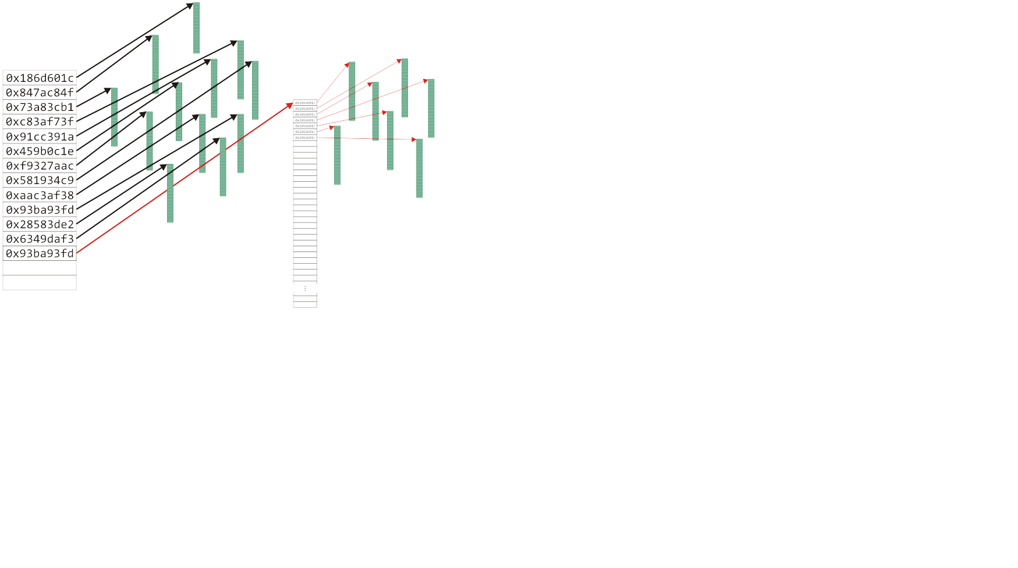
Hybrid data structures
2.2.2.4
The Unix inode was used to store information about large files
  The next entry is a pointer to an array that stores the next 1024 blocks
This stores files up to 4 MiB on a 32-bit computer

Slide 22
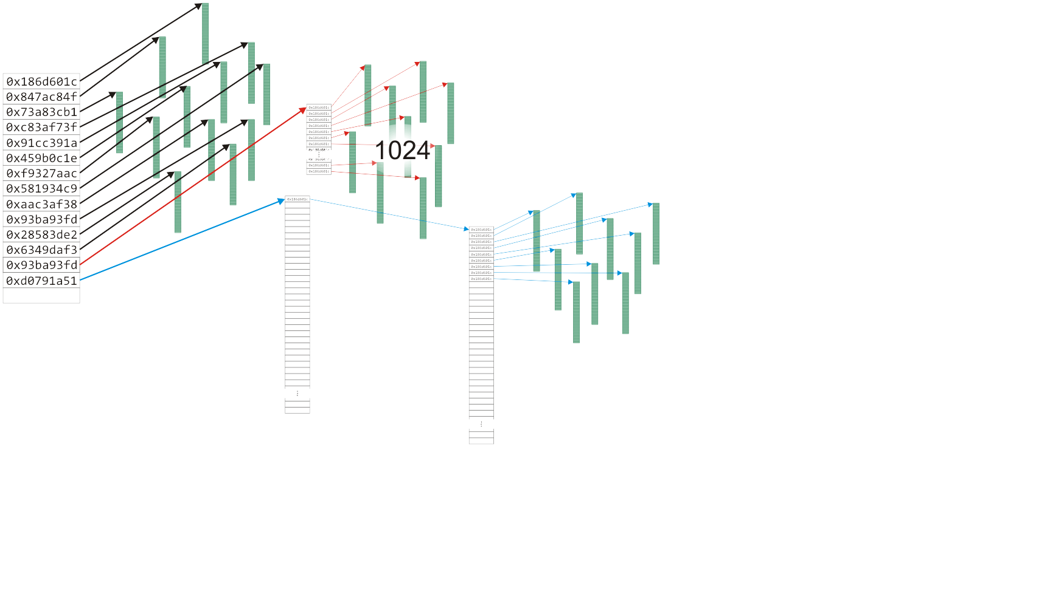
Hybrid data structures
2.2.2.4
The Unix inode was used to store information about large files
  The next entry has two levels of indirection for files up to 4 GiB
Notes:
22

Slide 23
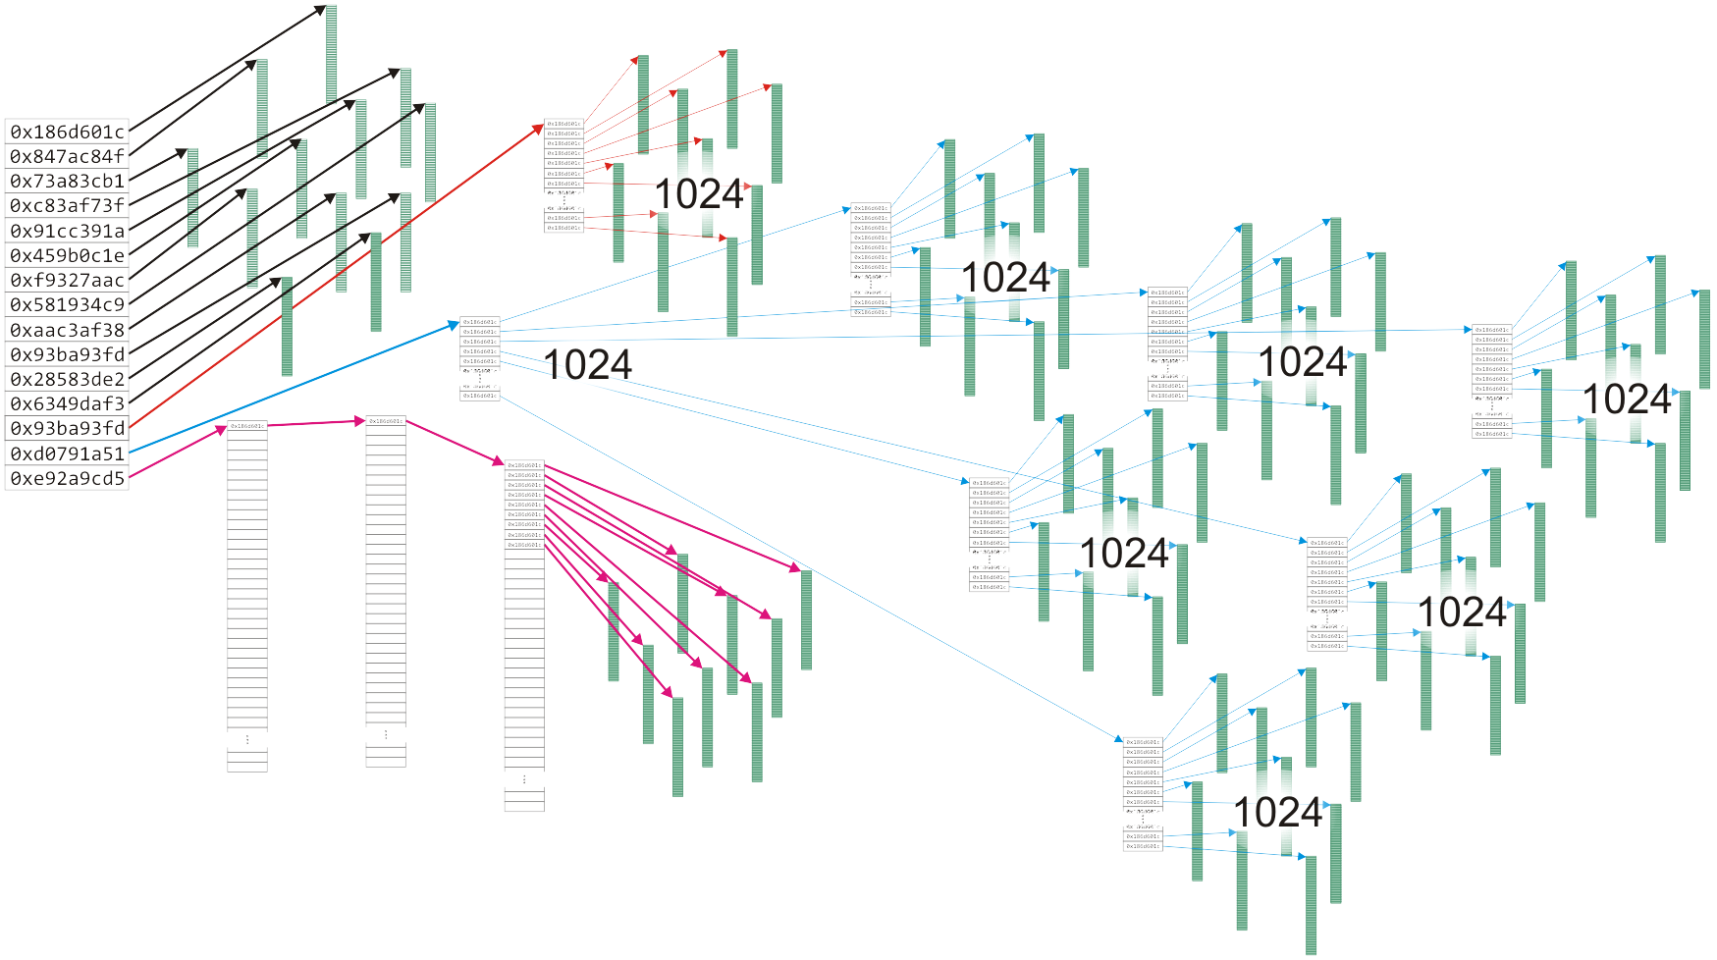
Hybrid data structures
2.2.2.4
The Unix inode was used to store information about large files
  The last entry has three levels of indirection for files up to 4 TiB
Notes:
23

Slide 24
Algorithm run times
2.2.3
Once we have chosen a data structure to store both the objects and the relationships, we must implement the queries or operations as algorithms
  The Abstract Data Type will be implemented as a class
  The data structure will be defined by the member variables
  The member functions will implement the algorithms
The question is, how do we determine the efficiency of the algorithms?

Slide 25
Operations
2.2.3
We will use the following matrix to describe operations at the locations within the structure
 | Front/1st | Arbitrary Location | Back/n^{th}
Find | ? | ? | ?
Insert | ? | ? | ?
Erase | ? | ? | ?

Slide 26
Operations on Sorted Lists
2.2.3.1
Given an sorted array, we have the following run times:
 | Front/1st | Arbitrary Location | Back/n^{th}
Find | Good | Okay | Good
Insert | Bad | Bad | Good* | Bad
Erase | Bad | Bad | Good
* only if the array is not full

Slide 27
Operations on Lists
2.2.3.2
 | Front/1st | Arbitrary Location | Back/n^{th}
Find | Good | Bad | Good
Insert | Bad | Bad | Good* | Bad
Erase | Bad | Bad | Good
* only if the array is not full
If the array is not sorted, only one operations changes:
Notes:
27

Slide 28

Operations on Lists
2.2.3.3
However, for a singly linked list where we a head and tail pointer, we have:
 | Front/1st | Arbitrary Location | Back/n^{th}
Find | Good | Bad | Good
Insert | Good | Bad | Good
Erase | Good | Bad | Bad

Slide 29
Operations on Lists
2.2.3.3
If we have a pointer to the k^{th} entry, we can insert or erase at that location quite easily
  Note, this requires a little bit of trickery: we must modify the value stored in the k^{th} node
 | Front/1st | Arbitrary Location | Back/n^{th}
Find | Good | Bad | Good
Insert | Good | Good | Good
Erase | Good | Good | Bad

Slide 30
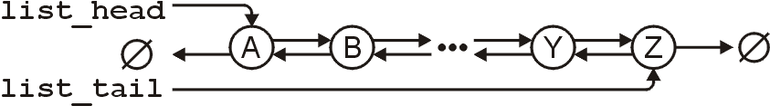
Operations on Lists
2.2.3.4
For a doubly linked list, one operation becomes more efficient:
 | Front/1st | Arbitrary Location | Back/n^{th}
Find | Good | Bad | Good
Insert | Good | Bad | Good
Erase | Good | Bad | Good

Slide 31
Summary
In this topic, we have introduced the concept of data structures
  We discussed contiguous, linked, and indexed allocation
  We looked at arrays and linked lists
  We considered
    Trees
    Two-dimensional arrays
    Hybrid data structures
  We considered the run time of the algorithms required to perform various queries and operations on specific data structures:
    Arrays and linked lists

