Slide 1

Outline
In this topic, we will examine code to determine the run time of various operations
We will introduce machine instructions
We will calculate the run times of:
  Operators +, -, =, +=, ++, etc.
  Control statements if, for, while, do-while, switch
  Functions
  Recursive functions

Slide 2
Motivation
The goal of algorithm analysis is to take a block of code and determine the asymptotic run time or asymptotic memory requirements based on various parameters
  Given an array of size n:
    Selection sort requires Θ(n²) time
    Merge sort, quick sort, and heap sort all require Θ(n ln(n)) time
  However:
    Merge sort requires Θ(n) additional memory
    Quick sort requires Θ(ln(n)) additional memory
    Heap sort requires Θ(1) memory

Slide 3
Motivation
The asymptotic behaviour of algorithms indicates the ability to scale
  Suppose we are sorting an array of size n
Selection sort has a run time of Θ(n²)
  2n entries requires (2n)² = 4n²
    Four times as long to sort
  10n entries requires (10n)² = 100n²
    One hundred times as long to sort

Slide 4
Motivation
The other sorting algorithms have Θ(n ln(n)) run times
  2n entries require (2n) ln(2n) = (2n) (ln(n) + 1) = 2(n ln(n)) + 2n
  10n entries require (10n) ln(10n) = (10n) (ln(n) + 1) = 10(n ln(n)) + 10n
In each case, it requires Θ(n) more time
However:
  Merge sort will require twice and 10 times as much memory
  Quick sort will require one or four additional memory locations
  Heap sort will not require any additional memory

Slide 5
Motivation
We will see algorithms which run in Θ(n^{lg(3)}) time
  lg(3) ≈ 1.585
  For 2n entries require (2n)^{lg(3)} = 2^{lg(3)} n^{lg(3)} = 3 n^{lg(3)}
    Three times as long to sort
  10n entries require (10n)^{lg(3)} = 10^{lg(3)} n^{lg(3)} = 38.5 n^{lg(3)}
    38 times as long to sort

Slide 6
Motivation
We will see algorithms which run in Θ(n^{lg(3)}) time
  lg(3) ≈ 1.585
  For 2n entries require (2n)^{lg(3)} = 2^{lg(3)} n^{lg(3)} = 3 n^{lg(3)}
    Three times as long to sort
  10n entries require (10n)^{lg(3)} = 10^{lg(3)} n^{lg(3)} = 38.5 n^{lg(3)}
    38 times as long to sort
Binary search runs in Θ(ln(n)) time:
  Doubling the size requires one additional search

Slide 7
Motivation
If we are storing objects which are not related, the hash table has, in many cases, optimal characteristics:
  Many operations are Θ(1)
  I.e., the run times are independent of the number of objects being stored
If we are required to store both objects and relations, both memory and time will increase
  Our goal will be to minimize this increase

Slide 8
Motivation
To properly investigate the determination of run times asymptotically:
  We will begin with machine instructions
  Discuss operations
  Control statements
    Conditional statements and loops
  Functions
  Recursive functions

Slide 9
Machine Instructions
Given any processor, it is capable of performing only a limited number of operations
These operations are called instructions
The collection of instructions is called the instruction set
  The exact set of instructions differs between processors
  MIPS, ARM, x86, 6800, 68k
  You will see another in the ColdFire in ECE 222
    Derived from the 68000, derived from the 6800

Slide 10
Machine Instructions
Any instruction runs in a fixed amount of time (an integral number of CPU cycles)
An example on the Coldfire is:
  0x06870000000F
which adds 15 to the 7th data register
As humans are not good at hex, this can be programmed in assembly language as
ADDI.L #$F, D7
  More in ECE 222

Slide 11
Machine Instructions
Assembly language has an almost one-to-one translation to machine instructions
  Assembly language is a low-level programming language
Other programming languages are higher-level:
Fortran, Pascal, Matlab, Java, C++, and C#
The adjective “high” refers to the level of abstraction:
  Java, C++, and C# have abstractions such as OO
  Matlab and Fortran have operations which do not map to relatively small number of machine instructions:
    >> 1.27^2.9 % 1.27**2.9 in Fortran
    2.0000036616123606774

Slide 12
Machine Instructions
The C programming language (C++ without objects and other abstractions) can be referred to as a mid-level programming language
  There is abstraction, but the language is closely tied to the standard capabilities
  There is a closer relationship between operators and machine instructions
Consider the operation a += b;
  Assume that the compiler has already has the value of the variable a in register D1 and perhaps b is a variable stored at the location stored in address register A1, this is then converted to the single instruction
  ADD (A1), D1

Slide 13
Operators
Because each machine instruction can be executed in a fixed number of cycles, we may assume each operation requires a fixed number of cycles
  The time required for any operator is Θ(1) including:
    Retrieving/storing variables from memory
    Variable assignment =
    Integer operations + - * / % ++ --
    Logical operations && || !
    Bitwise operations & | ^ ~
    Relational operations == != < <= => >
    Memory allocation and deallocation new delete

Slide 14
Operators
Of these, memory allocation and deallocation are the slowest by a significant factor
  A quick test on eceunix shows a factor of over 100
  They require communication with the operation system
  This does not account for the time required to call the constructor and destructor
Note that after memory is allocated, the constructor is run
  The constructor may not run in Θ(1) time

Slide 15
Blocks of Operations
Each operation runs in Θ(1) time and therefore any fixed number
of operations also run in Θ(1) time, for example:
    // Swap variables a and b
    int tmp = a;
    a = b;
    b = tmp;
    // Update a sequence of values
    // ece.uwaterloo.ca/~ece250/Algorithms/Skip_lists/src/Skip_list.h
    ++index;
    prev_modulus = modulus;
    modulus = next_modulus;
    next_modulus = modulus_table[index];

Slide 16
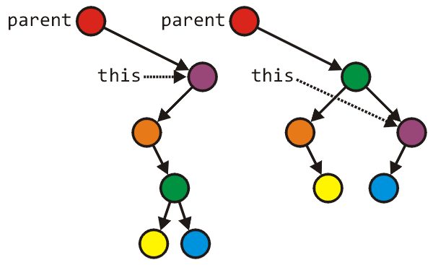
Blocks of Operations
Seldom will you find large blocks of operations without any additional control statements
This example rearranges an AVL tree structure
  Tree_node *lrl = left->right->left;
Tree_node *lrr = left->right->right;
parent = left->right;
parent->left = left;
parent->right = this;
left->right = lrl;
left = lrr;
Run time: Θ(1)

Slide 17
Blocks in Sequence
Θ(1)
Θ(n)
Θ(1)
Suppose you have now analyzed a number of blocks of code run in sequence
    template <typename T>
    void update_capacity( int delta ) {
    T *array_old = array;
    int capacity_old = array_capacity;
    array_capacity += delta;
    array = new T[array_capacity];
    for ( int i = 0; i < capacity_old; ++i ) {
    array[i] = array_old[i];
    }
    delete[] array_old;
    }
To calculate the total run time, add the entries: Θ(1 + n + 1) = Θ(n)

Slide 18
Blocks in Sequence
Θ(1)
Θ(1)
Θ(1 + 1 + min(M, N) + M + n + 1)
= Θ(M + n)
Θ(min(M, N))
Θ(M)
Note that min(M, N) ≤ M but we cannot say anything about M and n
Θ(n)
Θ(1)
This is taken from code found at
  http://ece.uwaterloo.ca/~ece250/Algorithms/Sparse_systems/
template <int M, int N>
Matrix<M, N> &Matrix<M, N>::operator= ( Matrix<M, N> const &A ) {
if ( &A == this ) {
return *this;
}
if ( capacity != A.capacity ) {
delete [] column_index;
delete [] off_diagonal;
capacity = A.capacity;
column_index = new int[capacity];
off_diagonal = new double[capacity];
}
for ( int i = 0; i < minMN; ++i ) {
diagonal[i] = A.diagonal[i];
}
for ( int i = 0; i <= M; ++i ) {
row_index[i] = A.row_index[i];
}
for ( int i = 0; i < A.size(); ++i ) {
column_index[i] = A.column_index[i];
off_diagonal[i] = A.off_diagonal[i];
}
return *this;
}

Slide 19
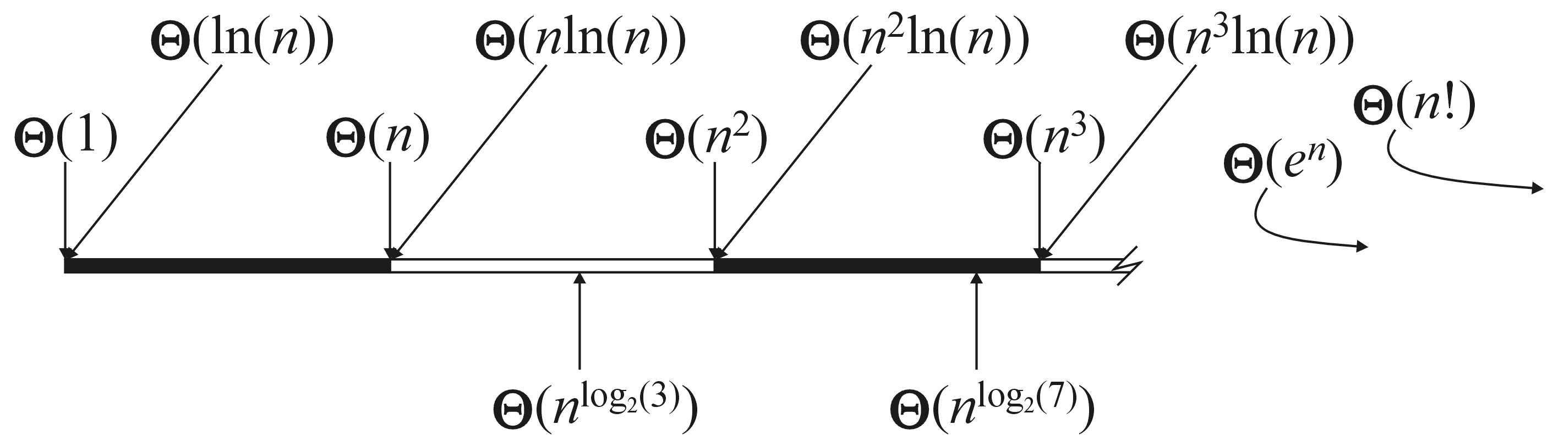
Blocks in Sequence
Other examples include:
  Run three blocks of code which are Θ(1), Θ(n²), and Θ(n)
  Total run time Θ(1 + n² + n) = Θ(n²)
  Run two blocks of code which are Θ(n ln(n)), and Θ(n^{1.5})
  Total run time Θ(n ln(n) + n^{1.5}) = Θ(n^{1.5})
Recall this linear ordering from the previous topic
  When considering a sum, take the dominant term

Slide 20
Control Statements
Next we will look at the following control statements
These are statements which potentially alter the execution of instructions
  Conditional statements
    if, switch
  Condition-controlled loops
    for, while, do-while
  Count-controlled loops
    for i from 1 to 10 do ... end do; # Maple
  Collection-controlled loops
    foreach ( int i in array ) { ... } // C#

Slide 21
Control Statements
Given any collection of nested control statements, it is always necessary to work inside out
  Determine the run times of the inner-most statements and work your way out

Slide 22
Control Statements
Given
    if ( condition ) {
    // true body
    } else {
    // false body
    }
The run time of a conditional statement is:
  the run time of the condition (the test), plus
  the run time of the body which is run
In most cases, the run time of the condition is Θ(1)

Slide 23
Control Statements
In some cases, it is easy to determine which statement must be run:
int factorial ( int n ) {
if ( n == 0 ) {
return 1;
} else {
return n * factorial ( n – 1 );
}
}

Slide 24
Control Statements
In others, it is less obvious
  Find the maximum entry in an array:
int find_max( int *array, int n ) {
max = array[0];
for ( int i = 1; i < n; ++i ) {
if ( array[i] > max ) {
max = array[i];
}
}
return max;
}

Slide 25
Analysis of Statements
In this case, we don’t know
If we had information about the distribution of the entries of the array, we may be able to determine it
  if the list is sorted (ascending) it will always be run
  if the list is sorted (descending) it will be run once
  if the list is uniformly randomly distributed, then???

Slide 26
Condition-controlled Loops
The C++ for loop is a condition controlled statement:
for ( int i = 0; i < N; ++i ) {
// ...
}
is identical to
int i = 0; // initialization
while ( i < N ) { // condition
// ...
++i; // increment
}

Slide 27
Condition-controlled Loops
The initialization, condition, and increment usually are single statements running in Θ(1)
for ( int i = 0; i < N; ++i ) {
// ...
}

Slide 28
Condition-controlled Loops
The initialization, condition, and increment statements are usually Θ(1)
For example,
for ( int i = 0; i < n; ++i ) {
// ...
}
Assuming there are no break or return statements in the loop,
the run time is Ω(n)

Slide 29
Condition-controlled Loops
If the body does not depend on the variable (in this example, i), then the run time of
for ( int i = 0; i < n; ++i ) {
// code which is Theta(f(n))
}
is Θ(n f(n))
If the body is O(f(n)), then the run time of the loop is O(n f(n))

Slide 30
Condition-controlled Loops
For example,
int sum = 0;
for ( int i = 0; i < n; ++i ) {
sum += 1; Theta(1)
}
This code has run time
Θ(n·1) = Θ(n)

Slide 31
Condition-controlled Loops
Another example,
int sum = 0;
for ( int i = 0; i < n; ++i ) {
for ( int j = 0; j < n; ++j ) {
sum += 1; Theta(1)
}
}
The previous example showed that the inner loop is Θ(n), thus the outer loop is
Θ(n·n) = Θ(n²)

Slide 32
Analysis of Repetition Statements
Suppose with each loop, we use a linear search an array of size m:
for ( int i = 0; i < n; ++i ) {
// search through an array of size m
// O( m );
}
The inner loop is O(m) and thus the outer loop is
O(n m)

Slide 33
Conditional Statements
Consider this example
    void Disjoint_sets::clear() {
    if ( sets == n ) {
    return;
    }
    max_height = 0;
    num_disjoint_sets = n;
    for ( int i = 0; i < n; ++i ) {
    parent[i] = i;
    tree_height[i] = 0;
    }
    }
Θ(1)
Θ(1)
Θ(n)
Θ(1)

Slide 34
Analysis of Repetition Statements
If the body depends on the variable (in this example, i), then the run time of
for ( int i = 0; i < n; ++i ) {
// code which is Theta(f(i,n))
}
is and if the body is
O(f(i, n)), the result is

Slide 35
Analysis of Repetition Statements
For example,
int sum = 0;
for ( int i = 0; i < n; ++i ) {
for ( int j = 0; j < i; ++j ) {
sum += i + j;
}
}
The inner loop is Θ(i) hence the outer is

Slide 36
Analysis of Repetition Statements
Another example:
int sum = 0;
for ( int i = 0; i < n; ++i ) {
for ( int j = 0; j < i; ++j ) {
for ( int k = 0; k < j; ++k ) {
sum += i + j + k;
}
}
}
From inside to out:
  Θ(1)
  Θ(j)
  Θ(i²)
  Θ(n³)

Slide 37
Control Statements
Switch statements appear to be nested if statements:
switch( i ) {
case 1: /* do stuff */ break;
case 2: /* do other stuff */ break;
case 3: /* do even more stuff */ break;
case 4: /* well, do stuff */ break;
case 5: /* tired yet? */ break;
default: /* do default stuff */
}

Slide 38
Control Statements
Thus, a switch statement would appear to run in O(n) time where n is the number of cases, the same as nested if statements
  Why then not use:
if ( i == 1 ) { /* do stuff */ }
else if ( i == 2 ) { /* do other stuff */ }
else if ( i == 3 ) { /* do even more stuff */ }
else if ( i == 4 ) { /* well, do stuff */ }
else if ( i == 5 ) { /* tired yet? */ }
else { /* do default stuff */ }

Slide 39
Control Statements
Question:
  Why would you introduce something into
  programming language which is redundant?
There are reasons for this:
  your name is Larry Wall and you are creating the Perl (not PERL) programming language
  you are introducing software engineering constructs, for example, classes

Slide 40
Control Statements
However, switch statements were included in the original C language... why?
First, you may recall that the cases must be actual values, either:
  integers
  characters
For example, you cannot have a case with a variable, e.g.,
  case n: /* do something */ break; //bad

Slide 41
Control Statements
The compiler looks at the different cases and calculates an appropriate jump
For example, assume:
  the cases are 0, 1, 2, 3, 4, 5, 6, 7, 8, 9, 10
  each case requires a maximum of 24 bytes (for example, six instructions)
Then the compiler simply makes a jump size based on the variable, jumping ahead either 0, 24, 48, 72, ..., or 240 instructions

Slide 42
Serial Statements
Suppose we run one block of code followed by another block of code
Such code is said to be run serially
If the first block of code is O(f(n)) and the second is O(g(n)), then the run time of two blocks of code is
  O( f(n) + g(n) )
which usually (for algorithms not including function calls) simplifies to one or the other

Slide 43
Serial Statements
Consider the following two problems:
  search through a random list of size n to find the maximum entry, and
  search through a random list of size n to find if it contains a particular entry
What is the proper means of describing the run time of these two algorithms?

Slide 44
Serial Statements
Searching for the maximum entry requires that each element in the array be examined, thus, it must run in Θ(n) time
Searching for a particular entry may end earlier: for example, the first entry we are searching for may be the one we are looking for, thus, it runs in O(n) time

Slide 45
Serial Statements
Therefore:
  if the leading term is big-Θ, then the result must be big-Θ, otherwise
  if the leading term is big-O, we can say the result is big-O
For example,
  O(n) + O(n²) + O(n⁴) = O(n + n² + n⁴) = O(n⁴)
  O(n) + Θ(n²) = Θ(n²)
  O(n²) + Θ(n) = O(n²)
  O(n²) + Θ(n²) = Θ(n²)

Slide 46
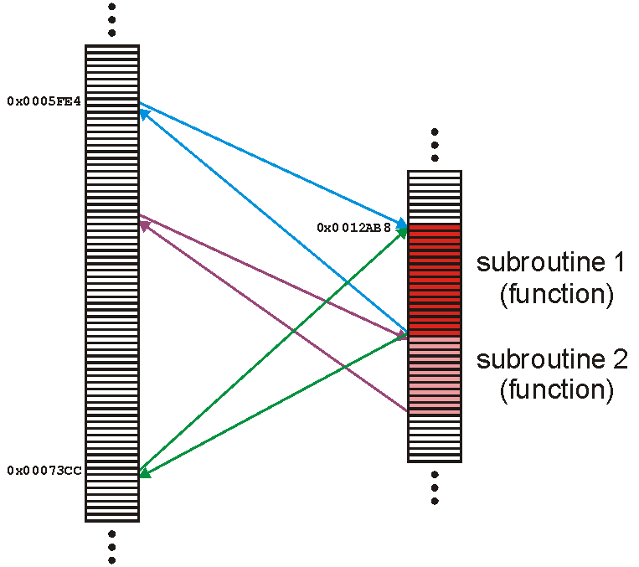
Functions
A function (or subroutine) is code which has been separated out

Slide 47
Functions
Because a subroutine (function) can be called from anywhere, we must:
  prepare the appropriate environment
  deal with arguments (parameters)
  jump to the subroutine
  execute the subroutine
  deal with the return value
  clean up

Slide 48
Functions
Fortunately, this is such a common task that all modern processors have instructions that perform most of these steps in one instruction
Thus, we will assume that the overhead required to make a function call and to return is Θ(1)

Slide 49
Functions
Because any function requires the overhead of a function call and return, we will always assume that
T_{f} = Ω(1)
That is, it is impossible for any function call to have a zero run time

Slide 50
Functions
Thus, given a function f(n) (the run time of which depends on n) we will associate the run time of f(n) by some function T_{f}(n)
  We may write this to T(n)
Because the run time of any function is at least O(1), we will include the time required to both call and return from the function in the run time

Slide 51
Functions
2T_{find}
T_{set_union}= 2T_{find} + Θ(1)
Θ(1)
Consider this function:
void Disjoint_sets::set_union( int m, int n ) {
m = find( m );
n = find( n );
if ( m == n ) {
return;
}
--num_disjoint_sets;
if ( tree_height[m] >= tree_height[n] ) {
parent[n] = m;
if ( tree_height[m] == tree_height[n] ) {
++( tree_height[m] );
max_height = std::max( max_height, tree_height[m] );
}
} else {
parent[m] = n;
}
}

Slide 52
Recursive Functions
A function is relatively simple if it simply performs operations and calls other functions
Most interesting functions designed to solve problems usually end up calling themselves
  Such a function is said to be recursive

Slide 53
Recursive Functions
As an example, we could implement the factorial function recursively:
int factorial( int n ) {
if ( n <= 1 ) {
return 1;
} else {
return n * factorial( n – 1 );
}
}

Slide 54
Recursive Functions
Thus, we may analyze the run time of this function as follows:
We don’t have to worry about the time of the conditional (Θ(1)) nor is there a probability involved with the conditional statement

Slide 55
Recursive Functions
The analysis of the run time of this function yields a recurrence relation:
T!(n) = T!(n – 1) + Θ(1) T!(1) = Θ(1)
This recurrence relation has Landau symbols…
  Replace each Landau symbol with a representative function:
  T!(n) = T!(n – 1) + 1 T!(1) = 1

Slide 56
Recursive Functions
Thus, to find the run time of the factorial function, we need to solve
T!(n) = T!(n – 1) + 1 T!(1) = 1
Using Maple:
> rsolve( {T(n) = T(n – 1) + 1, T(1) = 1}, T(n) );
n
Thus, T!(n) = Θ(n)

Slide 57
Recursive Functions
We can examine the first few steps:
  T!(n) = T!(n – 1) + 1
  = T!(n – 2) + 1 + 1 = T!(n – 2) + 2
  = T!(n – 3) + 3
From this, we see a pattern:
  T!(n) = T!(n – k) + k

Slide 58
Recursive Functions
If k = n – 1 then
  T!(n) = T!(n – (n – 1)) + n – 1
  = T!(1) + n – 1
  = 1 + n – 1 = n
Thus, T!(n) = Θ(n)

Slide 59
Recursive Functions
Incidentally, we may write the factorial function using the ternary ?: operator
  Ternary operators take three arguments—C++ has only one
int factorial( int n ) {
return (n <= 1) ? 1 : n * factorial( n – 1 );
}

Slide 60
Recursive Functions
Suppose we want to sort an array of n items
We could:
  go through the list and find the largest item
  swap the last entry in the list with that largest item
  then, go on and sort the rest of the array
This is called selection sort

Slide 61
Recursive Functions
void sort( int * array, int n ) {
if ( n <= 1 ) {
return; // special case: 0 or 1 items are always sorted
}
int posn = 0; // assume the first entry is the smallest
int max = array[posn];
for ( int i = 1; i < n; ++i ) { // search through the remaining entries
if ( array[i] > max ) { // if a larger one is found
posn = i; // update both the position and value
max = array[posn];
}
}
int tmp = array[n - 1]; // swap the largest entry with the last
array[n - 1] = array[posn];
array[posn] = tmp;
sort( array, n – 1 ); // sort everything else
}

Slide 62
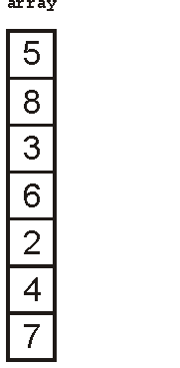
Recursive Functions
We could call this function as follows:
int array[7] = {5, 8, 3, 6, 2, 4, 7};
sort( array, 7 ); // sort an array of seven items

Slide 63
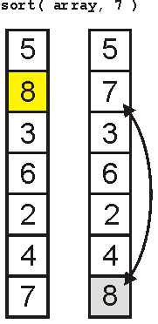
Recursive Functions
The first call finds the largest element

Slide 64
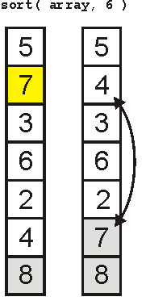
Recursive Functions
The next call finds the 2nd-largest element

Slide 65
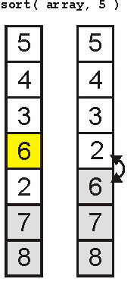
Recursive Functions
The third finds the 3rd-largest

Slide 66
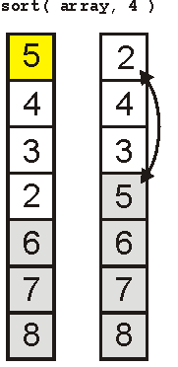
Recursive Functions
And the 4th

Slide 67
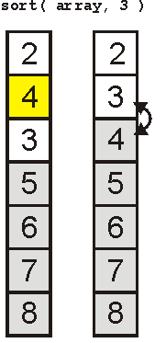
Recursive Functions
And the 5th

Slide 68
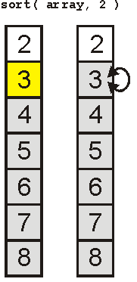
Recursive Functions
Finally the 6th

Slide 69
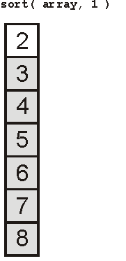
Recursive Functions
And the array is sorted:

Slide 70
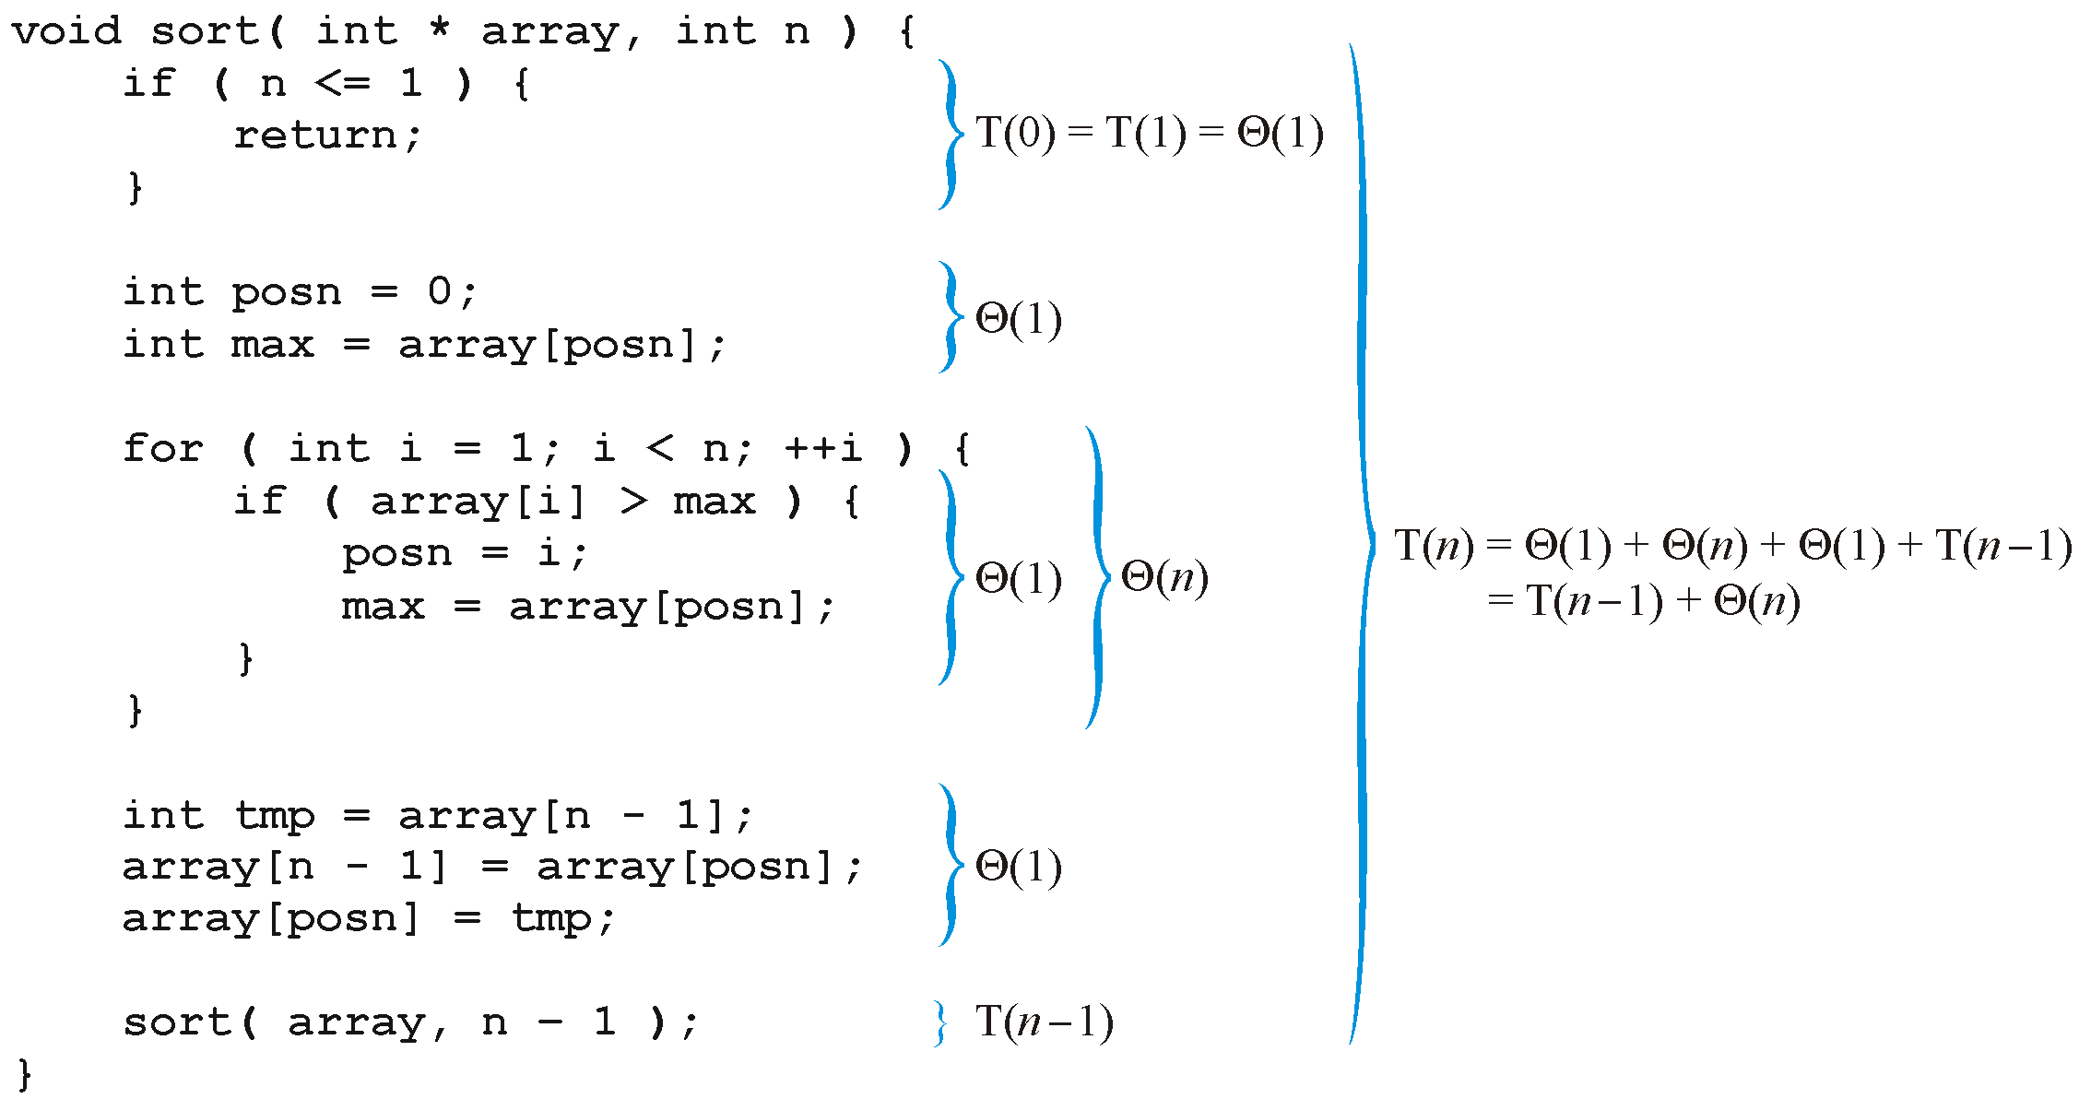
Recursive Functions
Analyzing the function, we get:

Slide 71
Recursive Functions
Thus, replacing each Landau symbol with a representative, we are required to solve the recurrence relation
T(n) = T(n – 1) + n T(1) = 1
The easy way to solve this is with Maple:
> rsolve( {T(n) = T(n – 1) + n, T(1) = 1}, T(n) );
> expand( % );

Slide 72
Recursive Functions
Consequently, the sorting routine has the run time
T(n) = Θ(n²)
To see this by hand, consider the following

Slide 73
Recursive Functions
Consider, instead, a binary search of a sorted list:
  Check the middle entry
  If we do not find it, check either the left- or right-hand side, as appropriate
Thus, T(n) = T((n – 1)/2) + Θ(1)

Slide 74
Recursive Functions
Also, if n = 1, then T(1) = Θ(1)
Thus we have to solve:
Solving this can be difficult, in general, so we will consider only special values of n
Assume n = 2^{k} – 1 where k is an integer
Then (n – 1)/2 = (2^{k} – 1 – 1)/2 = 2^{k – 1} – 1

Slide 75
Recursive Functions
For example, searching a list of size 31 requires us to check the center
If it is not found, we must check one of the two halves, each of which is size 15
31 = 2⁵ – 1
15 = 2⁴ – 1

Slide 76
Recursive Functions
Thus, we can write

Slide 77
Recursive Functions
Notice the pattern with one more step:

Slide 78
Recursive Functions
Thus, in general, we may deduce that after k – 1 steps:
because T(1) = 1

Slide 79
Recursive Functions
Thus, T(n) = k, but n = 2^{k} – 1
Therefore k = lg(n + 1)
However, recall that f(n) = Θ(g(n)) if for
Thus, T(n) = Θ(lg(n + 1)) = Θ (ln(n))

Slide 80
Cases
As well as determining the run time of an algorithm, because the data may not be deterministic, we may be interested in:
  Best-case run time
  Average-case run time
  Worst-case run time
In many cases, these will be significantly different

Slide 81
Cases
Searching a list linearly is simple enough
We will count the number of comparisons
  Best case:
    The first element is the one we’re looking for: O(1)
  Worst case:
    The last element is the one we’re looking for, or it is not in the list: O(n)
  Average case?
    We need some information about the list...

Slide 82
Cases
Assume the case we are looking for is in the list and equally likely distributed
If the list is of size n, then there is a 1/n chance of it being in the ith location
Thus, we sum
which is O(n)

Slide 83
Cases
Suppose we have a different distribution:
  there is a 50% chance that the element is the first
  for each subsequent element, the probability is reduced by ½
We could write:

Slide 84
Cases
You’re not expected to know this for the final, however, for interest:
> sum( i/2^i, i = 1..infinity );
2
Thus, the average case is O(1)

Slide 85
Cases
Previously, we had an example where we were looking for the number of times a particular assignment statement was executed:
int find_max( int * array, int n ) {
max = array[0];
for ( int i = 1; i < n; ++i ) {
if ( array[i] > max ) {
max = array[i];
}
}
return max;
}

Slide 86
Cases
  The best case is once (first element is largest)
  The worst case is n times
For the average case, we must consider:
  What is the probability that the i^{th} object is the largest of the first i objects?

Slide 87
Cases
Assume that elements in the array are evenly distributed
Thus, given a sub-list of size k, the probability that any one element is the largest is 1/k
Thus, given a value i, there are i + 1 objects, hence

Slide 88
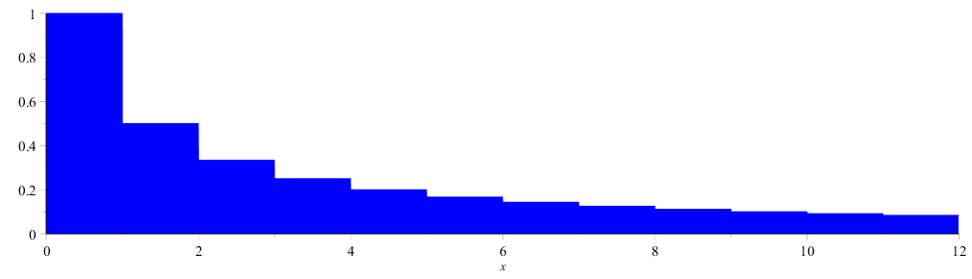
Cases
We can approximate the sum by an integral – what is the area under:

Slide 89
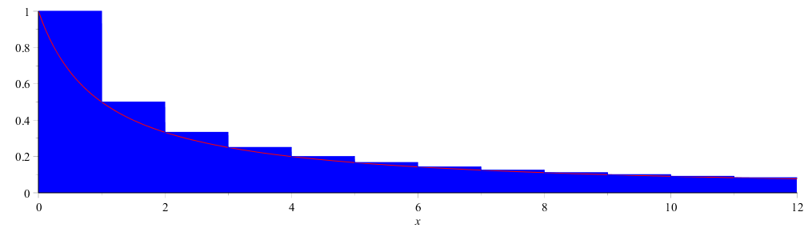
Cases
We can approximate this by the 1/(x + 1) integrated from 0 to n

Slide 90
Cases
From calculus:
How about the error? Our approximation would be useless if the error was O(n)

Slide 91
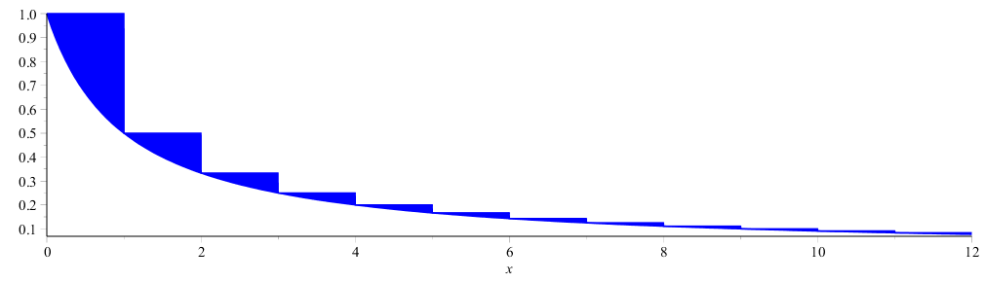
Cases
Consider the following image which highlights the errors
  The errors can be fit into the box [0, 1] × [0, 1]

Slide 92
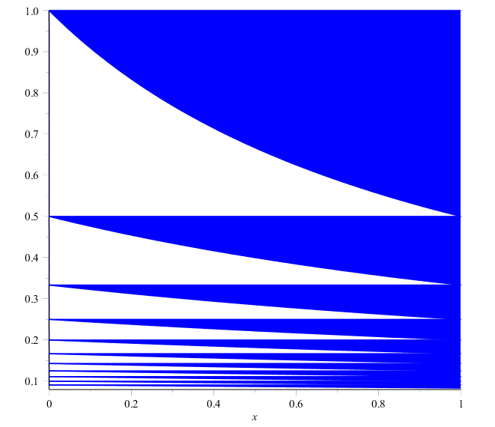
Cases
Consequently, the error must be < 1
In fact, it converges to γ ≈ 0.57721566490
  Therefore, the error is Θ(1)

Slide 93
Cases
Thus, the number of times that the assignment statement will be executed, assuming an even distribution is O(ln(n))

Slide 94
Cases
Thus, the total run of:
int find_max( int *array, int n ) {
max = array[0];
for ( int i = 1; i < n; ++i ) {
if ( array[i] > max ) {
max = array[i];
}
}
return max;
}
is

Slide 95
Summary
In these slides we have looked at:
  The run times of
    Operators
    Control statements
    Functions
    Recursive functions
  We have also defined best-, worst-, and average-case scenarios
We will be considering all of these each time we inspect any algorithm used in this class

Slide 96
Summary
In this topic, we looked at:
  Justification for using analysis
  Quadratic and polynomial growth
  Counting machine instructions
  Landau symbols o O Θ Ω ω
  Big-Θ as an equivalence relation
  Little-o as a linear ordering for the equivalence classes

