Slide 1
Outline
We will now look at our first abstract data structure
Relation: explicit linear ordering
Operations
Implementations of an abstract list with:
Linked lists
Arrays
Memory requirements
Strings as a special case
The STL vector class

Slide 2
Definition
3.1
An Abstract List (or List ADT) is linearly ordered data where the programmer explicitly defines the ordering
We will look at the most common operations that are usually
The most obvious implementation is to use either an array or linked list
These are, however, not always the most optimal

Slide 3
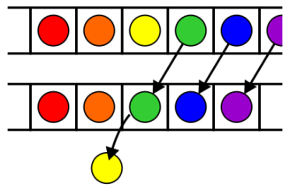
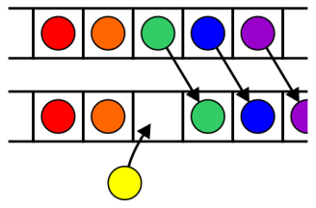
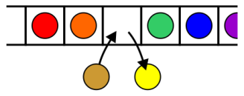
Operations
3.1.1
Operations at the k^{th} entry of the list include:
Access to the object Erasing an object
Insertion of a new object Replacement of the object

Slide 4
Operations
3.1.1
Given access to the k^{th} object, gain access to either the previous or next object
Given two abstract lists, we may want to
Concatenate the two lists
Determine if one is a sub-list of the other

Slide 5
Locations and run times
3.1.2
The most obvious data structures for implementing an abstract list are arrays and linked lists
We will review the run time operations on these structures
We will consider the amount of time required to perform actions such as finding, inserting new entries before or after, or erasing entries at
the first location (the front)
an arbitrary (k^{th}) location
the last location (the back or n^{th})
The run times will be Θ(1), O(n) or Θ(n)

Slide 6
Linked lists
3.1.3
We will consider these for
Singly linked lists
Doubly linked lists

Slide 7
Singly linked list
3.1.3.1
 | Front/1st node | k^{th} node | Back/n^{th} node
Find | Θ(1) | Ο(n)* | Θ(1)
Insert Before | Θ(1) | Ο(n)* | Θ(n)
Insert After | Θ(1) | Θ(1)* | Θ(1)
Replace | Θ(1) | Θ(1)* | Θ(1)
Erase | Θ(1) | Ο(n)* | Θ(n)
Next | Θ(1) | Θ(1)* | n/a
Previous | n/a | Ο(n)* | Θ(n)
* These assume we have already accessed the k^{th} entry—an O(n) operation

Slide 8
Singly linked list
3.1.3.1
 | Front/1st node | k^{th} node | Back/n^{th} node
Find | Θ(1) | Ο(n)* | Θ(1)
Insert Before | Θ(1) | Θ(1)* | Θ(1)
Insert After | Θ(1) | Θ(1)* | Θ(1)
Replace | Θ(1) | Θ(1)* | Θ(1)
Erase | Θ(1) | Θ(1)* | Θ(n)
Next | Θ(1) | Θ(1)* | n/a
Previous | n/a | Ο(n)* | Θ(n)
By replacing the value in the node in question, we can speed things up
– useful for interviews

Slide 9
Doubly linked lists
3.1.3.2
 | Front/1st node | k^{th} node | Back/n^{th} node
Find | Θ(1) | Ο(n)* | Θ(1)
Insert Before | Θ(1) | Θ(1)* | Θ(1)
Insert After | Θ(1) | Θ(1)* | Θ(1)
Replace | Θ(1) | Θ(1)* | Θ(1)
Erase | Θ(1) | Θ(1)* | Θ(1)
Next | Θ(1) | Θ(1)* | n/a
Previous | n/a | Θ(1)* | Θ(1)
* These assume we have already accessed the k^{th} entry—an O(n) operation

Slide 10
Doubly linked lists
3.1.3.2
Accessing the k^{th} entry is O(n)
 | k^{th} node
Insert Before | Θ(1)
Insert After | Θ(1)
Replace | Θ(1)
Erase | Θ(1)
Next | Θ(1)
Previous | Θ(1)

Slide 11
Other operations on linked lists
3.1.3.3
Other operations on linked lists include:
Allocation and deallocation of the memory requires Θ(n) time
Concatenating two linked lists can be done in Θ(1)
This requires a tail pointer

Slide 12
Arrays
3.1.4
We will consider these operations for arrays, including:
Standard or one-ended arrays
Two-ended arrays

Slide 13
Standard arrays
3.1.4
We will consider these operations for arrays, including:
Standard or one-ended arrays
Two-ended arrays

Slide 14
Run times
 | Accessing the k^{th} entry | Insert or erase at the
 |  | Front | k^{th} entry | Back
Singly linked lists | O(n) | Θ(1) | Θ(1)* | Θ(1) or Θ(n)
Doubly linked lists |  |  |  | Θ(1)
Arrays | Θ(1) | Θ(n) | O(n) | Θ(1)
Two-ended arrays |  | Θ(1)
* Assume we have a pointer to this node

Slide 15
Data Structures
In general, we will only use these basic data structures if we can restrict ourselves to operations that execute in Θ(1) time, as the only alternative is O(n) or Θ(n)
Interview question: in a singly linked list, can you speed up the two O(n) operations of
Inserting before an arbitrary node?
Erasing any node that is not the last node?
If you can replace the contents of a node, the answer is “yes”
Replace the contents of the current node with the new entry and insert after the current node
Copy the contents of the next node into the current node and erase the next node

Slide 16
Memory usage versus run times
All of these data structures require Θ(n) memory
Using a two-ended array requires one more member variable, Θ(1), in order to significantly speed up certain operations
Using a doubly linked list, however, required Θ(n) additional memory to speed up other operations

Slide 17
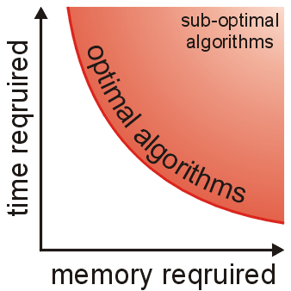
Memory usage versus run times
As well as determining run times, we are also interested in memory usage
In general, there is an interesting relationship between memory and time efficiency
For a data structure/algorithm:
Improving the run time usually requires more memory
Reducing the required memory usually requires more run time

Slide 18
Memory usage versus run times
Warning: programmers often mistake this to suggest that given any solution to a problem, any solution which may be faster must require more memory
This guideline not true in general: there may be different data structures and/or algorithms which are both faster and require less memory
This requires thought and research

Slide 19
The sizeof Operator
In order to determine memory usage, we must know the memory usage of the various built-in data types and classes
The sizeof operator in C++ returns the number of bytes occupied by a data type
This value is determined at compile time
It is not a function

Slide 20
The sizeof Operator
#include <iostream>
using namespace std;
int main() {
cout << "bool " << sizeof( bool ) << endl;
cout << "char " << sizeof( char ) << endl;
cout << "short " << sizeof( short ) << endl;
cout << "int " << sizeof( int ) << endl;
cout << "char * " << sizeof( char * ) << endl; cout << "int * " << sizeof( int * ) << endl;
cout << "double " << sizeof( double ) << endl;
cout << "int[10] " << sizeof( int[10] ) << endl;
return 0;
}
{eceunix:1} ./a.out # output
bool 1
char 1
short 2
int 4
char * 4
int * 4
double 8
int[10] 40
{eceunix:2}

Slide 21
Abstract Strings
A specialization of an Abstract List is an Abstract String:
The entries are restricted to characters from a finite alphabet
This includes regular strings “Hello world!”
The restriction using an alphabet emphasizes specific operations that would seldom be used otherwise
Substrings, matching substrings, string concatenations
It also allows more efficient implementations
String searching/matching algorithms
Regular expressions

Slide 22
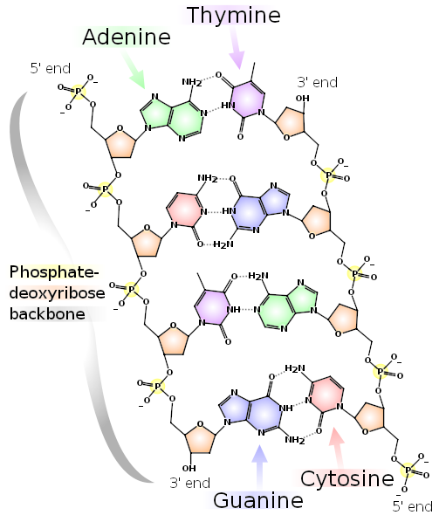
Abstract Strings
Strings also include DNA
The alphabet has 4 characters: A, C, G, and T
These are the nucleobases:
adenine, cytosine, guanine, and thymine
Bioinformatics today uses many of the algorithms traditionally restricted to computer science:
Dan Gusfield, Algorithms on Strings, Trees and Sequences: Computer Science and Computational Biology, Cambridge, 1997
http://books.google.ca/books?id=STGlsyqtjYMC
References:
http://en.wikipedia.org/wiki/DNA
http://en.wikipedia.org/wiki/Bioinformatics

Slide 23
Standard Template Library
In this course, you must understand each data structure and their associated algorithms
In industry, you will use other implementations of these structures
The C++ Standard Template Library (STL) has an implementation of the vector data structure
Excellent reference:
http://www.cplusplus.com/reference/stl/vector/

Slide 24
Standard Template Library
#include <iostream>
#include <vector>
using namespace std;
int main() {
vector<int> v( 10, 0 );
cout << "Is the vector empty? " << v.empty() << endl;
cout << "Size of vector: " << v.size() << endl;
v[0] = 42;
v[9] = 91;
for ( int k = 0; k < 10; ++k ) {
cout << "v[" << k << "] = " << v[k] << endl;
}
return 0;
}
$ g++ vec.cpp
$ ./a.out
Is the vector empty? 0
Size of vector: 10
v[0] = 42
v[1] = 0
v[2] = 0
v[3] = 0
v[4] = 0
v[5] = 0
v[6] = 0
v[7] = 0
v[8] = 0
v[9] = 91
$

Slide 25
Summary
In this topic, we have introduced Abstract Lists
Explicit linear orderings
Implementable with arrays or linked lists
Each has their limitations
Introduced modifications to reduce run times down to Θ(1)
Discussed memory usage and the sizeof operator
Looked at the String ADT
Looked at the vector class in the STL

Slide 26
References
[1] Donald E. Knuth, The Art of Computer Programming, Volume 1: Fundamental Algorithms, 3rd Ed., Addison Wesley, 1997, §2.2.1, p.238.
[2] Weiss, Data Structures and Algorithm Analysis in C++, 3rd Ed., Addison Wesley, §3.3.1, p.75.

Slide 27
Usage Notes
These slides are made publicly available on the web for anyone to use
If you choose to use them, or a part thereof, for a course at another institution, I ask only three things:
that you inform me that you are using the slides,
that you acknowledge my work, and
that you alert me of any mistakes which I made or changes which you make, and allow me the option of incorporating such changes (with an acknowledgment) in my set of slides
Sincerely,
Douglas Wilhelm Harder, MMath
dwharder@alumni.uwaterloo.ca

