Slide 1

Outline
This topic discusses the concept of a queue:
  Description of an Abstract Queue
  List applications
  Implementation
  Queuing theory
  Standard Template Library
  Description of an Abstract Deque
  Applications
  Implementations
  The STL and Iterations

Slide 2
Abstract Queue
3.3
An Abstract Queue (Queue ADT) is an abstract data type that emphasizes specific operations:
  Uses a explicit linear ordering
  Insertions and removals are performed individually
  There are no restrictions on objects inserted into (pushed onto) the queue—that object is designated the back of the queue
  The object designated as the front of the queue is the object which was in the queue the longest
  The remove operation (popping from the queue) removes the current front of the queue

Slide 3
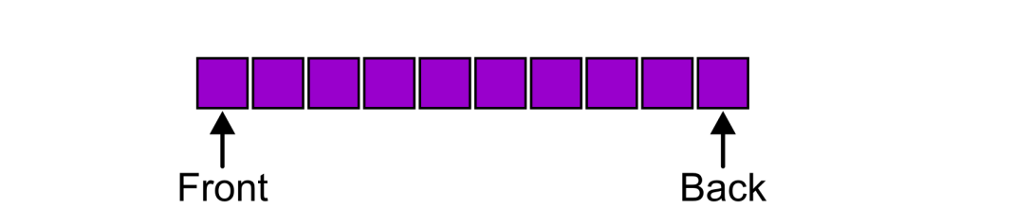
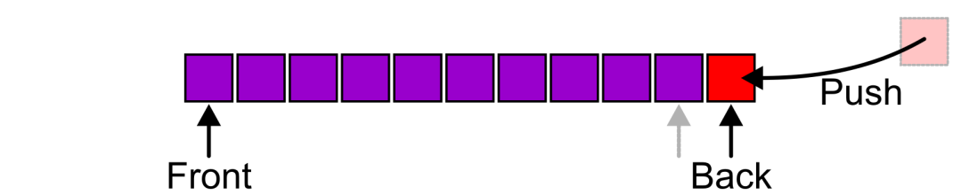
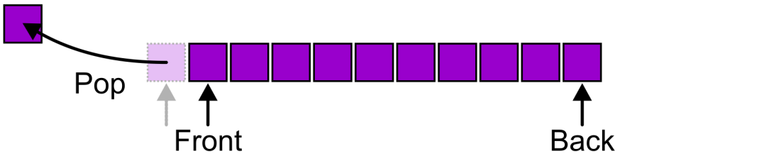
Abstract Queue
3.3.1
Also called a first-in–first-out (FIFO) data structure
  Graphically, we may view these operations as follows:

Slide 4
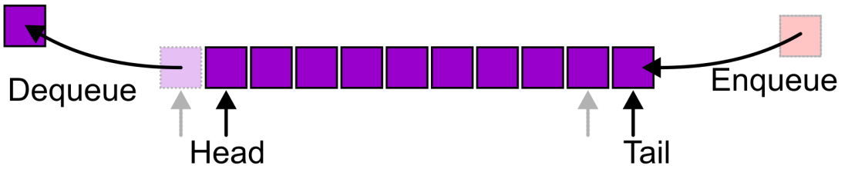
Abstract Queue
3.3.1
Alternative terms may be used for the four operations on a queue, including:

Slide 5
Abstract Queue
3.3.1
There are two exceptions associated with this abstract data structure:
  It is an undefined operation to call either pop or front on an empty queue

Slide 6
Applications
3.3.2
The most common application is in client-server models
  Multiple clients may be requesting services from one or more servers
  Some clients may have to wait while the servers are busy
  Those clients are placed in a queue and serviced in the order of arrival
Grocery stores, banks, and airport security use queues
The SSH Secure Shell and SFTP are clients
Most shared computer services are servers:
  Web, file, ftp, database, mail, printers, WOW, etc.

Slide 7
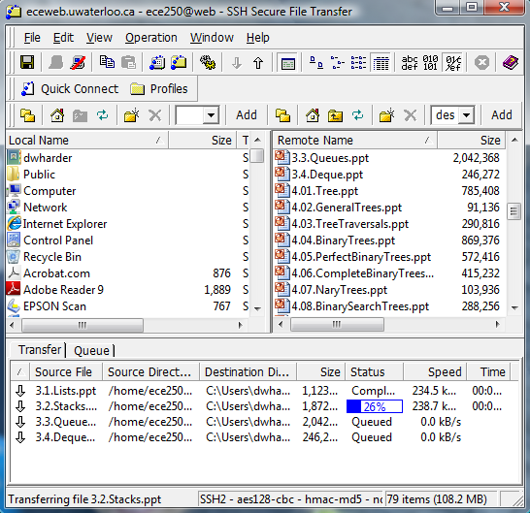
Applications
3.3.2
For example, in downloading these presentations from the ECE 250 web server, those requests not currently being downloaded are
marked as “Queued”

Slide 8
Implementations
3.3.3
We will look at two implementations of queues:
  Singly linked lists
  Circular arrays
Requirements:
  All queue operations must run in Θ(1) time

Slide 9
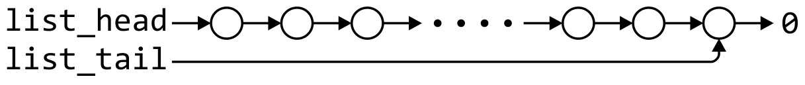
Linked-List Implementation
3.3.3.1
Removal is only possible at the front with Θ(1) run time
The desired behaviour of an Abstract Queue may be reproduced by performing insertions at the back
 | Front/1st | Back/n^{th}
Find | Θ(1) | Θ(1)
Insert | Θ(1) | Θ(1)
Erase | Θ(1) | Θ(n)

Slide 10
Single_list Definition
3.3.3.1
The definition of single list class from Project 1 is:
template <typename Type>
class Single_list {
public:
int size() const;
bool empty() const;
Type front() const;
Type back() const;
Single_node<Type> *head() const;
Single_node<Type> *tail() const;
int count( Type const & ) const;
void push_front( Type const & );
void push_back( Type const & );
Type pop_front();
int erase( Type const & );
};

Slide 11
Queue-as-List Class
3.3.3.1
The queue class using a singly linked list has a single private member variable: a singly linked list
template <typename Type>
class Queue{
private:
Single_list<Type> list;
public:
bool empty() const;
Type front() const;
void push( Type const & );
Type pop();
};

Slide 12
Queue-as-List Class
3.3.3.1
template <typename Type>
Type Queue<Type>::front() const {
if ( empty() ) {
throw underflow();
}
return list.front();
}
template <typename Type>
Type Queue<Type>::pop() {
if ( empty() ) {
throw underflow();
}
return list.pop_front();
}
The implementation is similar to that of a Stack-as-List
template <typename Type>
bool Queue<Type>::empty() const {
return list.empty();
}
template <typename Type>
void Queue<Type>::push( Type const &obj ) {
list.push_back( obj );
}
Notes:
12

Slide 13

Array Implementation
3.3.3.2
A one-ended array does not allow all operations to occur in Θ(1) time
 | Front/1st | Back/n^{th}
Find | Θ(1) | Θ(1)
Insert | Θ(n) | Θ(1)
Erase | Θ(n) | Θ(1)

Slide 14
Array Implementation
3.3.3.2
Using a two-ended array, Θ(1) are possible by pushing at the back and popping from the front
 | Front/1st | Back/n^{th}
Find | Θ(1) | Θ(1)
Insert | Θ(1) | Θ(1)
Remove | Θ(1) | Θ(1)

Slide 15
Array Implementation
3.3.3.2
We need to store an array:
  In C++, this is done by storing the address of the first entry
Type *array;
We need additional information, including:
  The number of objects currently in the queue and the front and back indices
int queue_size;
int ifront; // index of the front entry
int iback; // index of the back entry
  The capacity of the array
int array_capacity;
Notes:
15

Slide 16
Queue-as-Array Class
3.3.3.2
The class definition is similar to that of the Stack:
template <typename Type>
class Queue{
private:
int queue_size;
int ifront;
int iback;
int array_capacity;
Type *array;
public:
Queue( int = 10 );
~Queue();
bool empty() const;
Type front() const;
void push( Type const & );
Type pop();
};

Slide 17
Constructor
3.3.3.2
Before we initialize the values, we will state that
  iback is the index of the most-recently pushed object
  ifront is the index of the object at the front of the queue
To push, we will increment iback and place the new item at that location
  To make sense of this, we will initialize
  iback = -1;
  ifront = 0;
  After the first push, we will increment iback to 0, place the pushed item at that location, and now
Notes:
17

Slide 18
Constructor
3.3.3.2
Again, we must initialize the values
  We must allocate memory for the array and initialize the member variables
  The call to new Type[array_capacity] makes a request to the operating system for array_capacity objects
#include <algorithm>
// ...
template <typename Type>
Queue<Type>::Queue( int n ):
queue_size( 0 ),
iback( -1 ),
ifront( 0 ),
array_capacity( std::max(1, n) ),
array( new Type[array_capacity] ) {
// Empty constructor
}

Slide 19
Constructor
3.3.3.2
template <typename Type>
class Queue {
private:
int queue_size;
int iback;
int ifront;
int array_capacity;
Type *array;
public:
Queue( int = 10 );
~Queue();
bool empty() const;
Type top() const;
void push( Type const & );
Type pop();
};
template <typename Type>
Queue<Type>::Queue( int n ):
queue_size( 0 ),
iback( -1 ),
ifront( 0 ),
array_capacity( std::max(1, n) ),
array( new Type[array_capacity] )
{
// Empty constructor
}
Reminder:
  Initialization is performed in the order specified in the class declaration
Notes:
19

Slide 20
Destructor
3.3.3.2
The destructor is unchanged from Stack-as-Array:
template <typename Type>
Queue<Type>::~Queue() {
delete [] array;
}

Slide 21
Member Functions
3.3.3.2
These two functions are similar in behaviour:
template <typename Type>
bool Queue<Type>::empty() const {
return ( queue_size == 0 );
}
template <typename Type>
Type Queue<Type>::front() const {
if ( empty() ) {
throw underflow();
}
return array[ifront];
}

Slide 22
Member Functions
3.3.3.2
template <typename Type>
Type Queue<Type>::pop() {
if ( empty() ) {
throw underflow();
}
--queue_size;
++ifront;
return array[ifront - 1];
}
However, a naïve implementation of push and pop will cause difficulties:
template <typename Type>
void Queue<Type>::push( Type const &obj ) {
if ( queue_size == array_capacity ) {
throw overflow();
}
++iback;
array[iback] = obj;
++queue_size;
}
Notes:
22

Slide 23
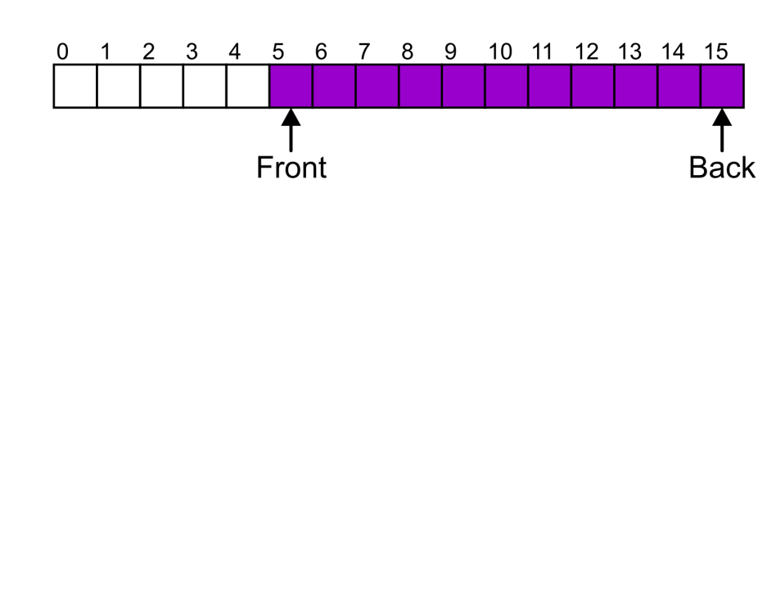
Member Functions
3.3.3.2
Suppose that:
  The array capacity is 16
  We have performed 16 pushes
  We have performed 5 pops
    The queue size is now 11
  We perform one further push
In this case, the array is not full and yet we cannot place any more objects in to the array
Notes:
23

Slide 24
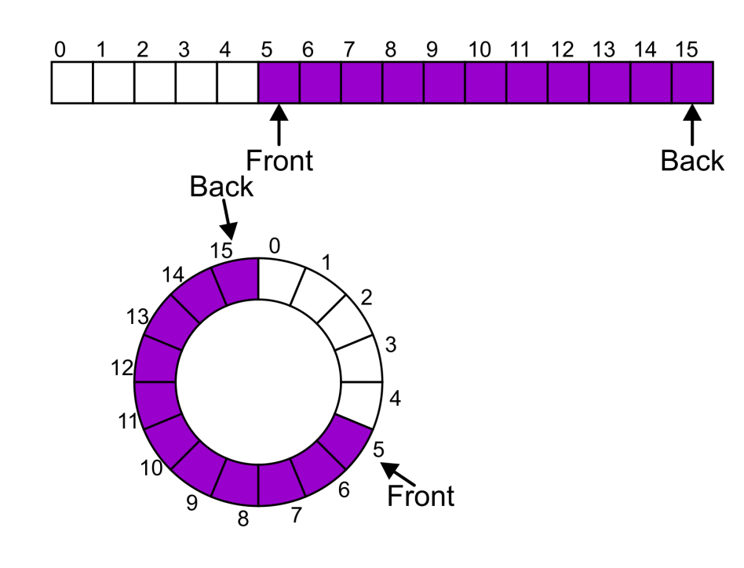
Member Functions
3.3.3.2
Instead of viewing the array on the range 0, …, 15, consider the indices being cyclic:
…, 15, 0, 1, …, 15, 0, 1, …, 15, 0, 1, …
This is referred to as a circular array
Notes:
24

Slide 25
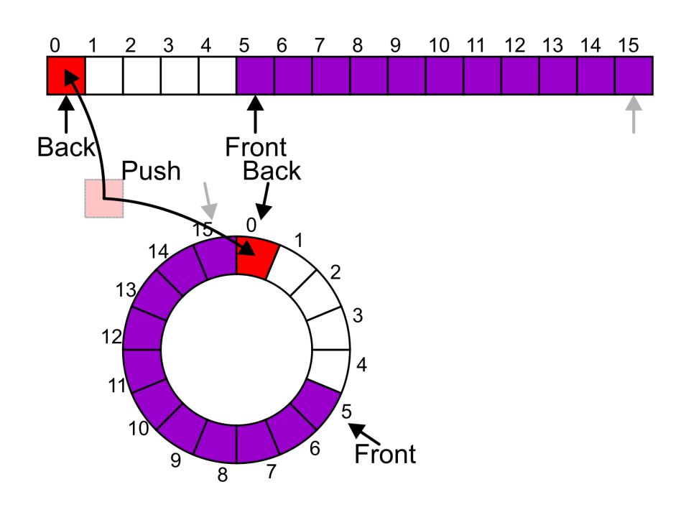
Member Functions
3.3.3.2
Now, the next push may be performed in the next available location of the circular array:
  ++iback;
  if ( iback == capacity() ) {
  iback = 0;
  }
Notes:
25

Slide 26
Exceptions
3.3.3.2
As with a stack, there are a number of options which can be used if the array is filled
If the array is filled, we have five options:
  Increase the size of the array
  Throw an exception
  Ignore the element being pushed
  Put the pushing process to “sleep” until something else pops the front of the queue
Include a member function bool full()

Slide 27
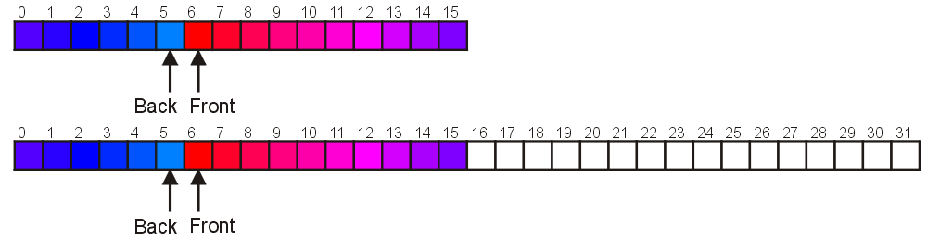
Increasing Capacity
3.3.4
Unfortunately, if we choose to increase the capacity, this becomes slightly more complex
  A direct copy does not work:

Slide 28
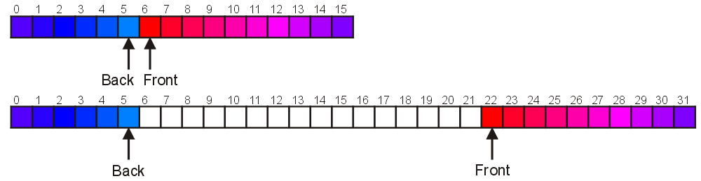
Increasing Capacity
3.3.4
There are two solutions:
  Move those beyond the front to the end of the array
  The next push would then occur in position 6
Notes:
28

Slide 29
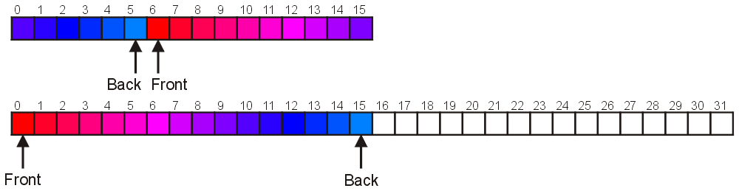
Increasing Capacity
3.3.4
An alternate solution is normalization:
  Map the front back at position 0
  The next push would then occur in position 16
Notes:
29

Slide 30
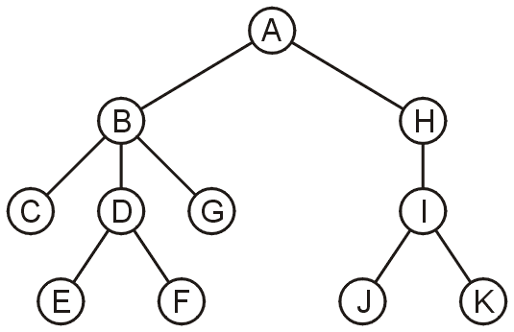
Application
3.3.5
Another application is performing a breadth-first traversal of a directory tree
  Consider searching the directory structure

Slide 31
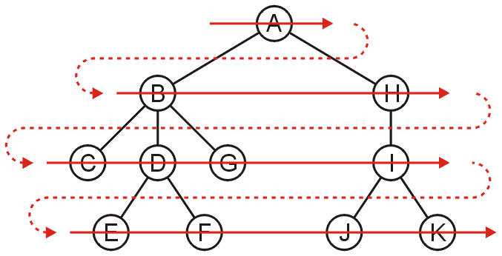
Application
3.3.5
We would rather search the more shallow directories first then plunge deep into searching one sub-directory and all of its contents
One such search is called a breadth-first traversal
  Search all the directories at one level before descending a level

Slide 32
Application
3.3.5
The easiest implementation is:
  Place the root directory into a queue
  While the queue is not empty:
    Pop the directory at the front of the queue
    Push all of its sub-directories into the queue
The order in which the directories come out of the queue will be in breadth-first order

Slide 33
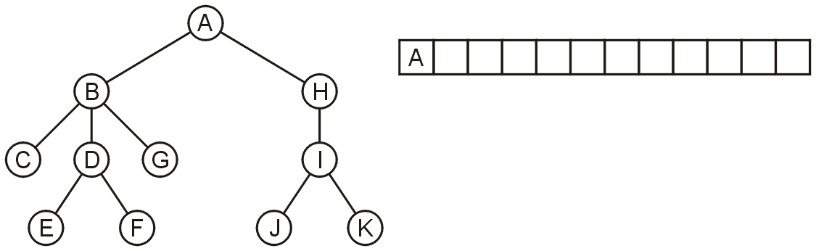
Application
3.3.5
Push the root directory A

Slide 34
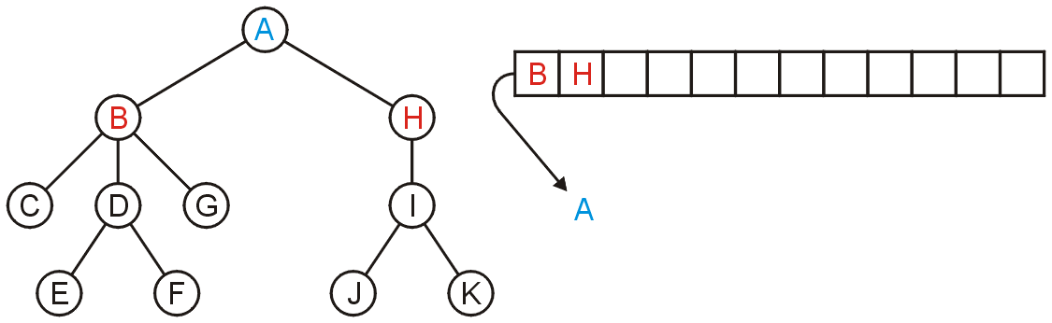
Application
3.3.5
Pop A and push its two sub-directories: B and H

Slide 35
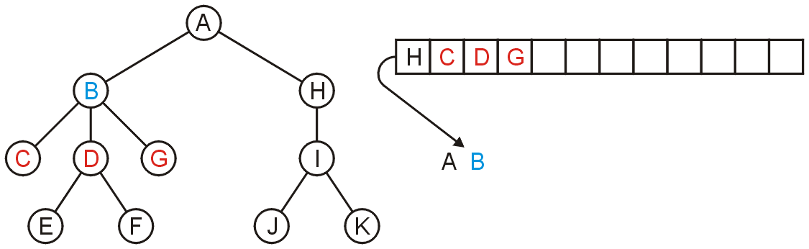
Application
3.3.5
Pop B and push C, D, and G

Slide 36
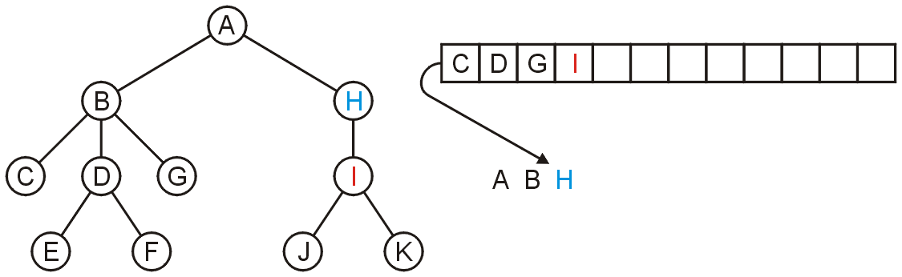
Application
3.3.5
Pop H and push its one sub-directory I

Slide 37
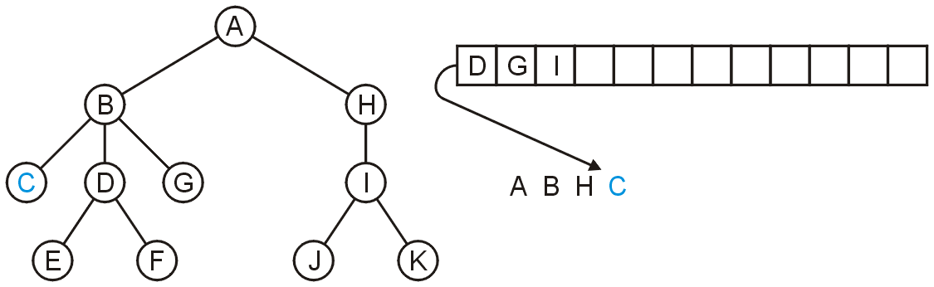
Application
3.3.5
Pop C: no sub-directories

Slide 38
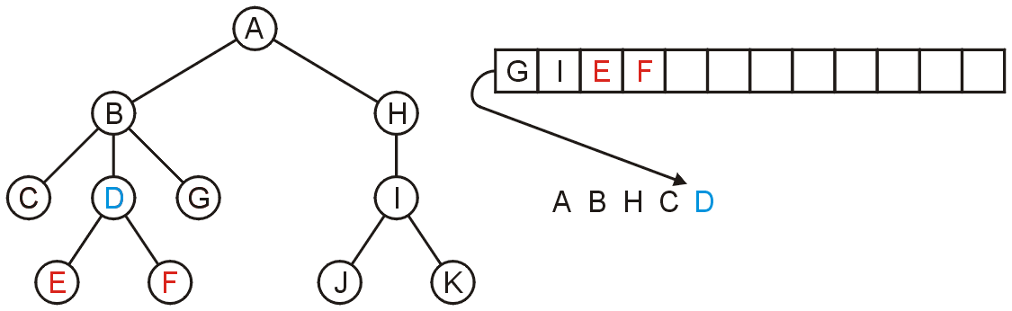
Application
3.3.5
Pop D and push E and F

Slide 39
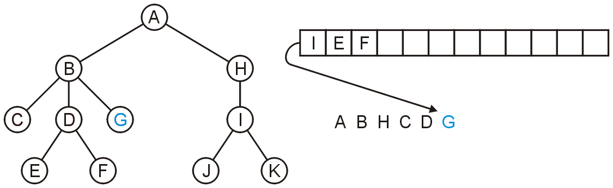
Application
3.3.5
Pop G

Slide 40
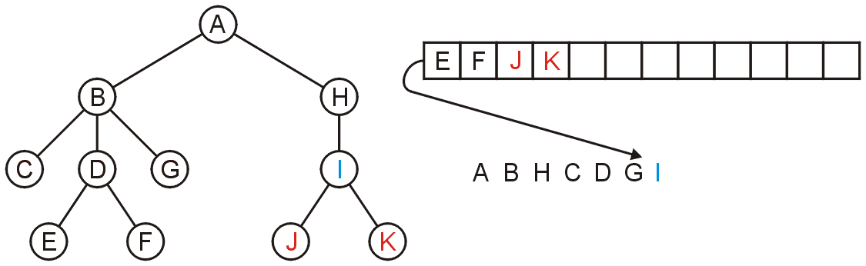
Application
3.3.5
Pop I and push J and K

Slide 41
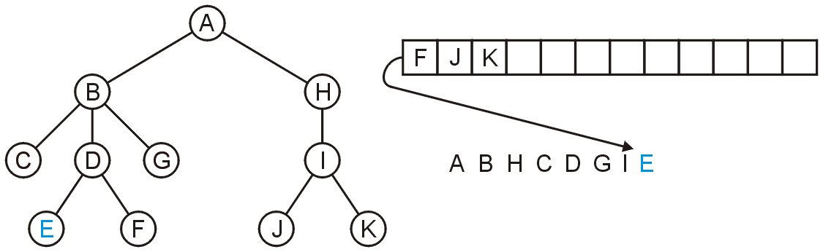
Application
3.3.5
Pop E

Slide 42
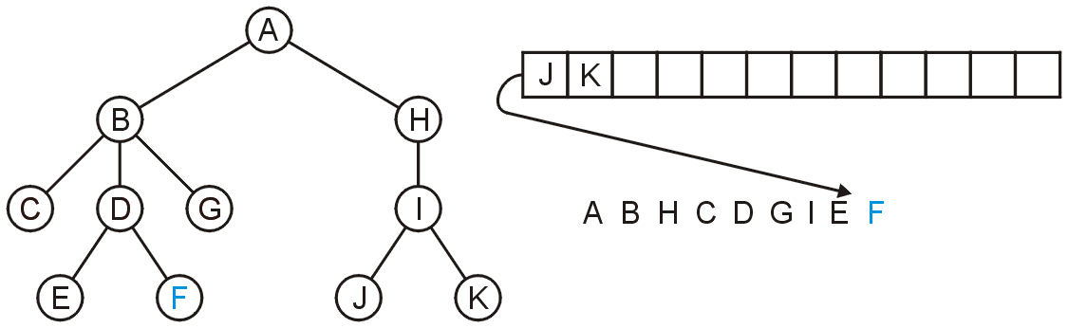
Application
3.3.5
Pop F

Slide 43
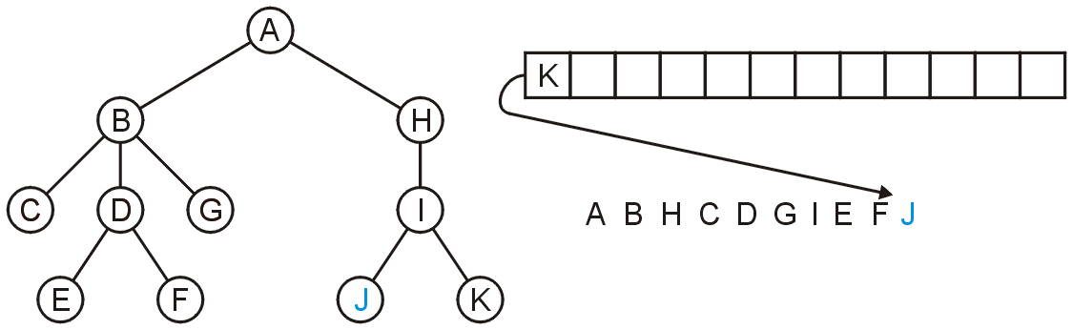
Application
3.3.5
Pop J

Slide 44
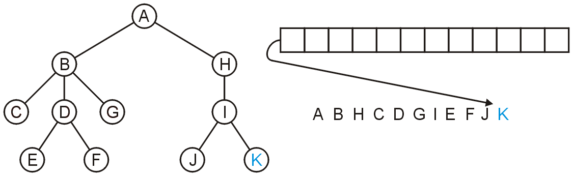
Application
3.3.5
Pop K and the queue is empty

Slide 45
Application
3.3.5
The resulting order
A B H C D G I E F J K
is in breadth-first order:

Slide 46
Standard Template Library
3.3.6
An example of a queue in the STL is:
#include <iostream>
#include <queue>
using namespace std;
int main() {
queue <int> iqueue;
iqueue.push( 13 );
iqueue.push( 42 );
cout << "Head: " << iqueue.front() << endl;
iqueue.pop(); // no return value
cout << "Head: " << iqueue.front() << endl;
cout << "Size: " << iqueue.size() << endl;
return 0;
}

Slide 47
Summary
The queue is one of the most common abstract data structures
Understanding how a queue works is trivial
The implementation is only slightly more difficult than that of a stack
Applications include:
  Queuing clients in a client-server model
  Breadth-first traversals of trees

Slide 48
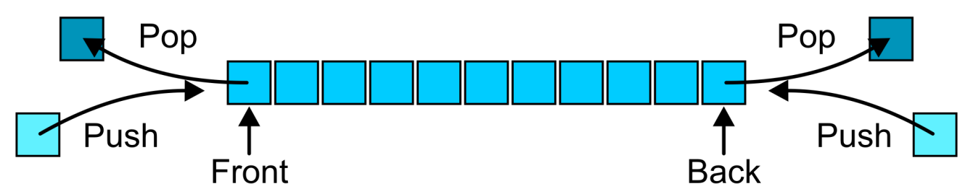
Abstract Deque
3.4.1
An Abstract Deque (Deque ADT) is an abstract data structure which emphasizes specific operations:
  Uses a explicit linear ordering
  Insertions and removals are performed individually
  Allows insertions at both the front and back of the deque

Slide 49
Abstract Deque
3.4.1
The operations will be called
front back
push_front push_back
pop_front pop_back
There are four errors associated with this abstract data type:
  It is an undefined operation to access or pop from an empty deque

Slide 50
Applications
3.4.2
Useful as a general-purpose tool:
  Can be used as either a queue or a stack
Problem solving:
  Consider solving a maze by adding or removing a constructed path at the front
  Once the solution is found, iterate from the back for the solution

Slide 51
Implementations
3.4.3
The implementations are clear:
  We must use either a doubly linked list or a circular array
Notes:
51

Slide 52
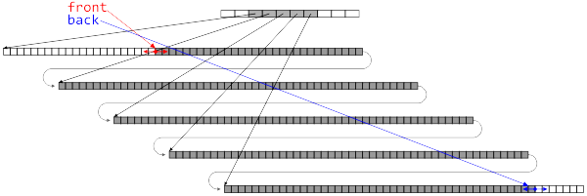
Standard Template Library
3.4.4
The C++ Standard Template Library (STL) has an implementation of the deque data structure
  The STL stack and queue are wrappers around this structure
The implementation is not specified, but the constraints are given which must be satisfied by any implementation
Notes:
52

Slide 53
Standard Template Library
3.4.4
The STL comes with a deque data structure:
  deque<T>
The signatures use stack terminology:
T &front();
void push_front(T const &);
void pop_front();
T &back();
void push_back(T const &);
void pop_back();

Slide 54
Standard Template Library
3.4.4
{eceunix:1} g++ deque_example.cpp
{eceunix:2} ./a.out
Is the deque empty? 0
Size of deque: 4
Back of the deque: 6
Back of the deque: 4
Back of the deque: 5
Back of the deque: 3
Is the deque empty? 1
{eceunix:3}
#include <iostream>
#include <deque>
using namespace std;
int main() {
deque<int> ideque;
ideque.push_front( 5 );
ideque.push_back( 4 );
ideque.push_front( 3 );
ideque.push_back( 6 ); // 3 5 4 6
cout << "Is the deque empty? " << ideque.empty() << endl;
cout << "Size of deque: " << ideque.size() << endl;
for ( int i = 0; i < 4; ++i ) {
cout << "Back of the deque: " << ideque.back() << endl;
ideque.pop_back();
}
cout << "Is the deque empty? " << ideque.empty() << endl;
return 0;
}

Slide 55
Accessing the Entries of a Deque
3.4.5
We will see three mechanisms for accessing entries in the deque:
  Two random access member functions
    An overloaded indexing operator ideque[10]
    The at() member function; and ideque.at( 10 );
  The iterator design pattern
The difference between indexing and using the function at( int ) is that the second will throw an out_of_range exception if it accesses an entry outside the range of the deque

Slide 56
T &deque::operator[]( int )
T &deque::at( int )
3.4.5
#include <iostream>
#include <deque>
using namespace std;
int main() {
deque<int> ideque;
ideque.push_front( 5 ); ideque.push_back( 4 );
ideque.push_front( 3 ); ideque.push_back( 6 ); // 5 3 4 6
for ( int i = 0; i <= ideque.size(); ++i ) {
cout << ideque[i] << " " << ideque.at( i ) << " ";
}
cout << endl;
return 0;
}
{eceunix:1} ./a.out # output
5 5 3 3 4 4 6 6 0
terminate called after throwing an instance of 'std::out_of_range'
what(): deque::_M_range_check
Abort

Slide 57
Stepping Through Deques
3.4.5
From Project 1, you should be familiar with this technique of stepping through a Single_list:
Single_list<int> list;
for ( int i = 0; i < 10; ++i ) { list.push_front( i ); }
for ( Single_node<int> *ptr = list.head(); ptr != 0; ptr = ptr->next() ) {
cout << ptr->retrieve();
}
Notes:
57

Slide 58
Stepping Through Deques
3.4.5
There are serious problems with this approach:
  It exposes the underlying structure
  It is impossible to change the implementation once users have access to the structure
  The implementation will change from class to class
    Single_list requires Single_node
    Double_list requires Double_node
  An array-based data structure does not have a direct analogy to the concept of either head() or next()
Notes:
58

Slide 59
Stepping Through Deques
3.4.5
More critically, what happens with the following code?
Single_list<int> list;
for ( int i = 0; i < 10; ++i ) { list.push_front( i ); }
Single_node<int> *ptr = list.head();
list.pop_front();
cout << ptr->retrieve() << endl; // ??
Notes:
59

Slide 60
Stepping Through Deques
3.4.5
Or how about…
Single_list<int> list;
for ( int i = 0; i < 10; ++i ) { list.push_front( i ); }
delete list.head(); // ?!
Notes:
60

Slide 61
Iterators
3.4.5
Project 1 exposes the underlying data structure for evaluation purposes
  This is, however, not good programming practice
The C++ STL uses the concept of an iterator to solve this problem
  The iterator is not unique to C++
  It is an industry recognized approach to solving a particular problem
  Such a solution is called a design pattern
    Formalized in Gamma et al. work Design Patterns
Notes:
61

Slide 62
Standard Template Library
3.4.5
Associated with each STL container class is a nested class termed an iterator:
  deque<int> ideque;
  deque<int>::iterator itr;
The iterator “refers” to one position within the deque
  It is similar a pointer but is independent of implementation

Slide 63
Analogy
3.4.5
Consider a filing system with an administrative assistant
Your concern is not how reports are filed (so long as it’s efficient), it is only necessary that you can give directions to the assistant

Slide 64
Analogy
3.4.5
You can request that your assistant:
  Starts with either the first or last file
  You can request to see the file the assistant is currently holding
  You can modify the file the assistant is currently holding
  You can request that the assistant either:
    Go to the next file, or
    Go to the previous file

Slide 65
Iterators
3.4.5
In C++, iterators overloads a number of operators:
  The unary * operator returns a reference to the element stored at the location pointed to by the iterator
  The operator ++ updates the iterator to point to the next position
  The operator -- updates the iterator to point to the previous location
Note: these look like, but are not, pointers...

Slide 66
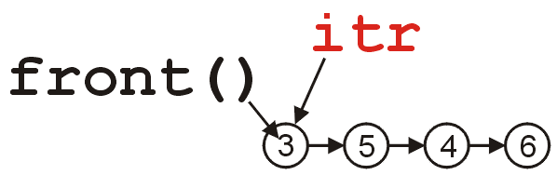
Iterators
3.4.5
We request an iterator on a specific instance of a deque by calling the member function begin():
  deque<int> ideque;
  ideque.push_front( 5 ); ideque.push_back( 4 );
  ideque.push_front( 3 ); ideque.push_back( 6 );
  // the deque is now 3 5 4 6
  deque<int>::iterator itr = ideque.begin();

Slide 67
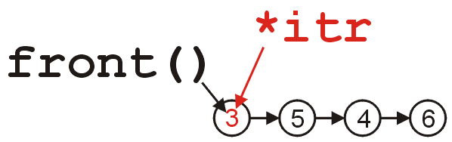

Iterators
3.4.5
We access the element by calling *itr:
  cout << *itr << endl; // prints 3
Similarly, we can modify the element by assigning to *itr:
  *itr = 11;
  cout << *itr << " == " << ideque.front() << endl;
  // prints 11 == 11

Slide 68
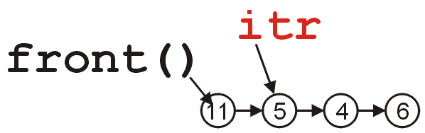
Iterators
3.4.5
We update the iterator to refer to the next element by calling ++itr:
  ++itr;
  cout << *itr << endl; // prints 5

Slide 69
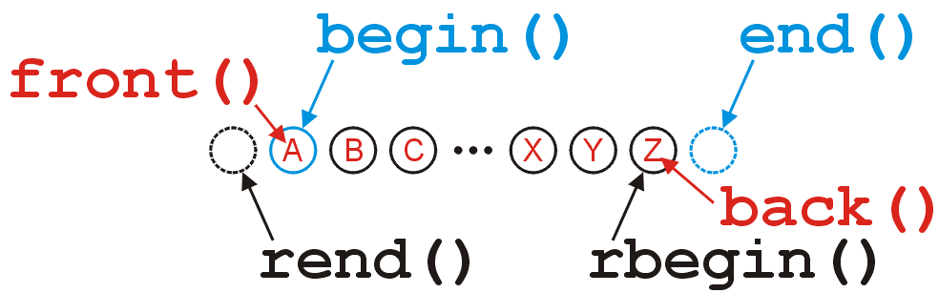
Iterators
3.4.5
The iterators returned by begin() and end() refer to:
  The first position (head) in the deque, and
  The position after the last element in the deque,
respectively:

Slide 70
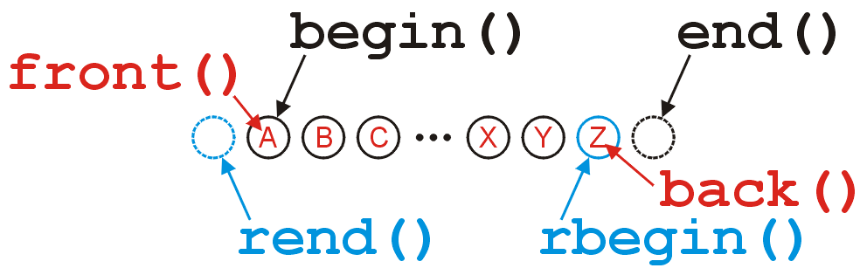
Iterators
3.4.5
The reverse iterators returned by rbegin() and rend() refer to:
  the last position (tail) in the deque, and
  the position before the first location in the deque,
respectively:

Slide 71
Iterators
3.4.5
If a deque is empty then the beginning and ending iterators are equal:
#include <iostream>
#include <deque>
using namespace std;
int main() {
deque<int> ideque;
cout << ( ideque.begin() == ideque.end() ) << " "
<< ( ideque.rbegin() == ideque.rend() ) << endl;
return 0;
}
{eceunix:1} ./a.out # output
1 1
{eceunix:2}

Slide 72
Iterators
3.4.5
Because we can have multiple iterators referring to elements within the same deque, it makes sense that we can use the comparison operator == and !=

Slide 73
Iterators
3.4.5
This code gives some suggestion as to why end() refers to the position after the last location in the deque:
for ( int i = 0; i != ideque.size(); ++i ) {
cout << ideque[i] << end;
}
for ( deque<int>::iterator itr = ideque.begin(); itr != ideque.end(); ++itr ) {
cout << *itr << end;
}

Slide 74
Iterators
3.4.5
Note: modifying something beyond the last location of the deque results in undefined behaviour
Do not use
deque<int>::iterator itr = ideque.end();
*itr = 3; // wrong
You should use the correct member functions:
ideque.push_back( 3 ); // right

Slide 75
Iterators
3.4.5
#include <iostream>
#include <deque>
using namespace std;
int main() {
deque<int> ideque;
ideque.push_front( 5 ); ideque.push_back( 4 );
ideque.push_front( 3 ); ideque.push_back( 6 ); // 3 5 4 6
deque<int>::iterator itr = ideque.begin();
cout << *itr << endl;
++itr;
cout << *itr << endl;
while ( itr != ideque.end() ) {
cout << *itr << " ";
++itr;
}
cout << endl;
return 0;
}
{eceunix:1} ./a.out # output
3
5
5 4 6
{eceunix:2}

Slide 76
Why Iterators?
3.4.5
Now that you understand what an iterator does, lets examine why this is standard software-engineering solution; they
  Do not expose the underlying structure,
  Require Θ(1) additional memory,
  Provide a common interface which can be used regardless of whether or not it’s a vector, a deque, or any other data structure
  Do not change, even if the underlying implementation does

Slide 77
Summary
In this topic, we have introduced the more general deque abstract data structure
  Allows insertions and deletions from both ends of the deque
  Internally may be represented by either a doubly-linked list or a two-ended array
More important, we looked at the STL and the design pattern of an iterator

Slide 78
References
[1] Donald E. Knuth, The Art of Computer Programming, Volume 1: Fundamental Algorithms, 3rd Ed., Addison Wesley, 1997, §2.2.1, p.238.
[2] Weiss, Data Structures and Algorithm Analysis in C++, 3rd Ed., Addison Wesley, §3.3.1, p.75.

Slide 79
References
Donald E. Knuth, The Art of Computer Programming, Volume 1: Fundamental Algorithms, 3rd Ed., Addison Wesley, 1997, §2.2.1, p.238.
Cormen, Leiserson, and Rivest, Introduction to Algorithms, McGraw Hill, 1990, §11.1, p.200.
Weiss, Data Structures and Algorithm Analysis in C++, 3rd Ed., Addison Wesley, §3.3.1, p.75.
Koffman and Wolfgang, “Objects, Abstraction, Data Strucutes and Design using C++”, John Wiley & Sons, Inc., Ch. 6.
Wikipedia, http://en.wikipedia.org/wiki/Double-ended_queue
These slides are provided for the ECE 250 Algorithms and Data Structures course. The material in it reflects Douglas W. Harder’s best judgment in light of the information available to him at the time of preparation. Any reliance on these course slides by any party for any other purpose are the responsibility of such parties. Douglas W. Harder accepts no responsibility for damages, if any, suffered by any party as a result of decisions made or actions based on these course slides for any other purpose than that for which it was intended.

Slide 80
References
Donald E. Knuth, The Art of Computer Programming, Volume 1: Fundamental Algorithms, 3rd Ed., Addison Wesley, 1997, §2.2.1, p.238.
Cormen, Leiserson, and Rivest, Introduction to Algorithms, McGraw Hill, 1990, §11.1, p.200.
Weiss, Data Structures and Algorithm Analysis in C++, 3rd Ed., Addison Wesley, §3.6, p.94.
Koffman and Wolfgang, “Objects, Abstraction, Data Strucutes and Design using C++”, John Wiley & Sons, Inc., Ch. 6.
Wikipedia, http://en.wikipedia.org/wiki/Queue_(abstract_data_type)
These slides are provided for the ECE 250 Algorithms and Data Structures course. The material in it reflects Douglas W. Harder’s best judgment in light of the information available to him at the time of preparation. Any reliance on these course slides by any party for any other purpose are the responsibility of such parties. Douglas W. Harder accepts no responsibility for damages, if any, suffered by any party as a result of decisions made or actions based on these course slides for any other purpose than that for which it was intended.

