Slide 1
Lighting For Video
Paul McCormick
AD30400 Video art
Spring 2014

Slide 2
Overview
Identify the 4 most common types of lights
Lighting hierarchy (main, fill, hair, background)
Discuss common lighting arrays (3 and 4 Point)
Location Lighting

Slide 3
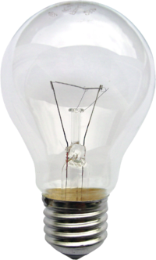
Incandescent
Burns with a yellow/orange light.
Inexpensive with a short burn life
Low wattage
Does not produce a great deal of light.

Slide 4
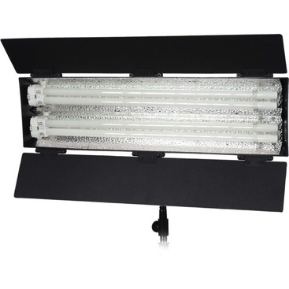
Fluorescent
Widely used in the video industry
Provides a soft, even light
Large selection of color temperatures

Slide 5
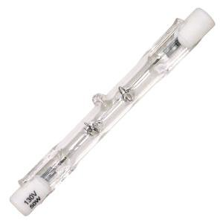
Halogen or Quartz
Most prevalent light source used in video production
Burns hot and bright and comes in high wattages
Long burn life
Intense heat and high power consumption

Slide 6
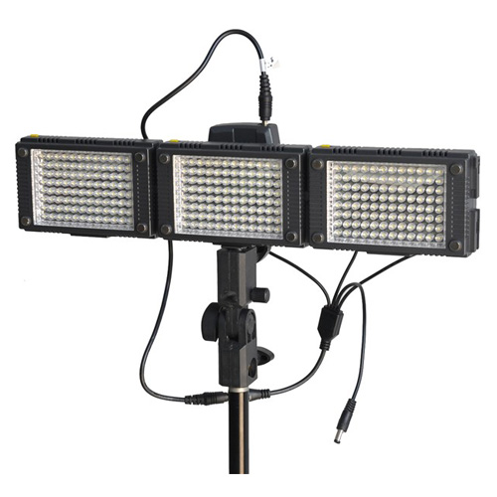
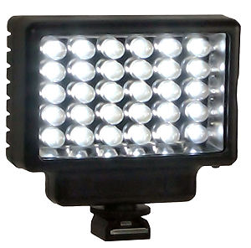
Led
  Low energy consumption with a high output
  Long burn life
  Both on and off camera options available

Slide 7
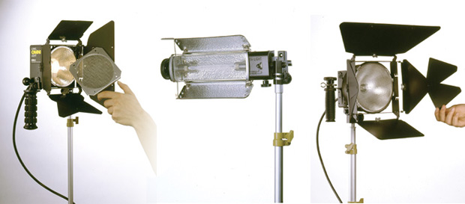
Kit Introduction

Slide 8
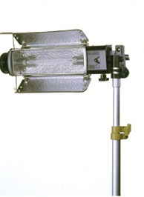
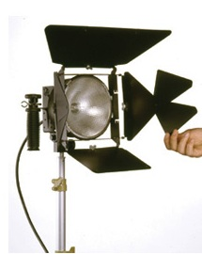
Spot Vs. Flood
Spot Light
  A narrow beam of light that often covers less than 45 degrees from source
  Used to highlight or accentuate
Flood Light
  Wide beam that covers an area of up to 120 degrees from source
  Used to fill in shadows

Slide 9
Main or Key Light
Key light is the most important light in a standard lighting set up.
The key light will be the hottest or brightest light its purpose is to highlight the subject
30 or 60-degree angle on the either side of the camera.

Slide 10
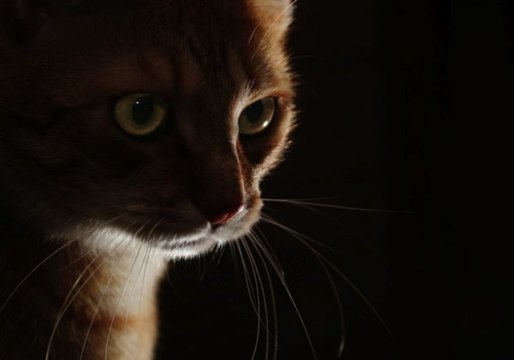
Key Light only
Using only a key light will unevenly accentuate the subject while leaving your background flat and under lit

Slide 11
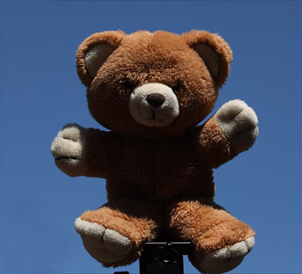
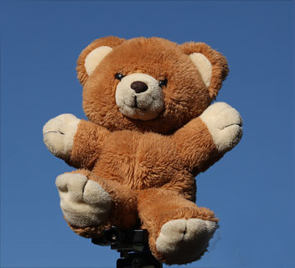
Key light placement
High Placement
  A key light placed above the subject projecting down will be felt as natural light and wont distort the shadows much.
Low placement
  A key light placed below the subject projecting up will cast shadows on the face and elongate facial features giving the subject a dramatic effect.

Slide 12
Fill Light
Used to reduce contrast caused by the key light.
Not as bright as key light
Placed opposite of the key light at the same angle

Slide 13
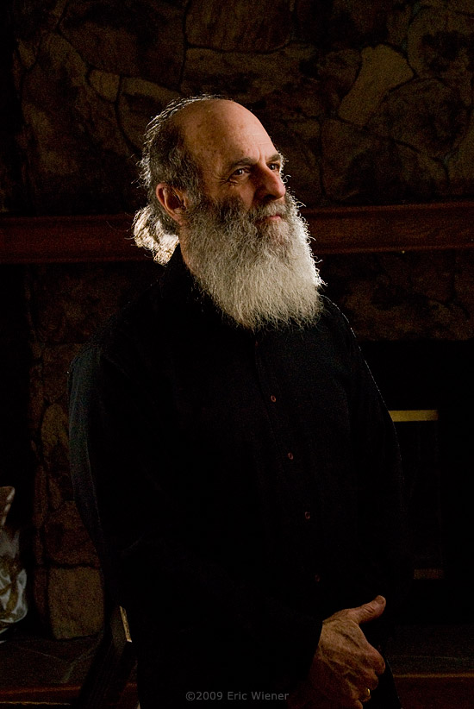
Hair or Kick light
Shines on the subject from behind
Gives the subject a rim of light
Separates the subject from the background and highlights contours

Slide 14
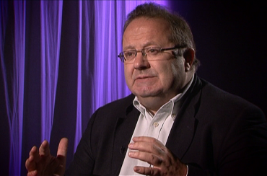
Background Light
Illuminates background elements
Placed very high or very low
Creates Depth

Slide 15
Three Point Set up with hair Light

Slide 16
Three Point Set Up with Background Light

Slide 17
Four Point Set up

Slide 18
Modifiers
Barn Doors
  Facilitate shaping of the beam of light from the fixture
Umbrella
  Diffuses your light reducing harshness
Bounce
  Reflective surface used to bounce a concentrated beam of light
Flag
  Object used to block light

Slide 19
Simple
Location Lighting
Using the sun and a bounce
  Bounce (spot) acts as key light
  Sun (flood) acts as fill and background

Slide 20
Other Resources
Strobist
http://strobist.blogspot.com/
Strobist Lighting 101
http://strobist.blogspot.com/2006/03/lighting-101.html
Vimeo Video School
http://vimeo.com/videoschool/
Online lighting diagram maker
http://www.lightingdiagrams.com/Creator
On Camera, Video Lighting for the Web
http://www.lynda.com/Business-Shooting-Video-tutorials/Camera-Webcam-Lighting-Techniques/108974-2.html?srchtrk=index%3a3%0alinktypeid%3a2%0aq%3alighting%0apage%3a1%0as%3arelevance%0asa%3atrue%0aproducttypeid%3a2

