Slide 1
AGEC 640 – Nov. 8, 2018 Today: Explaining Policies: The Political Economy of Agricultural Policy

Slide 2
What is the Q* on policy-makers’ minds?
Example: China
Yao, Yang (2011) “From production-oriented to welfare-oriented government.” East Asia Forum Quarterly 3(2): 6-7

Slide 3
Yang’s argument?
China’s “production oriented” government is distorting the economy by suppressing domestic consumption. “…economic growth is not the only concern of ordinary citizens. They also care about health, security for the elderly, housing, education, the environment, equality, and so on, none of which is necessarily linked with higher rates of economic growth.”

Slide 4
Yang’s evidence
The essence of economic policy favors economic growth over (immediate) welfare improvement;
20% of government spending is on economic affairs and infrastructure, compared with 10% in other countries;
High government savings rate (40% - even higher than households);
Budget bias toward local projects (60 x 70 x 60 = 25%);
Total subsidies ≈ 10% of GDP

Slide 5
Yang’s example: infrastructure investment
Elsewhere a virtue, but in China, a drag on consumption
Crowding out:
a 1% increase in provincial government budget allocated to infrastructure is associated with a 0.31% reduction in household consumption (as a share of GDP).

Slide 6
Why?
Legacy of planned economy
Planning focuses on agriculture, industry, and transportation as productive forces.
Lack of political participation by ordinary citizens
Government officials have incentives to pursue growth for both direct personal gain and promotion.

Slide 7
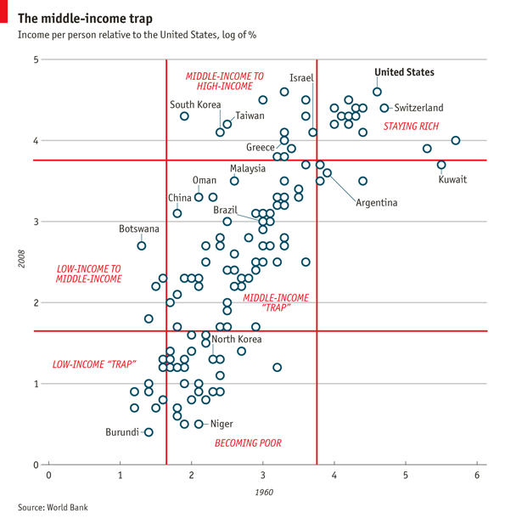
Consequences
Income distribution has worsened policies subsidize producers and minimize redistribution
Middle-income “trap” (rising wages reduce competitiveness, & entry to high value-added market lags)
Turning point: per capita PPP ≈ $8,000
China: $6,300 (2011 – at time of writing) $8,069 (2015 – most recent data)
https://www.economist.com/blogs/graphicdetail/2012/03/focus-3

Slide 8
How can people get government to help them towards Q*?
societies differ in their choice of mechanism, and also in how close they get to Q*
we could explain this in terms of “amateur sociology” (or real history, politics, anthropology, psychology, etc.)
but we can also explain policies in terms of real economics (=“political economy”):
assume policy-makers are optimizers, ask what function they optimize;
explain policy choices as equilibrium among optimizers, ask what kind of political market structure gives observed outcomes?

Slide 9
The many literatures of political economy
Classical political economy (1750s-1890s)
Hobbes, Locke, Smith, Marx; now “political philosophy”…
Marxian political economy (1920s-1970s)
Modeling social groups as autonomous agents (“classes”)
Today’s political economy (1960s-present)
“positive political economy”
“positive” studies of what is, as opposed to “normative” studies of what should be.
“neoclassical political economy”
“neoclassical” economics using mathematical methods, as opposed to “classical” work using only natural language
“public choice” or “rational choice”
terminology from the 1970s and 1980s

Slide 10
In the simplest political economy models, we are already in the best of all possible worlds!
If everyone is optimizing, observed policies might maximize aggregate welfare. What kinds of political markets would “rationalize” observed policies in this way?
Some benevolent-dictator models
(in which omnipotent leaders maximize their dynastic wealth)
Some median-voter models
(in which leaders seek policies that appeal to 50%+1 voters)
Some Tiebout-sorting models (from Tiebout 1956)
(in which leaders provide a set of options, and people move to jurisdictions where policies match their preferences)
These approaches don’t work very well: real governments don’t do anything close to predictions.

Slide 11
What do government’s actually do? Remember this? Average nominal rates of protection, by income group (2001)

Slide 12
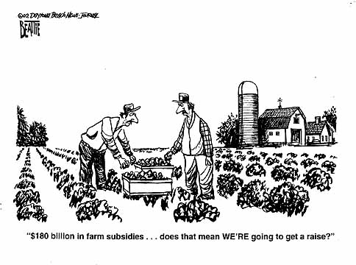
Who benefits from these interventions?

Slide 13
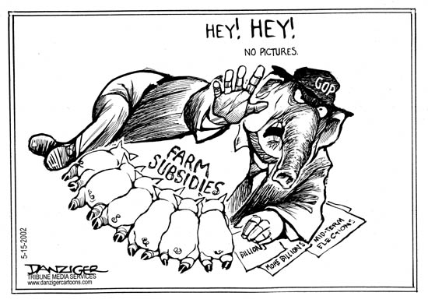
Farm policy is not a pretty sight!
Note this cartoon is from the U.S. in 2002; similar farm policies are supported by all political parties.

Slide 14
Modern political economy: Explanations with (political) market failure
More successful models use a principal-agent approach, in which principals (people) use agents (“leaders”) to acquire public goods.
With full information, costless transactions, etc., the losers from inefficient policy could always buy out the winners, leading to Q*.
So modern models rely on transaction costs or other limits on Coasian deal-making, most notably:
(1) Size of gains & rational ignorance (from Anthony Downs in a 1954 book)
(2) Size of group & free-ridership (mainly from Mancur Olson in a 1965 book)
(3) Accountability & rent-seeking (mainly from Anne Krueger in a 1974 article)
(4) Commitment & time-consistency (due to Kydland and Prescott in 1977)
(5) Loss aversion & behavioral economics (e.g. Kahnemann-Tversky 1979)
(6) Probability-weighted voting (Fernandez and Rodrik 1991)

Slide 15
Political economy theories: (1) Size of gains and the rational ignorance of losers
The basic idea of “rational ignorance” is that
learning about and participating in political action is costly,
so people won’t, unless it’s worthwhile to do so
Some implications of this model are that:
only those with relatively large stakes will participate in politics;
if people have similar and large stakes, they can lobby together;
the costs of participation can have a decisive influence;
if political information is easier to get, and
if political participation is easier to do,
then outcomes will be more economically efficient
…but participants in politics may deliberately choose confusing and ambiguous policies, to raise the costs of participation!

Slide 16
Political economy theories: (2) Size of interest groups and free ridership
The basic idea of the “interest-group” approach is that
policy choices are inherently collective actions,
so obtaining desired policies requires limiting free-ridership
Some implications of the interest-group approach are that people will invest more in politics if they:
are few in number (so each is less likely to free-ride)
are fixed in number (so new entrants won’t free-ride)

Slide 17
Political economy theories: (3) Rent-seeking and accountability
Some basic ideas of the “rent seeking” approach are that:
people with access to power use it to earn “policy rents”
people will use up policy rents in competitive lobbying
Some implications of the rent-seeking approach are that:
welfare costs of intervention are “Tullock trapezoids”, not “Harberger triangles”, as policy rents are “dissipated”
For example, if producers and quota holders have to lobby hard for their gains, they could spend up to A+C so total social “losses”=ABCD, not just the DWL triangles B+D.
Pd
A
C
B
D
Pw

Slide 18
Political economy theories: (4) Commitment mechanisms and time-consistency
The basic idea of time-consistency is that some peoples’ irreversible commitments are influenced by others’ recurrent choices
this can cause market failure when a seemingly profitable investment is not made because, if it were, others would change behavior making it unprofitable;
For example, Masters and McMillan (2003) try to explain why some governments choose paradoxically self-defeating policies for certain crops, with both high tax rates and low R&D investment. In this model:
farmers will not invest in production without a guarantee of low taxes, but
governments cannot commit to keep taxes low, so cannot induce farmers to invest
government R&D is not profitable, but high taxes yield some revenue
tropical crops are more affected by this than temperate-zone crops
This kind of trap is very common!

Slide 19
Political economy theories: (5) Loss aversion
Perhaps policies arise simply to limit adjustment, with the status-quo as their reference point.
This is known as
“loss aversion” in behavioral economics (see Kahnemann-Tversky) and as
“conservative social welfare function” in trade policy analysis (see Max Corden)
Either way, the implication is that people will pay more to avoid losses than to obtain gains…

Slide 20
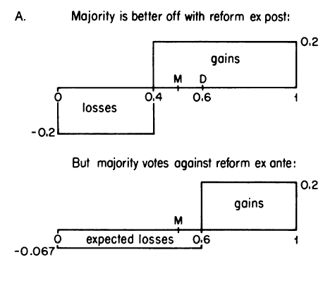
Political economy theories: (6) Probability-weighted voting
Fernandez and Rodrik “status quo bias” (AER 1991)
In some cases, gains/losses accrue to known people, while others are randomly distributed. Even with full rationality, this matters for politics! In their simplest example, the “gaining” sector employs 40% of the workforce; after reforms it would employ 60%. (Half of the workers in the “losing” sector would switch, but we/they don’t know which ones will switch.)
These reforms are efficient and popular after they are implemented, but unpopular beforehand and hence not implemented.
Reforms with the opposite characteristics would be reversed after adoption, hence an asymmetry and a source of “status-quo bias”
=(-0.2)*(0.4)*(0.5)/(0.6)
More generally, we might expect a bias towards the visible; economic growth requires “visionary” leadership in the sense of adding up costs and benefits independently of who pays/gets them

Slide 21
Also…choice of instruments available may influence policy
Policy-makers’ choice of policies can be influenced by the policy instruments they have available, and with more instruments they can get closer to Q*
For example,
poorer countries may use trade taxes to finance desirable public goods, simply because they lack the enforcement capacity to collect income or property taxes;
so their bias against agriculture could be unintended, just because they are net agriculture exporters; but self-perpetuating as policy weakens ag. and strengthens nonag. lobbying groups.
More generally,
societies with less institutional capacity/competency are likely to be further from Q*!

