Slide 1
AGEC 640 Agricultural Development and Policy
Farm structure and agricultural efficiency
September 6, 2018
Today: Farm size/structure, efficiency, tenure
Next week: Inputs, R&D and Technology

Slide 2
Farm structure in low-income countries
What farm size is economically efficient?
What do we mean by efficiency?
< brainstorming at the white board >

Slide 3
Does land tenure matter?
Theoretical argument:
Security of land rights should affect:
land prices (capitalization of improvements)
the intensity of cultivation
the use of credit.
And therefore…the efficiency of land use.
Gershon Feder and David Feeny (1991) “Land Tenure and Property Rights: Theory and Implications for Development Policy,” The World Bank Economic Review 5(1): 135-153.

Slide 4
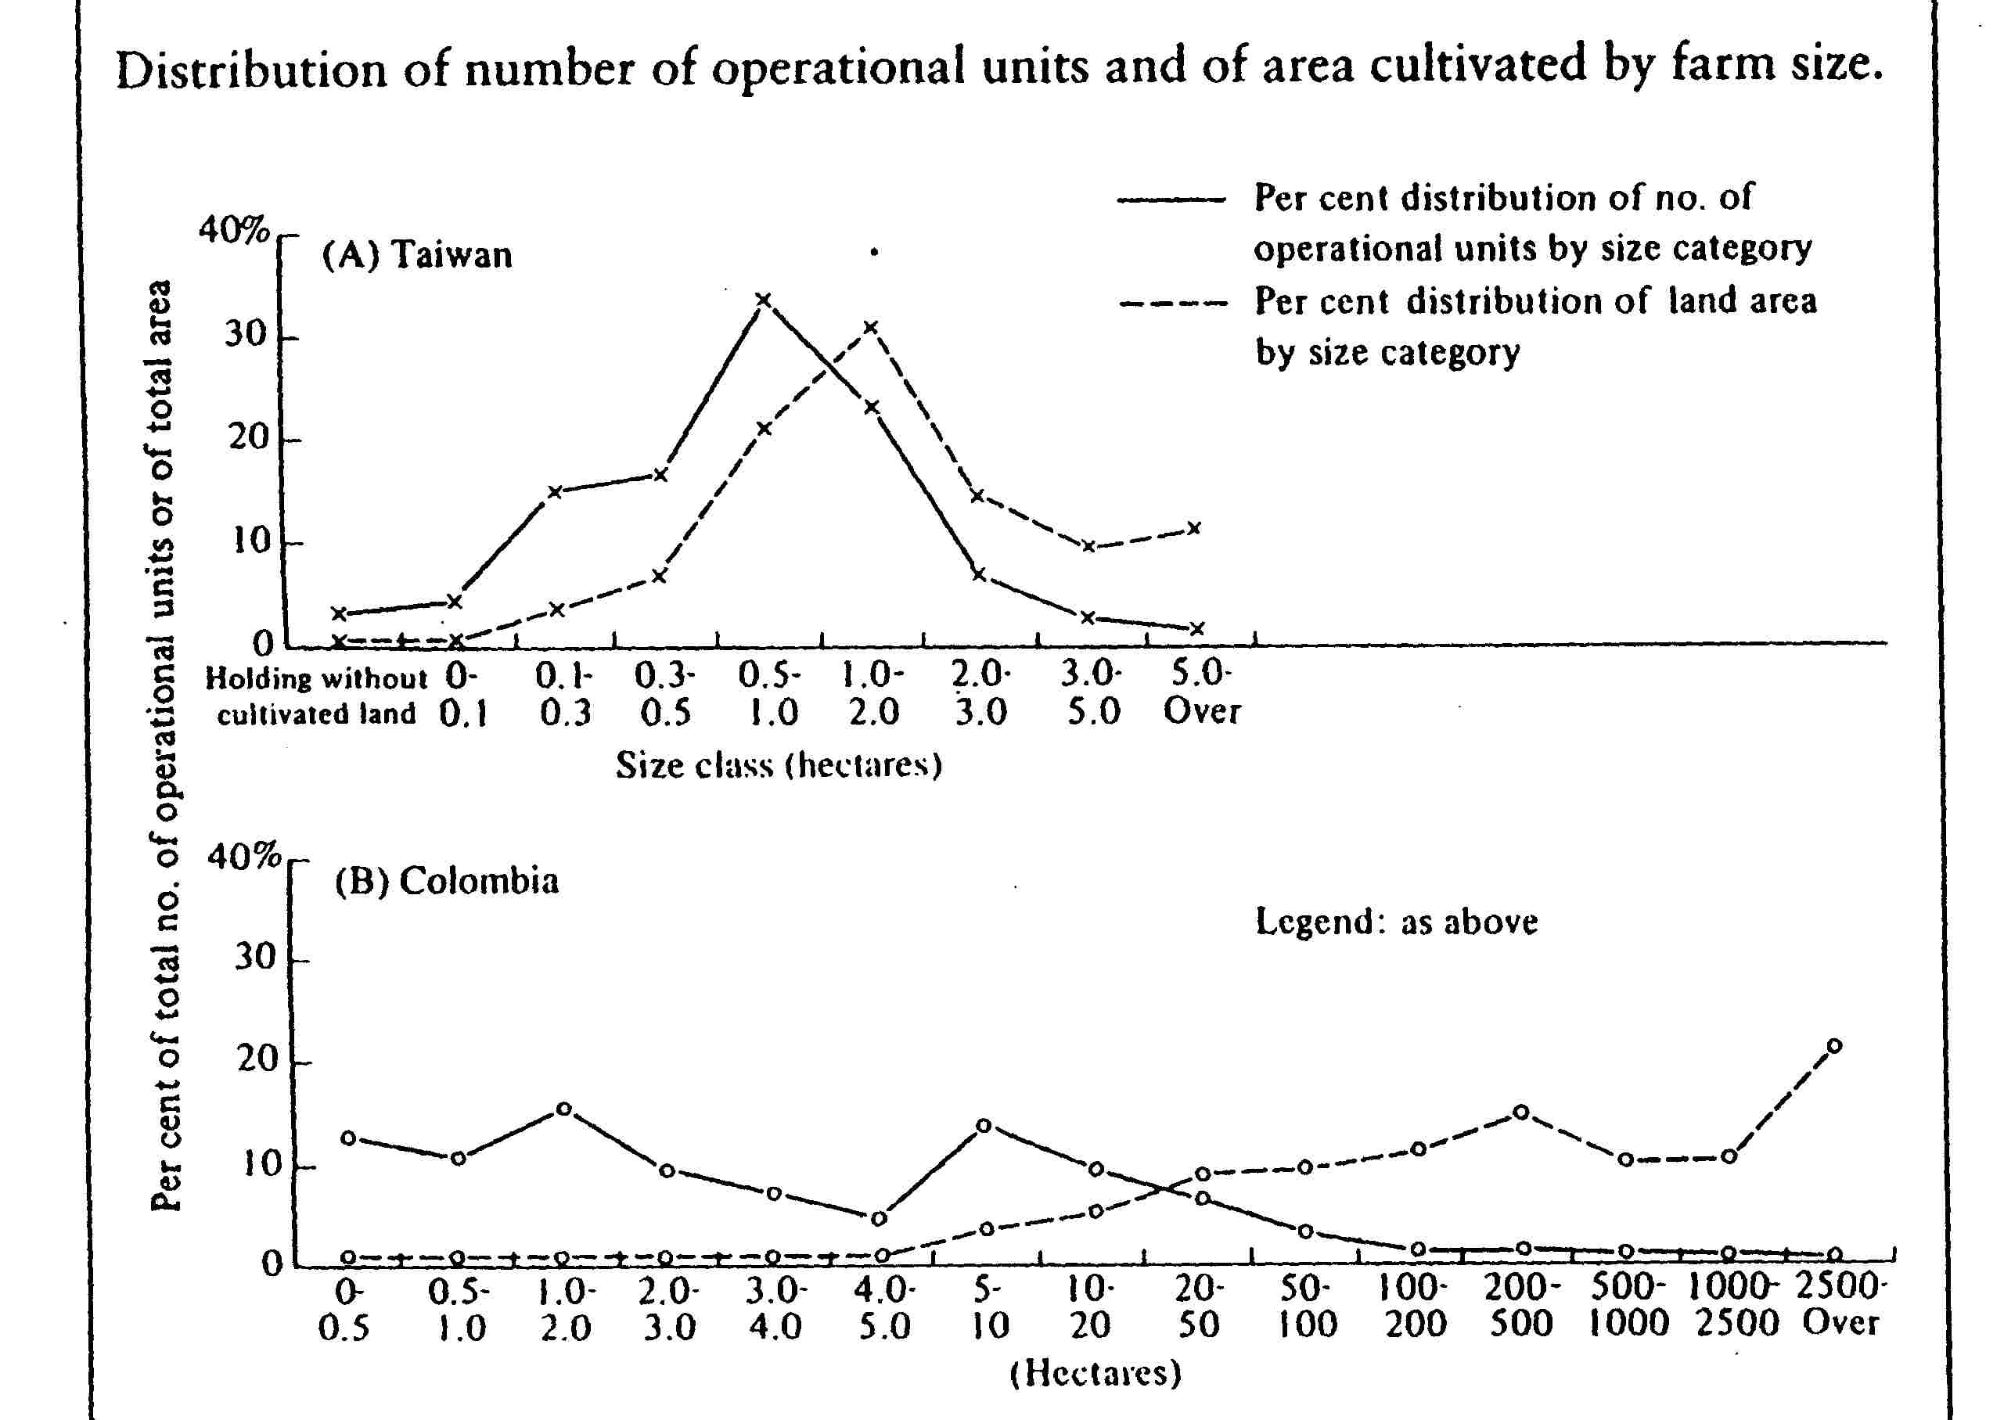
Two distributions of farm size
IF small farms are more efficient than large farms, then breaking up large farms will be desirable.
Source: Reprinted from Tomich, Kilby and Johnston, p. 20.

Slide 5
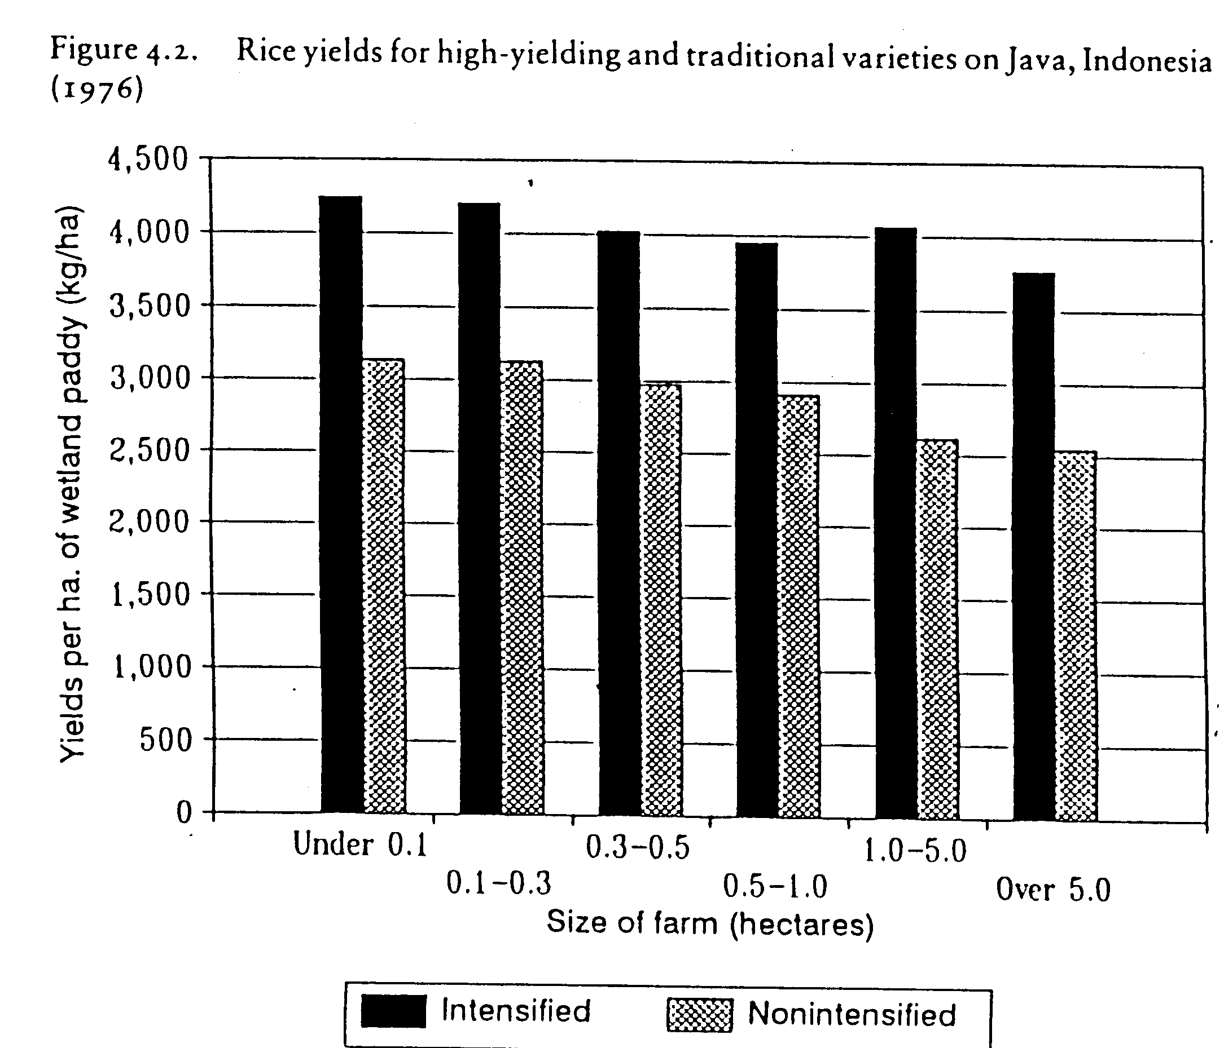

Slide 6
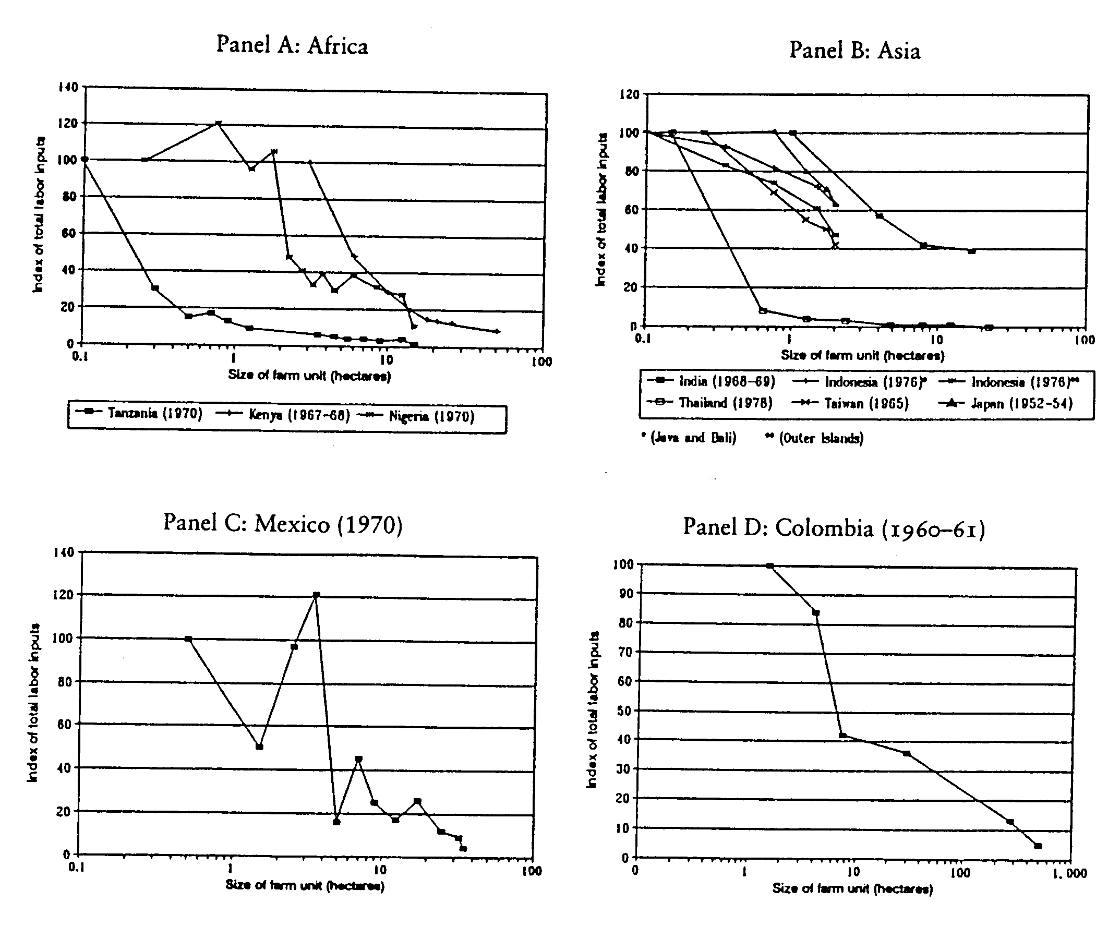
Farm size and labor use
Big farms use labor less intensively. Why is the intensity of labor use important?

Slide 7
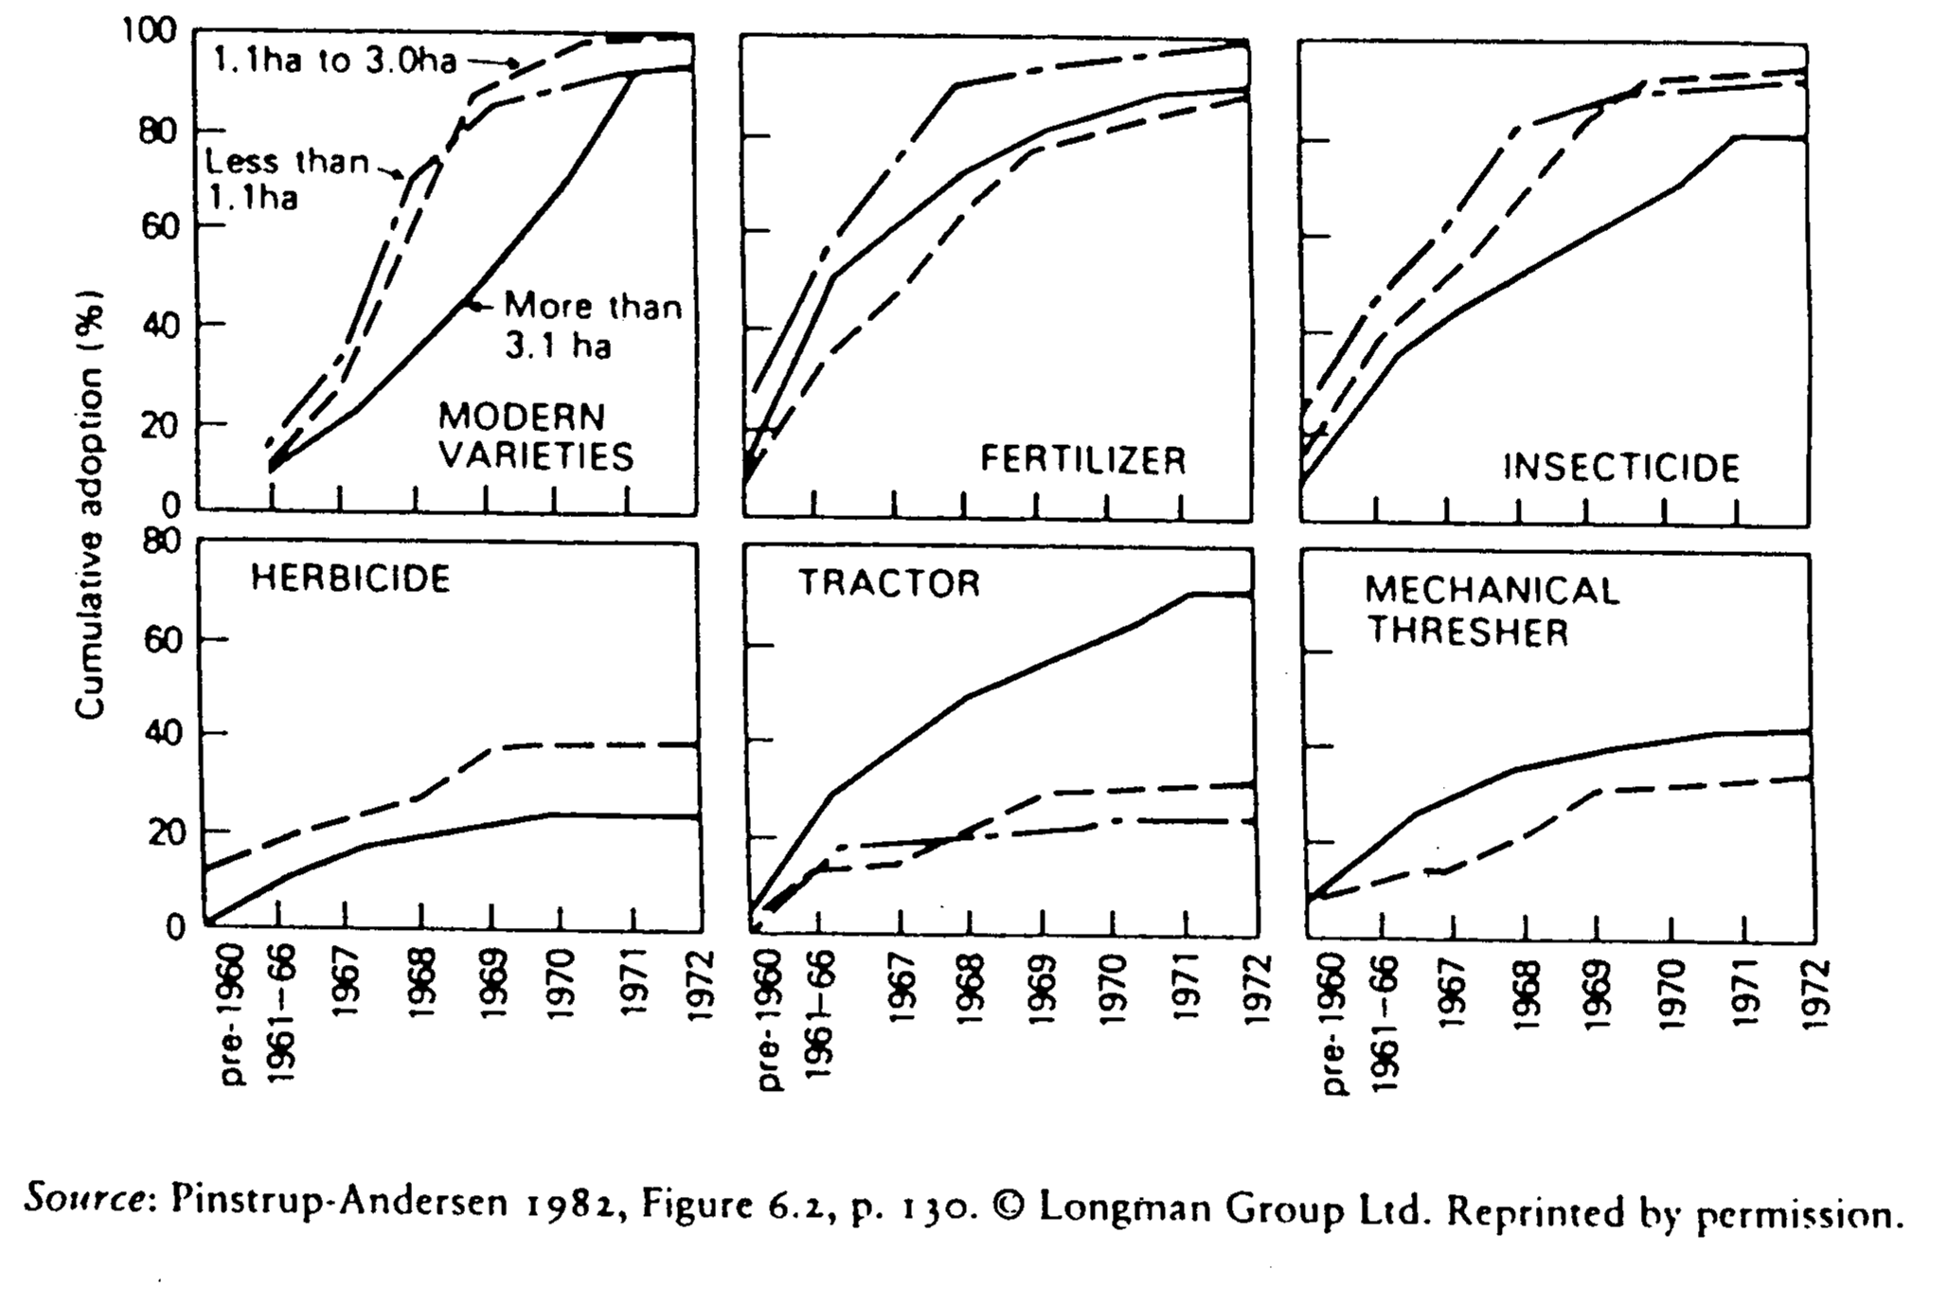
Farm size and technology adoption

Slide 8
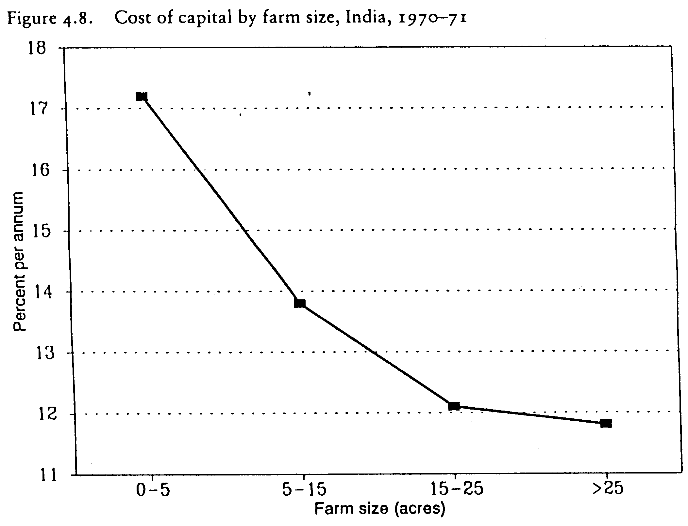
Farm size and the cost of capital
This is one explanation for the patterns in the previous slide
larger farms have better access to credit

Slide 9
Confused?
Is it better for a farm to be capital intensive or labor intensive?
How do we conceive of “efficiency”?

Slide 10
Thinking about efficiency…

Slide 11
Thinking about efficiency…
inefficient?
or efficient?

Slide 12
What farm size is economically efficient?
Need to take into account all inputs (factors)…
Land
Labor
Purchased inputs
“Total Factor Productivity” (TFP) is the portion of output not explained by the amount of inputs used in production. Its value is determined by how efficiently and intensely factors are utilized in production.
Usually measured as a “residual” or as a time trend for an index.

Slide 13
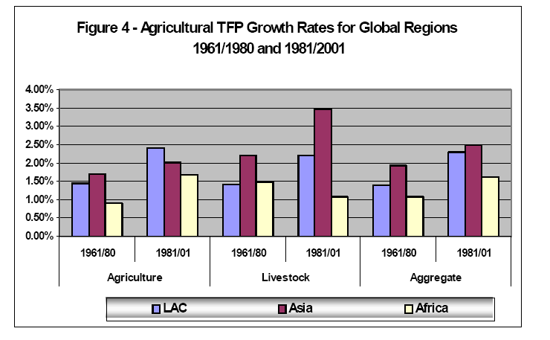
Source: Avila and Evenson “Total Factor Productivity Growth in Agriculture:
The Role of Technological Capital”
http://www.earthinstitute.columbia.edu/cgsd/events/documents/evenson.pdf

Slide 14
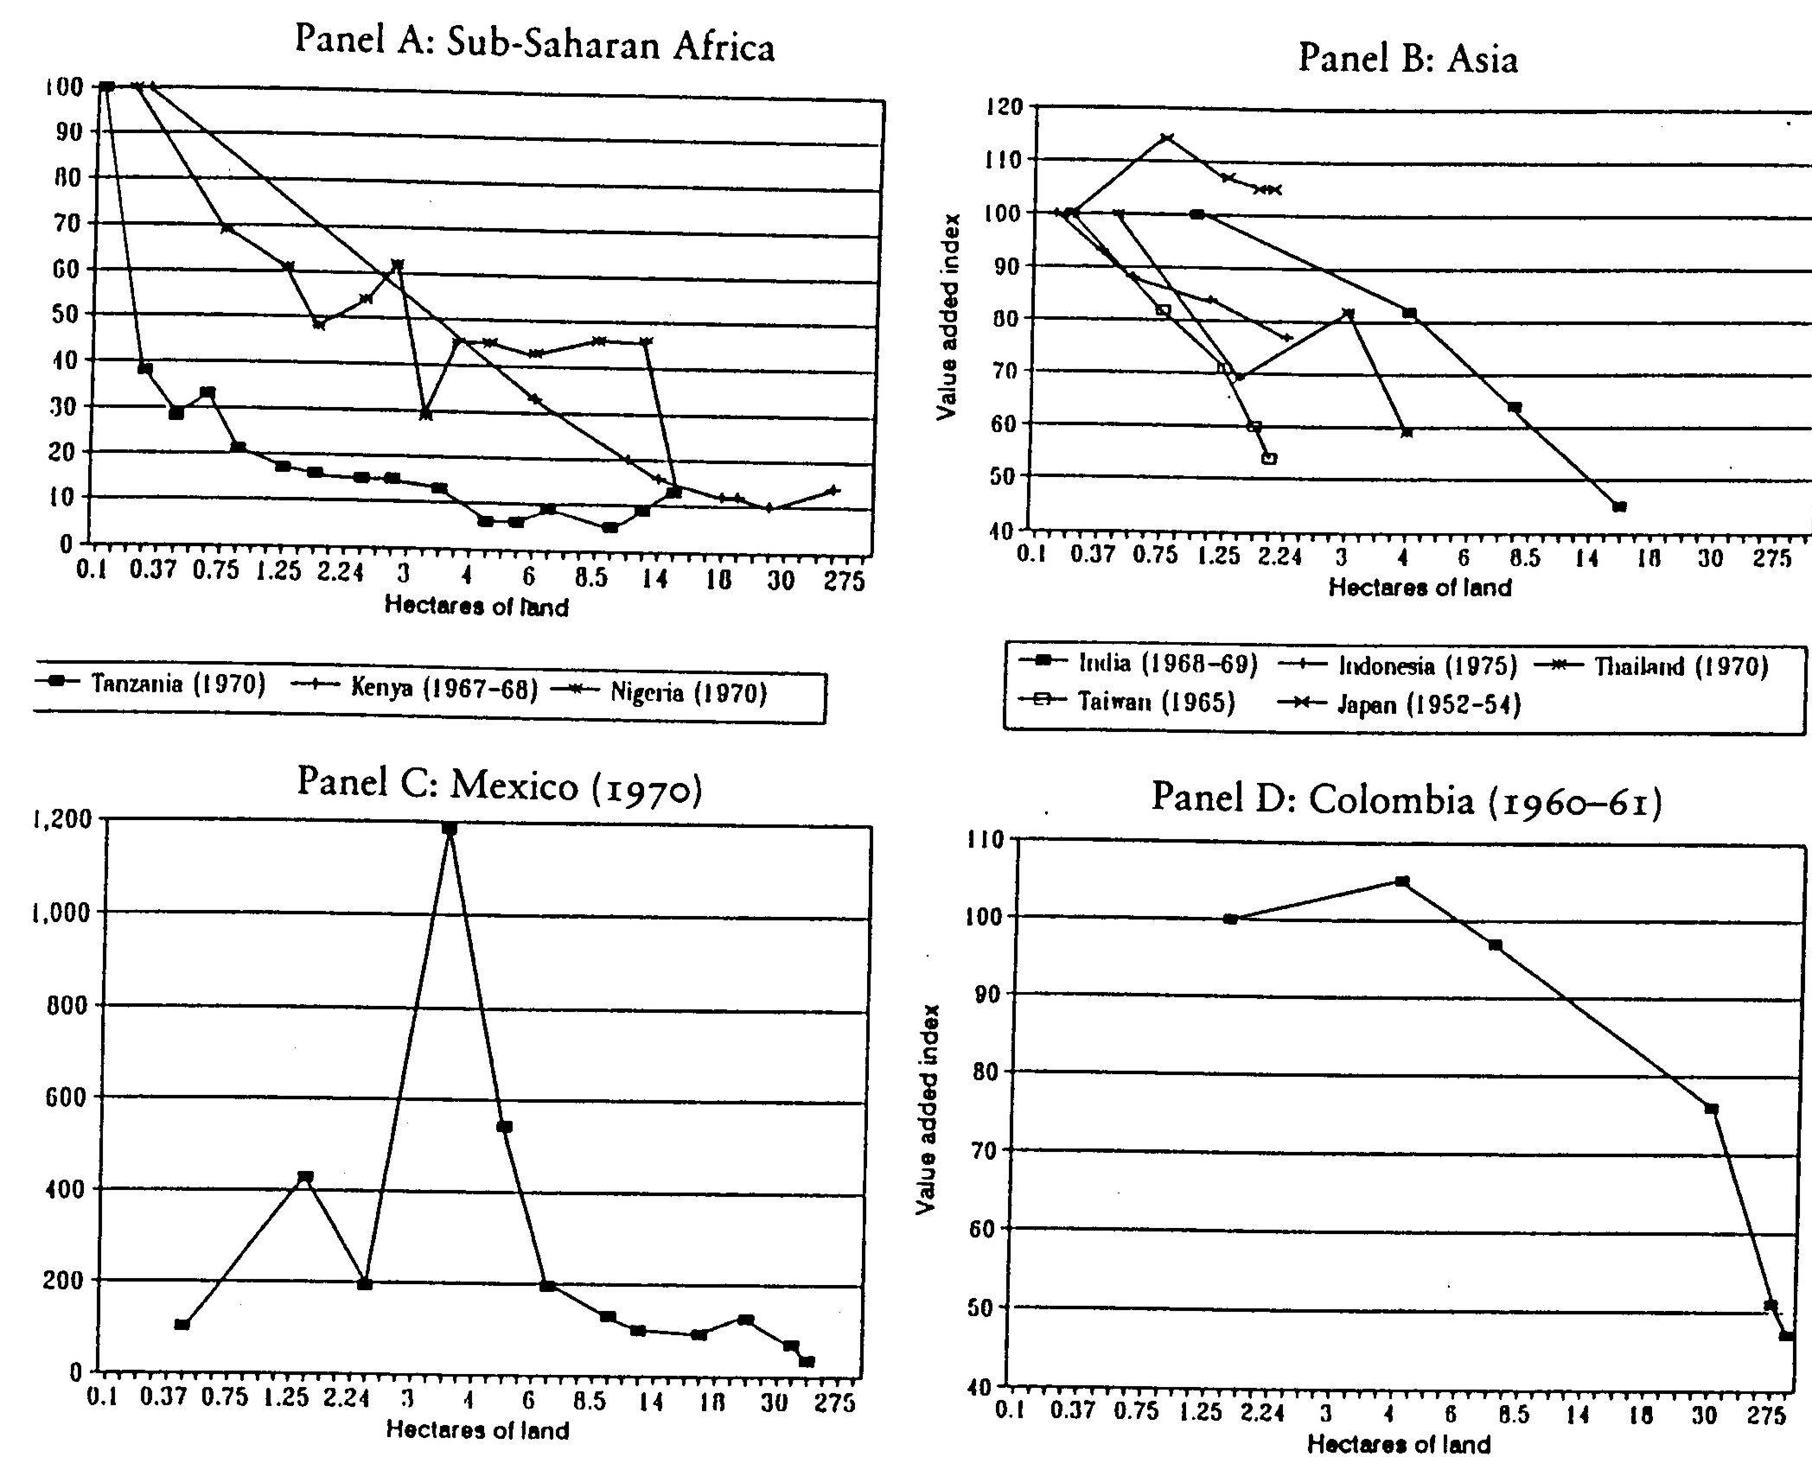
Farm size and total factor productivity

Slide 15
Ownership and technical efficiency on rice farms in the Philippines
Source: Figure 2 from Michler & Shively (2015) “Land Tenure, Tenure Security and Farm Efficiency: Panel Evidence from the Philippines.” Journal of Agricultural Economics 66(1): 155-169.

Slide 16
Conclusion: what is optimal farm size?
Across space, optimal farm size varies widely:
  across types of land (better land=>smaller farms)
  across farm families (more capital => larger farms)
Over time, “optimal size” is that which employs a family’s workers, earning their opportunity cost
  the optimal size falls and then rises, as the number of farmers rises
  and then falls, but farms remain family operations
Exceptions when supervision is easy or scale economies are large:
  confined livestock operations,
  crops that are closely tied to processing (e.g. tea & sugar)
If processing can be delayed (cotton, coffee, cocoa): smallholders
Tenure matters in theory and practice, but informal institutions may be as good as formal institutions.

