Slide 1
AGEC 640 Agricultural Development and Policy
Farm productivity and technology
September 11, 2018
Food supply
  First the “econ 101” theory of induced innovation
  Then data and historical experience

Slide 2
Let’s start with a conclusion…
From Econ 101: Innovation is only path to sustained growth
  Switch from self-sufficiency to markets gives (big?) one-time gain
  Once in markets, better prices give further (small?) one-time gains
    ...with diminishing marginal physical products!
  New technologies that raise physical productivity are essential
    Higher average product boosts payoff with same inputs
    Higher marginal product induces investment in more inputs
    Let’s build the analysis, piece by piece…

Slide 3
To explain production and technology choices…
Qty. of corn
(bu/acre)
observed consumption
(production +/- transactions)
observed transactions
(purchase, sale, gifts etc.)
observed production
(whatever it is)
Qty. of beans
(bushels/acre)

Slide 4
To explain production and technology choices, we start with a household model
other equally preferred choices (consumers are already at highest
level of “utility” they can reach
Qty. of corn
(bu/acre)
observed consumption
(production +/- transactions)
observed transactions
(purchase, sale, gifts etc.)
other possible buy/sell choices
(the “income” line)
slope is -Pb/Pc
(price of beans /
price of corn)
observed production
(whatever it is)
other possible choices
(the “production possibilities frontier”)
Qty. of beans
(bushels/acre)
In economics, each observed choice is already an optimum… for the chooser!

Slide 5
Decisions on input use can be understood in a similar way:
What does the observed input use optimize?
Qty. of corn
(bu/acre)
Qty. of machinery
(hp/acre)
highest profits
(slope=Pl/Pc)
observed input use
(whatever it is)
lowest cost
(slope=-Pl/Pm)
other possible choices
“input supply curve”
“isoquant”
(each curve shows
other possibilities
if nothing else changes)
Qty. of labor
(hours/acre)
Qty. of labor
(hours/acre)
Here, production choices depend only on market prices; when all inputs and outputs can be bought/sold, production is “separable” from consumption

Slide 6
…here is the complete picture:
Qty. of corn
(bu/acre)
Qty. of corn
(bu/acre)
Qty. of machinery
(hp/acre)
profits
(slope=Pl/Pc)
utility
income
(-Pb/Pc)
cost
(slope=-Pl/Pm)
Qty. of labor
(hours/acre)
Qty. of beans
(bushels/acre)
Qty. of labor
(hours/acre)
Now… if the individual is already optimizing,
how can their productivity and well-being ever improve?

Slide 7
Productivity can improve through the market, from self-sufficiency to specialization
Qty. of corn
(bu/acre)
If beans are more valuable in the market than on the farm…
production was chosen along PPF, to highest indifference curve
from consumption
…trading allows the farmer to reach whatever consumption gives a higher utility level
adjusting production
to market prices can overcome diminishing returns on the farm
self-sufficiency
(production= consumption)
Qty. of beans
(bushels/acre)

Slide 8
Once people are already trading in the market, if prices “improve” production will rise
Qty. of corn
(bu/acre)
Qty. of corn
(bu/acre)
Qty. of machinery
(hp/acre)
Price of labor rises, relative to cost of labor-saving technologies
Price of inputs falls, relative to output
Price of goods sold rises, relative to purchased goods
Qty. of labor
(hours/acre)
Qty. of beans
(bushels/acre)
Qty. of labor
(hours/acre)
…but with diminishing returns, productivity must fall,
with less and less output per unit of input.

Slide 9
How can productivity rise?
when people are already doing the best they can,
…and are facing diminishing returns?

Slide 10
Productivity growth requires innovation: a change in what is physically possible
Qty. of corn
(bu/acre)
Qty. of corn
(bu/acre)
Qty. of machinery
(hp/acre)
less of both inputs needed for given outputs
more output at each input level
more of both outputs for given resources
Qty. of labor
(hours/acre)
Qty. of beans
(bushels/acre)
Qty. of labor
(hours/acre)

Slide 11
Two prominent innovations
Herbicide-Tolerant
Seeds
Hybrid corn
Ag. output
(tons/hectare)
Qty. of labor
(days/hectare)
Qty. of fertilizer
(tons/hectare)
Qty. of traction
(hp/hectare)

Slide 12
The price ratio is the same.
How does the new technology affect input use?
Ag. output
(tons/hectare)
Qty. of labor
(days/hectare)
IRC w/new hybrid
Isoquant w/new seeds
IRC w/old variety
Isoquant w/old tech.
optimum with old variety
optim.w/old tech.
Qty. of fertilizer
(tons/hectare)
Qty. of traction
(hp/hectare)

Slide 13
Is it still optimal to use the old input levels?
Ag. output
(tons/hectare)
Qty. of labor
(days/hectare)
IRC w/new
Isoquant w/new
IRC w/old
Isoquant w/old
old qty. of fertilizer
old tractor set

Slide 14
In these cases, farmers can (and will?) adopt these new technologies at the old input levels…
Ag. output
(tons/hectare)
Qty. of labor
(days/hectare)
IRC w/new
Isoquant w/new
IRC w/old
Isoquant w/old
old qty. of fertilizer
old tractor set

Slide 15
This innovation is profitable and cost-reducing, without changing input levels
higher
profit
Ag. output
(tons/hectare)
Qty. of labor
(days/hectare)
IRC w/new
lower
costs
Isoquant w/new
IRC w/old
more output
Isoquant w/old
less labor
same qty. of fertilizer
same tractor set

Slide 16
But adjusting input use to the new technology is even better (higher profits, lower costs)
Ag. output
(tons/hectare)
Qty. of labor
(days/hectare)
even more output
lowest-possible cost along the isoquant w/ new herbicides
highest-possible profit along the IRC w/ new hybrids
more
labor
more fertilizer
less
horsepower

Slide 17
The change in marginal products determines farmers’ incentives to change input levels
Ag. output
(tons/hectare)
Qty. of labor
(days/hectare)
When the isoquant gets flatter, farmers are induced to use more labor and less horsepower
When the input response curve gets steeper,
farmers are induced to use more fertilizer and increase output
Qty. of fertilizer
(tons/hectare)
Qty. of traction
(hp/hectare)

Slide 18
Can this type of thinking help us predict what types of new technology are most desirable?
Ag. output
(tons/hectare)
Qty. of labor
(days/hectare)
New techniques using
more fertilizer
than currently
being used
New techniques using less horsepower
New techniques using fewer workers
New techniques
using less fertilizer
Qty. of fertilizer
(tons/hectare)
Qty. of traction
(hp/hectare)

Slide 19
New techniques are most desirable if they help farmers use the abundant factor.
This is known as “induced innovation”.
Ag. output
(tons/hectare)
labor-saving,
yield-increasing
innovations
new
old
new
old
labor-using, yield-increasing innovations
Qty. of labor
(tons/hectare)
Qty. of labor
(tons/hectare)

Slide 20
Some conclusions…
From Econ 101: Innovation is only path to sustained growth
  Switch from self-sufficiency to markets gives (big?) one-time gain
  Once in markets, better prices give further (small?) one-time gains
    ...with diminishing marginal physical products!
  New technologies that raise physical productivity are essential
    Higher average product boosts payoff with same inputs
    Higher marginal product induces investment in more inputs
    But, there is a bit more to the story…

Slide 21
The Hayami & Ruttan (1985) example:
Farm technology in U.S. and Japan, 1880-1980
In the US…
abundant cropland, expanding until 1935;
so farm machinery spread early in 19th century,
and little yield or productivity growth until 1930s
In Japan…
scarce cropland, with widespread irrigation
so fertilizer and new seeds spread early in 19th century,
and little machinery use or labor saving until 1960s

Slide 22
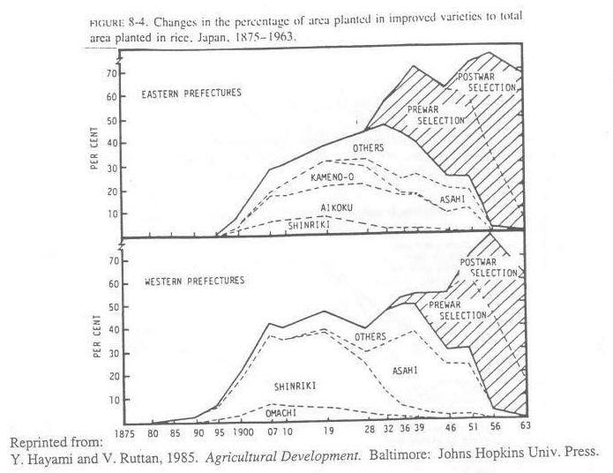
Japan’s rollout of new rice varieties began in 1880s

Slide 23
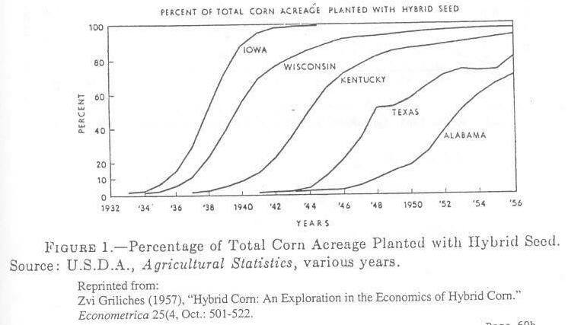
US spread of hybrid corn occurred later,
in S-shaped adoption curves with
varied start dates, speed of diffusion and ceiling level

Slide 24
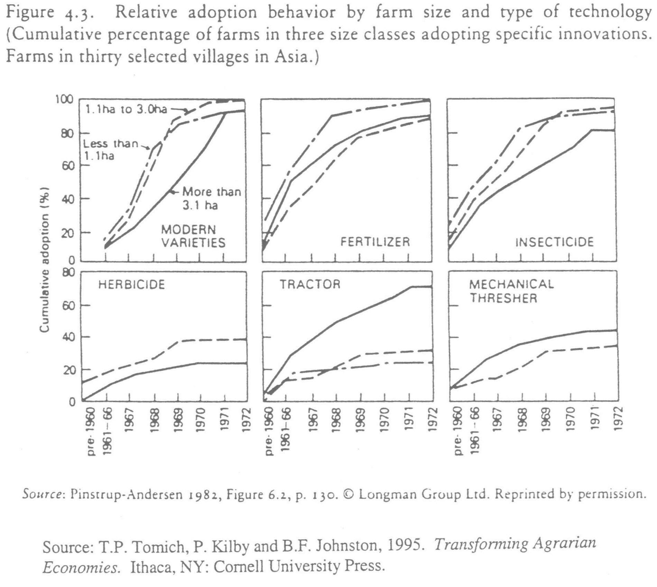
The “induced innovation” idea also applies
across farms within a country, as we saw here…

Slide 25
The green revolution uses international R&D to spread crop improvement faster
• In 1920s, an early green revolution occurred in E. Asia, as Japan bred new rice for their colonies in Taiwan & Korea.
• After WWII, threat of mass starvation and communism led U.S. and others to improve wheat for S.Asia & S.America, and new rice varieties for South & Southeast Asia.
• In recent years, some (smaller) effort to do this for Africa

Slide 26
Key characteristics of
“green revolution” technology
short stature, to
  concentrate nutrients in grain, not stalk, and
  support more grain without falling over (lodging);
photoperiod insensitivity, to
  give flexibility in planting/harvest dates,
  control maturation speed, with
    more time for grain filling, and
    early maturity for short rains or multicropping
many other traits
  pest and stress resistance
  leaf structure and position

Slide 27
The speed and timing of the green revolution
varies by region
US, Europe starts pre-WWII
S. & SE Asia starts in late 1960s
East Asia starts post-WWII
Africa’s slow and delayed green revolution has barely started!
Reproduced from W.A. Masters (2008), “Beyond the Food Crisis: Trade, Aid and Innovation in African Agriculture.” African Technology Development Forum 5(1): 3-15.
Notes:
Yields in Africa lagged those of South Asia before the genetic “green revolution”, which widened the gap thereafter.

Slide 28
Why are Africa’s yield gains slow & delayed?
One reason is soils and moisture
Selected Soil Fertility Constraints in Agriculture
(as percent of agricultural area)
Note: Constraints characterized using the Fertility Capability Classification (Sanchez et al., Smith).
Source: Stanley Wood (2002), IFPRI file data.

Slide 29
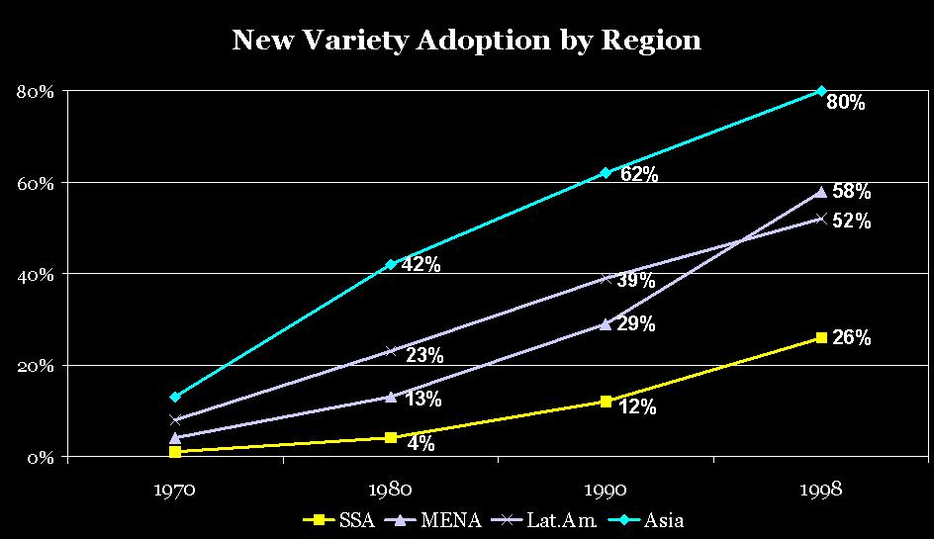
But crucially, most African farmers still use old seed types; new seeds are coming out now
Source: Calculated from data in Evenson and Gollin, 2003.
Notes:
Africa has been exactly a generation behind Asia in new variety adoption. Africa’s “adoption curve” is normal, just delayed.

Slide 30
A key reason for delayed adoption
is less local research to meet local needs
Public Research Expenditure per Unit of Land, 1971-91
(1985 PPP dollars per hectare of agricultural land)
4
3
2
1
0
1971
1972
1973
1974
1975
1976
1977
1978
1979
1980
1981
1982
1983
1984
1985
1986
1987
1988
1989
1990
1991
Sub-Saharan Africa
All Developing Countries
All Developed Countries
Source: Calculated from IFPRI and FAOStat file data

Slide 31
The composition of foreign aid to Africa has changed radically over time
In the 1970s and 1980s, donors gave much more food aid than aid for agricultural production
In the 1990s and 2000s, health and debt relief grew; food aid declined but so did aid for agriculture
Reproduced from W.A. Masters (2008), “Beyond the Food Crisis: Trade, Aid and Innovation in African Agriculture.” African Technology Development Forum 5(1): 3-15.

Slide 32
Why has there been so little effort on food crop improvement for Africa?
Early conditions were unfavorable
  Until early 1960s
    almost all of Africa was under European colonial rule
    most countries were land-abundant exporters of cash crops
  Until mid-1980s
    most African governments taxed agriculture heavily, as
    the region remained land abundant (but exported less and less)
When population growth finally outstripped land supply in the 1980s and 1990s, the rest of the world…
  was awash in grain – no fear of mass starvation
  had won cold war – no fear of Africa becoming communist
  seen export growth in Asia – thought Africa could import its food

Slide 33
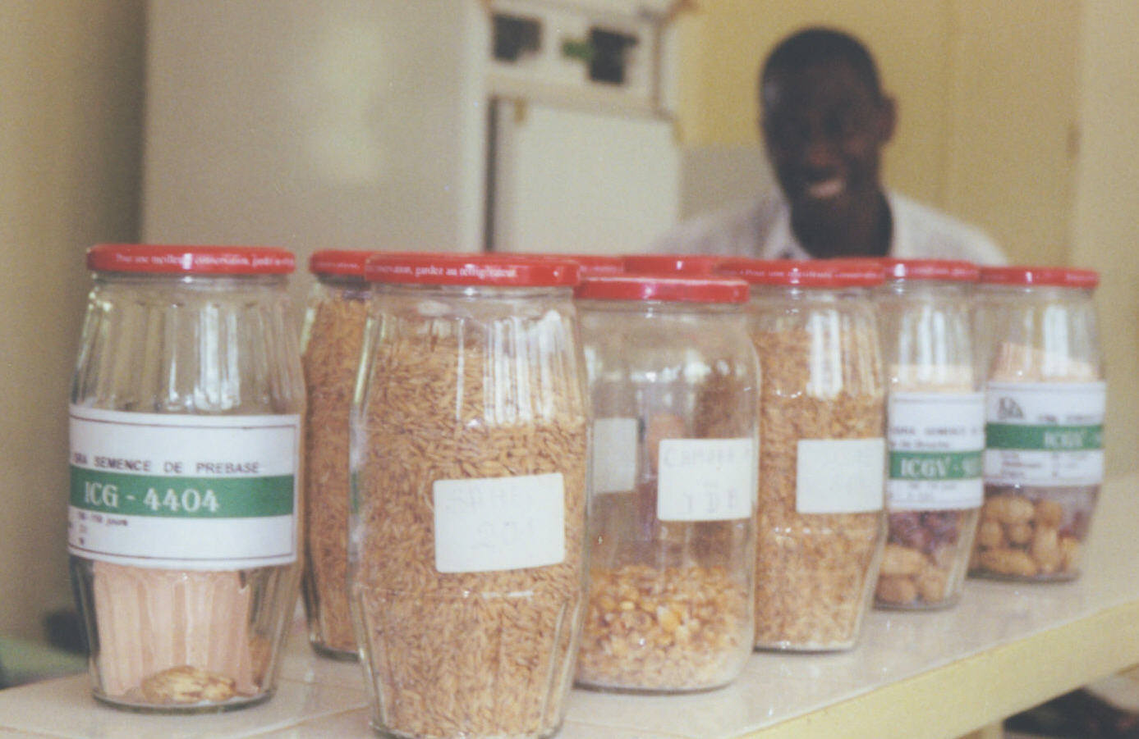
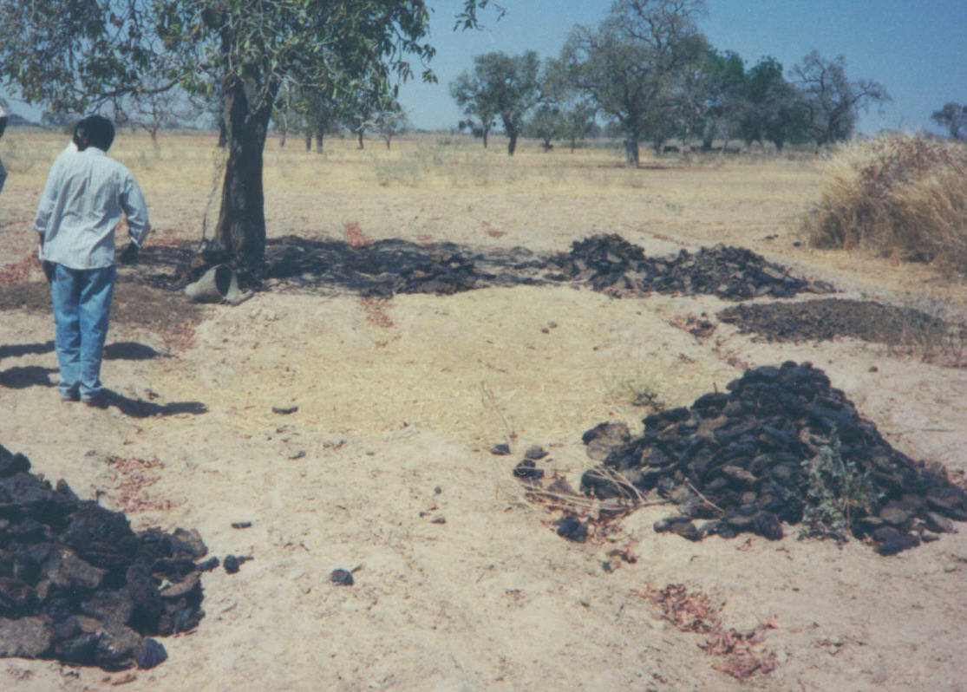
To respond to farmers’ needs, crop improvement involves multiple innovations
Genetic improvement
Agronomic improvement
(by scientists, using controlled trials)
(by farmers, using land & labor)

Slide 34
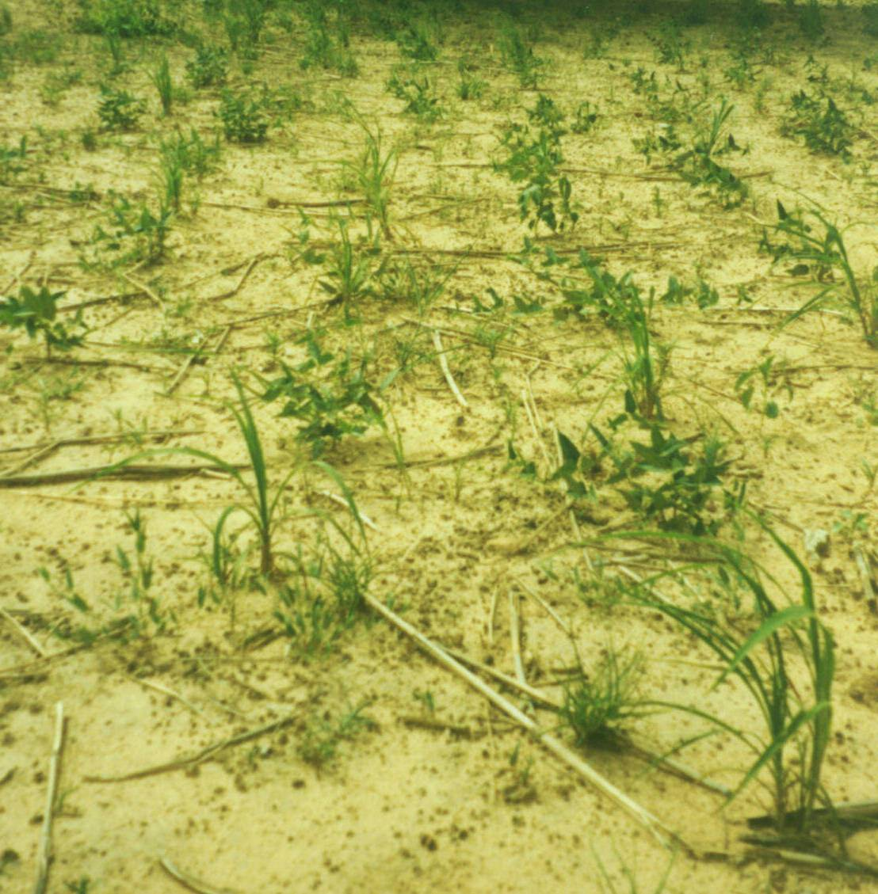
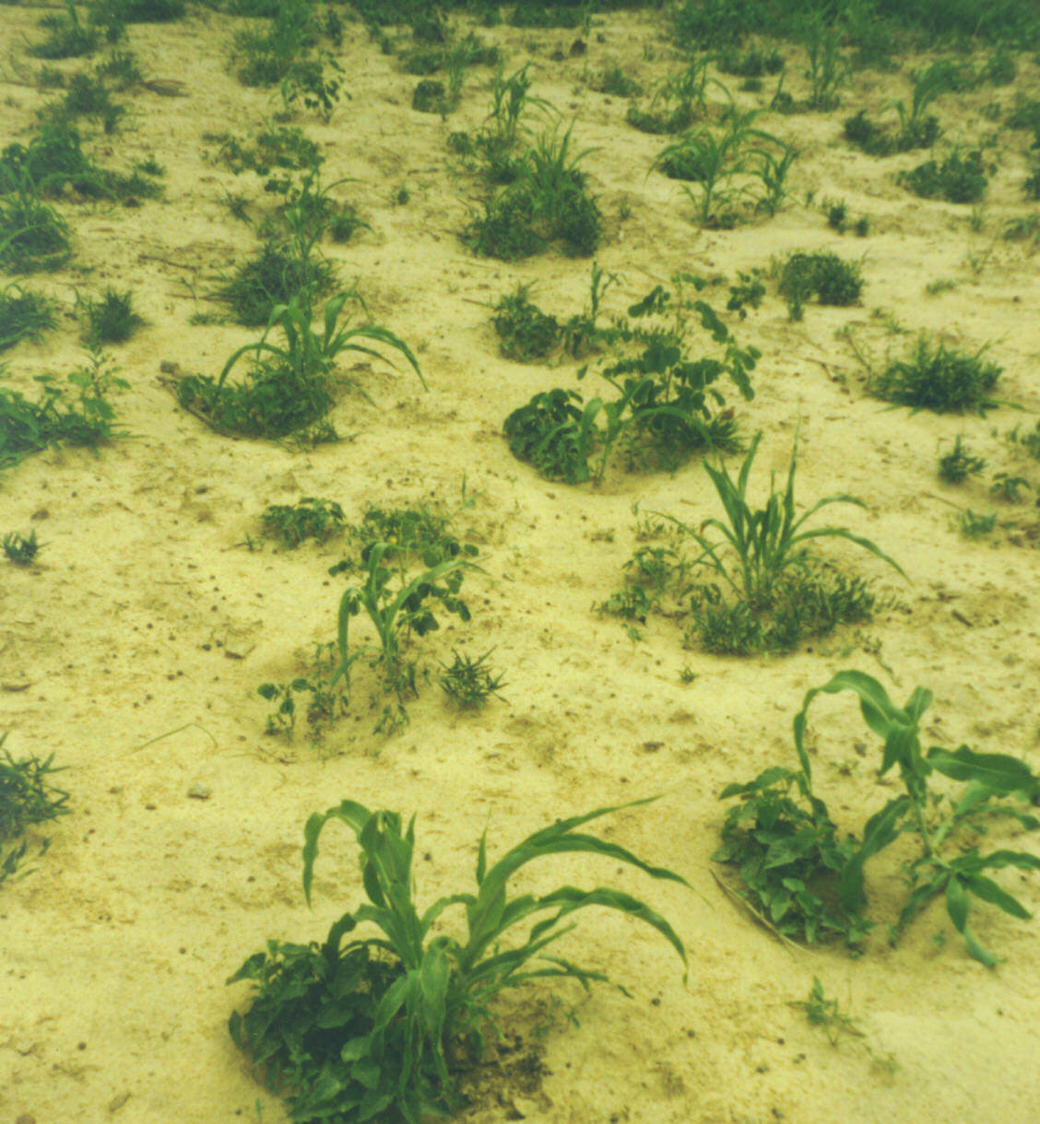
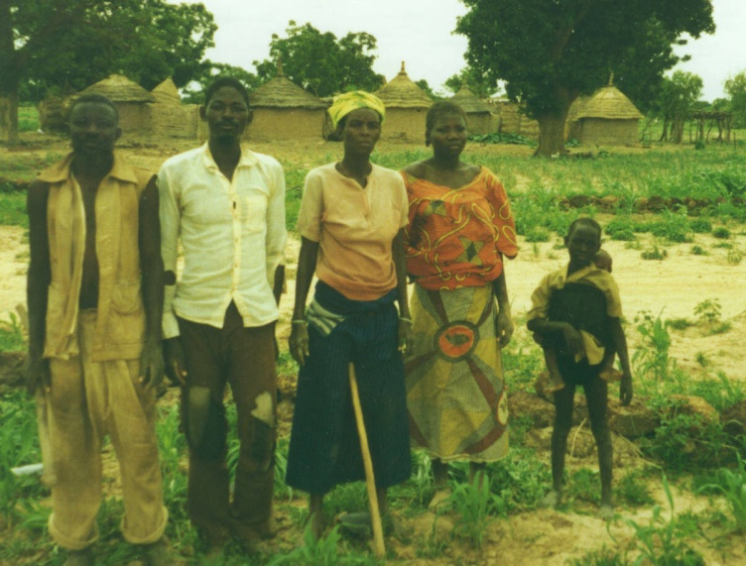
New techniques to manage soils and conserve moisture are spreading
traditional
“flat” planting
labor-intensive
“Zai” microcatchments
For these fields, the workers are:

Slide 35
The role of policy in agricultural technology
Innovation is subject to severe market failures
R&D + dissemination is often…
  a natural monopoly
    “non-rival” in production, with high fixed costs, low or zero marginal cost
  a provider of public goods
    “non-excludable” in consumption, so difficult or impossible to recover costs
  R&D activity often involves asymmetric information
    a “credence good” for investors in R&D and for potential adopters of new technologies
Thus private firms provide too little innovation…
  the pace and type of innovation depends crucially on government, using its monopoly of force and taxation.

Slide 36
Policy options to promote innovation
How can government lead society to do more innovation?
  public research and education
  from 1100s in Europe, rise of Medieval universities
  from 1870s in US and Japan, founding of agricultural research
  patents
  in 1624, Britain enacted a formal “Statute of Monopolies”;
  in 1787, patent law written into Article 1 of the U.S. constitution
  prizes
  in 1714, the British Parliament offered a £20,000 reward for an accurate way to measure longitude at sea
  many other examples…

Slide 37
Is there enough R&D?
Economists suspect under-spending, perhaps because:
  benefits are dispersed and hard to observe, and
  costs are specific and easy to observe
  most analysis try to answer using returns to research:
    if returns are above average, there is under-spending;
    if returns are below average, there is over-spending.
What do Alston et al. find?
  confirms systematic under-spending (high returns),
  but finds large variance in results, possibly due to:
    poor measurement
    variance in the management of research
    inherent riskiness of research activities

Slide 38
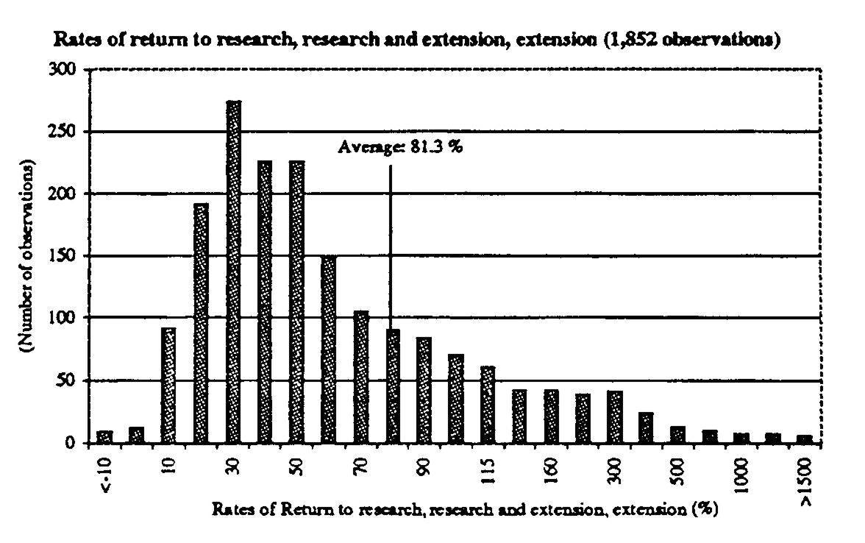

Slide 39
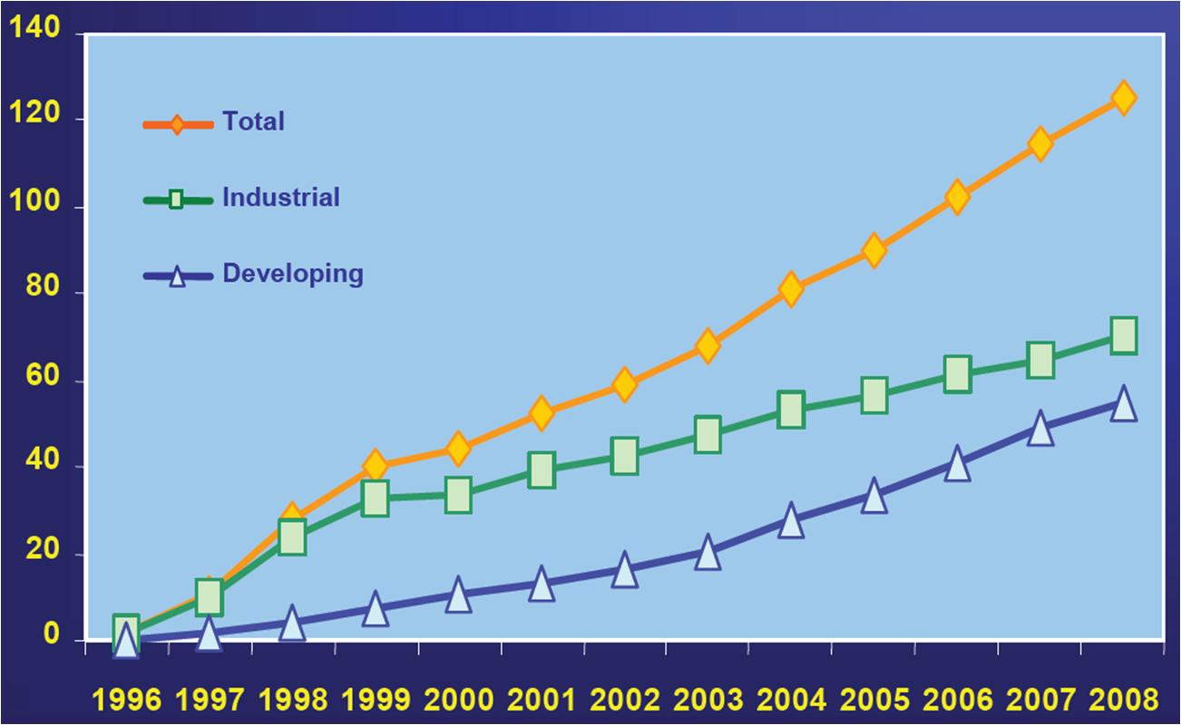
What’s new in ag. research?
Molecular biology!
Global Area of Biotech Crops, 1996 to 2008:
Industrial and Developing Countries (m. ha)
Approx. share of global farm area in 2008
Worldwide: 2.5% of
4.96 b. ha
Indust. Co.:
5.4% of
1.29 b. ha
Dev’ing. Co.:
1.5% of
3.67 b. ha
Reproduced from Clive James (2008), Global Status of Commercialized Biotech/GM Crops: 2008. ISAAA Brief No. 39. ISAAA: Ithaca, NY (www.isaaa.org).

Slide 40
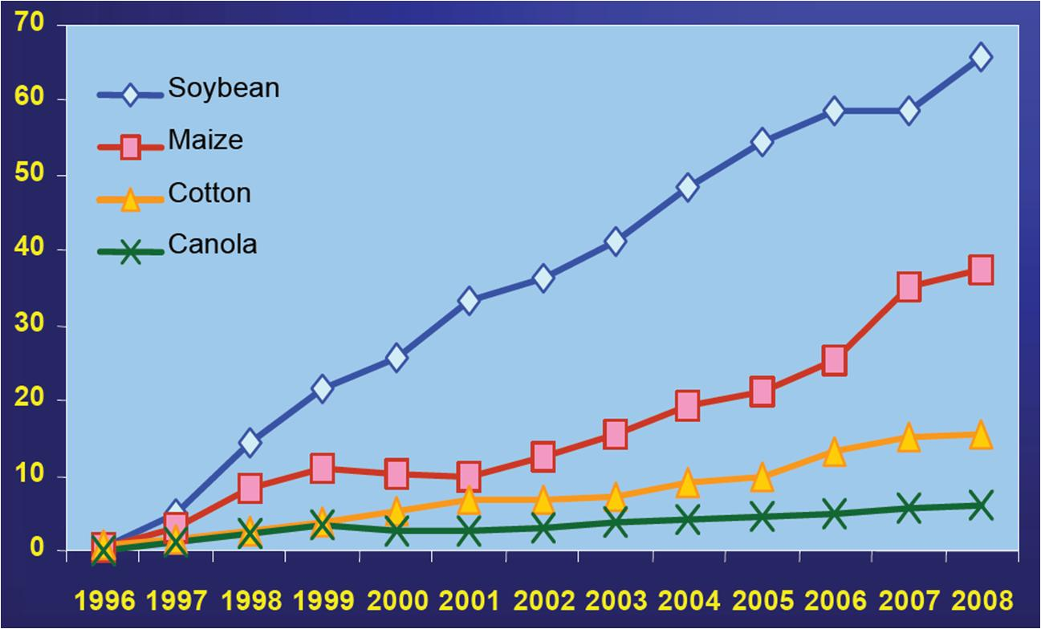
New biotechnologies hold great promise but so far only for a few crops
Global Area of Biotech Crops, 1996 to 2008,
By Crop (millions of hectares)
Share of global area for that crop in 2008
Soybeans: 70% of
95 m. ha
Maize:
24% of 157 m. ha
Cotton:
46% of 34 m. ha
Canola:
20% of 30 m. ha
Reproduced from Clive James (2008), Global Status of Commercialized Biotech/GM Crops: 2008. ISAAA Brief No. 39. ISAAA: Ithaca, NY (www.isaaa.org).

Slide 41
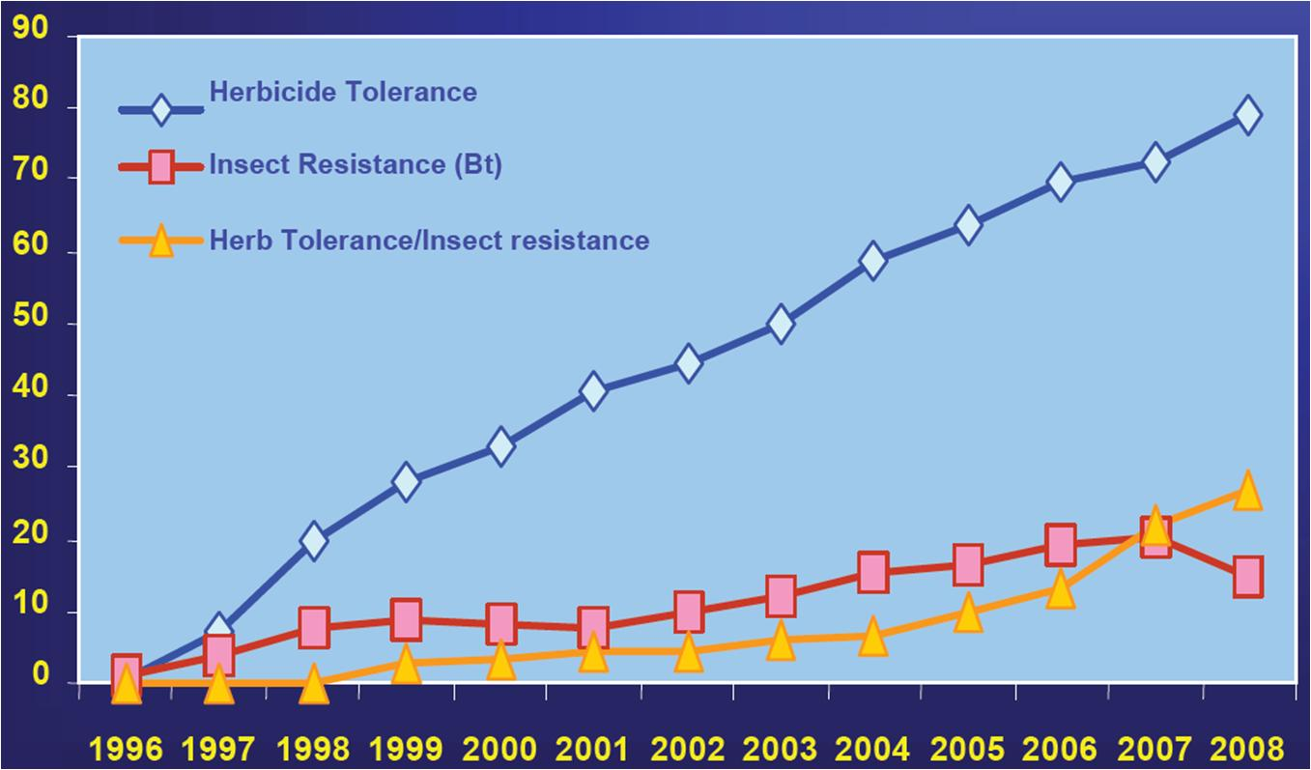
New biotechnologies hold great promise but so far only through a few traits
Global Area of Biotech Crops, 1996 to 2008,
By Trait (millions of hectares)
Reproduced from Clive James (2008), Global Status of Commercialized Biotech/GM Crops: 2008. ISAAA Brief No. 39. ISAAA: Ithaca, NY (www.isaaa.org).

Slide 42
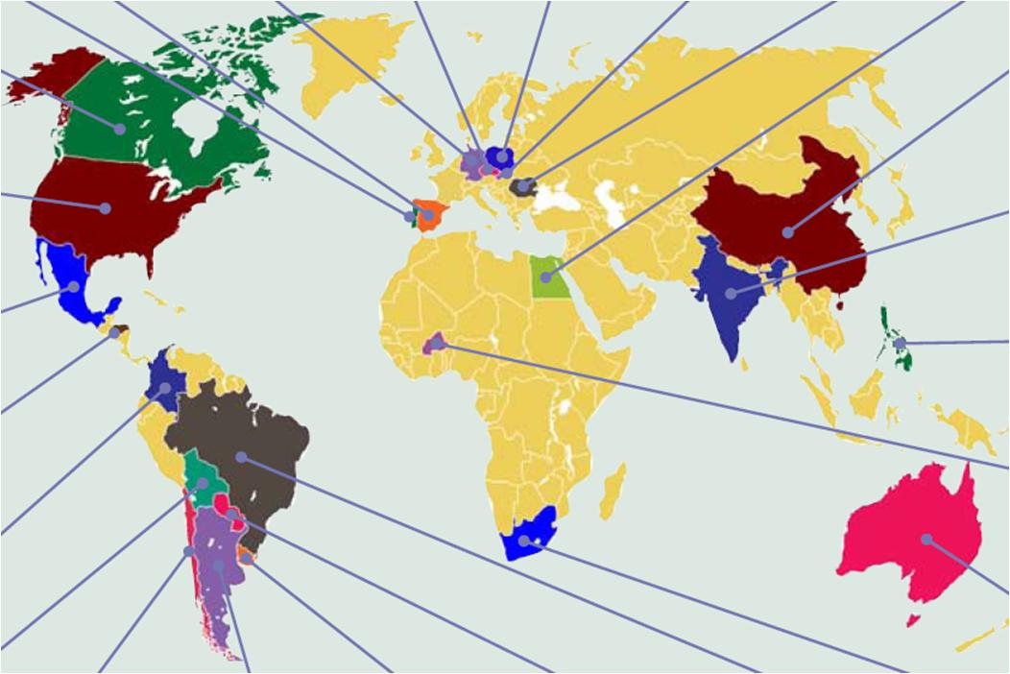
New biotechnologies hold great promise but so far a relatively narrow impact
Global Status of Biotech/GM Crops (hectares in 2008)
Portugal
<0.05 m.
Spain 0.1 m.
Germany
<0.05 m.
Czech R.
<0.05 m.
Poland
<0.05 m.
Slovakia <0.05 m.
Romania <0.05 m.
Egypt
<0.05 m.
Canada
7.6 m.
China 3.8 m.
mainly
cotton
USA 62.5 m.
India
7.6 m.
only
cotton
Mexico 0.1 m.
Philippines 0.4 m.
Honduras <0.05 m.
Burkina Faso <0.05 m.
Colombia
<0.05 m.
Australia 0.2 m.
Bolivia 0.6 m.
Chile <0.05 m.
Argentina 21 m.
Uruguay 0.7 m.
Paraguay 2.7 m.
Brazil 15.8 m.
S.Africa 1.8 m.
Reproduced from Clive James (2008), Global Status of Commercialized Biotech/GM Crops: 2008. ISAAA Brief No. 39. ISAAA: Ithaca, NY (www.isaaa.org).

Slide 43
Some more conclusions…
In practice: Innovation sometimes responds to incentives
  “Induced” innovation would save increasingly scarce resources, and use increasingly abundant ones
  But public action is needed to drive and direct technology
    Patents and other IPRs where copying is easily detected
    Public investment where gains are non-excludable
    (as in much of agricultural research!)

