Slide 1
AGEC 640 – Ag Development & Policy
Measuring Policies
Sept 25 – Oct 4, 2018
Today (slides 1-26):
the free trade benchmark--why compare to world prices?
Thursday (slides 27-40):
how far are policies from free trade? How to measure?
… use protection formulas to compare interventions
Then: return to finish up these slides (41-80).
(4 lectures from this ppt in total)

Slide 2
Readings
For this week:
  Look at Masters, “Guidelines…”
For next week:
  Tsakok, “Single market analysis…”
  OECD, “Ag. Policies in OECD Countries…”

Slide 3
From last week, recall how
economic surplus treats the market as a household
highest indifference level in a household model
highest economic surplus in a market model
Qty. of “a” goods
Price of “b” goods
predicted optimum choice of the household
predicted equilibrium among optimizing people
Qa
Pb
slope of income
line =-Pb*/Pa*
Qb
Qty of “b”
Qb

Slide 4
As in the household model, the geometry of optimization ensures a gain from trade
producers of “b” lose
A
Qty. of “a” goods
Price of “b” goods
“consumers” gain
A
B
==> net social gain is
B
Net gain from trade
a Harberger triangle
A
B
Qty of “b”
Qty of “b”

Slide 5
…and the geometry of optimization ensures
an efficiency loss from trade restriction
producers of b gain
A
Qty. of “a” goods
Price of “b” goods
consumers of b lose
ABCD
government gains tariff revenue
C
welfare loss from trade restriction
==> net social loss is
Harberger triangles
B
D
Pb+t
t
A
B
C
D
Pb/Pa
Pb
(Pb+t)/Pa
Qty of “b”
Qty of “b”

Slide 6
The logic is the same for trade taxes and for trade quotas
An import tax raises the price that importers must pay
An import quota limits the quantity
that importers can import
S
S+quota
P+tariff
P’
A
B
C
D
P
A
B
C
D
P
Qp
Qp’
Qc’
Qc
Qp
Qp’
Qc’
Qc
C.S. change: -ABCD
P.S. change: +A
tariff revenue: +C
net change: -B D
C.S. change: -ABCD
P.S. change: +A
quota rent: +C
net change: -B D
Note that this “tariff-quota equivalence” is limited; if there are changes in S, D or Pw, the two policies lead to different responses!

Slide 7
So…when we measure trade policies, we will use “free trade” as a benchmark
Deviations from free trade reduce national welfare, as long as
  individual producers and consumers are optimizing, and
  market outcomes are a perfectly competitive equilibrium between people, who thereby act as if they were one household.
Remember, these are strong assumptions!
  To the extent that buyers or sellers don’t trust each other, quantity goes toward zero -- unless remedied by trust in a brand or certification
  To the extent that sellers are protected from competition by barriers to entry, they can restrict quantity to raise profits

Slide 8
A Review of Thinking:
Classical political economy from 1776 through the 1880s
(the first arguments for free trade as a benchmark)
Adam Smith (1776):
  wealth depends on the extent of the market
    ==> a country cannot get rich by restricting its trade!
David Ricardo (1817):
  the pattern of trade depends only on relative costs within the country,
  rather than absolute costs across countries
    ==> a country cannot get rich by restricting its trade!!
John Stuart Mill (1873):
  there may be infant industries
    ==> a country might be able to get rich by restricting its trade
  but successful lobbyists tend to represent established interests
==> a country cannot get rich by restricting its trade!!!

Slide 9
A Review of Thinking:
Neoclassical trade theory in the early 20th century
(more detailed explanations of free trade as a benchmark)
Heckscher (1919) and Ohlin (1933)
  Even with similar technology, relative costs would vary with
  differences in factor abundance...
Viner (1937)
  …and differences in industry-specific resources...
Samuelson (1962)
  … and differences in country-specific patterns of demand…
Salter (1959) and Swan (1960)
  … and differences in the exchange rate & trade balance.
==> changes in all these things can change a country’s pattern of trade, without any policy change.

Slide 10
Post-war challenges to optimality of free trade
“Trade pessimists” (Prebisch 1950, Singer 1950)
  Terms of trade (i.e. the relative price) for LDCs…
    worsen when worldwide incomes go up (due to income elasticities)
    worsen when LDCs try to increase trade (due to price inelasticity)
    ==> Restricting trade might permit import-substitution industrialization
“Development linkages” (Hirschman 1958; Rosenstein-Rodan 1943)
– “big push” industrialization
  key industries have beneficial effects on other activities
    ==> Restricting trade may exploit forward and backward linkages
“New trade theory” in mid-1980s (led by Krugman’s “Geography and Trade”)
  industries with scale economies (e.g. aircraft) can generate “rents”
  industries using new skills (“high tech”) generate positive externalities/spillovers
    ==> “Strategic” trade restrictions might shift the location of industries
“Competitive advantage” (Michael Porter)
  Industries tend to “cluster” in response to successful policies
  ==> Trade restrictions might shift concentrate industrial growth

Slide 11
Perennial arguments against free trade…
Let’s list the key claims, then see how they hold up:
(1) free trade’s OK but more trade is better, so export subsidies;
(2) free trade’s OK, but not without a level playing field: foreigners subsidize their producers, or restrict access to their markets, so we should do so as well;
(3) free trade’s OK, but not yet: first, our producers need temporary “infant industry” protection
(4) free trade’s OK, but not for this industry: it’s needed for “national security”, employment, or other non-market reasons why prices do not reflect full costs/benefits
(5) free trade’s OK, but if we (slightly) restrict trade we can get (slightly) improved prices, by market power
Let’s go through all of these using supply-demand diagrams…

Slide 12
The “exports are good” argument: is more trade better?
P_{d}
A
C
D
E
an export subsidy:
B
F
P_{w}
Qd’
Qd
Qs
Qs’
CS loss: area AB
PS gain: area ABCDE
Subsidy cost: area BCDEF
Net loss: area BF
Remember it’s not trade as such, but free trade that’s desirable
(at least in this model)

Slide 13
The “level playing field” argument: do foreigners’ interventions justify our interventions?
For example, if foreigners start to restrict their imports, would free trade still be optimal for us? How would that affect these diagrams?
Our country
Int’l. Trade
The rest of the world
S_{exports}
Pt
D_{imports}
Q
(tons)
Q
(tons)
Q
(thou. tons)

Slide 14
The “level playing field” argument: do foreigners’ interventions justify our interventions?
Foreigners’ interventions will change the world supply-demand balance, but not the optimality of free trade for us…
Our country
Int’l. Trade
The rest of the world
S_{exports}
Pt
D_{imports}
Q
(tons)
Q
(tons)
Q
(thou. tons)

Slide 15
The “free trade later” argument:
When does infant industry protection pay off?
Protection is costly now…
but could pay off later
Cost reduction = supply increase due to learning-by-doing
Price
($/unit)
Pdom
A
B
C
D
Ptrade
Qs
Qs’
Qd’
Qd
CS loss: area ABCD
PS gain: area A
Tariff gain: area C
Net loss: area BD
What is the PS gain due to this cost reduction?

Slide 16
The “free trade later” argument:
When does infant industry protection pay off?
Protection is costly now…
but could pay off later
Cost reduction = supply increase due to learning-by-doing
Price
($/unit)
Harberger triangle losses now
Pdom
A
B
C
D
Cost reduction gains later
Ptrade
Qs
Qs’
Qd’
Qd
CS loss: area ABCD
PS gain: area A
Tariff gain: area C
Net loss: area BD
What is the PS gain due to this cost reduction?

Slide 17
The “free trade later” argument:
When does infant industry protection pay off?
Protection is costly now…
but could pay off later
Annual economic surplus gain or loss
Policy-induced gains
Cost reduction gains if and when productivity improves
No policy
(no gain or loss)
Harberger triangle losses due to protection (these last forever!)
Policy-induced losses
Years

Slide 18
The “free trade later” argument:
When does infant industry protection pay off?
Protection is costly now…
but could pay off later
The ‘Mill-Bastable test’ asks what is the payoff to this investment:
is protection a better bet than paying directly for R&D or education?
Annual economic surplus gain or loss
Policy-induced gains
net gains later
No policy
(no gain or loss)
net costs now
Policy-induced losses
Is Σ[NB_{t}/(1+r)^{t}] > 0?
It depends on NB, t, and r!
Years

Slide 19
The “free trade is for others” argument:
Do S and D curves tell the whole story?
If raising production in this industry would be good for national security, how would that be shown on the diagram?
Price
($/unit)
Pdom
A
B
C
D
Ptrade
Qs
Qs’
Qd’
Qd
CS loss: area ABCD
PS gain: area A
Tariff gain: area C
Net loss: area BD

Slide 20
The “free trade is for others” argument:
Do S and D curves tell the whole story?
If raising production in this industry would be good for national security, how would that be shown on the diagram?
S= MC
Price
($/unit)
S – external benefit
(i.e. the value of the “positive externality”)
Ptrade
Qs
Qs*
Qd

Slide 21
The “free trade is for others” argument:
Do S and D curves tell the whole story?
If you cannot subsidize directly, how much of the external benefit should you capture through trade policy?
Should you go all the way to Qs*?
Price
($/unit)
S= MC
S – external benefit
Pdom
Ptrade
That would create an efficiency gain from more production…
…but an efficiency loss from less consumption (a “by-product distortion”)
Qs
Qs*
Qd’
Qd

Slide 22
The “free trade is for others” argument:
Do S and D curves tell the whole story?
If you cannot subsidize directly, how much of the external benefit should you capture through trade policy?
The “second-best” policy equates
AT THE MARGIN
the trade-off between the external benefit of more production with the efficiency cost of less consumption
Price
($/unit)
S= MC
S – ext. ben.
Pdom
The second-best Qs** is where…
Pdom**
Ptrade
marginal efficiency gain from more production…
…just equals marginal efficiency loss from less consumption
Qs**
Qd**

Slide 23
The “market power” argument:
Can large countries influence their trade prices?
For example, if our country is about the same size as the whole rest of the world, would free trade at Pt still be optimal for us? Could we intervene to improve our well-being? What would that do to foreigners?
Our country
Int’l. Trade
The rest of the world
S_{exports}
Pt
D_{imports}
Q
(tons)
Q
(tons)
Q
(tons)

Slide 24
The “market power” argument:
Can large countries influence their trade prices?
Maybe: to complete this diagram, we need to draw market power! Take a trade course!!!
Our country
Int’l. Trade
The rest of the world
S_{exports}
Pt
D_{imports}
Q
(tons)
Q
(tons)
Q
(tons)

Slide 25
In sum…
There are a few cases where small trade restrictions could raise national economic surplus above what can be achieved through free trade.
(1) the “level playing field” argument is valid only as a bargaining strategy: intervention hurts us even more than it hurts them
(2) the “infant industry” argument is rarely valid: the future gains from learning-by-doing are unlikely to outweigh its present costs, and in any case similar learning would occur in other sectors too.
(3) the “national security” argument or other non-market benefits are valid arguments for intervention, but these should be aimed at production or consumption, not trade.
(4) the “large country” market power argument is a valid argument for some intervention, but calls for small restrictions on exports and this is not usually what governments do.
In practice, most trade policy is redistribution within the country, favoring concentrated, vocal groups at the expense of others.

Slide 26
Measuring policies: some conclusions
Much of economic theory questions freer trade, by
  Finding conditions under which freer trade is not more efficient than some hypothetical alternative policy,
  but there is rarely a political mechanism to generate and sustain the economically optimal policy,
  so the fundamental argument for laissez-faire in trade reflects the nature of political institutions;
Economics’ conclusion about freer trade does not extend to laissez-faire in domestic markets;
  we can identify numerous areas where successful policy-making is important for higher economic welfare.
So, we can measure trade policy relative to world prices
  “less policy” (with tradable-good prices closer to world prices) is better,
  although we don’t know how much better!
  effects on econ surplus rise with the square of the distortion

Slide 27
9/27/18 Starts here

Slide 28
Review, from previous week… we saw a variety of trade policies
Policies on imports
Policies on exports
Policies that
help producers
raise Pd
above Pt
import
tariffs
or
quotas
export
subsidies
Policies that
help consumers
lower Pd
below Pt
import
subsidies
(rarely seen)
export taxes or quotas
Policies that work through trade affect both producers and consumers.
Subsidies on trade expand quantities traded, while taxes on trade reduce them.

Slide 29
Policies that tax production affect a market like this:
and a variety of “domestic” policies,
e.g. taxes on production or consumption
S’ (market supply, after taxes)
tax
S (producers’ marginal cost)
and policies that tax consumption look like this:
D (consumers’ demand)
tax
D’ (market demand, after taxes)
Taxes restrict the market supply or demand, shifting them to the left…

Slide 30
Policies that subsidize production work like this:
“Domestic” policies can also be
subsidies on production or consumption
S (producers’ marginal cost)
subsidy
S’ (market supply, after taxes)
and policies that subsidize consumption look like this:
D’ (market demand, after subsidies)
subsidy
D (consumers’ demand)
Subsidies expand market supply or demand -- they shift curves to the right.

Slide 31
Comparing Policies Across Markets
Can we reduce these models of policy effects to a single
“measure”, using only observable data?
Example of trade policy
(import tariff)
for an importable
Example of trade policy
(export subsidy)
for an exportable
Pdom
A
C
D
E
B
F
Ptrade
Pdom
A
B
C
D
Ptrade
Price
($/unit)
Qs
Qs’
Qd’
Qd
Qd’
Qd
Qs
Qs’

Slide 32
Measures of “Protection” or “Assistance” focus only on price comparisons
Comparing “domestic” and “world” prices
  for a similar item, at the same place & time
  what it actually costs, versus…
  what it would cost with free trade
  this can be the tariff rate, or “tariff-equivalent” cost of non-tariff barriers (NTBs)
“Nominal” protection focuses only on output:
  Nominal protection coefficient
  NPC = (Pd/Pw) ( a coefficient on Pw)
  Nominal rate of protection
  NRP = (Pd/Pw) – 1 ( a percentage of Pw)

Slide 33
Nominal Protection
  It is hard to estimate the value of market failures and opportunity costs for NONTRADALBE goods.
  For this reason NRP and NPC are most reliably used only in the case of TRADED goods, for which the opportunity cost is the value of the good in trade (i.e. the “parity price”).
  Origins:
  17th-18th century: English tariffs on imports of wine, sugar, coffee, tea, and rum
1813: English House of Commons debates banning imports of wheat to support prices
Thomas Malthus argued grain imports would reduce wages, and hurt manufacturers
David Ricardo supported free trade to exploit Britain’s comparative advantage.
Adam Smith generally opposed “mercantilism” and favored free trade
“every thing ought to be left to its own level”
1815: Corn Laws enacted to keep Prussian wheat out, bread prices high. Rioting in London.
Smith’s Wealth of Nations (1776) contains a commentary on the “Corn Trade”
(in Book 4) in which he computes duties on common imports – basically the first
calculations of NRPs. Still in use after 200 years!!!

Slide 34
Using nominal protection
  With free trade, NRP=0 and NPC=1
  NRP > 0 (or NPC >1) implies policy is helping producers at the expense of consumers, and generating either quota rents or tariff revenues.
  NRP < 0 ( or NPC <1) implies policy is helping consumers at the expense of producers, spending government funds on export subsidies.
  Keep in mind that “protection” is defined from the prospective of the producer. When producers are protected consumers are harmed. When consumers are protected, we refer to this as “negative protection” because the reference population is producers.

Slide 35
Using nominal protection
  Beware of which Pw & Pd you have!
  Note especially:
    location, time & quality of the item in trade
    transaction costs (transport, storage, processing) between trade and the domestic market
  Any comparison between Pw & Pd should consider:
    marketing margins associated with packaging and location
    seasonal variations:
      from post-harvest (low opportunity cost)
      to pre-harvest (high opportunity cost)
    spatial variations:
      from surplus-area (low opportunity cost)
      to deficit-area (high opportunity cost)

Slide 36
Average nominal rates of protection by income group (2001)
Stylized patterns consistent with development paradox

Slide 37
How nominal protection is calculated can vary widely!
Kyodo News Service (Japan)-- June 9, 2005 [excerpt]
Japan's milled rice tariff 778% under new WTO formula
Japan's tariff on milled rice imports is 778 percent under a new formula for global trade talks, up sharply from the earlier-published 490 percent, sources familiar with the matter said Thursday.
The new figure was calculated for the ongoing trade liberalization talks under the World Trade Organization, using a new formula that requires unit-based tariffs to be recalculated into ad-valorem (percentage) tariffs for a progressive tariff reduction proposal, which subjects higher tariff rates to deeper reductions.
The current unit-based tariff on rice is 341 yen per kilogram. As a percentage of trade prices, the tariff rate rises as the base import price declines. The earlier-published rate of 490 percent on an ad valorem basis was based on 1996-98 import prices.

Slide 38
How do changes in nominal protection relate to changes in producer and consumer surplus?
What are the effects of cutting protection from 80% to 40%?
How do they differ from cutting from 40% to zero?
The easy one: what is the econ surplus effect of changing from 40% to zero?
Producer Surplus change:
Consumer Surplus change:
Tariff or quota rent change:
Net econ. surplus change:
-E
Pd =180
E+F+G+H+I+J
A
B
C
D
-(G+H+I)
Pd’ =140
F+J
E
F
G
H
I
J
Pw =100
Now, what would be the effect of changing from 80% to 40%?
Producer Surplus change:
Consumer Surplus change:
Tariff or quota rent change:
Net econ. surplus change:
-A
A+B+C+D
-C+(G+I)
B+G+D+I
Reducing the highest tariffs (‘tariff peaks’) causes the greatest welfare gain;
The level of the NRP measures the marginal distortion in production and consumption
away from the opportunity cost of the product, which is always Pw.

Slide 39
From nominal to effective protection
We just saw how NRPs relate to econ surplus
Now, how do NRPs relate to profitability & incentives?
  The NRP measures change in output price or firm revenue
  How does that relate to profitability or incentives?
    e.g. with an NRP of 10%, e.g. Pw is $100/unit, and Pd is $110/unit
    NRP = 110/100 =1.1, but what is the effect of NRP on profits?
    with perfect competition, profits are always zero…
    but we can distinguish between inputs (in elastic supply)
    and value added (labor + capital, with inelastic supply)
    if the inputs cost $60 per unit of output, then…
    NRP of 10% raises value added by (110-60)/(100-60)=5/4=1.25
    It doesn’t matter whether inputs are imported or not! If the inputs are potential importables, then the formula applies. Why?

Slide 40
Effective rate of protection (ERP)
ERP extends the concept of NRP to consider how inputs fit into the overall picture.
As we shall see, even if the NRP is low, a protected industry may benefit enormously if it uses inputs that are protected. In contrast, protection may be offset if the industry uses inputs that are taxed.
The “leverage” effect of protection can be large for industries that have a low “value added” (i.e. ones for which the share of value added in total cost is small). This is one reason why they lobby so hard for protection!
As an example, think of protection of cotton or textiles, which may have impacts on incentives to produce garments. If the textile industry is protected, and textiles inputs are a share of the total cost of garments, then the textile protection may harm the garment industry, and if the value added by the garment industry is small, it may lobby hard for its own protection!

Slide 42
10/02/18 Starts here

Slide 43
Effective and nominal protection can be very different!
Using effective protection to take account of input costs is especially important when policy affects input prices!
For example…
  A government wants to help pork producers, so gives them some trade protection:
    e.g. for pork, Pd = 120, Pw = 100
  But government also wants to help feed producers, so gives them protection too:
    e.g. for feed, Pd = 80, Pw = 50
  How does the combination of both policies affect net incentives for pork production?
  We need some more information!
    If it takes one unit of feed per unit of pork, then is the government helping or hurting pork producers?

Slide 44
Using effective protection
By assuming a fixed input-output coefficient, the effective protection approach allows us to add up policy effects on value added, using current techniques and quantities:
  EPC = (Pd-a_{i}Pd_{i})/(Pw-a_{i}Pw_{i})
  where a_{i} = observed input-output coefficients
  ERP = EPC - 1
  As before,
  EPC=1 or ERP=0 is free trade
  EPC>1 or ERP>0 is helping this sector at expense of others
  EPC<1 or ERP<0 is taxing this sector to support others

Slide 45
Effective protection and input substitution
The EPC/ERP formula assumes input-output coefficients are not affected by the policy.
  How likely? Empirical issue.
Can we anticipate producers’ response to policies that affect input prices?
  Sometimes.
For example, protection of local steel firms may lead a country’s steel-using industries to switch to plastics or aluminum.
  But by how much?
Once we allow quantities to change, we need a “fully-specified” model of economic behavior, as opposed to these “indicators” of protection or taxation.

Slide 46
Measures of “Protection” or “Assistance” focus only on price comparisons
Comparing “domestic” and “world” prices
  for a similar item, at the same place & time
  what it actually costs, versus…
  what it would cost with free trade
  this can be the tariff rate, or “tariff-equivalent” cost of non-tariff barriers (NTBs)
“Nominal” protection focuses only on output:
  Nominal protection coefficient
  NPC = (Pd/Pw) ( a coefficient on Pw)
  Nominal rate of protection
  NRP = (Pd/Pw) – 1 ( a percentage of Pw)

Slide 49
Using effective protection
By assuming a fixed input-output coefficient, the effective protection approach allows us to add up policy effects on value added, using current techniques and quantities:
  EPC = (Pd-a_{i}Pd_{i})/(Pw-a_{i}Pw_{i})
  where a_{i} = observed input-output coefficients
  ERP = EPC - 1
  As before,
  EPC=1 or ERP=0 is free trade
  EPC>1 or ERP>0 is helping this sector at expense of others
  EPC<1 or ERP<0 is taxing this sector to support others

Slide 50
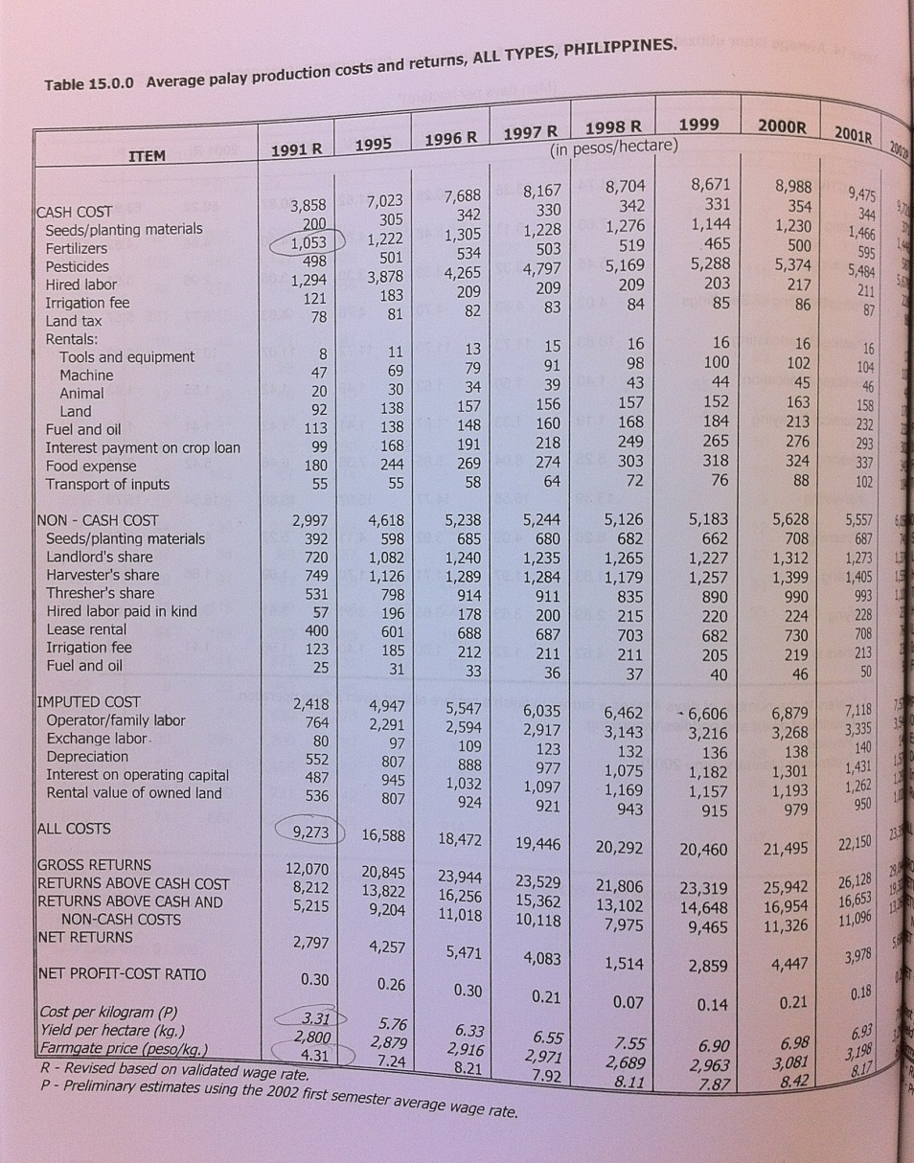
Philippine rice, revisited
Focus on 1991 data, as “rough” estimate
Fertilizer = 1053/9273 ≈ 11% of cost
(vs. 6% in 1999)
Fertilizer = 0.11 x 3.31 ≈ 0.36 pesos/kg
Cost = 3.31/4.31 ≈ 77% of price
Fertilizer = 0.11/0.77= 18% of cost share
Numerator= (P_{d}-r_{d})/exrate
Denominator= (P_{w}-r_{w})
Source: Philippine Rice Statistics 1970-2002, vol. 2, Bureau of Ag Statistics

Slide 51
Philippine rice, revisited
Fertilizer = 1053/9273 ≈ 11% of cost
Fertilizer = 0.11 x 3.31 ≈ 0.36 pesos/kg
Cost = 3.31/4.31 ≈ 77% of price
Fertilizer = 14/77 ≈ 18% of cost share
Numerator= (P_{d} - αr_{d})/exrate
Denominator= (P_{w} - αr_{w})

Slide 52
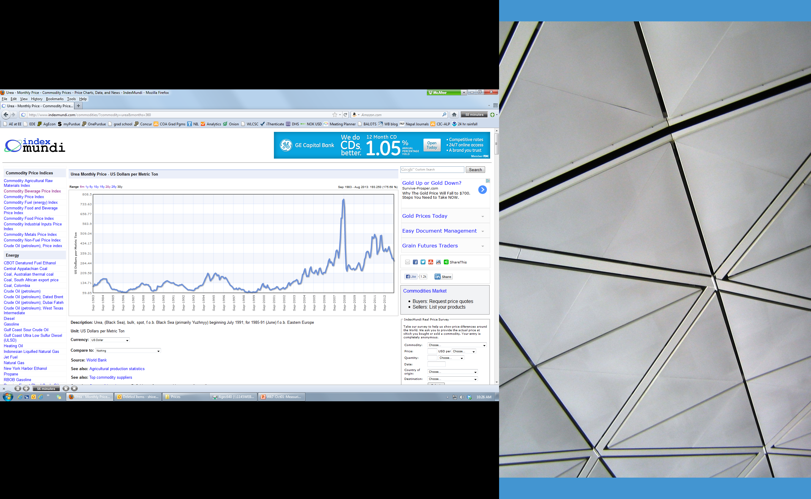
Philippine rice, revisited
Philippines fertilizer price = 5.37 Pesos/kg ≈$0.21/kg
world fertilizer price ≈0.10/kg
Source: http://www.indexmundi.com/commodities/?commodity=urea&months=360

Slide 54
Remember:
Effective and nominal protection can be very different!
Using effective protection to take account of input costs is especially important when policy affects input prices!

Slide 55
From effective protection to
Aggregate Measures of Support
What about policies that intervene directly in value added (labor, capital, etc.?)
Although economic profits are zero with perfect competition, we can think about policies affecting “profits” which we expect then to be capitalized into asset prices and input costs.
To compare policy effects on those producer “profits”:
  PSE = [(Pd-Pw)+a_{i}(Pd_{i}-Pw_{i}) + other transfers)]
Often Producer Support Estimates (PSEs) are shown as total monetary value, implicitly as transfer per unit multiplied times total quantity produced

Slide 56
Properties of alternative PSE ratios
The “percentage PSE” is PSE as a share of revenue (Pd):
  PSE = [(Pd-Pw)+a_{i}(Pd_{i}-Pw_{i}) + other transfers)]/Pd
The same data can also be shown relative to world price (Pw):
  this was called “Subsidy Ratio to Producers” by S.R. Pearson (SRP), but is now known as the “Nominal Assistance Coefficient” by the OECD, in analogy with the “Nominal Protection Coefficient” (NPC):
  SRP or NAC = [(Pd-Pw)+a_{i}(Pd_{i}-Pw_{i}) + other transfers)]/Pw
  NPC = Pd/Pw
Using Pw instead of Pd will give priority rankings that are more consistent with the rankings of policies’ effect on profits, but PSEs relative to Pd are still used more widely.

Slide 57
Another kind of aggregate measure:
Domestic Resource Costs
  To compare the “comparative advantage” of various activities, given various distortions, some people use the total cost of nontradables per unit of tradable value added:
  DRC = (domestic factor costs)/(Pw-a_{i}Pw_{i})
  The DRC has the same denominator as the EPC. This kind of ratio can also be calculated relative to Pw, which is a kind of “social cost-benefit ratio”:
  SCB = (domestic factor costs + a_{i}Pw_{i})/Pw
  = total costs / total benefits
  Using the SCB instead of the DRC will give priority rankings that are more consistent with the rankings of policies’ effects on profits in a more general model.

Slide 58
Policy measurement: some conclusions
  In each case we are using:
    world prices as opportunity costs,
    observed prices as measure of policy effects,
    input-output coefficients as weights to add up prices,
    and some formula with which to aggregate the price changes.
  Drawback – no “adjustment” taking place with these
    Although the indicators can give some idea of policy magnitudes and efficiency levels, they cannot predict quantity or welfare changes, so models are needed…
    And since the ease and cost of computing is falling fast, models are
    coming into policy-making far more than in the past
  … but “indicator” measures still matter!

Slide 59
10/04/18 Starts here
Source: https://www.cbd.int/financial/pes/swiss-pesagriculturalpolicy.pdf

Slide 60
Agricultural support:
defined by the OECD as…
the annual monetary value of gross transfers to agriculture from consumers and
taxpayers, arising from governments' policies that support agriculture, regardless
of their objectives and their economic impacts.
http://www.oecd.org/tad/agricultural-policies/producerandconsumersupportestimatesdatabase.htm
THINK: total policy transfers, measured at the farm gate. This includes:
- price support
- direct payments
- foregone revenue

Slide 61
Comparison of policy measures over time

Slide 62
Comparison of PSEs across countries
Within country, the long-term trend is downward (almost) everywhere…
…but read this.

Slide 63
Composition of PSEs by policy instrument
A = per area
An = per animal
R = revenue
I = income

Slide 64
EU and US PSEs by policy instrument
Source: Agricultural Policies in OECD Countries: At a Glance 2008, pages 64 and 84

Slide 65
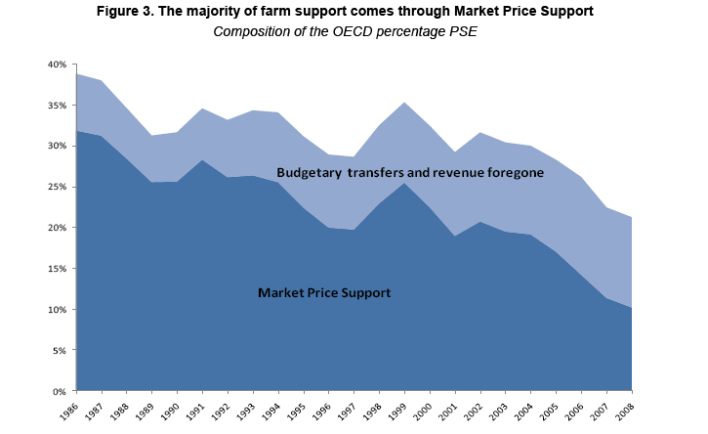
Bottom line on type of support
Source: OECD 2009 (http://www.oecd.org/dataoecd/23/7/44924550.pdf)

Slide 66
EU and US PSEs by commodity
MPS=Market Price Support
SCT =Single Commodity Transfer
PSE = Producer support estimate
Source: Agricultural Policies in OECD Countries: At a Glance 2008, pages 64 and 84

Slide 67
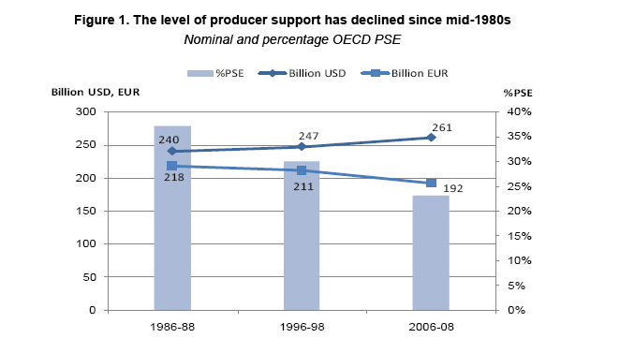
Trend in producer support
Source: OECD 2009 (http://www.oecd.org/dataoecd/23/7/44924550.pdf)

Slide 68

For further reading:
OECD 2009 (http://www.oecd.org/dataoecd/23/7/44924550.pdf)

Slide 69
The evidence?
Distortions have worsened and improved
Constant 2000 US$ (billions)
Very interesting!
Source: Anderson, K. (2009). Distortions to Agricultural Incentives: A Global Perspective, 1955 to 2007, London: Palgrave Macmillan and Washington DC: World Bank.

Slide 70
Non-agricultural distortions have also changed
Developing Countries
Tariffs on non-ag. products have fallen quickly
Percent
so relative assistance
to agriculture has benefited
High-Income Countries
Here, NRA≈RRA
Percent
Source: Anderson, K. (2009). Distortions to Agricultural Incentives: A Global Perspective, 1955 to 2007, London: Palgrave Macmillan and Washington DC: World Bank.

Slide 71
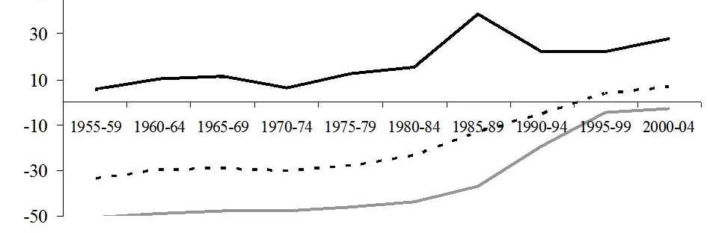
Reforms have reduced both anti-farm and anti-trade biases
Developing countries
Importables
Total
0
Exportables
Percent
This gap is anti-trade bias
This level is anti-farm bias
High-income countries plus
Europe’s transition economies
High-income countries’ biases have also shrunk
Importables
Percent
Total
Exportables
0
Source: Anderson, K. (2009). Distortions to Agricultural Incentives: A Global Perspective, 1955 to 2007, London: Palgrave Macmillan and Washington DC: World Bank.

Slide 72
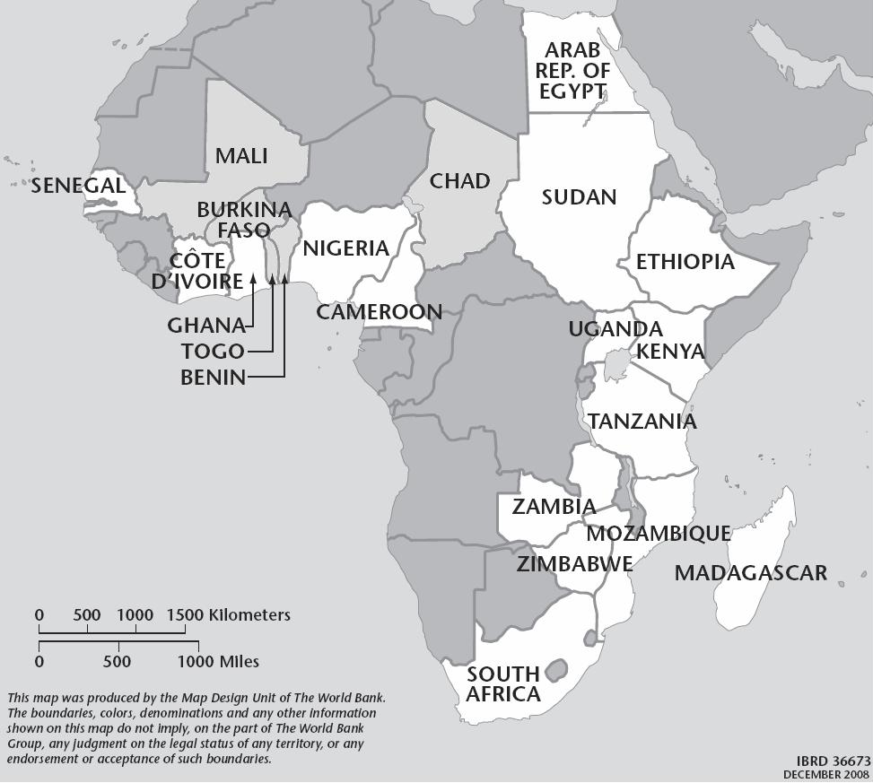
On average, Africa has had very large and sustained reforms since the 1990s
Importable products
All farm products
Smaller
anti-trade bias since 1990s
Exportable products
Smaller
anti-farm bias
Source: K. Anderson and W. Masters (eds), Distortions to Agricultural Incentives in Africa. Washington, DC: The World Bank, 2009.

Slide 73
Asia has large pro-farm shift; ending net support to ag in 80s and net export taxes in 90s.
Importable products
No more anti-farm bias since 1980s
All farm products
Exportable products
Not much net export taxation since 1990s
Source: K. Anderson and W. Martin (eds), Distortions to Agricultural Incentives in Asia. Washington, DC: The World Bank, 2009.

Slide 74
Latin America has had similar trends at a slower pace, supporting ag. since 1990s
Importable products
All farm products
Exportable products
Source: K. Anderson and A. Valdes (eds), Distortions to Agricultural Incentives in Latin America. Washington, DC: The World Bank, 2009.

Slide 75
Reform paths vary within regions
Examples in Africa
NRAs for tradable farm products (1955-2004): each dot is a country/year; line is country

Slide 76
Reform paths vary within regions
Examples in Asia
NRAs for tradable farm products (1955-2004): each dot is a country/year; line is country

Slide 77
Reform paths vary within regions
Examples in Latin America
NRAs for tradable farm products (1955-2004): each dot is a country/year; line is country

Slide 78
Reform paths vary within regions
Examples among High-Income Countries
NRAs for tradable farm products (1955-2004): each dot is a country/year; line is country

Slide 79
To explain and predict policy change, we’ll need to merge regions and test hypotheses
A key variable will be per-capita income
National average NRAs by real income per capita, with 95% confidence bands
Anti-farm bias ends at about $5,000/yr
Anti-trade bias ends above $12,000/yr
(≈$400/yr)
(≈$3,000/yr)
(≈$22,000/yr)
Source: Calculations from data available at www.worldbank.org/agdistortions. Each line shows data from 66 countries in each year from 1961 to 2005 (n=2520), smoothed with confidence intervals using Stata’s lpolyci at bandwidth 1 and degree 4. Income per capita is expressed in US$ at 2000 PPP prices.

Slide 80
Oct 9
No class
Fall Break
Next class
Oct 11
Exam

