Slide 1
workshop Engineering Design Coaching Tool for Sustainability and Ethically-conscientious Education
Şenay Purzer
Purdue University, West Lafayette, Indiana
https://web.ics.purdue.edu/~spurzer/esera2023
Notes:
The Engineering Design Coaching Tool is an instructional scaffold designed to promote student reasoning through discourse centred around the negotiation of design risk and benefits. This tool is particularly effective in promoting student agency and design reasoning through planned questioning. The session includes a presentation of two frameworks. The Honeycomb of Engineering Framework represents design practices connected through the central practice of negotiation. The Design Reasoning Quadrants Framework represents fluency across four types of reasoning necessary for effective design: experiential reasoning, trade-offs reasoning, first-principles reasoning, and futures reasoning. Centred on the negotiation of risks and benefits, a core practice of engineering, the framework allows classroom discourse and questioning necessary for sustainable and ethically-conscientious ways of creating, monitoring, managing, and improving technological systems.

Slide 2
Today’s agenda
The theory behind Design Coaching
Research on design reasoning
Coding Protocol for eliciting and supporting fluency in design reasoning
The Engineering Design Coaching Tool
Practice using the Engineering Design Coaching Tool

Slide 3
What is engineering?
 | Engineering is engaging in conscientious negotiation of risks and benefits in order to create, monitor, manage, or improve technological systems for the betterment and transformation of societies at the intersection of people and natural resources. (Purzer, 2023)
Notes:
Engineering is the creation, monitoring, management, and improvement of technological systems through the careful negotiation of risks and benefits.
Engineering is multi-facetted with different types of inquiries
The design process is adoptable to different types of engineering inquiries

Slide 4
negotiation and argumentation
Engineering reasoning is engaging in conscientious negotiation of risks and benefits in order to create, monitor, manage, or improve technological systems for the betterment and transformation of societies at the intersection of people and natural resources. | Scientific reasoning is engaging in argumentation from evidence in order to construct explanations or develop explanatory models.
Purzer, Ş., Quintana‐Cifuentes, J., & Menekse, M. (2021). The honeycomb of engineering framework: Philosophy of engineering guiding precollege engineering education. Journal of Engineering Education, 111(1), 19-39. https://doi.org/10.1002/jee.20441
Osborne, J. (2013). The 21st century challenge for science education: Assessing scientific reasoning. Thinking Skills and Creativity, 10, 265-279. https://doi.org/10.1016/j.tsc.2013.07.006
Notes:
Engineering is the creation, monitoring, management, and improvement of technological systems through the careful negotiation of risks and benefits.
Engineering is multi-facetted with different types of inquiries
The design process is adoptable to different types of engineering inquiries

Slide 5
Semantic Fluency in Engineering Design Reasoning
Design decisions require an understanding of context, trade-offs, disciplinary knowledge, and an ability to imagine design ideas in new situations. Such decision-making requires fluency in transitioning between different modes of reasoning.
Maton’s Legitimation Code Theory provided the foundation for the Engineering Design Reasoning Quadrants Framework, which details semantic gravity, semantic density, and semantic waves for disciplinary discourse
Dong, A., Maton, K. and Carvalho, L. (2014). The Structuring of Design Knowledge Lucila Carvalho. London, UK: Routledge, 2014.
Maton, M. (2013). Making semantic waves: A key to cumulative knowledge-building,” Linguist. Educ., 24(1), 8–22.
Quintana-Cifuentes, J., & Purzer, S. (2022). Semantic Fluency in Design Reasoning. International Journal of Engineering Education, 38(6). https://par.nsf.gov/biblio/10396304
Wolmarans, N. “Inferential reasoning in design: Relations between material product and specialised disciplinary knowledge,” Des. Stud., vol. 45, pp. 92–115, 2016.

Slide 6
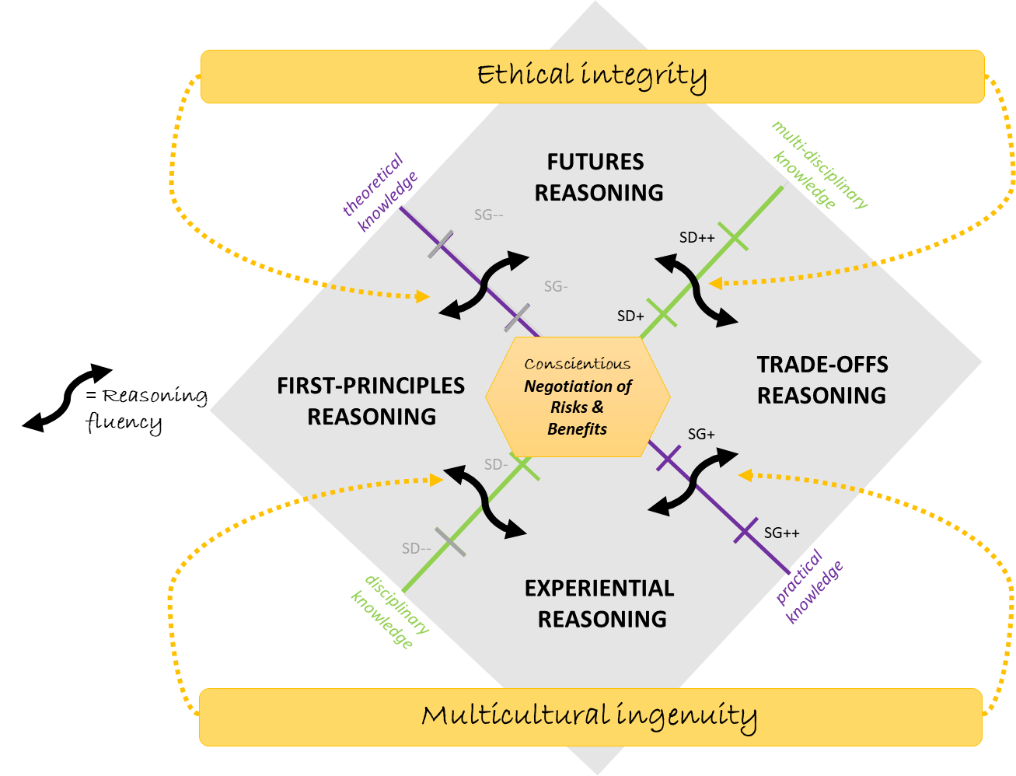
Engineering Design Reasoning Quadrants Framework
Experiential observations represent reasoning based on new experiments as well as past lived experiences. Such reasoning can reflect subjective values or objective claims.
First-principles reasoning represents thinking in terms of disciplinary core ideas that can be associated with science as well as other disciplines.
Trade-offs reasoning entails the designer’s multi-criteria thinking and efforts to optimize the design while weighing and balancing multiple competing design requirements.
Complex abstractions reasoning enable predicting the performance of a design in a new setting and require the combination of first-principles and trade-offs reasoning (Quintana-Cifuentes & Purzer, 2022).

Slide 7
The potential of engineering in K-12 education to promote agency, sustainability, and ethical design
requires the careful examination of benefits and burdens and conscientious negotiation of design trade-offs [ethical INTEGRITY]
engages youth as transformative agents by promoting agency and ownership of ideas and negotiation through first-principles and trade-offs [transformative AGENCY]
promotes reasoning with practical as well as theoretical knowledge and disciplinary depth as well as interdisciplinary breadth towards a fluency across experimental reasoning, first-principles reasoning and, and futures reasoning [reasoning FLUENCY]
values different ways of thinking and approaching problems (e.g., cultural and indigenous ways of thinking) [multicultural INGENUITY]

Slide 8
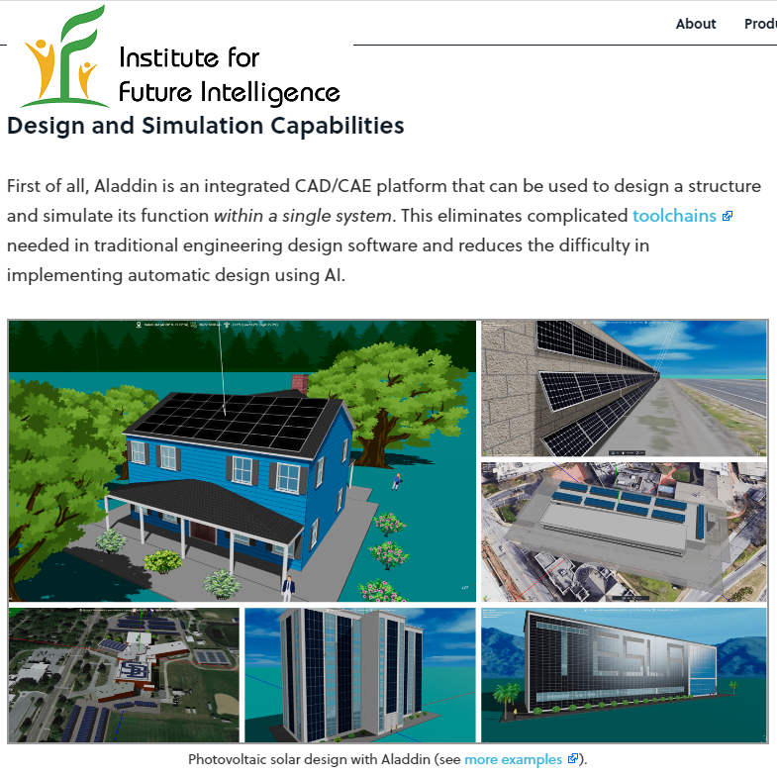
Data Collection
Energy efficient house design criteria
minimize the energy needed to keep the building comfortable on a sunny day or a cold night (and ideally meet negative net energy)
minimize the total cost of the building- cannot exceed $250,000
comfortably accommodate a family of four (approximately 2200 ft2 or 204 m2)
have an attractive exterior.
https://intofuture.org/aladdin.html
Design Challenge
Teacher Selection
5-minute Student Final Presentation
Final Design Review with Each student
Transcripts of Design Review Conversations
Project introduced by the university team but let by classroom teachers
Data Collection
Data Analysis

Slide 9
Design Review Session - Mike
Reviewer (Q1) | “I like how you… describing your presentation that for you, this was a mix of traditional and modern. Really, I was struck looking at the house, it looks like one you could see in a neighborhood. What other kind of houses and shapes did you explore first?”
Mike (A1) | “So, a few of the first houses that I tried were basically rectangles, but I saw when I looked around the room, a lot people were already doing rectangles. And I am not going to follow the trend, so I based off of a lot of the houses in my neighborhood. A lot of my house have the side garage and then they have different rooms to the left of the house facing. So, I explored a lot of designs, I even tried circle house, but it did not work out because the roof did not attach right. I decided on this one because it was more related, you know, it was familiar to me..”
Reviewer (Q2) | “Ok, very interesting, so it was again one way to look at the design. Did you look at the energy performance of the different homes?”
Mike (A2) | “Definitely the circle one, because the roof on the circle one, it allowed a lot of sunlight to hit a lot of areas on the roof, and by putting a lot of solar panels down, I could maximize the efficiency, so it was around negative three, thirty-five thousand kilowatts per hours, but it looked like a muffin, so I didn’t really like that. So, basically, I came to a conclusion the more roof space that the sunlight hit, the more kilowatt per hours, the less kilowatt per hours.”
Notes:
`

Slide 10
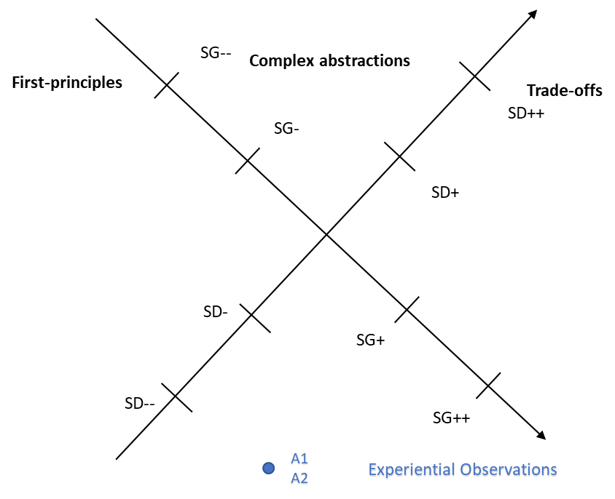
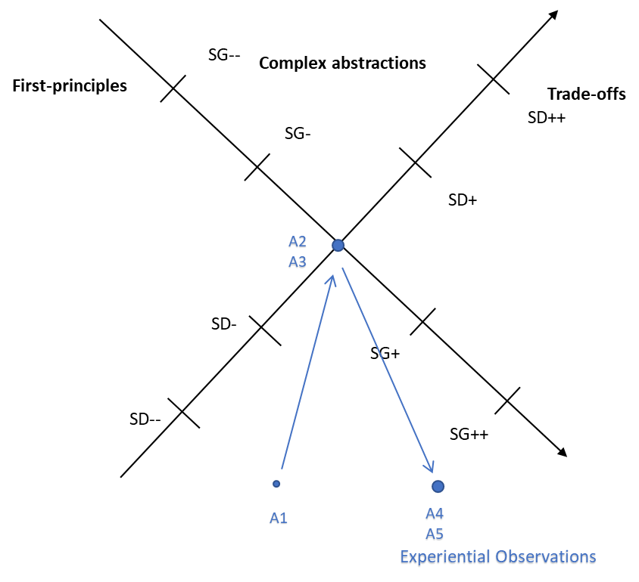
One Quadrant Fluency (EX only)
Ryan
Oliver

Slide 11
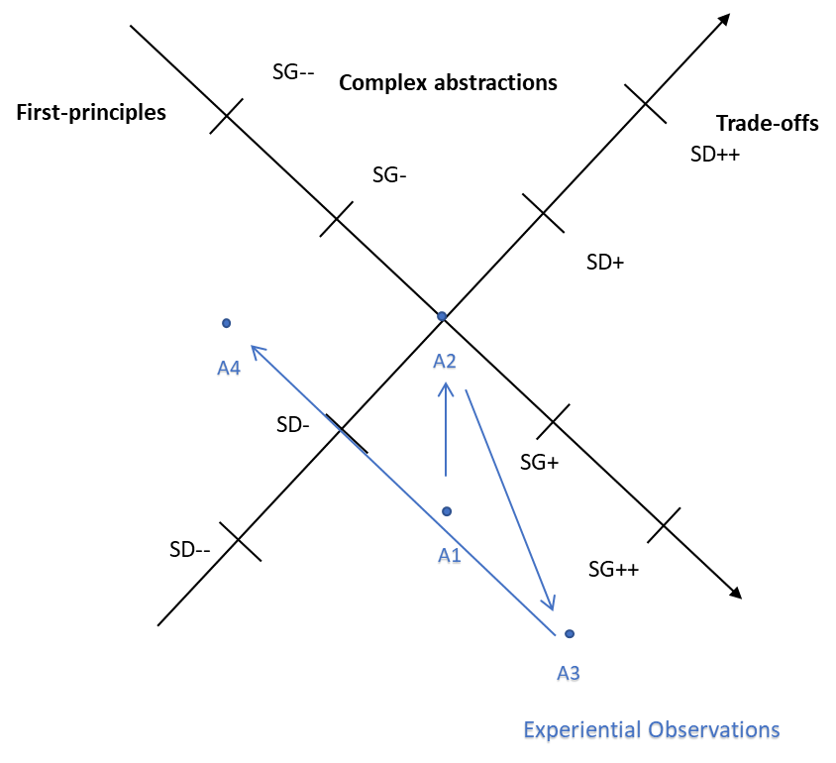
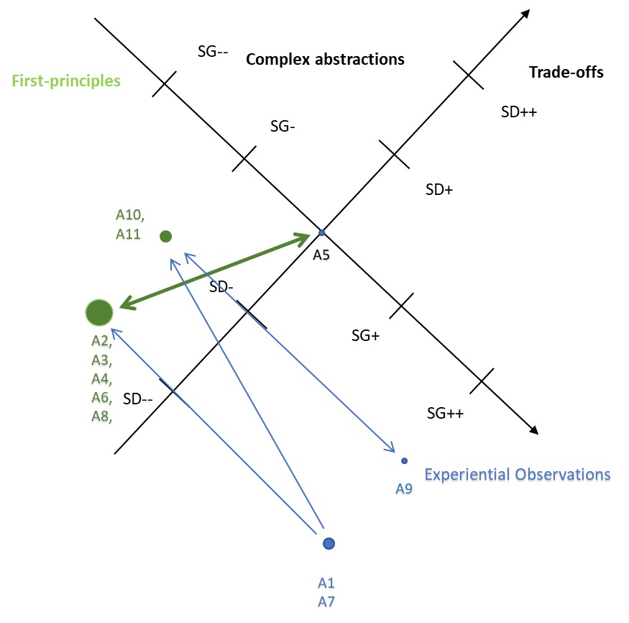
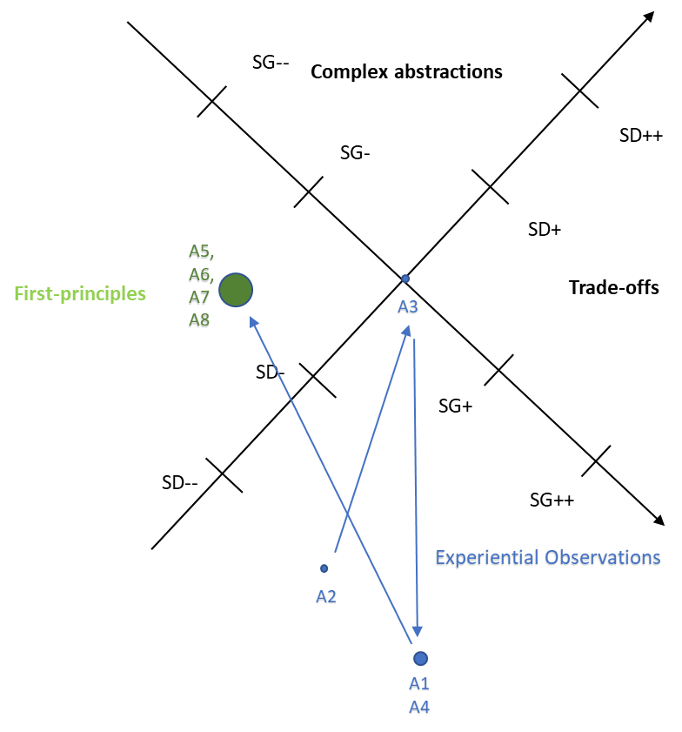
Two Quadrant Fluency (EX-FP)
Will
Tori
David

Slide 12
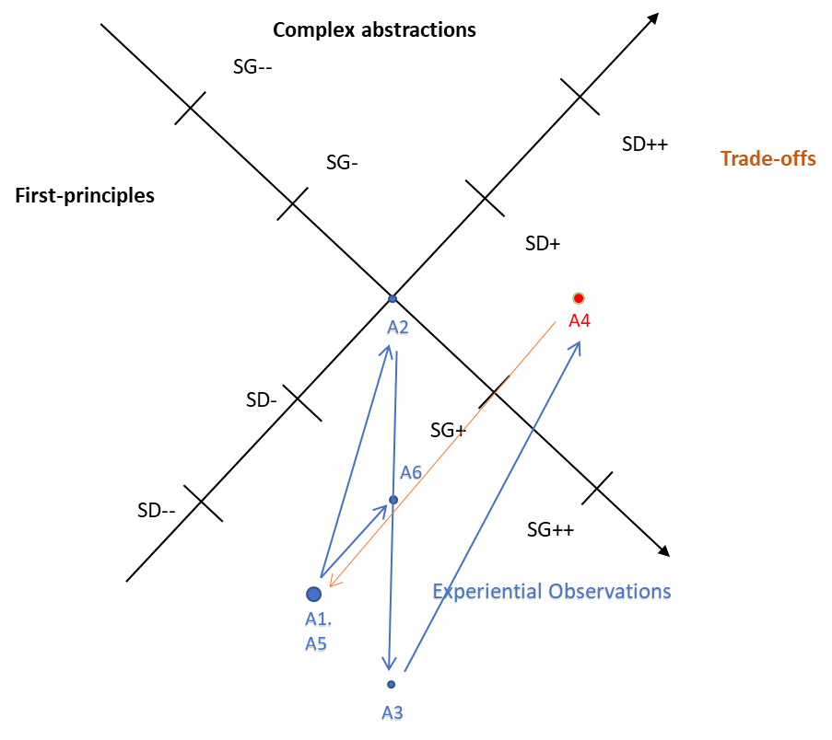
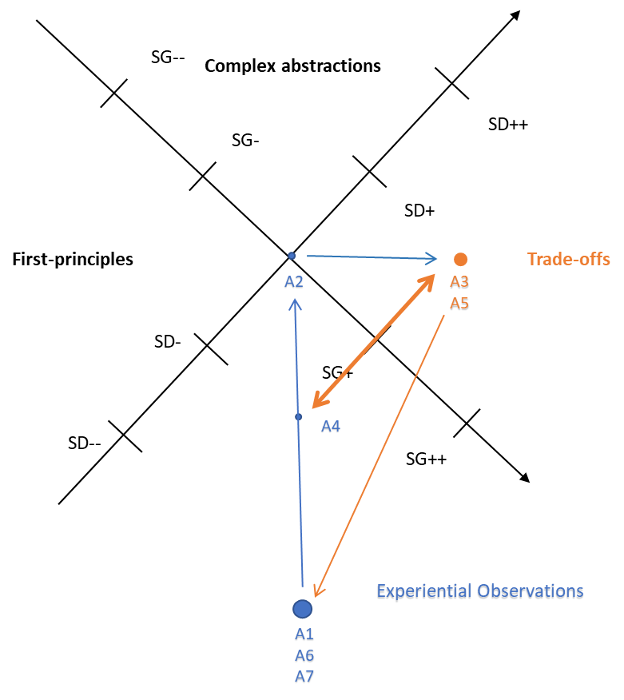
Two Quadrant Fluency (EX-TF)
Pedro
Lisa

Slide 13
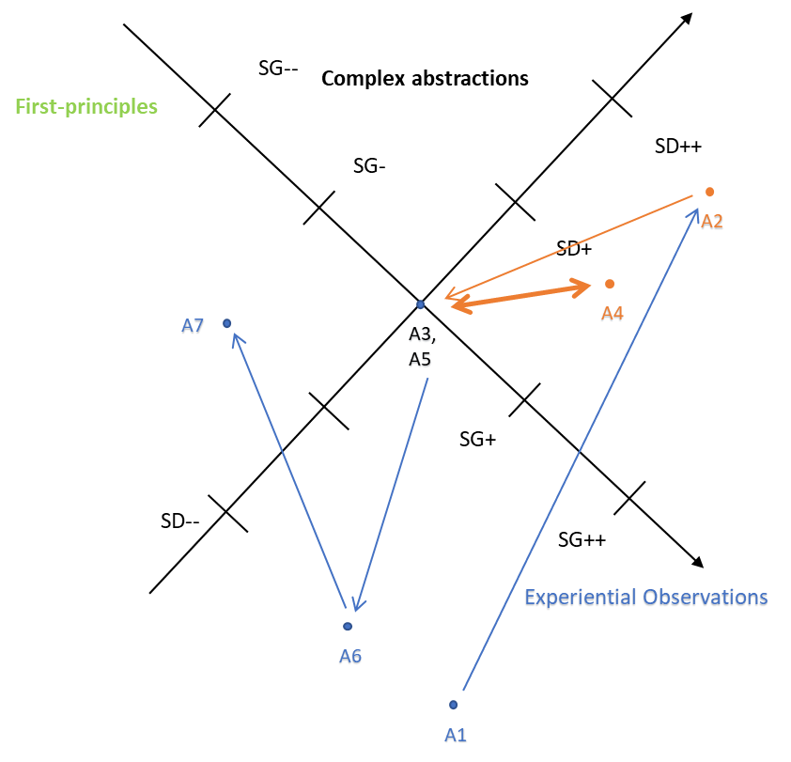
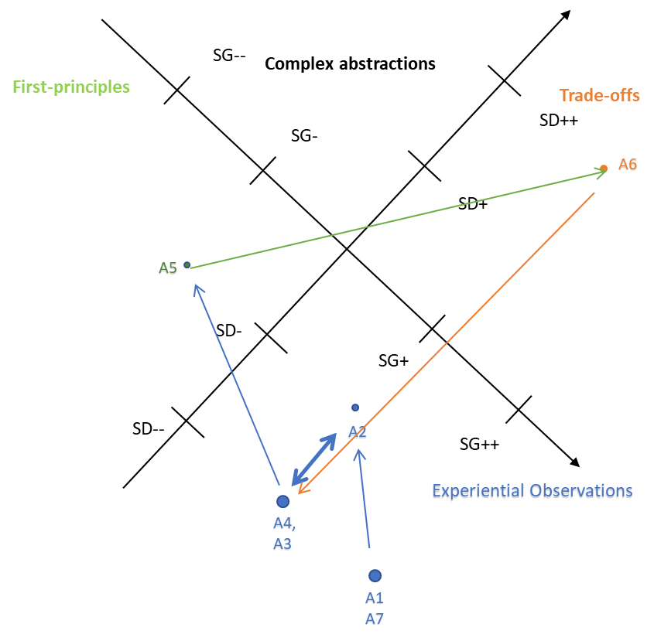
Three Quadrant Fluency (EX-FP-TF)
Mike
Alex

Slide 14
Today’s agenda
The theory behind Design Coaching
Research on design reasoning
Coding Protocol for eliciting and supporting fluency in design reasoning
The Engineering Design Coaching Tool
Practice using the Engineering Design Coaching Tool

Slide 15
Coding Protocol for Engineering Design Fluency

Slide 16
Design Review Session - Ender
Reviewer (Q1) | “I like how you… describing your presentation that for you, this was a mix of traditional and modern. Really, I was struck looking at the house, it looks like one you could see in a neighborhood. What other kind of houses and shapes did you explore first?”
Mike (A1) | “So, a few of the first houses that I tried were basically rectangles, but I saw when I looked around the room, a lot people were already doing rectangles. And I am not going to follow the trend, so I based off of a lot of the houses in my neighborhood. A lot of my house have the side garage and then they have different rooms to the left of the house facing. So, I explored a lot of designs, I even tried circle house, but it did not work out because the roof did not attach right. I decided on this one because it was more related, you know, it was familiar to me..”
Size of the house: 188 m² Annual energy: -6580 kWh Total cost: $236,416 Special features: Cut-out the front lawn, 2 car garage, 26 max efficiency solar panels
Reviewer (Q2) | “Ok, very interesting, so it was again one way to look at the design. Did you look at the energy performance of the different homes?”
Mike (A2) | “Definitely the circle one, because the roof on the circle one, it allowed a lot of sunlight to hit a lot of areas on the roof, and by putting a lot of solar panels down, I could maximize the efficiency, so it was around negative three, thirty-five thousand kilowatts per hours, but it looked like a muffin, so I didn’t really like that. So, basically, I came to a conclusion the more roof space that the sunlight hit, the more kilowatt per hours, the less kilowatt per hours.”
Notes:
`

Slide 17
Design Review Session - Ender
Reviewer (Q5-6) | Question 5: “So, let me ask differently. Let’s imagine you don’t have any solar panels. Which one would you think will be a better design decision if there is not a solar panel, having a big surface roof, or smaller surface roof?” Question 6: “And tell me why?
Mike (A6) | “Because…I usually say the bigger the roof the bigger the house. I like big houses... I guess, I don’t know how to put it.”
Reviewer (Q7) | “So yes, it would actually…yes. Think about heat transfer and the possible impact.”
Mike (A7) | “Oh yeah!! Yeah… the larger the surface area in summer it could consequently make the roof very hot which can basically increase AC usage which is something that will…Because in my first test that was actually one of the first issues the AC skyrocketed when up like nineties and in December drop. So, I think actually both of them have disadvantages one of the disadvantages is AC usage, but the advantage more room for solar panels, so that the conclusion.”
27-29 MAY 2021

Slide 18
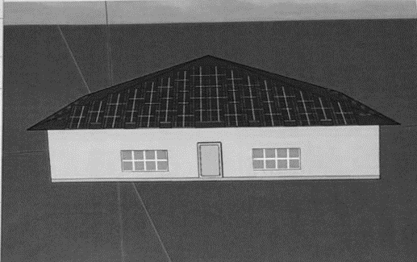
Lisa’s House
Peri’s House
Size of the house: 192 m² Annual energy: -32806 kWh Total cost: $239,127 Special features: My house is full of special features. My yellow door attracts the eye to the front house. The farmhouse style is very unique, and eye catching…
Size of the house: 198 m² Annual energy: -13,175 kWh Total cost: $222,229 Special features: Walls are monochromatic. The door stands out. You cannot see the solar panels from the ground, but if you were nine meters tall, they just blend into the roof. Short enough that you can retrieve whatever it is that your child just threw onto the roof. Tinted windows so that the floors (or rooms with windows) don’t overheat.

Slide 19
Design Coaching Tool for Socially-Transformative Engineering Pedagogy
Design Coaching Tool for Socially-Transformative Engineering Pedagogy
Experiential Questions elicit Multicultural Ingenuity
Experiential Questions elicit Multicultural Ingenuity
I am intrigued by ______ , can you tell me more about this feature?
I am intrigued by ______ , can you tell me more about this feature?
Solar panel type, location, orientation
Building shape, windows, doors
Location of trees
Roof, wall, freestandin
Cardinal direction
Roof style
Window size, location
deciduous evergreen
Cardinal location
What has inspired this feature?
What has inspired this feature?
What is the purpose of this system? Who would use it?
What is the purpose of this system? Who would use it?
Trade-Offs Questions
First Principles Questions
Trade-Offs Questions
First Principles Questions
You talked about / , what’s the application of (scientific, ethical) principle here?
I heard you talk about ______ , how about ______?
You talked about / , what’s the application of (scientific, ethical) principle here?
I heard you talk about ______ , how about ______?
KWh produced
Appeal
If we defined ____ (theory/law) as _____, what would this mean for your design?
Cost
Safety
If we defined ____ (theory/law) as _____, what would this mean for your design?
You mentioned ______ , and _____, how do they impact one another?
You mentioned ______ , and _____, how do they impact one another?
Solar path
Social values
What are the advantages/ disadvantages of this? For example, when you lowered ___, did this impact ____ or ____?
What are the advantages/ disadvantages of this? For example, when you lowered ___, did this impact ____ or ____?
Heat transfer
Aesthetic values
Futures Reasoning Questions model Ethical Integrity
Futures Reasoning Questions model Ethical Integrity
Consider _______ , how would your solution change with/without this aspect?
Consider _______ , how would your solution change with/without this aspect?
In 10 years from today, who would benefit from this design? Who might be harmed? How would this inform a re-design?
In 10 years from today, who would benefit from this design? Who might be harmed? How would this inform a re-design?
Notes:
If we define heat transfer as the rate at which an object transfers energy and this rate depends on: the surface area, volume and material of the object and the nature of the surface with which the object is in contact.
The bigger the temperature difference between a body and its surroundings, the faster the rate at which heat is transferred.
Purzer, Quintana-Cifuentes, & Lingam (2021). https://docs.lib.purdue.edu/eneoer/1

Slide 20
Today’s agenda
The theory behind Design Coaching
Research on design reasoning
Coding Protocol for eliciting and supporting fluency in design reasoning
The Engineering Design Coaching Tool
Practice using the Engineering Design Coaching Tool

Slide 21
Your Design Challenge
Draw a sketch of your house and then re-design your house to
maximize KWh generated with solar panels by adding solar panels or modifying windows
maintain or integrate cultural values of the city/ neighborhood/ residents
ensure sufficient sunshine entering the house
Prepare for a peer design review using the Coaching Tool

Slide 22
Design Coaching Tool for Socially-Transformative Engineering Pedagogy
Experiential Questions elicit Multicultural Ingenuity
I am intrigued by ______ , can you tell me more about this feature?
Transformative AGENCY
designers are transformative agents through agency and ownership of their ideas and negotiation through first-principles and trade-offs
What has inspired this feature?
What is the purpose of this system? Who would use it?
Trade-Offs Questions
First Principles Questions
I heard you talk about ______ , how about ______?
You talked about / , what’s the application of (scientific, ethical) principle here?
Reasoning FLUENCY
reasoning with practical as well as theoretical knowledge and disciplinary depth as well as interdisciplinary breadth towards a fluency across experimental reasoning, first-principles reasoning and, and futures reasoning
If we defined ____ (theory/law) as _____, what would this mean for your design?
You mentioned ______ , and _____, how do they impact one another?
What are the advantages/ disadvantages of this? For example, when you lowered ___, did this impact ____ or ____?
Futures Reasoning Questions model Ethical Integrity
Consider _______ , how would your solution change with/without this aspect?
In 10 years from today, who would benefit from this design? Who might be harmed? How would this inform a re-design?
Notes:
If we define heat transfer as the rate at which an object transfers energy and this rate depends on: the surface area, volume and material of the object and the nature of the surface with which the object is in contact.
The bigger the temperature difference between a body and its surroundings, the faster the rate at which heat is transferred.
Purzer, Quintana-Cifuentes, & Lingam (2021). https://docs.lib.purdue.edu/eneoer/1

Slide 23
6 Engineering Inquiries in the Honeycomb of Engineering Framework
ENGINEERING ANALYSIS
Given data...
USER-CENTERED DESIGN
Given a vague problem description …
PROBLEM SCOPING
Purpose: understand the challenge
Gather information on context, users, issues, and existing solutions
Analyze, visualize, consolidate evidence to form arguments
Determine design requirements, functions, metrics, and trade-offs
ENGINEERING OPTIMIZATION
Given a sub-optimal system…
Conscientious
Negotiation
Risks & Benefits
DESIGN-BUILD-TEST
Given design requirements…
EVALUATION
Purpose: generate evidence
communicate evidence
communicate requirements
Set up experiments, test beds to collect data
Generate and represent
ideas with sketches and low-fidelity prototypes
communicate alternatives
Presenter Author 1290
LEARNING AND AGENCY THROUGH DESIGN NEGOTIATION: THE HONEYCOMB OF ENGINEERING
Parallel Session - 1.11 (Oral Presentations), 15:00-16:30 Monday, 28 August, 2023
Build testable prototypes to simulate form and function
REVERSE ENGINEERING
Given a system to be examined…
ENGINEERING SCIENCE
Given a research question…
Purpose: develop alternatives
IDEATION
Purzer, Ş., Quintana-Cifuentes, J., & Menekse, M. (2021). The honeycomb of engineering framework: Philosophy of engineering guiding precollege engineering education. Journal of Engineering Education, 111( 1), 19– 39. https://doi.org/10.1002/jee.20441
Notes:
Taking an epistemological position, I created the Honeycomb of Engineering framework, which recognized multiple inquiries of engineering but also provide the pedagogical translations of these inquiries. The Honeycomb of Engineering takes an epistemological perspective to outline a classification of six types of engineering inquiries:

Slide 24
Prior research
Aladdin
https://intofuture.org/aladdin.html (free, browser-based, AI-enabled, open access)
Engineering in K-12
Purzer, S., Quintana-Cifuentes, J.P. (2019). Integrating engineering in K-12 science education: spelling out the pedagogical, epistemological, and methodological arguments. Discip Interdscip Sci Educ Res, 1(13), 1-12. https://doi.org/10.1186/s43031-019-0010-0
Design Coaching Tool
Purzer, Quintana-Cifuentes, & Lingam (2021). https://docs.lib.purdue.edu/eneoer/1
Purzer, S., Schimpf, C., Quintana-Cifuentes, J., Sereiviene, E., Lingam, I. & Jiang, R. (2022). Refine by design: An engineering design Review coaching tool for supporting teacher student reasoning. The Science Teacher, 89(6), 34-39.
Design Reasoning
Quintana-Cifuentes, J., & Purzer, S. (2022). Semantic Fluency in Design Reasoning. International Journal of Engineering Education, 38(6). https://par.nsf.gov/biblio/10396304
Purzer, Ş., Quintana‐Cifuentes, J., & Menekse, M. (2021). The honeycomb of engineering framework: Philosophy of engineering guiding precollege engineering education. Journal of Engineering Education, 111(1), 19-39. https://doi.org/10.1002/jee.20441
Purzer, Ş., Goldstein, M. H., Adams, R. S., Xie, C., & Nourian, S. (2015). An exploratory study of informed engineering design behaviors associated with scientific explanations. International Journal of STEM education, 2(1), 1-12. https://doi.org/10.1186/s40594-015-0019-7

Slide 25
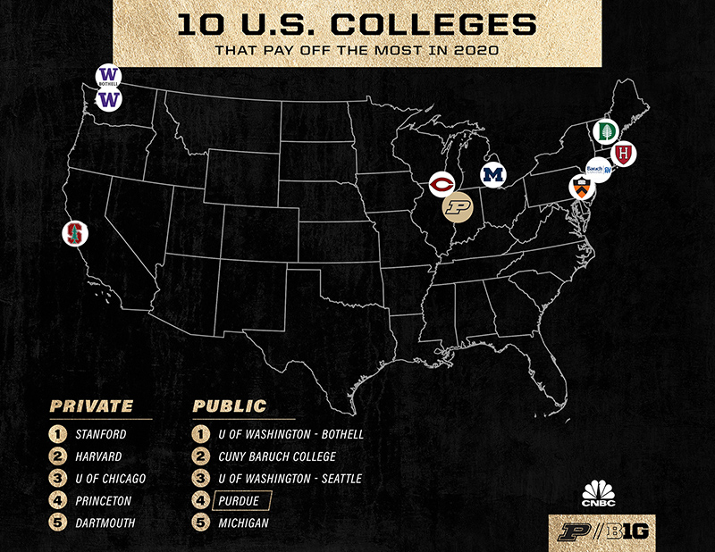
workshop Engineering Design Coaching Tool for Sustainability and Ethically-conscientious Education
Şenay Purzer
purzer@purdue.edu
Purdue University
The work presented in this manuscript is based upon work supported by the National Science Foundation DRL #1721054. Any opinions, findings, and conclusions or recommendations expressed in this paper, however, are those of the authors and do not necessarily reflect the views of the National Science Foundation.
Also Presenter Author 1290
LEARNING AND AGENCY THROUGH DESIGN NEGOTIATION: THE HONEYCOMB OF ENGINEERING
Parallel Session - 1.11 (Oral Presentations), 15:00-16:30 Monday, 28 August, 2023
https://web.ics.purdue.edu/~spurzer/esera2023
Notes:
The practice of negotiation in engineering can be considered as analogous to argumentation in science. Engineering is creating, monitoring, managing, and improving technological systems through the careful negotiation of risks and benefits. The Honeycomb of Engineering framework describes engineering with an epistemological lens first but then articulate its pedagogical translations. Engineering encompasses different types of inquiries: user-centered design, design-build-test, engineering optimization, engineering science, engineering analysis, reverse engineering. In addition, engineering design is a flexible and adoptable vehicle that can be used to guide different types of engineering inquiries, with the negotiation of risk and benefits at the center of this process. My goal is to broaden the view of engineering education from simply being defined as a hands-on approach and uncover the underestimated potential of engineering for education. Engineering education can promote a diverse range of outcomes such as purposeful utilization of students’ cultural heritage and assets, develop reasoning necessary for learning but also sustainable and ethically-conscientious design; and build students’ agency and decision-making skills.

Slide 26
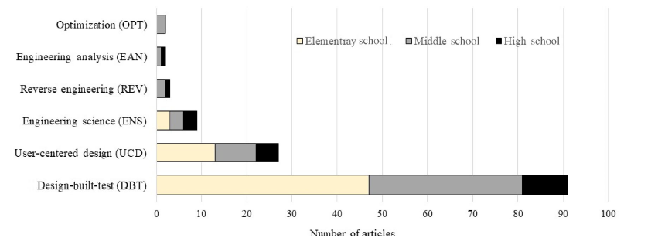
6 Types of Engineering Inquiries: Honeycomb of Engineering
Purzer, Ş., Quintana‐Cifuentes, J., & Menekse, M. (2021). The honeycomb of engineering framework: Philosophy of engineering guiding precollege engineering education. Journal of Engineering Education. https://doi.org/10.1002/jee.20441

Slide 27
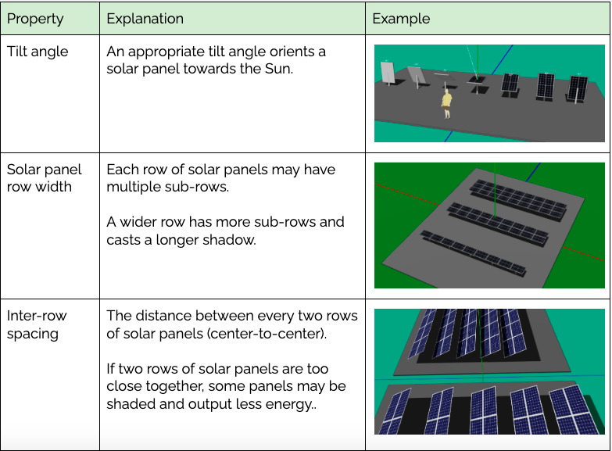
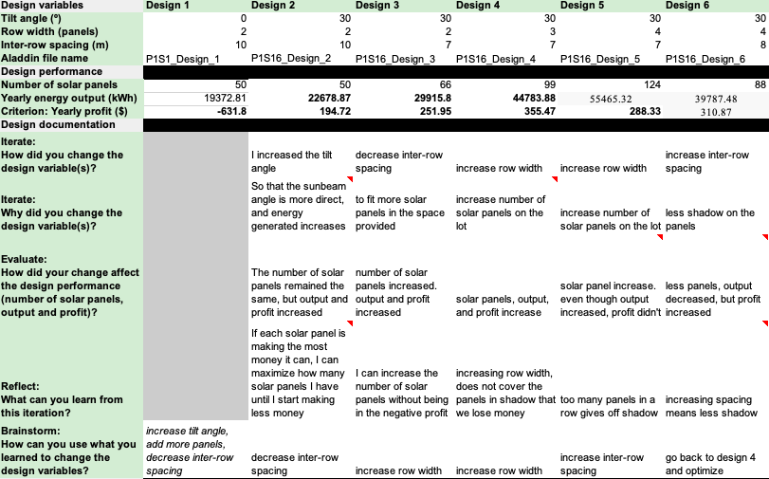
Key design variables & Student Design Journal
Notes:
The student design journal elicited students reasoning through some questions such as:
How did you change the design variable(s)?
Why did you change the design variable(s)?
What can you learn from this iteration?
While making optimization, students changed those variables to produce as much energy as possible for their solar farm design and to reduce cost, you can see on the left side of the page.

Slide 28
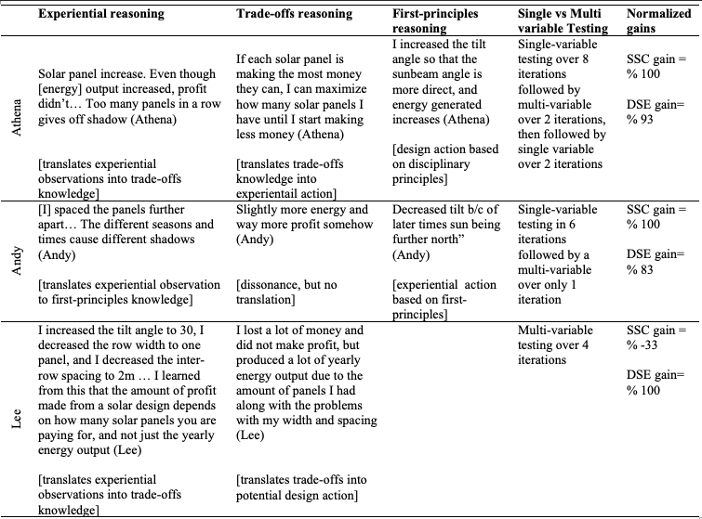
Reasoning fluency
Filiz
Notes:
Here is the overview of our results.
That includes case study students' quotation based on different type of reasoning
Normalized gains, as well.

